Slide 1
Lecture 39
CSE 331
Dec 8, 2021

Slide 2

Please have a face mask on

Slide 3
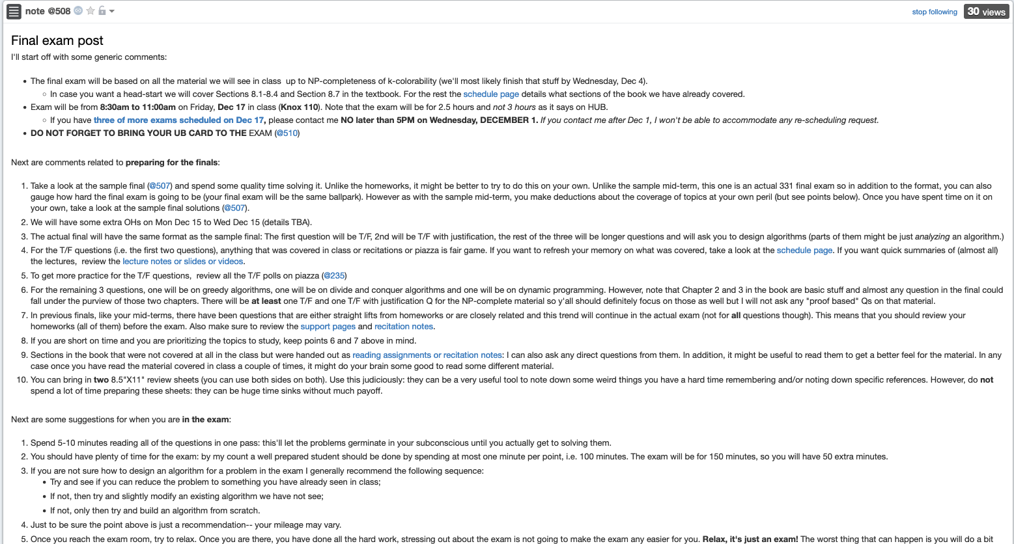
Final exam post

Slide 4
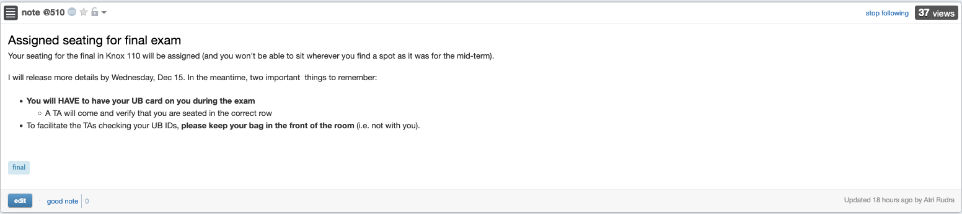
Bring your UB card to final

Slide 5
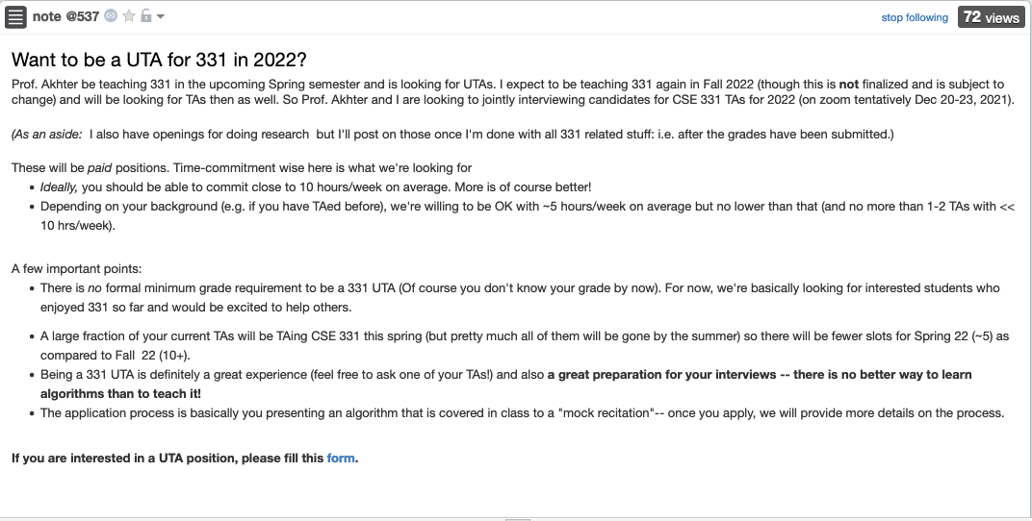
Interested in TAing CSE 331?

Slide 6
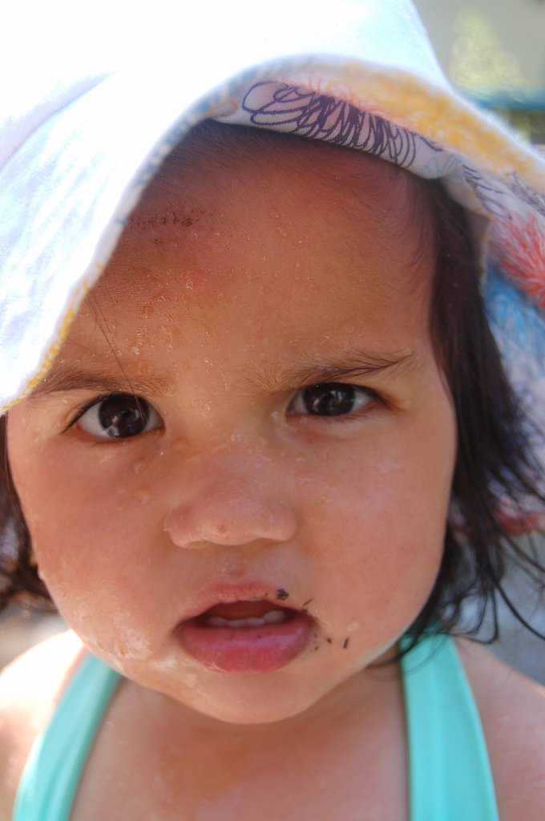
Questions?

Slide 7




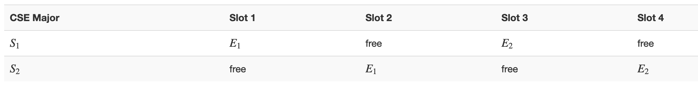
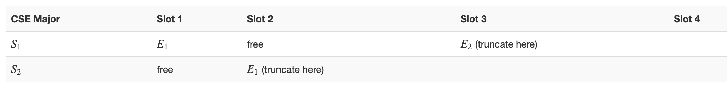






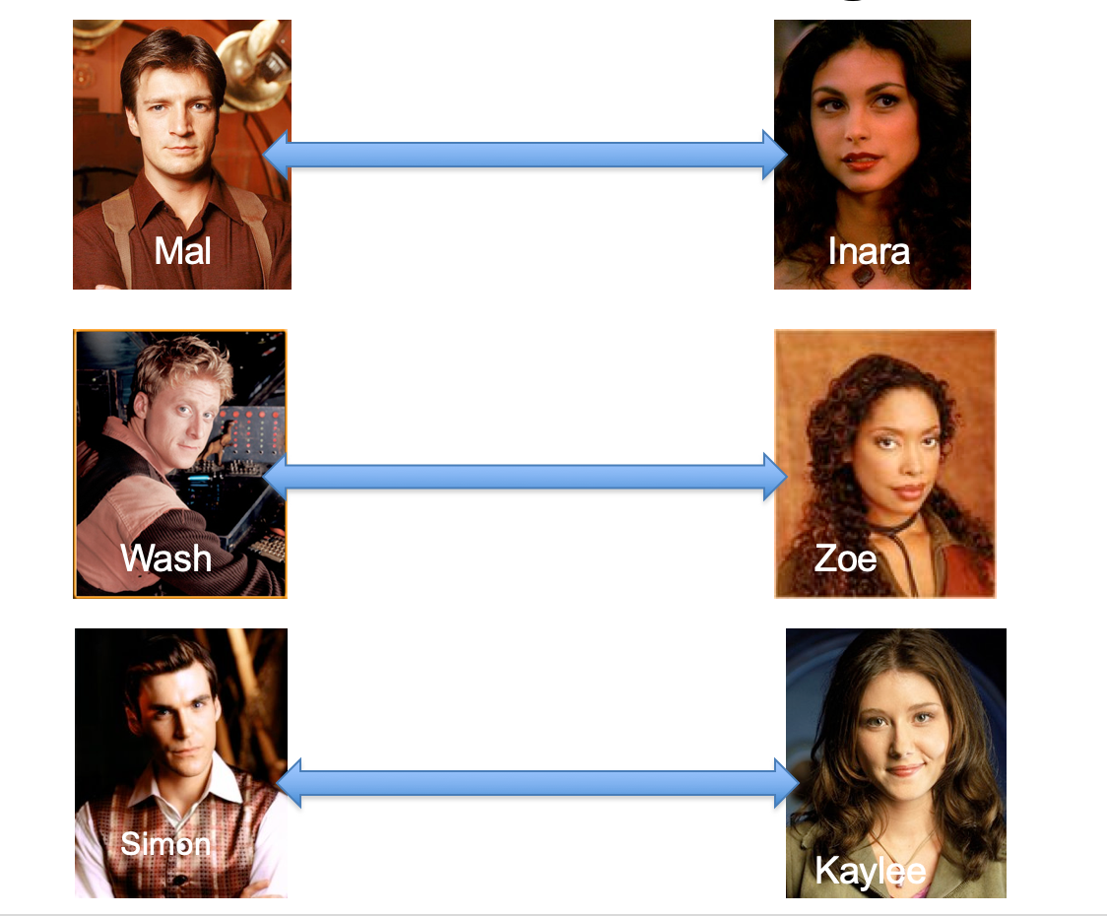
Poly time steps
Arbitrary Y instance
ANY algo for stable matching problem works!
Pre-process the input
Output for Y instance
All processing
is poly-time
Algo for X
Post-process the output

Slide 8



Poly time algo for X
Y is NP-hard
Arbitrary Y instance
Poly time algo for Y
X is NP-hard
Pre-process the input
Output for Y instance
All processing
is poly-time
Algo for X
Post-process the output
Mostly trivial

Slide 9

Arbitrary Y instance
AlgoIS (G,k)
G’ = G
Pre-process the input
Output for Y instance
k’ = n-k
b = AlgoVC(G’,k’)
Algo for X
return b
Post-process the output
(G,n-k)
Algo for VC
(G,k)

Slide 10
Questions?

Slide 11
Today’s agenda
NP-completeness of k-colorability
Beyond NP-completeness

