Slide 1

Welcome
to
CSE 331

Slide 2
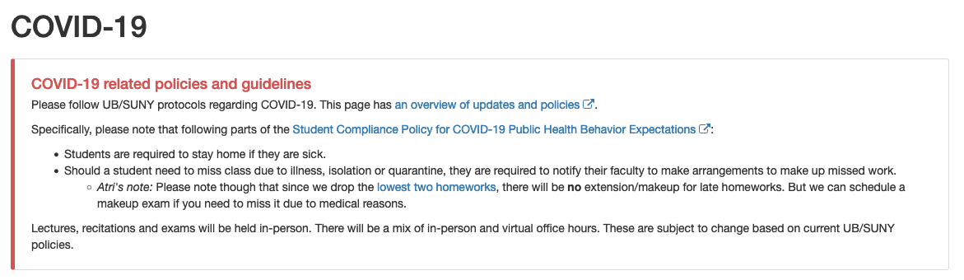
Please follow COVID-19 policies

Slide 3

Let’s do some introductions
http://www.zazzle.com/warning_teaching_assistant_bag-149882665435161818

Slide 4





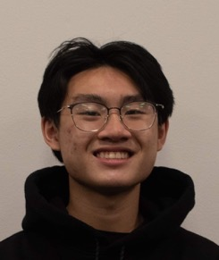


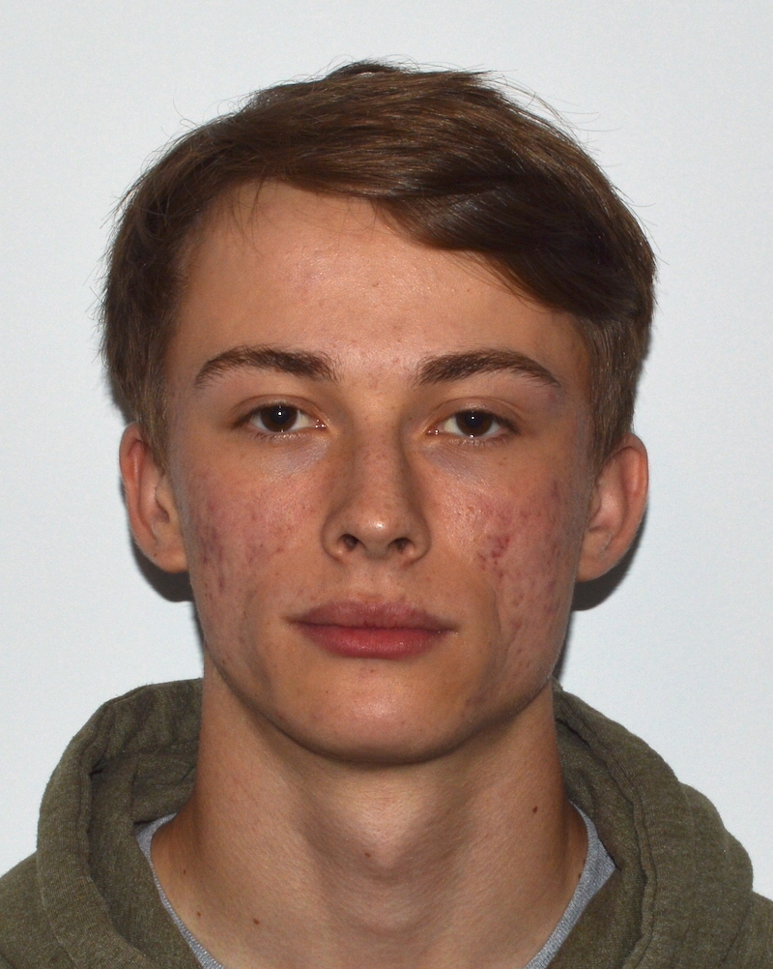


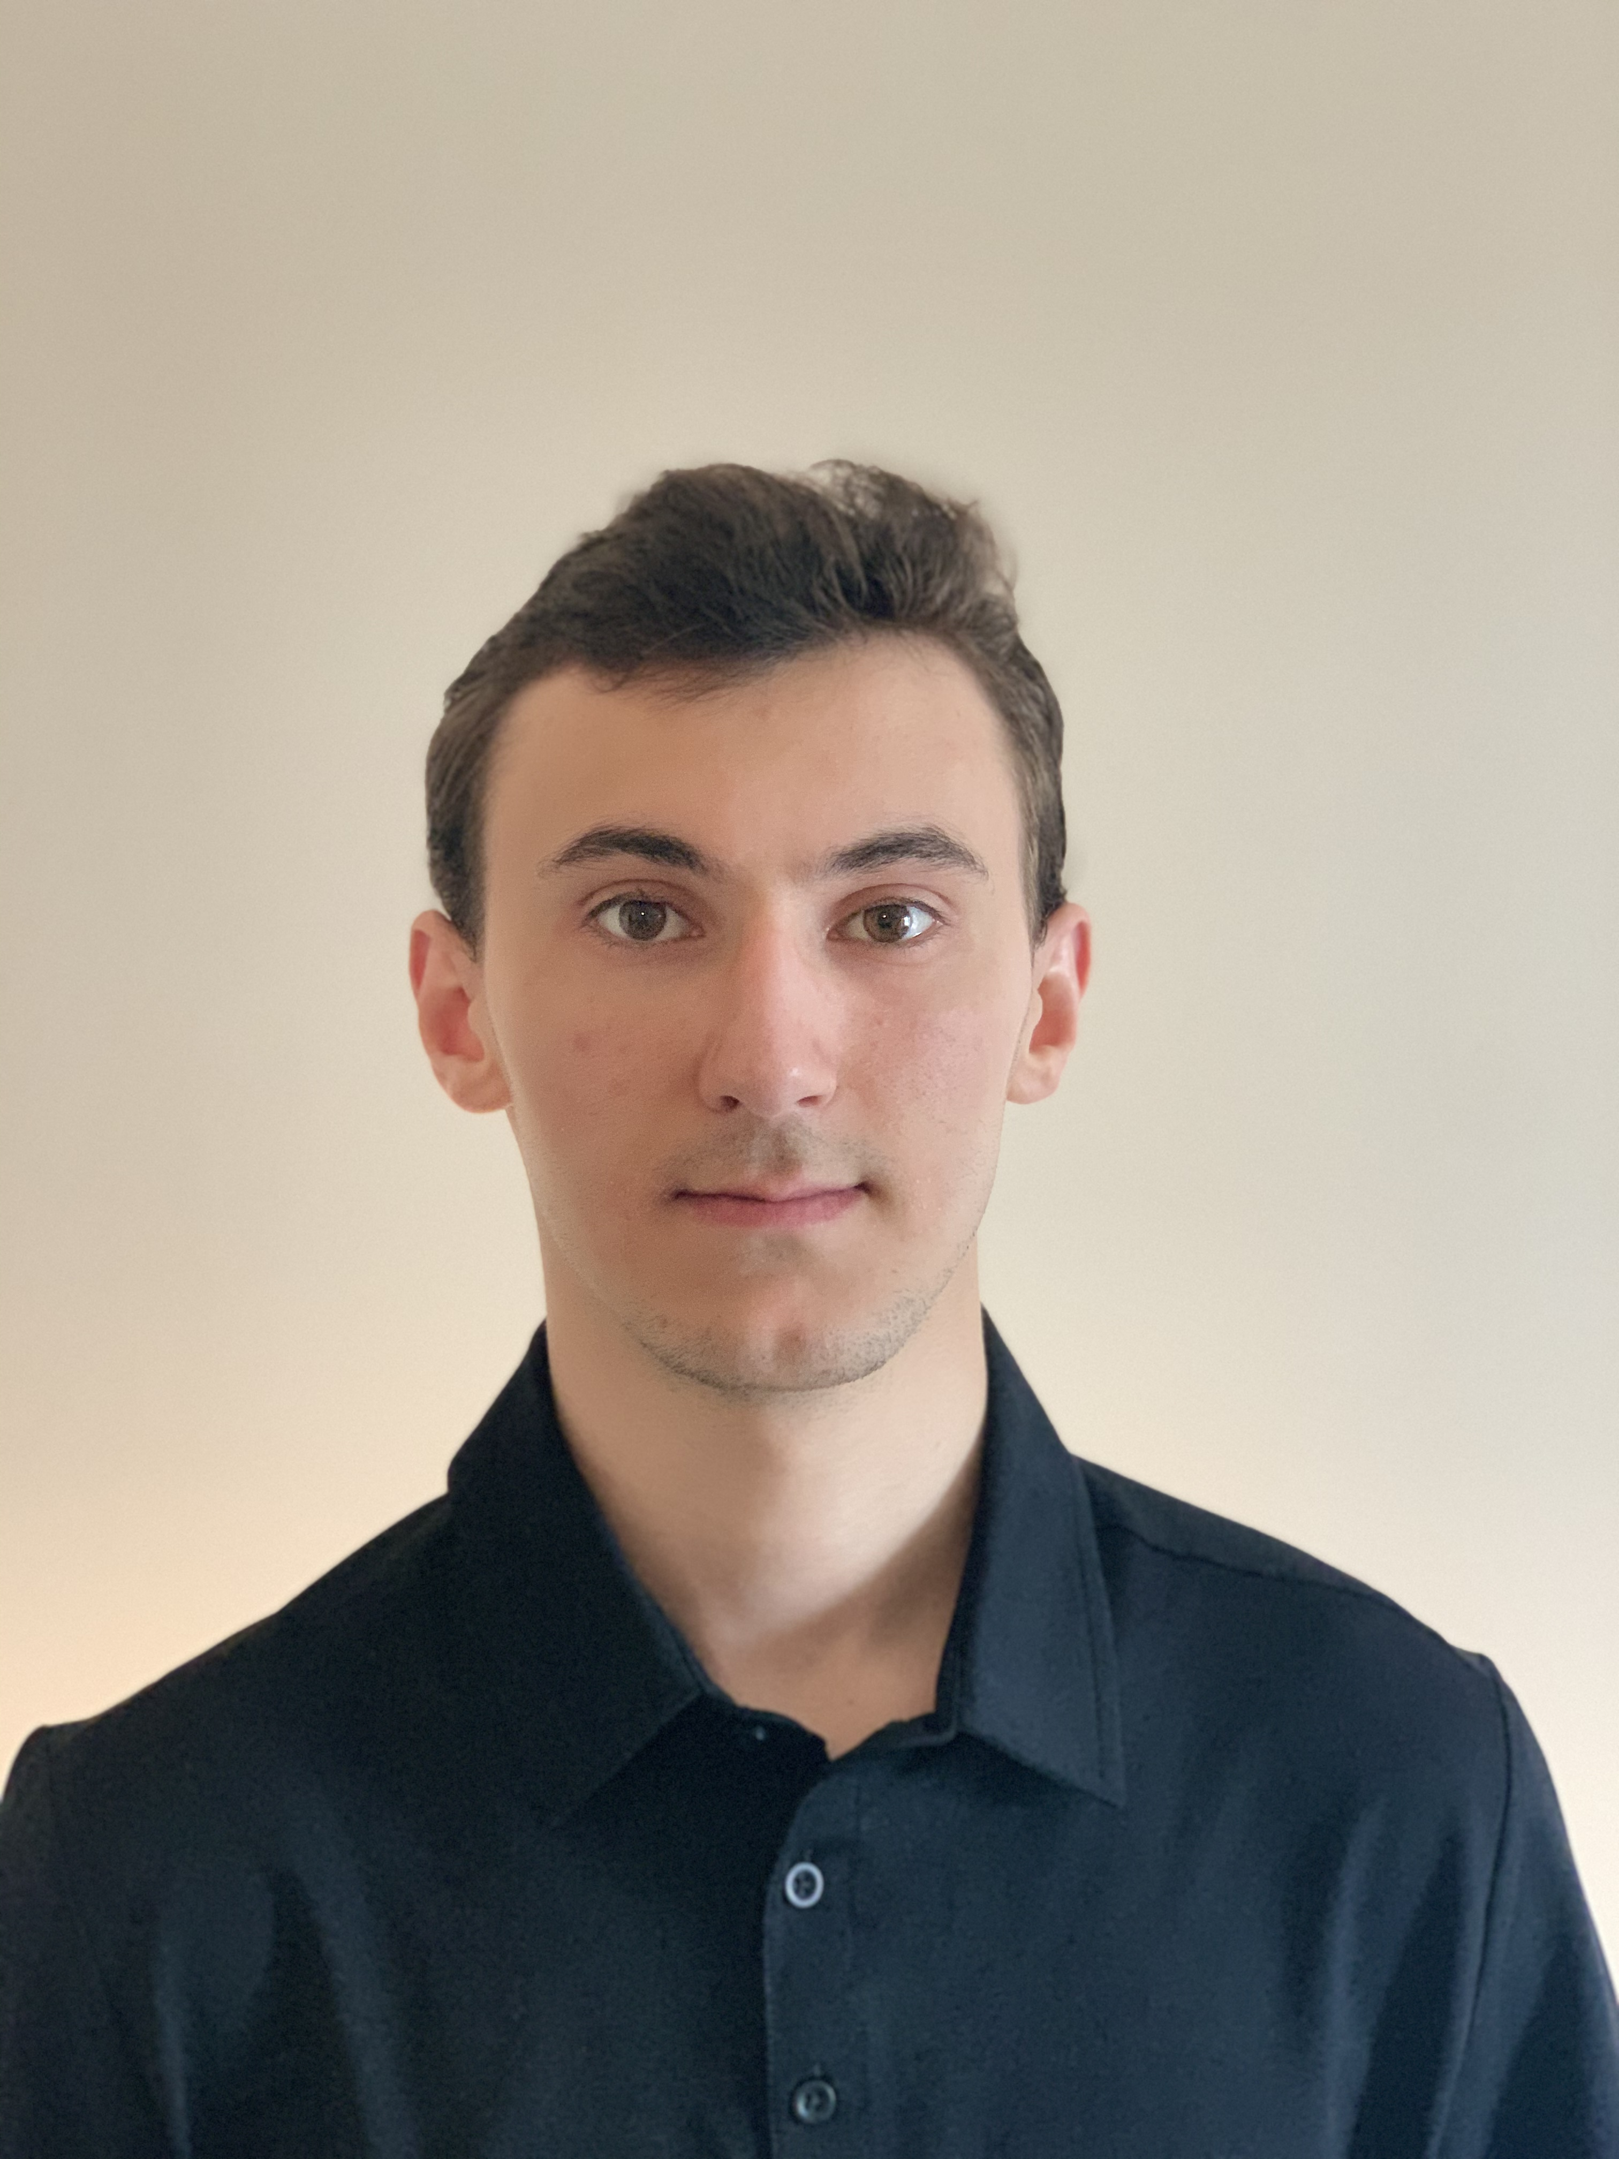
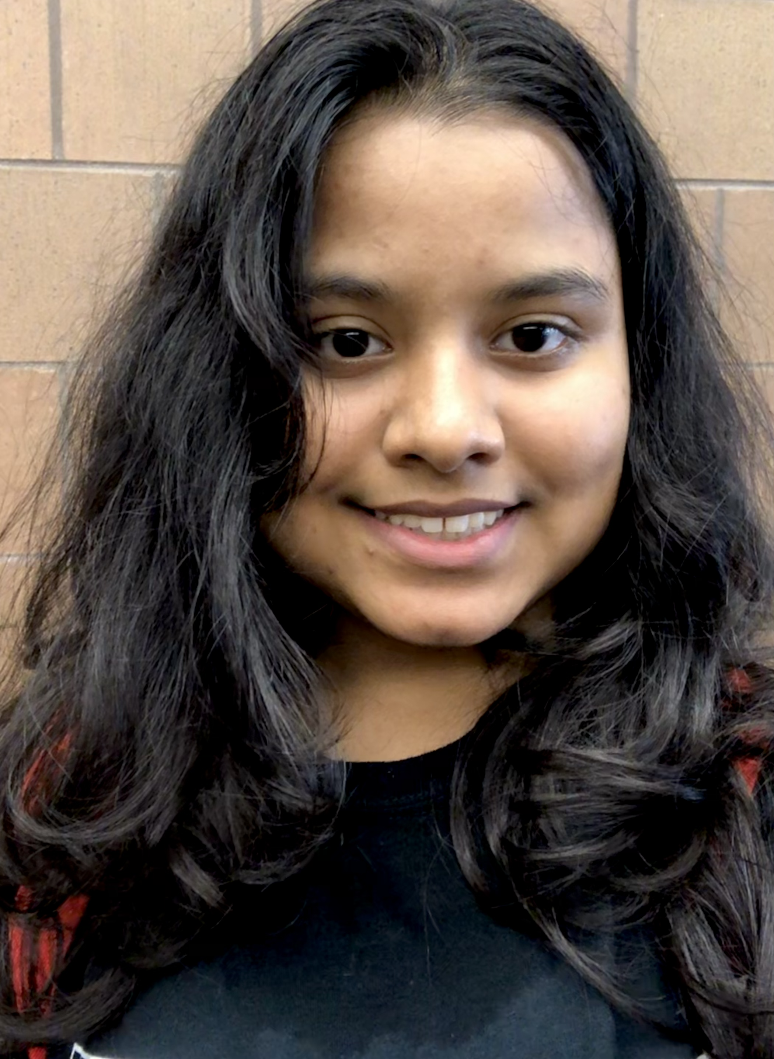
TAs first
Sebastian
James
Rachael
Zachary
Caleb
Korey
Nick
Michael
Richard
Hunter
Trevor
Ben
Rrucha

Slide 5

Lectures will be videotaped
http://www.imdb.com/title/tt0363510/mediaviewer/rm2499681792

Slide 6
About Me
Just Atri please!
Atri Rudra
atri@buffalo.edu
Office: See piazza for location
Office hours: Wed 4:00-4:50pm; Fri, 12:30-1:20pm
OH start this Wed

Slide 7
Contact us all at
Or use piazza!
cse-331-staff@buffalo.edu
TAs will not respond to individual emails (except for re-grading requests)

Slide 8
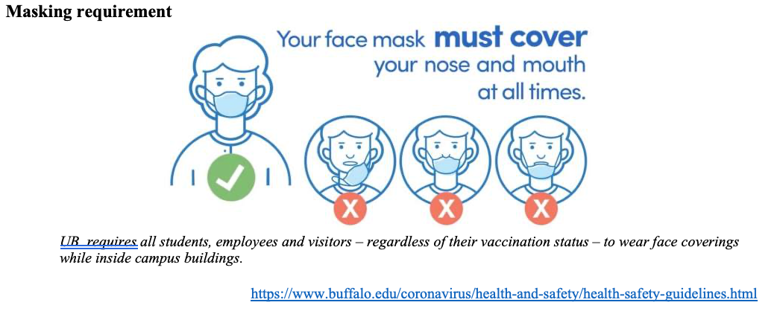
CSE 331 in times of COVID
Lectures and recitations will be in-person
Office hours will be a mix of in-person and virtual locations
Exams and Quizzes will be in-person

Slide 9
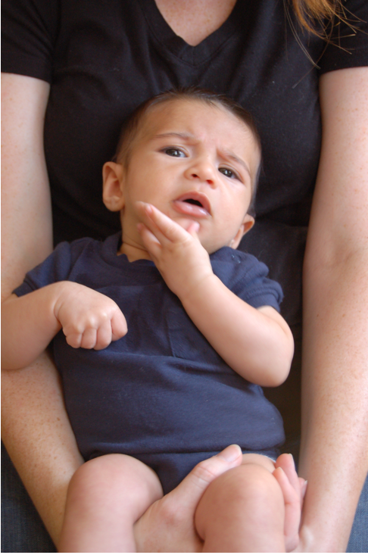
Questions/Comments?

Slide 10
Handouts for today
Syllabus (online)
Homework Policy document (online)

Slide 11
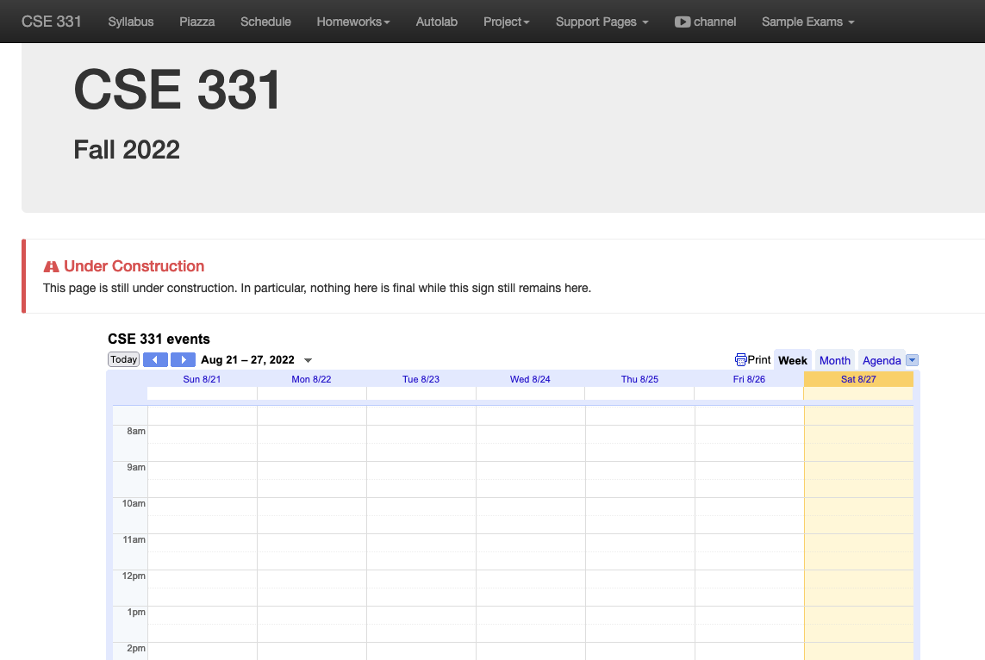
One Stop Shop for the Course
http://www-student.cse.buffalo.edu/~atri/cse331/fall22/index.html

Slide 12
Three things to remember
WORK HARD!
DO NOT CHEAT!
READ CAREFULLY!

Slide 13
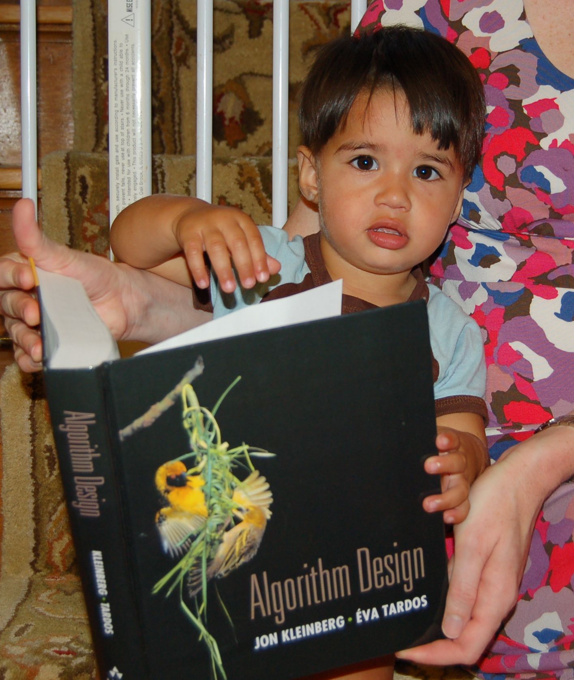
Wait.. What???
Make sure you follow submission
instructions
Two most common ways of losing points
Make sure you read problem
statements carefully

Slide 14
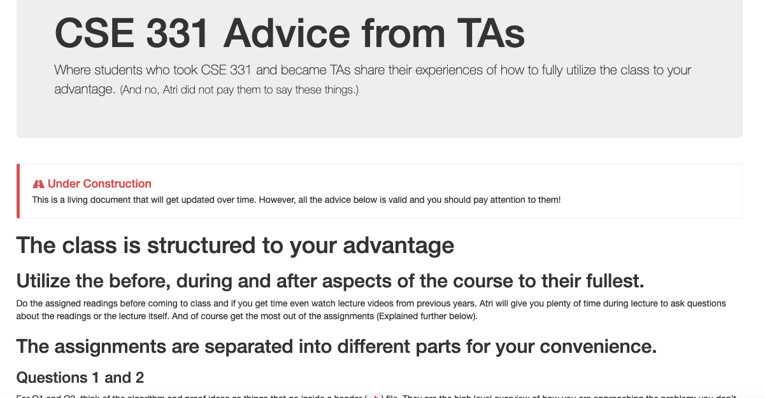
Advice from 331 TAs
http://www-student.cse.buffalo.edu/~atri/cse331/support/advice/index.html

Slide 15
Academic Dishonesty
All your submissions must be your own work
Penalty:
  Minimum: A grade reduction in course
  Possible: F (or higher penalty) if warranted
YOUR responsibility to know what is cheating, plagiarism etc.
  If not sure, come talk to me
Excuses like “I have a job,” “This was OK earlier/in my country,” “This course is hard,” etc. WON’T WORK
I DO NOT HAVE ANY PATIENCE WITH ANY CHEATING :
YOU WILL GET A GRADE REDUCTION IN THE COURSE
FOR YOUR FIRST MISTAKE

Slide 16
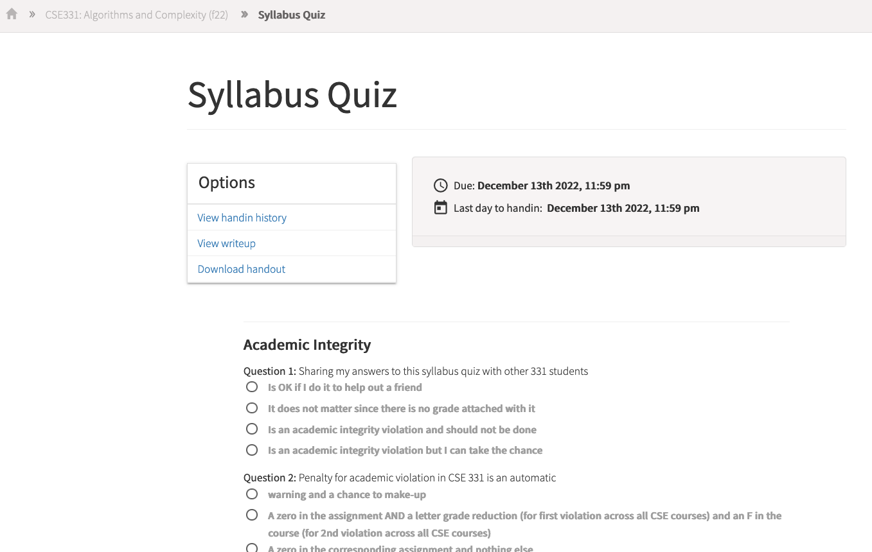
Read the syllabus CAREFULLY!
No graded material will be handed back until you pass the syllabus quiz!

Slide 17
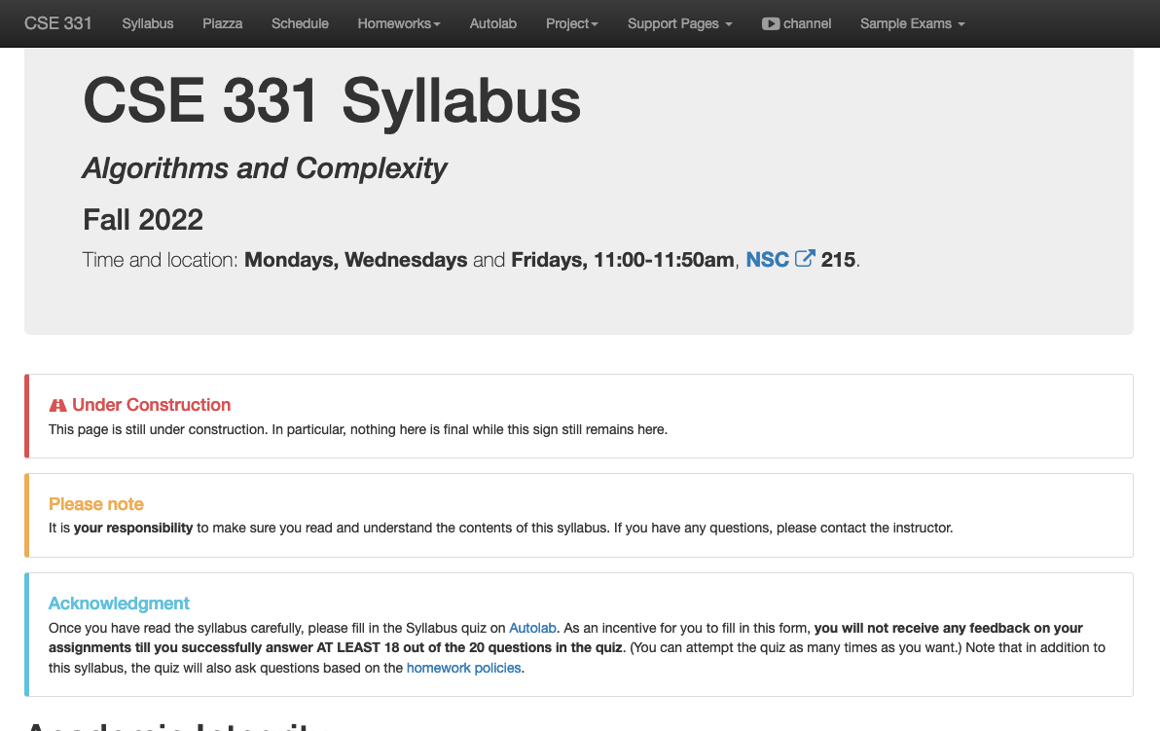
More information on the quiz

Slide 18
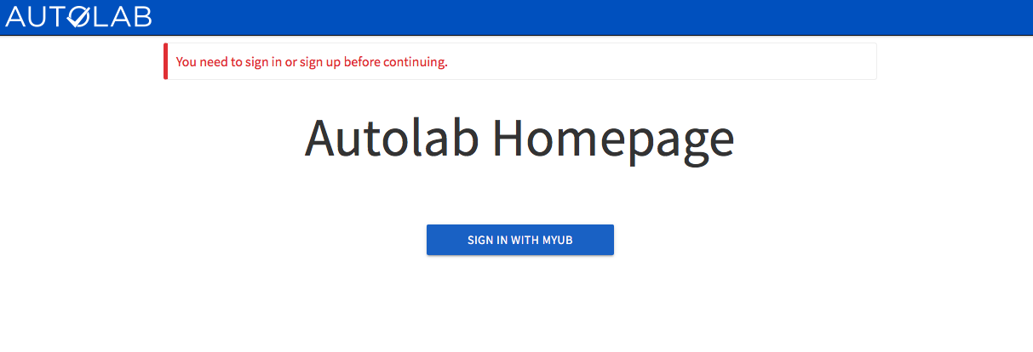
Autolab
https://autograder.cse.buffalo.edu/

Slide 19
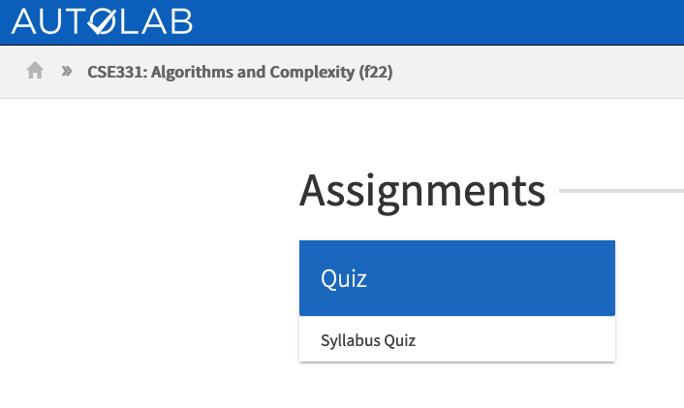
You can submit the following now
If you were registered by 4pm on Monday, Aug 22 you should be on Autolab

Slide 20
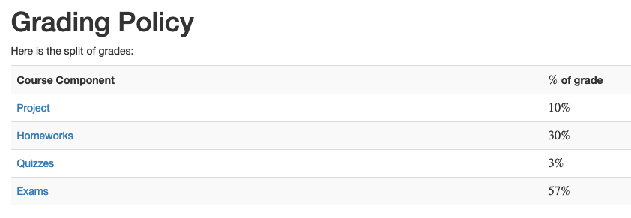
Grading break-down

Slide 21
Questions/Comments?

Slide 22
Pre-requisites
Required (officially)
  CSE 250, [CSE 191 or MTH 311] and MTH 142
  At least a C- (this is recommended)
Required (for practical purposes)
  Comfort with proofs
  Willingness to work hard!

Slide 23
Accessibility Resources
Information included in the syllabus
In short, let me know and consult with Accessibility Resources

Slide 24
Preferred Name
If you prefer using name diff from UB records
Let me know and we’ll make a note of it.

Slide 25
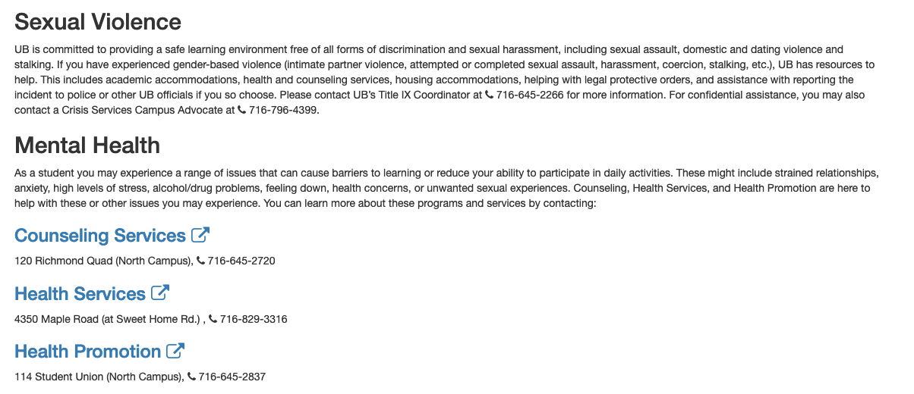
Critical Campus Resources

Slide 26
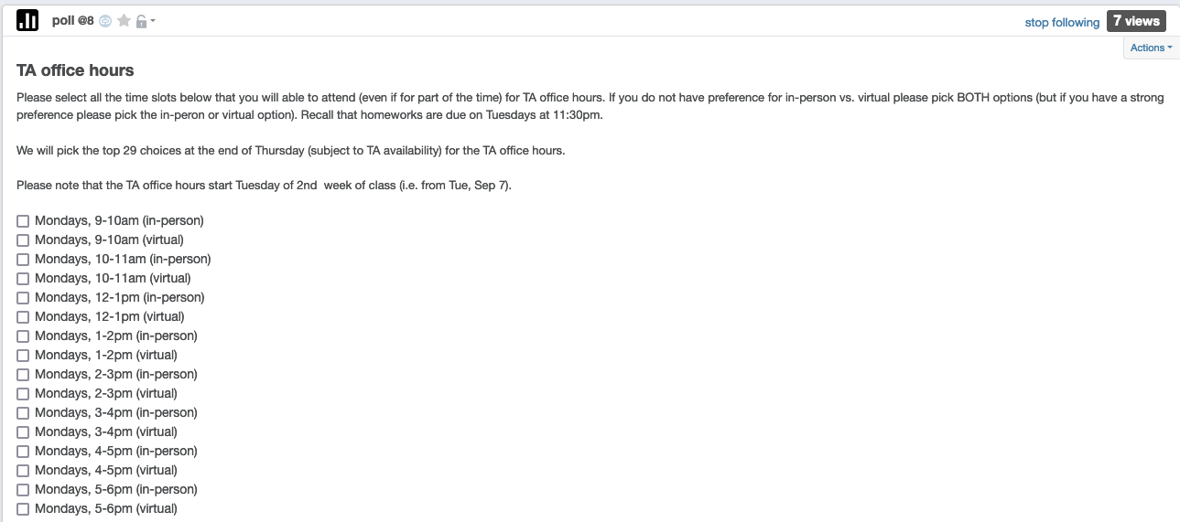
TA Office hours
YOU decide!

Slide 27
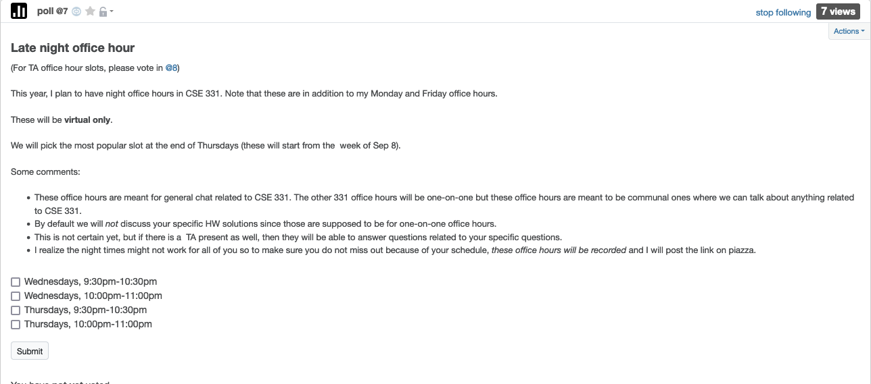
Late night office hour
YOU decide!

Slide 28
Recitations
Are on for this week!
RECITATIONS

Slide 29
Please stick to your recitation section
At least for the first month since all sections are full

Slide 30
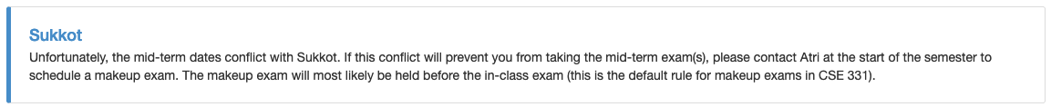
Exams
Mid term (two parts)
  Mon, Oct 10 and Wed, Oct 12, 2021. Usual place and time.
Final exam
  Fri, Dec 12, 2021. NSC 215, 12:00-2:30pm

Slide 31
The HW structure
DROP lowest TWO Q1, Q2, Q3 scores
Three questions
Q1 and Q2 are proof based while Q3 is programming
Q1 worth 50 points
The hard proof based Q2 and programming Q3 worth 25 points each
HWs due by 11:30pm on Tuesdays

Slide 32
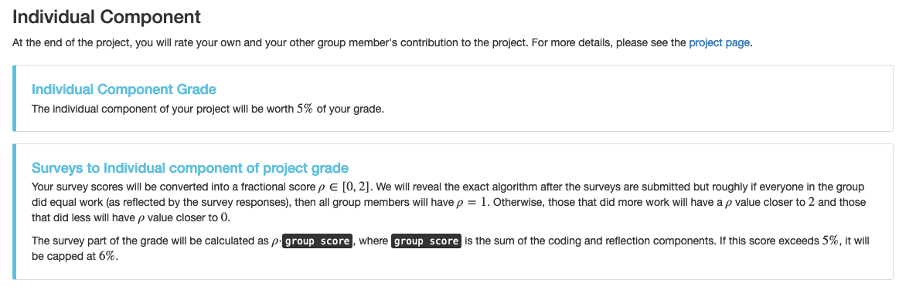
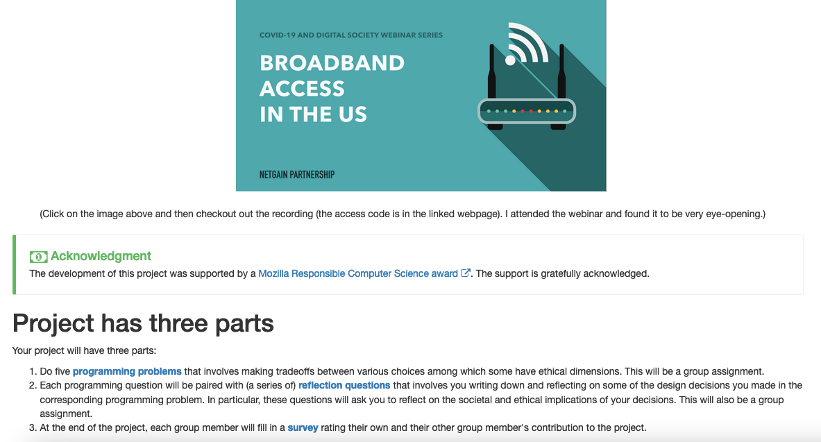
~2 month long project!

Slide 33
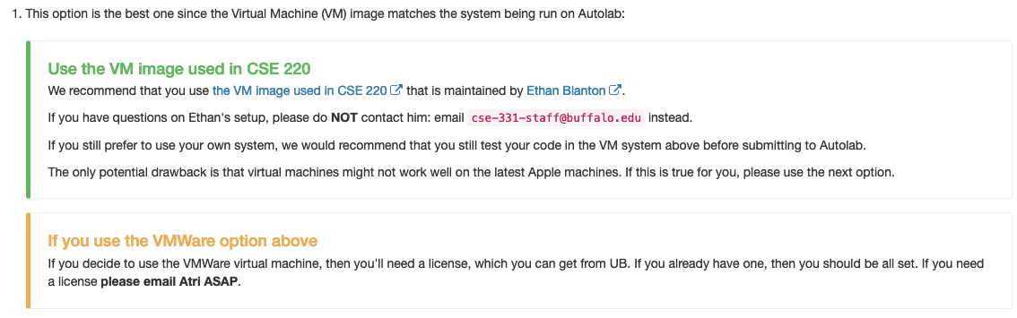
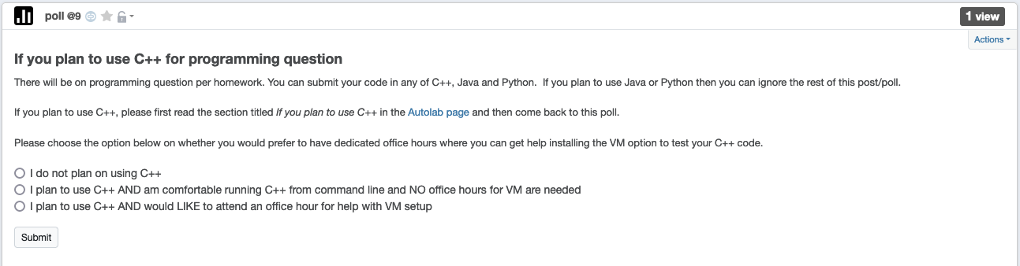
C++ vs Java/Python
Use Java/Python if as you just as comfortable with as C++
There might be a how to use Unix session in week 2
If want to use VMware, please email me to get a license
License requests submitted every Tue morning

Slide 34
Questions/Comments?

Slide 35
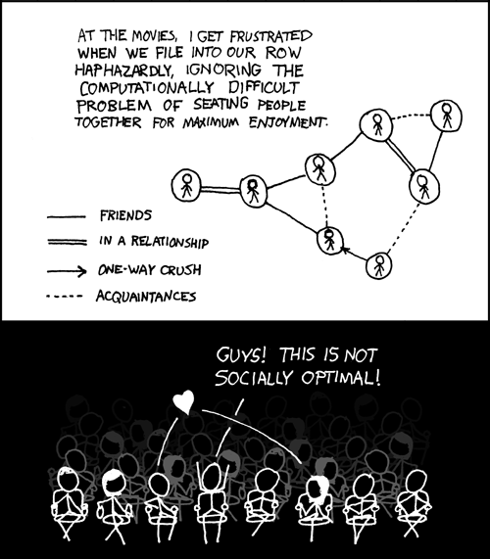
This course: how to solve problems!
http://xkcd.com/173/

Slide 36
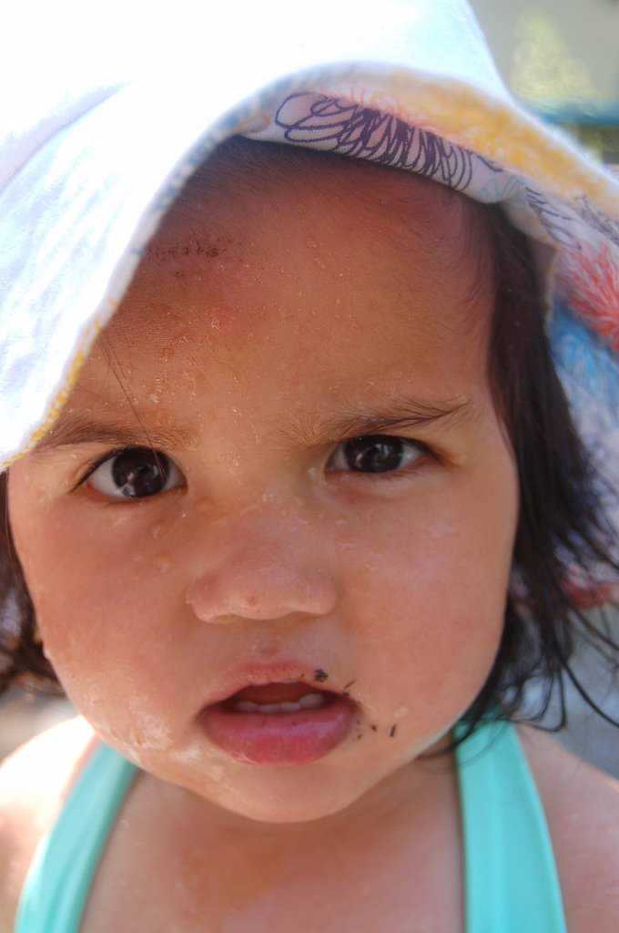
Why should I care ?

Slide 37

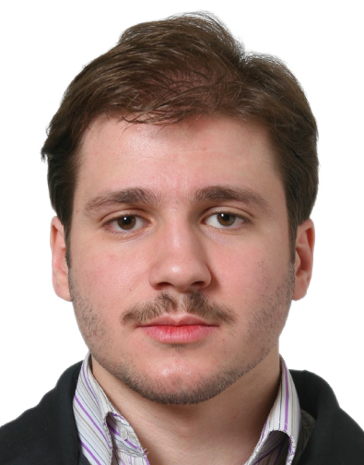
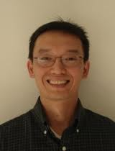
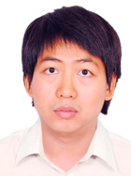
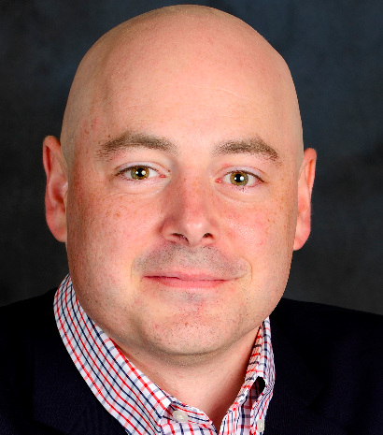


Combining Shadows to Understanding the network

Slide 38
The key technical problem
Given the three projections, what is the largest size of the original set of points?

Slide 39
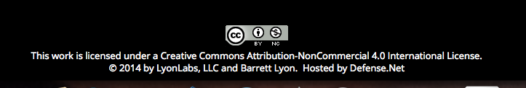
Detecting Communities

Slide 40
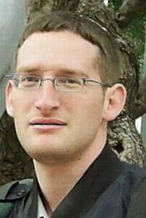
Conquering Shadows to Conquering the Internet
Algorithmically compute the missing set

Slide 41




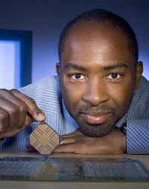

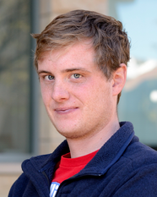
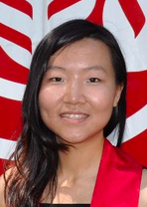

The proof is in the performance
>
10x faster
Better algorithm with little hacking will beat a worse algorithm with tons of hacking

Slide 42
The key technical problem
Highly trivial: 4³ = 64
Still trivial: 4² = 16
Correct answer: 4^{1.5} = 8

Slide 43
Questions/Comments?

