Slide 1
Lecture 10
CSE 331
Sep 21, 2022

Slide 2
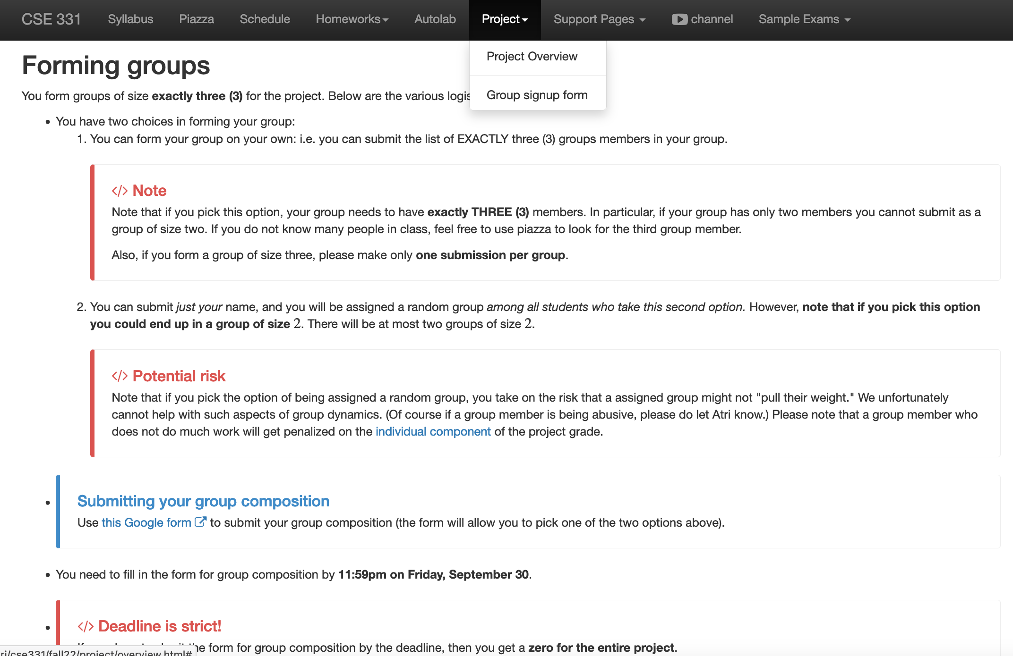
Project groups due in <2 weeks
Deadline: Friday, Sep 30, 11:59pm

Slide 3

If you need it, ask for help

Slide 4
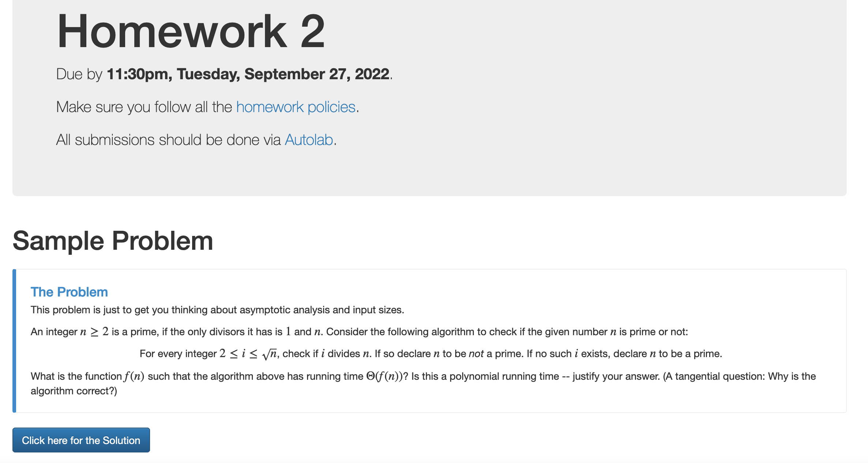
Homework 2 out!

Slide 5
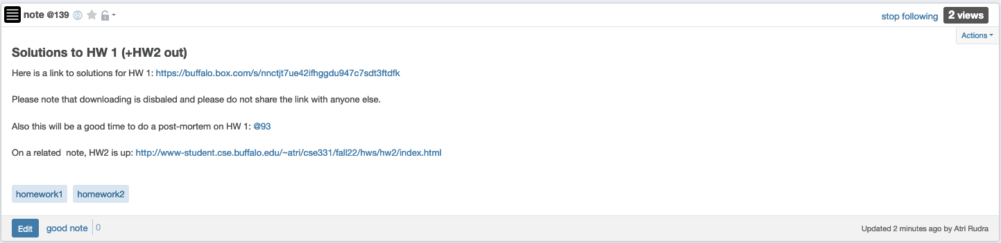
HW 1 solutions

Slide 6
Implementation Steps
(0) How to represent the input?
(1) How do we find a free woman w?
(2) How would w pick her best unproposed man m?
(3) How do we know who m is engaged to?
(4) How do we decide if m prefers w’ to w?

Slide 7
Overall running time
Init(1-4)
n² X ( Query/Update(1-4) )

Slide 8
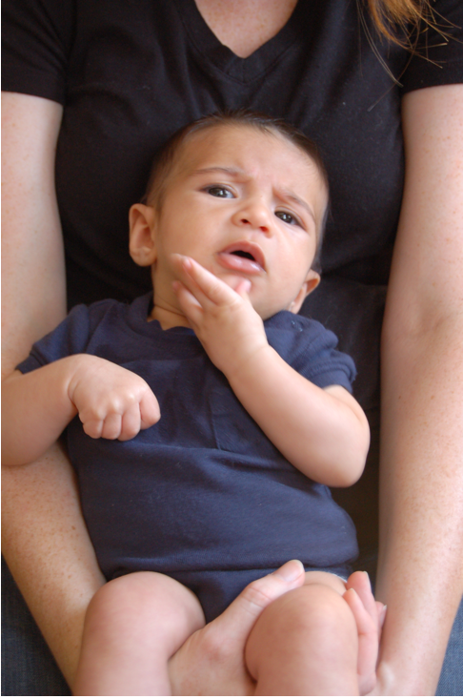
Questions?

Slide 9
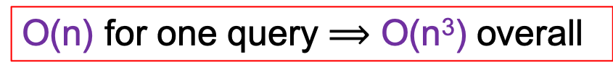
Answering Q4
rank i
w
w’
woman w
man m
w
w’
man m
j
k
ManPref [m][i]
Initialization time?
O(n²) time overall
Ranking [m][w]
O(1) query time
(4) How do we decide if m prefers w’ to w?

Slide 10
Puzzle
Prove that any algorithm for the SMP takes Ω(n²) time

Slide 11




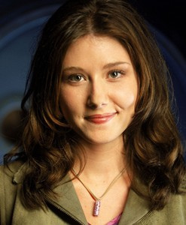


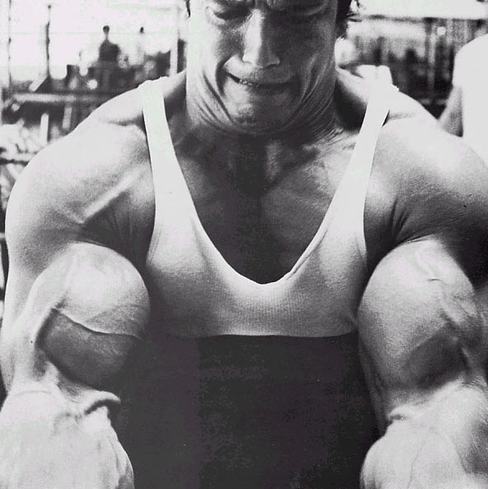
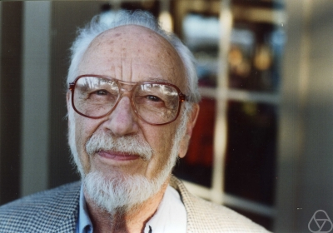
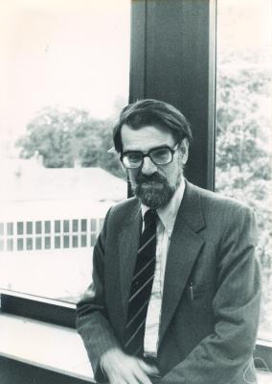
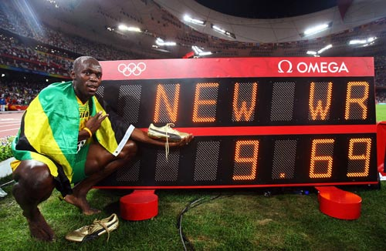
Main Steps in Algorithm Design
Problem Statement
Problem Definition
Algorithm
n!
“Implementation”
Analysis
Correctness Analysis

Slide 12

Reading Assignments
Sec 1.1 and Chap. 2 in [KT]

Slide 13
Up Next….
Problem Statement
A generic tool to abstract out problems
Problem Definition
Algorithm
“Implementation”
Analysis

Slide 14
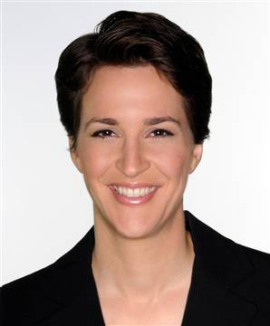
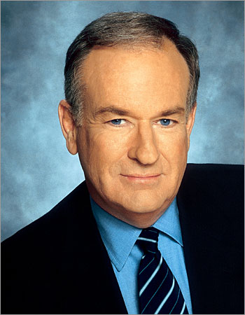





Graphs
Representation of relationships between pairs of entities/elements
Edge
Entities: News hosts
Relationship: Mention in other’s program
Vertex/Node

Slide 15
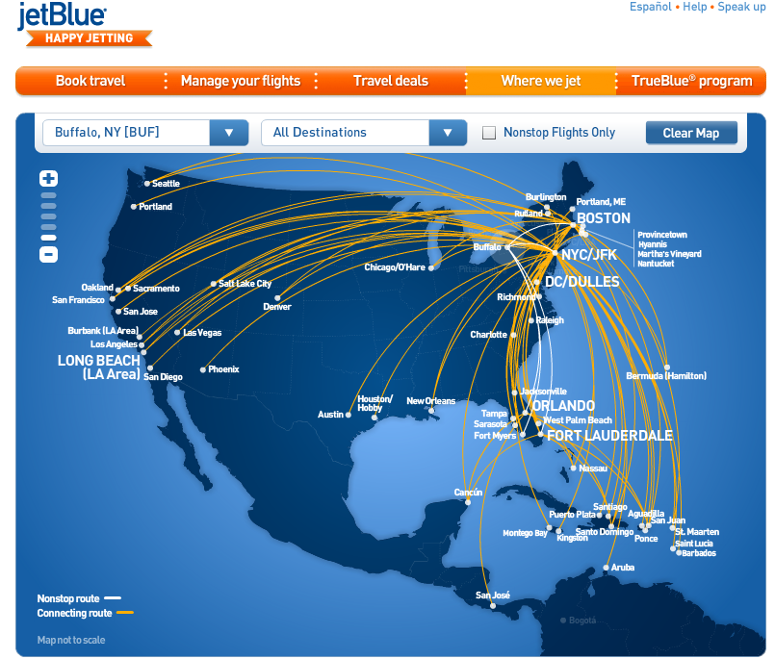
Graphs are omnipresent
Airline Route maps

Slide 16
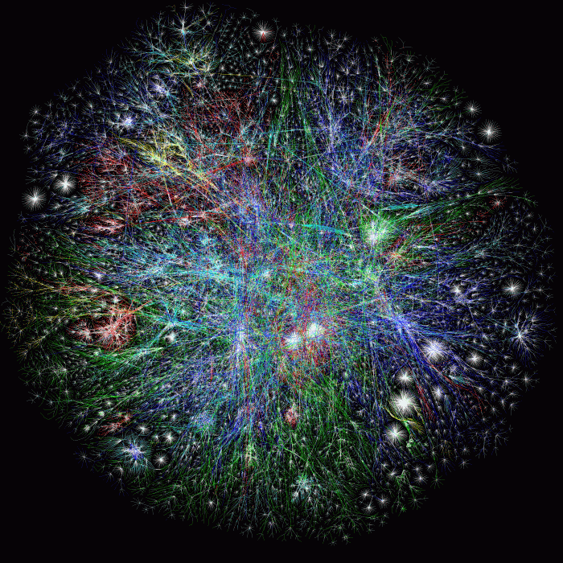
What does this graph represent?
Internet

Slide 17
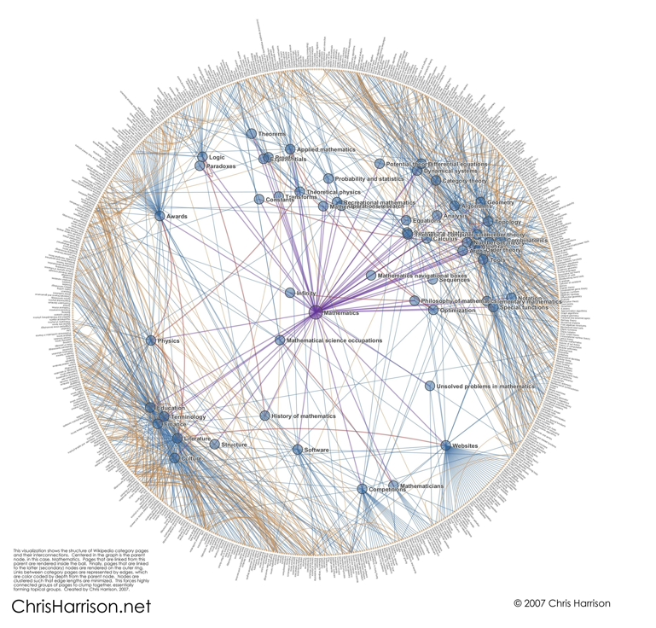
And this one?
Math articles on Wikipedia

Slide 18
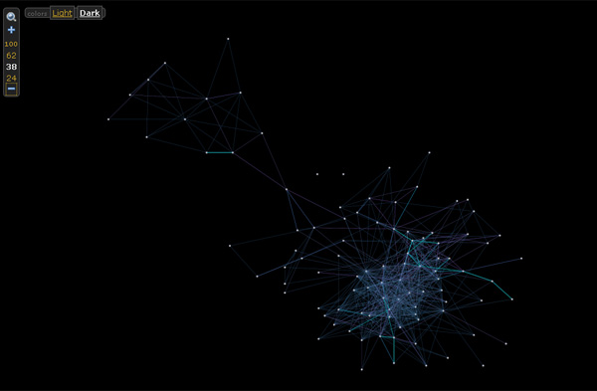

And this one?

Slide 19
Rest of today’s agenda
Basic Graph definitions

Slide 20

Paths
,
Sequence of vertices connected by edges
Connected
Path length 3
,
,
,

Slide 21
Connectivity
u and w are connected iff there is a path between them
A graph is connected iff all pairs of vertices are connected

Slide 22


Connected Graphs
Every pair of vertices has a path between them

Slide 23
Cycles
Sequence of k vertices connected by edges, first k-1 are distinct
,
,
,

Slide 24


Slide 25
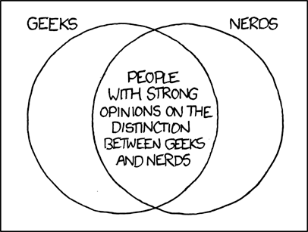
Formally define everything
http://imgs.xkcd.com/comics/geeks_and_nerds.png

