Slide 1
Lecture 11
CSE 331
Sep 23, 2022

Slide 2

Register project groups 1 week!
Deadline: Friday, Sep 30, 11:59pm

Slide 3

If you need it, ask for help

Slide 4

Couple of clarifications

Slide 5
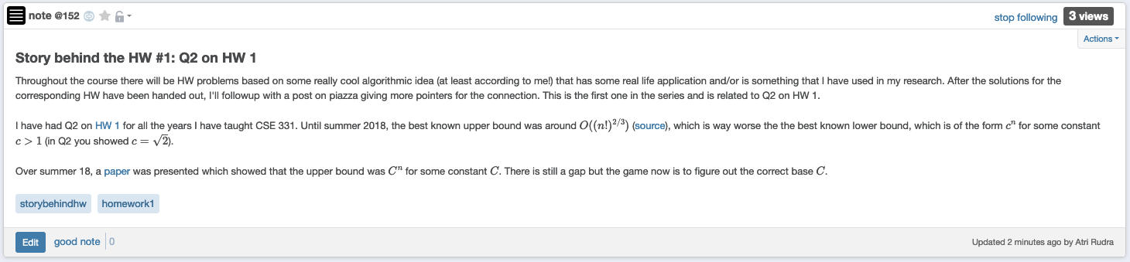
Story behind HW 1 Q2

Slide 6

Questions/Comments?

Slide 7










Distance between u and v
Length of the shortest length path between u and v
RM
BO
Distance between RM and BO?
1

Slide 8
Tree
Connected undirected graph with no cycles

Slide 9

Rooted Tree

Slide 10
A rooted tree
AC’s child=SG
Pick any vertex as root
SG’s parent=AC
Let the rest of the tree hang under “gravity”

Slide 11
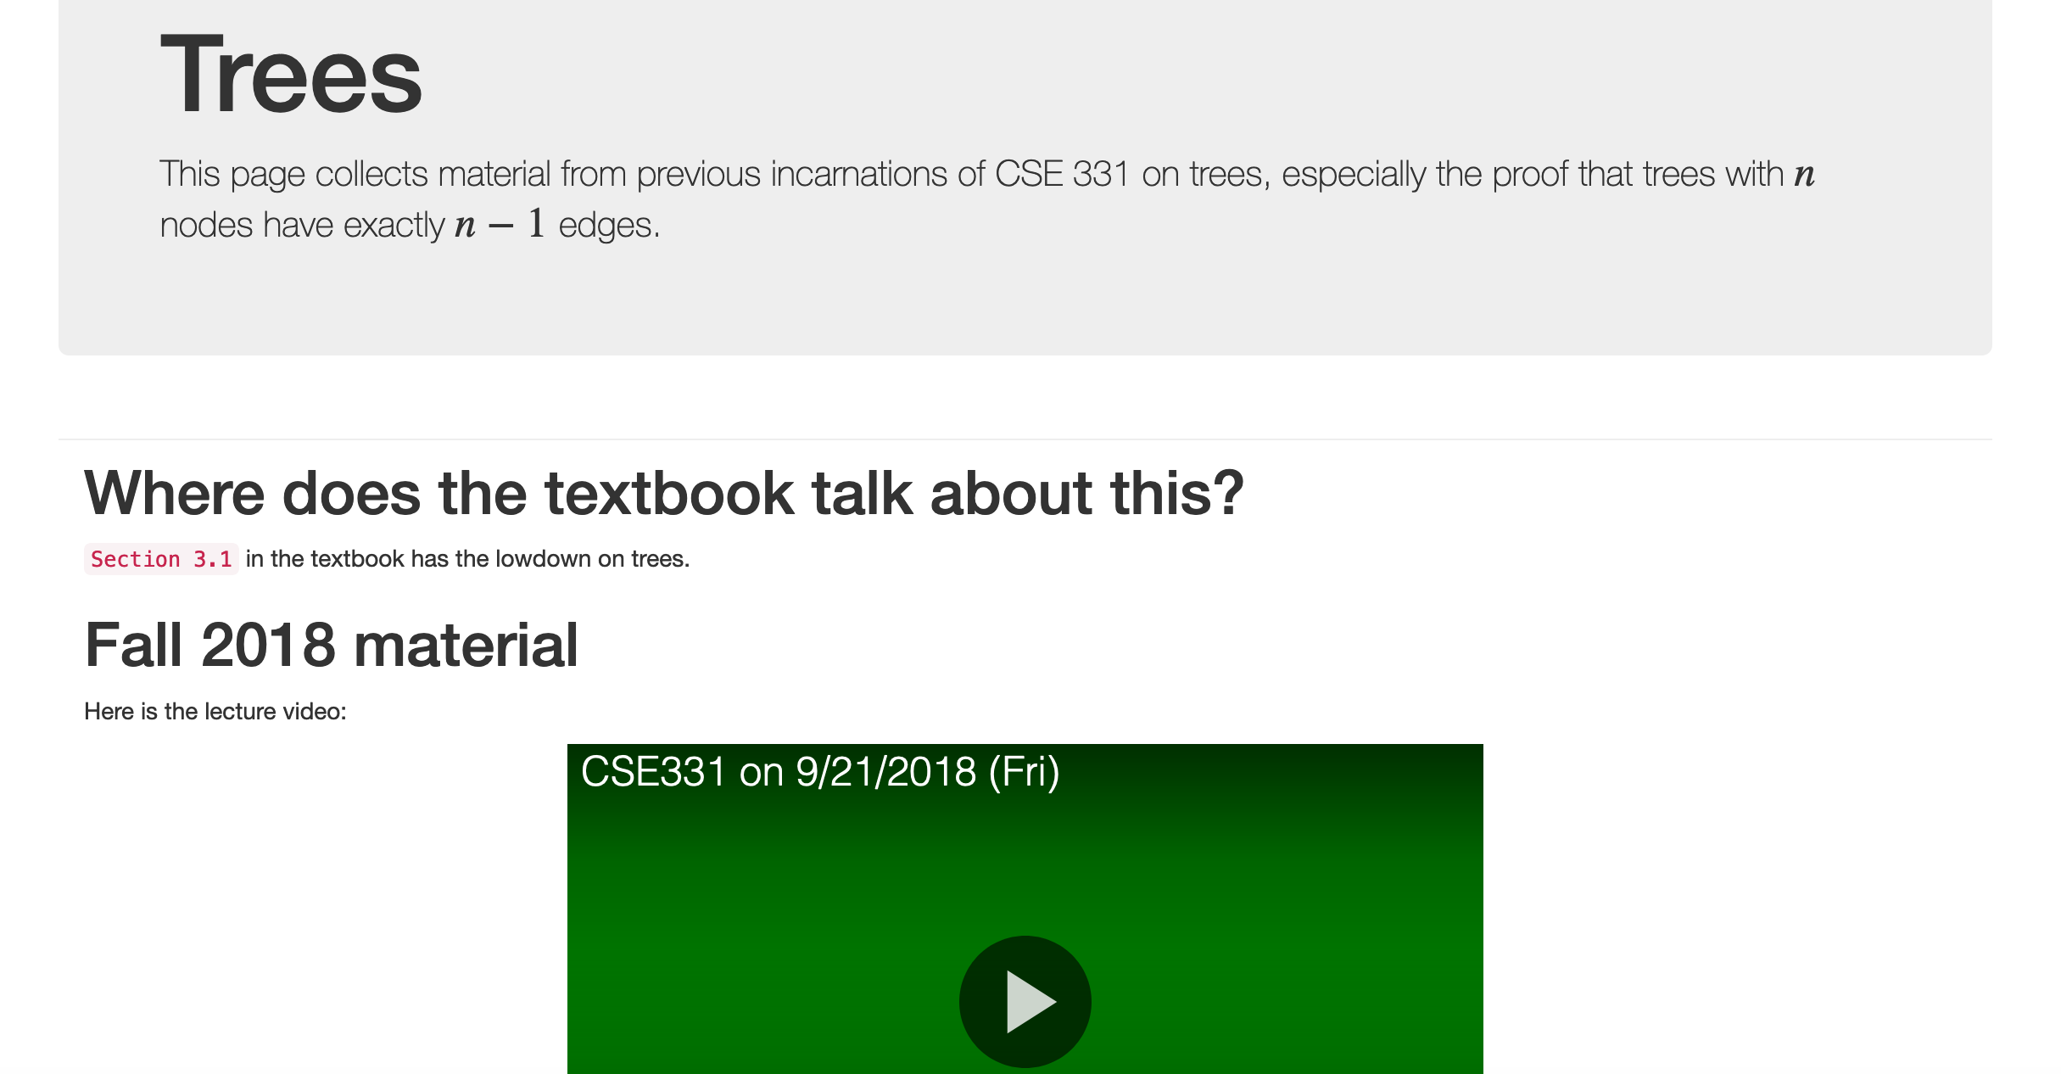
Every n vertex tree has n-1 edges

Slide 12
Every n vertex tree has n-1 edges
Let T be an undirected graph on n nodes
Then ANY two of the following implies the third:
T is connected
T has no cycles
T has n-1 edges

Slide 13
Questions/Comments?

Slide 14
Rest of Today’s agenda
Algorithms for checking connectivity

Slide 15
Checking by inspection

Slide 16

What about large graphs?
s
t
Are s and t connected?

Slide 17
Brute-force algorithm?
List all possible vertex sequences between s and t
n^{n} such sequences
Check if any is a path between s and t

Slide 18

Algorithm motivation
all

Slide 19
Questions/Comments?

Slide 20
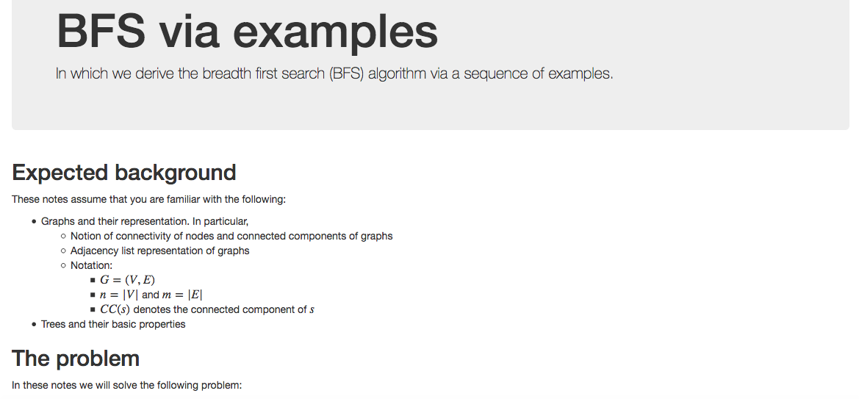
Breadth First Search (BFS)

Slide 21
Connectivity Problem
Input: Graph G = (V,E) and s in V
Output: All t connected to s in G
Connected component of s

Slide 22
Breadth First Search (BFS)
Build layers of vertices connected to s
L₀ = {s}
Assume L₀,..,L_{j} have been constructed
L_{j+1} set of vertices not chosen yet but are connected by an edge to L_{j}
Stop when new layer is empty

Slide 23
BFS Tree
BFS naturally defines a tree rooted at s
Add non-tree edges
L_{j} forms the jth “level” in the tree
u in L_{j+1} is child of v in L_{j} from which it was “discovered”
1
7
9
1
L₀
2
3
L₁
2
3
8
0
4
5
4
5
7
8
L₂
6
6
L₃

Slide 24
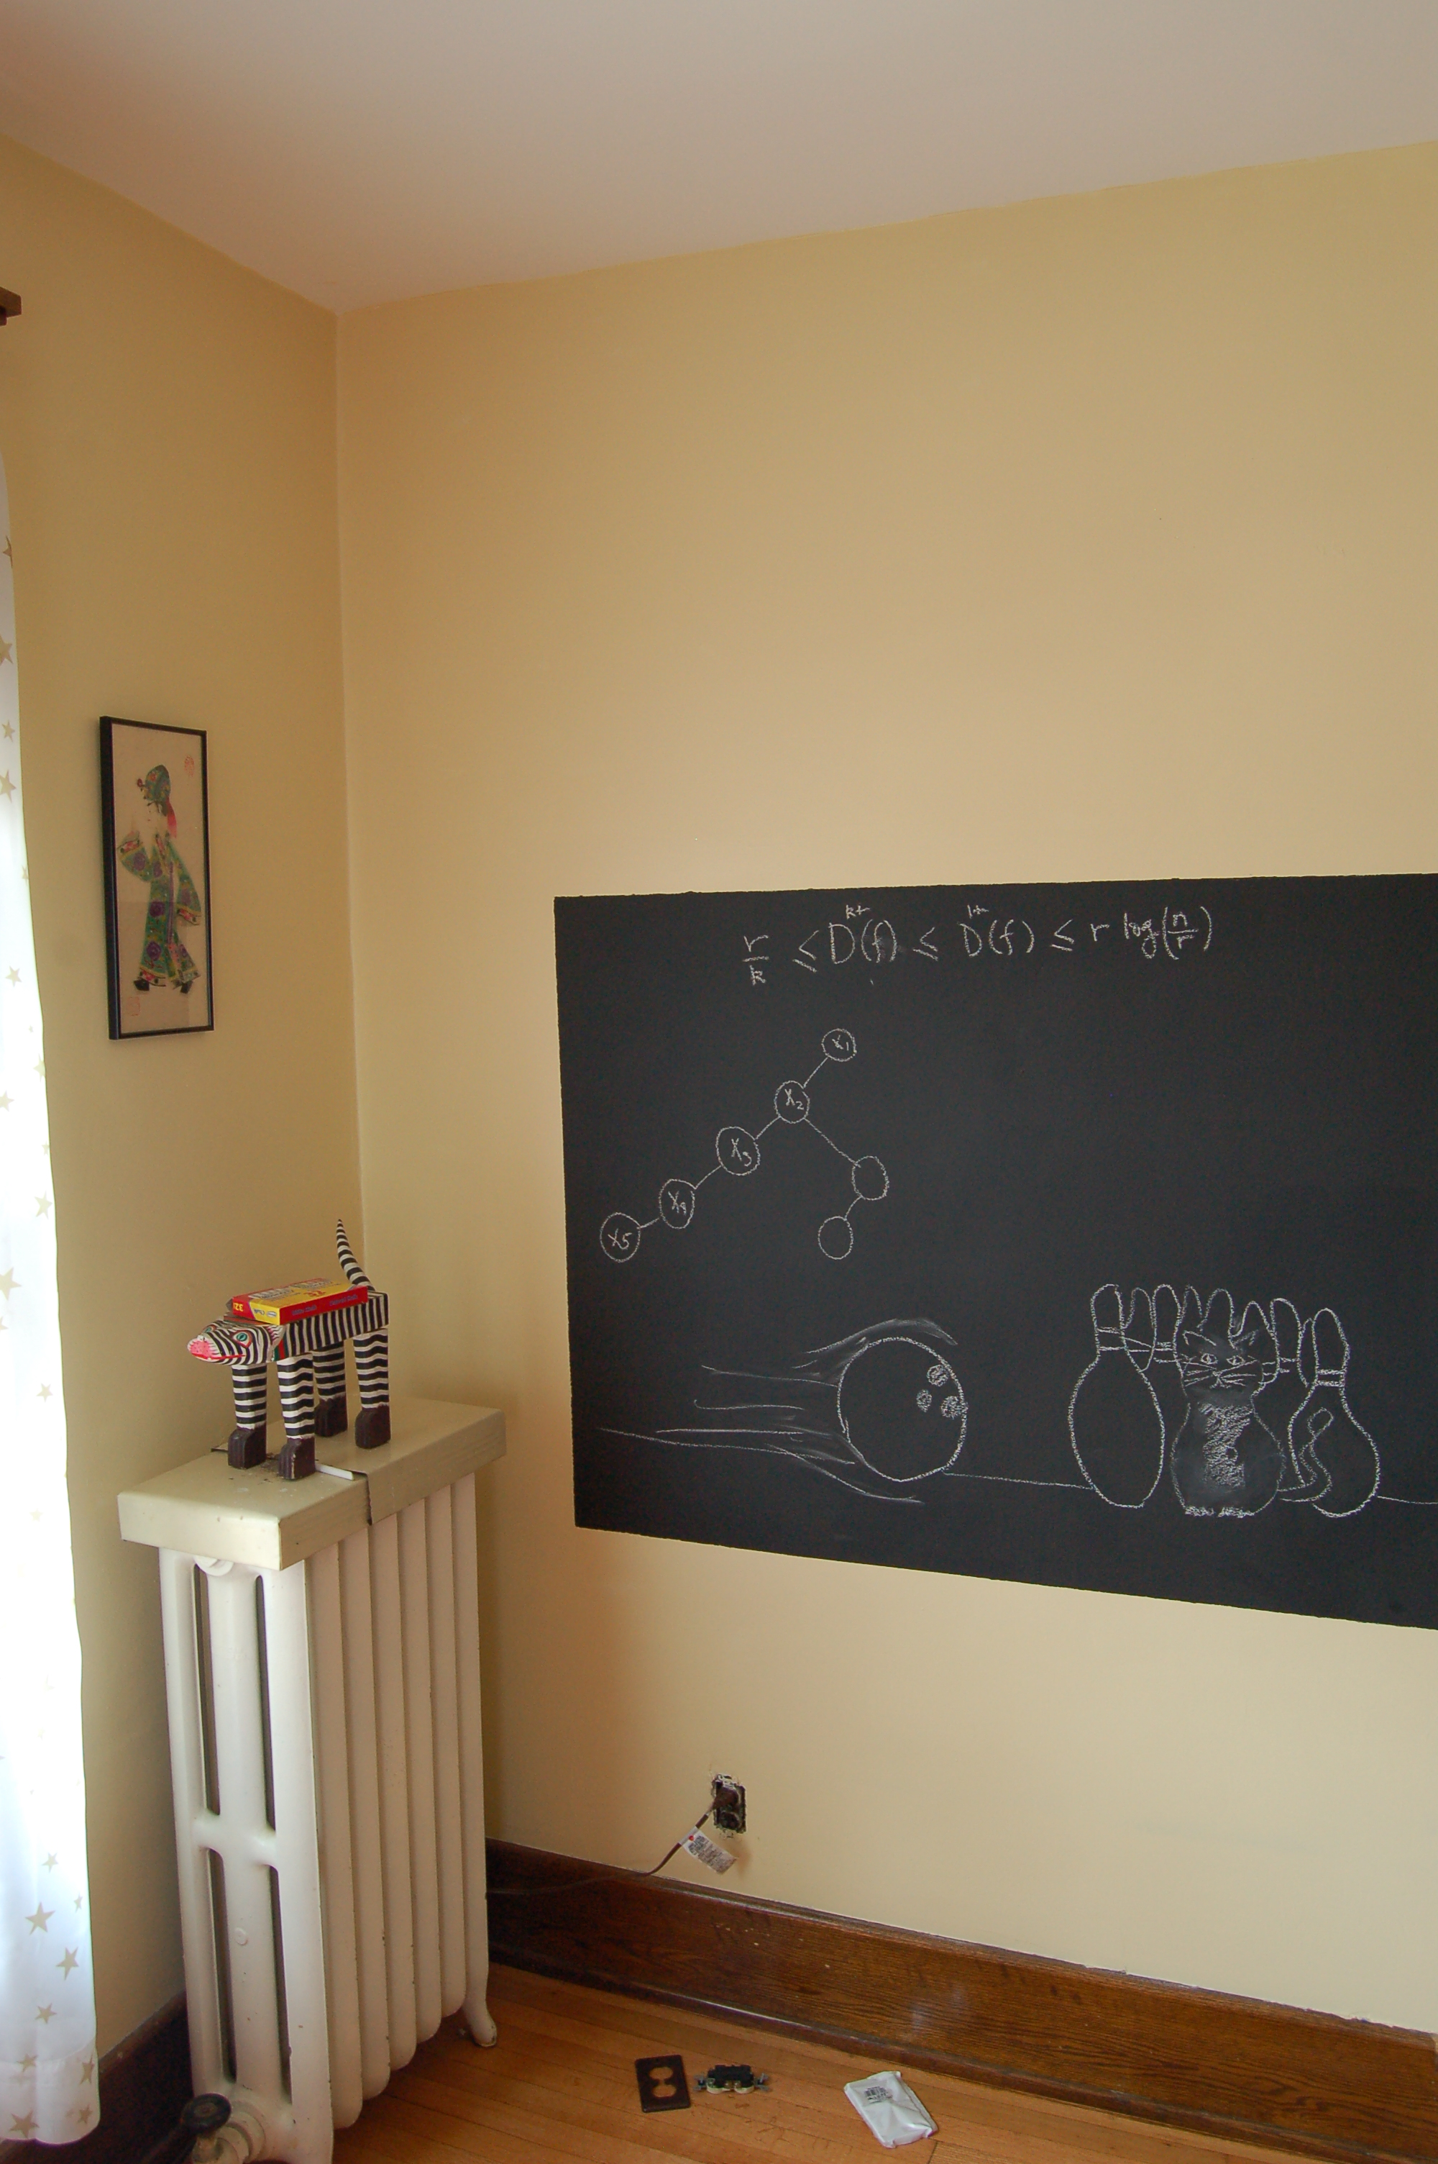
Argue on the board…

