Slide 1
Lecture 17
CSE 331
Oct 7, 2022

Slide 2
Quiz 1– 11:00-11:10am

Slide 3
Lecture starts at 11:15am

Slide 4
Quiz 1 timelines
Solutions: posted by today evening
Grading: finished by Saturday

Slide 5
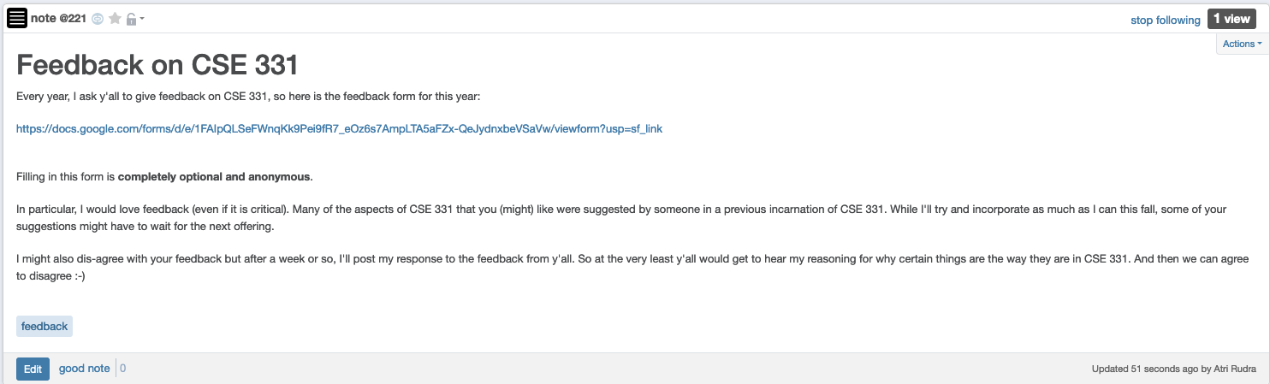
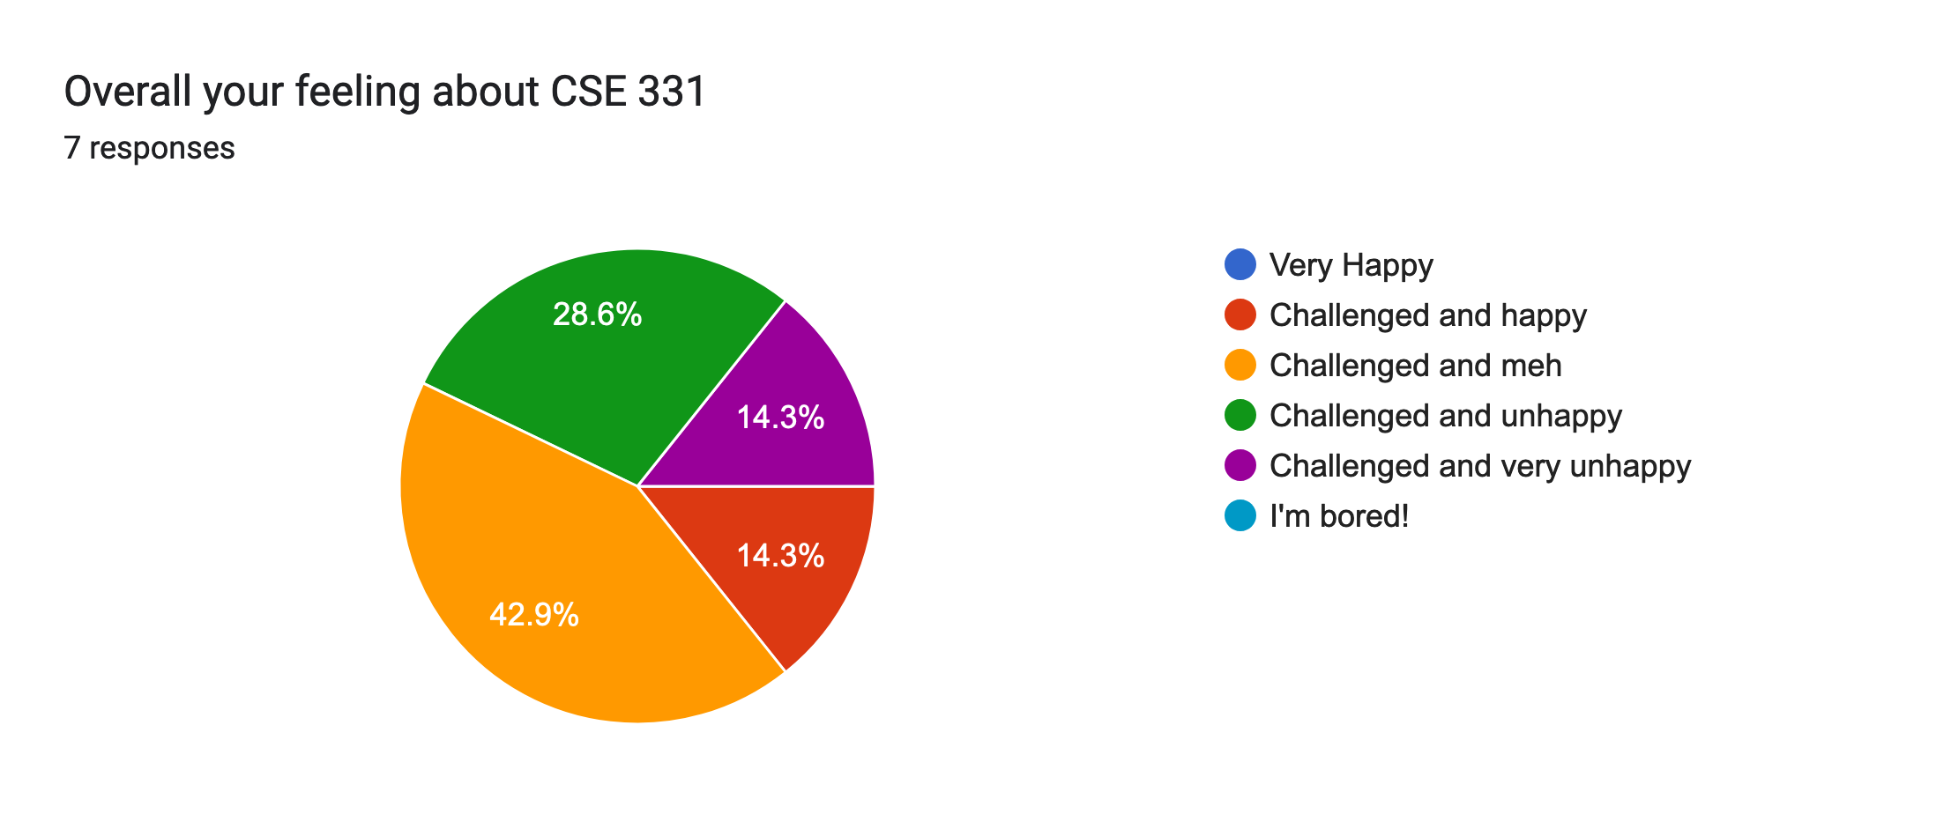
Please do fill in the feedback

Slide 6
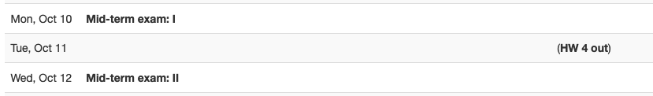
Mid-terms next week

Slide 7
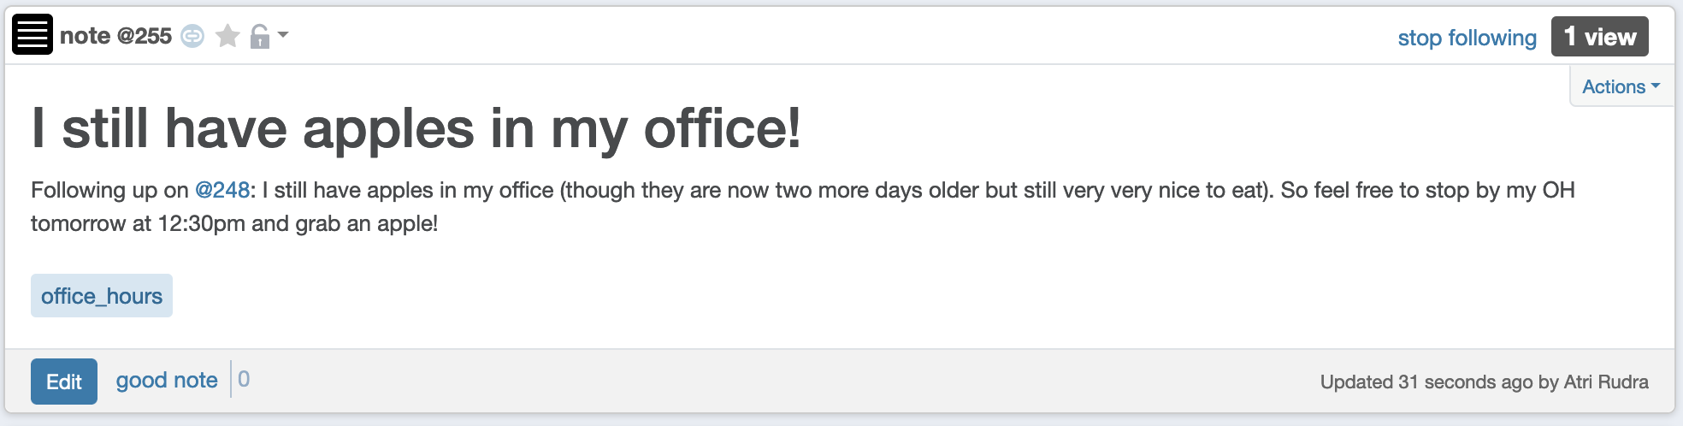
I still have more apples ☺

Slide 8
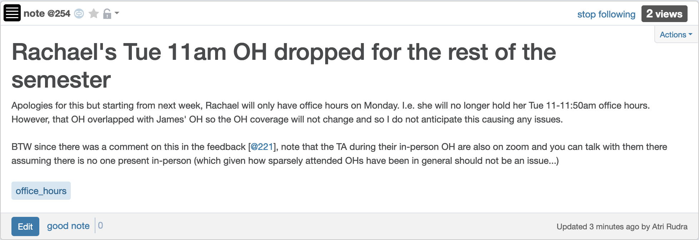
Rachael OH only on Mondays

Slide 9
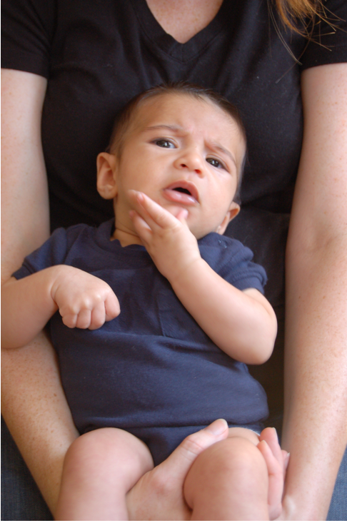
Questions?

Slide 10
Runtime analysis of Greedy Algo.
R: set of requests
O(1)
Set S to be the empty set
Repeated at most n times
While R is not empty
O(n)
O(1)
Choose i in R with the earliest finish time
Add i to S
O(n)
Overall: O(n) + n*O(n) = O(n²)
Remove all requests that conflict with i from R
Return S* = S
O(n)

Slide 11
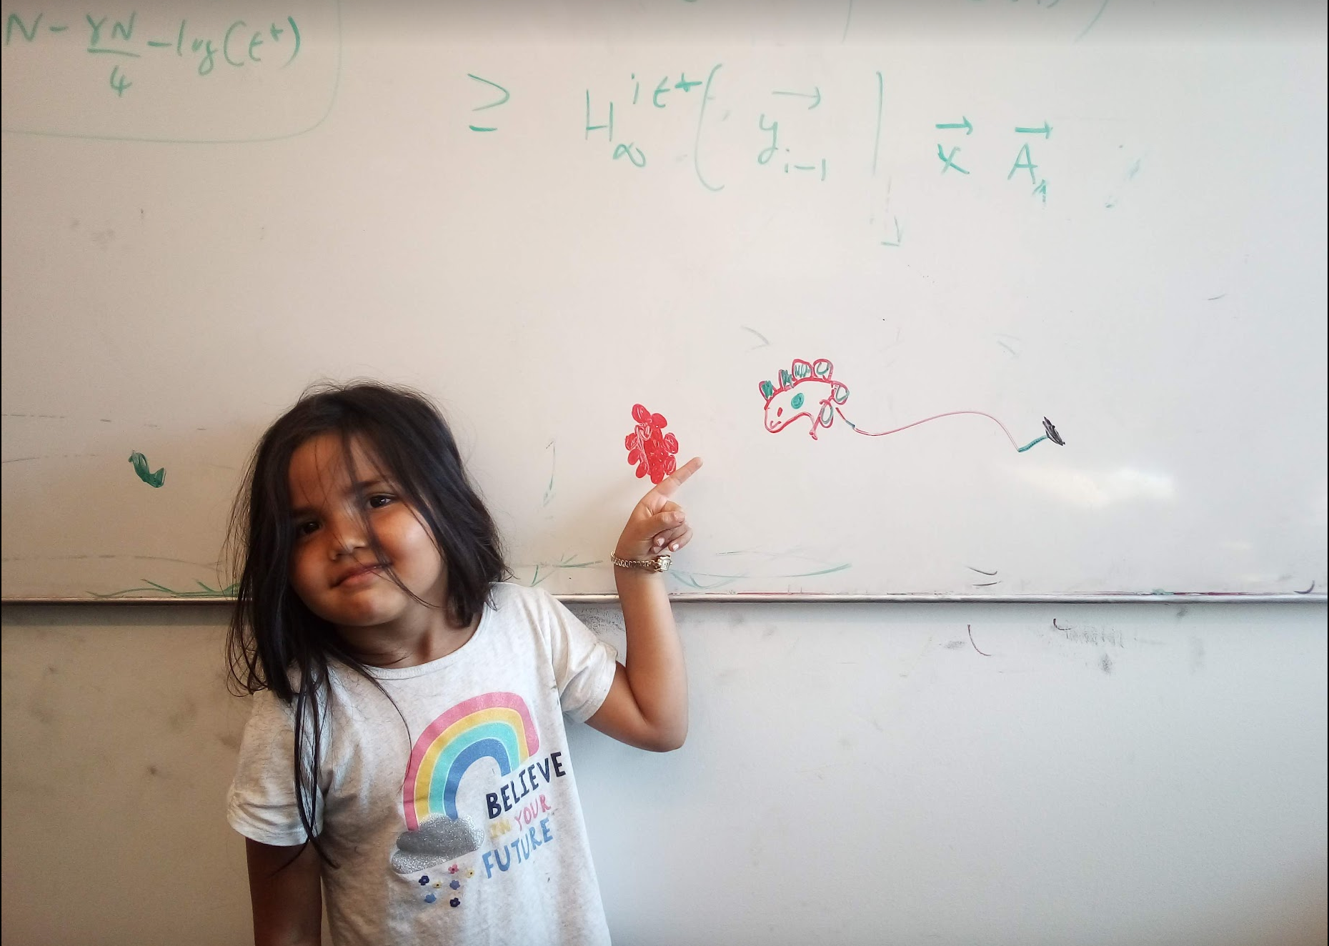
Questions/Comments?

Slide 12
Algorithm implementation
Go through the intervals in order of their finish time
3
How can you tell in O(1) time if any of 2,3 or 4 conflict with 1?
Check if s[i] < f(1)
2
1
4
O(n log n) run time
In general, if jth interval is the last one chosen
Pick smallest i>j such that s[i] ≥ f(j)

Slide 13
The final algo
O(n log n) time sort intervals such that f(i) ≤ f(i+1)
O(n) time build array s[1..n] s.t. s[i] = start time for i
Add 1 to A and set f = f(1)
For i = 2 .. n
If s[i] ≥ f
Add i to A
Set f = f(i)
Return A* = A

Slide 14
Questions/Comments?

Slide 15
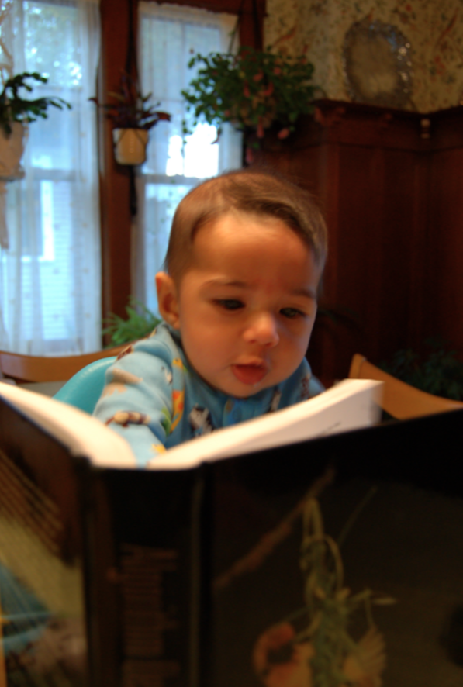
Reading Assignment
Sec 4.1 of [KT]

Slide 16

The “real” end of Semester blues
There are deadlines and durations of tasks
Write up a term paper
Party!
Exam study
331 HW
Project
Friday
Saturday
Sunday
Monday
Tuesday

Slide 17
The “real” end of Semester blues
There are deadlines and durations of tasks
Write up a term paper
Exam study
Party!
331 HW
Project
Friday
Saturday
Sunday
Monday
Tuesday

Slide 18
The algorithmic task
YOU decide when to start each task
Write up a term paper
Exam study
You have to do ALL the tasks
Party!
331 HW
Project
Friday
Saturday
Sunday
Monday
Tuesday

Slide 19
Scheduling to minimize lateness
All the tasks have to be scheduled
GOAL: minimize maximum lateness
Write up a term paper
Exam study
Party!
331 HW
Project
Friday
Saturday
Sunday
Monday
Tuesday

Slide 20
One possible schedule
All the tasks have to be scheduled
GOAL: minimize maximum lateness
Lateness = 0
Lateness = 2
331 HW
Party!
Exam study
Write up a term paper
Friday
Saturday
Sunday
Monday
Tuesday

Slide 21
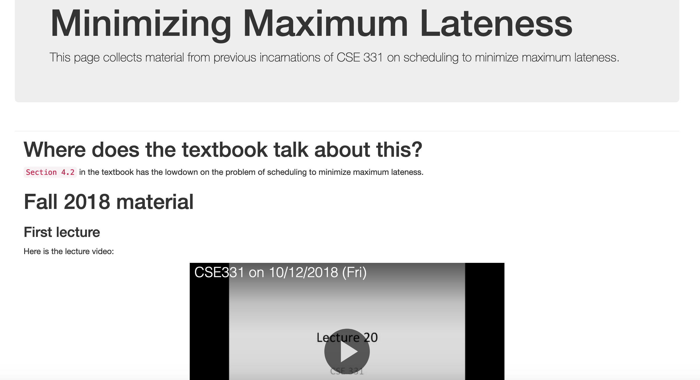
Minimizing Max Lateness

Slide 22
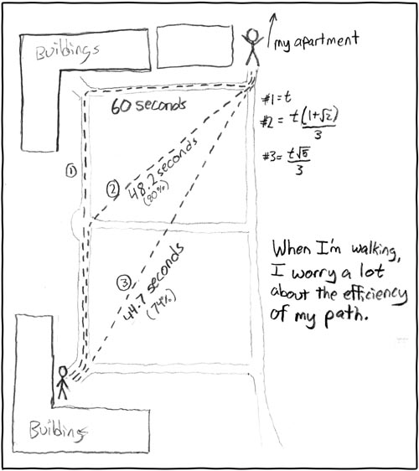
Rest of today
Shortest Path Problem
http://xkcd.com/85/

Slide 23
Reading Assignment
Sec 2.5 of [KT]

Slide 24
Shortest Path problem
s
100
Input: Directed graph G=(V,E)
Edge lengths, l_{e} for e in E
“start” vertex s in V
w
5
15
u
s
s
w
5
5
15
u
u
Output: All shortest paths from s to all nodes in V

Slide 25
Naïve Algorithm
Ω(n!) time

Slide 26
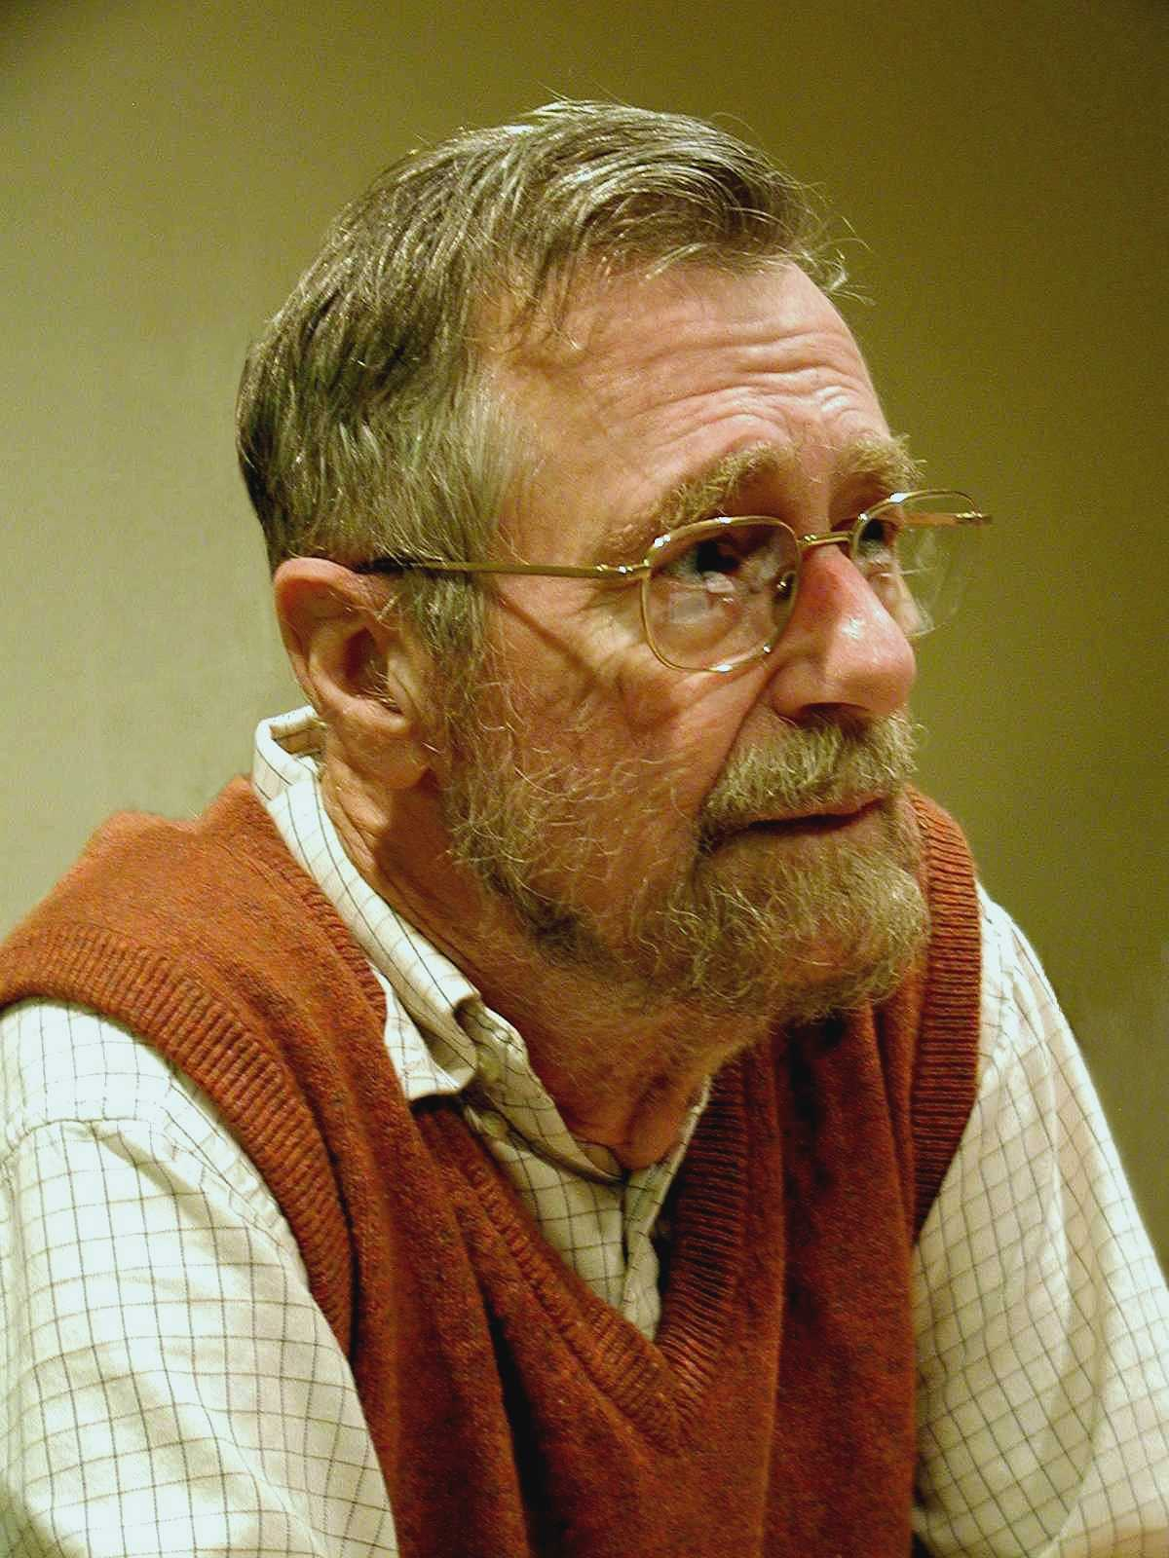
Dijkstra’s shortest path algorithm
E. W. Dijkstra (1930-2002)

