Slide 1
Lecture 2
CSE 331
Aug 31, 2022

Slide 2
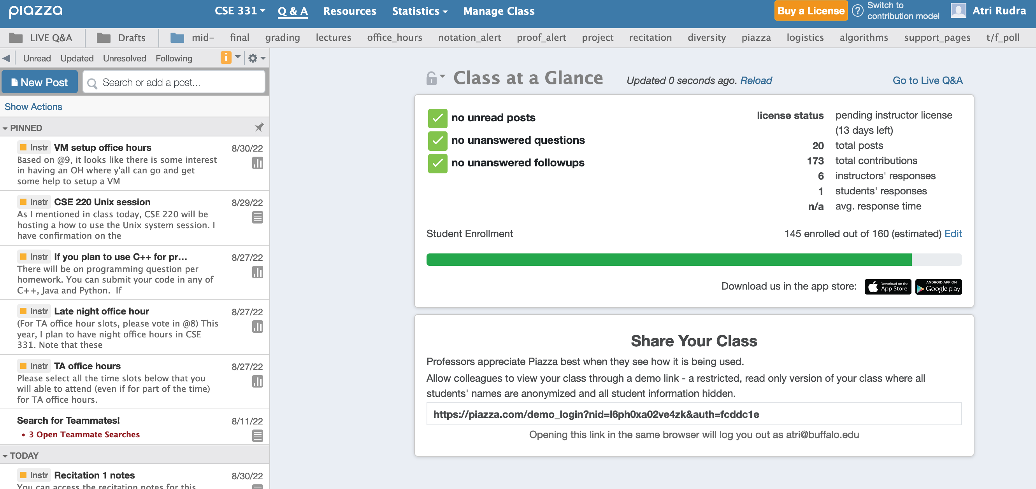
Enroll on Piazza
https://piazza.com/buffalo/fall2022/cse331/

Slide 3
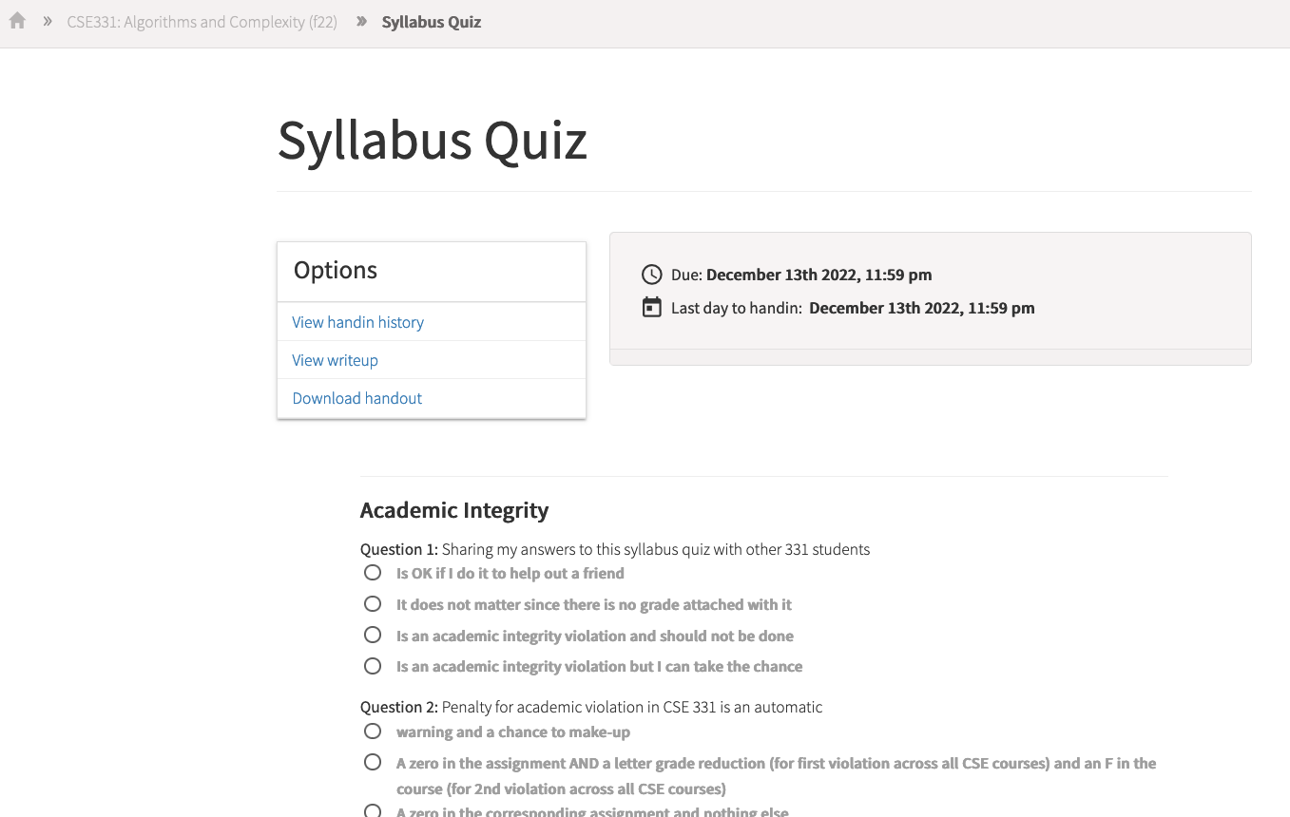
Read the syllabus CAREFULLY!
No graded material will be handed back until you pass the syllabus quiz!

Slide 4
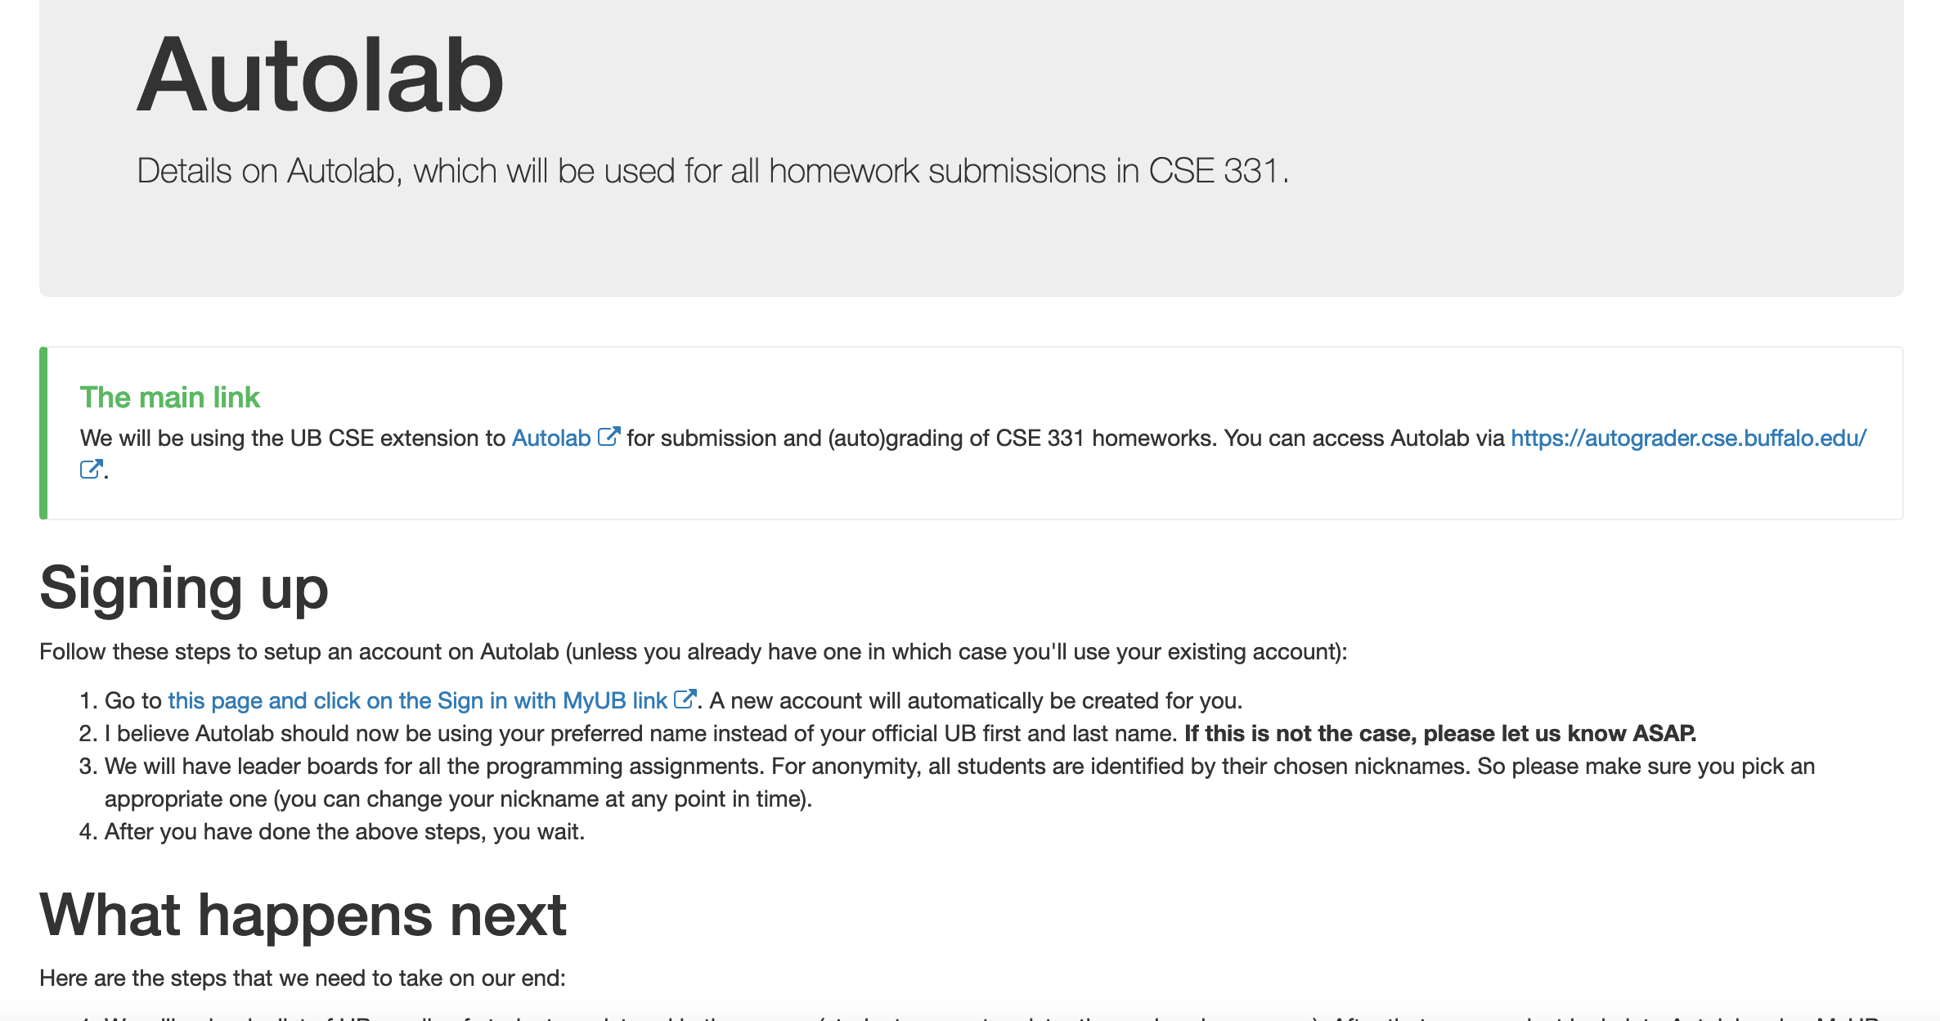
Autolab FAQ

Slide 5
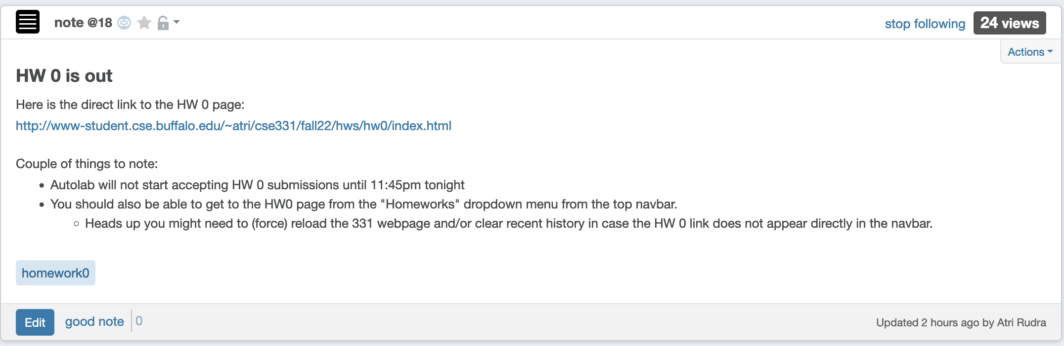
Homework 0 is out

Slide 6
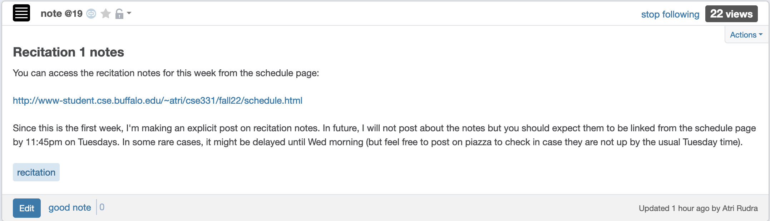
Recitation notes for this week

Slide 7
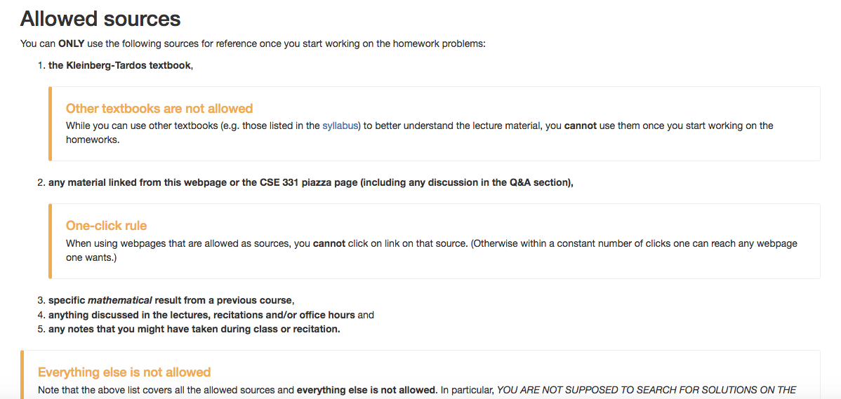
Allowed Sources

Slide 8
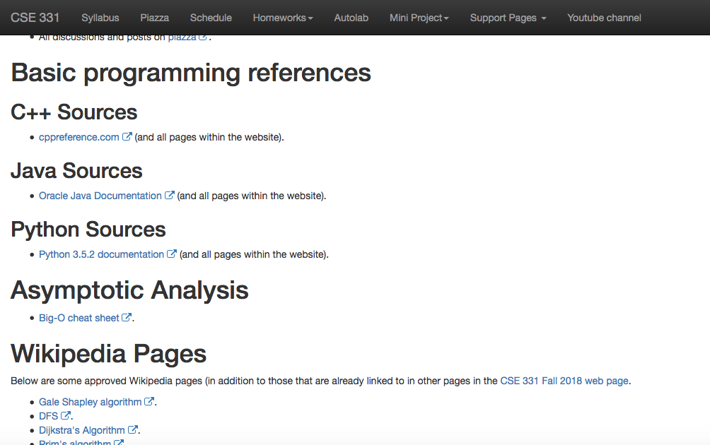
… even for programming Q
http://www-student.cse.buffalo.edu/~atri/cse331/fall18/policies/allowed-sources.html

Slide 9
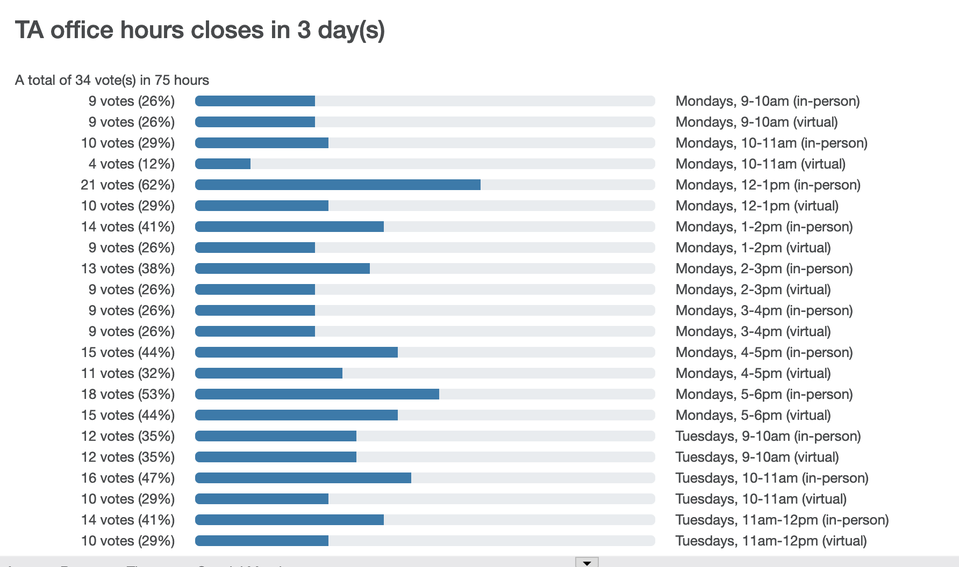
TA Office hours finalized tomorrow

Slide 10
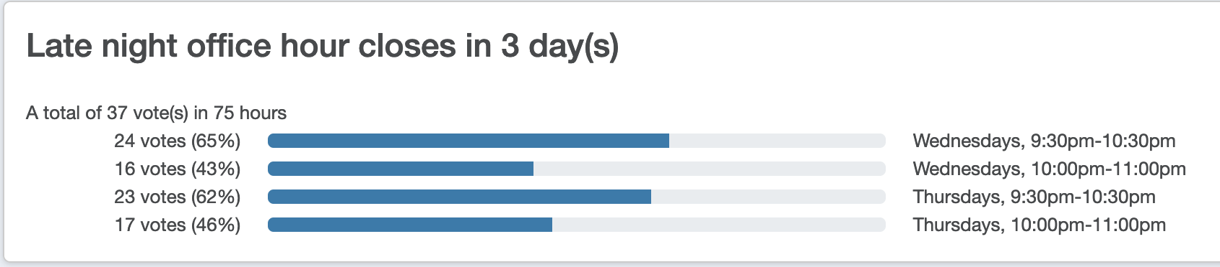
Night Office hour as well

Slide 11
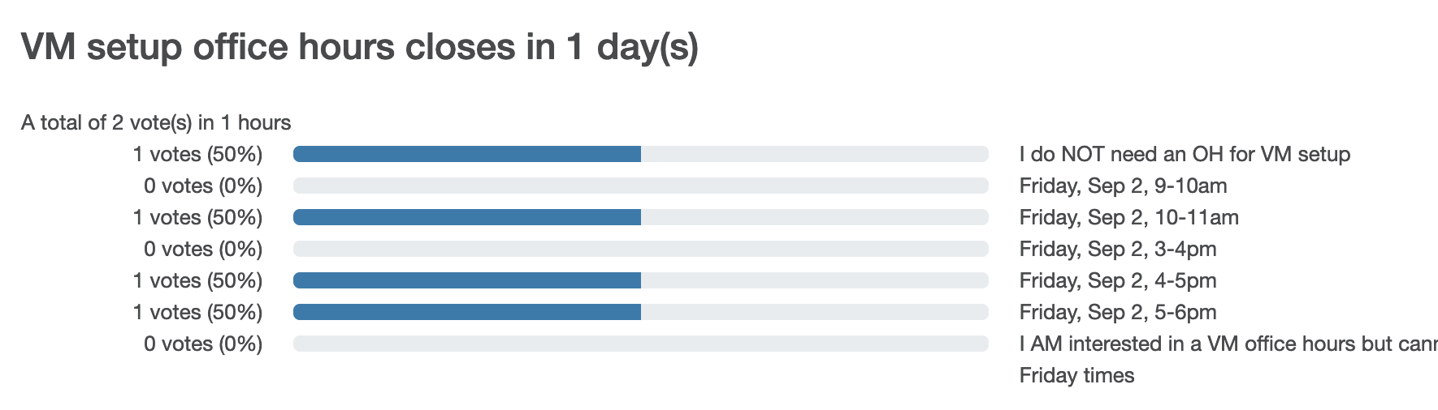
Special OH for VM setup
Time finalized tonight!

Slide 12
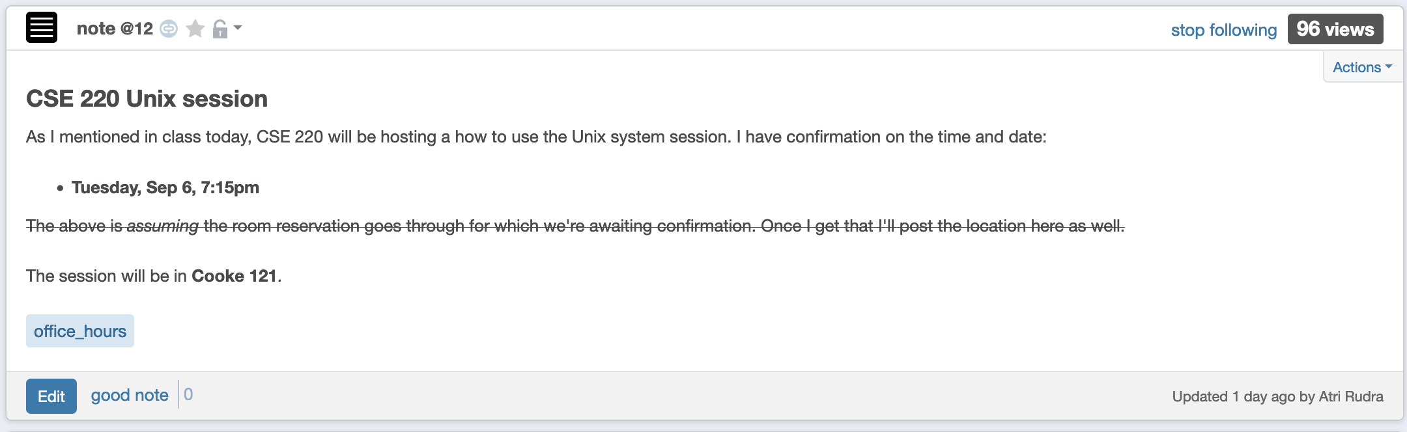
How to Unix session

Slide 13
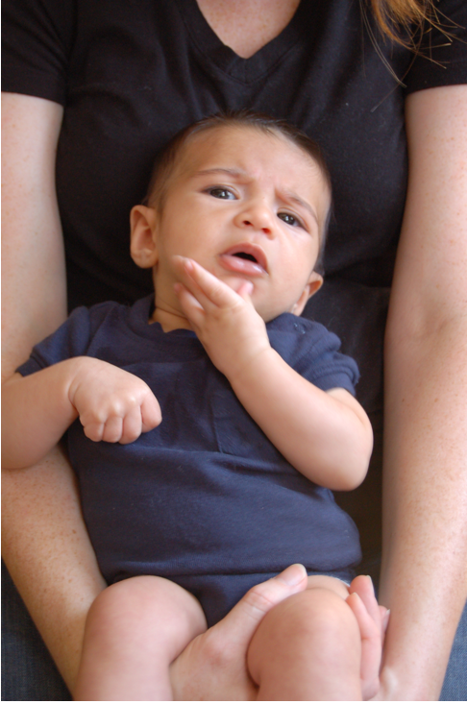
Questions/Comments?

Slide 14
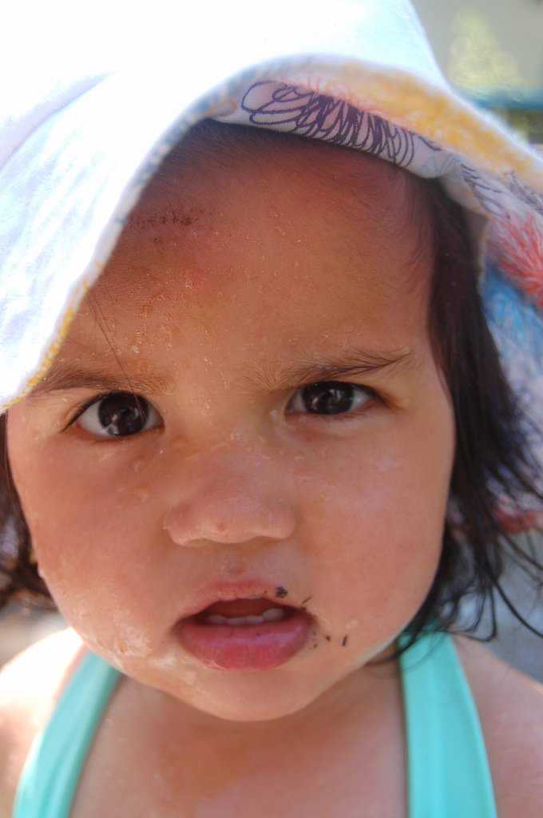
Why should I care about CSE 331?

Slide 15



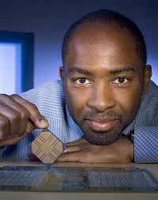
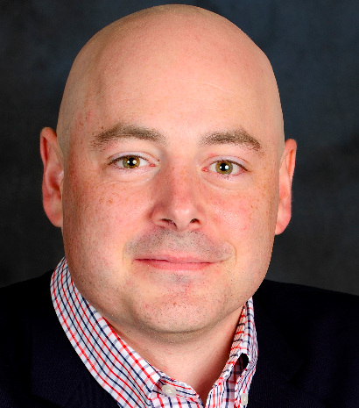

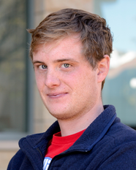
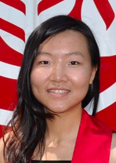

The proof is in the performance
>
10x faster
Better algorithm with little hacking will beat a worse algorithm with tons of hacking

Slide 16



If detecting communities is not for you

Slide 17
From someone who got a Google job
“You can let your algorithms class know that the phone interviews are essentially like a difficult algorithms test.
Lots of data structures, specifying the algorithm, analyzing the
run time and space requirements... And all on the phone and
you're supposed to talk through your thought process.”

Slide 18
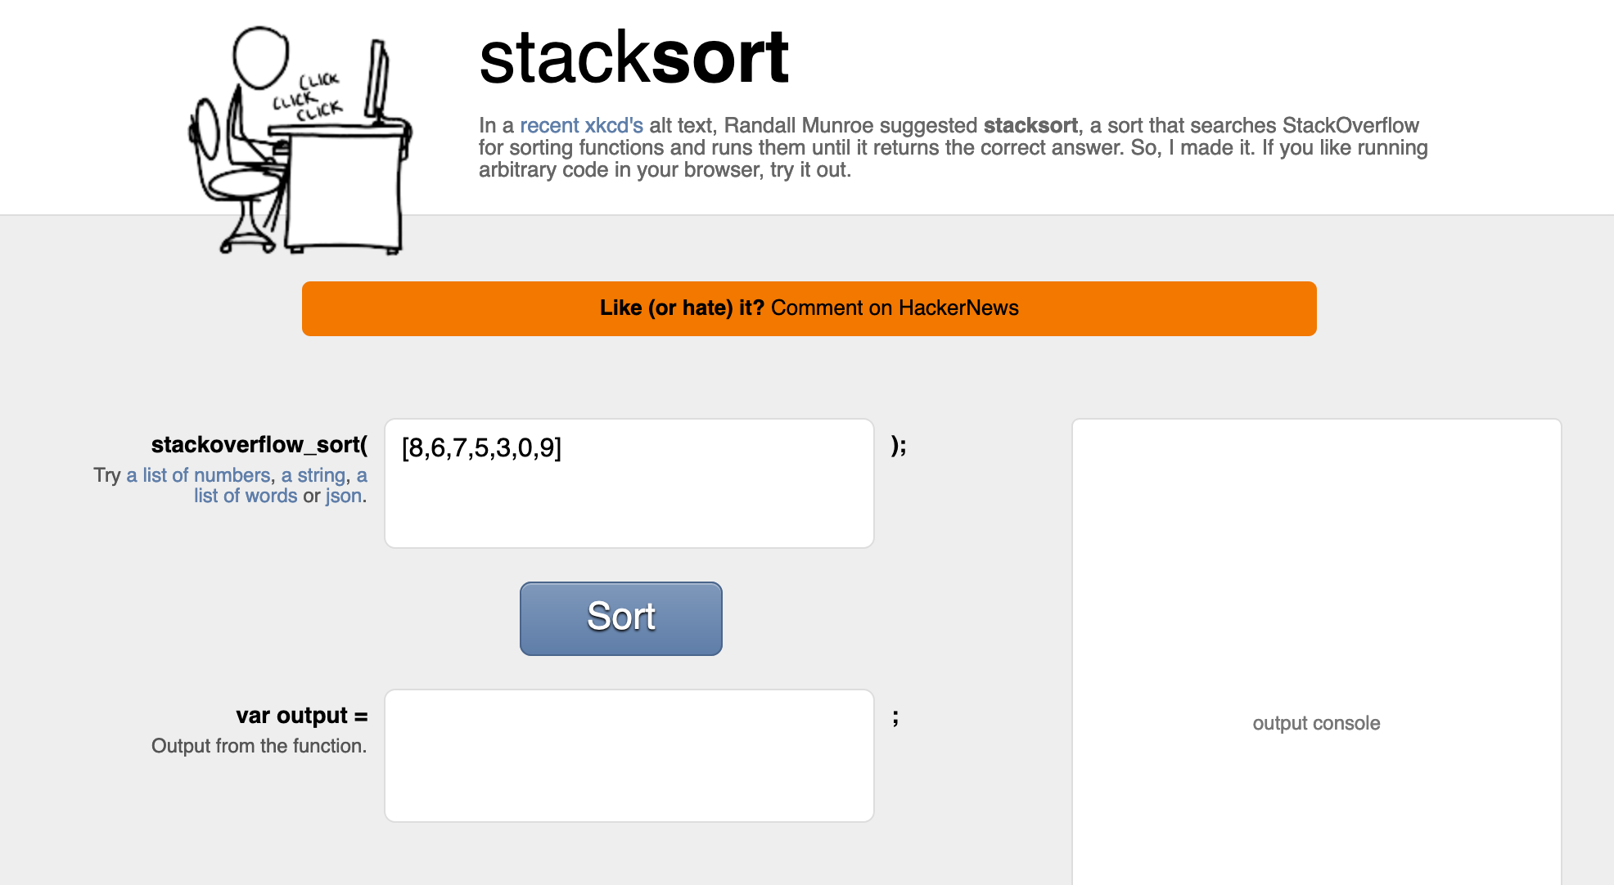
Coding jobs will be done by AI

Slide 19
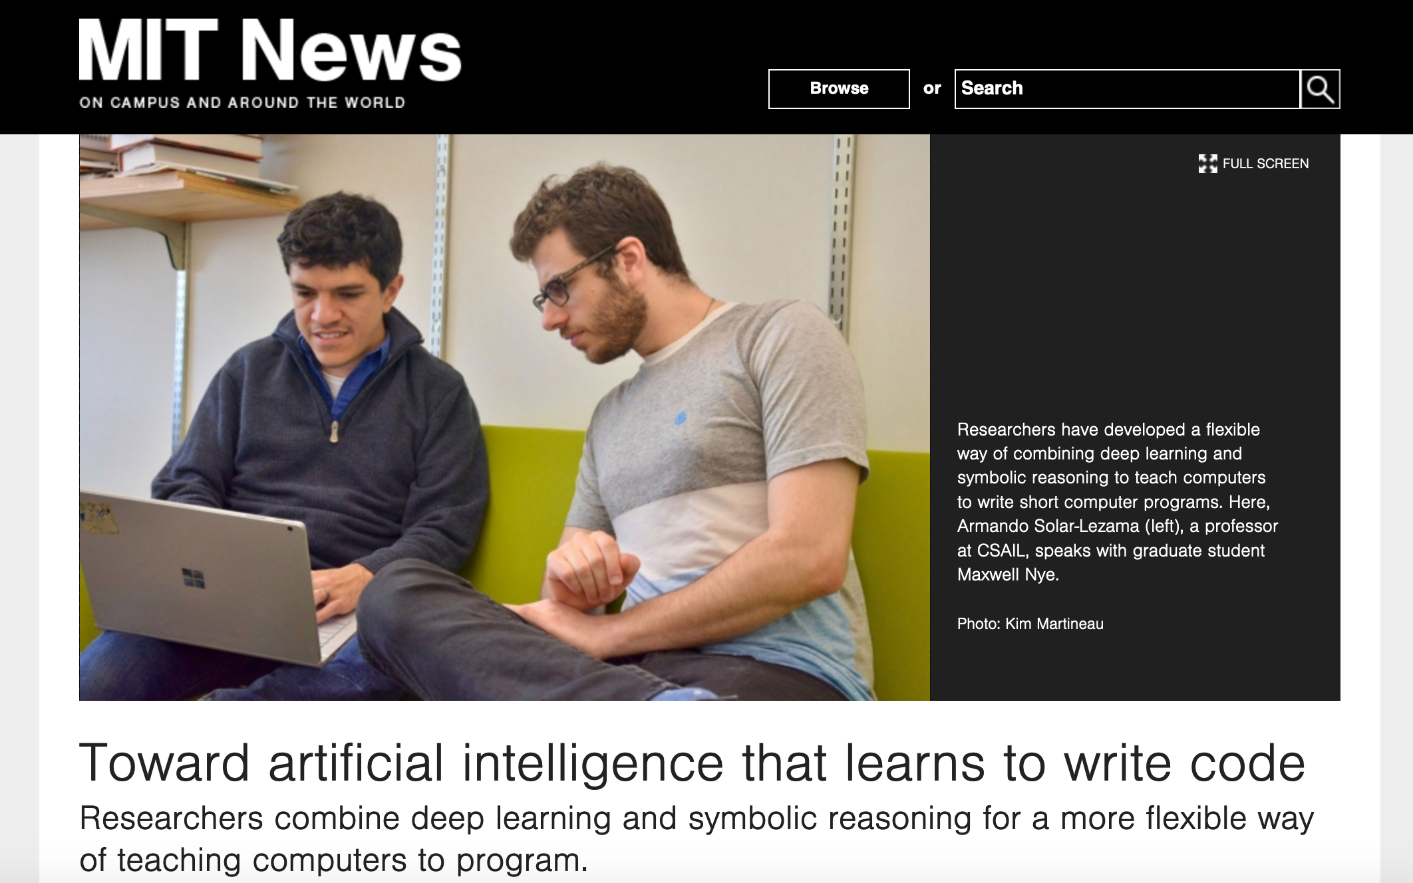
Coding jobs will be done by AI

Slide 20
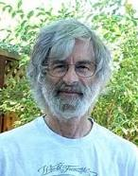

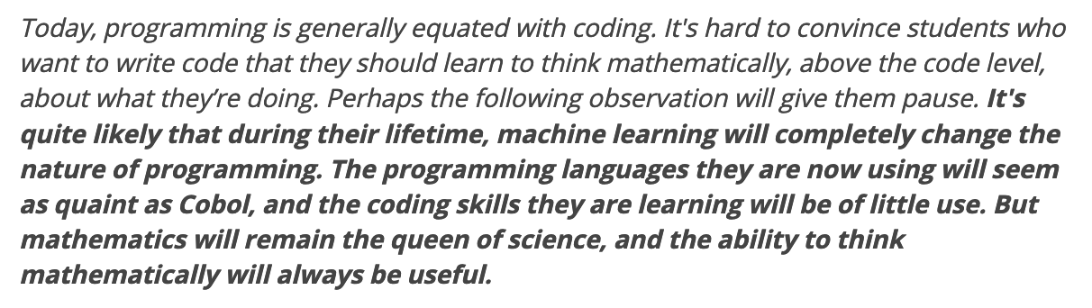
So am I doomed?
There will still be room for high level algorithmic thinking!

Slide 21
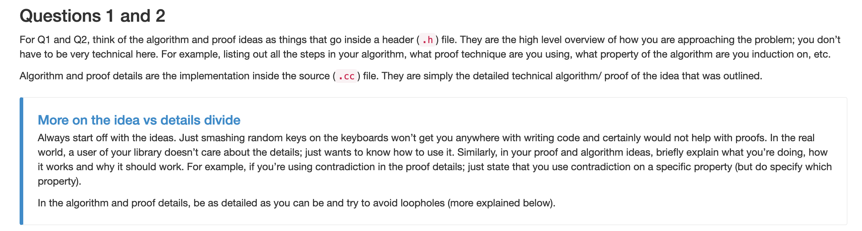
Proof Idea vs. Proof Details

Slide 22
Questions/Comments?

Slide 23

Bit more about the course
IT’LL BE

Slide 24

We’ll do loads of
s
http://www.impawards.com/2005/proof.html
Writing down your thought process formally and precisely!

Slide 25
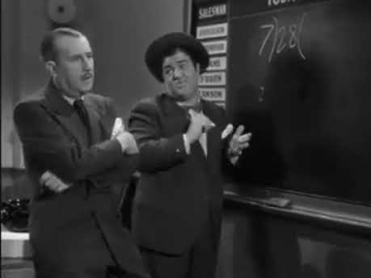
An incorrect “proof”

Slide 26
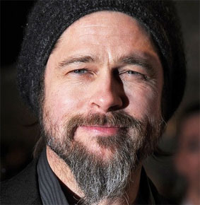
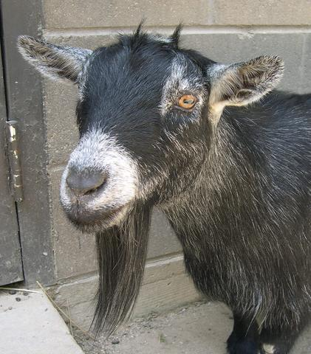
A more subtle incorrect “proof”
Brad Pitt had a beard
waleg.com
Every goat has a beard
animaldiversity.org
Hence, Brad Pitt is a goat.

Slide 27
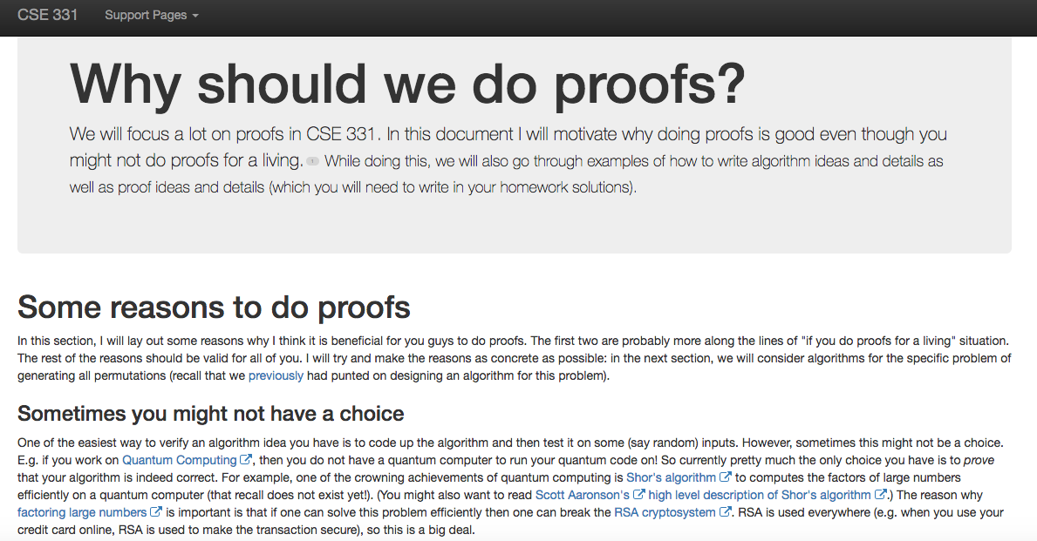
http://www-student.cse.buffalo.edu/~atri/cse331/support/proofs/index.html

Slide 28
A common complaint
Your examples in class look nothing
like HW questions.

Slide 29

True because….
zazzle.com

Slide 30
False because…
HWs and exams will test your
understanding of the material

Slide 31
To get an A in the class
Have to get at least 90.0000000000000000000000%
Rest graded on the curve

Slide 32
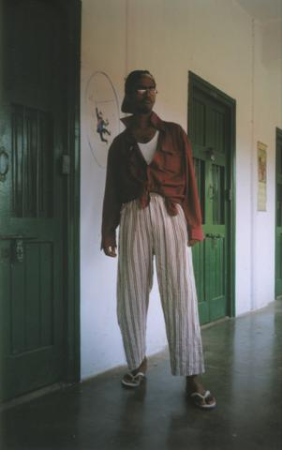
A cautionary tale…
When I was an undergrad
  Took algorithms as a sophomore
Understood all the lectures
Did not study outside of lectures
  (We had no homeworks)
Did decent on the mid-term
Nearly flunked the finals
Got a C

Slide 33
Questions/Comments?

Slide 34

How we will make 331
RIDING

Slide 35
What we’ll strive to do
Help you with your questions and/or doubts
If need be, email us for time outside of regular office hours

Slide 36
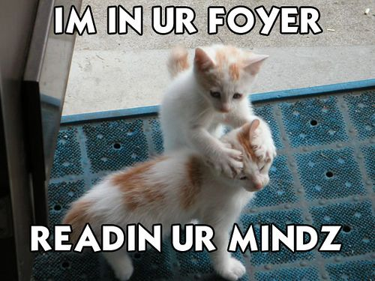
We’re not mind readers

Slide 37

If you need it, ask for help

Slide 38
More chances to recover
Lowest two Q1, Q2 and Q3 HW scores will be dropped
If you do better on the final exam than the mid-term exam
then only final exam score will count

Slide 39
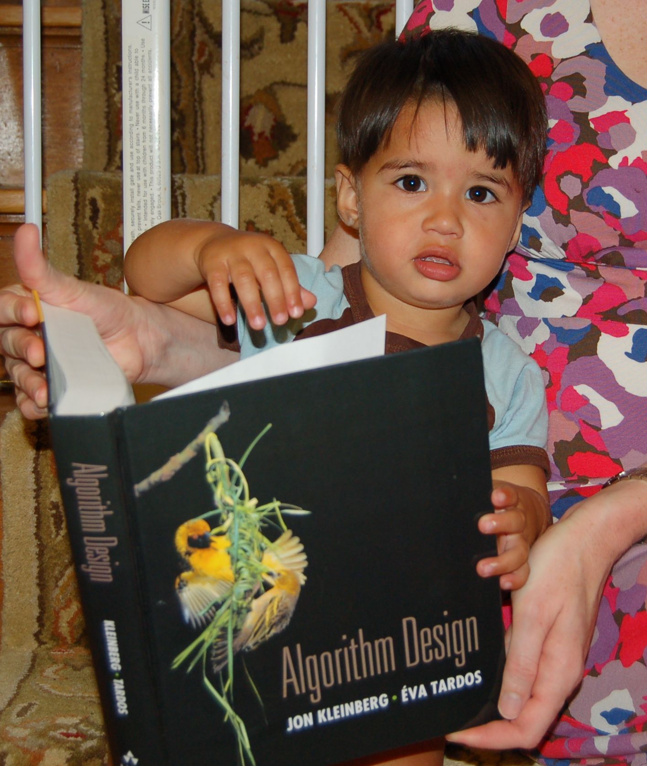
Follow the Textbook

Slide 40
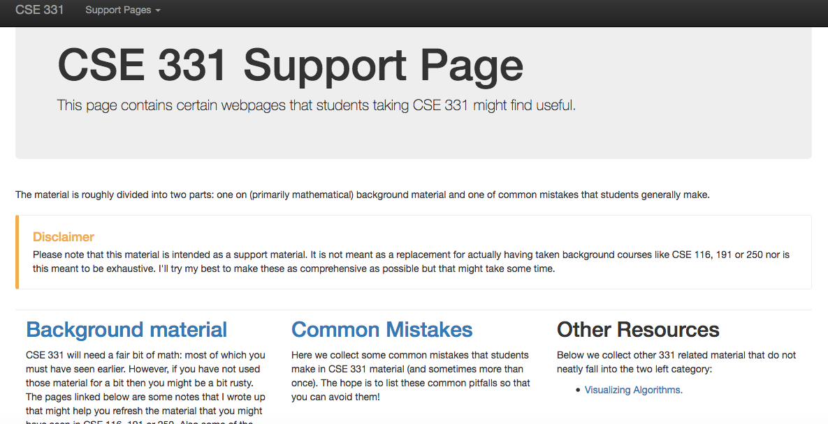
http://www-student.cse.buffalo.edu/~atri/cse331/support/index.html

Slide 41
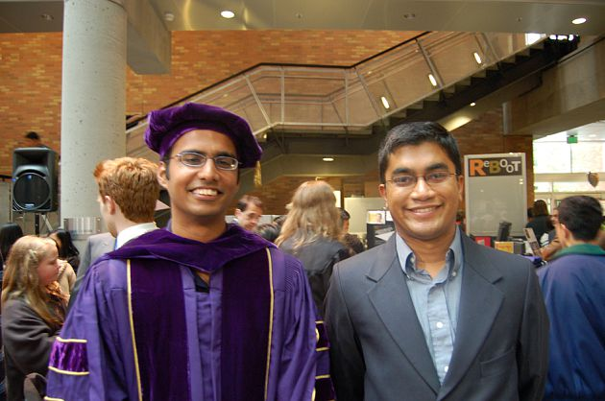
The cautionary tale has a silver lining…
Ph.D. in algorithms/complexity
C in undergrad algorithms

Slide 42
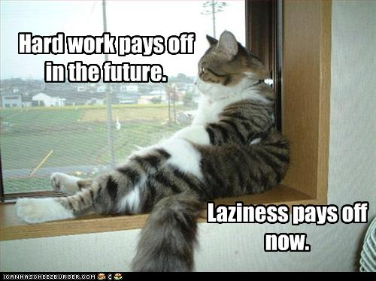
The only way to do well is to work hard

Slide 43
Questions/Comments?

Slide 44
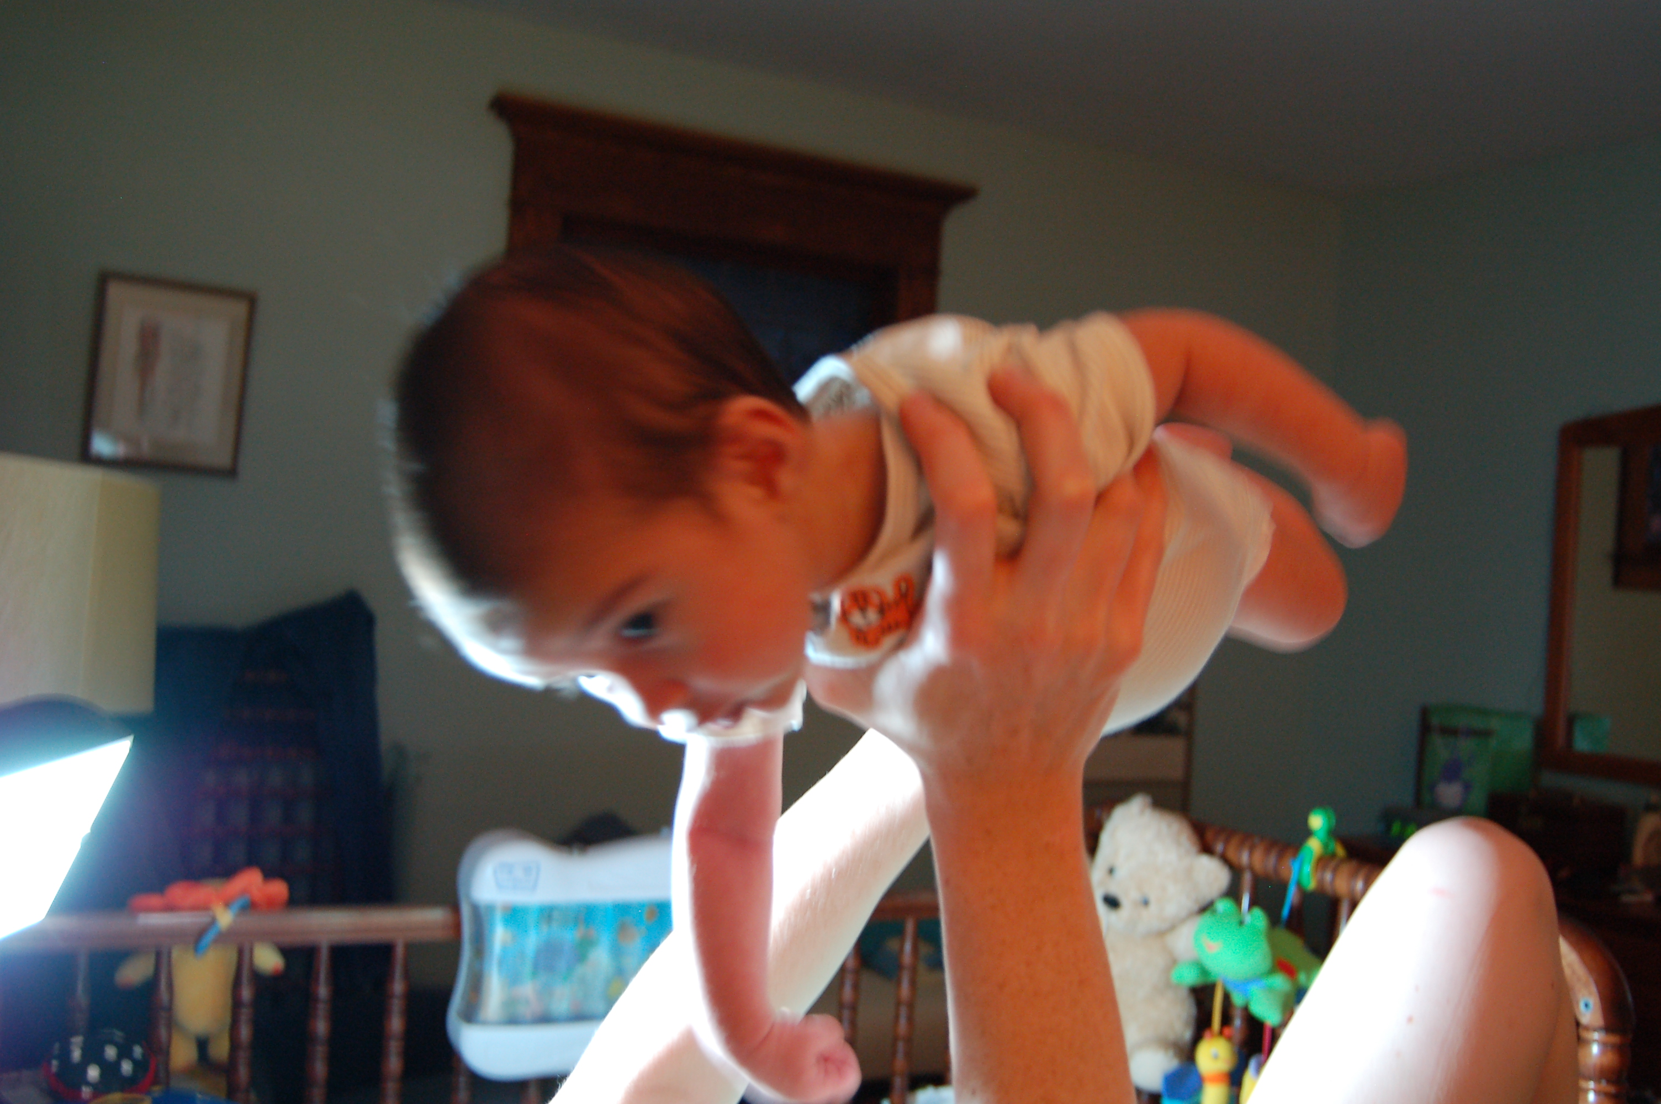
Let the fun begin!

Slide 45
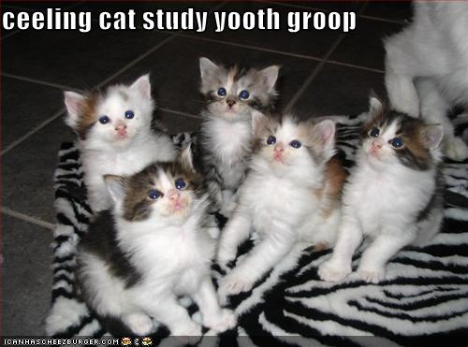
Remember: Stick with your group

Slide 46
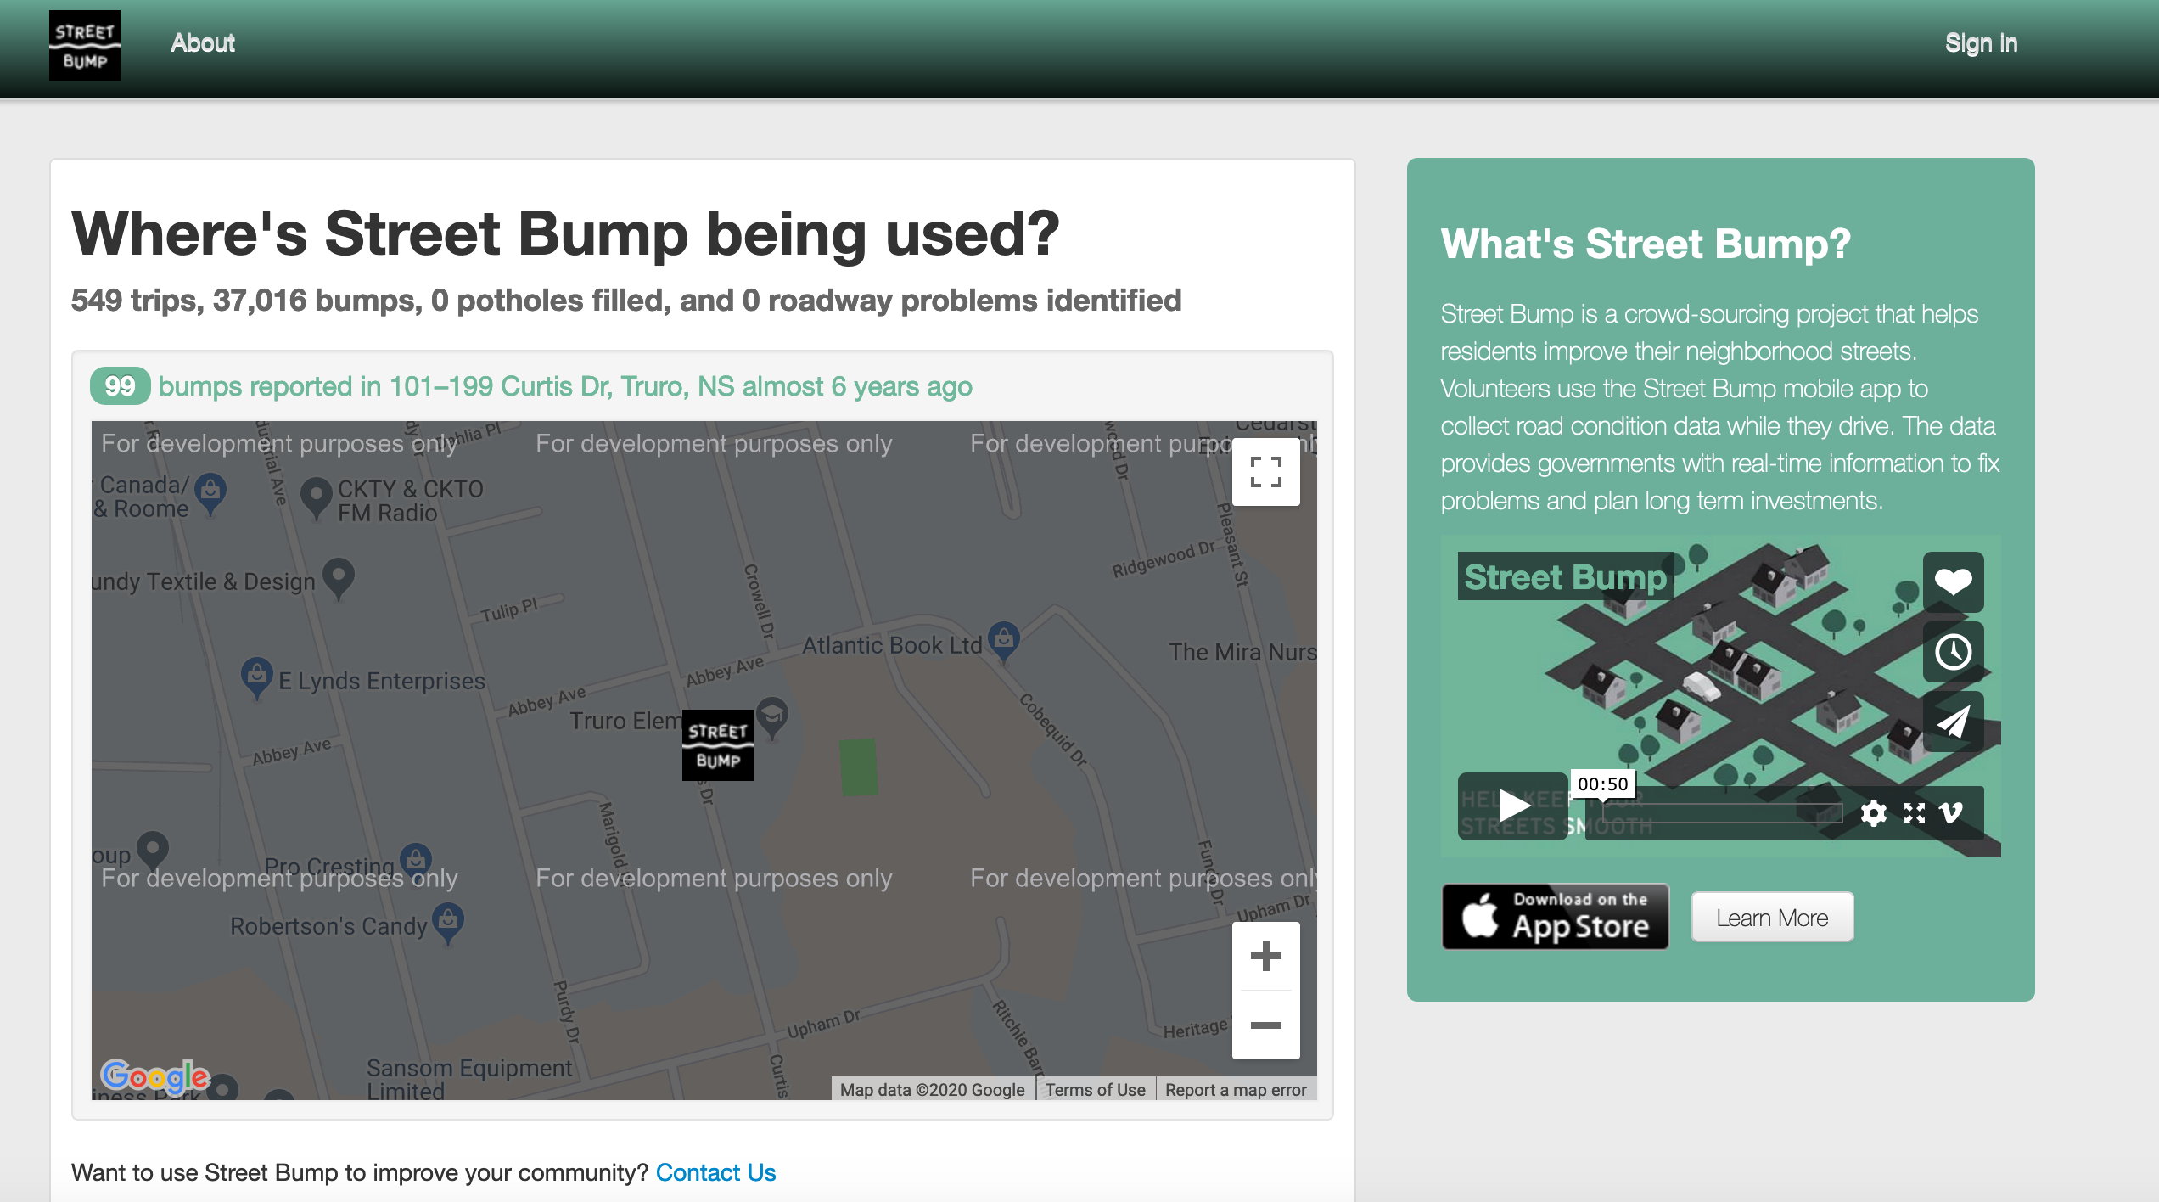
Common solution: Let’s build an app for that!
Potential issues?

Slide 47
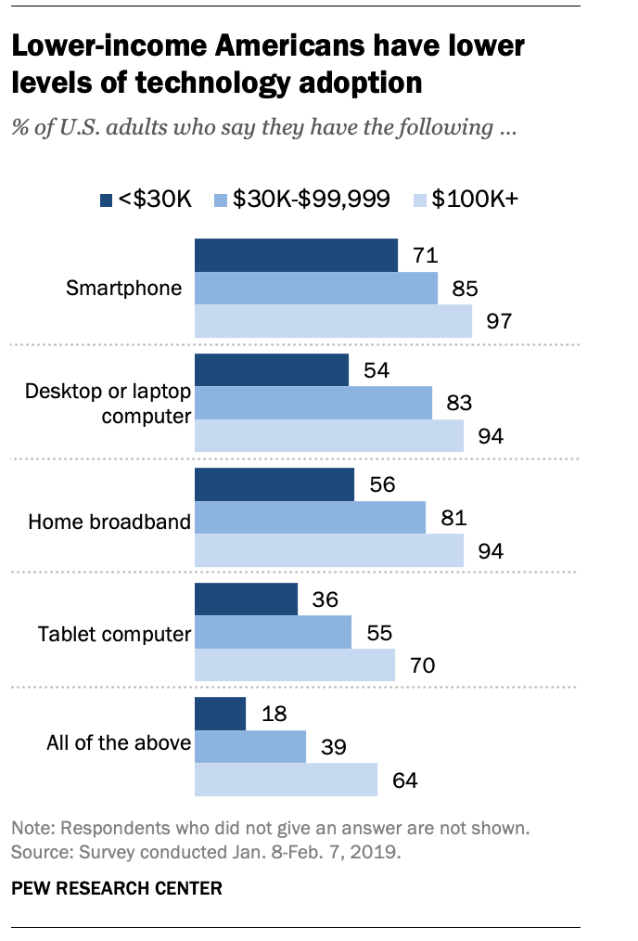
The smartphone blind-spot
Many of us in CSE assume that “everyone”
has smartphones
More generally, we assume “everyone” has access to the Internet

Slide 48
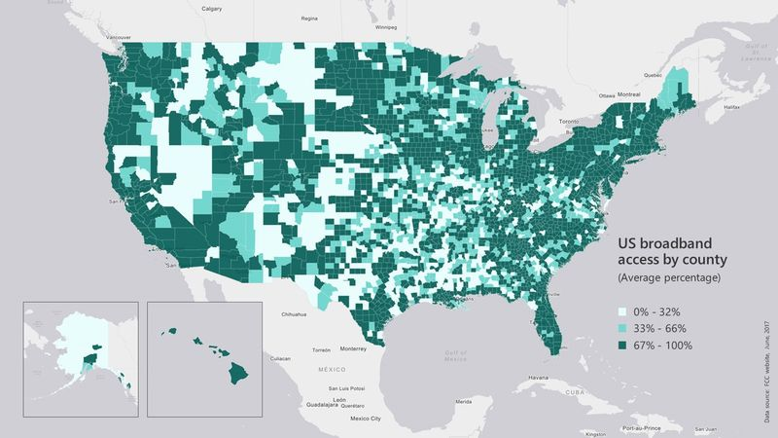
Broadband access
https://assets.bwbx.io/images/users/iqjWHBFdfxIU/iZSjibxE1KJs/v1/800x-1.jpg

Slide 49
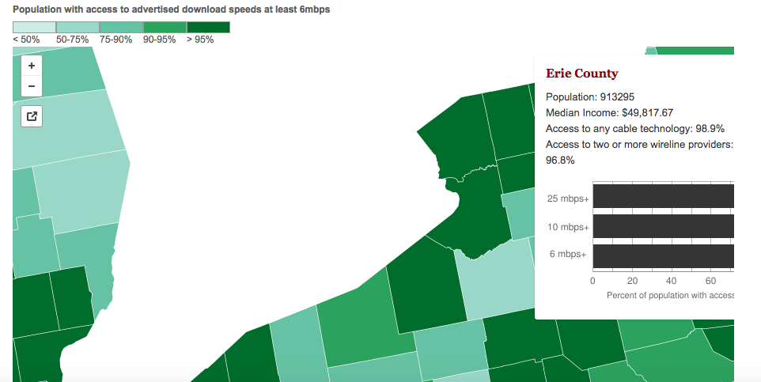
Erie county is reasonably good
http://www.governing.com/gov-data/broadband-speeds-availability.html

Slide 50
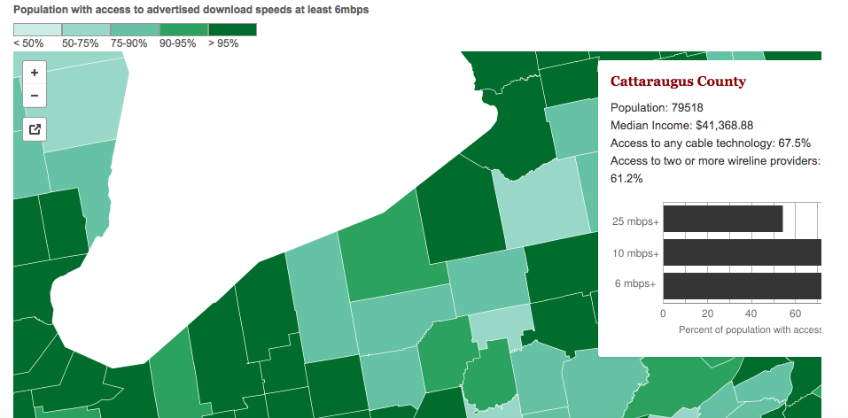
One county over
http://www.governing.com/gov-data/broadband-speeds-availability.html

Slide 51
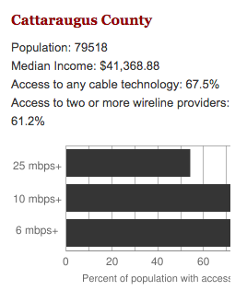
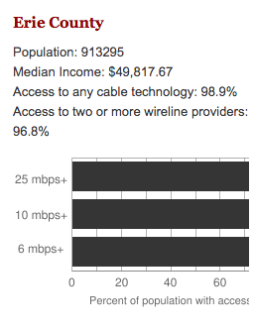
Make broadband more available
BOTH technical and societal issues
Say you are tasked to come up with the infrastructure

