Slide 1
Lecture 26
CSE 331
Nov 2, 2022

Slide 2
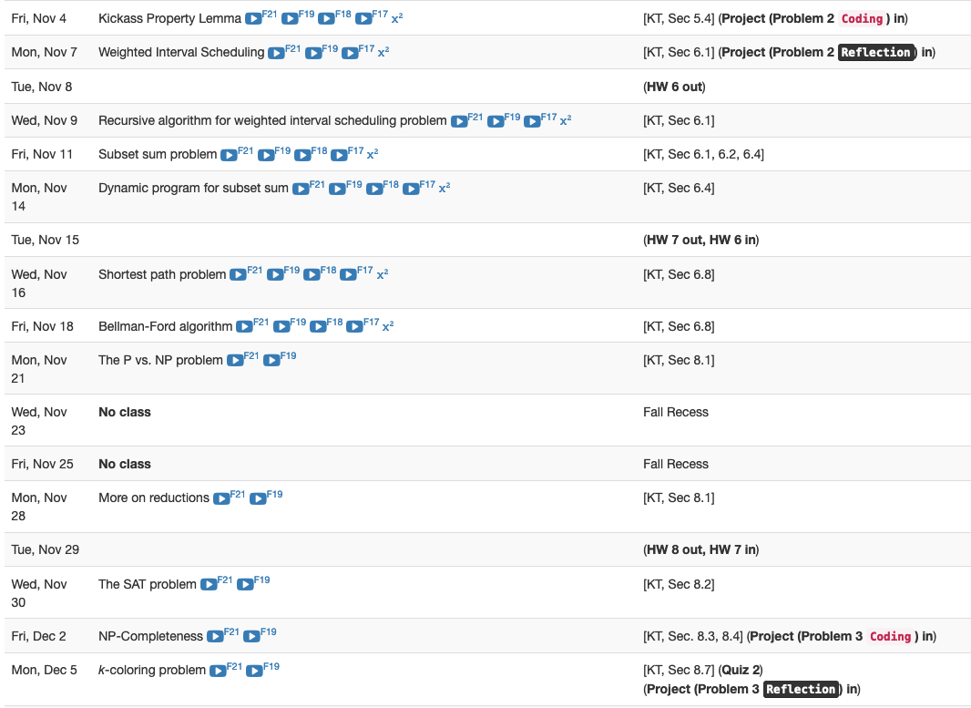
Coding P2 due Friday

Slide 3

Group formation instructions
Follow instructions EXACTLY as they are stated

Slide 4
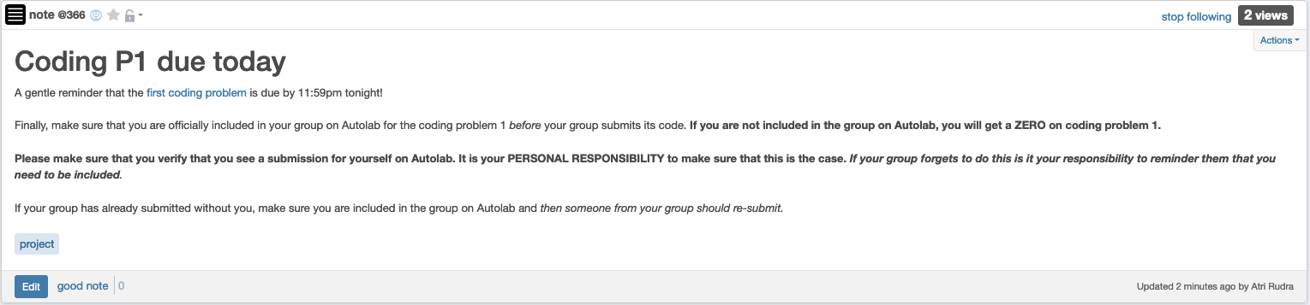
Make sure you are in your group

Slide 5
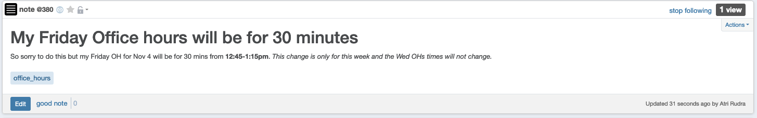
Friday OH shortened to 30 mins

Slide 6
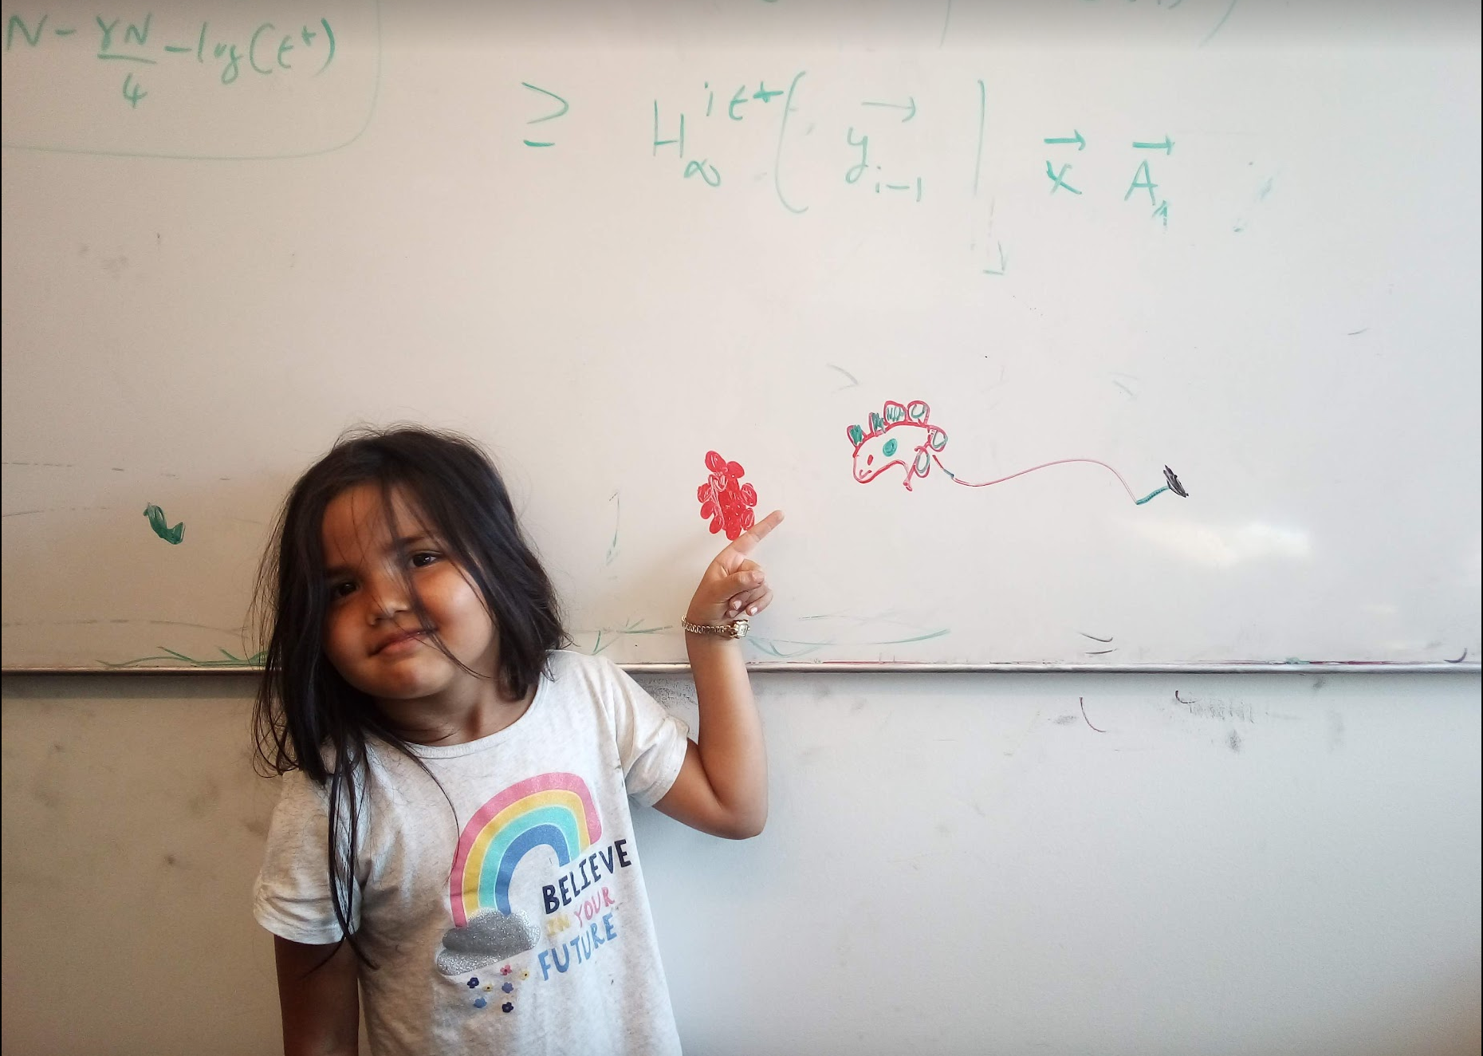
Questions/Comments?

Slide 7
Multiplying two numbers
Given two numbers a and b in binary
a=(a_{n-1},..,a₀) and b = (b_{n-1},…,b₀)
Elementary school algorithm is O(n²)
Compute c = a x b

Slide 8
The current algorithm scheme
Shift by O(n) bits
Adding O(n) bit numbers
Mult over n bits
a • b = a¹b¹ •2^{2[n/2]} + (a¹b⁰+a⁰b¹)•2^{[n/2]} + a⁰b⁰
Multiplication over n/2 bit inputs
T(n) is O(n²)
T(n) ≤ 4T(n/2) + cn
T(1) ≤ c

Slide 9
The key identity
a¹b⁰+a⁰b¹= (a¹+a⁰)(b¹+b⁰) - a¹b¹ - a⁰b⁰

Slide 10
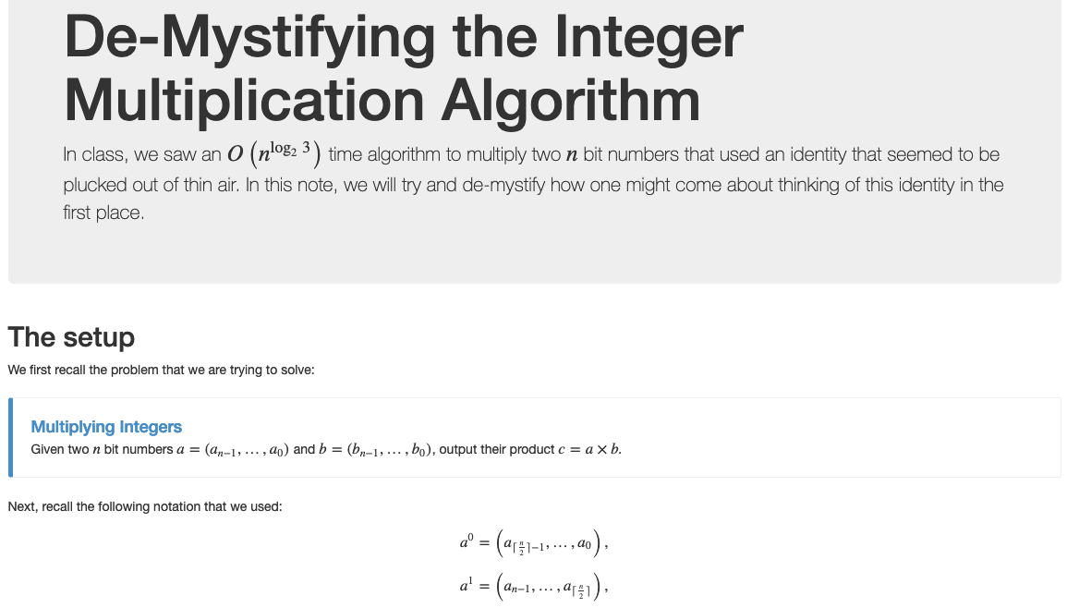
Wait, how do you think of that?

Slide 11
The final algorithm
Input: a = (a_{n-1},..,a₀) and b = (b_{n-1},…,b₀)
T(1) ≤ c
Mult (a, b)
If n = 1 return a₀b₀
T(n) ≤ 3T(n/2) + cn
a¹ = a_{n-1},…,a_{[n/2]} and a⁰ = a_{[n/2]-1},…, a₀
O(n^{log}₂ ³) = O(n^{1.59})
run time
Compute b¹ and b⁰ from b
x = a¹ + a⁰ and y = b¹ + b⁰
Let p = Mult (x, y), D = Mult (a¹, b¹), E = Mult (a⁰, b⁰)
All green operations
are O(n) time
F = p - D - E
return D • 2^{2[n/2]} + F • 2^{[n/2]} + E
a • b = a¹b¹ •2^{2[n/2]} +( (a¹+a⁰)(b¹+b⁰) - a¹b¹ - a⁰b⁰ ) •2^{[n/2]} + a⁰b⁰

Slide 12
Questions/Comments?

Slide 13
Closest pairs of points
Input: n 2-D points P = {p₁,…,p_{n}}; p_{i}=(x_{i},y_{i})
d(p_{i},p_{j}) = ( (x_{i}-x_{j})²+(y_{i}-y_{j})²)^{1/2}
Output: Points p and q that are closest

Slide 14
Group Talk time
O(n²) time algorithm?
1-D problem in time O(n log n) ?

Slide 15
Sorting to rescue in 2-D?
Pick pairs of points closest in x co-ordinate
Pick pairs of points closest in y co-ordinate
Choose the better of the two

Slide 16
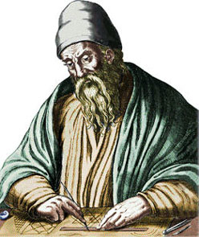
A property of Euclidean distance
d(p_{i},p_{j}) = ( (x_{i}-x_{j})²+(y_{i}-y_{j})²)^{1/2}
y_{j}
y_{i}
x_{i}
x_{j}
The distance is larger than the x or y-coord difference

Slide 17
Questions/Comments?

Slide 18
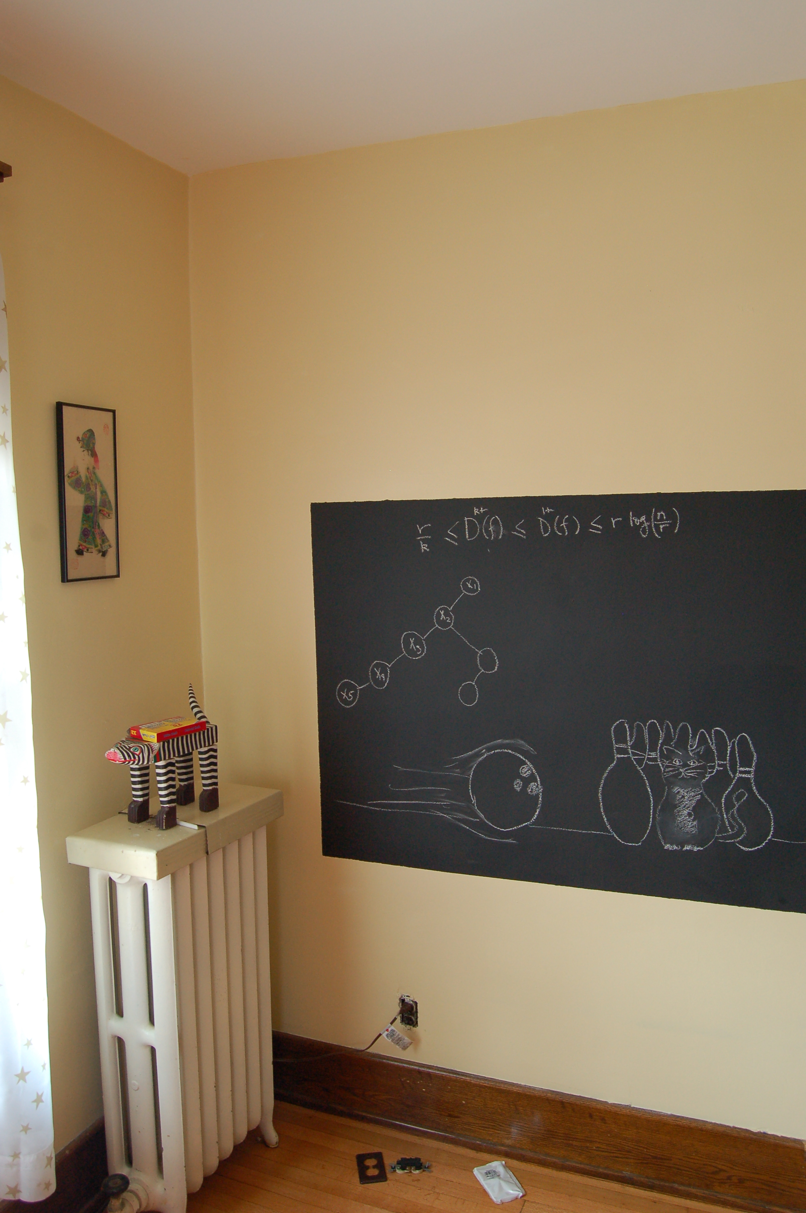
Problem definition on the board…

Slide 19
Rest of Today’s agenda
Divide and Conquer based algorithm

Slide 20
Dividing up P
R
Q
First n/2 points according to the x-coord

Slide 21
Recursively find closest pairs
R
Q
δ = min (blue, green)

Slide 22
An aside: maintain sorted lists
P_{x} and P_{y} are P sorted by x-coord and y-coord
Q_{x}, Q_{y}, R_{x}, R_{y} can be computed from P_{x} and P_{y} in O(n) time

Slide 23

An easy case
> δ
R
Q
All “crossing” pairs have distance > δ
δ = min (blue, green)

Slide 24
Life is not so easy though
R
Q
δ = min (blue, green)

