Slide 1
Lecture 3
CSE 331
Sep 2, 2022

Slide 2
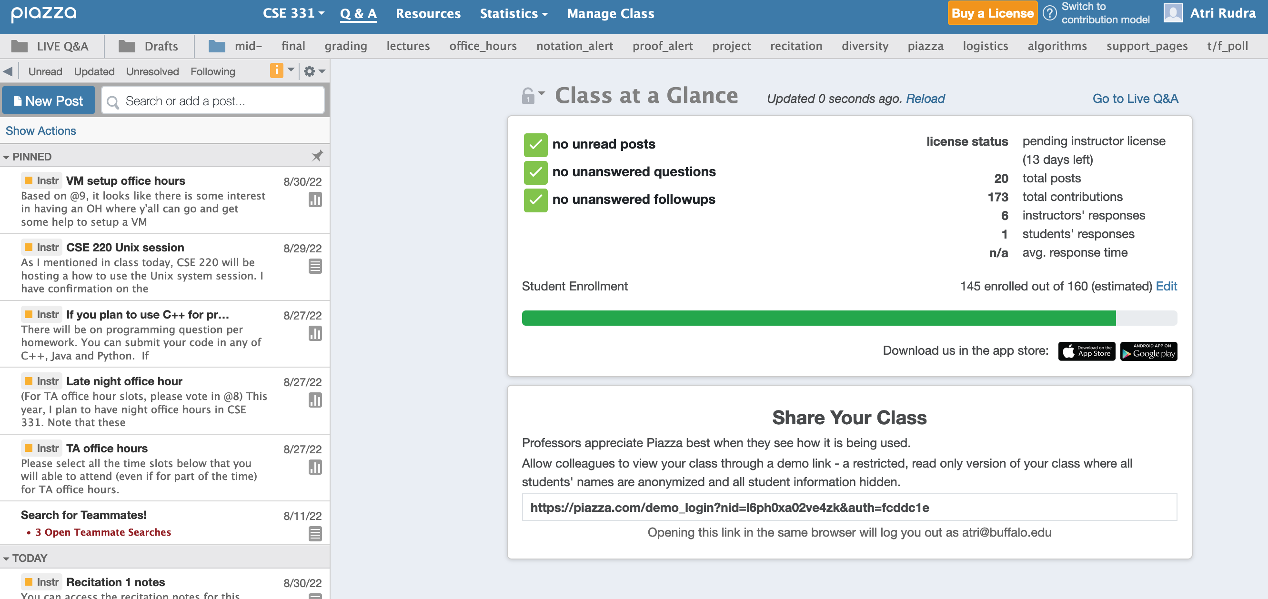
Participate on Piazza
https://piazza.com/buffalo/fall2022/cse331/

Slide 3
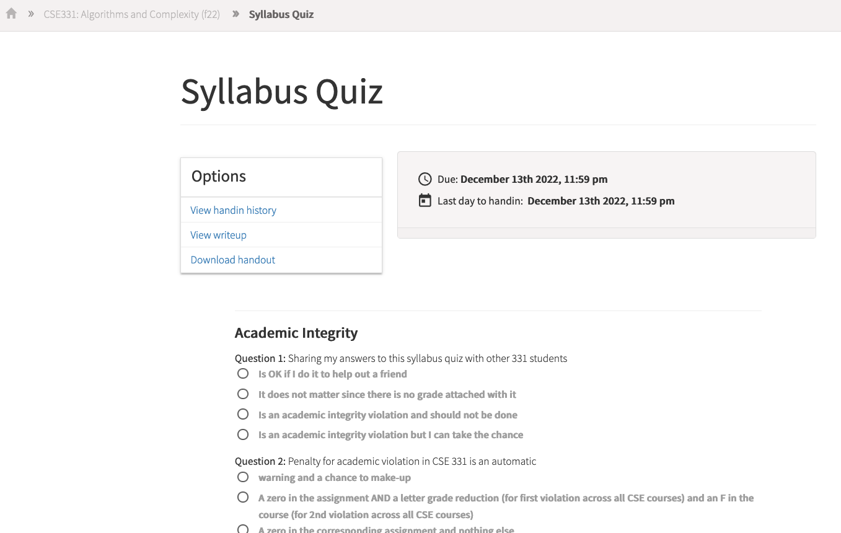
Read the syllabus CAREFULLY!
No graded material will be handed back until you pass the syllabus quiz!

Slide 4
Please do keep on asking Qs!
The only bad question is the one that is not asked!

Slide 5
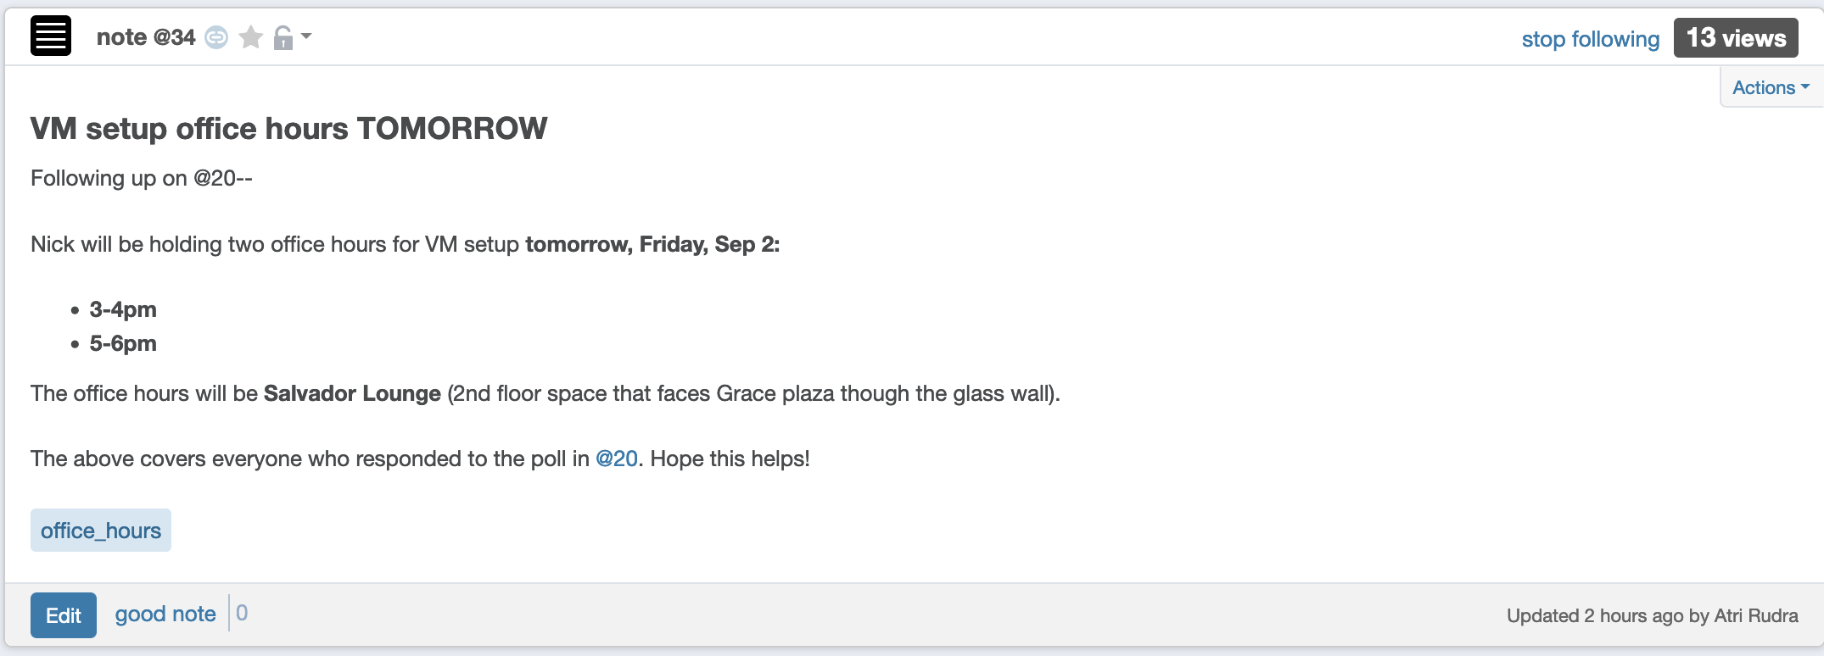
VM setup OH today

Slide 6
TA office hours
Finalized by today
Details will be posted on piazza
OH next week dedicated to help with proofs

Slide 7
Two comments on Programming
Programming is worth about 16% of your final grade
Algorithm design/proofs are worth about 80% of your final grade
Invest your time wisely

Slide 8
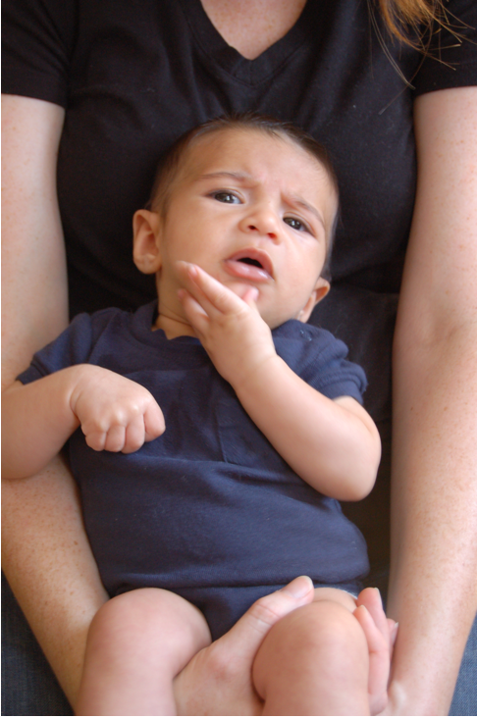
Questions/Comments?

Slide 9
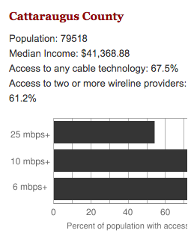
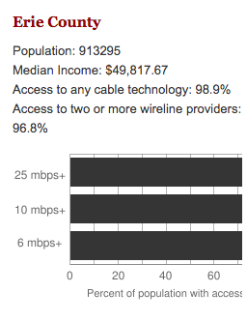
Make broadband more available
Say you are tasked to come up with the infrastructure

Slide 10
Make broadband more available
Input requirements
Is Internet a right?
Environmental factors
Where are the customers located?
Security/Privacy
What are the bandwidth requirements?
Where is funding coming from?
How is the input represented?
Income inequality in
population
What objective are we optimizing?
How should the connections be configured?
Get regulatory approval
Output requirements
Hire people
Get access to physical space
Problem Definition
Outreach
Where should we lay down the physical stuff?
What algorithm should be use to do this?
Algorithm Design
Implement the scheme
How should we do testing and maintenance?

Slide 11
Main Steps in Algorithm Design
Problem Statement
Real world problem
Problem Definition
Precise mathematical def
Algorithm
“Implementation”
Data Structures
Analysis
Correctness/Run time

Slide 12

National Resident Matching

Slide 13

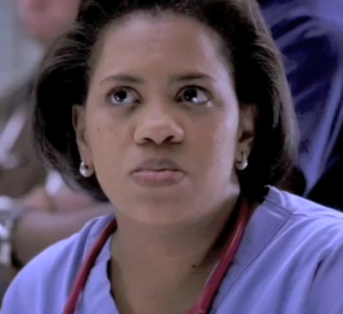




(Screen) Docs are coming to BUF
Buffalo General
Bailey (Grey’s Anatomy)
Millard Filmore (Gates Circle)
JD (Scrubs)
Millard Filmore (Suburban)

Slide 14
What can go wrong?

Slide 15
The situation is unstable!

Slide 16

What happens in real life
Preferences
Information
Preferences

Slide 17
NRMP plays matchmaker

Slide 18
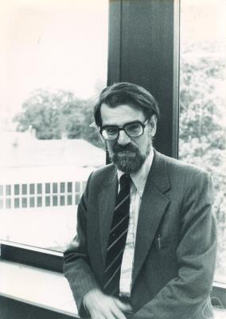
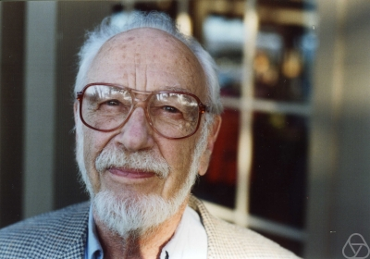
Stable Matching Problem
David Gale
Lloyd Shapley

Slide 19
Questions/Comments?

Slide 20
Matching Employers & Applicants
Input: Set of employers (E)
Set of applicants (A)
Preferences
Output: An assignment of applicants to employers that is “stable”
For every x in A and y in E such that x is not assigned to y, either
(i) y prefers every accepted applicant to x; or
(ii) x prefers her employer to y

Slide 21
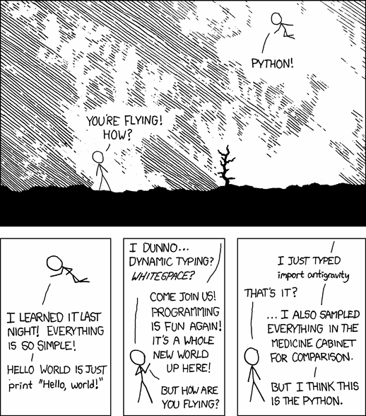
Simplicity is good
http://xkcd.com/353/

Slide 22
Questions to think about
1) How do we specify preferences?
Preference lists
2) Ratio of applicant vs employers
1:1
3) Formally what is an assignment?
(perfect) matching
4) Can an employer get assigned > 1 applicant?
NO
5) Can an applicant have > 1 job?
NO
6) How many employer/applicants in an applicants/employers preferences?
All of them
7) Can an employer have 0 assigned applicants?
NO
8) Can an applicant have 0 jobs?
NO

Slide 23
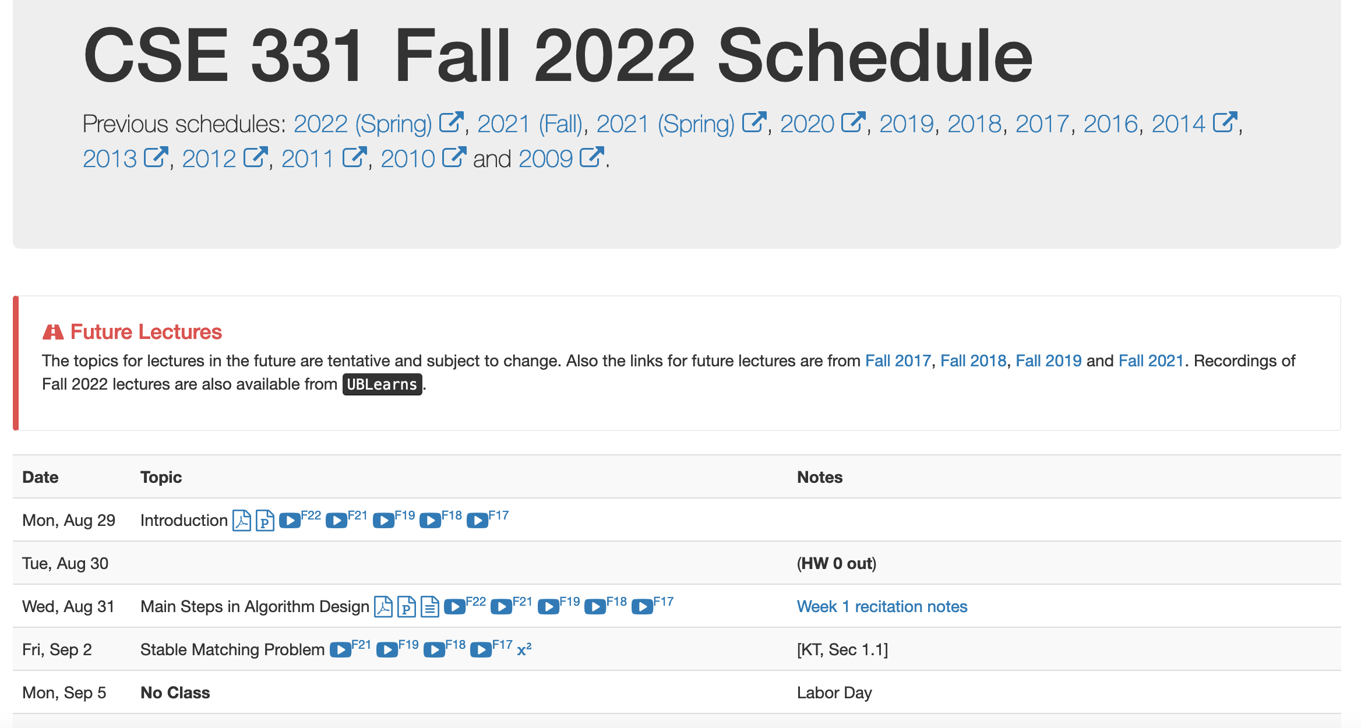
Lost in Notation….

Slide 24
Questions/Comments?

Slide 25
Non-feminist reformulation
n men
Each with a preference list
n women
Match/marry them in a “stable” way

Slide 26






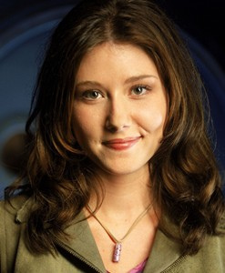
On matchings
Mal
Inara
Wash
Zoe
Simon
Kaylee

Slide 27
Is this a valid matching?
Mal
Inara
Wash
Zoe
Simon
Kaylee

Slide 28
Is this a valid matching?
Mal
Inara
Wash
Zoe
Simon
Kaylee

Slide 29
Is this a valid matching?
Mal
Inara
Wash
Zoe
Simon
Kaylee

Slide 30
Which one is a perfect matching?
Mal
Inara
Wash
Zoe
Simon
Kaylee

Slide 31
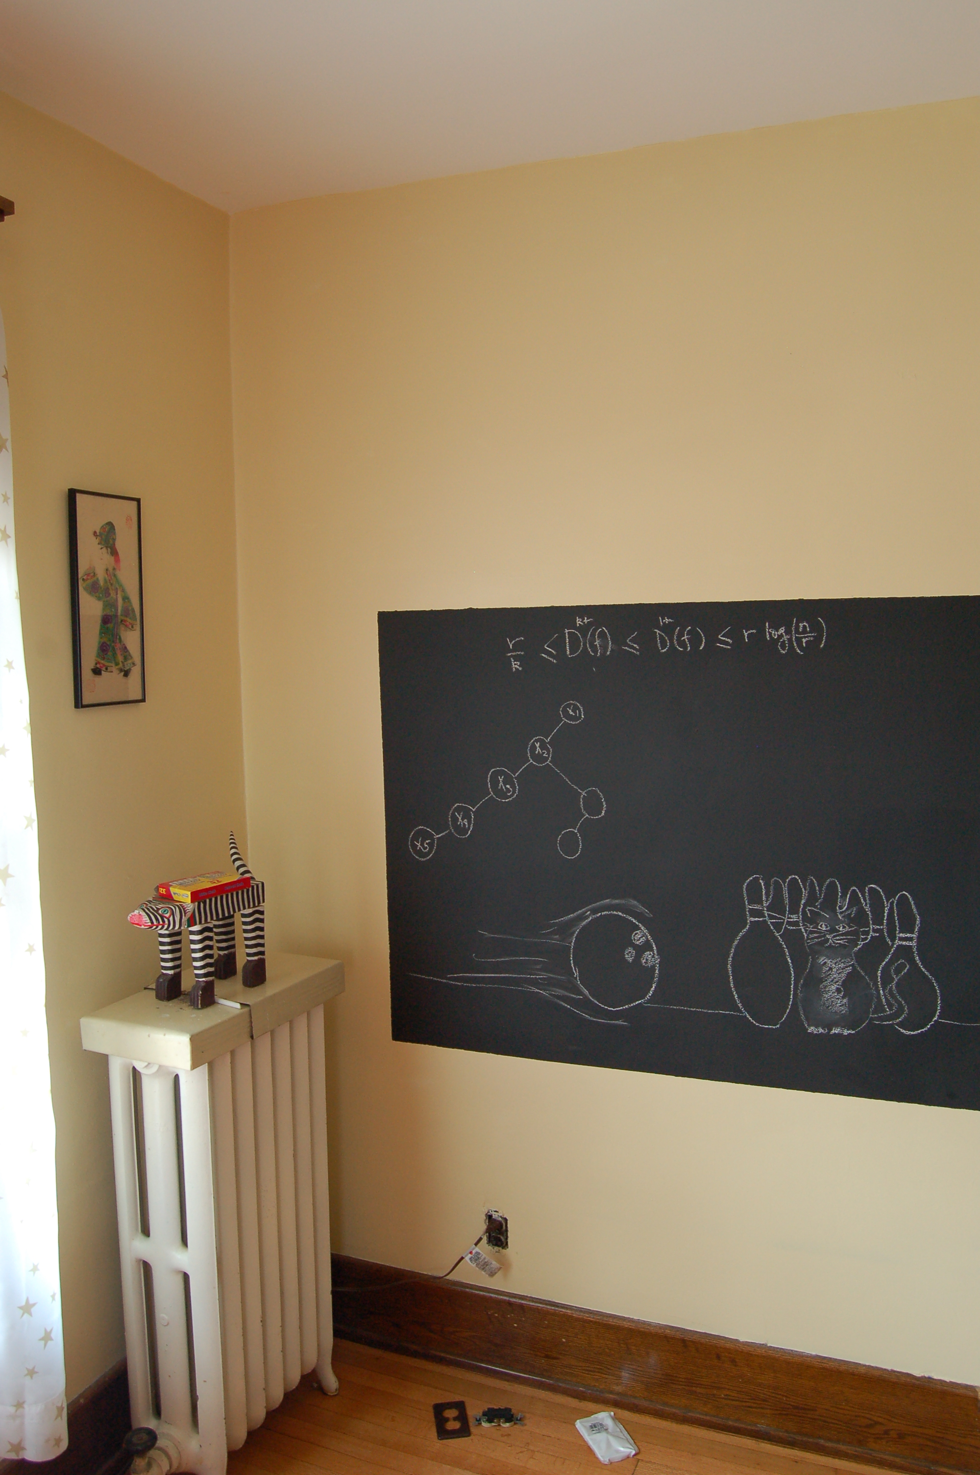
On to the board…

