Slide 1
Lecture 30
CSE 331
Nov 11, 2022

Slide 2
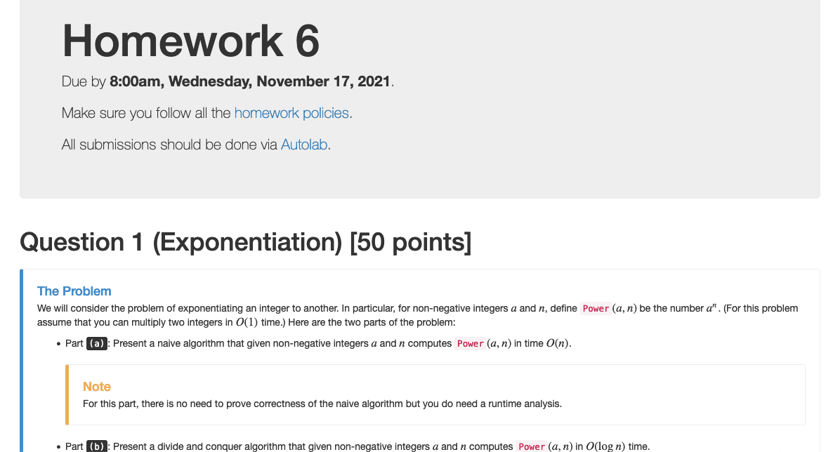
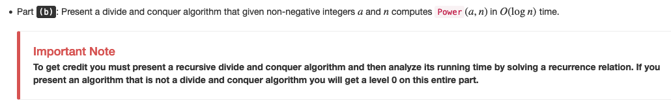
Homework 6 out

Slide 3

A dope panel on Tue!

Slide 4
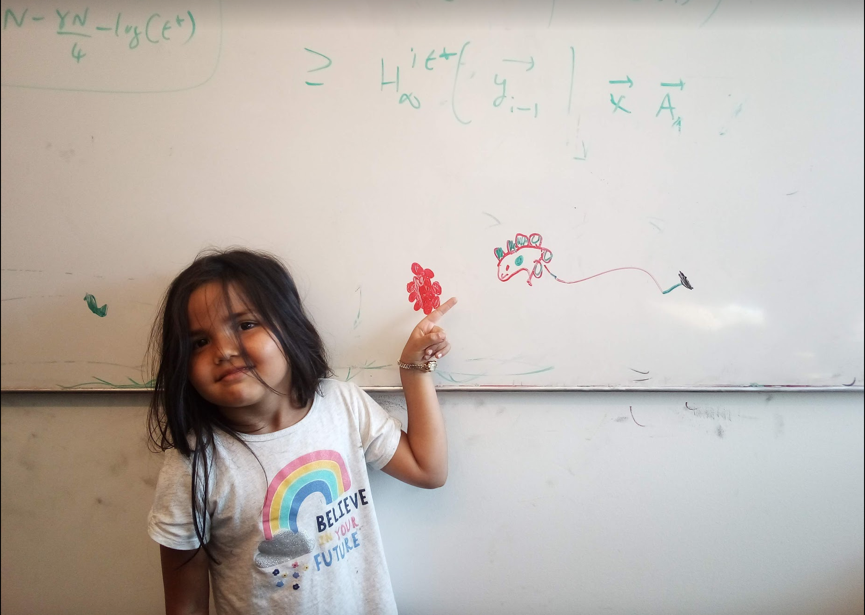
Questions/Comments?

Slide 5
Weighted Interval Scheduling
Input: n jobs (s_{i},f_{i},v_{i})
Output: A schedule S s.t. no two jobs in S have a conflict
Goal: max Σ_{i in S} v_{j}
Assume: jobs are sorted by their finish time

Slide 6
Couple more definitions
p(j) = largest i < j s.t. i does not conflict with j
p(j) < j
= 0 if no such i exists
OPT(j) = optimal value on instance 1,..,j

Slide 7
Property of OPT
j not in OPT(j)
j in OPT(j)
OPT(j) = max { v_{j} + OPT( p(j) ), OPT(j-1) }
Given OPT(1),…., OPT(j-1), how can one figure out if j in optimal solution or not?

Slide 8
A recursive algorithm
Compute-Opt(j)
If j = 0 then return 0
return max { v_{j} + Compute-Opt( p(j) ), Compute-Opt( j-1 ) }
OPT(j) = max { v_{j} + OPT( p(j) ), OPT(j-1) }

Slide 9
Exponential Running Time
1
p(j) = j-2
2
3
Only 5 OPT values!
4
5
OPT(5)
Formal proof: Ex.
OPT(3)
OPT(4)
OPT(3)
OPT(1)
OPT(2)
OPT(2)
OPT(1)
OPT(2)
OPT(1)
OPT(1)
OPT(1)

Slide 10
A recursive algorithm
M-Compute-Opt(j) = OPT(j)
M-Compute-Opt(j)
If j = 0 then return 0
If M[j] is not null then return M[j]
M[j] = max { v_{j} + M-Compute-Opt( p(j) ), M-Compute-Opt( j-1 ) }
return M[j]
Run time = O(# recursive calls)

Slide 11
Bounding # recursions
M-Compute-Opt(j)
O(n) overall
If j = 0 then return 0
If M[j] is not null then return M[j]
M[j] = max { v_{j} + M-Compute-Opt( p(j) ), M-Compute-Opt( j-1 ) }
return M[j]
Whenever a recursive call is made an M value is assigned
At most n values of M can be assigned

Slide 12
Questions/Comments?

Slide 13
Property of OPT
OPT(j) = max { v_{j} + OPT( p(j) ), OPT(j-1) }
Given OPT(1), …, OPT(j-1),
one can compute OPT(j)

Slide 14
Recursion+ memory = Iteration
Iteratively compute the OPT(j) values
Iterative-Compute-Opt
M[0] = 0
For j=1,…,n
M[j] = max { v_{j} + M[p(j)], M[j-1] }
M[j] = OPT(j)
O(n) run time

Slide 15


Slide 16
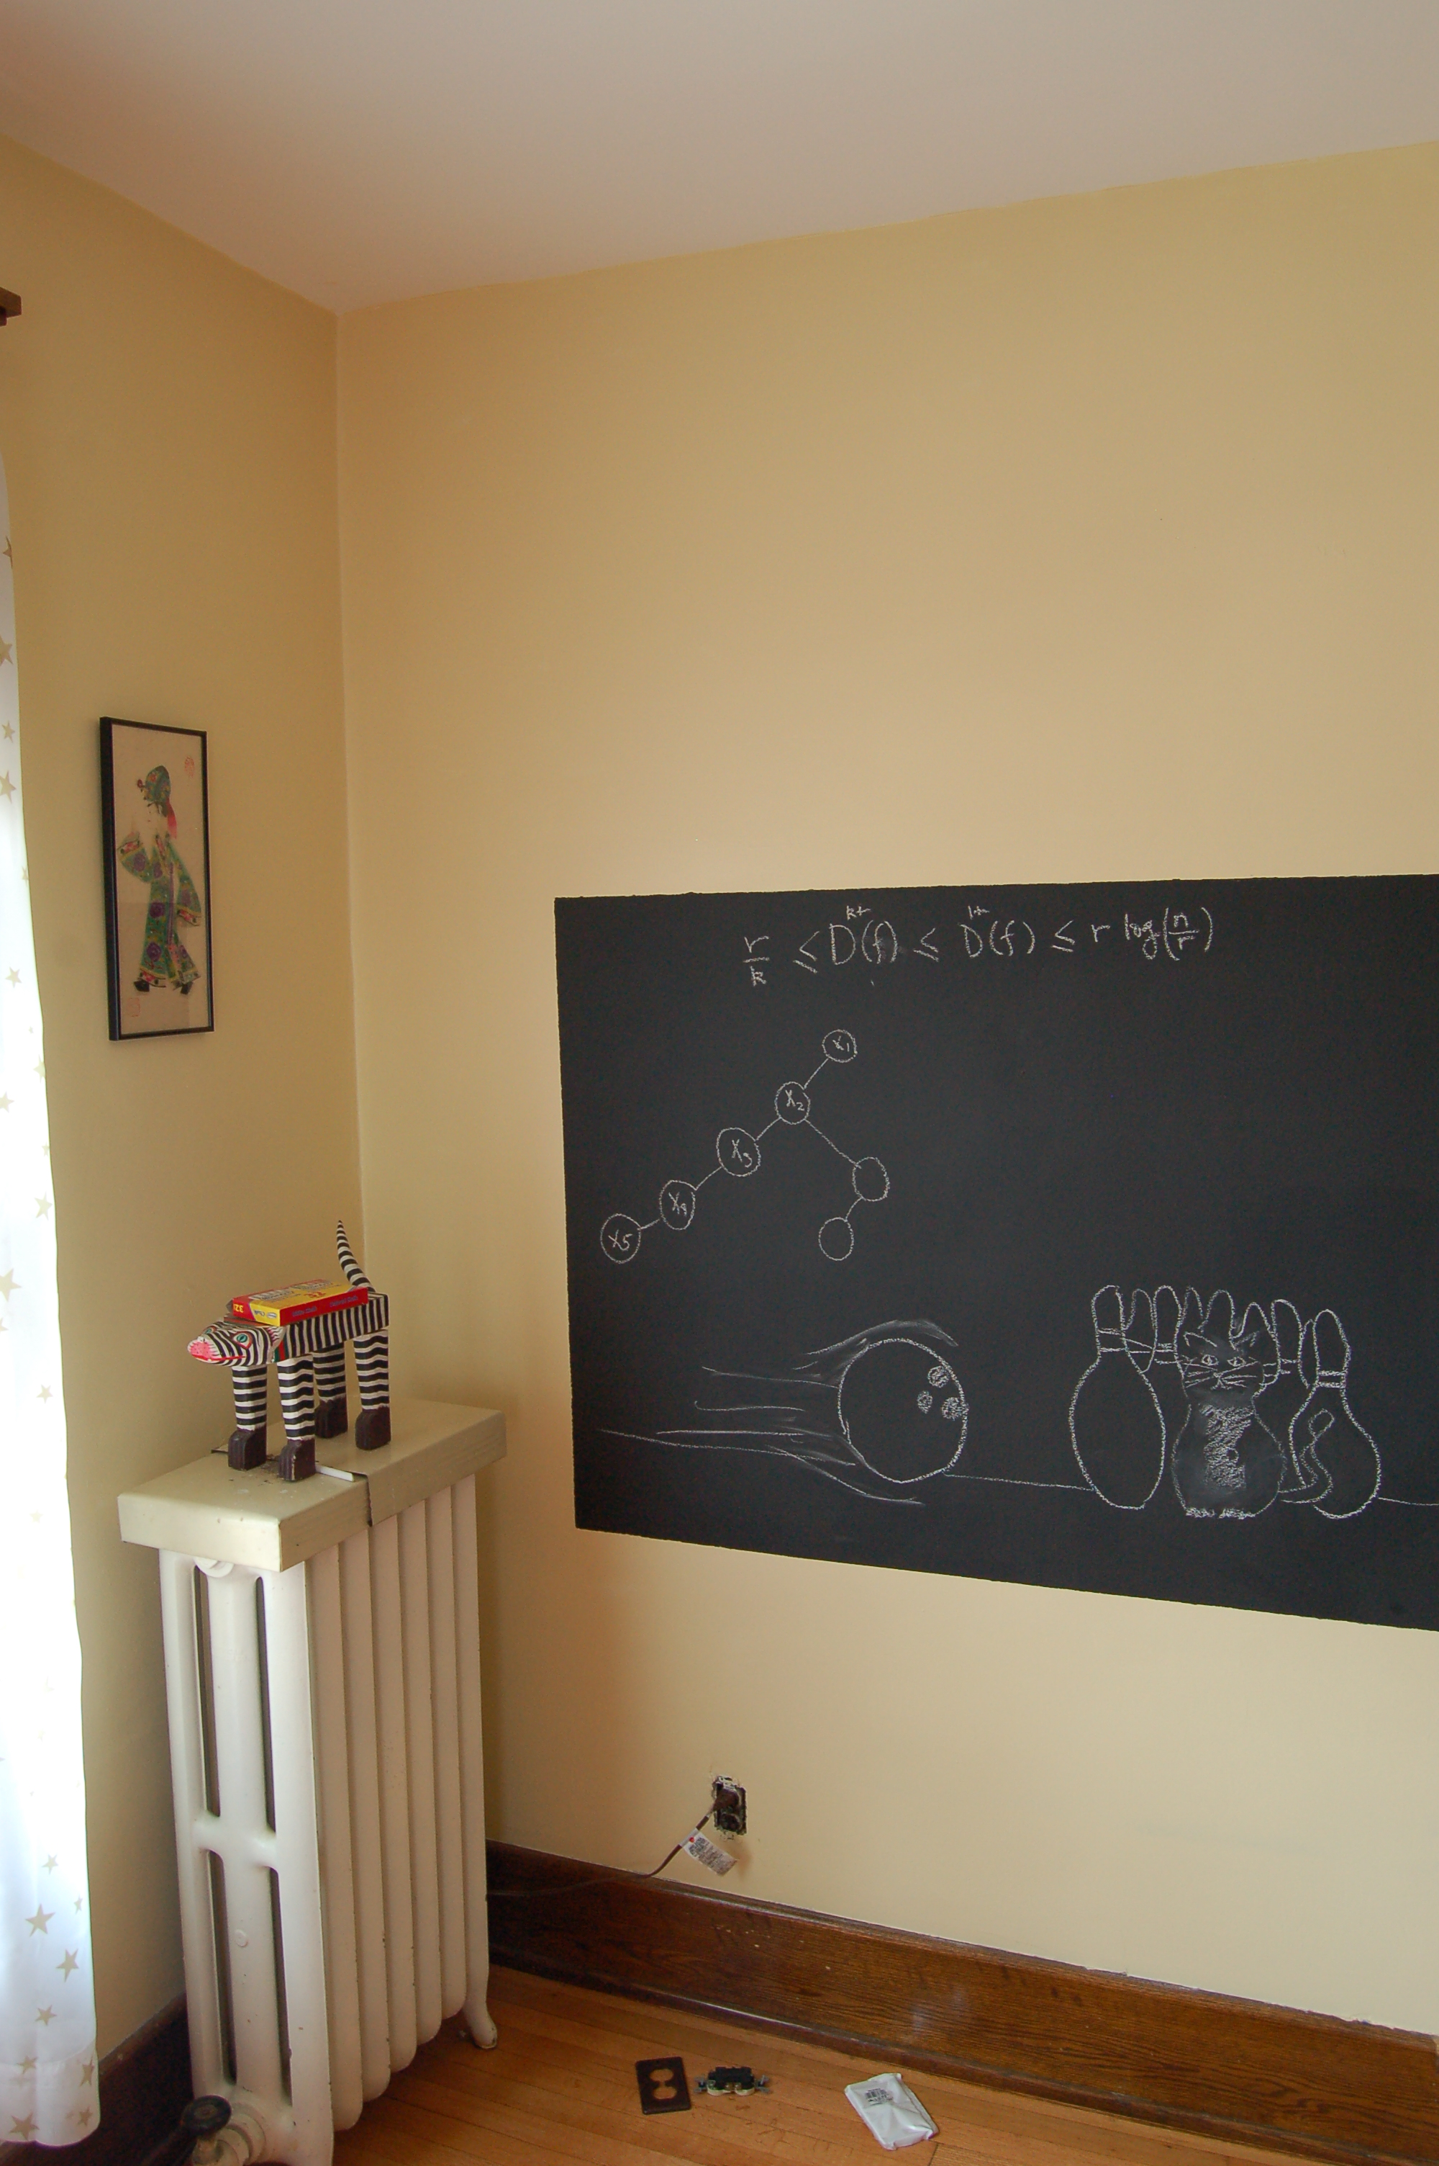
Algo run on the board…

Slide 17

Reading Assignment
Sec 6.1, 6.2 of [KT]

Slide 18
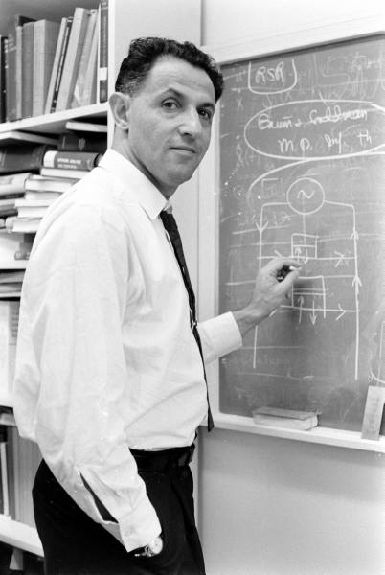
When to use Dynamic Programming
There are polynomially many sub-problems
OPT(1), …, OPT(n)
Richard Bellman
Optimal solution can be computed from solutions to sub-problems
OPT(j) = max { v_{j} + OPT( p(j) ), OPT(j-1) }
There is an ordering among sub-problem that allows for iterative solution
OPT (j) only depends on OPT(j-1), …, OPT(1)

Slide 19

Scheduling to min idle cycles
n jobs, i^{th} job takes w_{i} cycles
You have W cycles on the cloud
What is the maximum number of cycles you can schedule?

Slide 20
Rest of today’s agenda
Dynamic Program for Subset Sum problem

Slide 21
May the Bellman force be with you

