Slide 1
Lecture 34
CSE 331
Nov 28, 2022

Slide 2
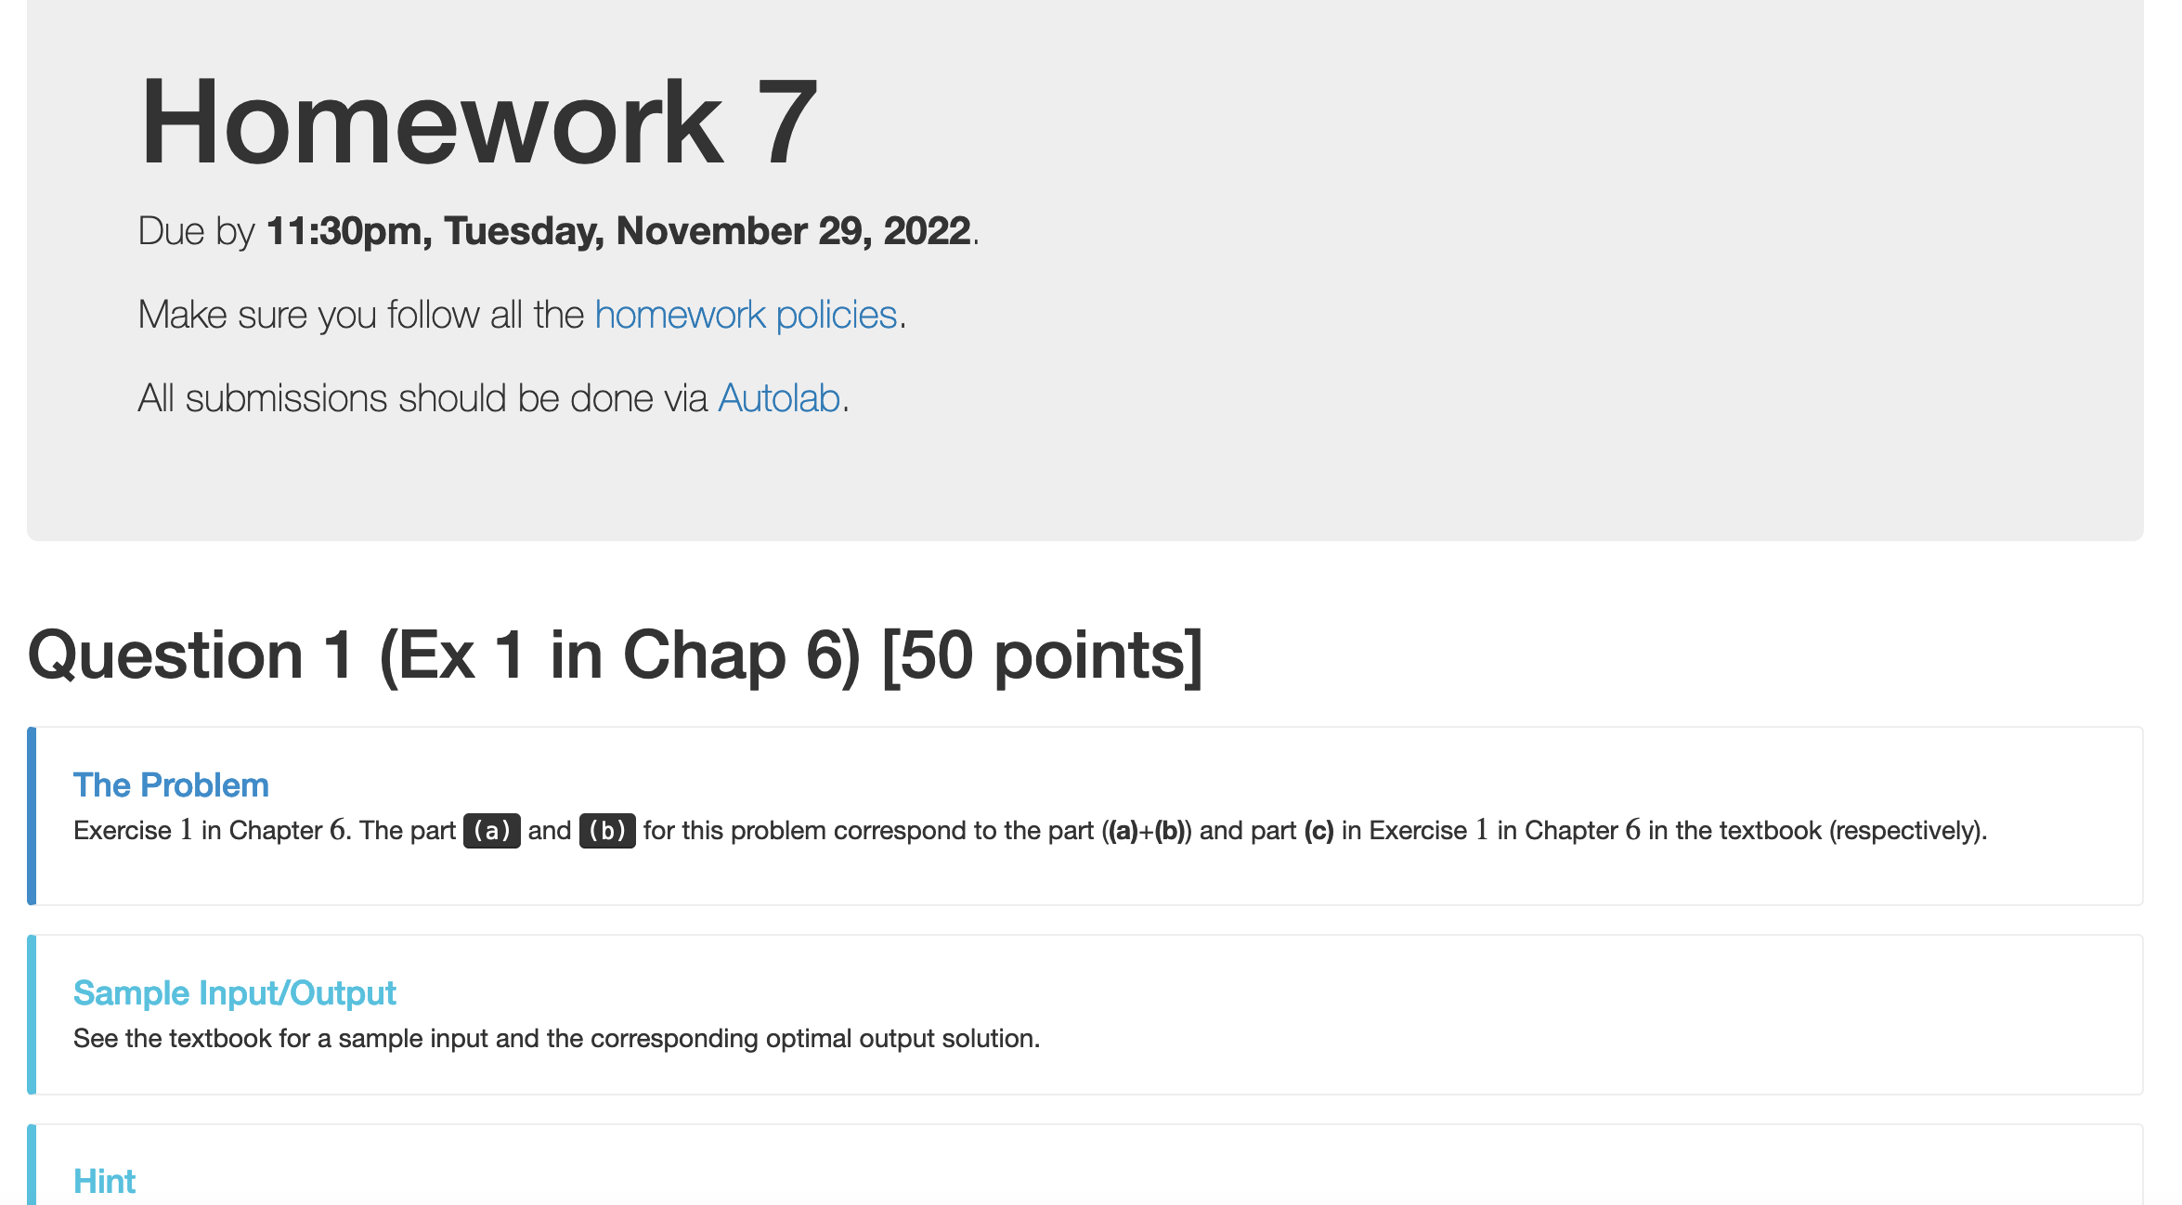
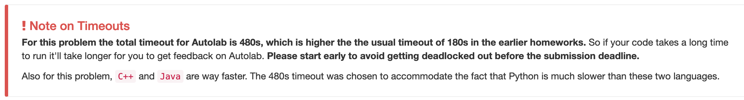
HW 7 reminders

Slide 3
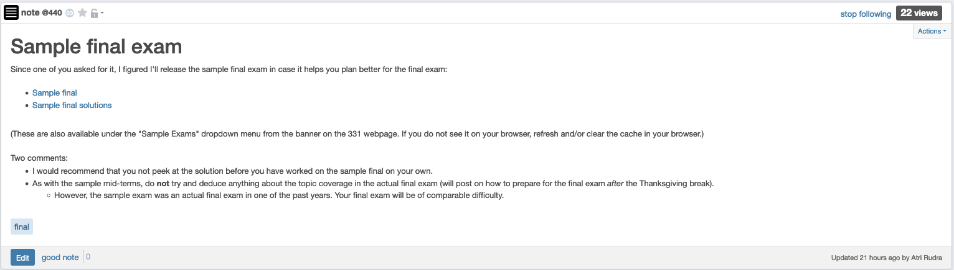
Sample final exam

Slide 4
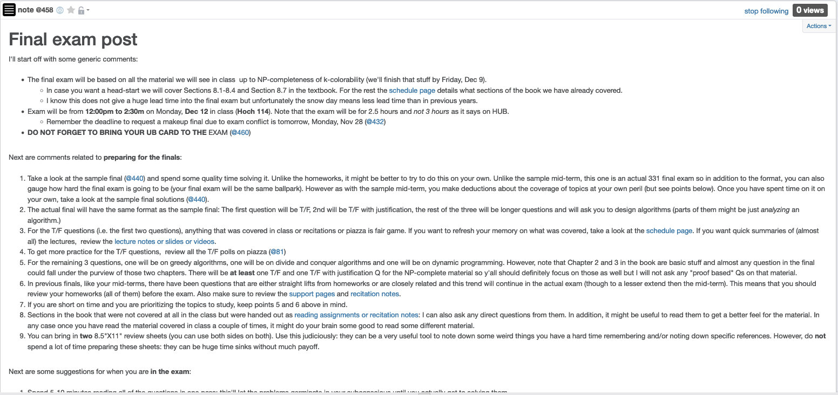
Final exam post

Slide 5
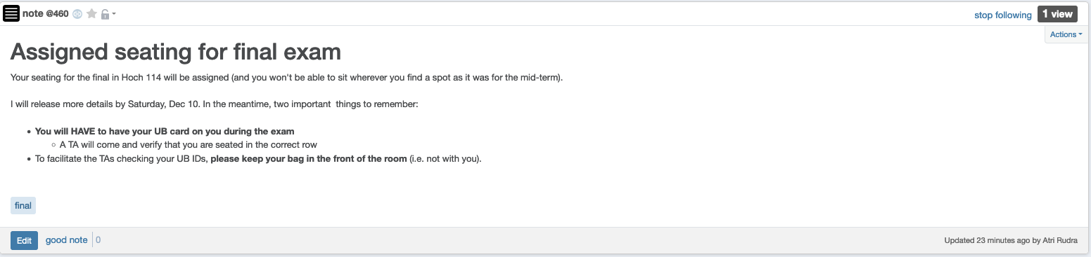
Bring your UB card to final

Slide 6
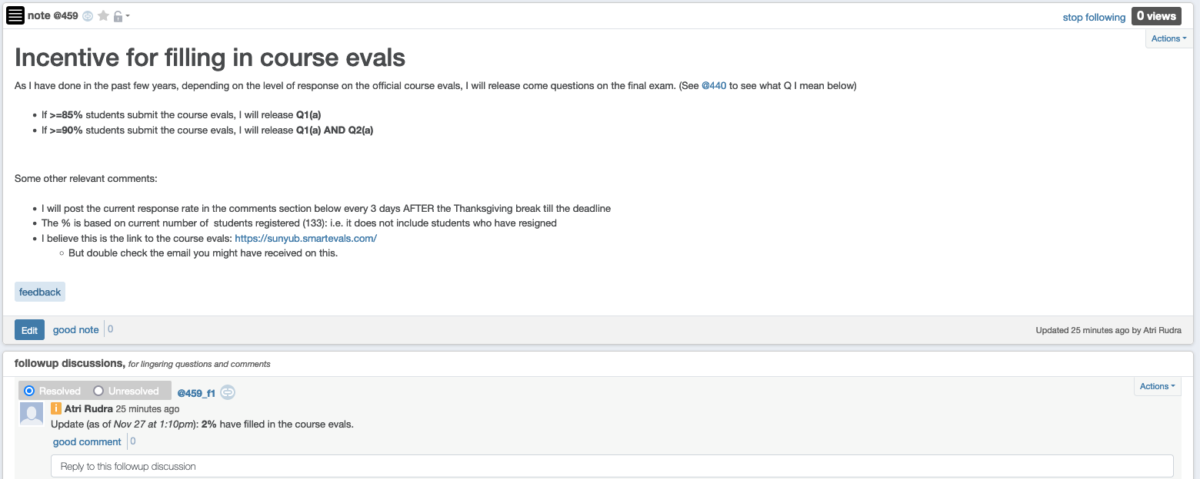
Incentive to complete course evals

Slide 7
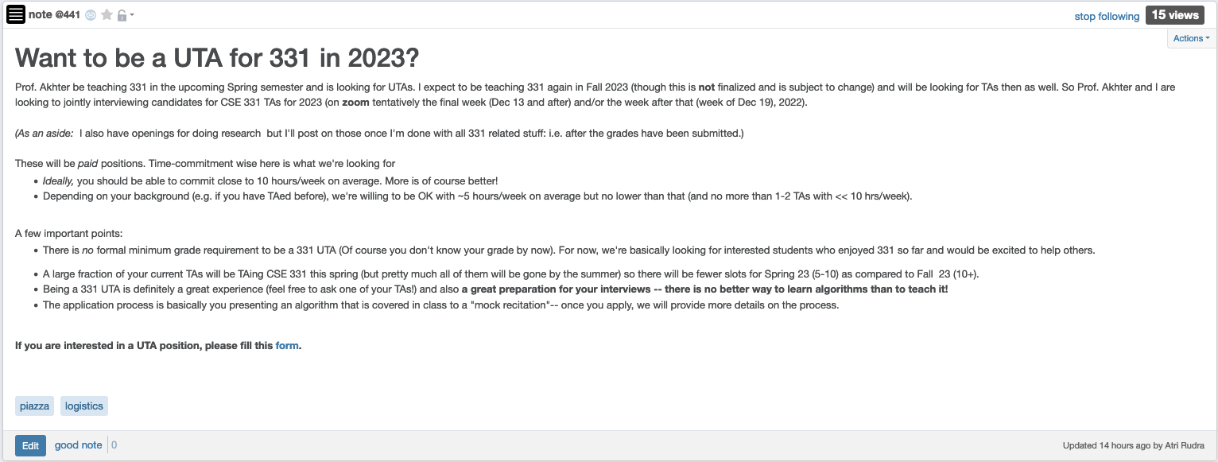
CSE 331 UTA positions for 2023

Slide 8
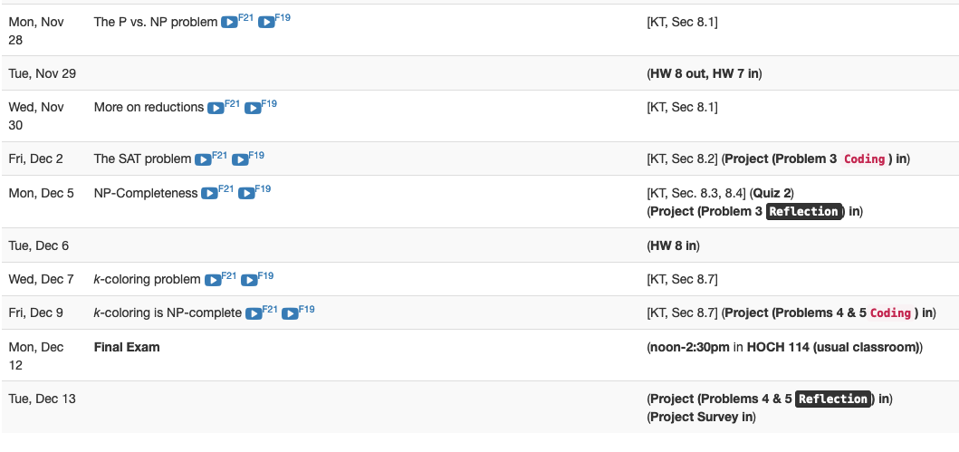
Next two weeks are brutal

Slide 9

Questions?

Slide 10
Shortest Path Problem
Input: (Directed) Graph G=(V,E) and for every edge e has a cost c_{e} (can be <0)
t in V
Output: Shortest path from every s to t
Assume that G has no negative cycle
1
1
s
t
Shortest path has cost negative infinity
899
100
-1000

Slide 11
The recurrence
OPT(u,i) = shortest path from u to t with at most i edges
OPT(u,i) = min { OPT(u,i-1), min_{(u,w) in E} { c_{u,w} + OPT(w, i-1)} }

Slide 12
Some consequences
OPT(u,i) = cost of shortest path from u to t with at most i edges
OPT(u,i) = min { OPT(u, i-1), min_{(u,w) in E} { c_{u,w} + OPT(w,i-1)} }
OPT(u,n-1) is shortest path cost between u and t
Can compute the shortest path between s and t given all OPT(u,i) values

Slide 13
Bellman-Ford Algorithm
Runs in O(n(m+n)) time
Only needs O(n) additional space

Slide 14
Questions?

Slide 15
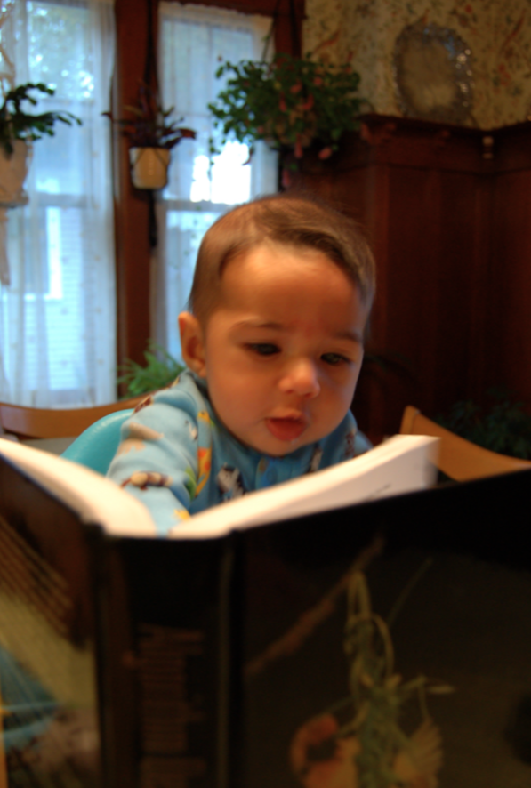
Reading Assignment
Sec 6.8 of [KT]

Slide 16
Longest path problem
Given G, does there exist a simple path of length n-1 ?

Slide 17

Longest vs Shortest Paths

Slide 18

Two sides of the “same” coin
Shortest Path problem
Can be solved by a polynomial time algorithm
Is there a longest path of length n-1?
Given a path can verify in polynomial time if the answer is yes

Slide 19
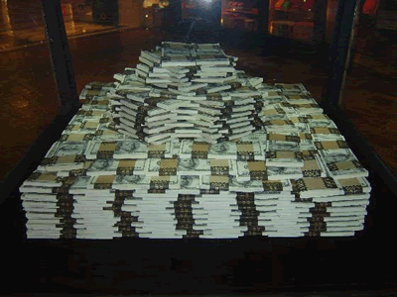
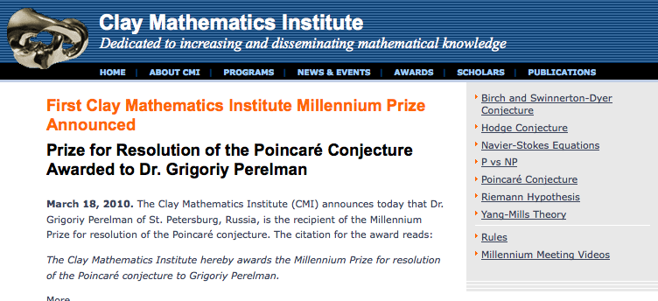
Poly time algo for longest path?

Slide 20
P vs NP question
P: problems that can be solved by poly time algorithms
Is P=NP?
NP: problems that have polynomial time verifiable witness to optimal solution
Alternate NP definition: Guess witness and verify!

Slide 21
Proving P ≠ NP
Pick any one problem in NP and show it cannot be solved in poly time
Pretty much all known proof techniques provably will not work

Slide 22
Proving P = NP
Will make cryptography collapse
Compute the encryption key!
Prove that all problems in NP can be solved by polynomial time algorithms
Solving any ONE problem in here in poly time will prove P=NP!
NP
NP-complete problems

Slide 23

A book on P vs. NP

Slide 24
Questions?

Slide 25

The course so far…
https://www.teepublic.com/sticker/1100935-obama-yes-we-can

Slide 26

The rest of the course…
Under certain assumptions,
https://www.madduckposters.com/products/megamind-no-you-cant?variant=13565168320556

Slide 27
No, you can’t– what does it mean?
NO algorithm will be able to solve a problem in polynomial time
Still for worst-case runtime

Slide 28
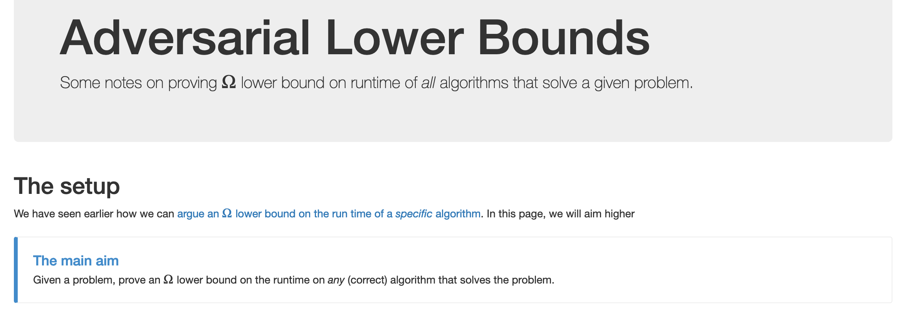
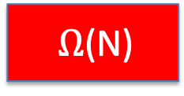
No, you can’t take- 1
What is the best lower bound you can prove?

Slide 29
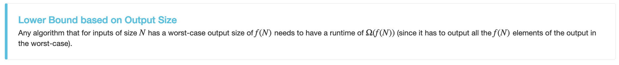
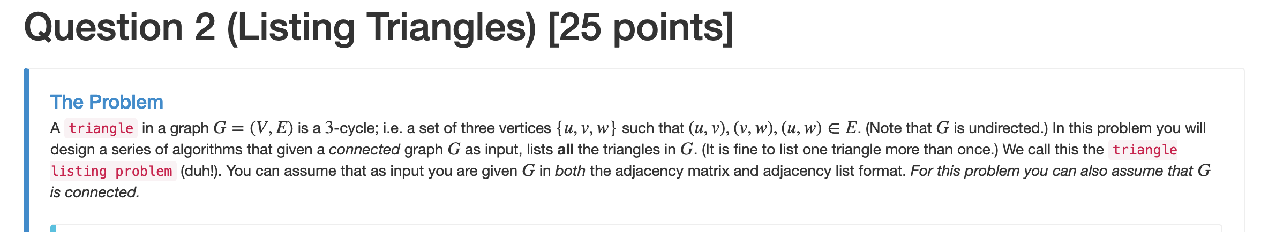
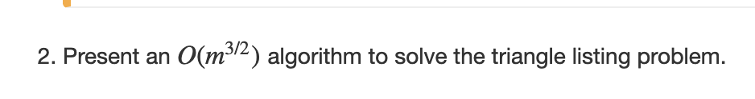
No, you can’t take- 2
Lower bounds based on output size
Exists graphs with m^{3/2} triangles

Slide 30
No, you can’t take- 2
Lower bounds based on output size
On input n, output 2^{n} many ones
Every algo takes (doubly) exponential time
But at heart problem is “trivial”
From now on, output size is always O(N) and could even be binary.

Slide 31
No, you can’t take -3
Argue that a given problem is AS HARD AS
a “known” hard problem
How can we argue something like this?
Reductions

Slide 32
So far: “Yes, we can” reductions
https://www.teepublic.com/sticker/1100935-obama-yes-we-can

Slide 33
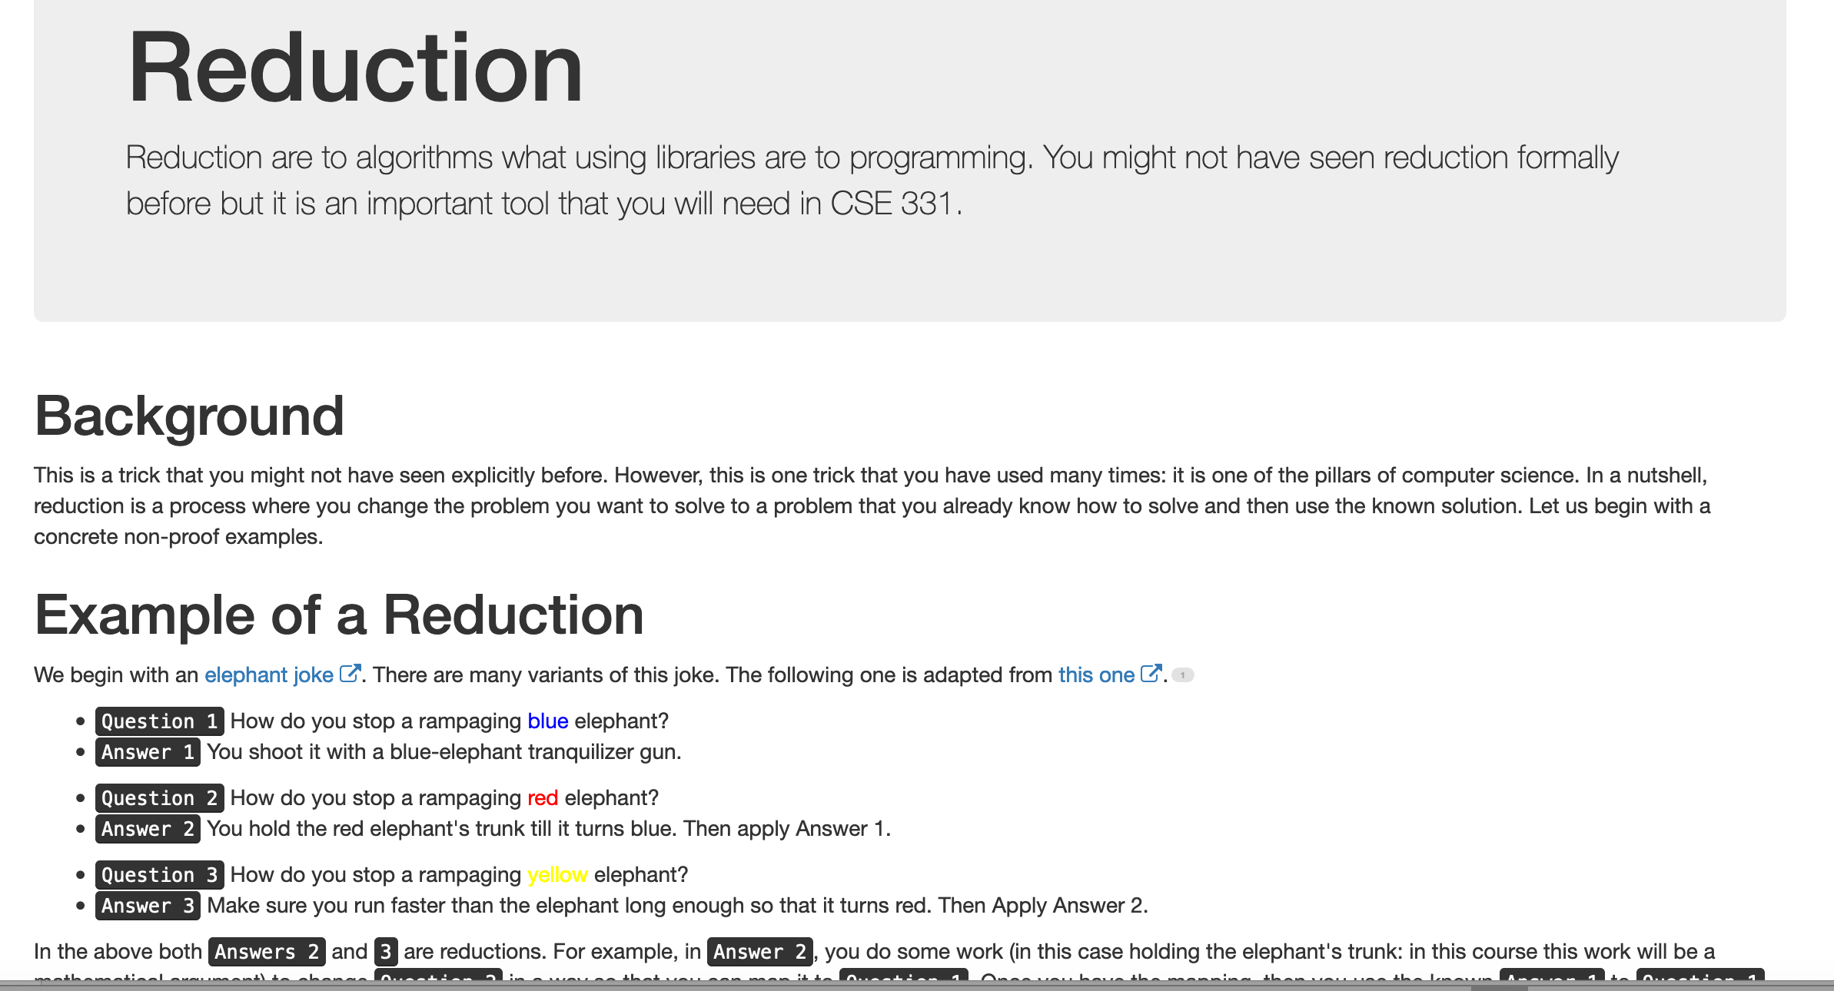
Reduce Y to X where X is “easy”

Slide 34
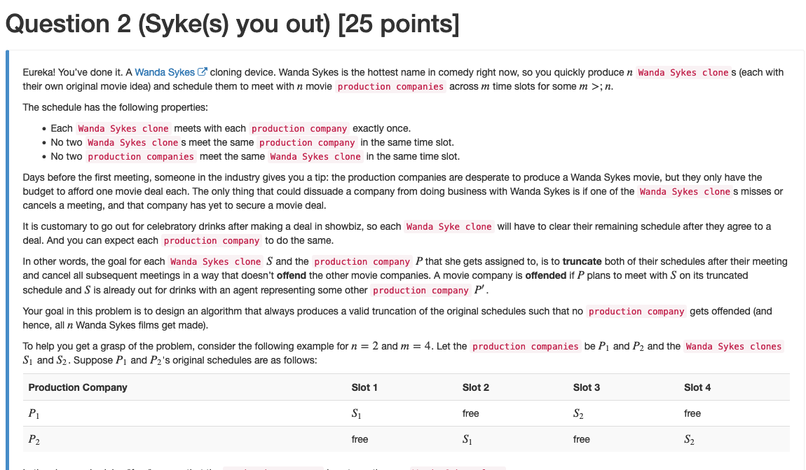
“Yes, we can” reductions (Example)

Slide 35


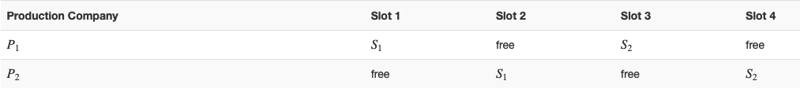
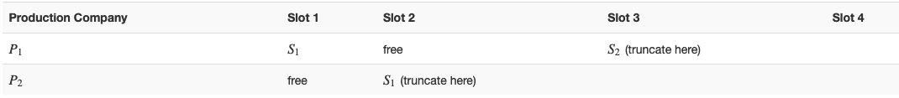




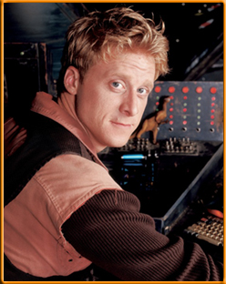

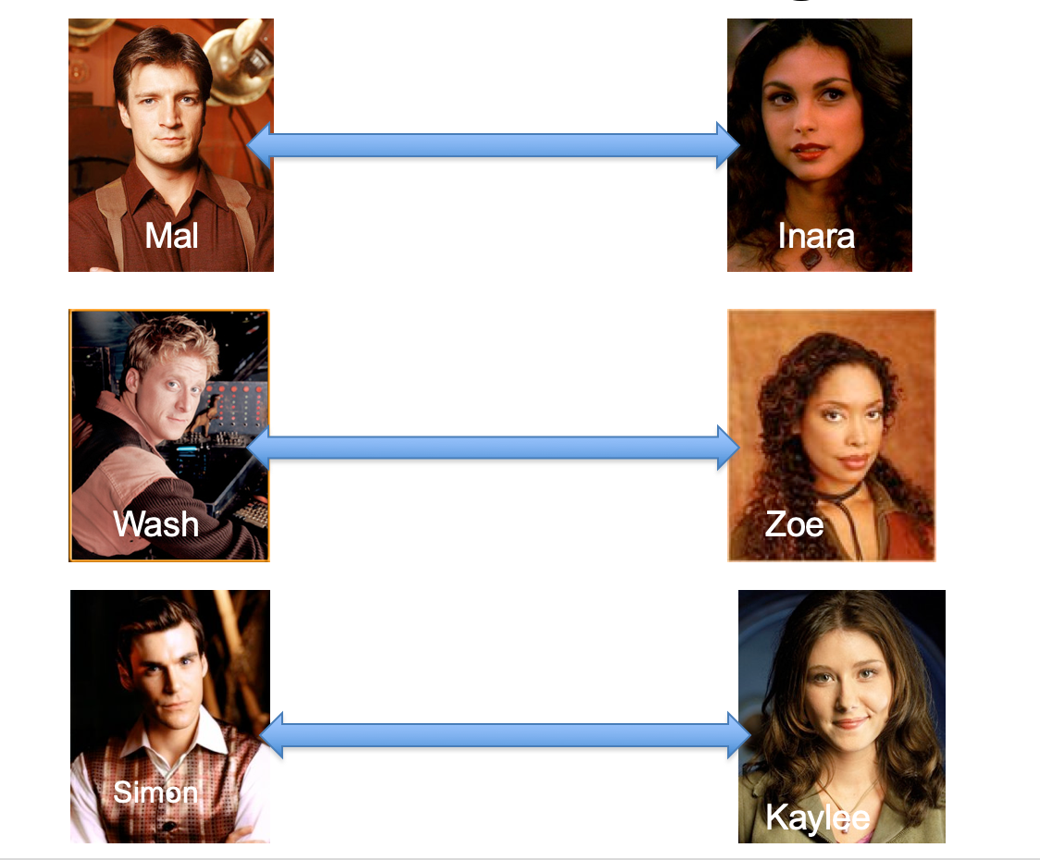
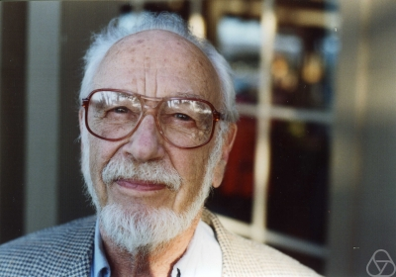
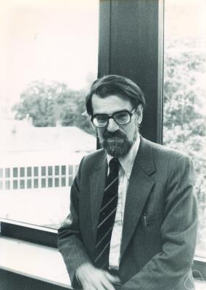
Overview of the reduction

Slide 36
Nothing special about GS algo
ANY algo for stable matching problem works!

Slide 37
Another observation
Poly time steps
ANY algo for stable matching problem works!

Slide 38
Poly time reductions
Poly time steps
ANY algo for stable matching problem works!

Slide 39

Poly time steps
Arbitrary Y instance
ANY algo for stable matching problem works!
Pre-process the input
Output for Y instance
All processing
is poly-time
Algo for X
Post-process the output

Slide 40


Poly time algo for X
Arbitrary Y instance
Poly time algo for Y
Pre-process the input
Output for Y instance
All processing
is poly-time
Algo for X
Post-process the output

Slide 41

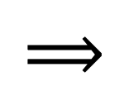
!B !A

Slide 42

No poly time algo for Y
Poly time algo for X
Arbitrary Y instance
No poly time algo for X
Poly time algo for Y
Pre-process the input
Output for Y instance
All processing
is poly-time
Algo for X
Post-process the output

