Slide 1
Lecture 35
CSE 331
Nov 30, 2022

Slide 2
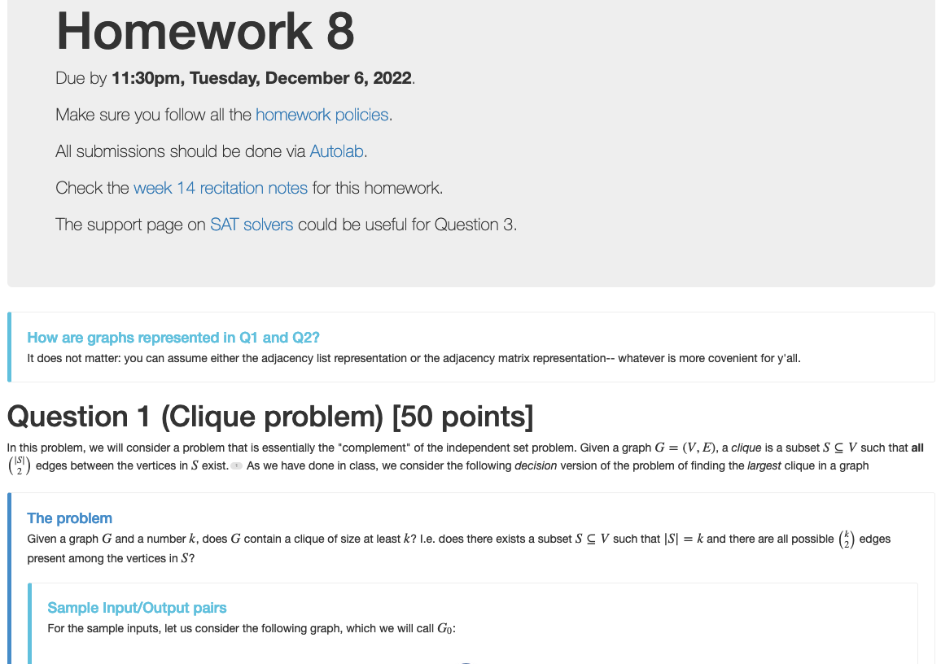
Homework 8 out (last one!!)

Slide 3
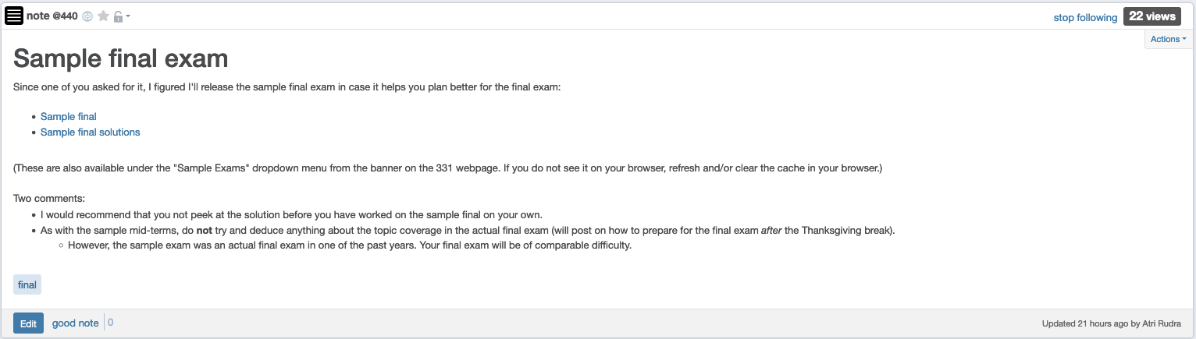
Sample final exam

Slide 4
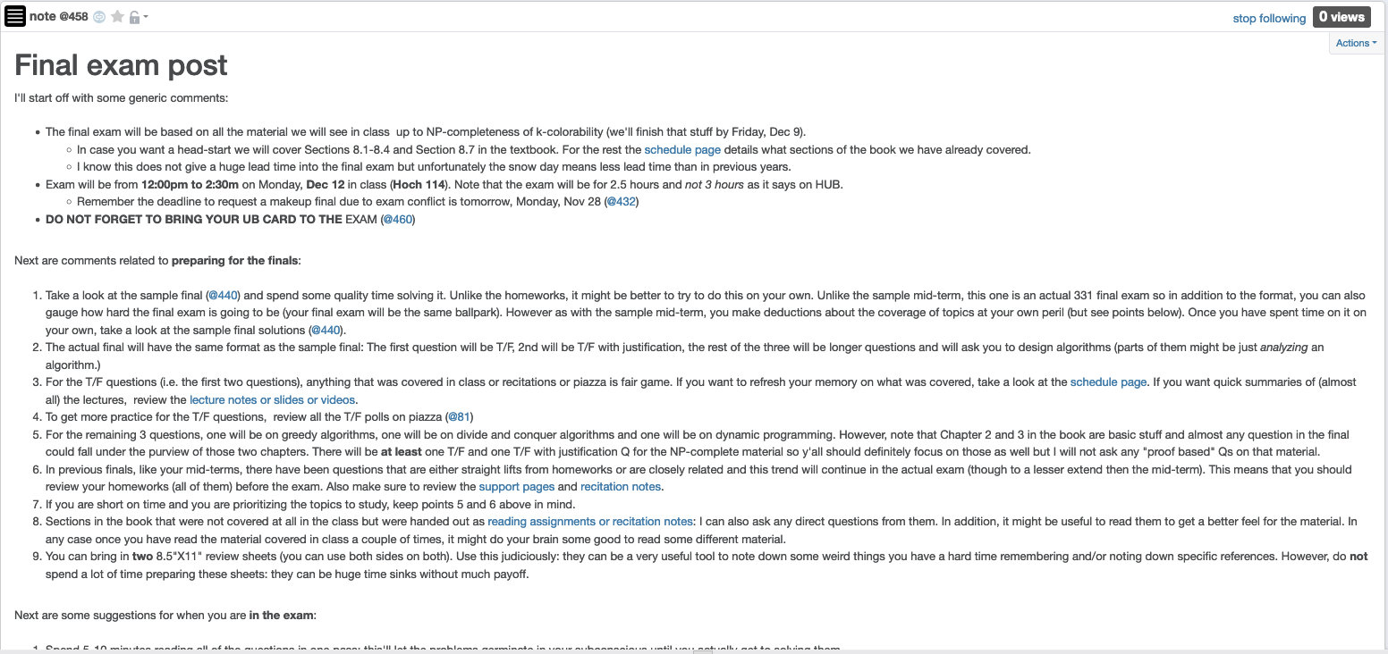
Final exam post

Slide 5
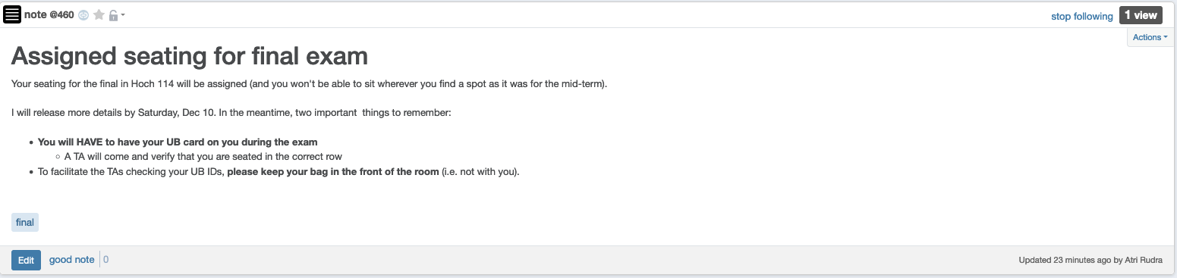
Bring your UB card to final

Slide 6
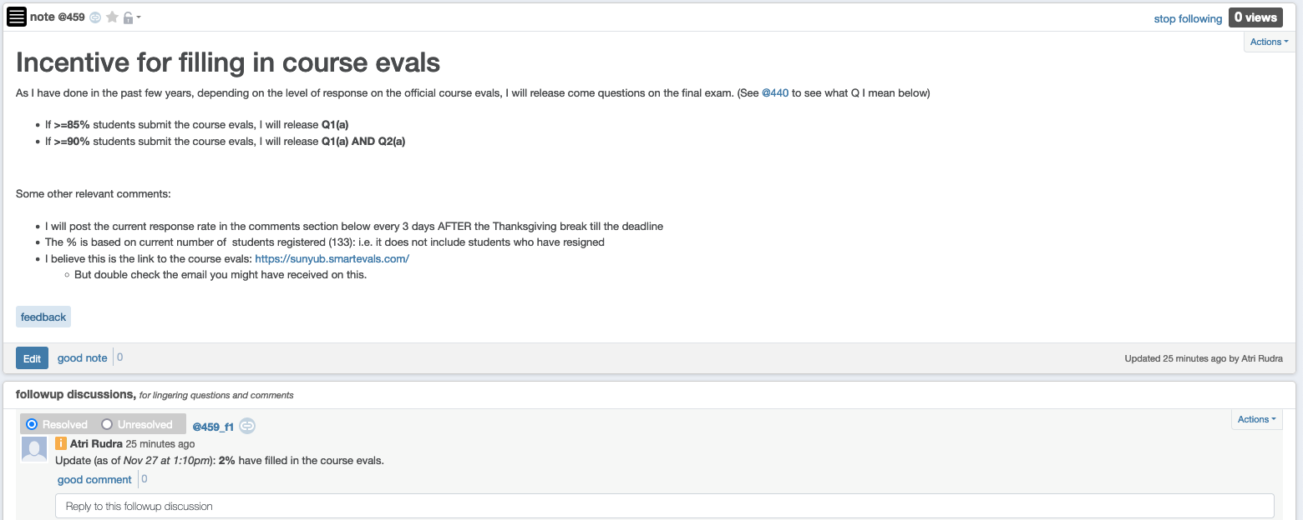
Incentive to complete course evals

Slide 7
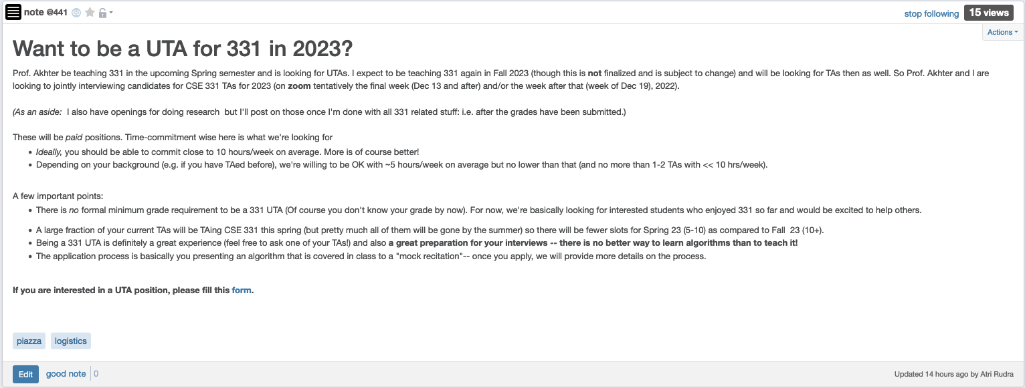
CSE 331 UTA positions for 2023

Slide 8
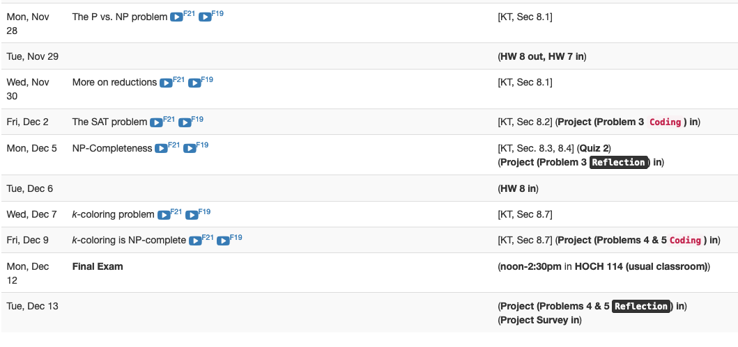
Next two weeks are brutal

Slide 9
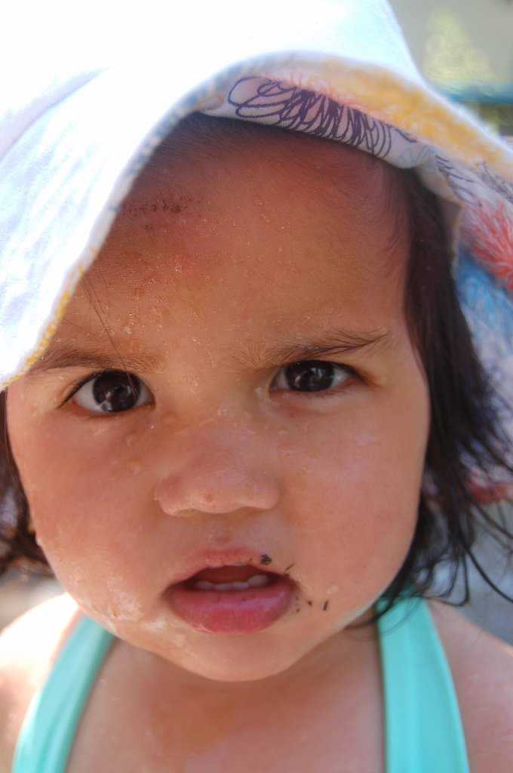
Questions?

Slide 10



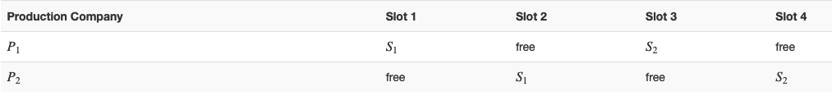
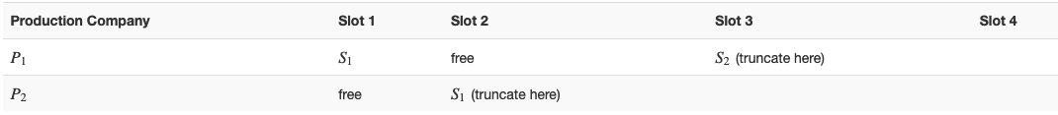


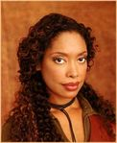
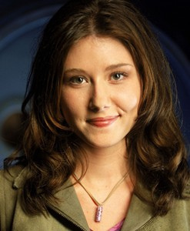
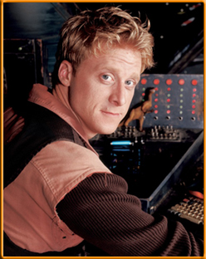

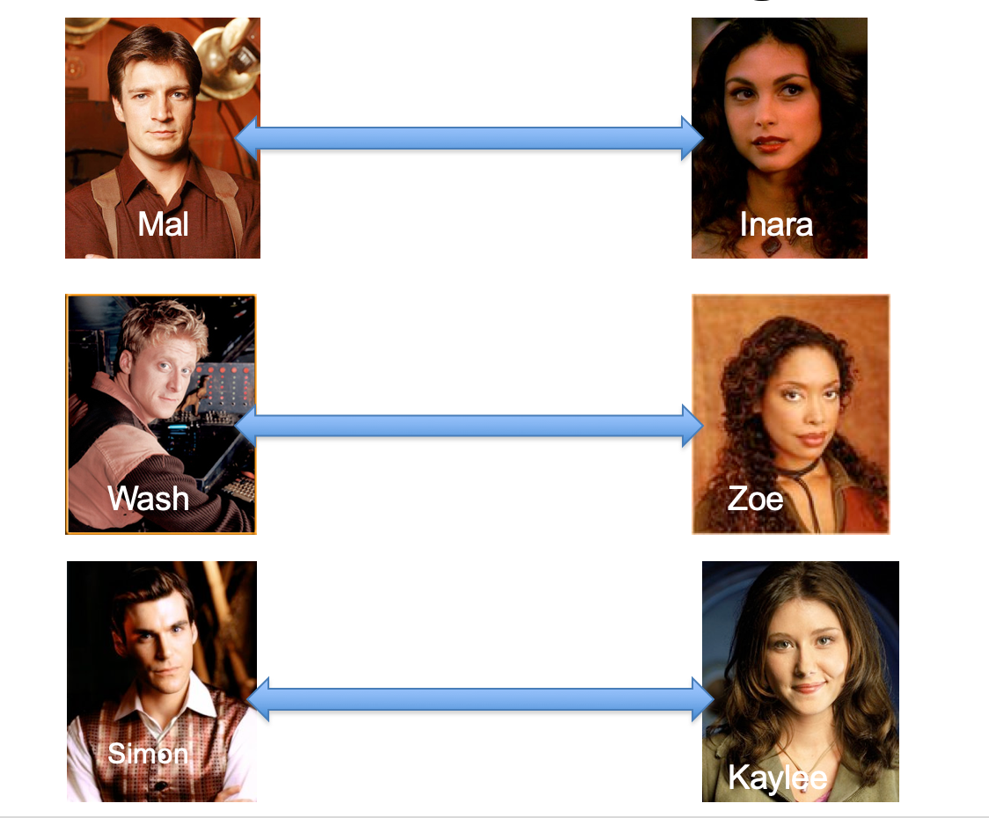
Poly time steps
Arbitrary Y instance
ANY algo for stable matching problem works!
Pre-process the input
Output for Y instance
All processing
is poly-time
Algo for X
Post-process the output

Slide 11

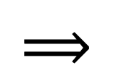
!B !A

Slide 12



No poly time algo for Y
Poly time algo for X
Arbitrary Y instance
No poly time algo for X
Poly time algo for Y
Pre-process the input
Output for Y instance
All processing
is poly-time
Algo for X
Post-process the output

Slide 13
Plan for today
More on reductions
Quick definition of P and NP

