Slide 1
Lecture 36
CSE 331
Dec 2, 2022

Slide 2
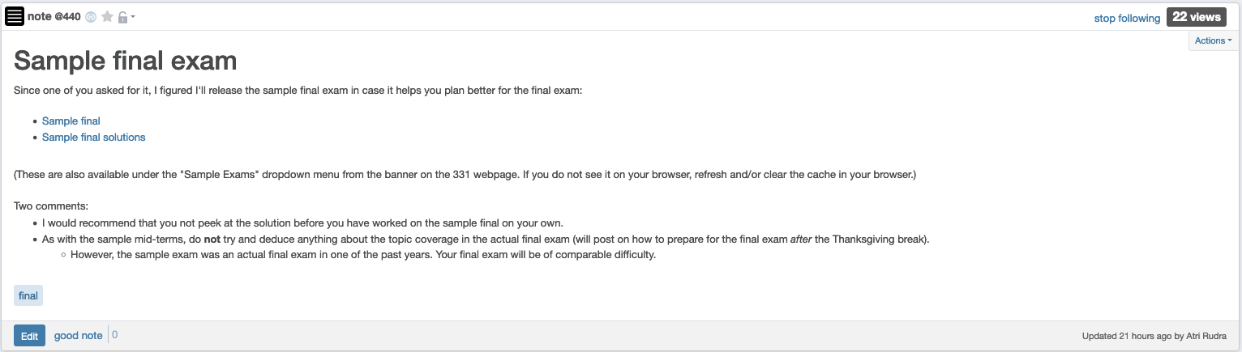
Sample final exam

Slide 3
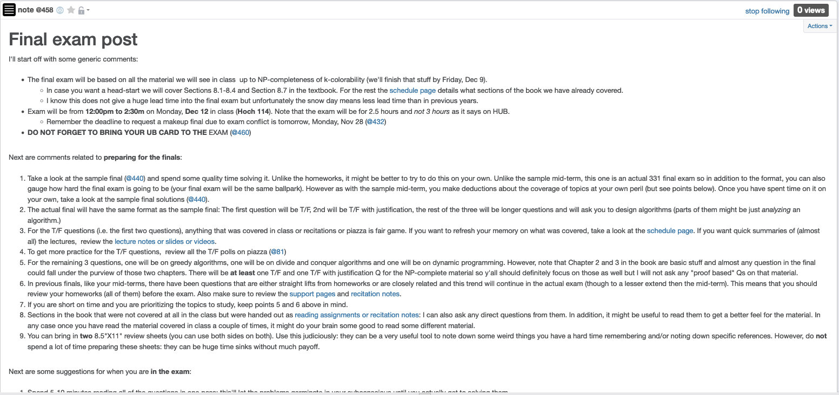
Final exam post

Slide 4
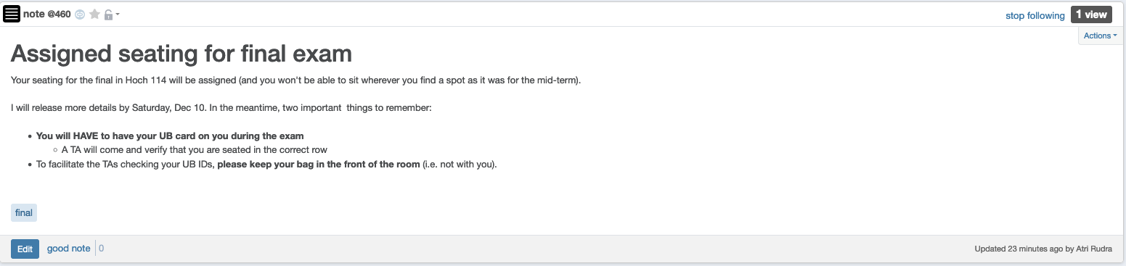
Bring your UB card to final

Slide 5
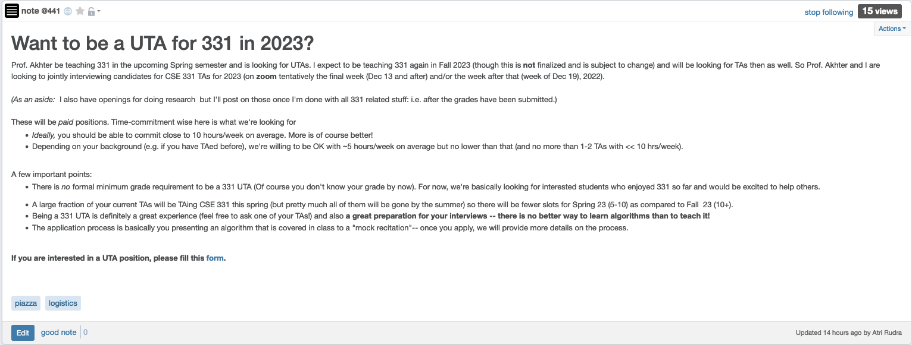
CSE 331 UTA positions for 2023

Slide 6
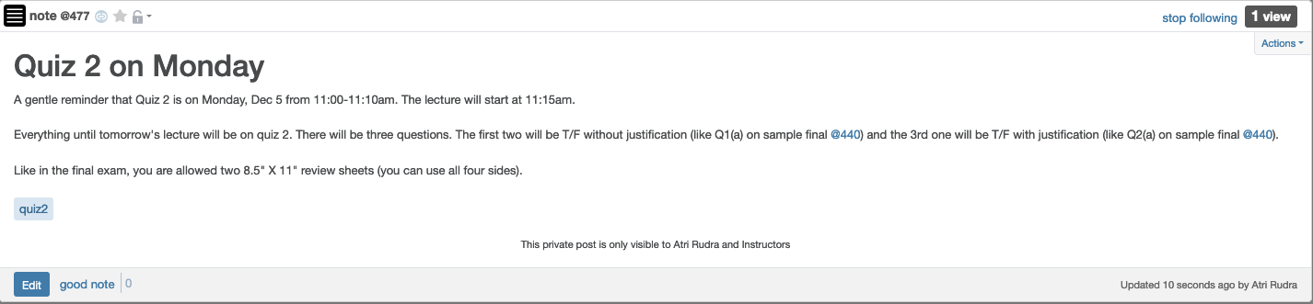
Quiz 2 on Monday

Slide 7
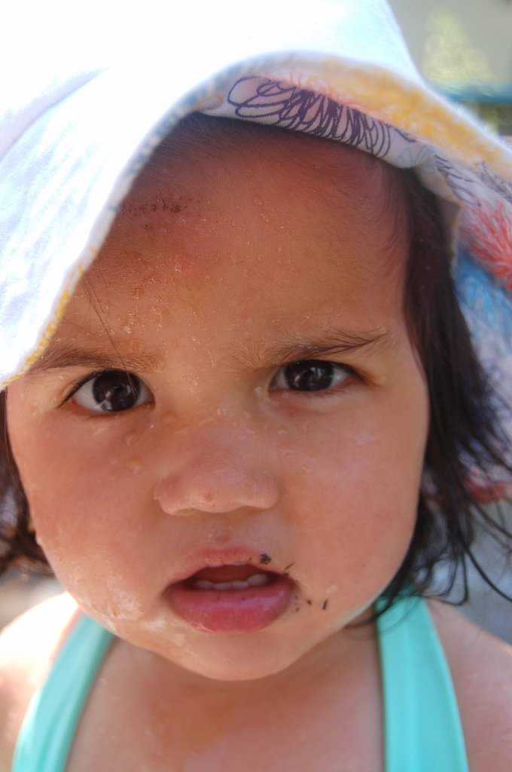
Questions?

Slide 8



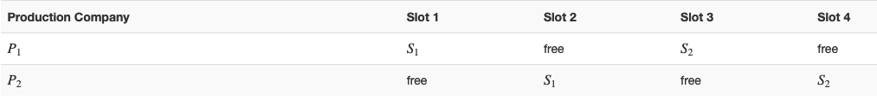
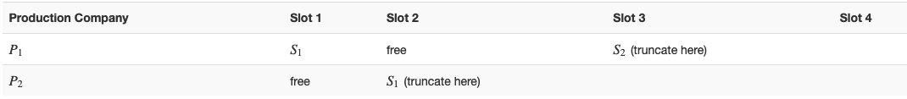






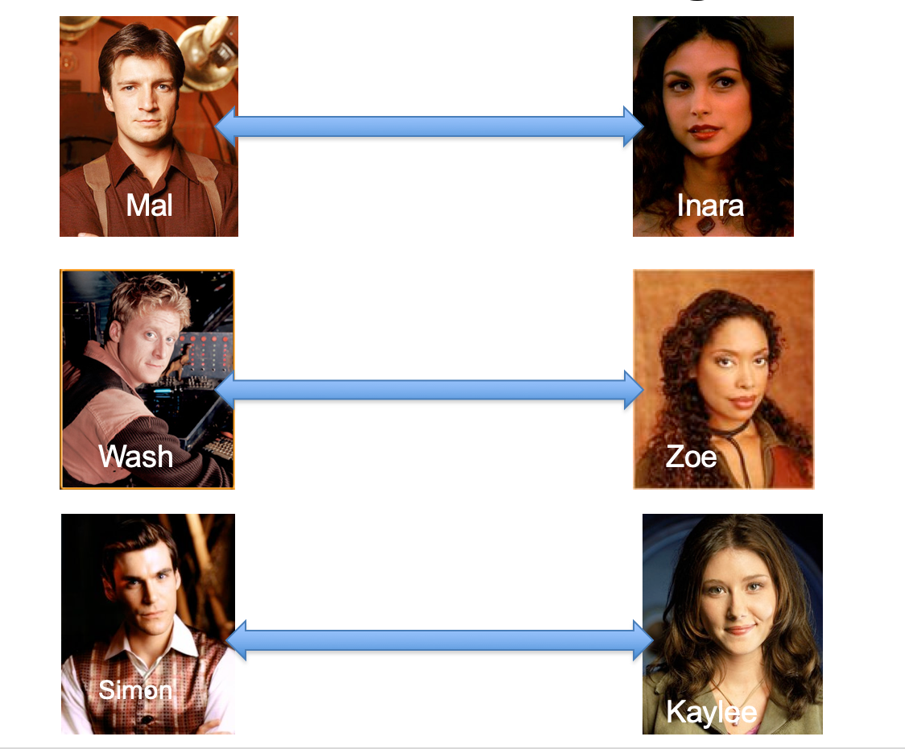
Poly time steps
Arbitrary Y instance
ANY algo for stable matching problem works!
Pre-process the input
Output for Y instance
All processing
is poly-time
Algo for X
Post-process the output

Slide 9



No poly time algo for Y
Poly time algo for X
Arbitrary Y instance
No poly time algo for X
Poly time algo for Y
Pre-process the input
Output for Y instance
All processing
is poly-time
Algo for X
Post-process the output

Slide 10
P vs NP question
P: problems that can be solved by poly time algorithms
Is P=NP?
NP: problems that have polynomial time verifiable witness to optimal solution

Slide 11


More on P
Only consider Boolean output problems
A problem Y is a subset of possible input (with output 1)
A(w) denotes output of algo A on input w
A solves Y if A(w) = 1 iff w $∈$ Y
Y $∈$P if there exists a poly time A that solves Y

Slide 12

Independent Set (IS)
Input: Graph G = (V,E) and number k
Output: Yes iff G has an IS of size $≥$k

Slide 13

Vertex Cover (VC)
Input: Graph G = (V,E) and number k
Output: Yes iff G has a VC of size $≤$k

Slide 14
Questions?

Slide 15

Plan for today
Finish defining NP
Define NP-completeness
IS $≤$_{P}VC
Introduce SAT (?)

