Slide 1
Lecture 4
CSE 331
Sep 7, 2022

Slide 2
Please do keep on asking Qs!
The only bad question is the one that is not asked!
Not just technical Qs but also on how the class is run

Slide 3

We’re not mind readers

Slide 4

If you need it, ask for help

Slide 5
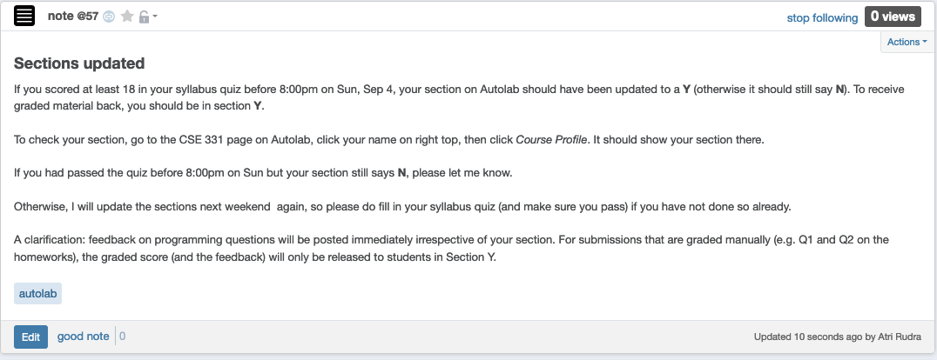
Syllabus Quiz (and sections)

Slide 6
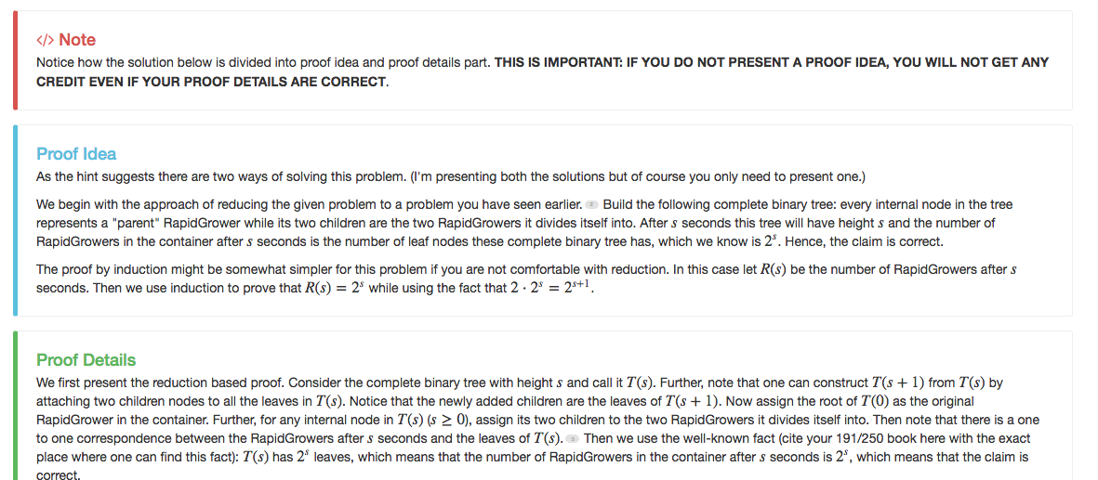
Separate Proof idea/proof details

Slide 7
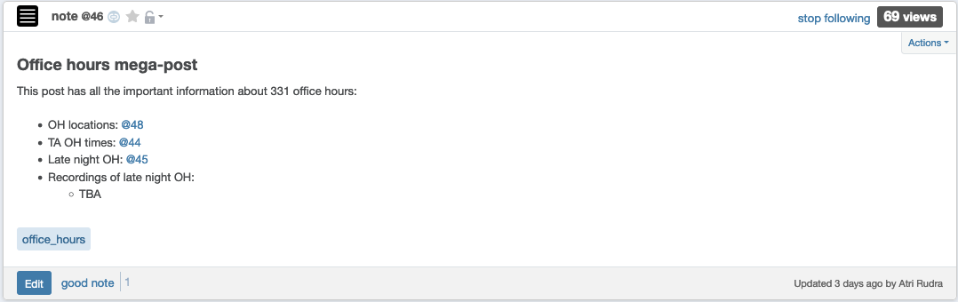
Office hours finalized
Come ask your proof related Questions!

Slide 8
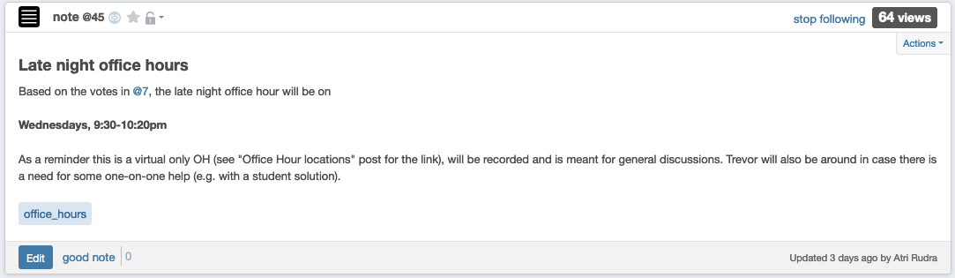
Late night office hour starts tonight!

Slide 9
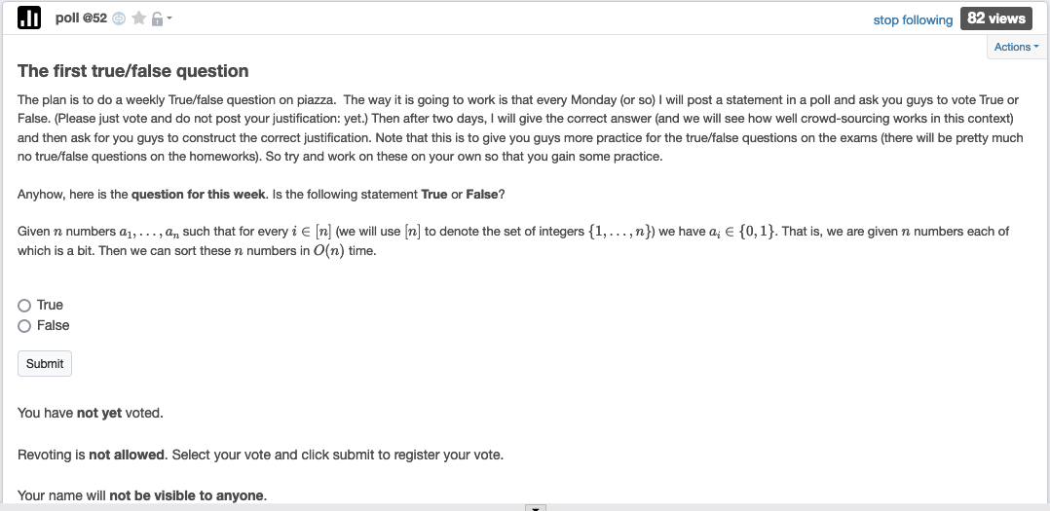
1st True/False poll

Slide 10
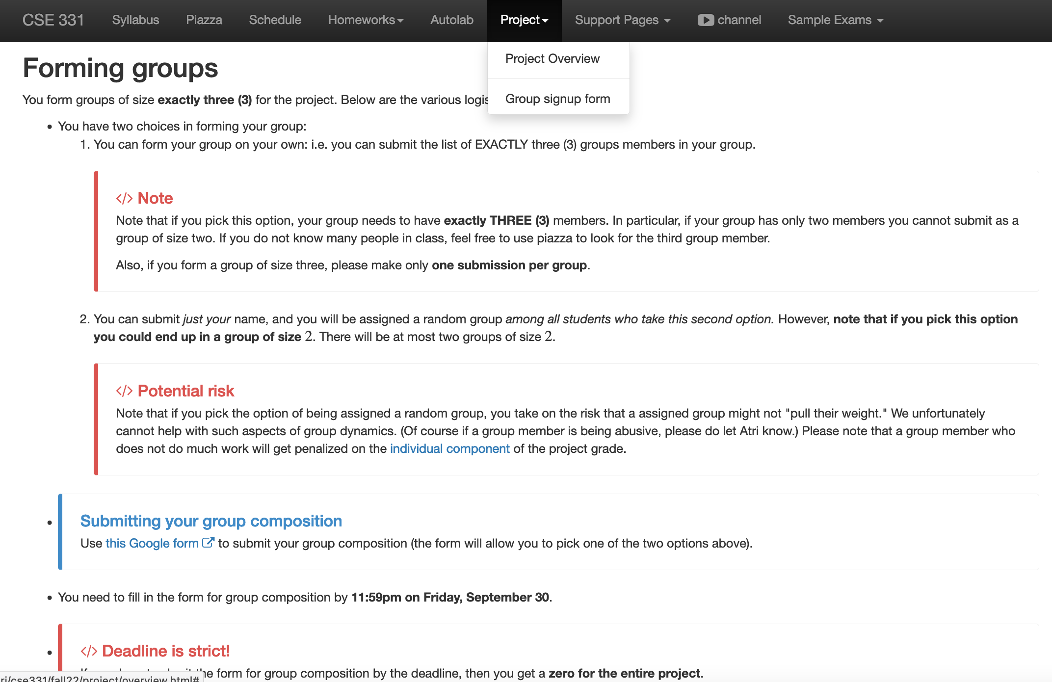
Register your project groups
Deadline: Friday, Sep 30, 11:59pm

Slide 11

Update on VM

Slide 12
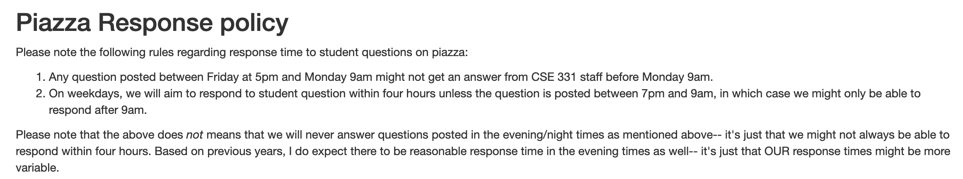
Piazza Response policy

Slide 13
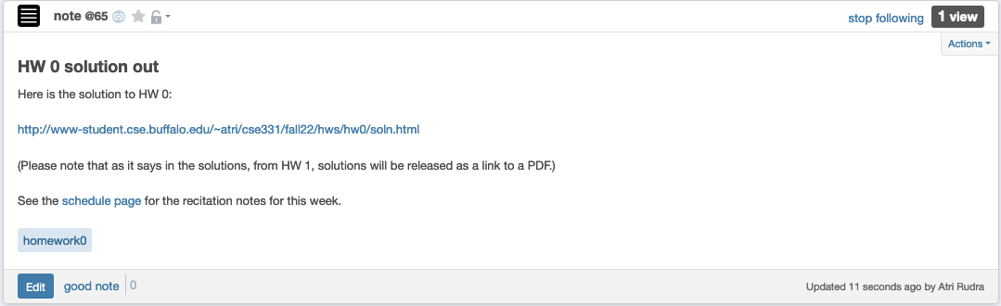
Solutions to HW 0 out

Slide 14
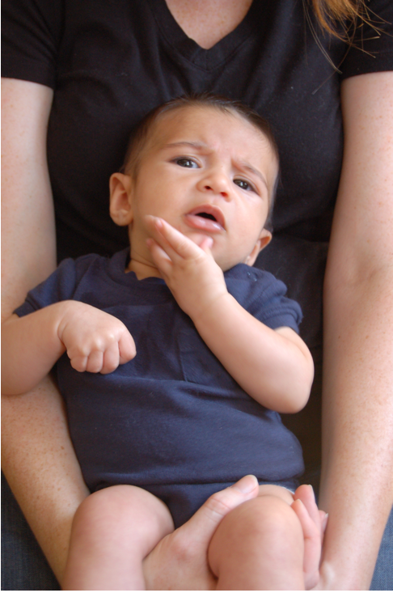
Questions/Comments?

Slide 15
Incorrect Proof Details: Q1(b) on HW0
Argument does not use ANYTHING about the problem statement!
Follows from part (a)
Let P(n) be the number of perfect matchings with n men and n women
Base case: P(1) = 1! = 1
This assumes number of perfect matchings only depends on n
Inductive hypothesis: Assume that P(n-1) = (n-1)!
Inductive step: Note that P(n) = n*P(n-1) = n*(n-1)! = n!
What are the issues with the above “proof”?

Slide 16
Incorrect Proof Details: Q1(b) on HW0
Needs justification
Claim 1: Number of perfect matchings is = number of permutations of
1…n
Claim 2: Number of permutations of 1…n is n!
Needs justification
Claims 1 + 2 prove the result
Follow from 191 (?)
What are the issues with the above proof?

Slide 17
Proof by contradiction for Q1(a)
Assume for contradiction there is an example where number of perfect
matchings depends on the identities of the men and women.
Let n =1 and consider two cases
(1) M = {BP} and W = {JA}
(2) M = {BBT} and W = {AJ}
You can only assume things about the example directly implied by it being a counter-example
In both cases the number of perfect matchings is 1 = 1!
There is NO contradiction
Hence contradiction.
What are the issues with the above proof?

Slide 18
Questions/Comments?

Slide 19
Questions to think about
1) How do we specify preferences?
Preference lists
2) Ratio of applicant vs employers
1:1
3) Formally what is an assignment?
(perfect) matching
4) Can an employer get assigned > 1 applicant?
NO
5) Can an applicant have > 1 job?
NO
6) How many employer/applicants in an applicants/employers preferences?
All of them
7) Can an employer have 0 assigned applicants?
NO
8) Can an applicant have 0 jobs?
NO

Slide 20







On matchings
Mal
Inara
Wash
Zoe
Simon
Kaylee

Slide 21
A valid matching
Mal
Inara
Wash
Zoe
Simon
Kaylee

Slide 22
Not a matching
Mal
Inara
Wash
Zoe
Simon
Kaylee

Slide 23
Perfect Matching
Mal
Inara
Wash
Zoe
Simon
Kaylee

Slide 24

Questions/Comments?

Slide 25
Preferences
Mal
Inara
Wash
Zoe
Simon
Kaylee

Slide 26
Instability
Mal
Inara
Wash
Zoe
Simon
Kaylee

Slide 27

Back to the board…

