Slide 1
Lecture 6
CSE 331
Sep 12, 2022

Slide 2
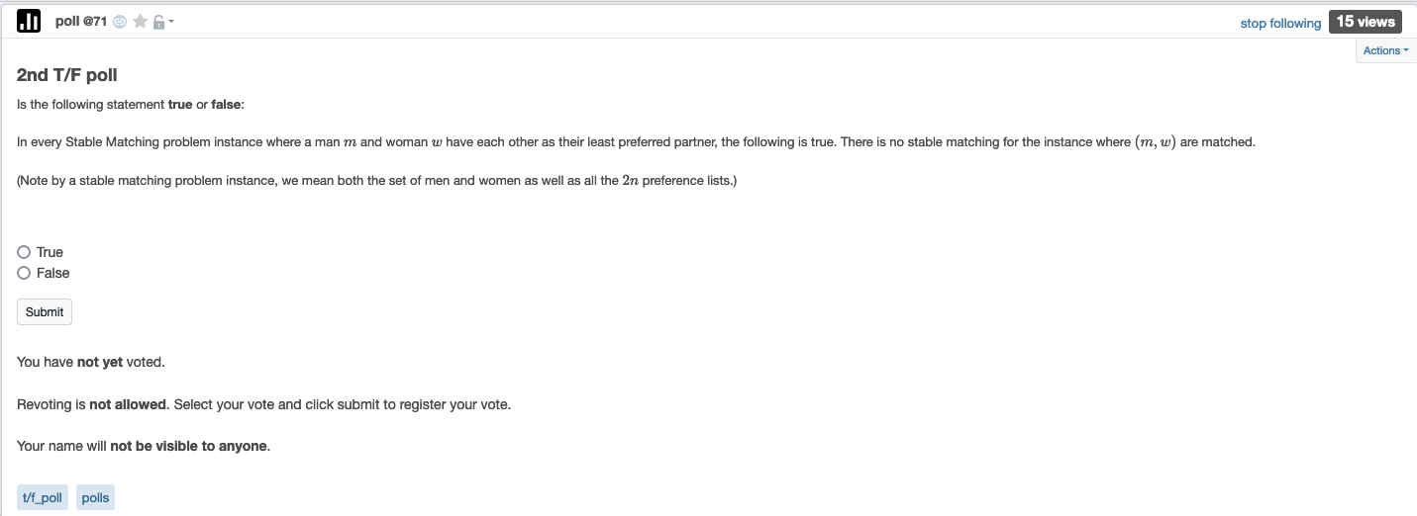
2nd T/F poll up

Slide 3
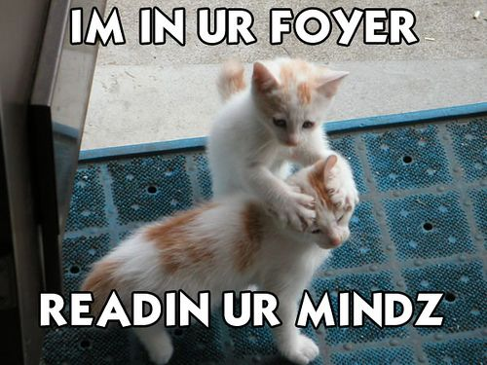
We’re not mind readers

Slide 4

If you need it, ask for help

Slide 5
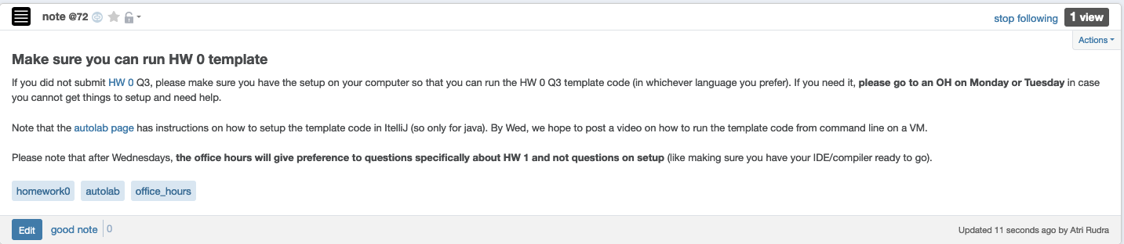
Make sure you can run HW0 code

Slide 6
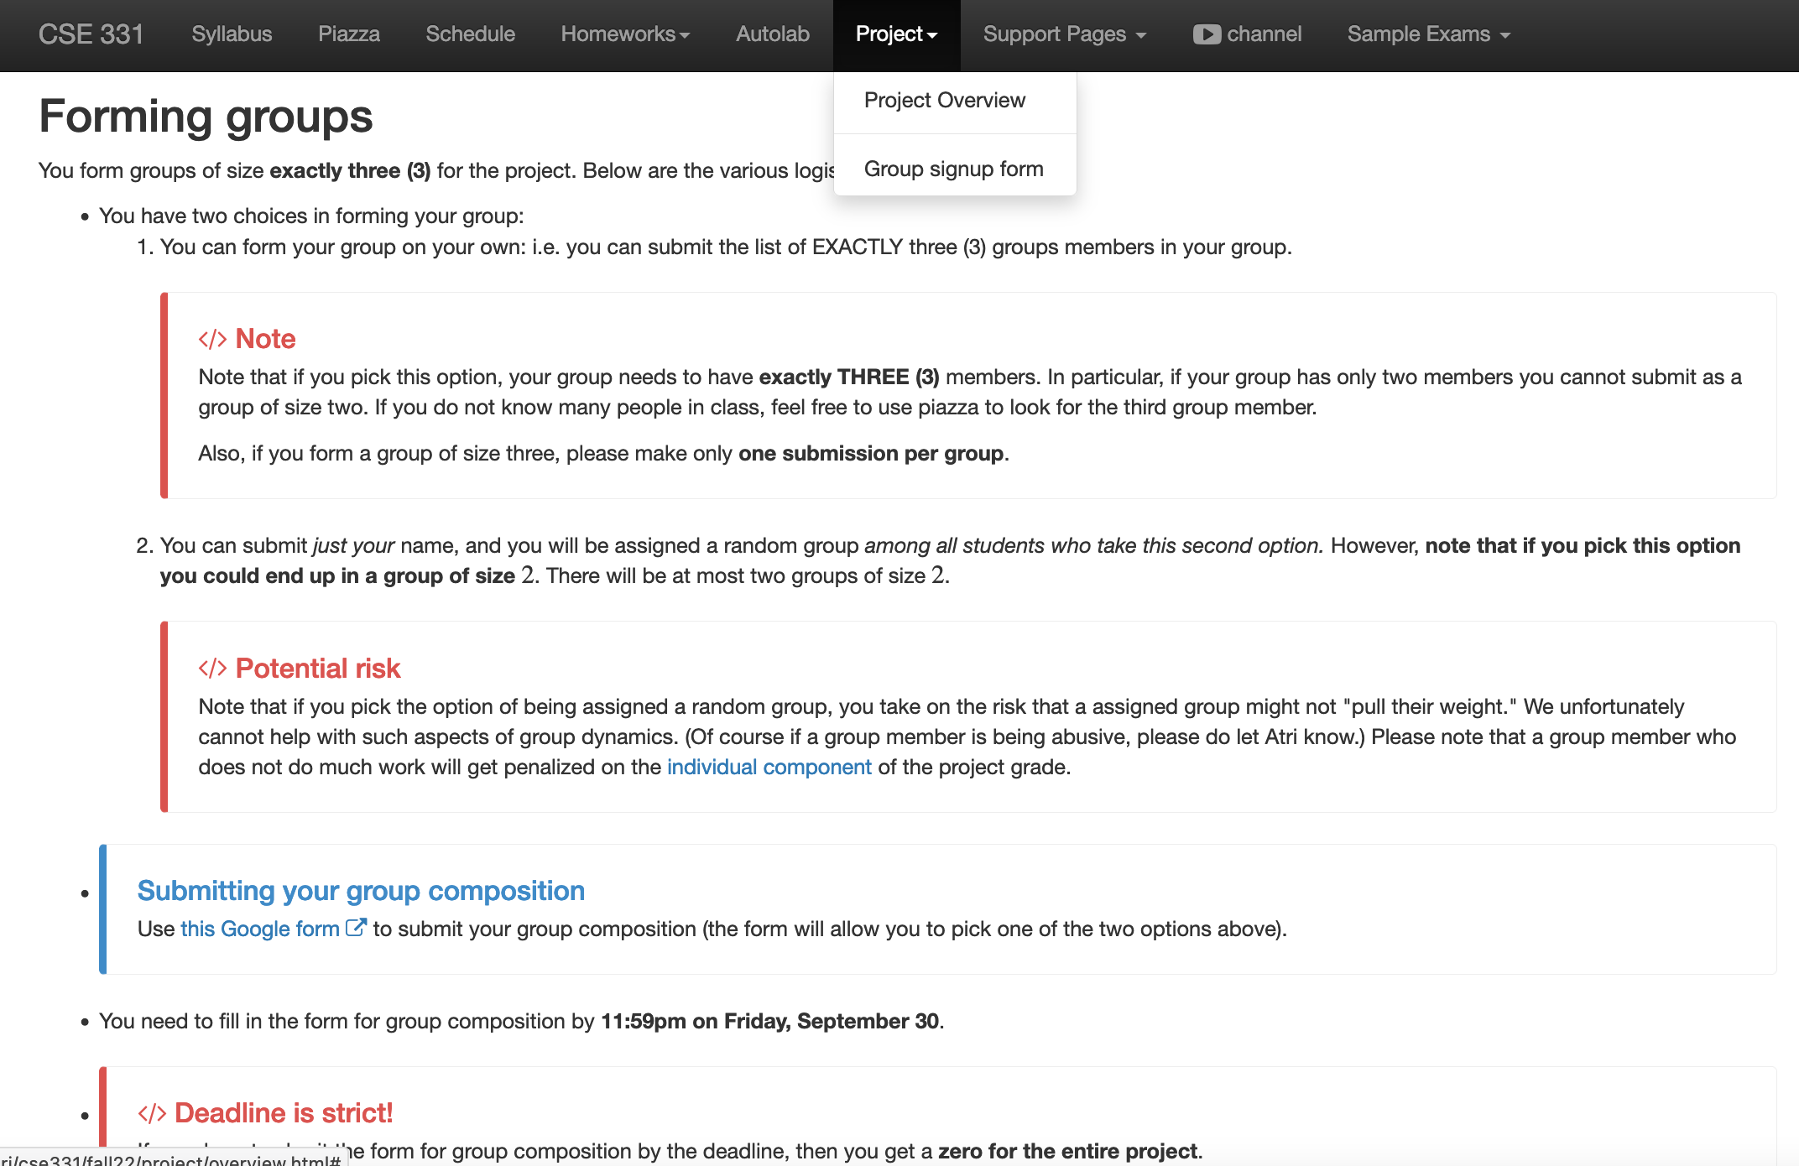
Register your project groups
Deadline: Friday, Sep 30, 11:59pm

Slide 7
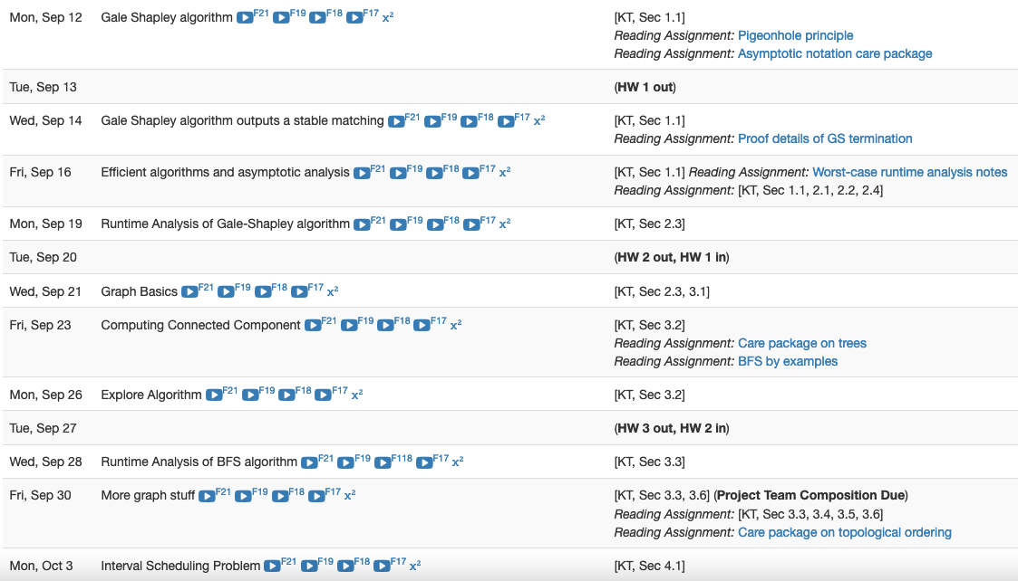
HW 1 gets released this Tue

Slide 8
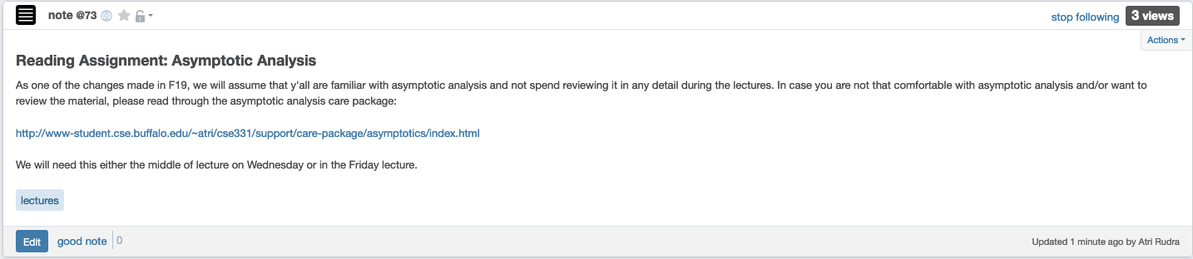
Reading Assignment - I

Slide 9
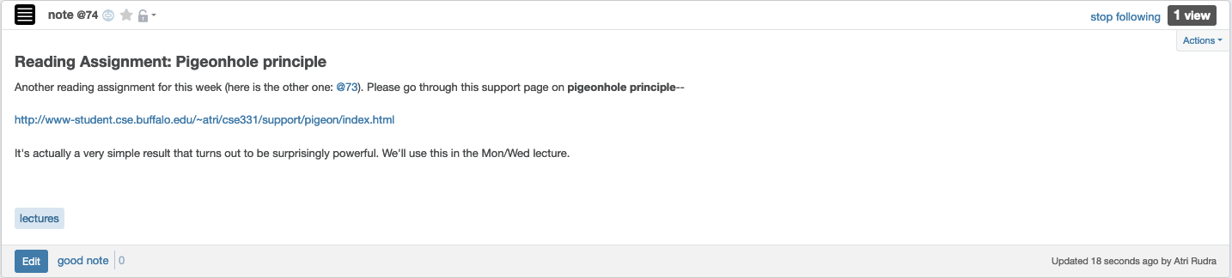
Reading Assignment - II

Slide 10
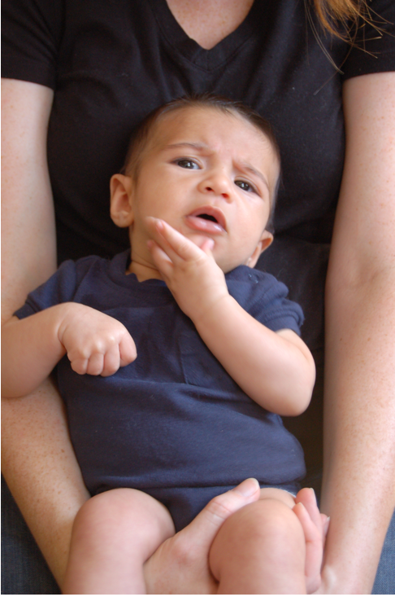
Questions/Comments?

Slide 11
Stable Marriage problem
Input: M and W with preferences
Output: Stable Matching
Set of men M and women W
Preferences (ranking of potential spouses)
Matching (no polyandry/gamy in M X W)
Perfect Matching (everyone gets married)
m
w
Instablity
m’
w’
Stable matching = perfect matching+ no instablity

Slide 12
Two Questions
Does a stable marriage always exist?
If one exists, how quickly can we
compute one?

Slide 13
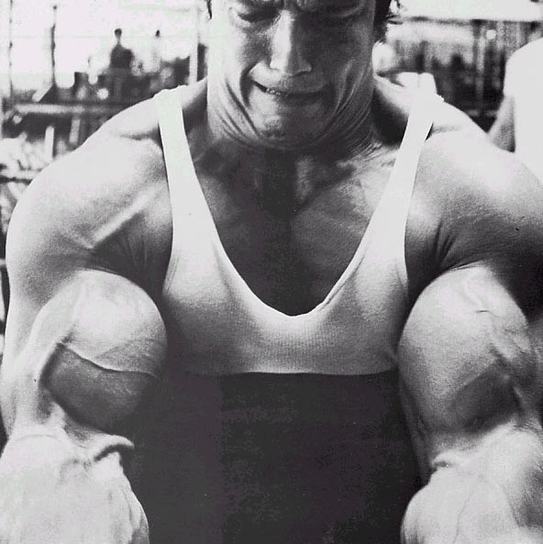
The naïve algorithm
Incremental algorithm to produce all n! prefect matchings?
Go through all possible perfect matchings S
If S is a stable matching
then Stop
n! matchings
Else move to the next perfect matching

Slide 14
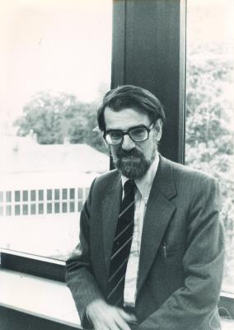
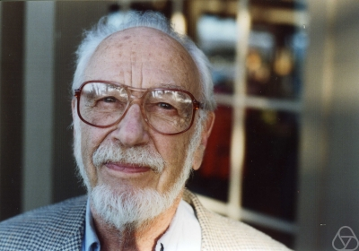
Gale-Shapley Algorithm
David Gale
Lloyd Shapley
O(n²) algorithm

Slide 15
Moral of the story…
>

Slide 16
Questions/Comments?

Slide 17
Rest of today’s agenda
Finish off GS algorithm
Run of GS algorithm on an instance
Prove correctness of the GS algorithm

Slide 18
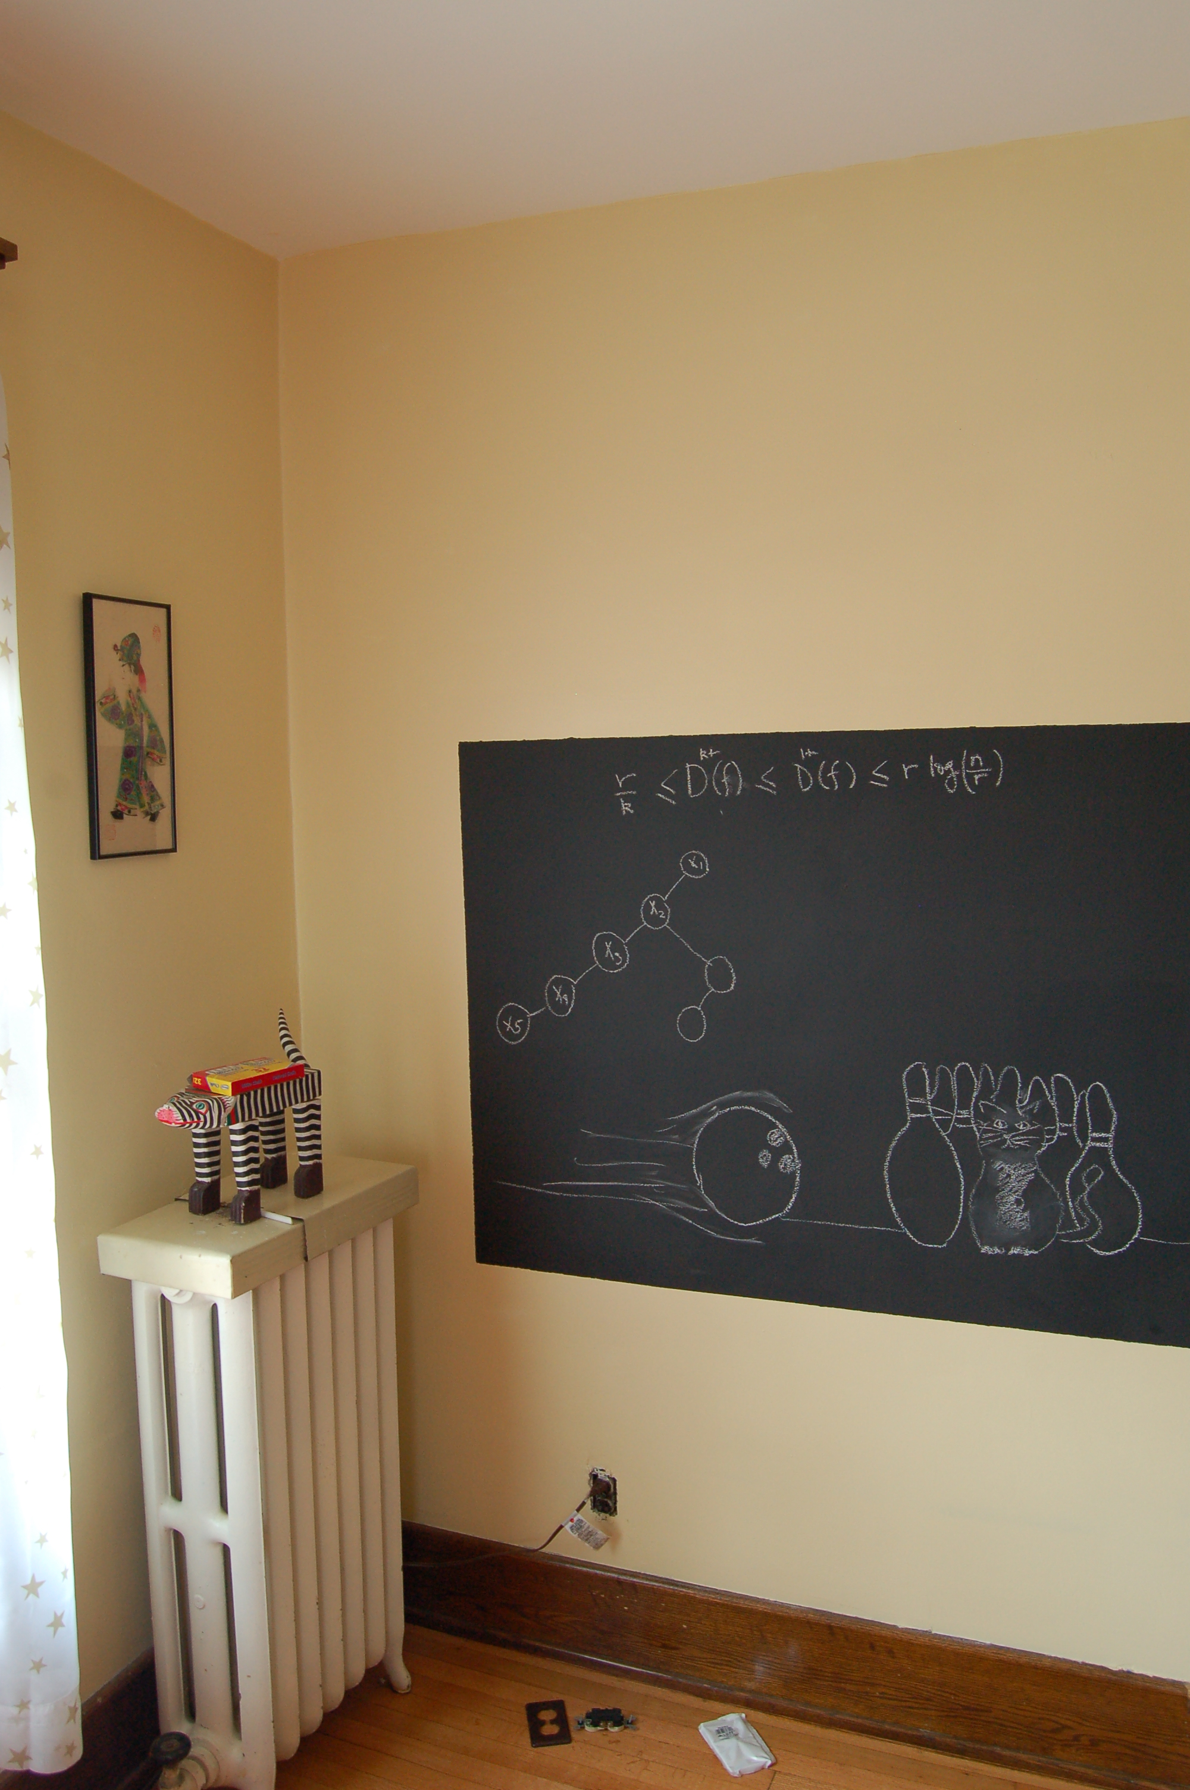
Back to the board…

Slide 19
Gale-Shapley Algorithm
Intially all men and women are free
While there exists a free woman who can propose
Let w be such a woman and m be the best man she has not proposed to
w proposes to m
If m is free
(m,w) get engaged
Else (m,w’) are engaged
If m prefers w’ to w
w remains free
Else
(m,w) get engaged and w’ is free
Output the engaged pairs as the final output

Slide 20
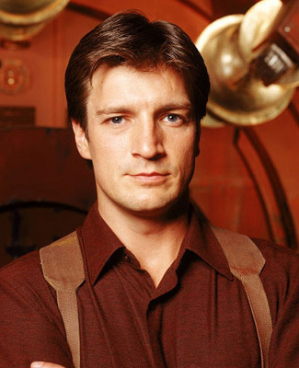
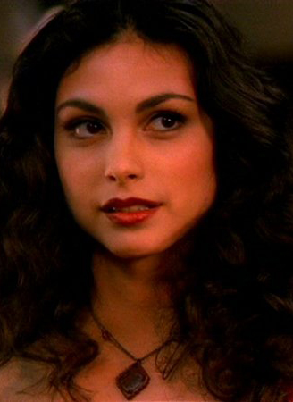
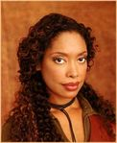
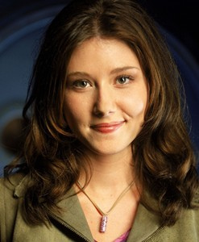
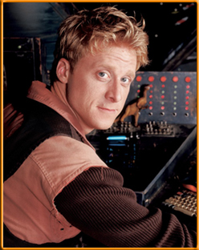
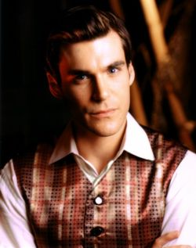
Preferences
Mal
Inara
Wash
Zoe
Simon
Kaylee

Slide 21
GS algorithm: Firefly Edition
Mal
Inara
Wash
Zoe
1
2
3
4
5
6
Simon
Kaylee
1
2
3
4
5
6

Slide 22
Observation 1
Intially all men and women are free
While there exists a free woman who can propose
Let w be such a woman and m be the best man she has not proposed to
w proposes to m
If m is free
(m,w) get engaged
Once a man gets engaged, he remains engaged (to “better” women)
Else (m,w’) are engaged
If m prefers w’ to w
w remains free
Else
(m,w) get engaged and w’ is free
Output the engaged pairs as the final output

Slide 23
Observation 2
Intially all men and women are free
While there exists a free woman who can propose
Let w be such a woman and m be the best man she has not proposed to
w proposes to m
If m is free
If w proposes to m after m’, then she prefers m’ to m
(m,w) get engaged
Else (m,w’) are engaged
If m prefers w’ to w
w remains free
Else
(m,w) get engaged and w’ is free
Output the set S of engaged pairs as the final output

Slide 24
Questions/Comments?

Slide 25
Why bother proving correctness?
Consider a variant where any free man or free woman can propose
Is this variant any different? Can you prove it?

Slide 26
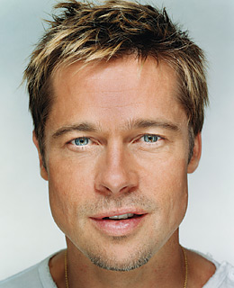
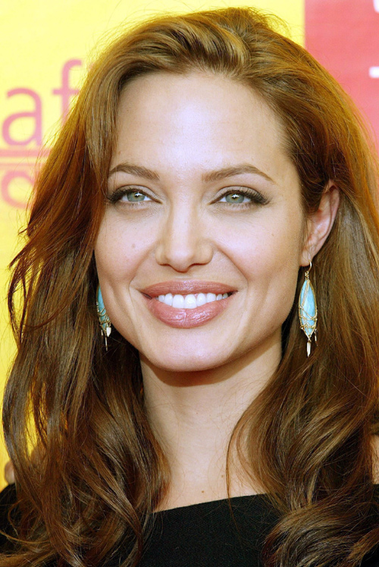
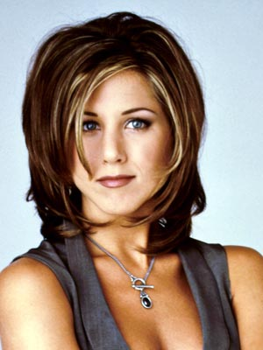
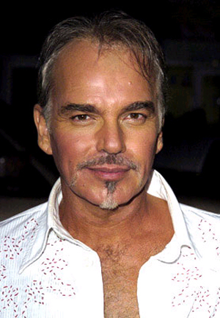
GS’ does not output a stable marriage
BP
AJ
BBT
JA

