Slide 1
Lecture 8
CSE 331
Sep 16, 2022

Slide 2

If you need it, ask for help

Slide 3
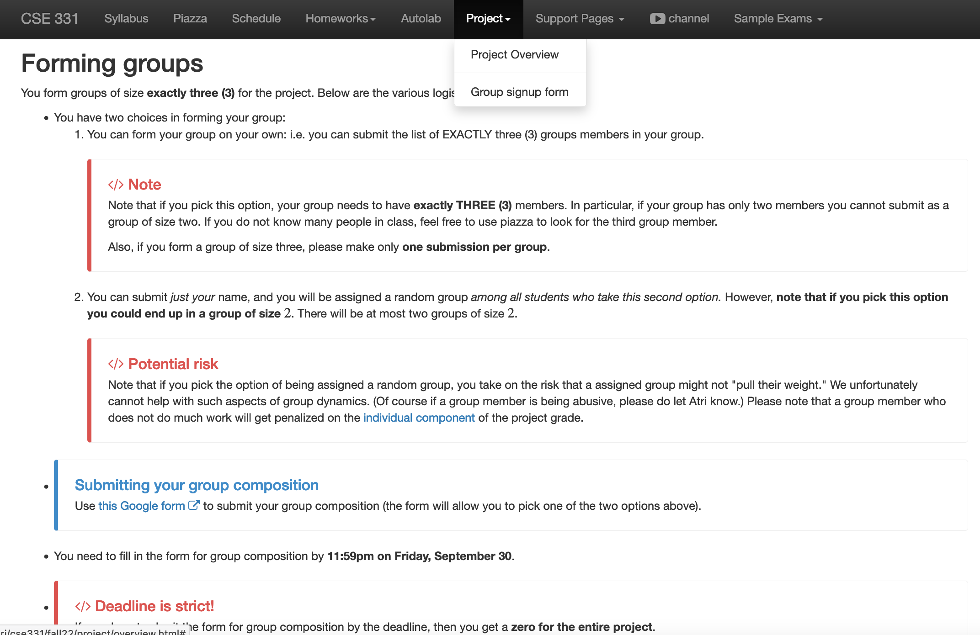
Register your project groups
Deadline: Friday, Sep 30, 11:59pm

Slide 4
Your UBIT ID is
xyz if your email ID is xyz@buffalo.edu
NOT
xyz@buffalo.edu
Your UB person number

Slide 5
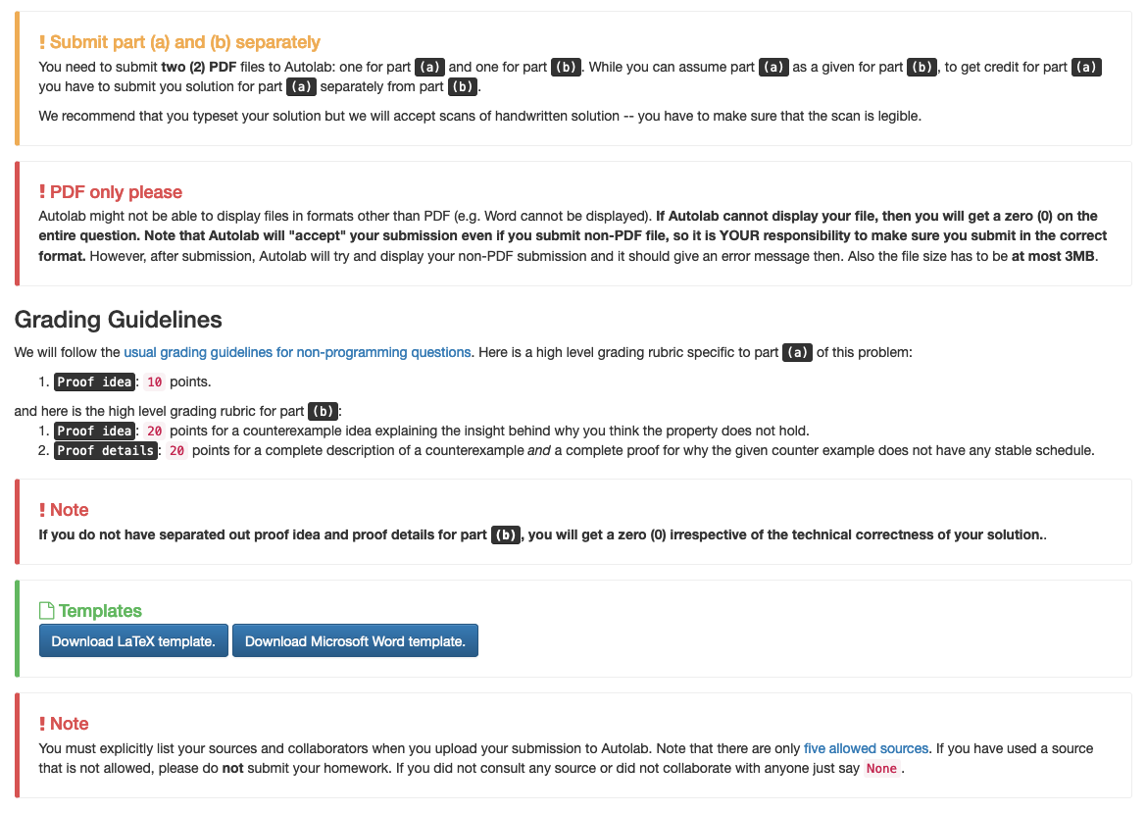
Follow ALL instructions on HW1

Slide 6
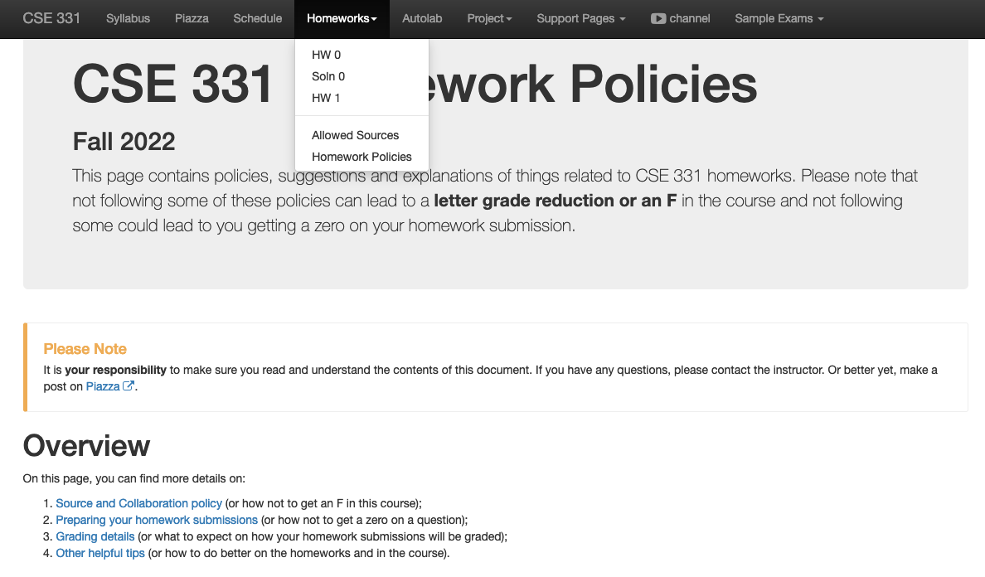
Review the HW policy doc!

Slide 7
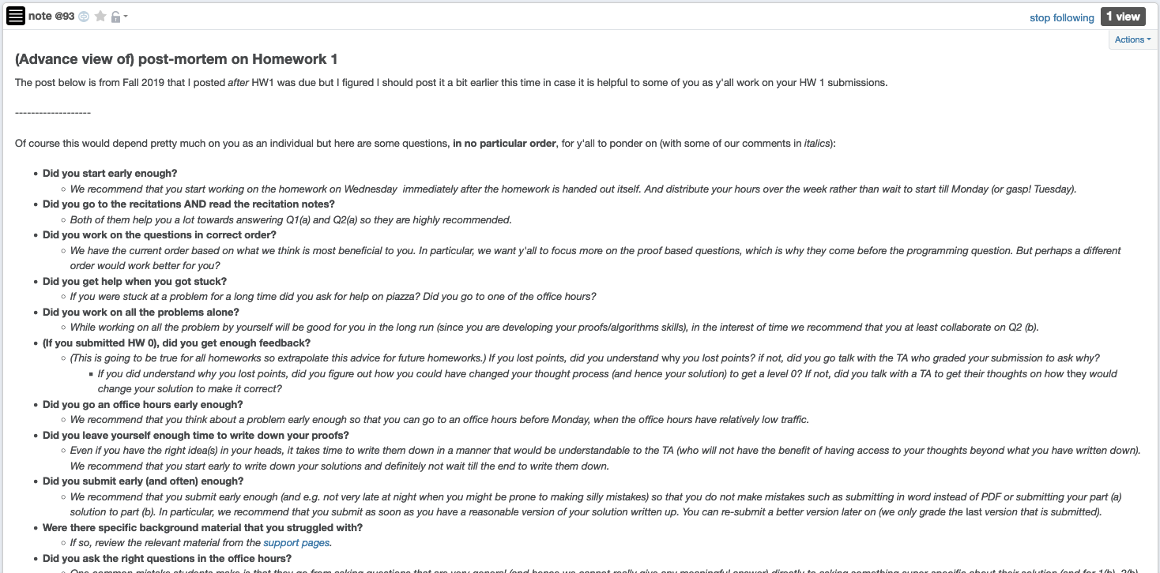
HW 1 (pre)post-mortem

Slide 8
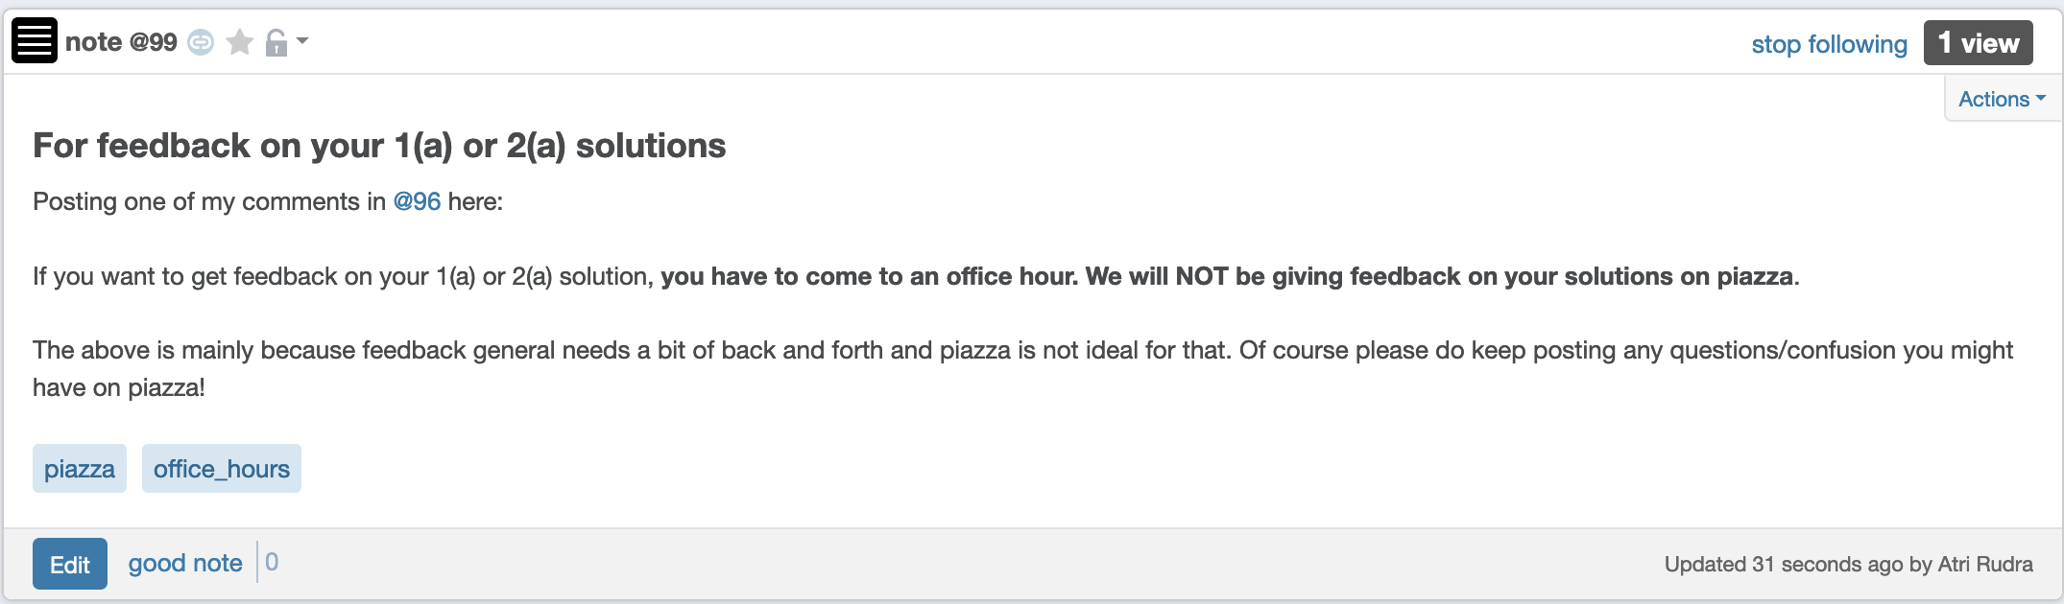
Feedback on 1(a)/2(a) solutions

Slide 9
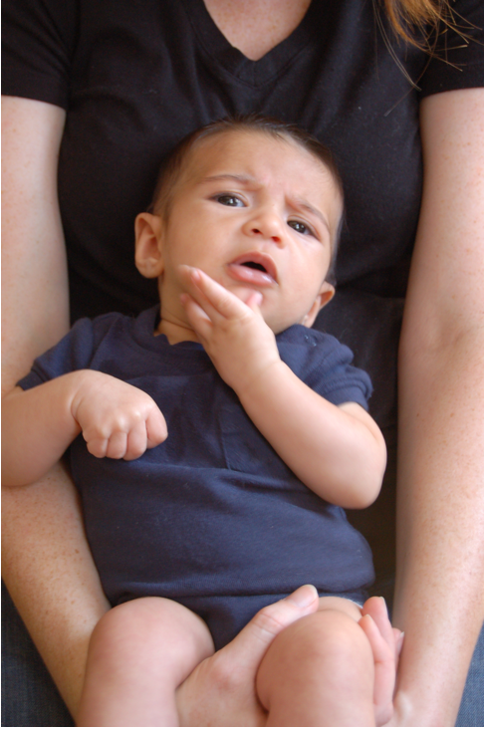
Questions/Comments?

Slide 10
Gale-Shapley Algorithm
Intially all men and women are free
While there exists a free woman who can propose
Let w be such a woman and m be the best man she has not proposed to
w proposes to m
If m is free
(m,w) get engaged
Else (m,w’) are engaged
If m prefers w’ to w
w remains free
Else
(m,w) get engaged and w’ is free
Output the engaged pairs as the final output

Slide 11
The Lemmas
Lemma 1: The GS algorithm has at most n² iterations
Lemma 2: S is a perfect matching
Lemma 3: S has no instability

Slide 12
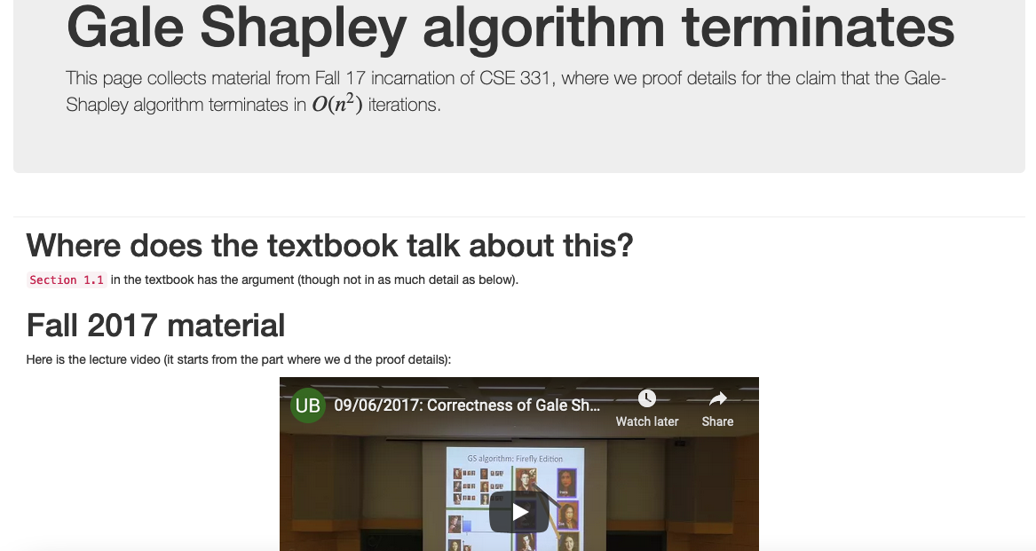
Proof Details of Lemma 1

Slide 13
Questions/Comments?

Slide 14

Proof technique de jour
Proof by contradiction
Assume the negation of what you want to prove
After some reasoning
Source: 4simpsons.wordpress.com

Slide 15
Two obervations
Obs 1: Once m is engaged he keeps getting
engaged to “better” women
Obs 2: If w proposes to m’ first and then to m
(or never proposes to m) then she
prefers m’ to m

Slide 16
Proof of Lemma 3
By contradiction
w’ last proposed to m’
Assume there is an instability (m,w’)
m prefers w’ to w
m
w
w’ prefers m to m’
m’
w’

Slide 17




Contradiction by Case Analysis
Depending on whether w’ had proposed to m or not
Case 1: w’ never proposed to m
w’ prefers m’ to m
By Obs 2
m
Assumed w’ prefers m to m’
w’
Source: 4simpsons.wordpress.com

Slide 18


Case 2: w’ had proposed to m
w’
Case 2.1: m had accepted w’ proposal
m is finally engaged to w
m
Thus, m prefers w to w’
4simpsons.wordpress.com
By Obs 1
Case 2.2: m had rejected w’ proposal
m was engaged to w’’ (prefers w’’ to w’)
By Algo def
m is finally engaged to w (prefers w to w’’)
By Obs 1
m prefers w to w’
4simpsons.wordpress.com

Slide 19
Overall structure of case analysis
Did w’ propose to m?
Did m accept w’ proposal?
4simpsons.wordpress.com
4simpsons.wordpress.com
4simpsons.wordpress.com

Slide 20
Questions?

Slide 21
Extensions
Fairness of the GS algorithm
Different executions of the GS algorithm

Slide 22

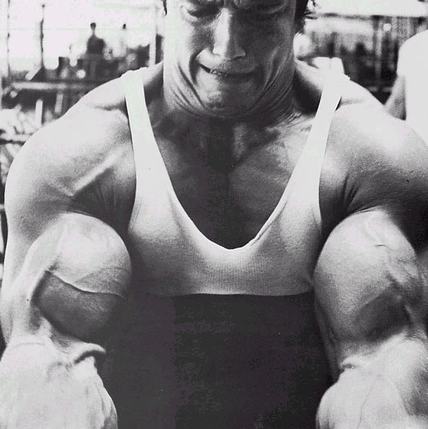
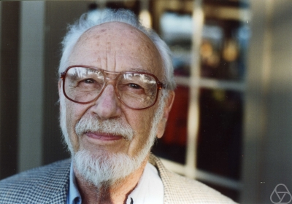
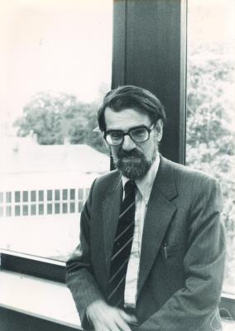

Main Steps in Algorithm Design
Problem Statement
Problem Definition
Algorithm
n!
“Implementation”
Analysis
Correctness Analysis

Slide 23



Definition of Efficiency
An algorithm is efficient if, when implemented, it runs quickly on real instances
Implemented where?
Platform independent definition
What are real instances?
Worst-case Inputs
N = 2n² for SMP
Efficient in terms of what?
Input size N

Slide 24
Definition-II
Analytically better than brute force
n!
How much better? By a factor of 2?

Slide 25
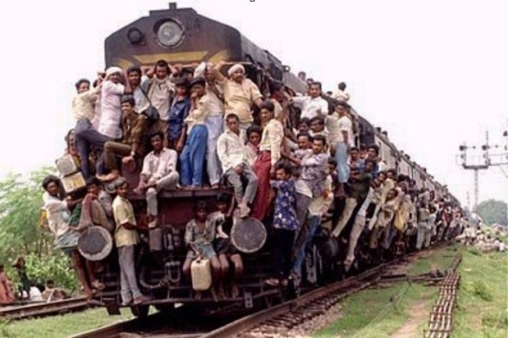
Definition-III
Should scale with input size
If N increases by a constant factor,
so should the measure
Polynomial running time
At most c.N^{d} steps (c>0, d>0 absolute constants)
Step: “primitive computational step”

Slide 26
More on polynomial time
Problem centric tractability
Can talk about problems that are not efficient!

Slide 27
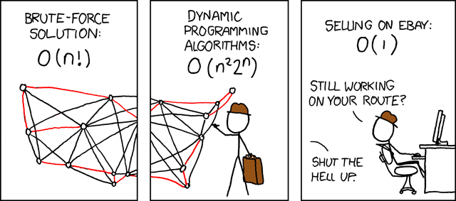
Asymptotic Analysis
Travelling Salesman Problem
(http://xkcd.com/399/)

Slide 28
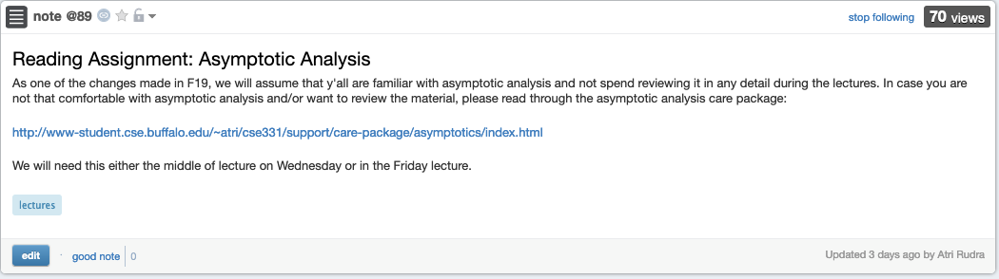
Reading Assignment for today

Slide 29
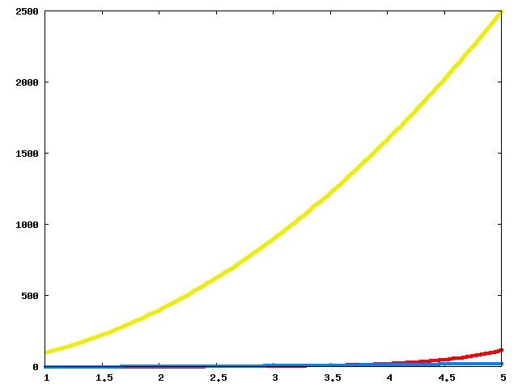
Which one is better?

Slide 30
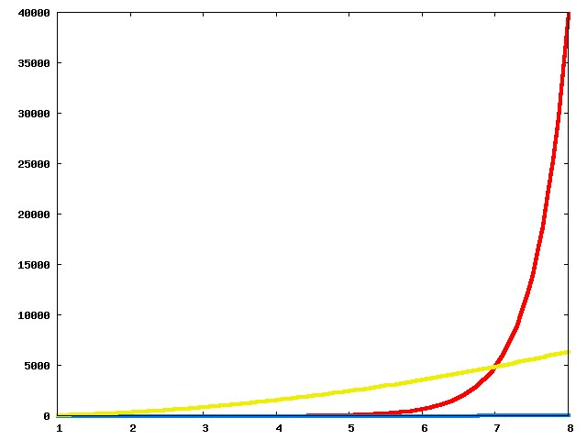
Now?

Slide 31
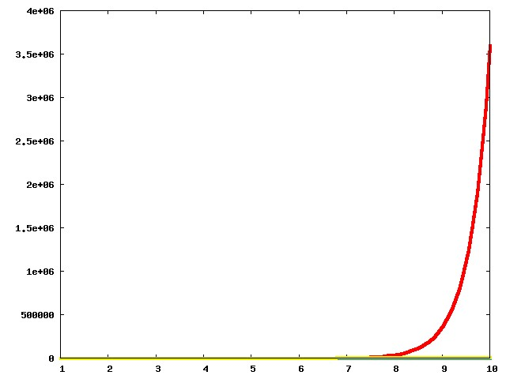
And now?

Slide 32
The actual run times
n!
100n²
Asymptotic View
n²

Slide 33
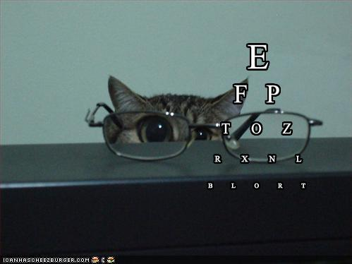
Asymptotic Notation
≤ is O with glasses
≥ is Ω with glasses
= is Θ with glasses

Slide 34
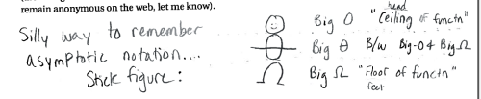
Another view
© Aleksandra Patrzalek, 2012

Slide 35
g(n) is O(f(n))
c*f(n) for some c>0
g(n)
n
n₀

Slide 36
g(n) is Ω(f(n))
g(n)
ε*f(n) for some ε>0
n
n₁

Slide 37
g(n) is Θ(f(n))
g(n)
ε*f(n) for some ε>0
n
n₁

Slide 38
Properties of O (and Ω)
Transitive
g is O(f) and f is O(h) then
g is O(h)
Step 1 // O(n) time
Step 2 // O(n) time
Additive
g is O(h) and f is O(h) then
g+f is O(h)
Overall: O(n) time
Multiplicative
g is O(h₁) and f is O(h₂) then
g*f is O(h₁*h₂)
Overall: O(n²) time
While (loop condition) // O(n²) iterations
Stuff happens // O(1) time

