Slide 1
Lecture 9
CSE 331
Sep 19, 2022

Slide 2
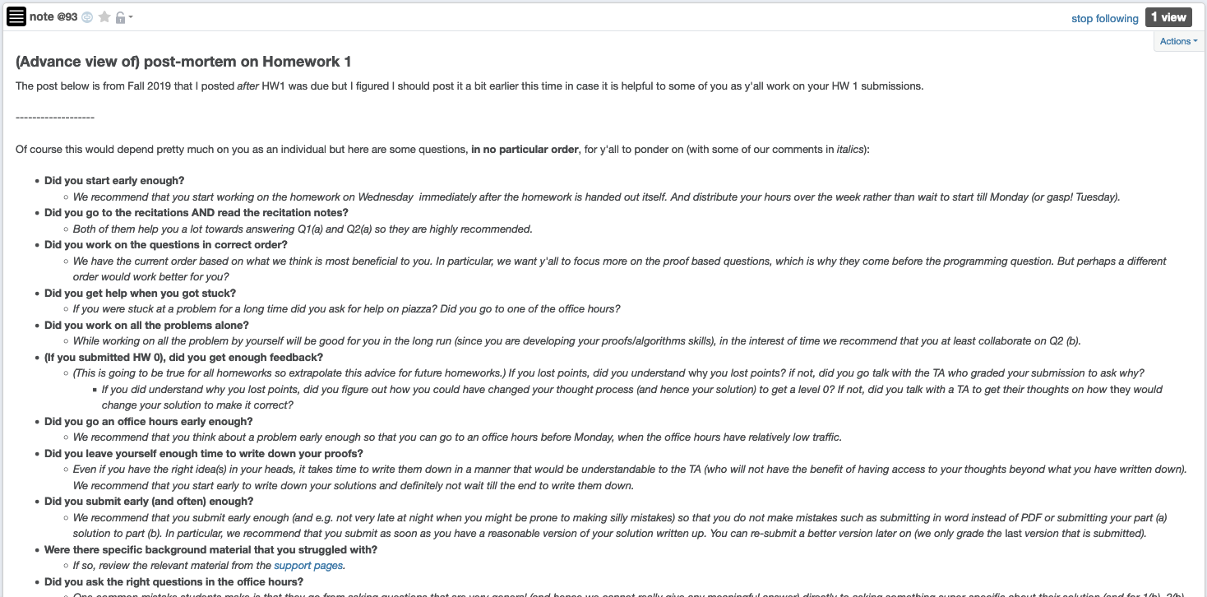
HW 1 (pre)post-mortem

Slide 3
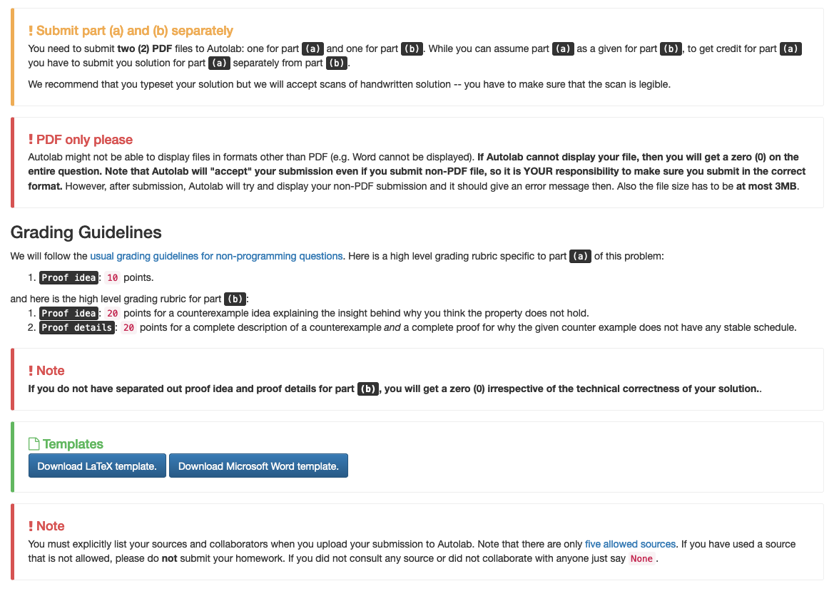
Follow ALL instructions on HW1

Slide 4
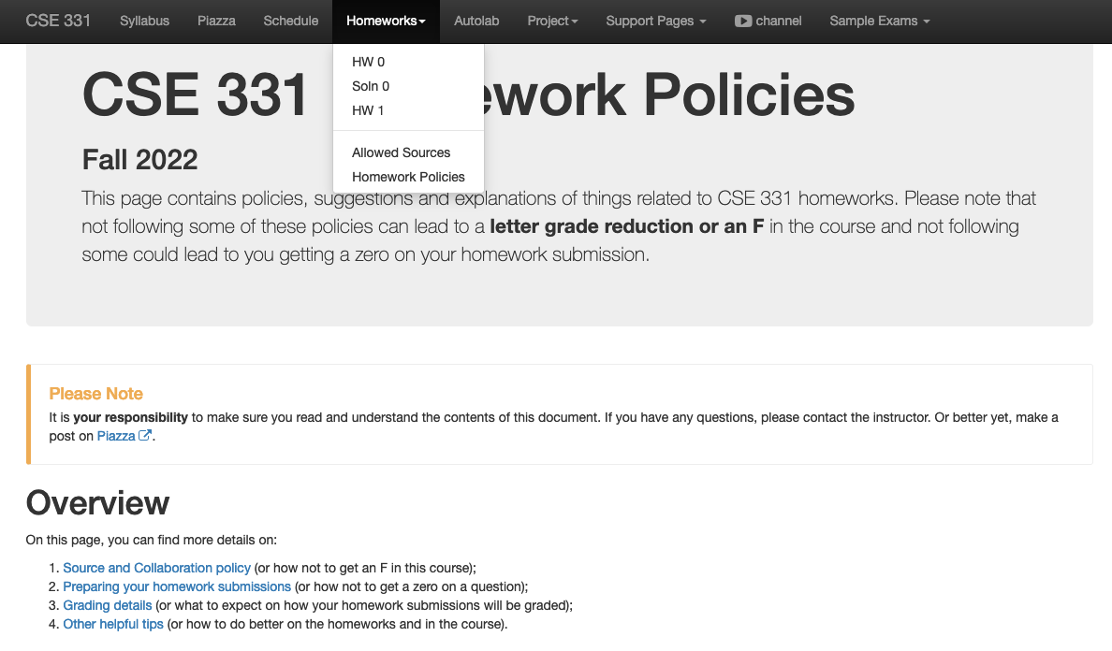
Review the HW policy doc!

Slide 5
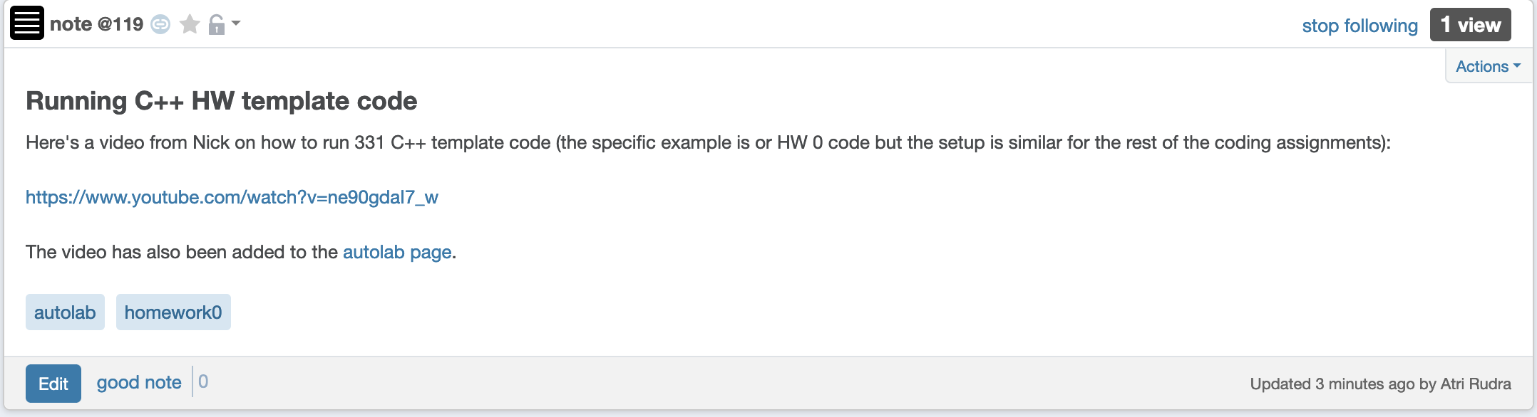
Running C++ template on Linux

Slide 6
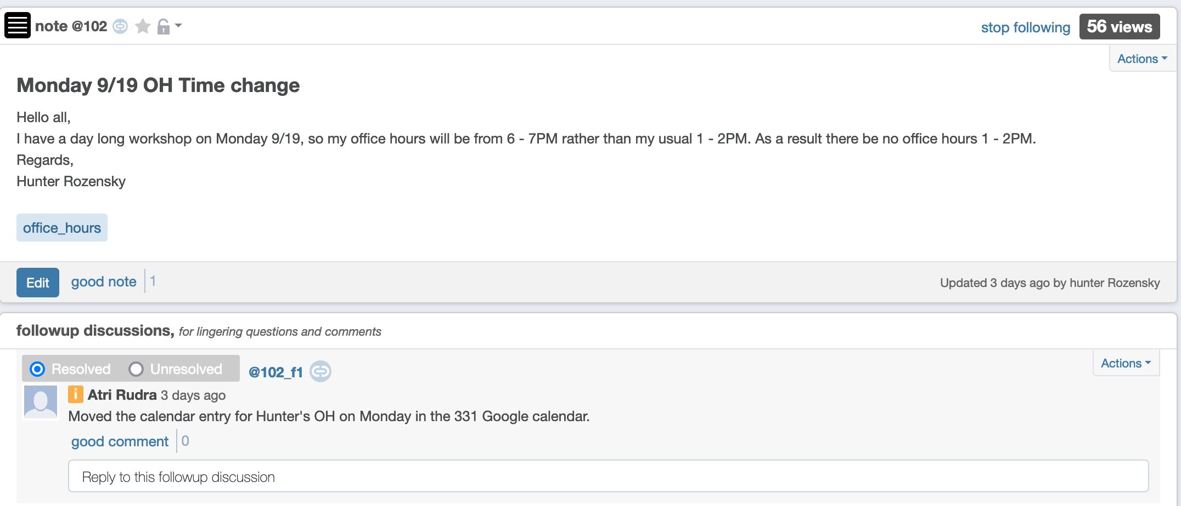
Hunter’s OH today at 6pm

Slide 7

If you need it, ask for help

Slide 8
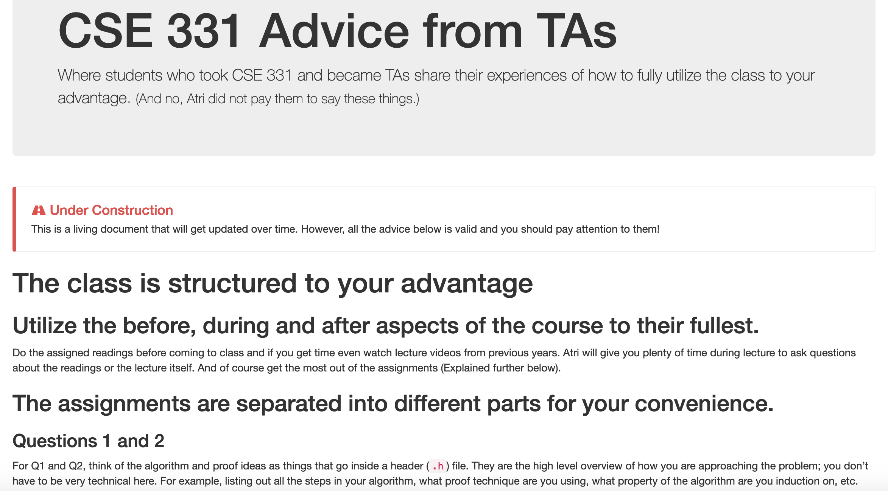
Advice from TAs

Slide 9
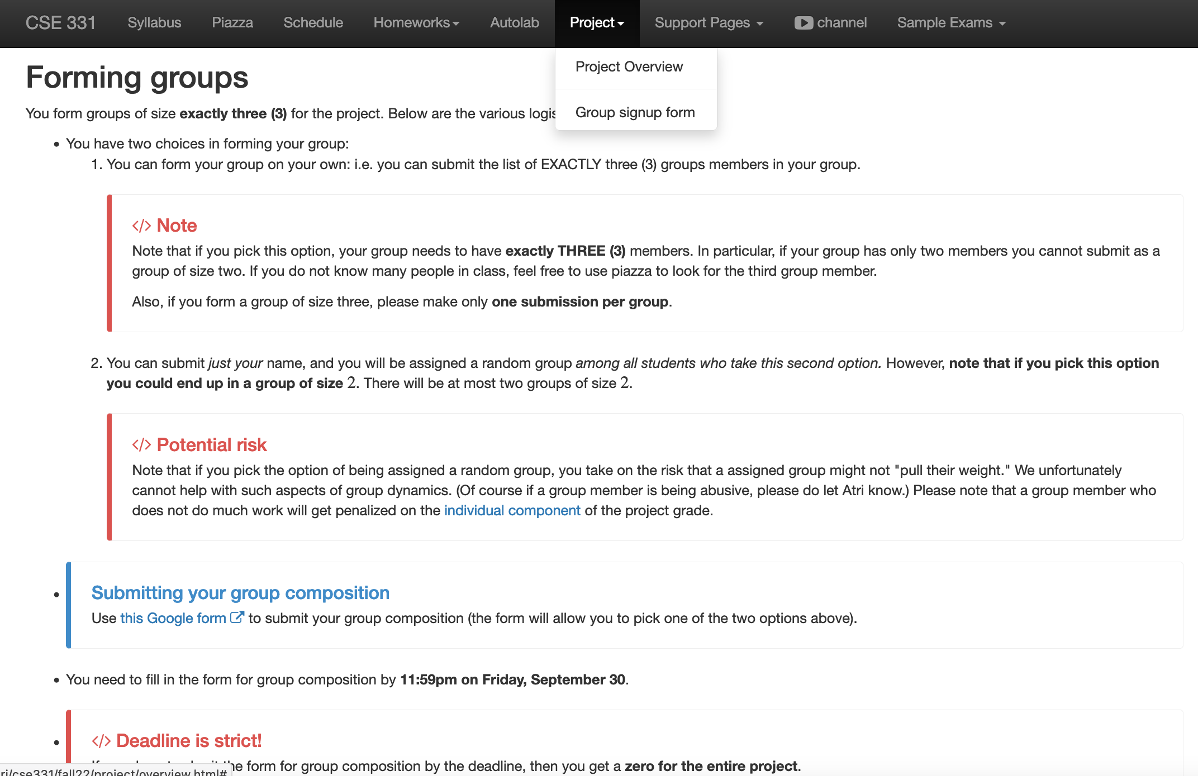
Register your project groups
Deadline: Friday, Sep 30, 11:59pm

Slide 10
Your UBIT ID is
xyz if your email ID is xyz@buffalo.edu
NOT
xyz@buffalo.edu
Your UB person number

Slide 11
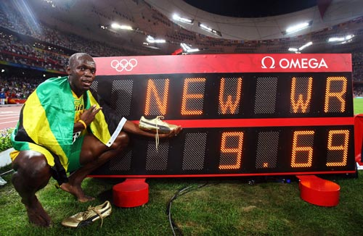
Today’s agenda
O(n²) implementation of the Gale-Shapley algorithm
Some practice with run time analysis

Slide 12
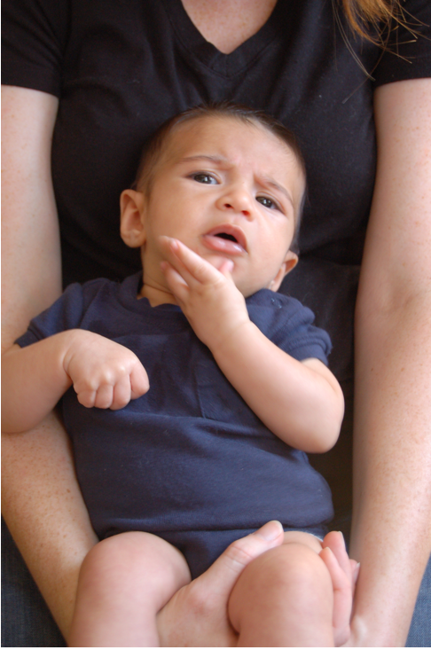
Questions?

Slide 13
g(n) is O(f(n))
c*f(n) for some c>0
g(n)
n
n₀

Slide 14
Properties of O (and Ω)
Transitive
g is O(f) and f is O(h) then
g is O(h)
Step 1 // O(n) time
Step 2 // O(n) time
Additive
g is O(h) and f is O(h) then
g+f is O(h)
Overall: O(n) time
Multiplicative
g is O(h₁) and f is O(h₂) then
g*f is O(h₁*h₂)
Overall: O(n²) time
While (loop condition) // O(n²) iterations
Stuff happens // O(1) time

Slide 15
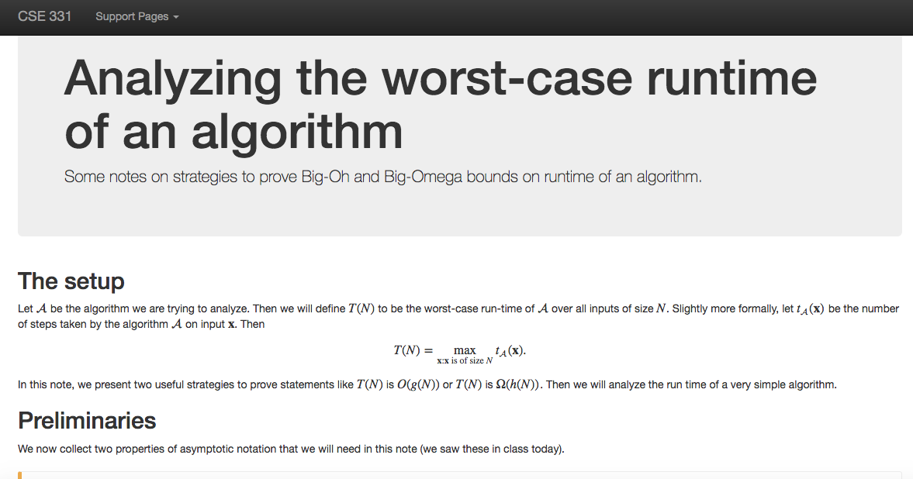
Another Reading Assignment

Slide 16
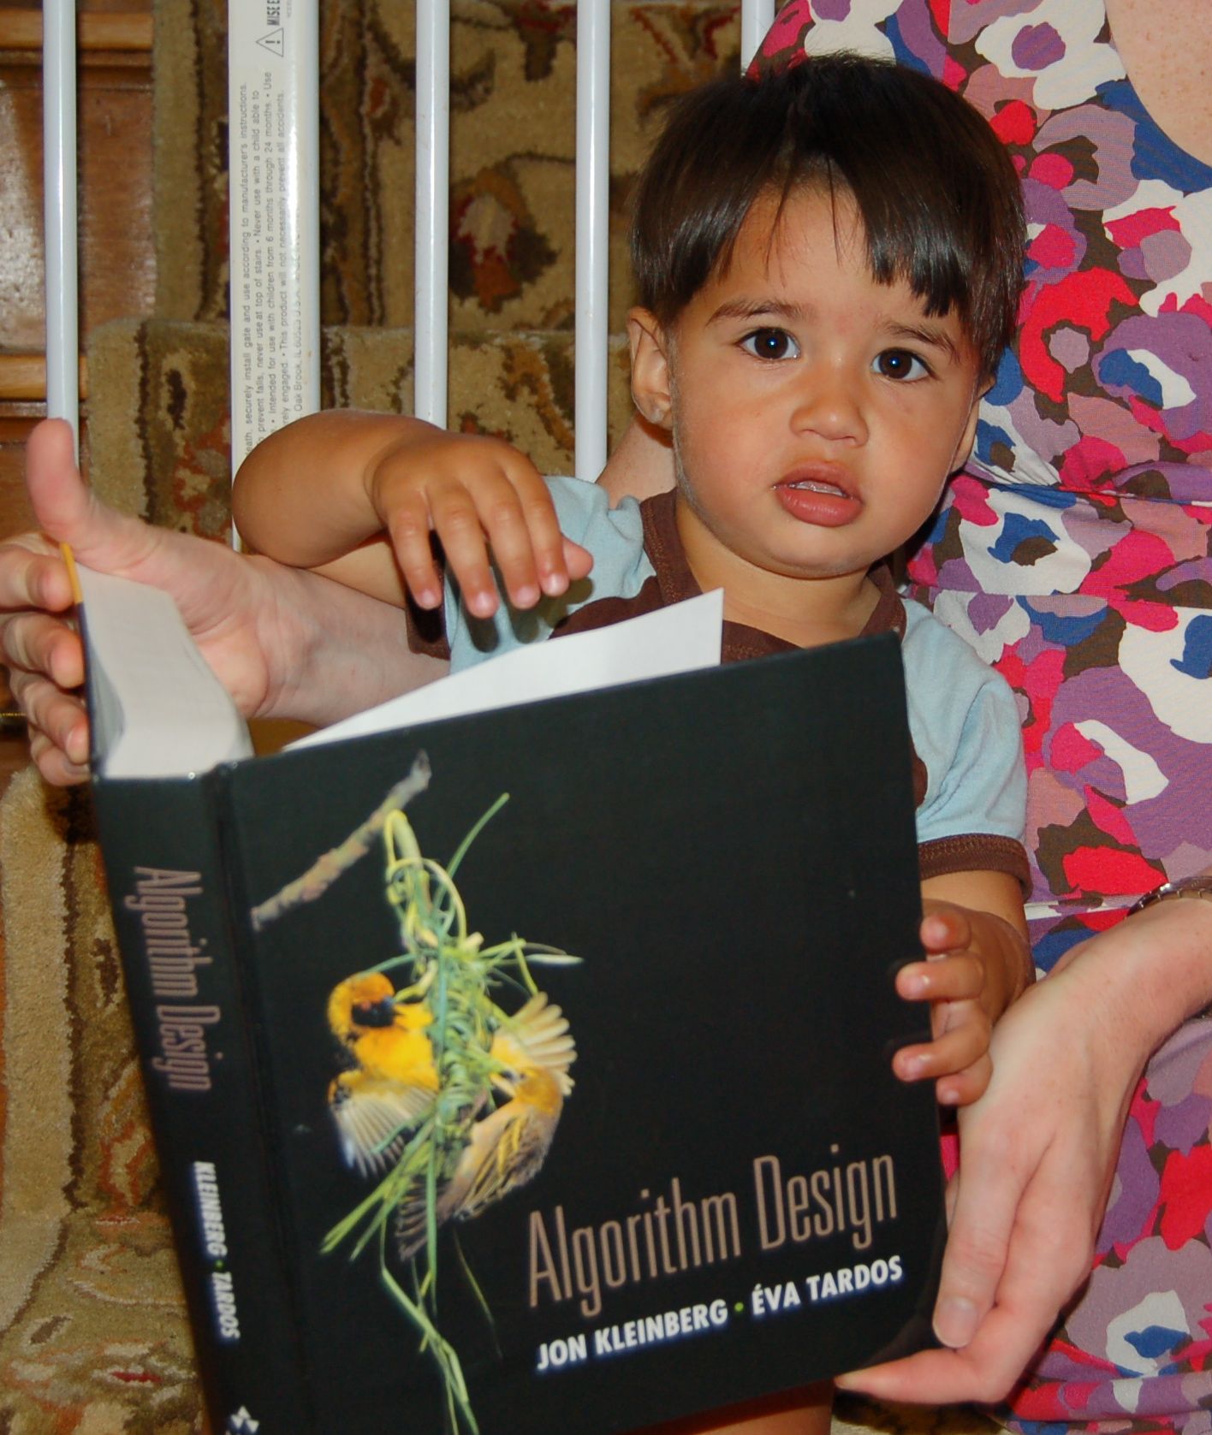
Reading Assignments
Sections 1.1, 1.2, 2.1, 2.2 and 2.4 in [KT]

Slide 17
Gale-Shapley Algorithm
At most n² iterations
Intially all men and women are free
While there exists a free woman who can propose
Let w be such a woman and m be the best man she has not proposed to
w proposes to m
O(1) time implementation
If m is free
(m,w) get engaged
Else (m,w’) are engaged
If m prefers w’ to w
w remains free
Else
(m,w) get engaged and w’ is free
Output the engaged pairs as the final output

Slide 18
Implementation Steps
(0) How to represent the input?
(1) How do we find a free woman w?
(2) How would w pick her best unproposed man m?
(3) How do we know who m is engaged to?
(4) How do we decide if m prefers w’ to w?

Slide 19
Overall running time
Init(1-4)
n² X ( Query/Update(1-4) )

Slide 20
Questions?

Slide 21
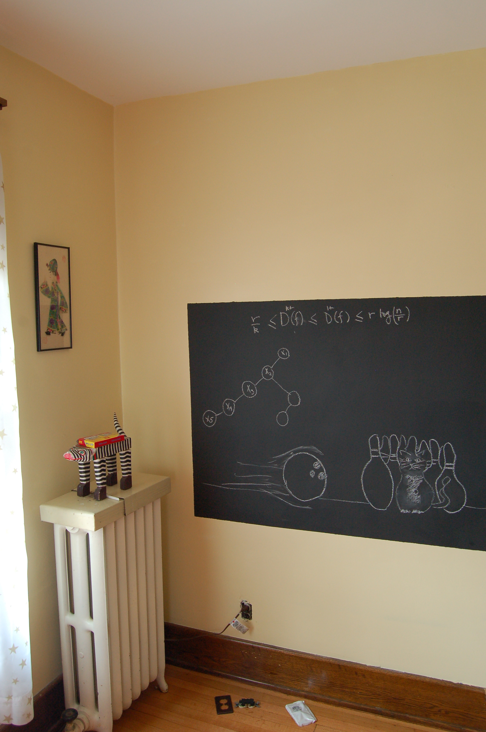
Rest on the board…

