Slide 1
Syllabus Walkthrough
CSE 331
Aug 26, 2023

Slide 2
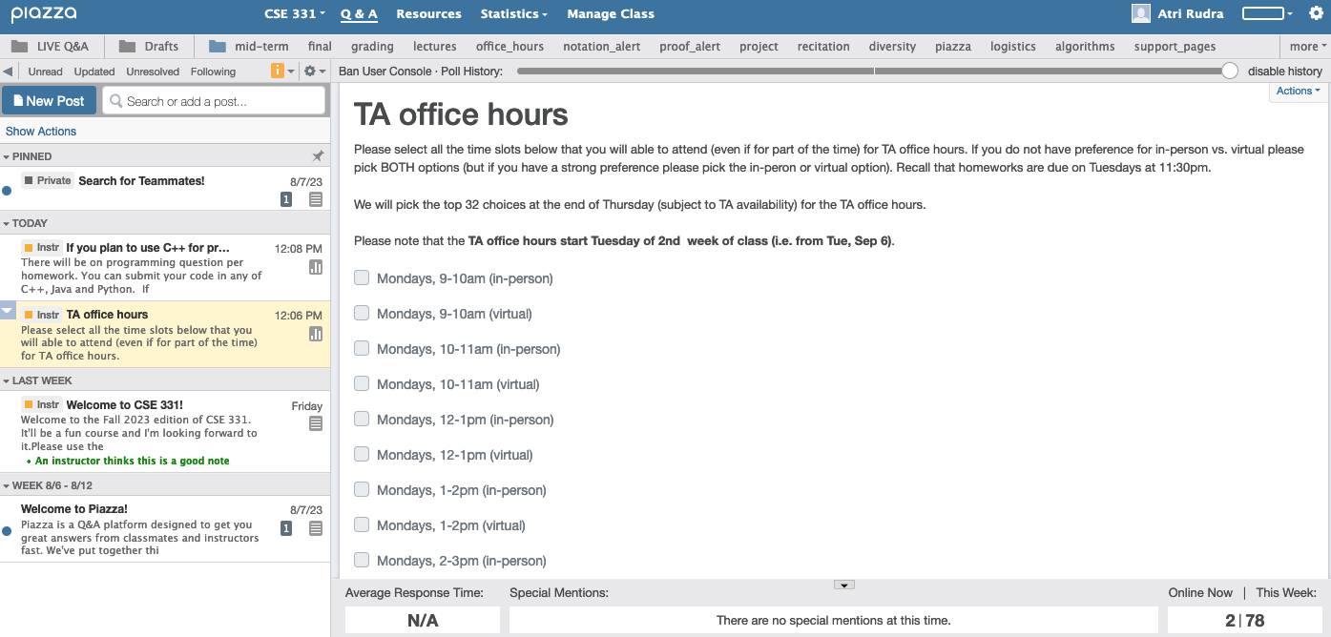
Make sure you are on Piazza
https://piazza.com/buffalo/fall2023/cse331/

Slide 3
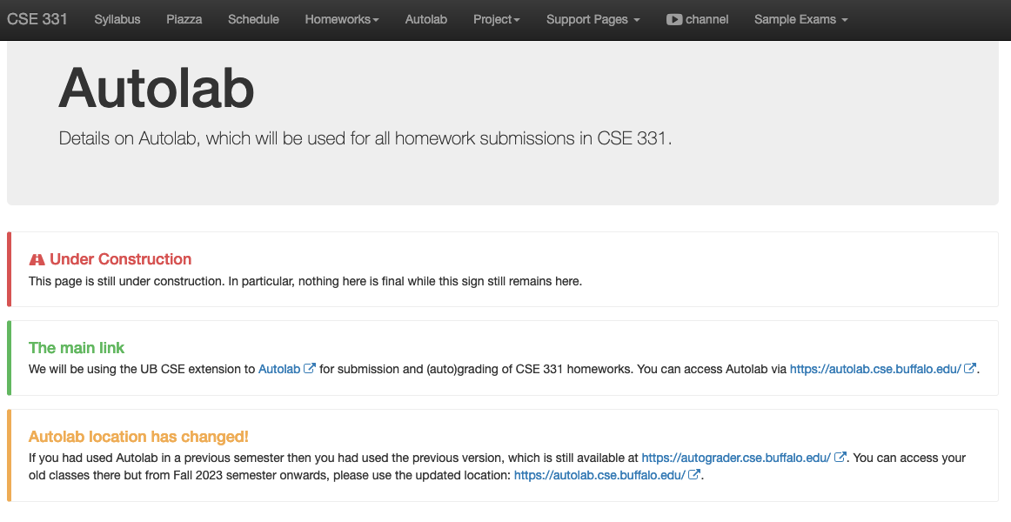
Access to Autolab

Slide 4
Academic Dishonesty
All your submissions must be your own work
Penalty:
  Minimum: A grade reduction in course
  Possible: F (or higher penalty) if warranted
YOUR responsibility to know what is cheating, plagiarism etc.
  If not sure, come talk to me
Excuses like “I have a job,” “This was OK earlier/in my country,” “This course is hard,” etc. WON’T WORK
I DO NOT HAVE ANY PATIENCE WITH ANY CHEATING :
YOU WILL GET A GRADE REDUCTION IN THE COURSE
FOR YOUR FIRST MISTAKE

Slide 5
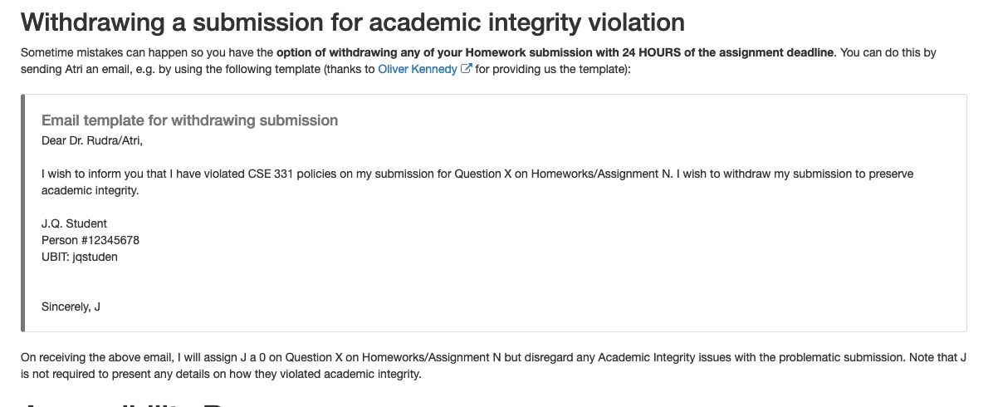
Withdrawing a suspect submission

Slide 6

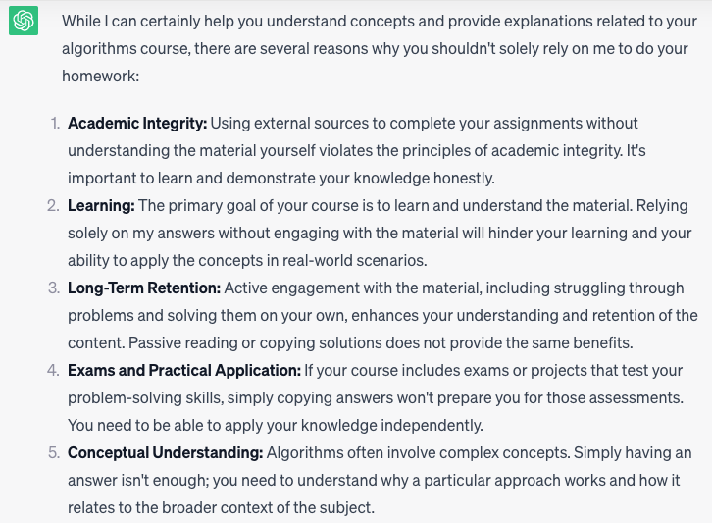
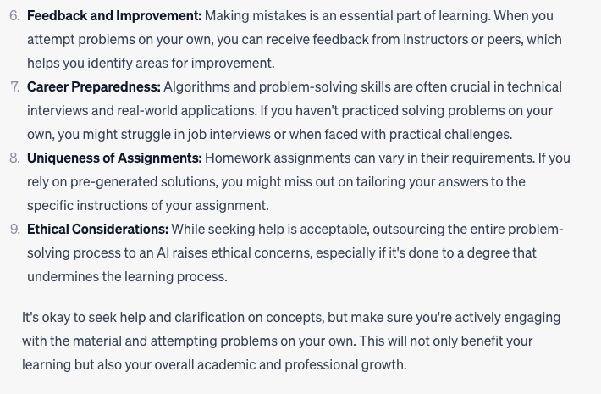
Use of ChatGPT is not allowed

Slide 7
In spirit of trust but verify
TAs will have access to a database of ChatGPT answers to cross check
It’s no fun failing any of you but use of ChatGPT will result in an F

Slide 8
Use of ChatGPT is not allowed

Slide 9
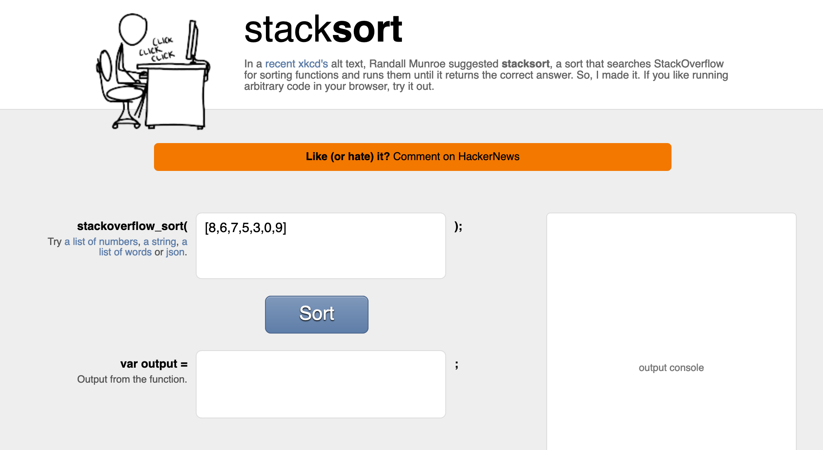
Coding jobs will be done by AI

Slide 10
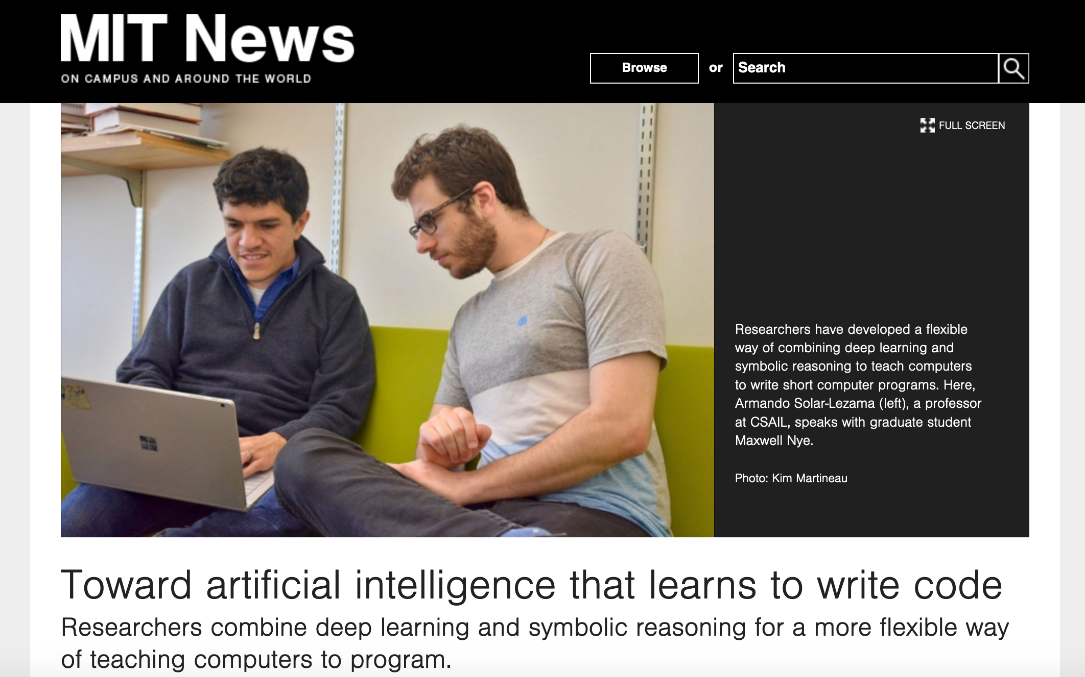
Coding jobs will be done by AI

Slide 11
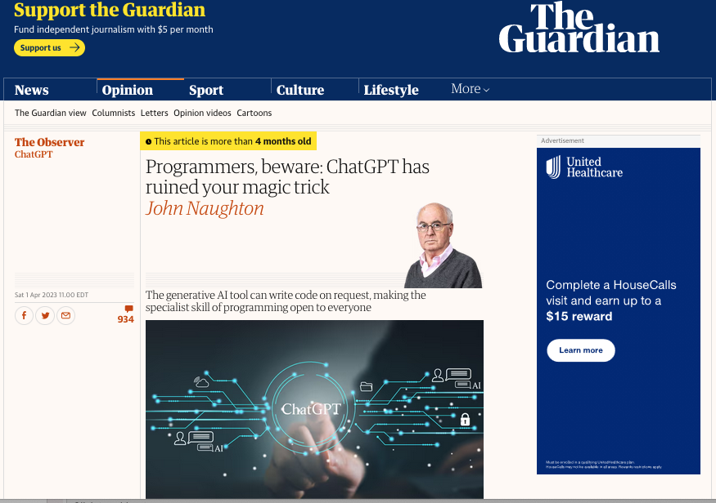
It happened sooner than expected

Slide 12
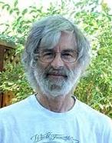

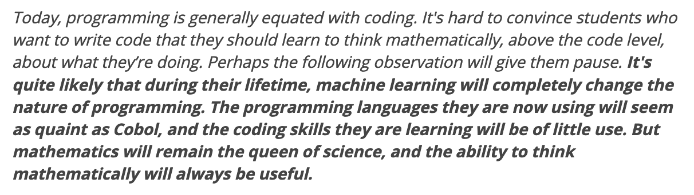
So am I doomed?
There will still be room for high level algorithmic thinking!

Slide 13
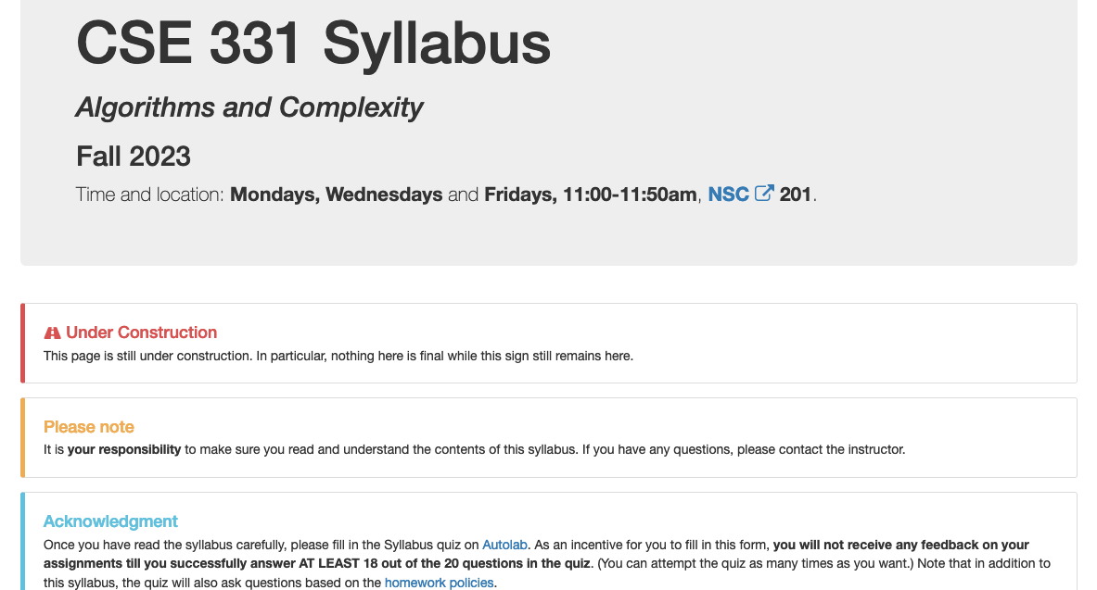
Read the syllabus CAREFULLY!

Slide 14
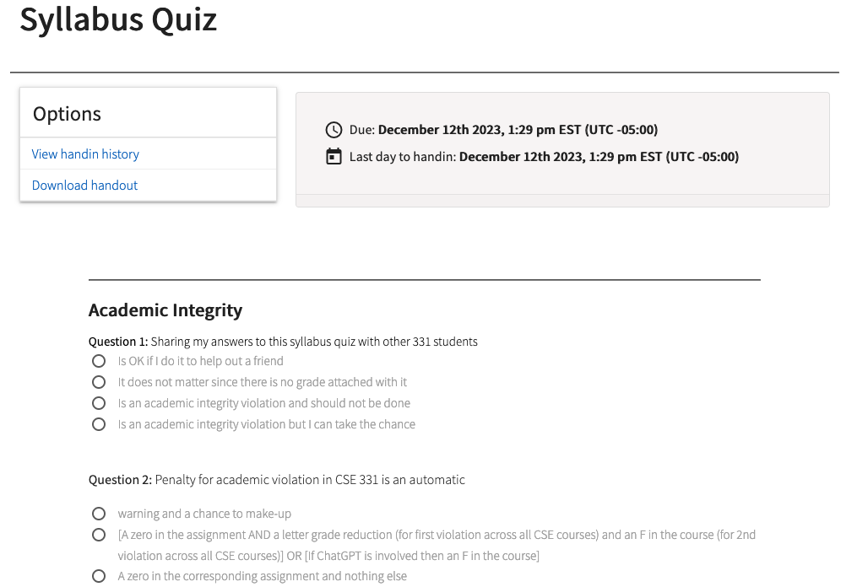
In spirit of trust but verify
No graded material will be handed back until you pass the syllabus quiz!

Slide 15
Accessibility Resources
Information included in the syllabus
In short, let me know and consult with Accessibility Resources

Slide 16
Preferred Name
If you prefer using name diff from UB records
Let me know and we’ll make a note of it.

Slide 17
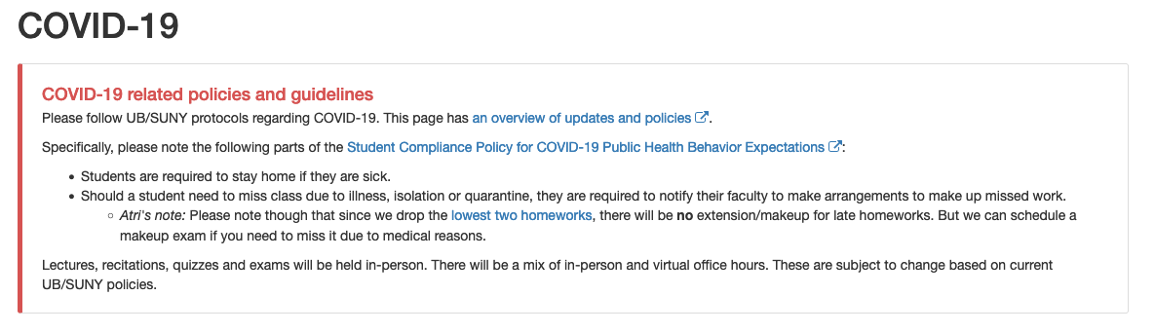
Please follow COVID-19 policies

Slide 18

Lectures will be videotaped
http://www.imdb.com/title/tt0363510/mediaviewer/rm2499681792

Slide 19
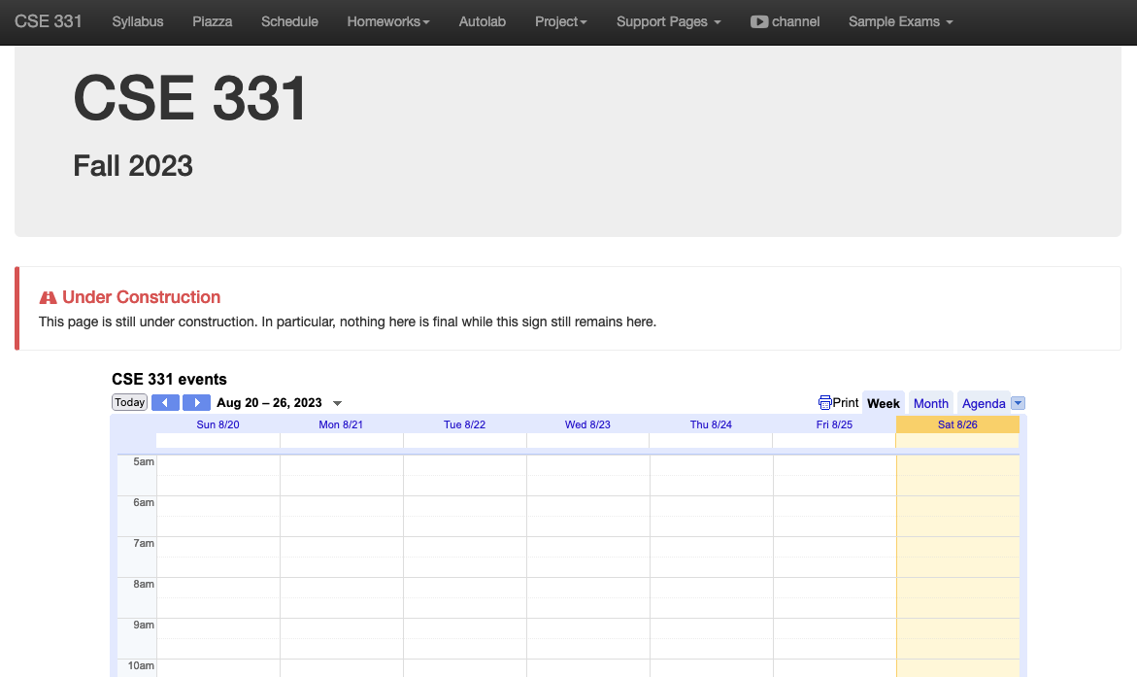
One Stop Shop for the Course
http://www-student.cse.buffalo.edu/~atri/cse331/fall23/index.html

Slide 20
Three things to remember
WORK HARD!
DO NOT CHEAT!
READ CAREFULLY!

Slide 21
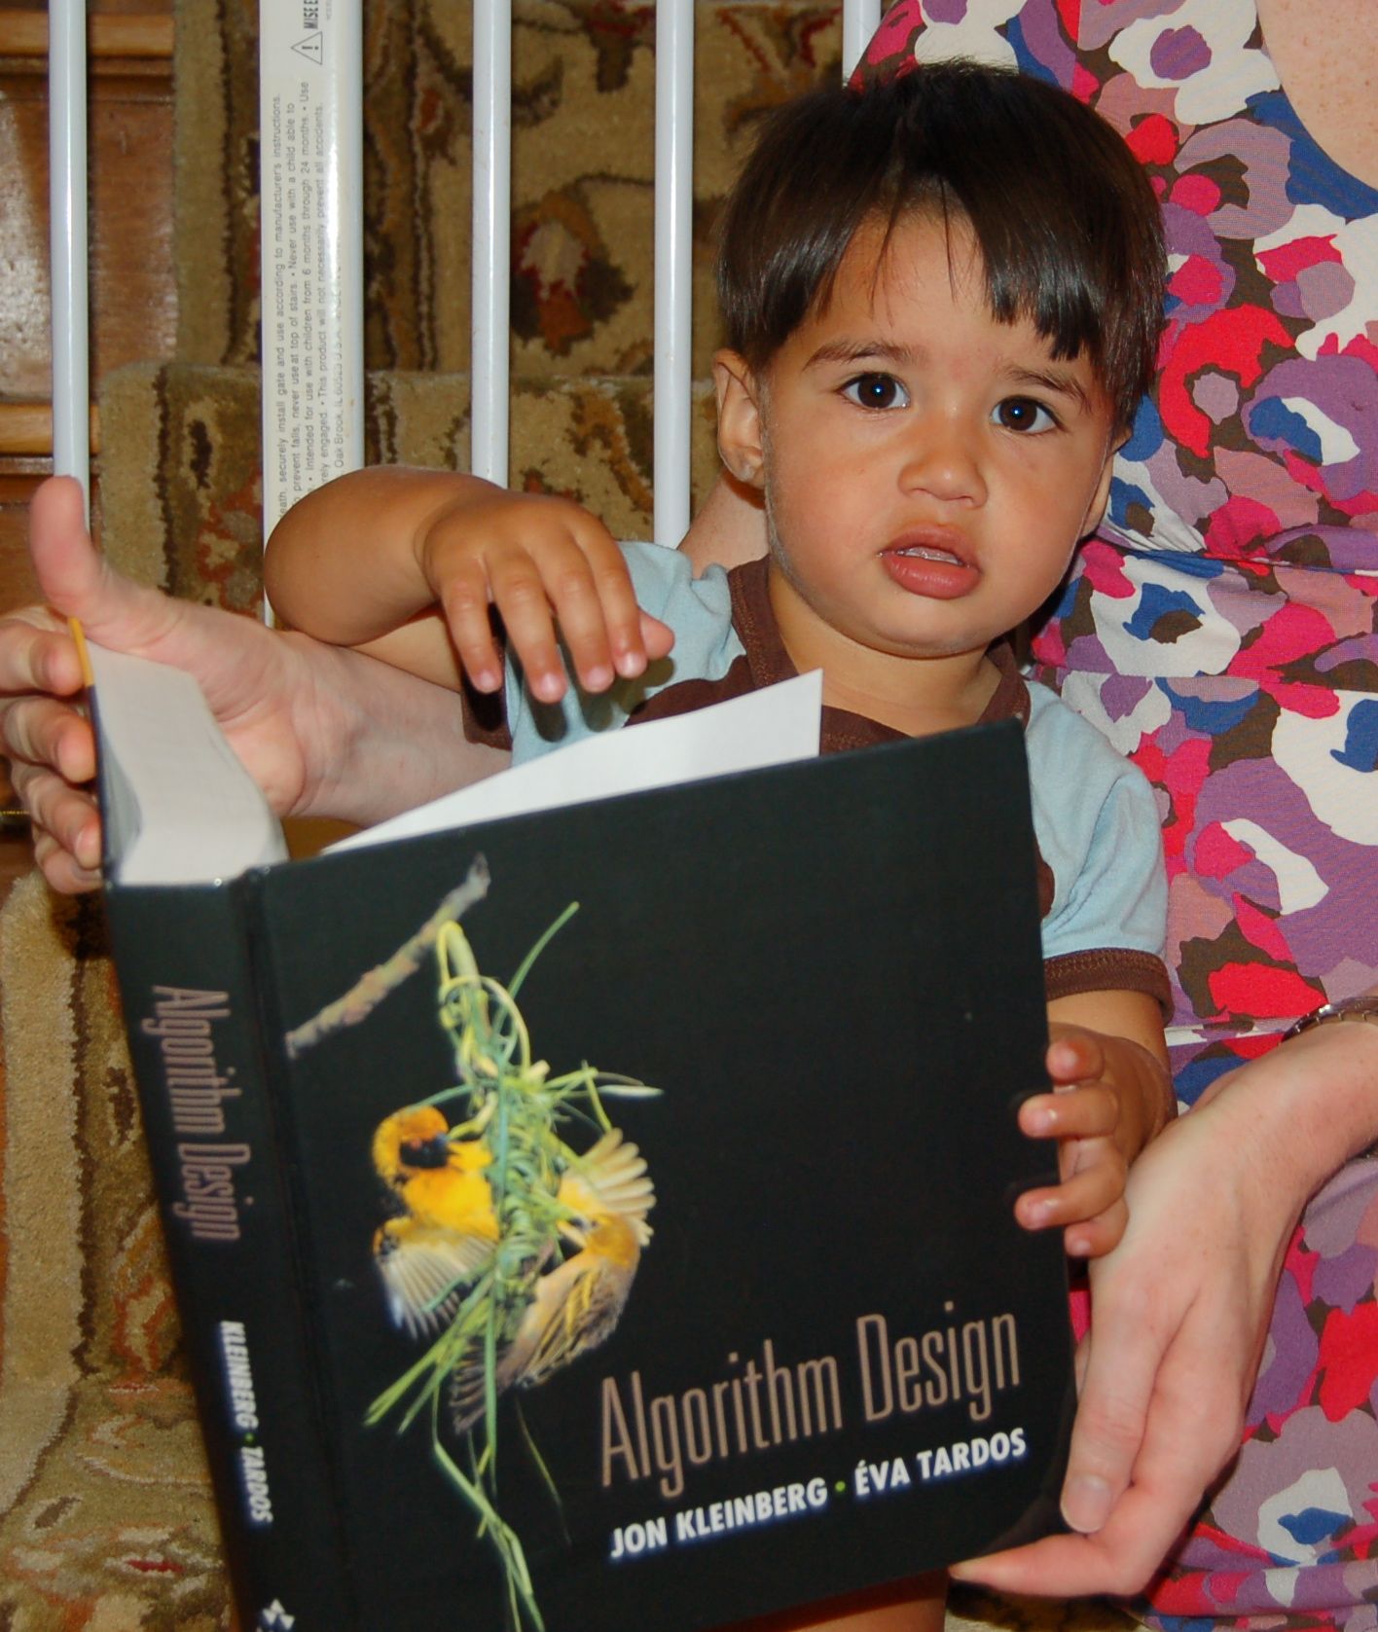
Wait.. What???
Make sure you follow submission
instructions
Two most common ways of losing points
Make sure you read problem
statements carefully

Slide 22
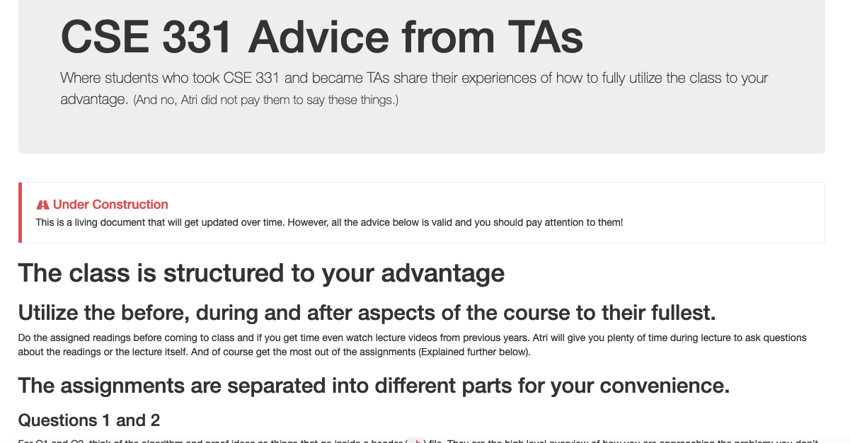
Advice from 331 TAs
http://www-student.cse.buffalo.edu/~atri/cse331/support/advice/index.html

Slide 23
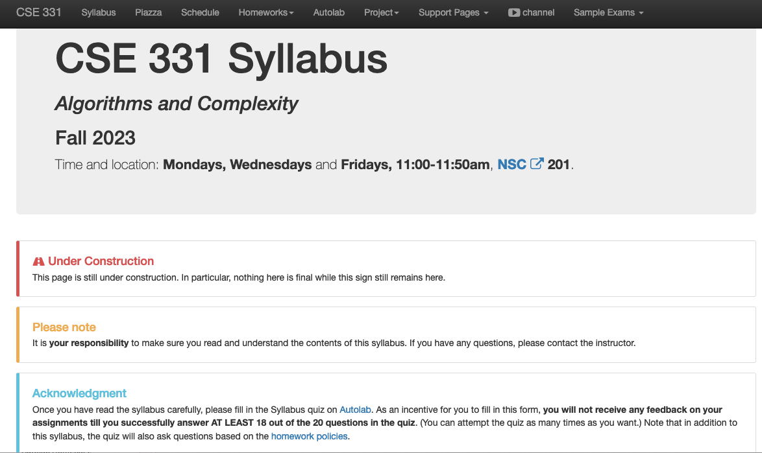
More information on the quiz

Slide 24
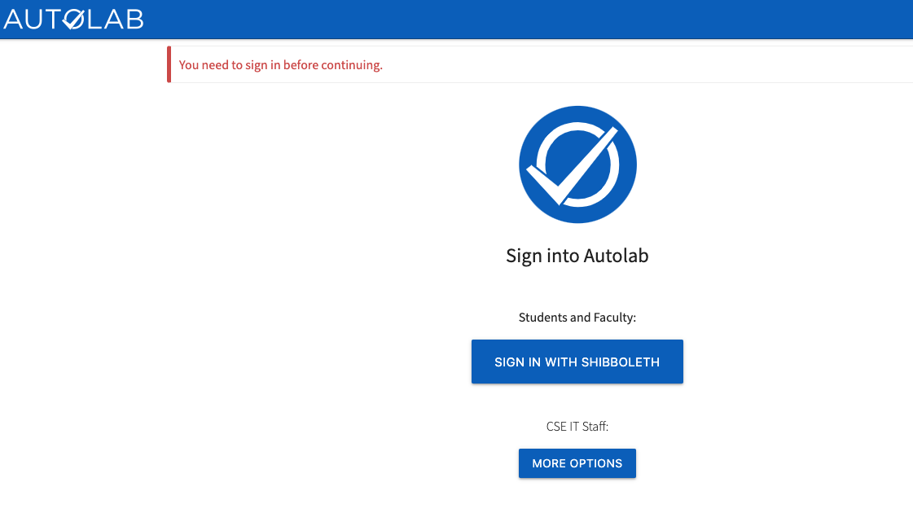
Autolab
https://autolab.cse.buffalo.edu/

Slide 25
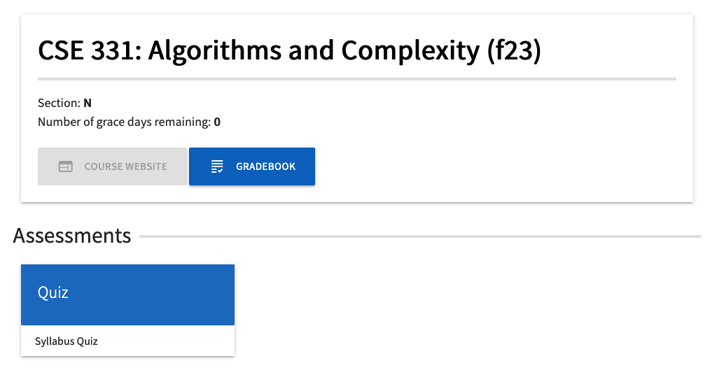
You can submit the following now
If you were registered by 10pm on Friday, Aug 18 you should be on Autolab

Slide 26
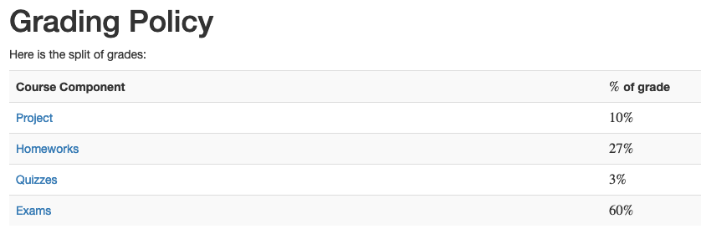
Grading break-down
Changes from Fall 2022
HWs are worth (a bit) less and exams are worth (a bit) more
Quiz scores can only be replaced with score on T/F Qs on final exam

Slide 27
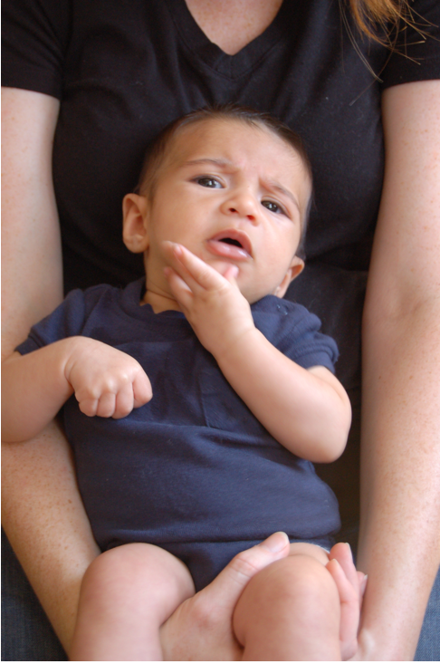
Questions/Comments?

Slide 28
Pre-requisites
Required (officially)
  CSE 250, [CSE 191 or MTH 311] and MTH 142
  At least a C- (this is recommended)
Required (for practical purposes)
  Comfort with proofs
  Willingness to work hard!

Slide 29
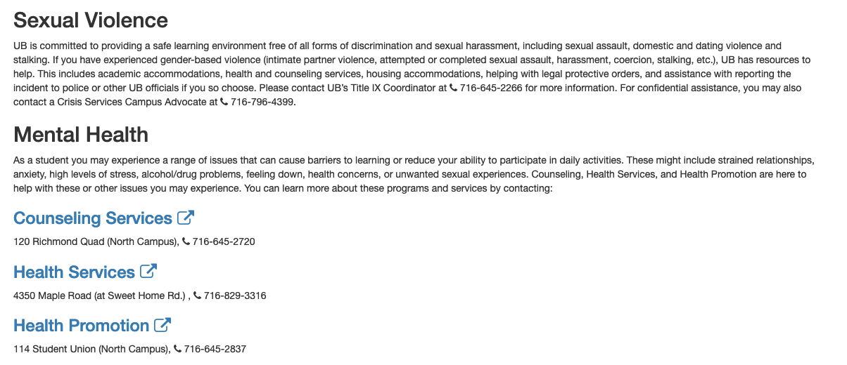
Critical Campus Resources

Slide 30
TA Office hours
YOU decide!

Slide 31
Recitations
Are on for this week!
RECITATIONS

Slide 32
Please stick to your recitation section
At least for the first month since all sections are full

Slide 33
Exams
Mid term (two parts)
  Wed, Oct 18 and Fri, Oct 20. Usual place and time.
Final exam
  Wed, Dec 13. NSC 201, 12:00-2:30pm

Slide 34
The HW structure
DROP lowest TWO Q1, Q2, Q3 scores
Three questions
Q1 and Q2 are proof based while Q3 is programming
Q1 worth 50 points
The hard proof based Q2 and programming Q3 worth 25 points each
HWs due by 11:30pm on Tuesdays

Slide 35
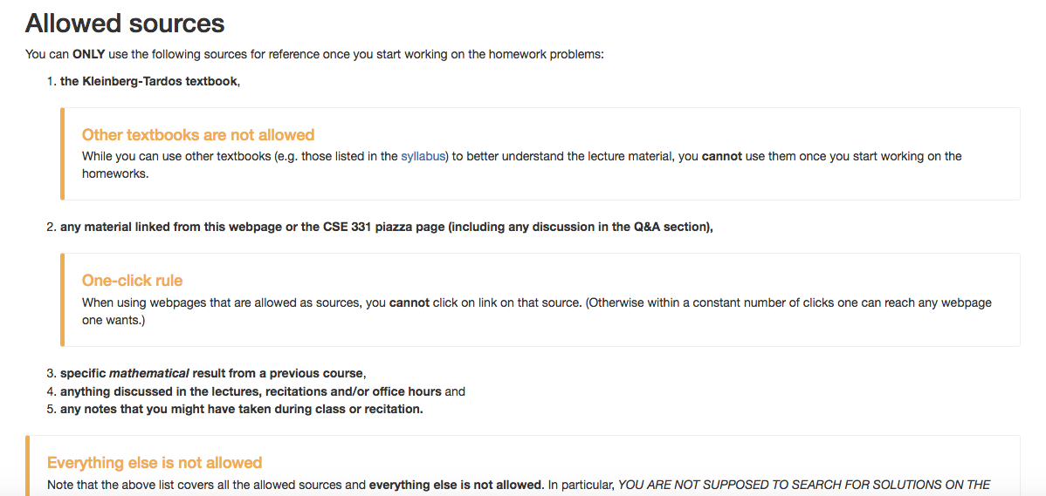
Allowed Sources

Slide 36
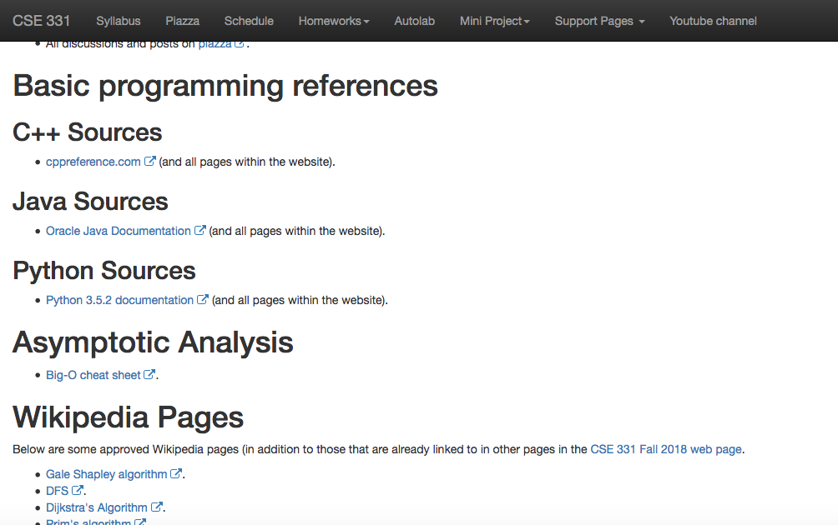
… even for programming Q
http://www-student.cse.buffalo.edu/~atri/cse331/fall18/policies/allowed-sources.html

Slide 37
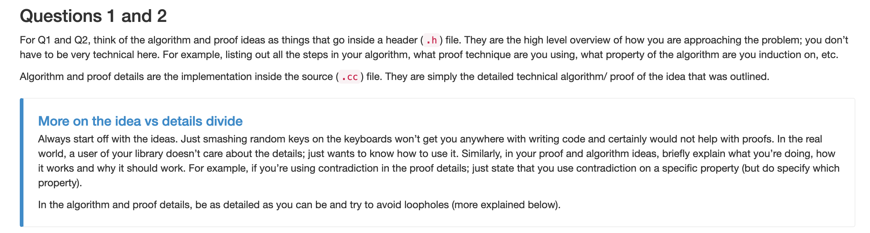
Proof Idea vs. Proof Details

Slide 38
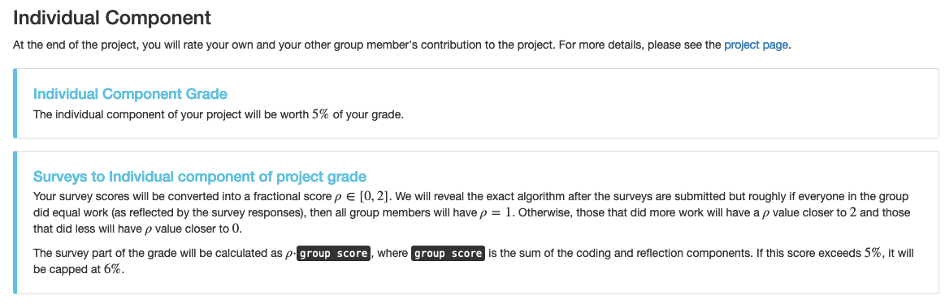
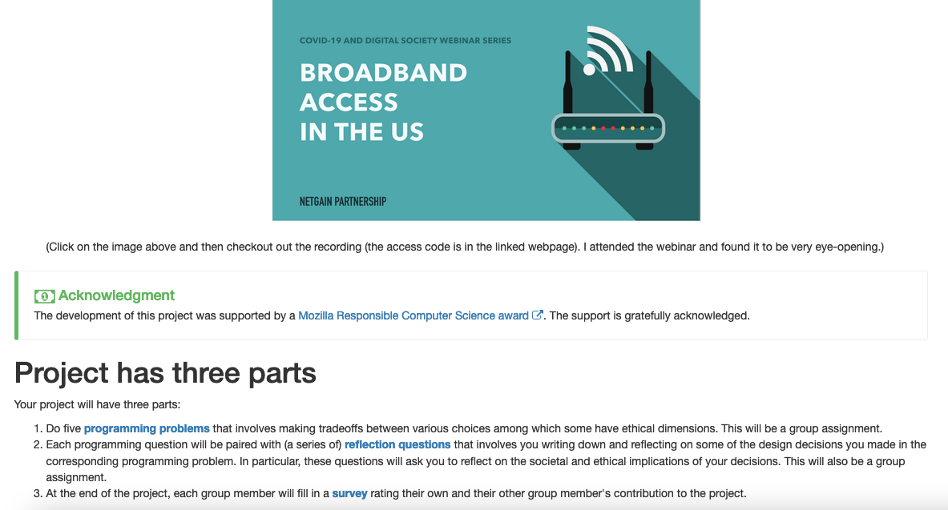
~2 month long project!

Slide 39
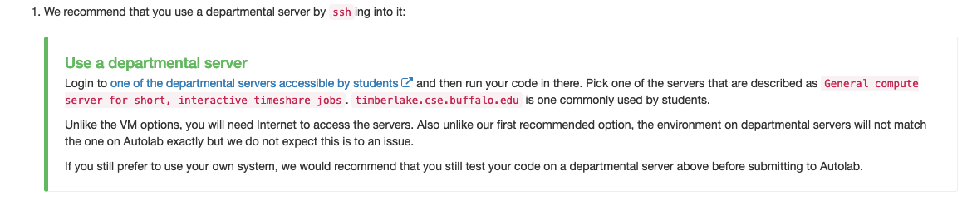
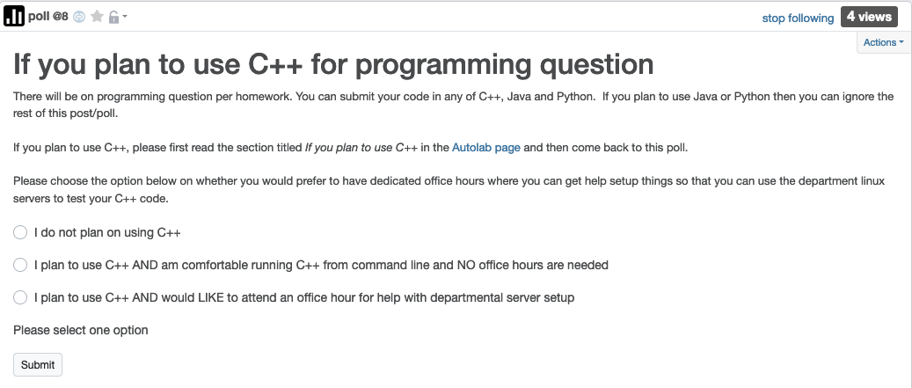
C++ vs Java/Python
Use Java/Python if as you can
There might be a how to use Unix session in week 2

Slide 40
Questions/Comments?

Slide 41

Bit more about the course
IT’LL BE

Slide 42

We’ll do loads of
s
http://www.impawards.com/2005/proof.html
Writing down your thought process formally and precisely!

Slide 43
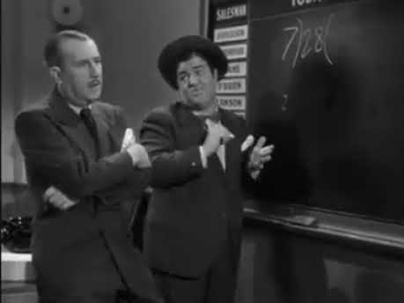
An incorrect “proof”

Slide 44
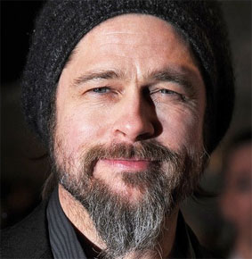
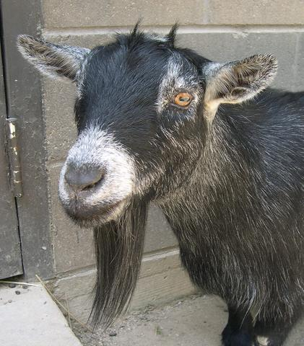
A more subtle incorrect “proof”
Brad Pitt had a beard
waleg.com
Every goat has a beard
animaldiversity.org
Hence, Brad Pitt is a goat.

Slide 45
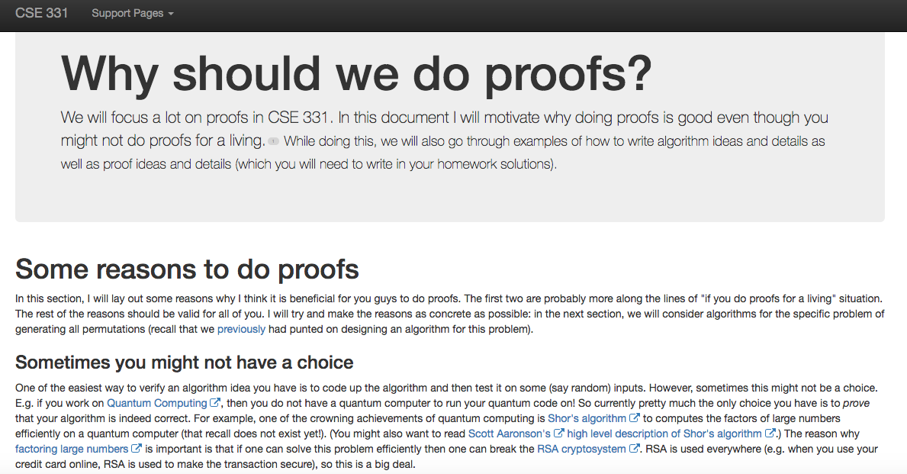
http://www-student.cse.buffalo.edu/~atri/cse331/support/proofs/index.html

Slide 46
A common complaint
Your examples in class look nothing
like HW questions.

Slide 47
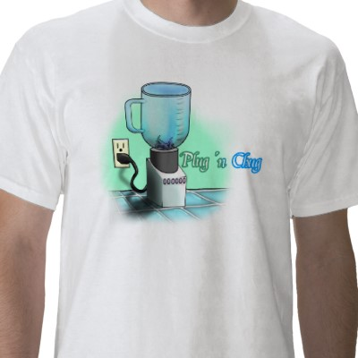
True because….
zazzle.com

Slide 48
False because…
HWs and exams will test your
understanding of the material

Slide 49
To get an A in the class
Have to get at least 90.0000000000000000000000%
Rest graded on the curve

Slide 50
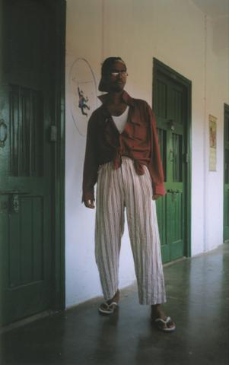
A cautionary tale…
When I was an undergrad
  Took algorithms as a sophomore
Understood all the lectures
Did not study outside of lectures
  (We had no homeworks)
Did decent on the mid-term
Nearly flunked the finals
Got a C

Slide 51
Questions/Comments?

Slide 52

How we will make 331
RIDING

Slide 53
What we’ll strive to do
Help you with your questions and/or doubts
If need be, email us for time outside of regular office hours

Slide 54
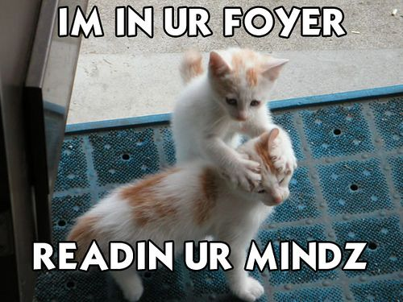
We’re not mind readers

Slide 55
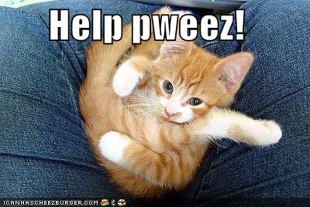
If you need it, ask for help

Slide 56
More chances to recover
Lowest two Q1, Q2 and Q3 HW scores will be dropped
If you do better on the final exam than the mid-term exam
then only final exam score will count

Slide 57
Follow the Textbook

Slide 58
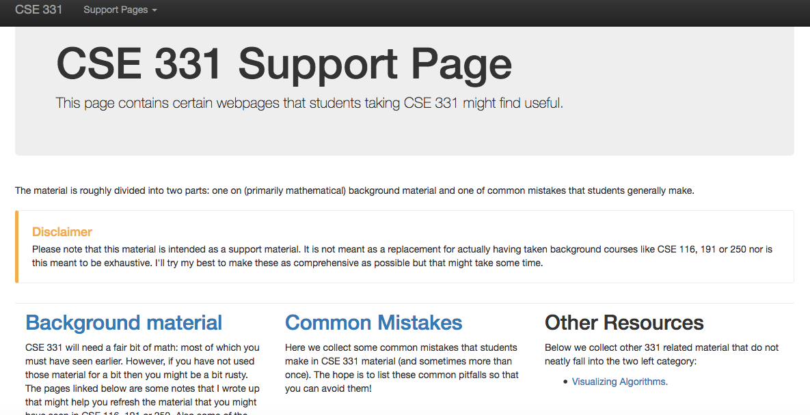
http://www-student.cse.buffalo.edu/~atri/cse331/support/index.html

Slide 59
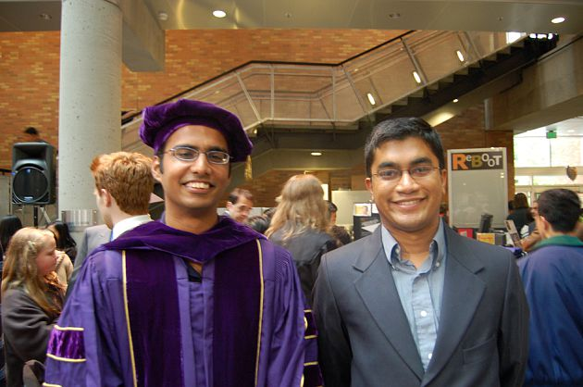
The cautionary tale has a silver lining…
Ph.D. in algorithms/complexity
C in undergrad algorithms

Slide 60
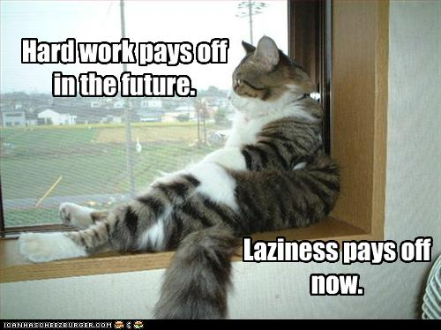
The only way to do well is to work hard

