Slide 1

Welcome
to
CSE 331

Slide 2

Let’s do some introductions
http://www.zazzle.com/warning_teaching_assistant_bag-149882665435161818

Slide 3


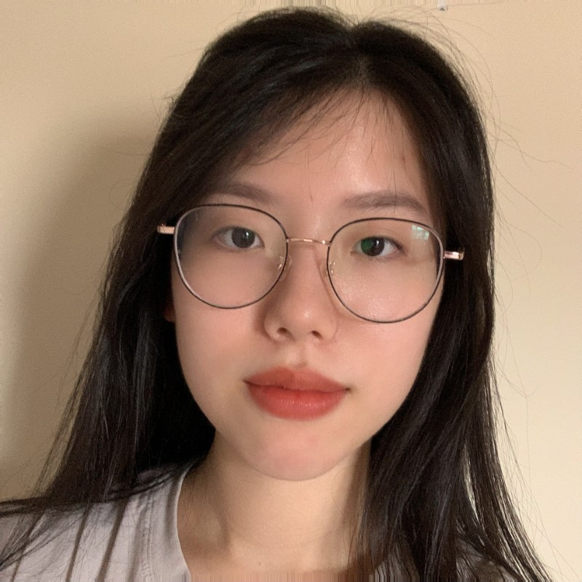
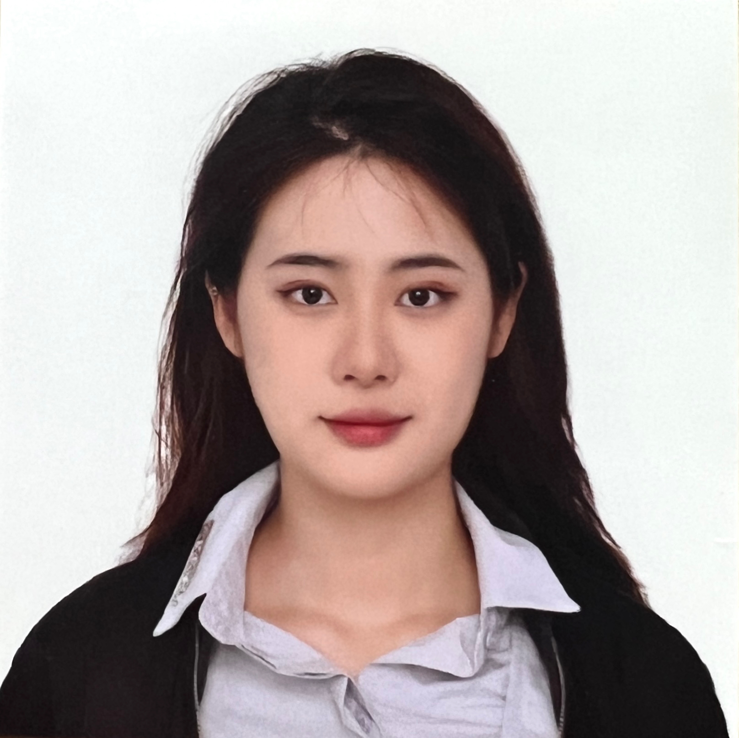
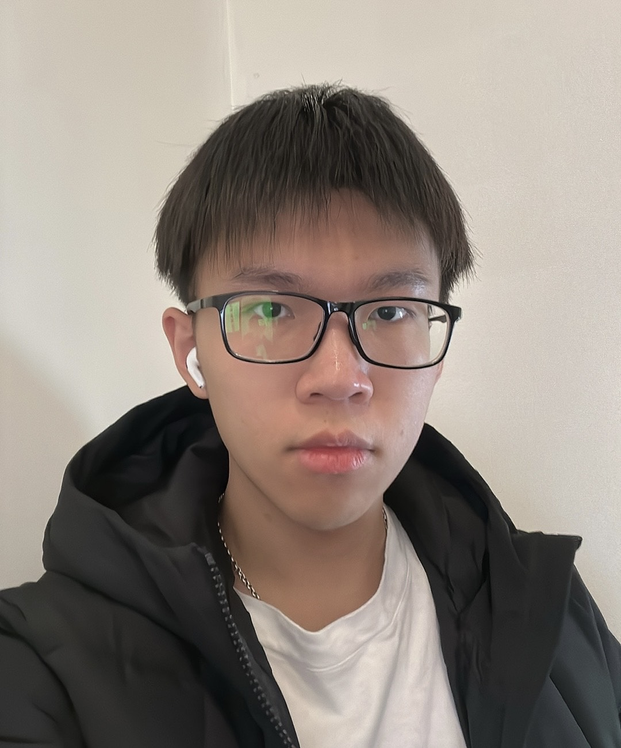


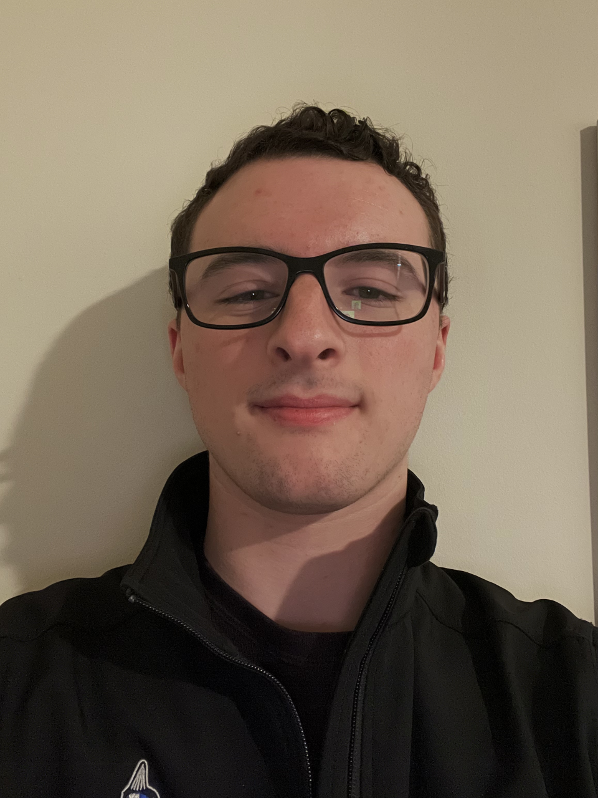
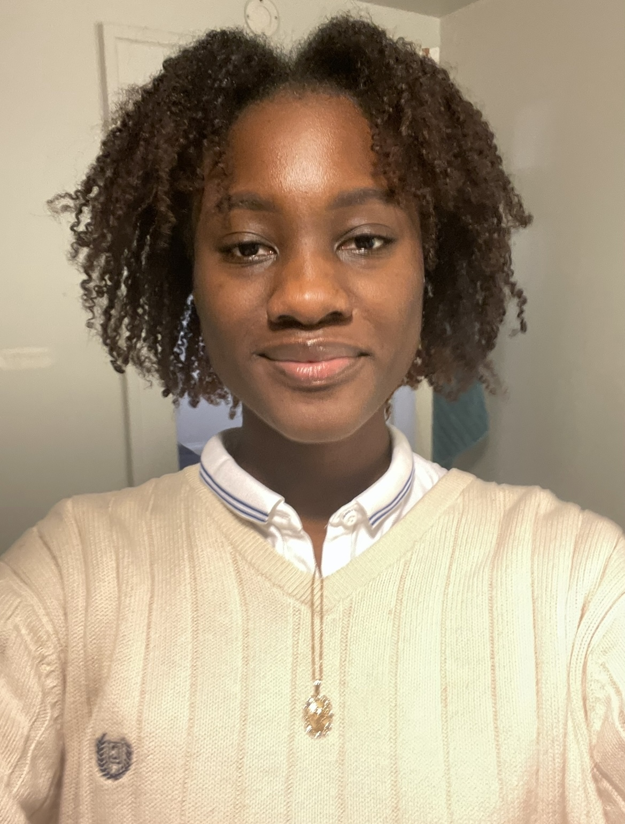

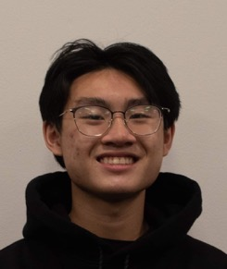
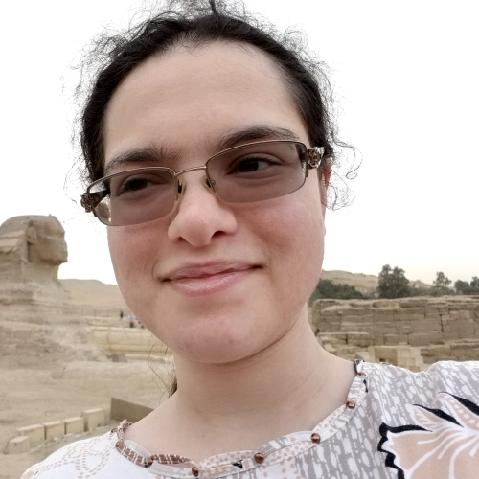
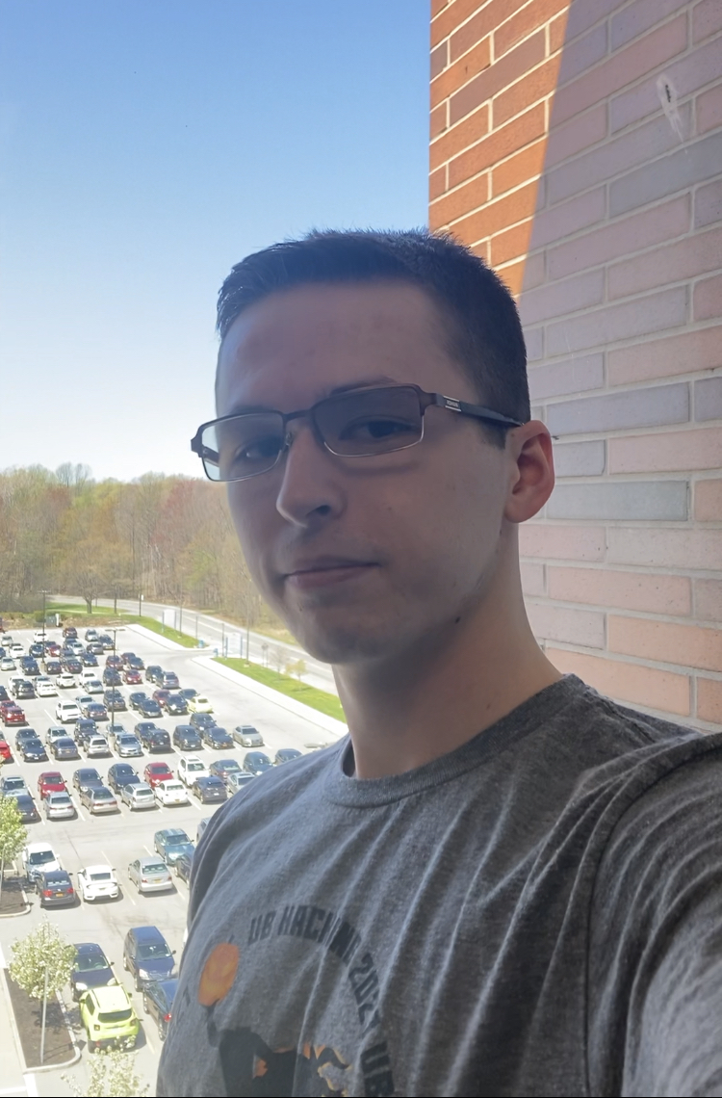
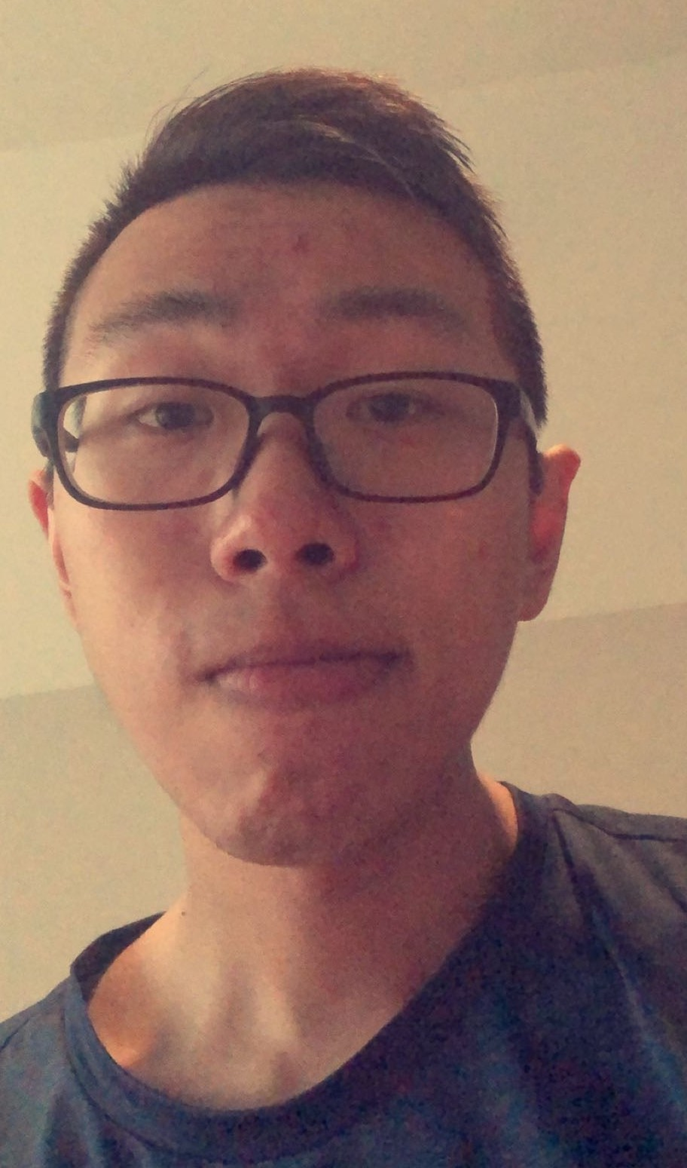


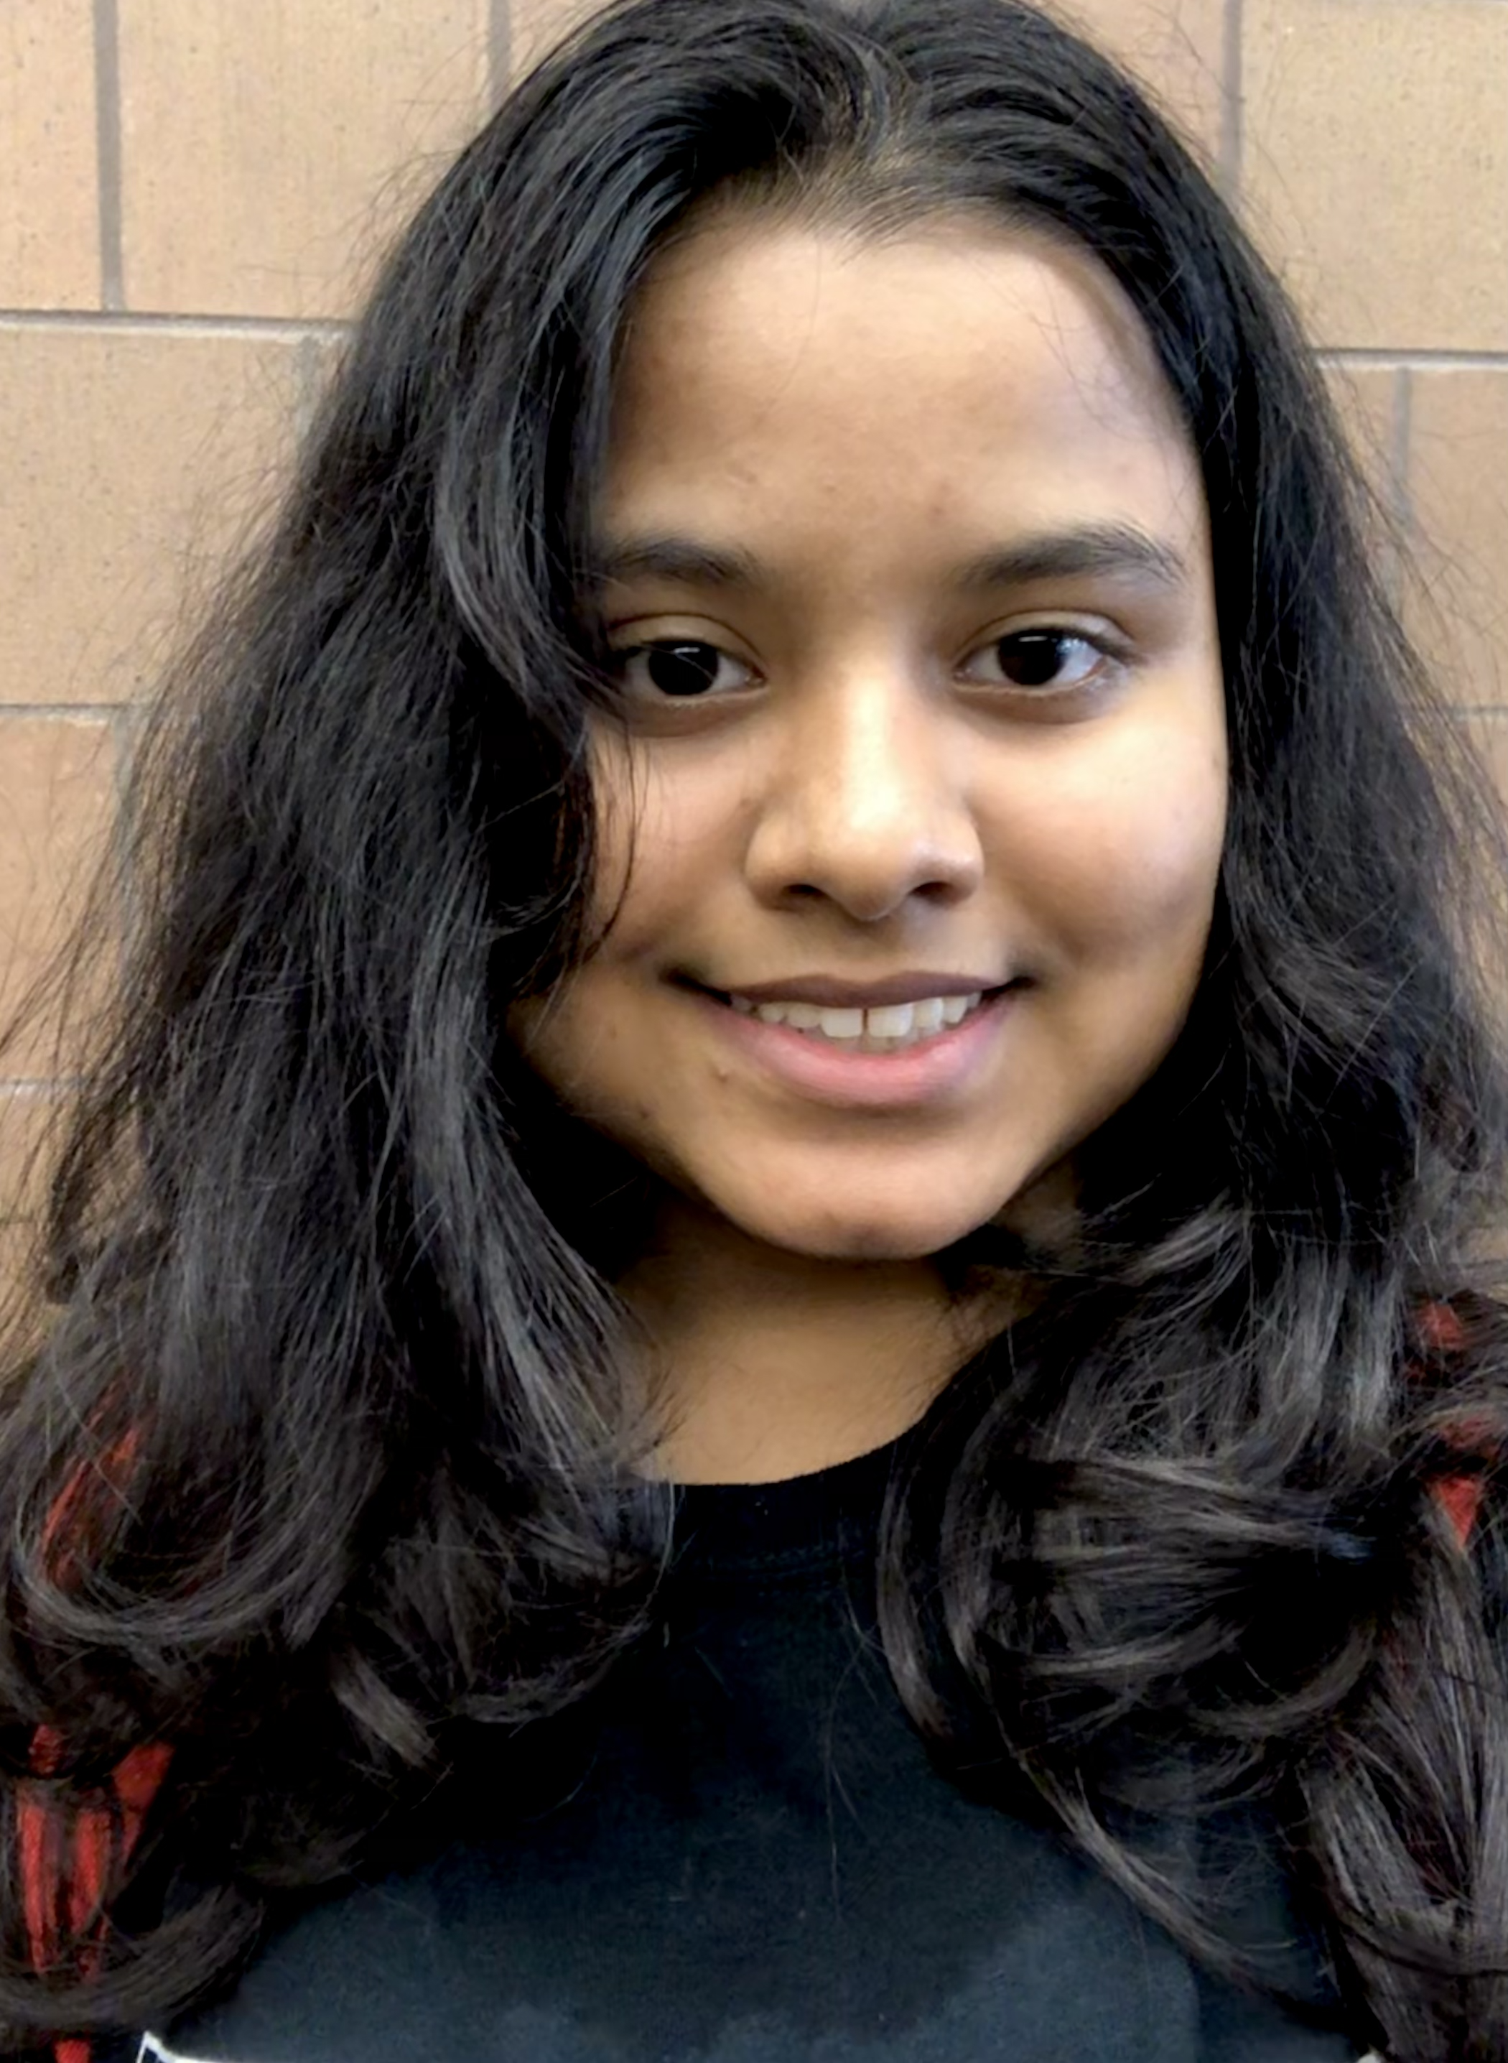


TAs first
Ahana
Sebastian
Junyan
Mary
Wei
Adi
Mokshita
Harrison
Sabrina
Caleb
Korey
Heba
Ryan
Billy
Trevor
Alex
Rrucha
Sujal
Dylan

Slide 4
About Me
Just Atri please!
Atri Rudra
atri@buffalo.edu
Office: See piazza for location
Office hours: Mon, Fri, 1:00-1:50pm
OH start this Fri

Slide 5
Contact us all at
Or use piazza!
cse-331-staff@buffalo.edu
TAs will not respond to individual emails (except for re-grading requests)

Slide 6
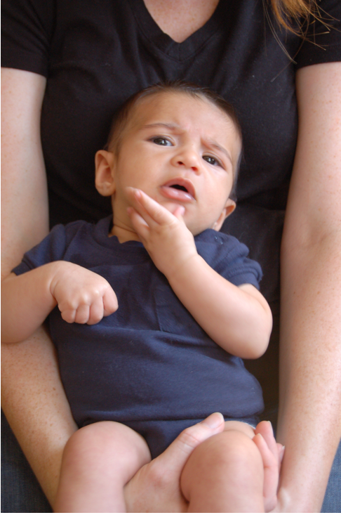
Questions/Comments?

Slide 7
Handouts for today
Syllabus (online)
Syllabus Walkthrough video (online)
Homework Policy document (online)

Slide 8
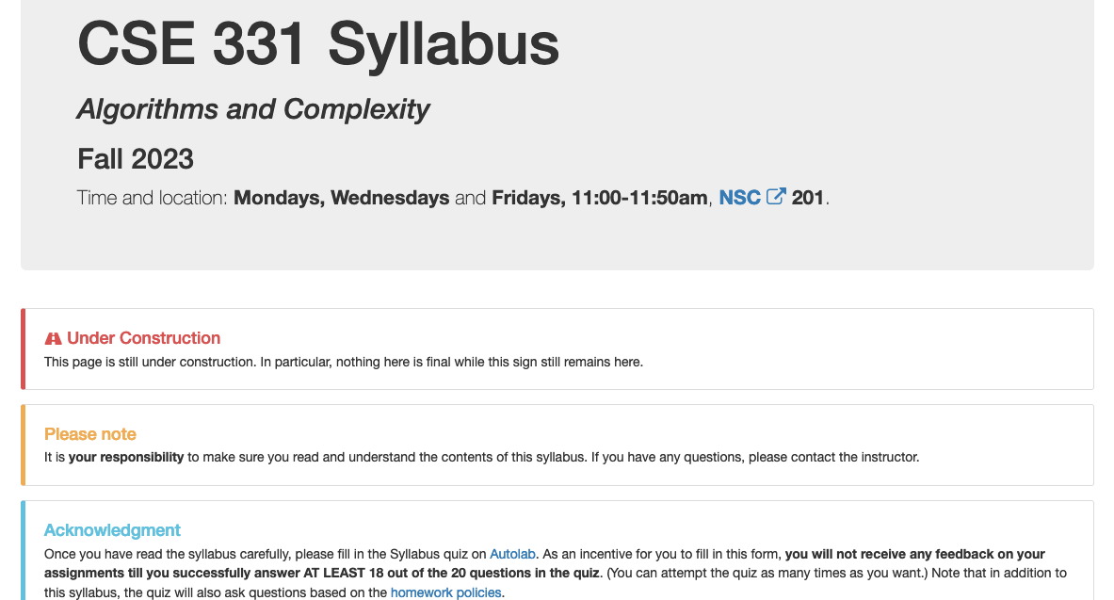
Read the syllabus CAREFULLY!

Slide 9
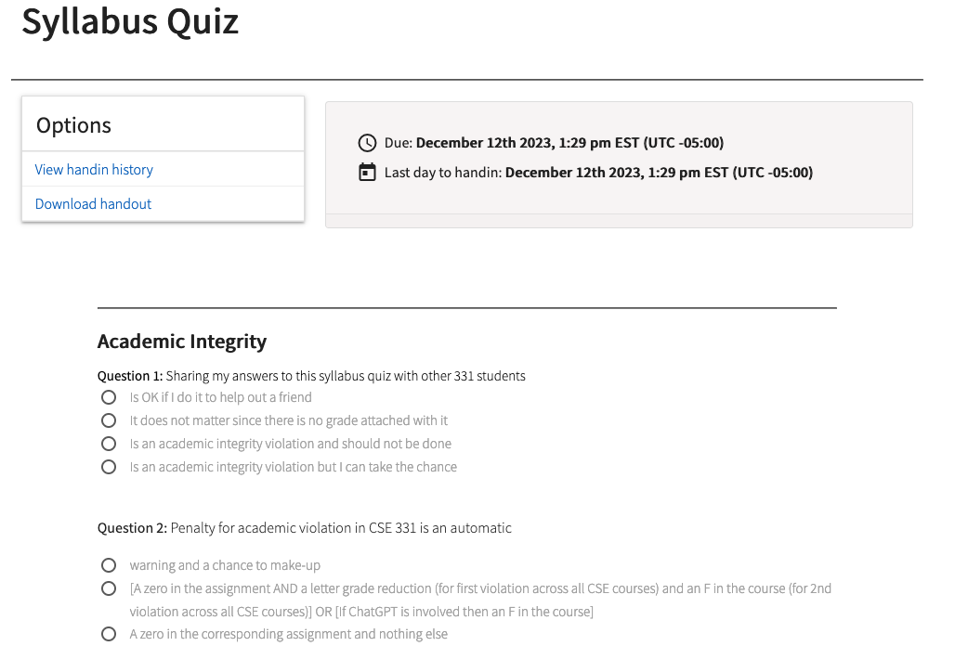
In spirit of trust but verify
No graded material will be handed back until you pass the syllabus quiz!

Slide 10
Accessibility Resources
Information included in the syllabus
In short, let me know and consult with Accessibility Resources

Slide 11
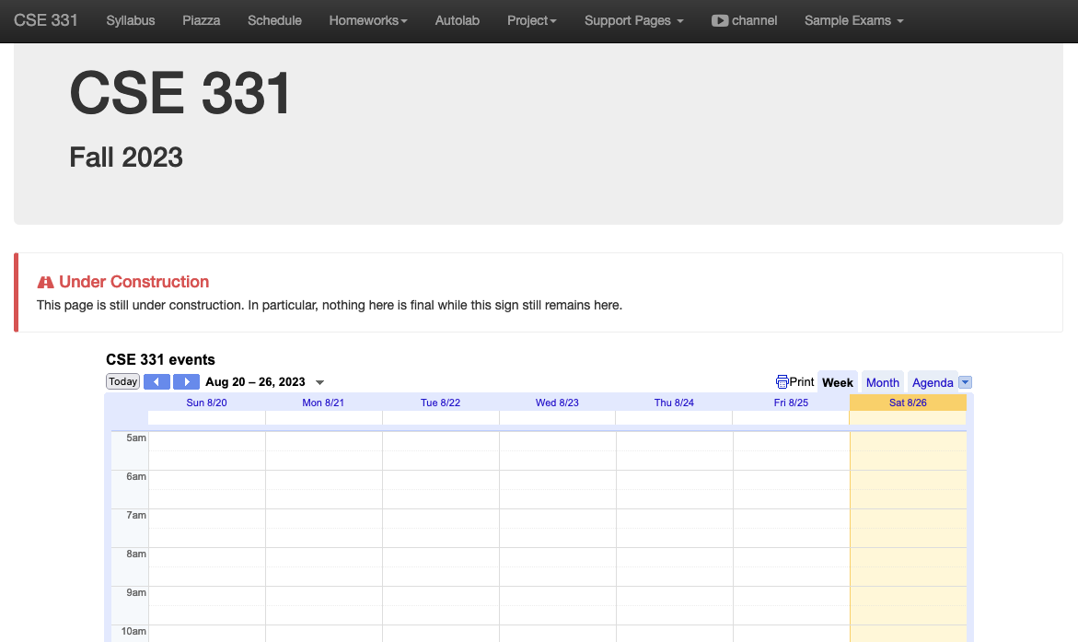
One Stop Shop for the Course
http://www-student.cse.buffalo.edu/~atri/cse331/fall23/index.html

Slide 12
Three things to remember
WORK HARD!
DO NOT CHEAT!
READ CAREFULLY!

Slide 13
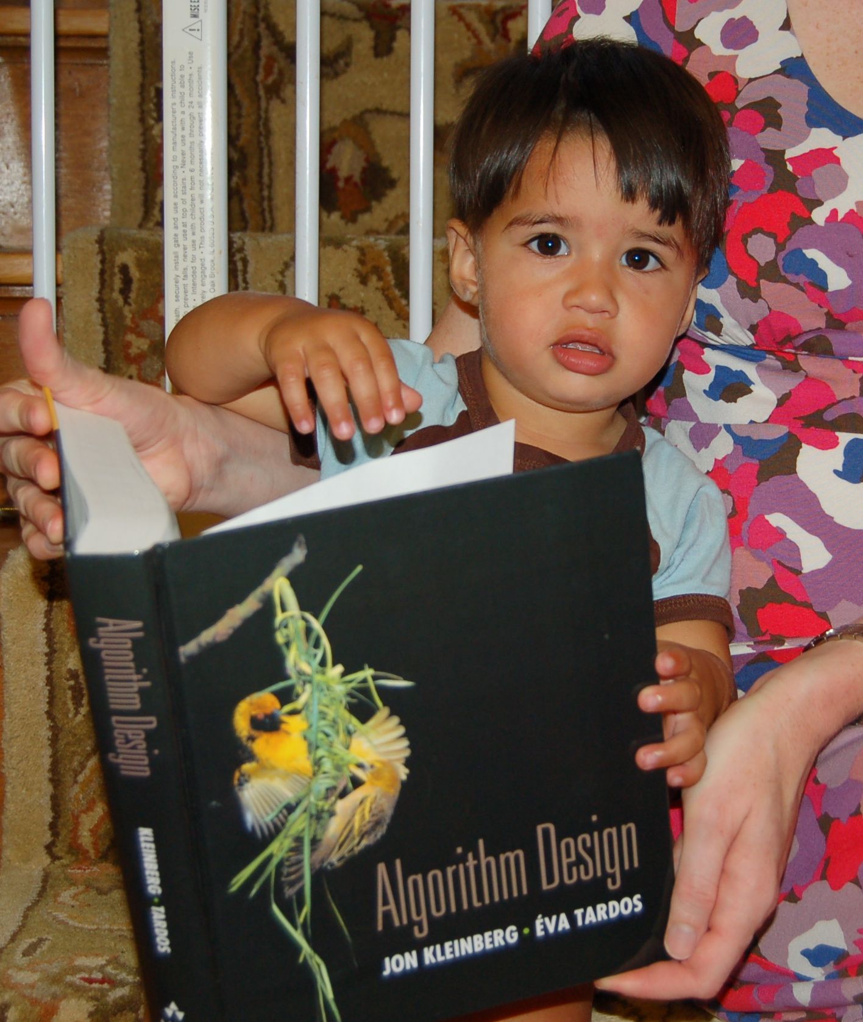
Wait.. What???
Make sure you follow submission
instructions
Two most common ways of losing points
Make sure you read problem
statements carefully

Slide 14
Academic Dishonesty
All your submissions must be your own work
Penalty:
  Minimum: A grade reduction in course
  Possible: F (or higher penalty) if warranted
YOUR responsibility to know what is cheating, plagiarism etc.
  If not sure, come talk to me
Excuses like “I have a job,” “This was OK earlier/in my country,” “This course is hard,” etc. WON’T WORK
I DO NOT HAVE ANY PATIENCE WITH ANY CHEATING :
YOU WILL GET A GRADE REDUCTION IN THE COURSE
FOR YOUR FIRST MISTAKE

Slide 15
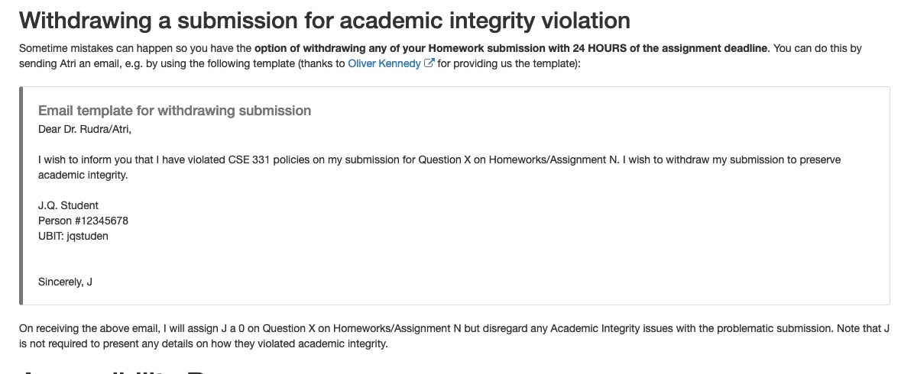
Withdrawing a suspect submission

Slide 16

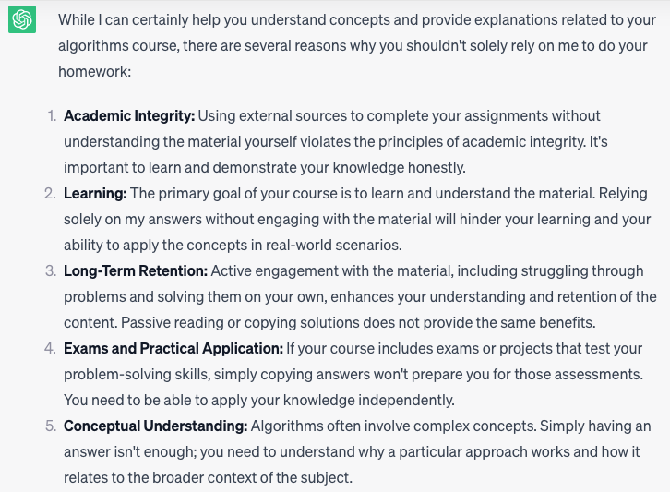
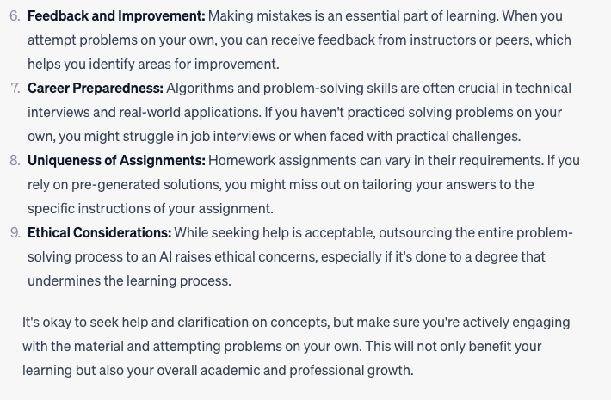
Use of ChatGPT is not allowed

Slide 17
In spirit of trust but verify
TAs will have access to a database of ChatGPT answers to cross check
It’s no fun failing any of you but use of ChatGPT will result in an F

Slide 18
Use of ChatGPT is not allowed

Slide 19
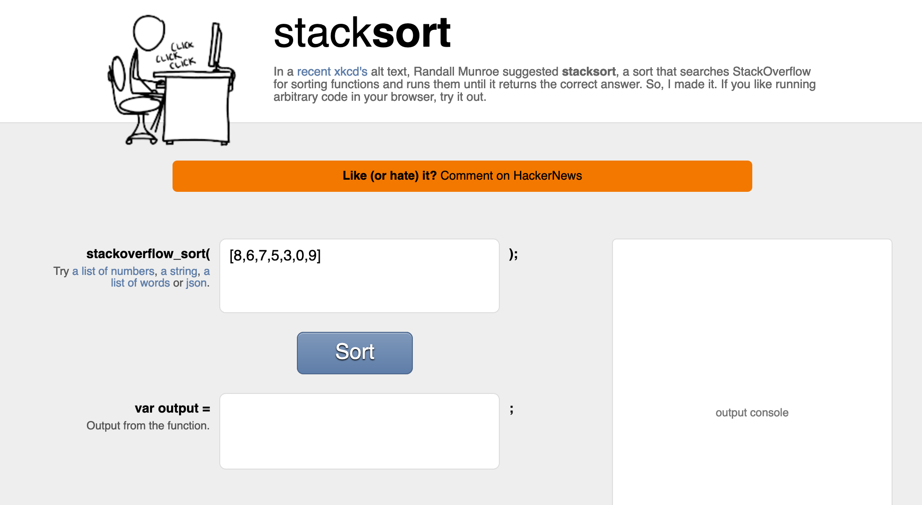
Coding jobs will be done by AI

Slide 20
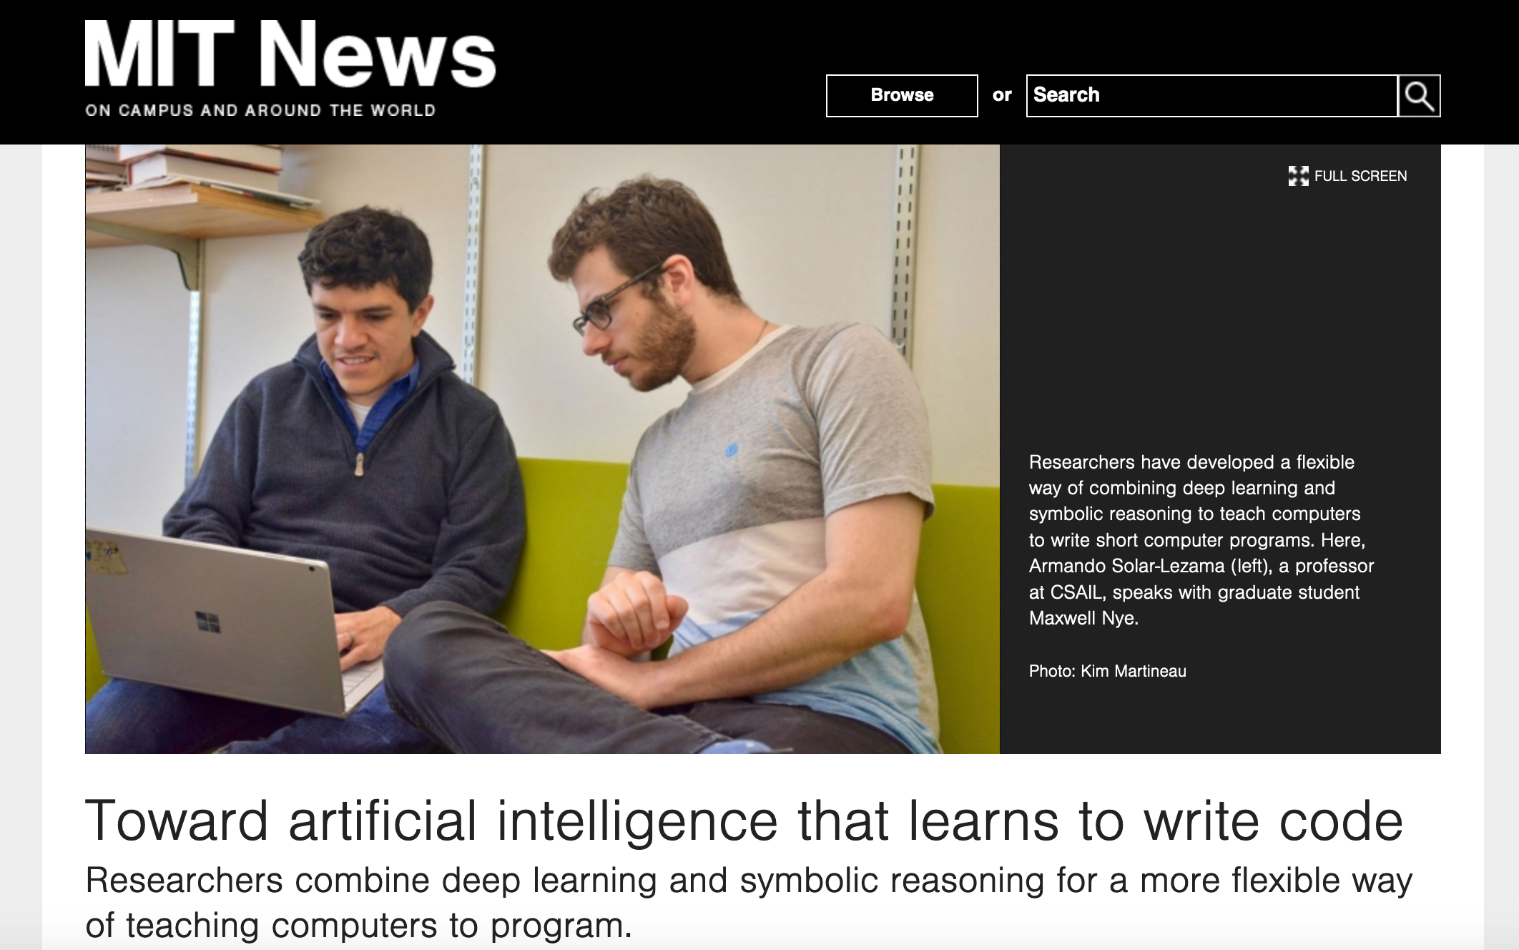
Coding jobs will be done by AI

Slide 21
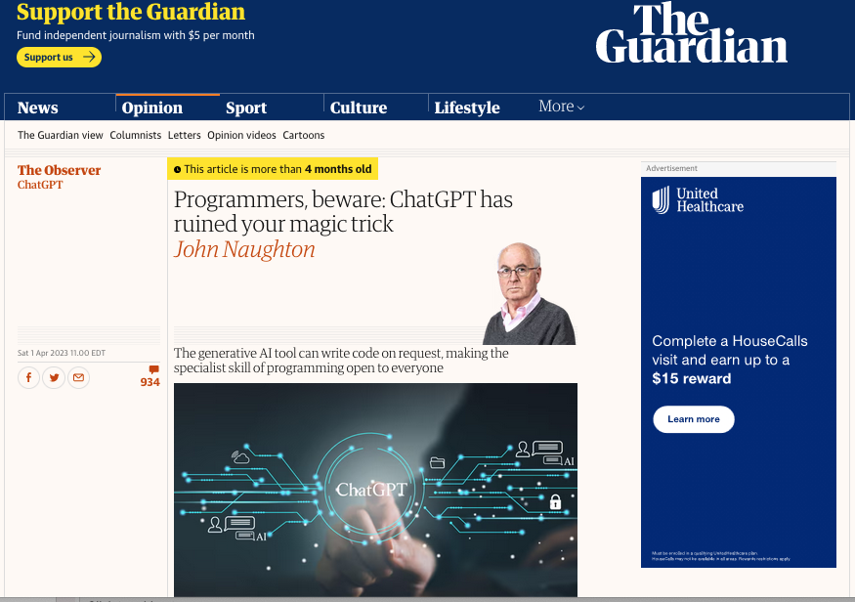
It happened sooner than expected

Slide 22
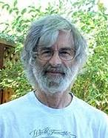
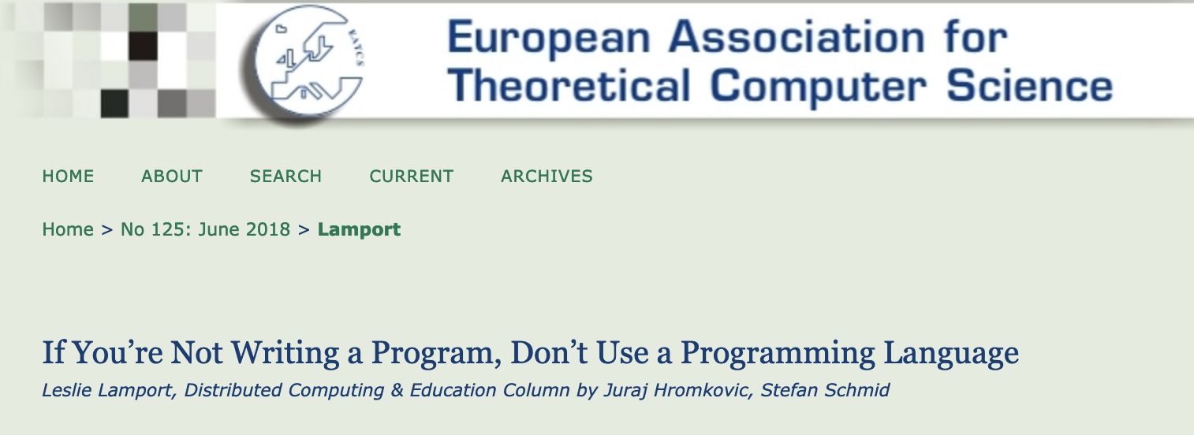
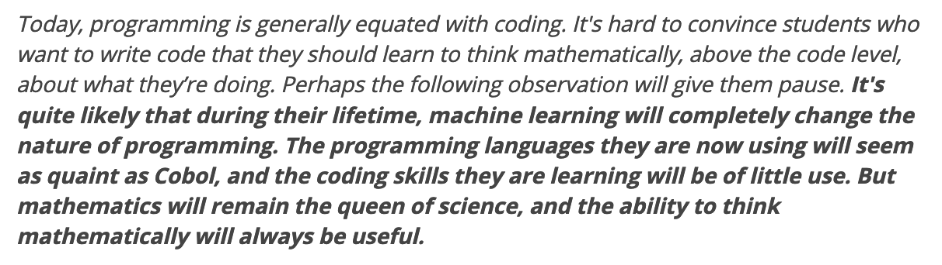
So am I doomed?
There will still be room for high level algorithmic thinking!

Slide 23
Questions/Comments?

Slide 24
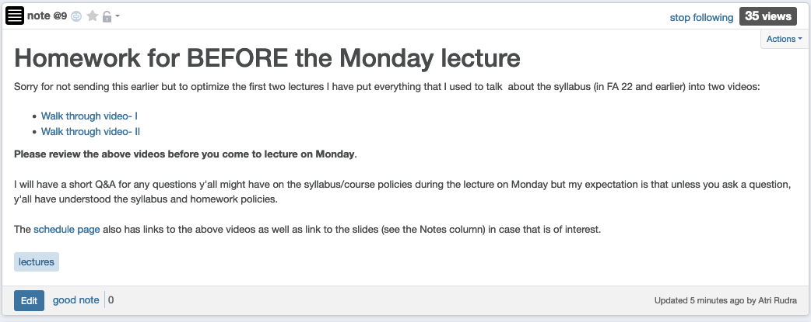
Any question on course policies?

Slide 25
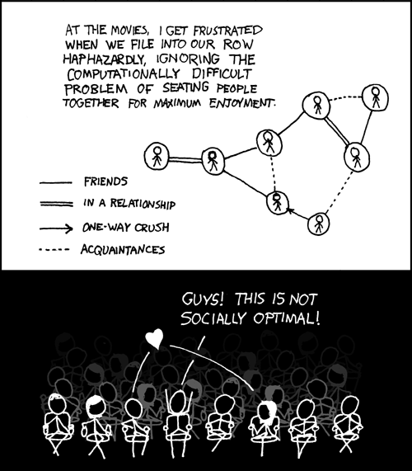
This course: how to solve problems!
http://xkcd.com/173/

Slide 26

Why should I care ?

Slide 27

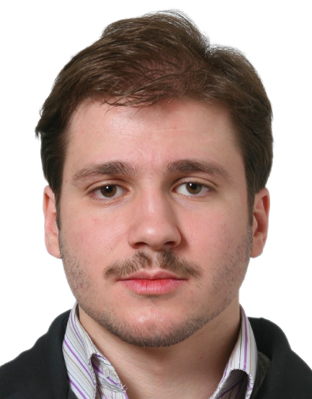
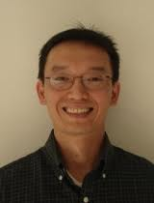
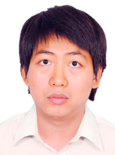



Combining Shadows to Understanding the network

Slide 28
The key technical problem
Given the three projections, what is the largest size of the original set of points?

Slide 29
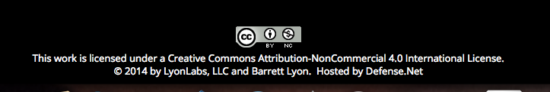
Detecting Communities

Slide 30
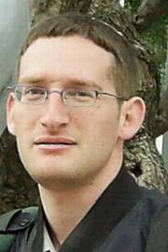
Conquering Shadows to Conquering the Internet
Algorithmically compute the missing set

Slide 31




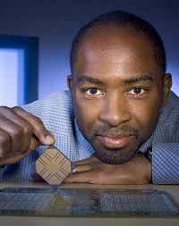

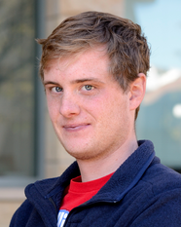
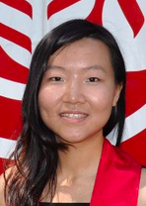

The proof is in the performance
>
10x faster
Better algorithm with little hacking will beat a worse algorithm with tons of hacking

Slide 32
The key technical problem
Highly trivial: 4³ = 64
Still trivial: 4² = 16
Correct answer: 4^{1.5} = 8

Slide 33
Questions/Comments?

Slide 34
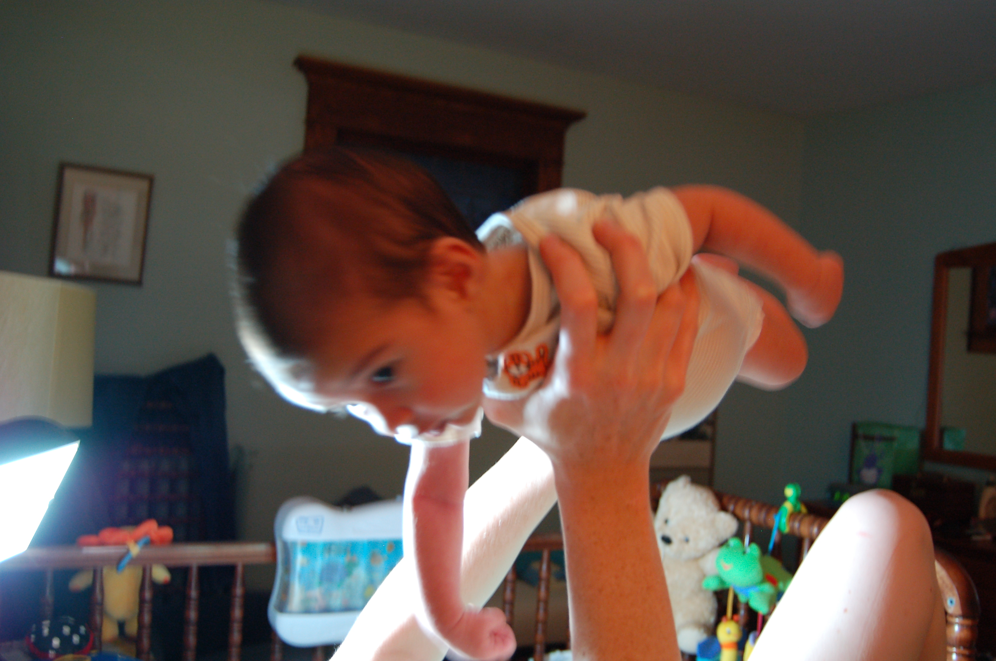
Let the fun begin!

Slide 35
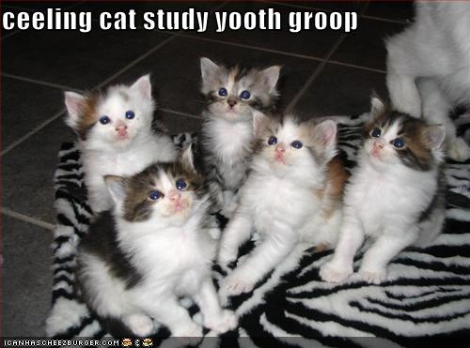
Remember: Stick with your group

Slide 36
Let’s do a proof!
Recall: There are 8 HWs
Q1 worth 50 pts, Q2 worth 25 pts, Q3 worth 25 pts
At the end of the semester I give you two options
Option 1: I pick sum of your max 6 HW scores (out of 600)
Score on HW i = Q1 score + Q2 score + Q3 score on HW i
Option 2: I pick your max 6 Q1 scores + max 6 Q2 scores +
max 6 Q3 scores (out of 600)
Which of the following is correct?
A. Option 1 is always better
B. Option 2 is always better
C. Depends on the actual scores: sometimes Option 1 is better, sometimes Option 2 is
Give a proof that your answer is correct!

