Slide 1
Lecture 11
CSE 331
Sep 22, 2023

Slide 2

Register project groups 1 week!
Deadline: Friday, Sep 29, 11:59pm

Slide 3
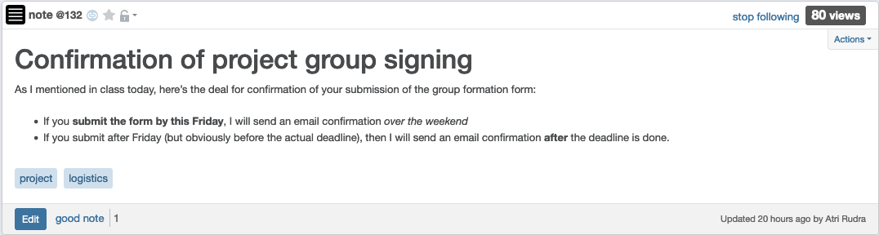
Confirmation of form submission

Slide 4

If you need it, ask for help

Slide 5

Couple of clarifications

Slide 6
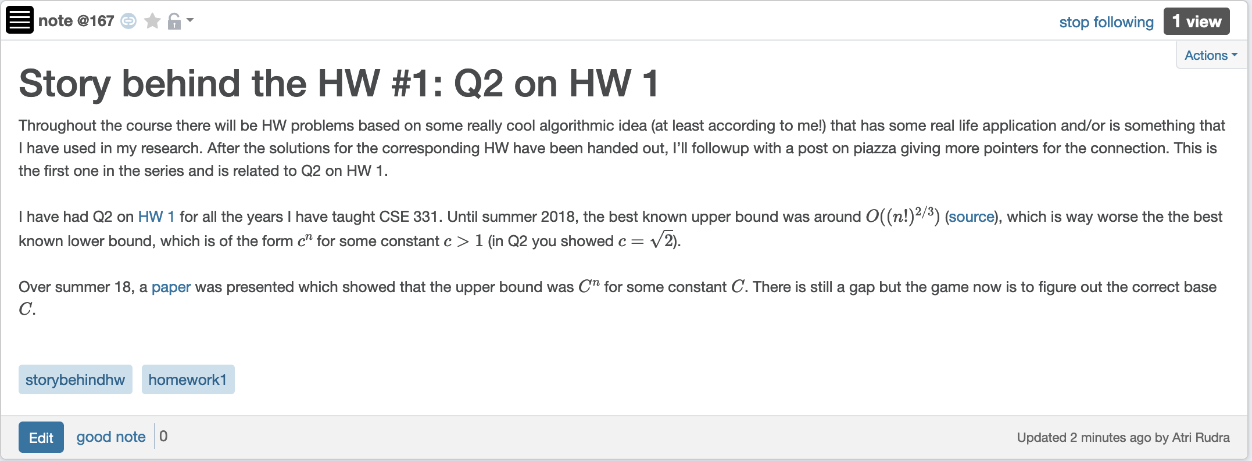
Story behind HW 1 Q2

Slide 7
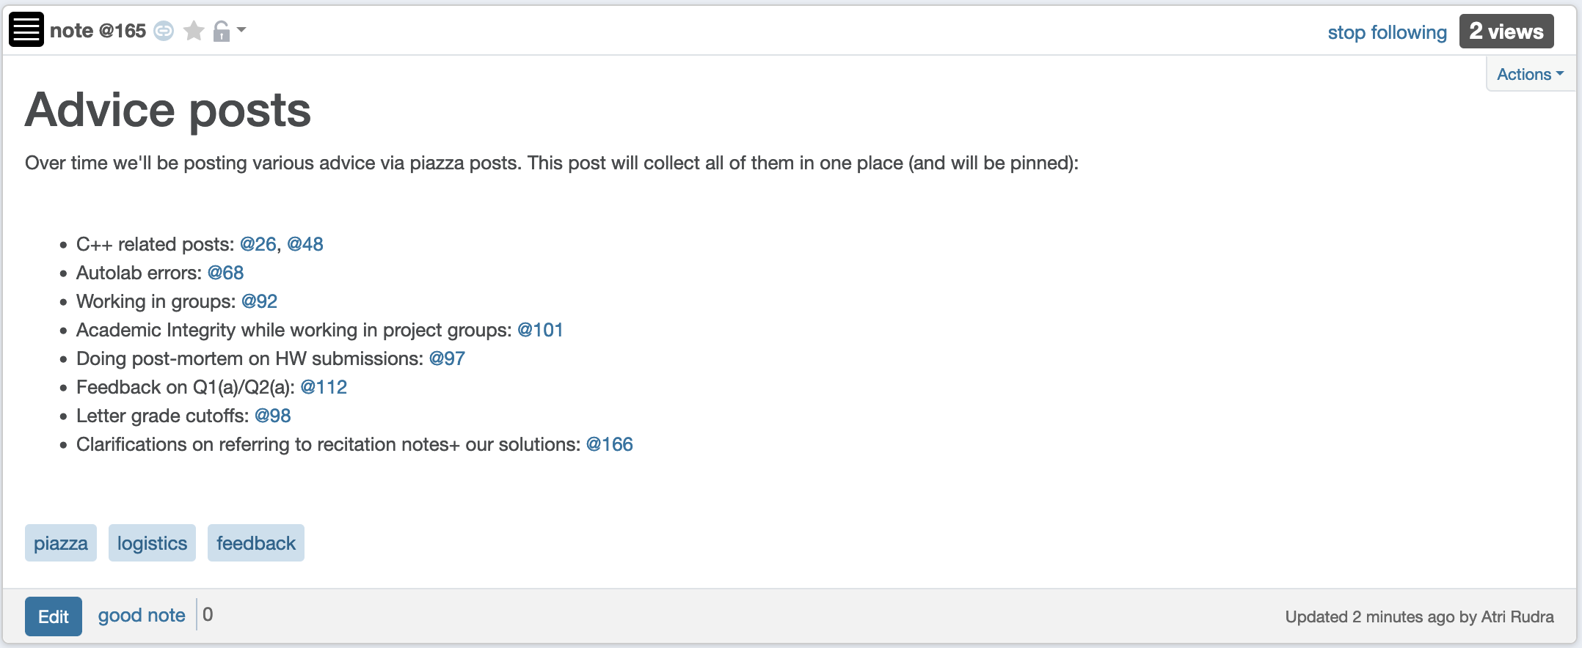
Advice “mega post”

Slide 8

Out of town next week Mon-Th
Tervor will cover my Mon office hours
Dr. Sarıyüce will cover the Mon and Wed lecture

Slide 9
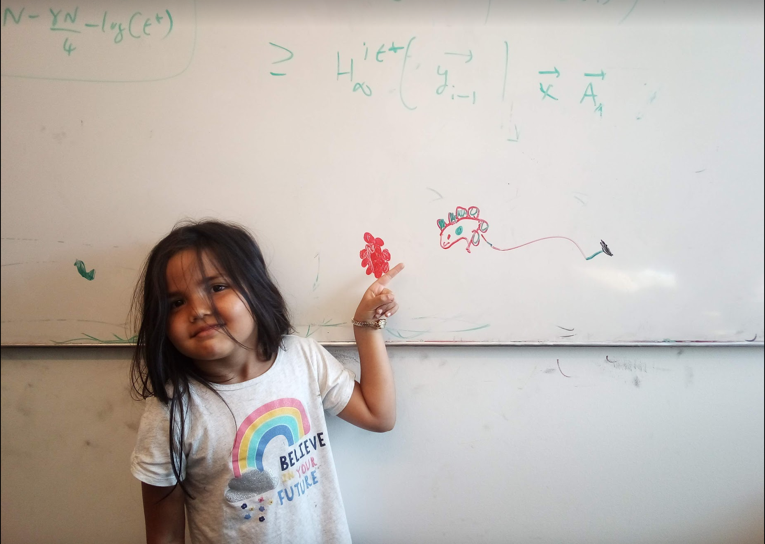
Questions/Comments?

Slide 10
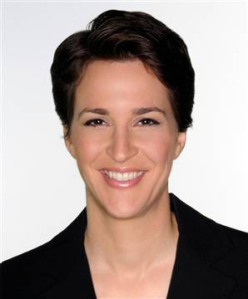







Paths
,
Sequence of vertices connected by edges
Connected
Path length 3
,
,
,

Slide 11
Connectivity
u and w are connected iff there is a path between them
A graph is connected iff all pairs of vertices are connected

Slide 12


Connected Graphs
Every pair of vertices has a path between them

Slide 13
Cycles
Sequence of k vertices connected by edges, first k-1 are distinct
,
,
,

Slide 14


Slide 15
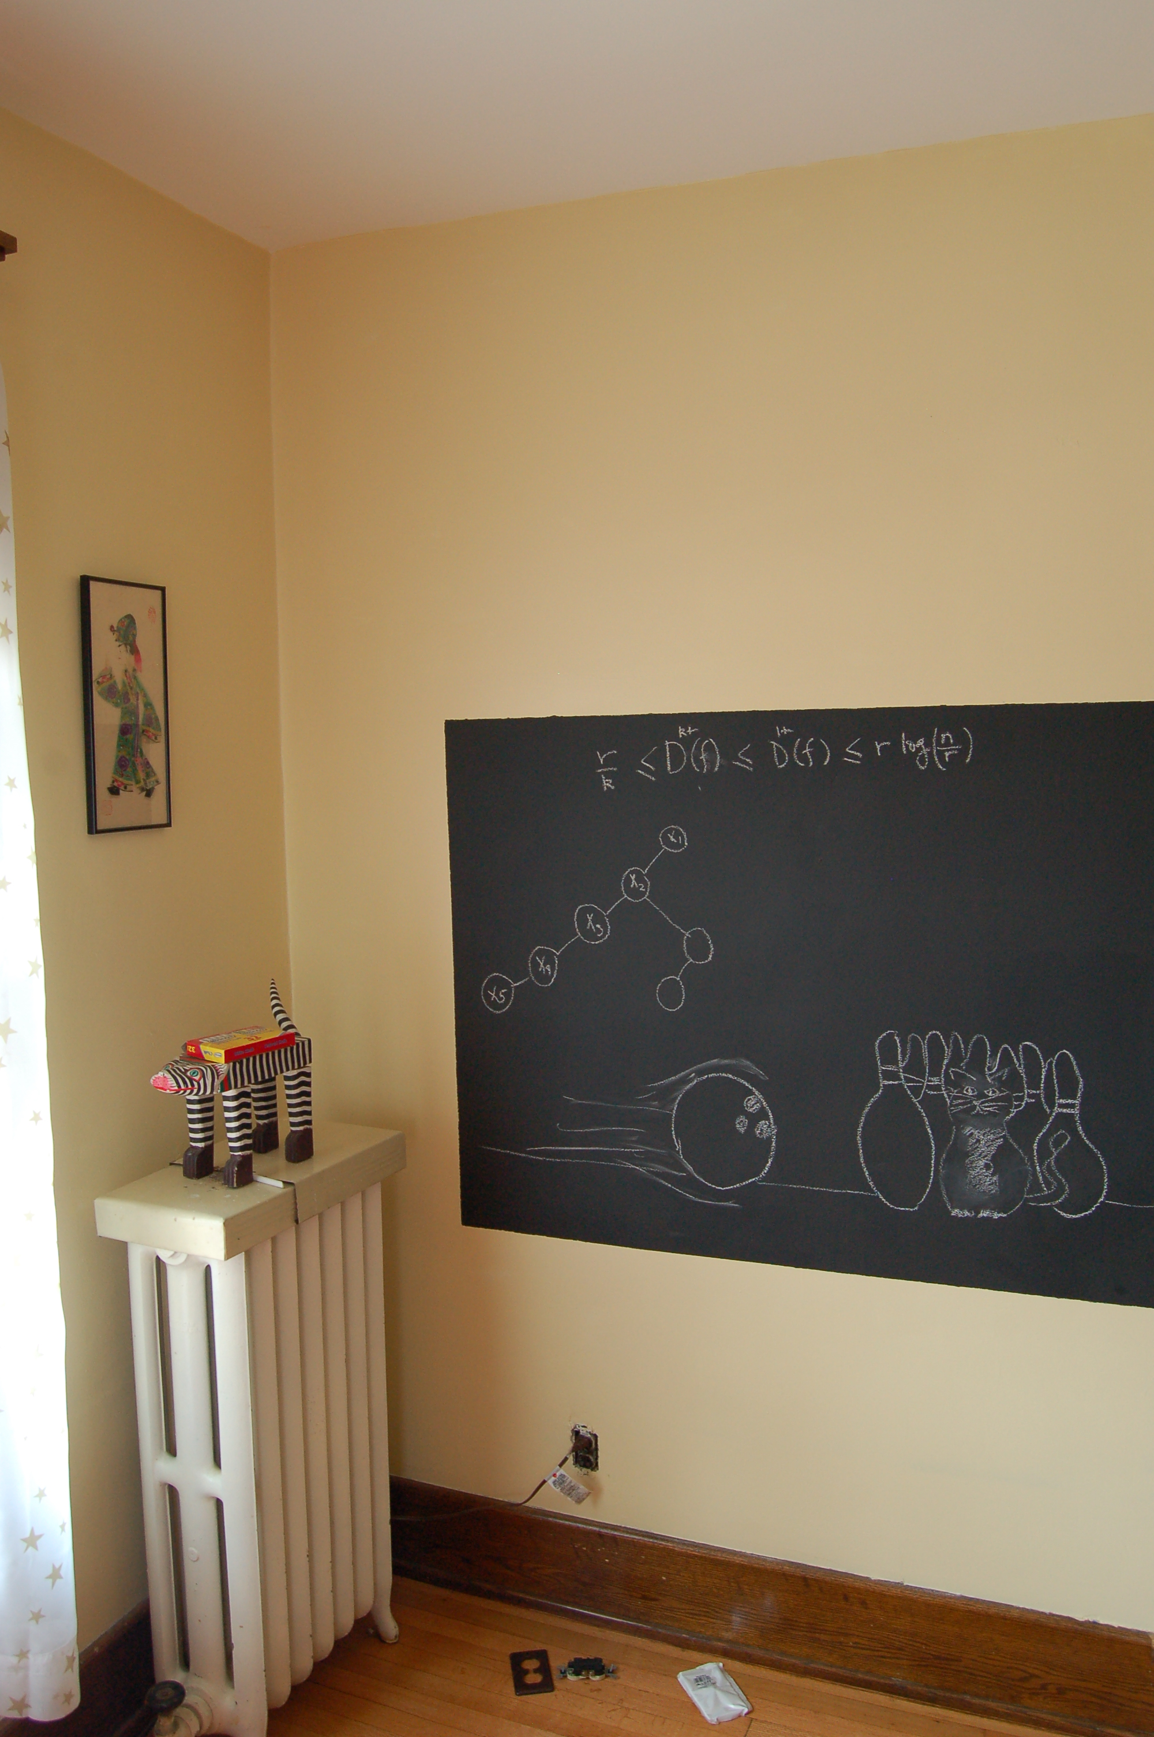
Definitions on the board…

Slide 16
Distance between u and v
Length of the shortest length path between u and v
RM
BO
Distance between RM and BO?
1

Slide 17
Tree
Connected undirected graph with no cycles

Slide 18

Rooted Tree

Slide 19
A rooted tree
AC’s child=SG
Pick any vertex as root
SG’s parent=AC
Let the rest of the tree hang under “gravity”

Slide 20
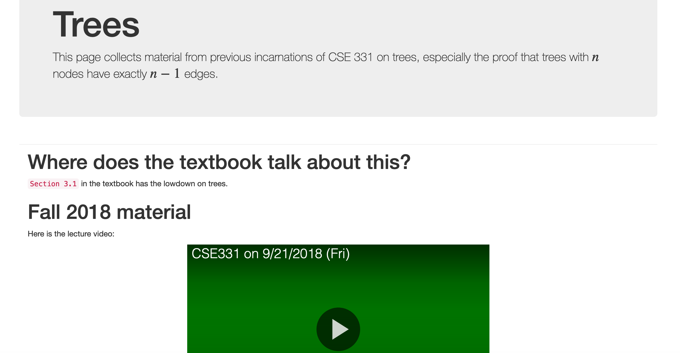
Every n vertex tree has n-1 edges

Slide 21
Every n vertex tree has n-1 edges
Let T be an undirected graph on n nodes
Then ANY two of the following implies the third:
T is connected
T has no cycles
T has n-1 edges

Slide 22
Questions/Comments?

Slide 23
Rest of Today’s agenda
Algorithms for checking connectivity

Slide 24
Checking by inspection

Slide 25
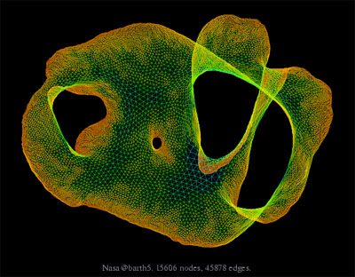
What about large graphs?
s
t
Are s and t connected?

Slide 26
Brute-force algorithm?
List all possible vertex sequences between s and t
n^{n} such sequences
Check if any is a path between s and t

Slide 27

Algorithm motivation
all

Slide 28
Questions/Comments?

Slide 29
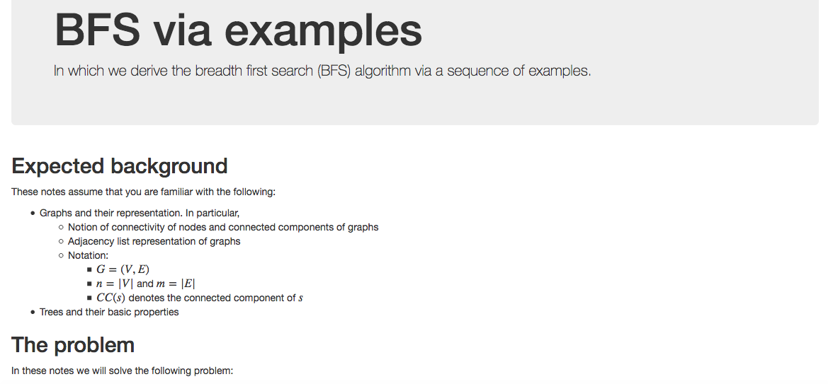
Breadth First Search (BFS)

Slide 30
Connectivity Problem
Input: Graph G = (V,E) and s in V
Output: All t connected to s in G
Connected component of s

Slide 31
Breadth First Search (BFS)
Build layers of vertices connected to s
L₀ = {s}
Assume L₀,..,L_{j} have been constructed
L_{j+1} set of vertices not chosen yet but are connected by an edge to L_{j}
Stop when new layer is empty

