Slide 1
Lecture 14
CSE 331
Sep 29, 2023

Slide 2

If you need it, ask for help

Slide 3
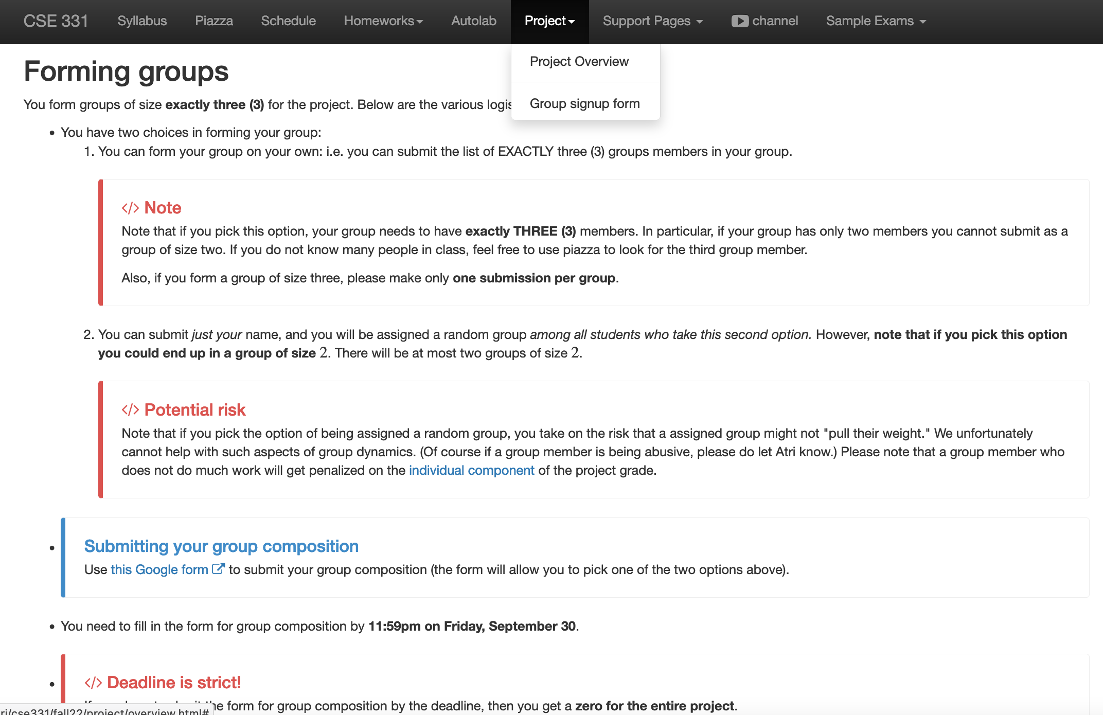
Register project groups TONIGHT!
Deadline: Friday, Sep 29, 11:59pm

Slide 4
Upcoming quiz/exams
Quiz 1 Friday NEXT week
Mid-term 1 Wednesday Oct 18
Mid-term 2 Fri two days after Mid-term 1

Slide 5

Bit more on Quiz 1

Slide 6
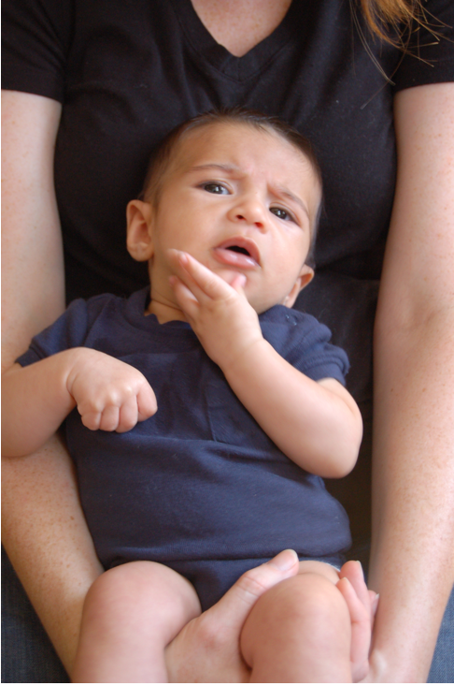
Questions?

Slide 7
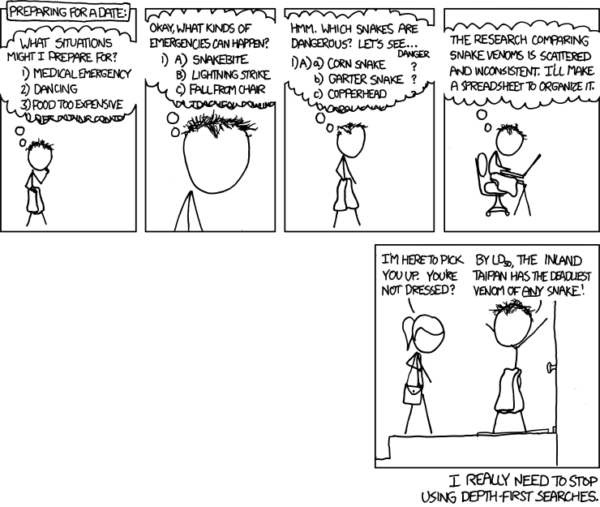
Depth First Search (DFS)
http://xkcd.com/761/

Slide 8
DFS(u)
Mark u as explored and add u to R
For each edge (u,v)
If v is not explored then DFS(v)

Slide 9
A DFS run
Every non-tree edge is between a node and its ancestor
1
DFS(u)
1
7
u is explored
2
2
3
For every unexplored
neighbor v of u
8
4
DFS(v)
4
5
5
DFS tree
6
6
3
8
7
Notes:
Note that the tree is arbitrary based on which neighbor was visited first.

Slide 10
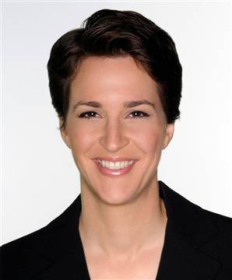







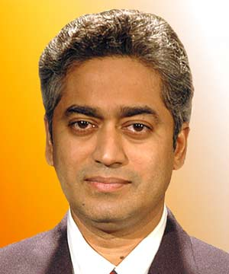

Connected components are disjoint
Either Connected components of s and t are the same or are disjoint
Algorithm to compute ALL the connected components?
Can run Explore instead of BFS
Run BFS on some node s. Then run BFS on t that is not connected to s

Slide 11
Computing all CCs
9
0
1
7
9
1
L₀
2
3
L₁
2
3
8
0
4
5
4
5
7
8
L₂
6
6
L₃

Slide 12
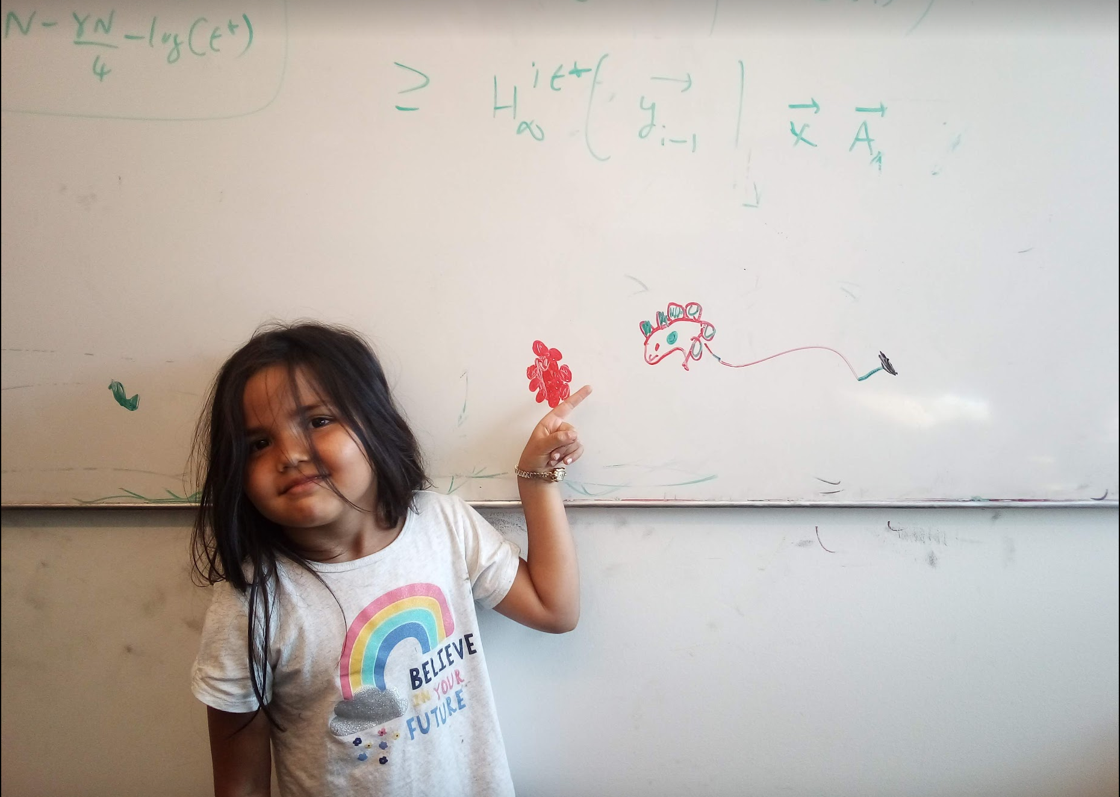
Questions/Comments?

Slide 13

Today’s agenda
Run-time analysis of BFS (DFS)

Slide 14

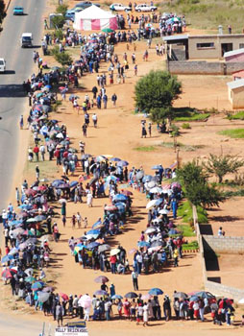
Stacks and Queues
Last in First out
First in First out
Notes:
We will need to keep track of visited nodes during our traversals.

Slide 15
But first…
How do we represent graphs?
Notes:
When using an algorithm to solve a problem, the runtime depends on how data is organized.

Slide 16
Graph representations
0
1
1
1
0
0
Better for sparse graphs and traversals
1
0
0
Adjacency matrix
Adjacency List
O(1)
(u,v) in E?
O(n) [ O(n_{v}) ]
O(n)
All neighbors of u?
O(n_{u})
O(n²)
Space?
O(m+n)

Slide 17
Questions/Comments?

Slide 18

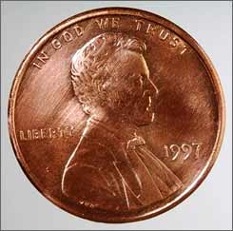
2m = Σ _{u in V} n_{u}
Rest of the graph
Give 2 pennies to each edge
Total # of pennies = 2m
n_{v}=3
u
n_{u}=4
v
Each edges gives one penny to its end points
# of pennies u receives = n_{u}

Slide 19
Breadth First Search (BFS)
Build layers of vertices connected to s
L₀ = {s}
Assume L₀,..,L_{j} have been constructed
L_{j+1} set of vertices not chosen yet but are connected to L_{j}
Stop when new layer is empty
Use CC[v] array
Use linked lists

Slide 20
Rest of Today’s agenda
Space complexity of Adjacency list representation
Quick run time analysis for BFS
Quick run time analysis for DFS (and Queue version of BFS)

