Slide 1
Lecture 15
CSE 331
Oct 2, 2023

Slide 2
Upcoming quiz/exams
Quiz 1 This FRIDAY
Mid-term 1 Wednesday Oct 18
Mid-term 2 Fri two days after Mid-term 1

Slide 3
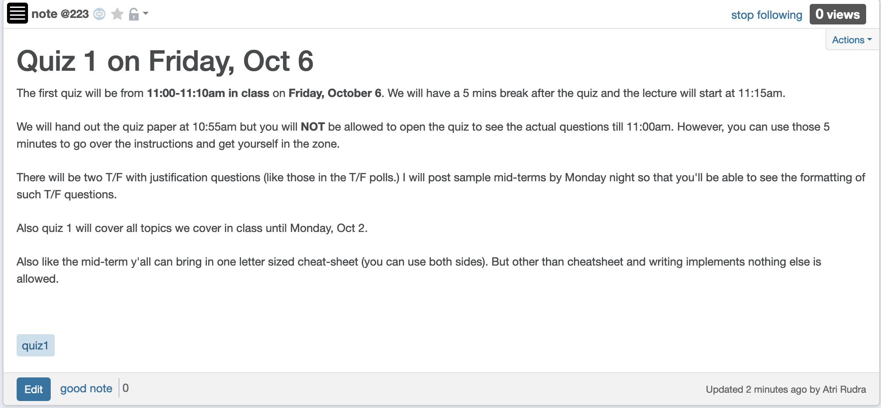
Bit more on Quiz 1

Slide 4
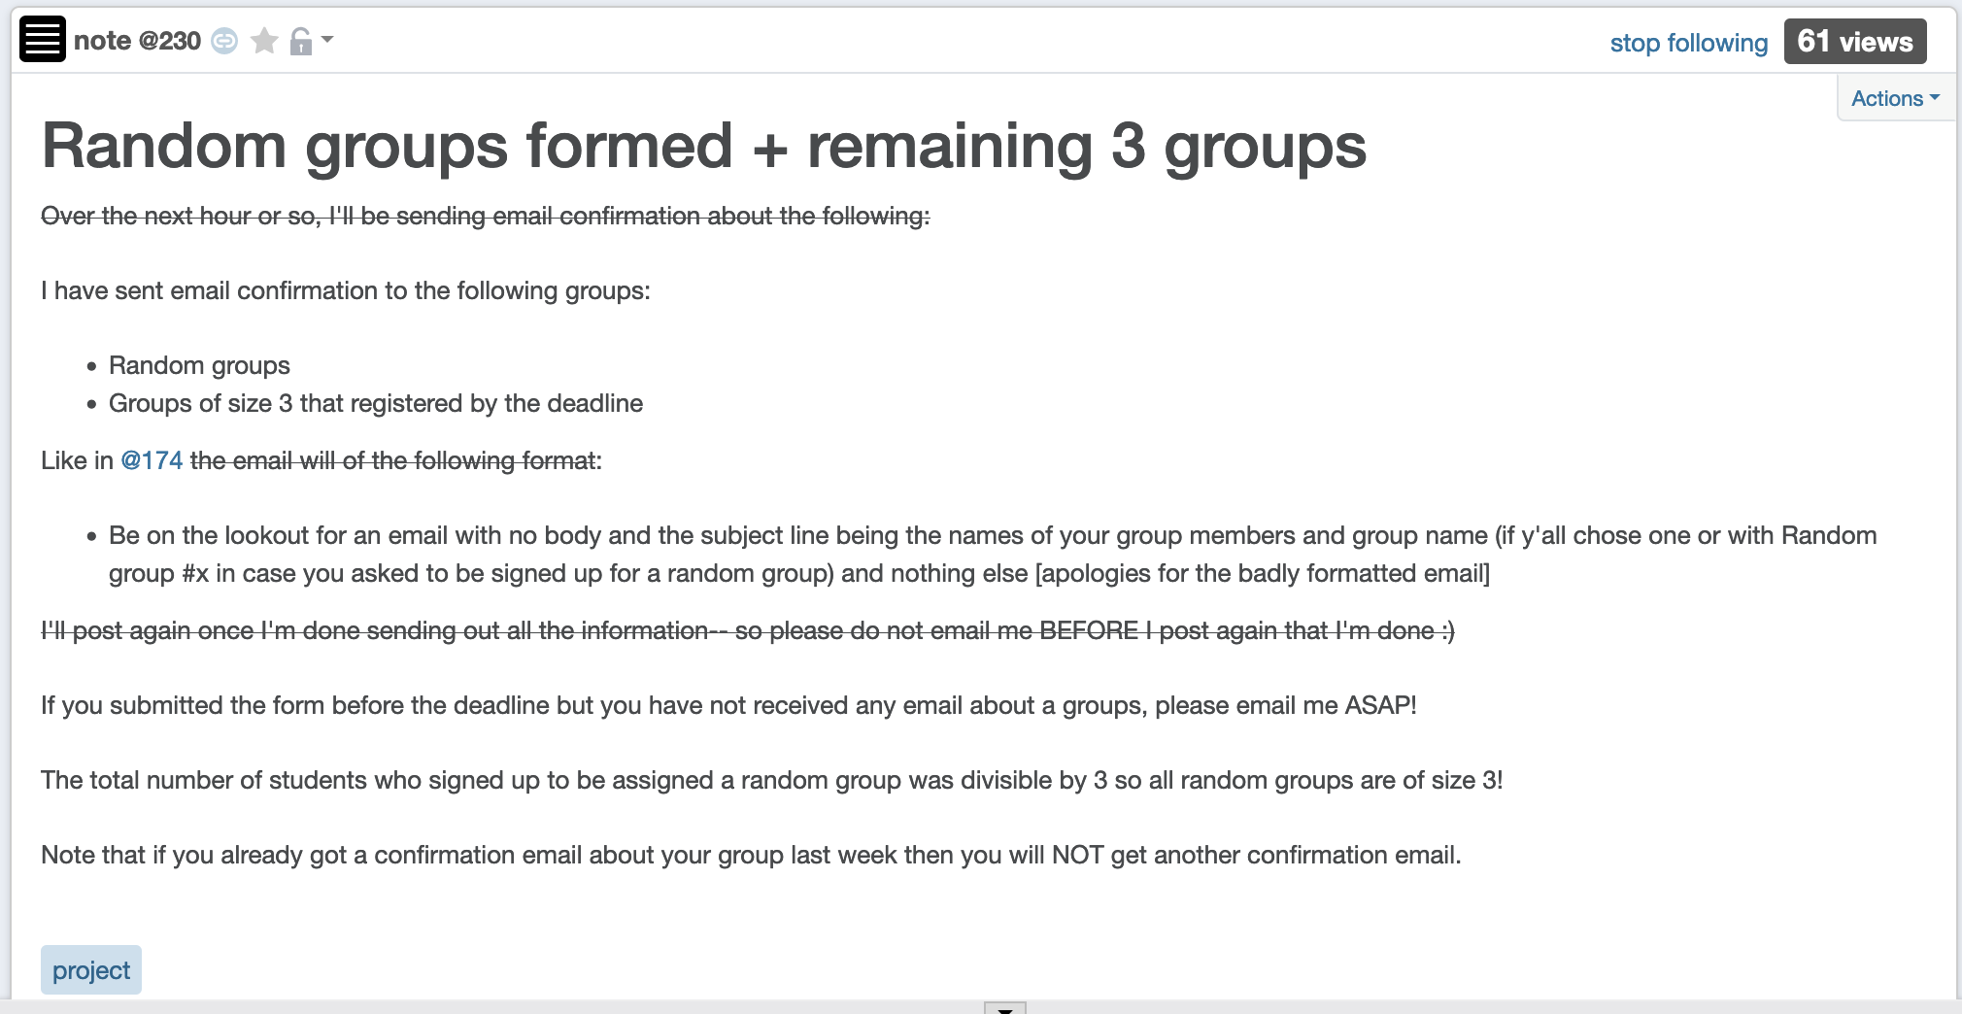
Project Groups formed

Slide 5
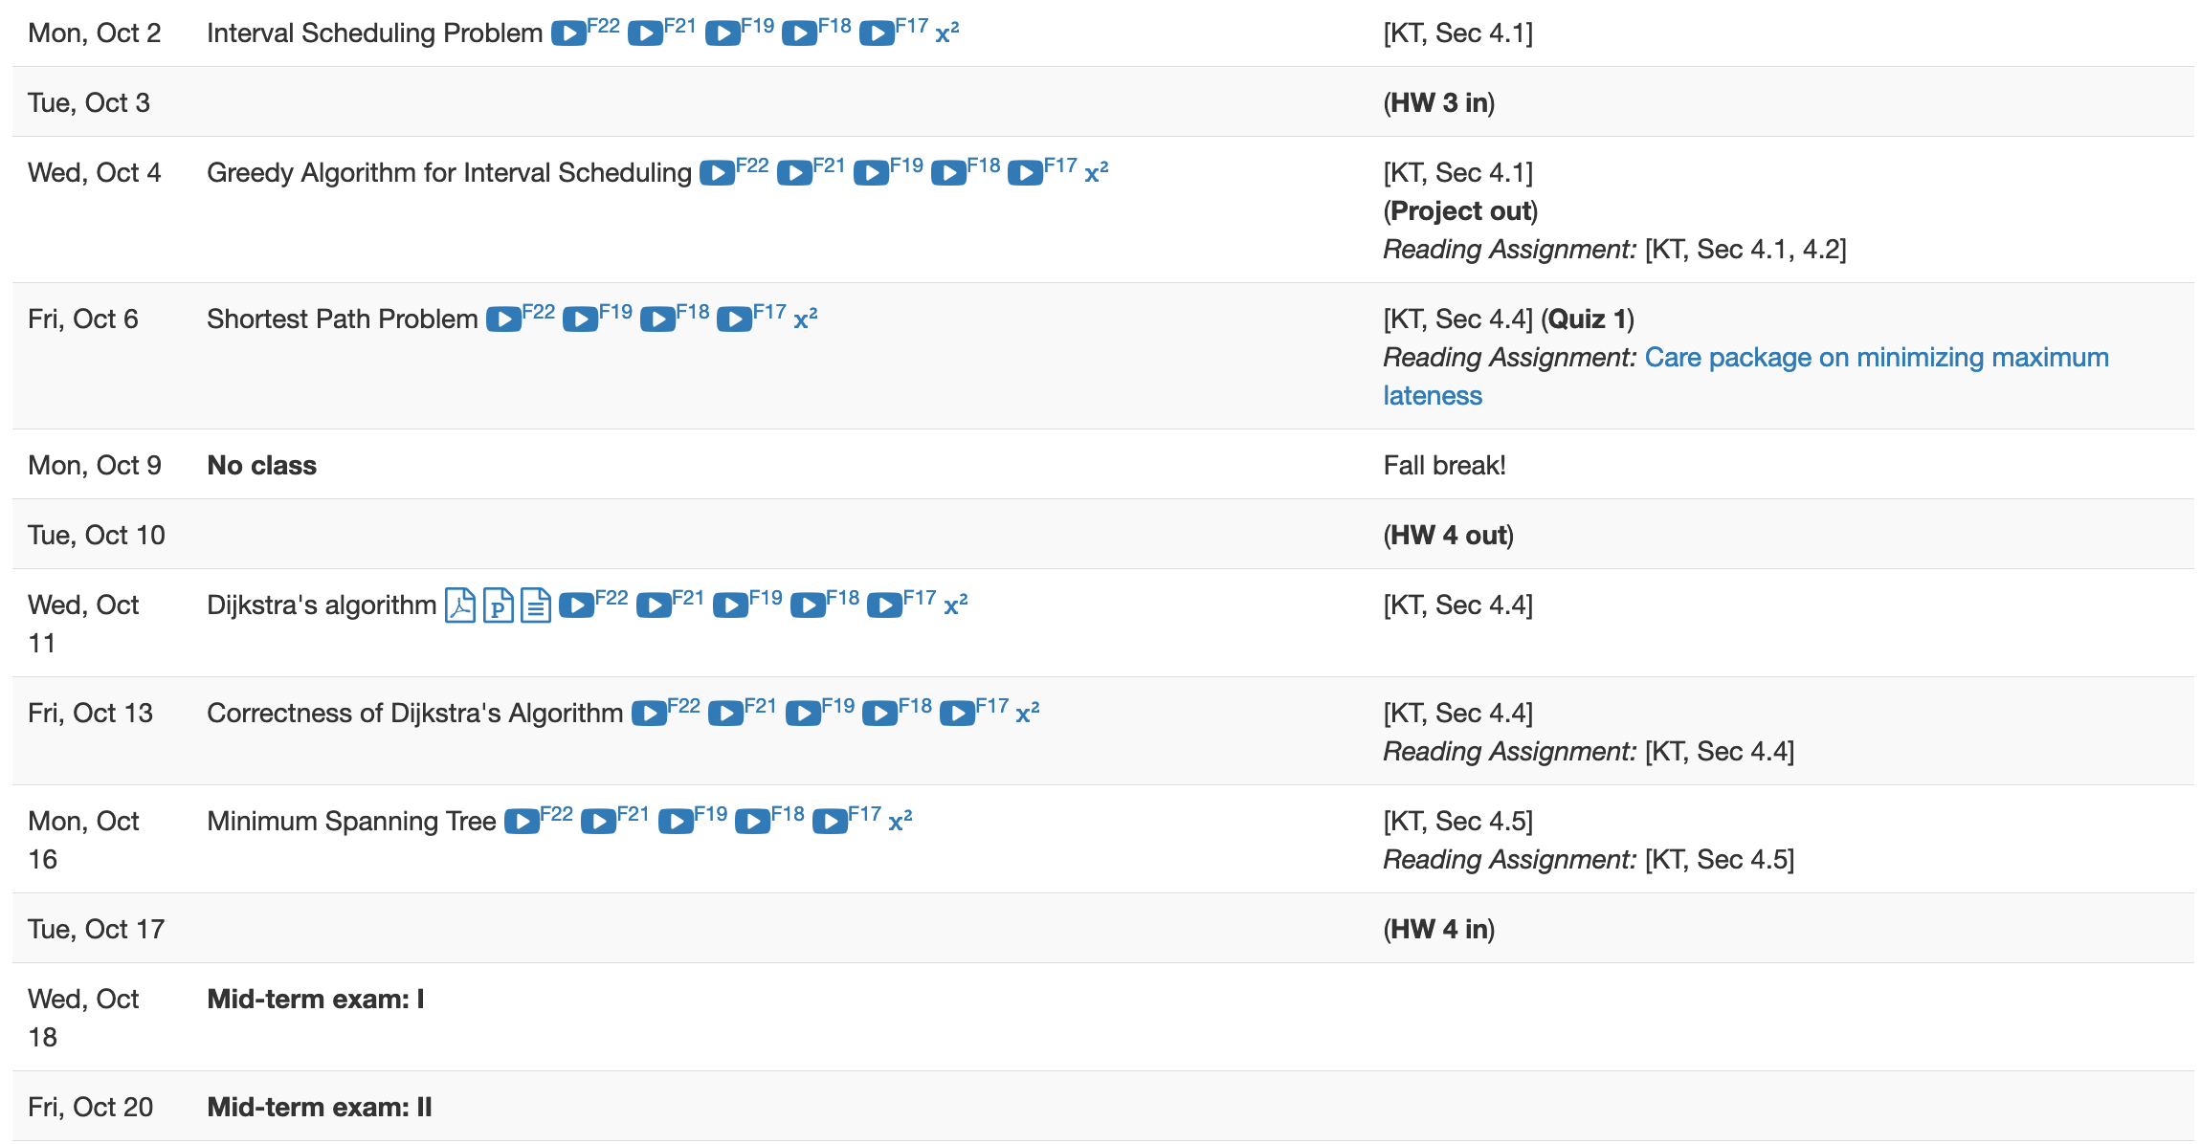
Next few weeks are gonna be busy

Slide 6
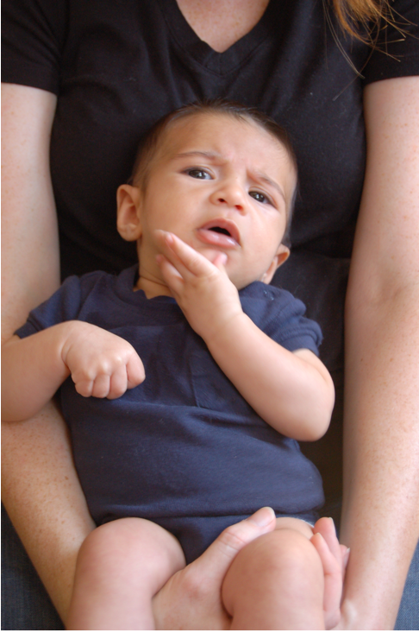
Questions?

Slide 7
Breadth First Search (BFS)
Build layers of vertices connected to s
L₀ = {s}
Assume L₀,..,L_{j} have been constructed
L_{j+1} set of vertices not chosen yet but are connected to L_{j}
Stop when new layer is empty
Use CC[v] array
Use linked lists

Slide 8
Rest of Today’s agenda
Quick run time analysis for BFS
Quick run time analysis for DFS (and Queue version of BFS)
Helping you schedule your activities for the day

Slide 9
O(m+n) BFS Implementation
Input graph as Adjacency list
BFS(s)
Array
CC[s] = T and CC[w] = F for every w≠ s
Set i = 0
Set L₀= {s}
While L_{i} is not empty
Linked List
L_{i+1} = Ø
For every u in L_{i}
For every edge (u,w)
Version in KT also computes a BFS tree
If CC[w] = F then
CC[w] = T
Add w to L_{i+1}
i++

Slide 10
All the layers as one
BFS(s)
All layers are considered in first-in-first-out order
CC[s] = T and CC[w] = F for every w≠ s
Set i = 0
Set L₀= {s}
While L_{i} is not empty
L_{i+1} = Ø
For every u in L_{i}
Can combine all layers into one queue: all the children of a node are added to the end of the queue
For every edge (u,w)
If CC[w] = F then
CC[w] = T
Add w to L_{i+1}
i++

Slide 11
An illustration
1
2
3
4
5
7
8
6
1
7
2
3
8
4
5
6

Slide 12
Queue O(m+n) implementation
BFS(s)
CC[s] = T and CC[w] = F for every w≠ s
O(n)
Intitialize Q= {s}
O(1)
While Q is not empty
Repeated at most once for each vertex u
Σ_{u} O(n_{u}) =
O(Σ_{u} n_{u}) =
O(m)
Delete the front element u in Q
For every edge (u,w)
Repeated n_{u} times
O(1)
If CC[w] = F then
O(n_{u})
CC[w] = T
O(1)
Add w to the back of Q

Slide 13
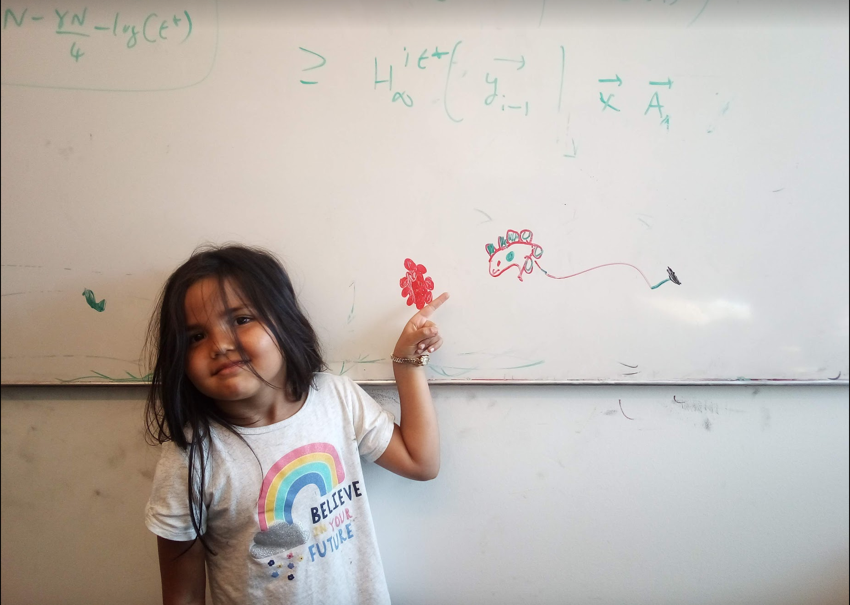
Questions/Comments?

Slide 14
Implementing DFS in O(m+n) time
Same as BFS except stack instead of a queue

Slide 15
A DFS run using an explicit stack
7
8
1
7
6
7
3
2
3
5
8
4
4
5
5
3
6
2
3
1

Slide 16
DFS stack implementation
DFS(s)
CC[s] = T and CC[w] = F for every w≠ s
Same
O(m+n) run time analysis as for BFS
Intitialize Ŝ = {s}
While Ŝ is not empty
Pop the top element u in Ŝ
If CC[u] = F then
CC[u] = T
For every edge (u,w)
Push w to the top of Ŝ

Slide 17
Questions/Comments?

Slide 18
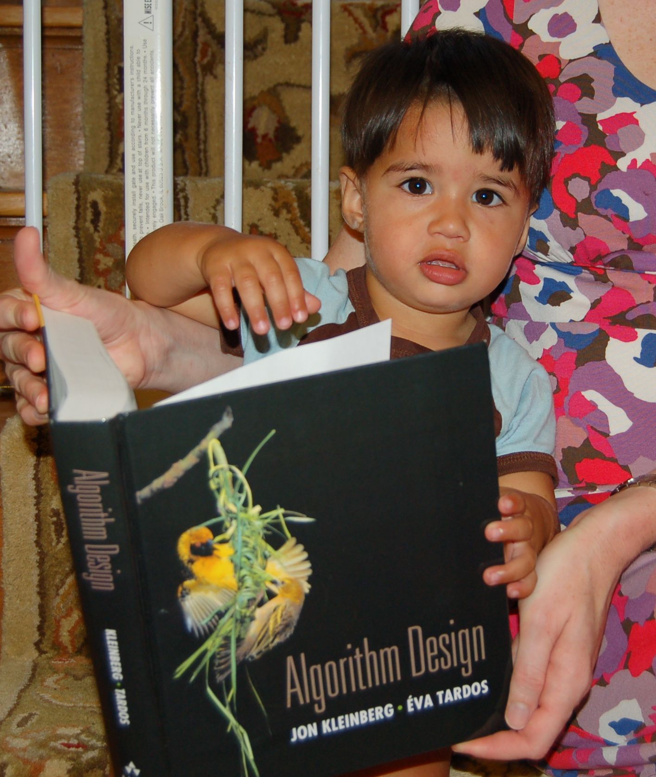
Reading Assignment
Sec 3.3, 3.4, 3.5 and 3.6 of [KT]

Slide 19


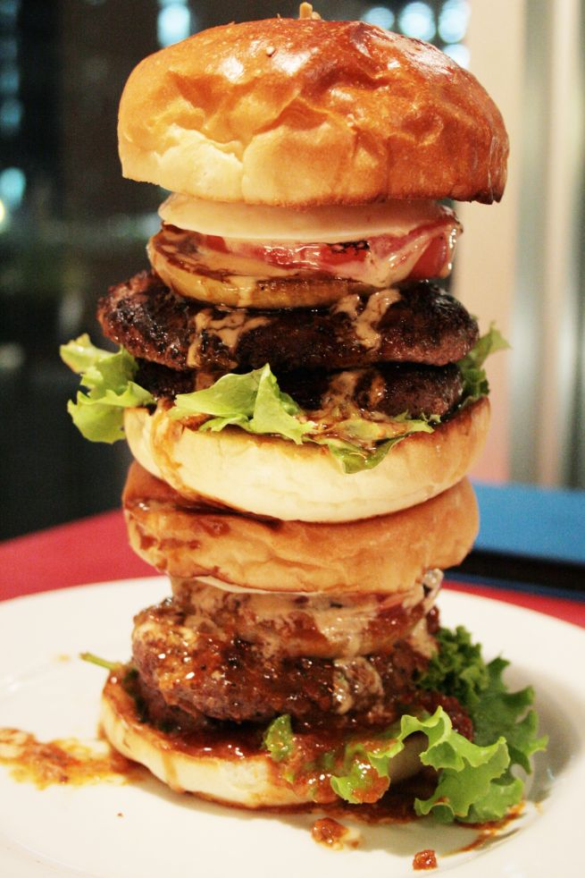
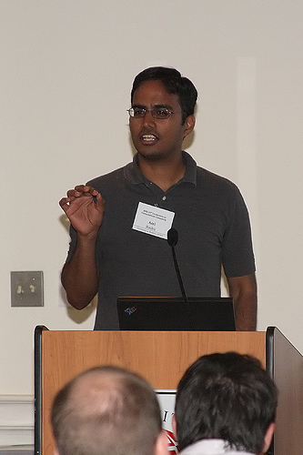
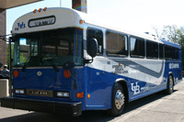
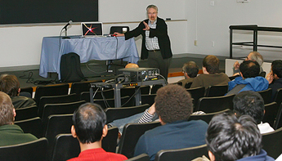
Directed graphs
Model asymmetric relationships
Precedence relationships
u needs to be done before w means (u,w) edge

Slide 20
Directed graphs
Adjacency matrix is not symmetric
Each vertex has two lists in Adj. list rep.

Slide 21
Directed Acyclic Graph (DAG)
No directed cycles
Precedence relationships are consistent

Slide 22
Topological Sorting of a DAG
Order the vertices so that all edges go “forward”

Slide 23

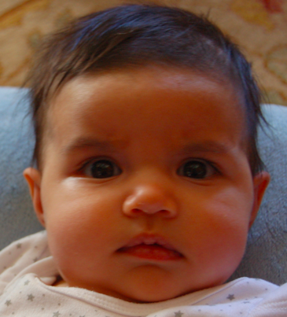
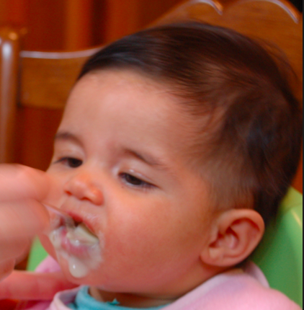
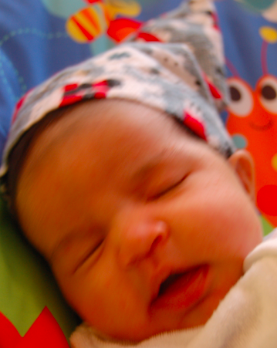
Probabilistic Graphical Models (PGMs)
http://ginaskokopelli.com/wp-content/uploads/2013/01/DiaperDealsLogo.jpg
D
E
H
f_{S|E}(s,e) = Pr[S=s|E=e]
S
S
E
f_{S|E}
Σ
1
1
0.8
φ (h) =
f_{H|D,S}(h,d,s) × f_{S|E}(s,e)
× f_{D|E}(d,e) × f_{E}(e)
1
0
0.3
d,s,e
0
1
0.2
0
0
0.7

Slide 24
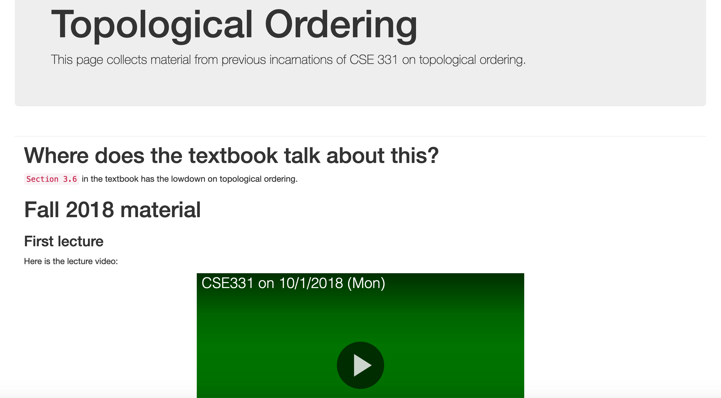
More details on Topological sort

Slide 25
Questions/Comments?

Slide 26
Mid-term material until here

Slide 27




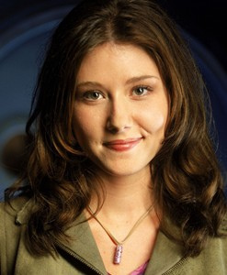
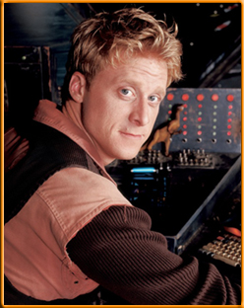

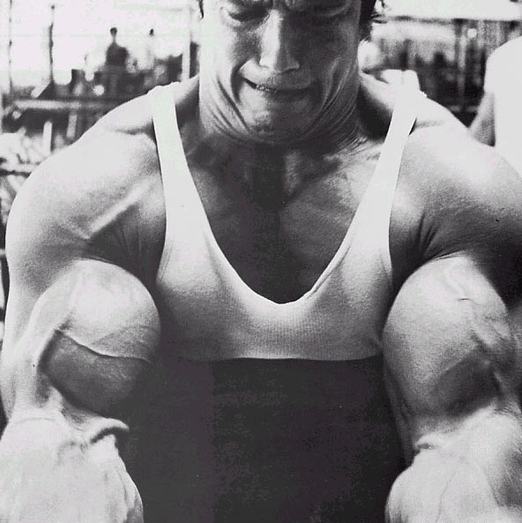
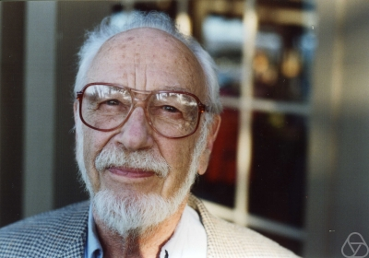
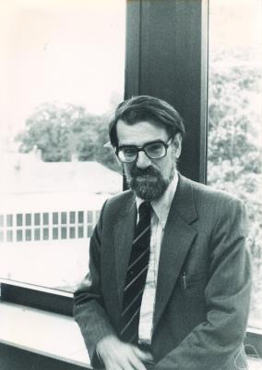
Main Steps in Algorithm Design
Problem Statement
Problem Definition
Algorithm
n!
“Implementation”
Data Structures
Analysis
Correctness+Runtime Analysis

Slide 28
Where do graphs fit in?
Problem Statement
A tool to define problems
Problem Definition
Algorithm
“Implementation”
Data Structures
Analysis
Correctness+Runtime Analysis

Slide 29
Rest of the course*
Problem Statement
Problem Definition
Three general techniques
Algorithm
“Implementation”
Data Structures
Analysis
Correctness+Runtime Analysis

Slide 30

Greedy algorithms
Build the final solution piece by piece
Being short sighted on each piece
Never undo a decision
Know when you see it

Slide 31

End of Semester blues
Can only do one thing at any day: what is the maximum number of tasks that you can do?
Write up a term paper
Party!
Exam study
331 homework
331 HW
Project
Friday
Saturday
Sunday
Monday
Tuesday

Slide 32
The optimal solution
Can only do one thing at any day: what is the maximum number of tasks that you can do?
Party!
Exam study
331 HW
Friday
Saturday
Sunday
Monday
Tuesday

Slide 33
Interval Scheduling Problem
Input: n intervals [s(i), f(i)) for 1≤ i ≤ n
{ s(i), … ,f(i)-1 }
Output: A schedule S of the n intervals
No two intervals in S conflict
|S| is maximized

Slide 34
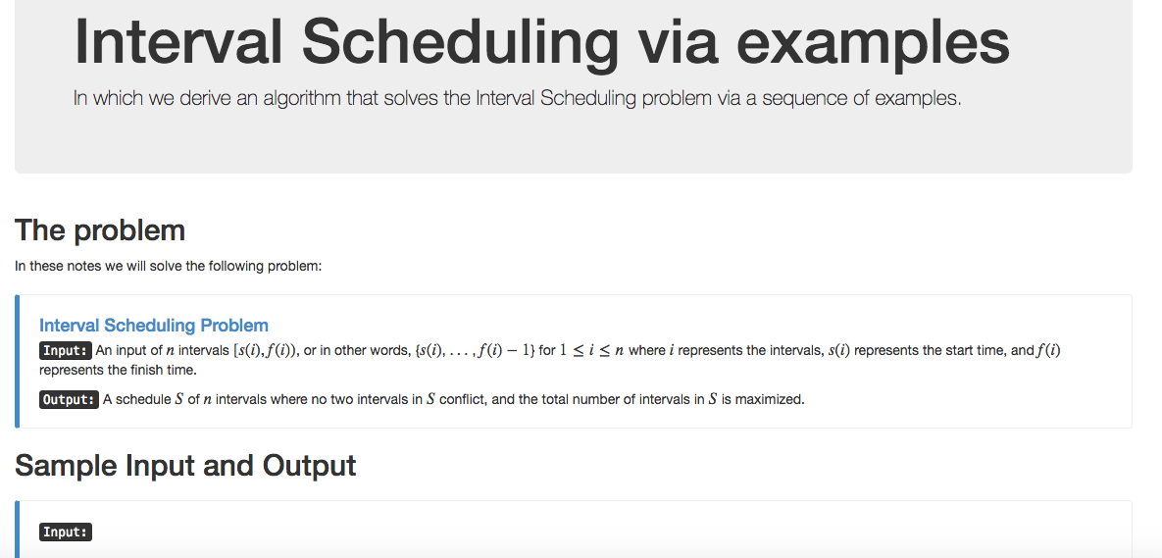
Algorithm with examples

