Slide 1
Lecture 17
CSE 331
Oct 6, 2023

Slide 2
Quiz 1– 11:02-11:12am

Slide 3
Lecture starts at 11:17am

Slide 4
Quiz 1 timelines
Solutions: posted by today evening
Grading: finished by next week

Slide 5
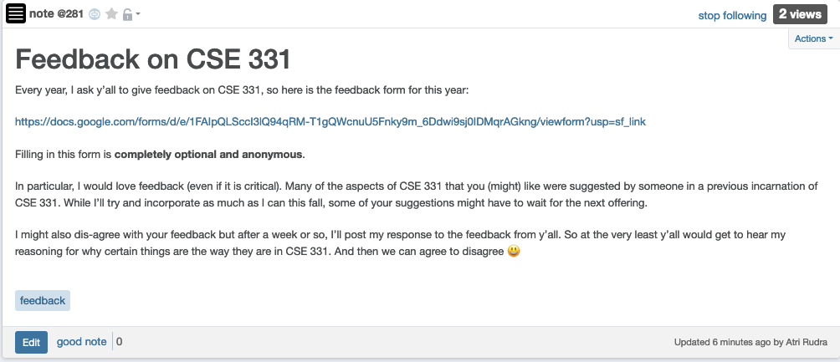
Please do fill in the feedback

Slide 6
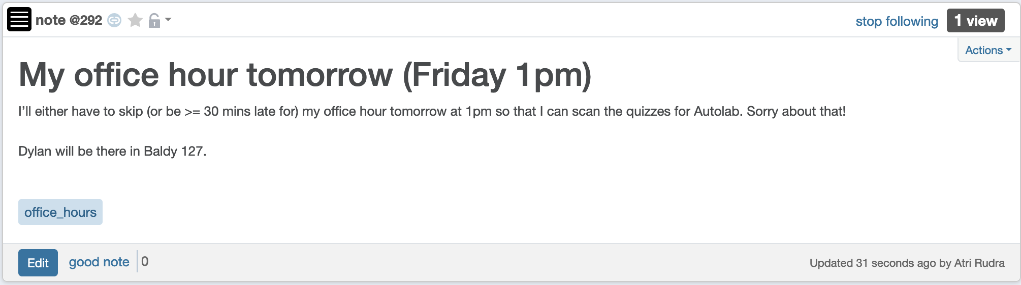
My office hour today

Slide 7
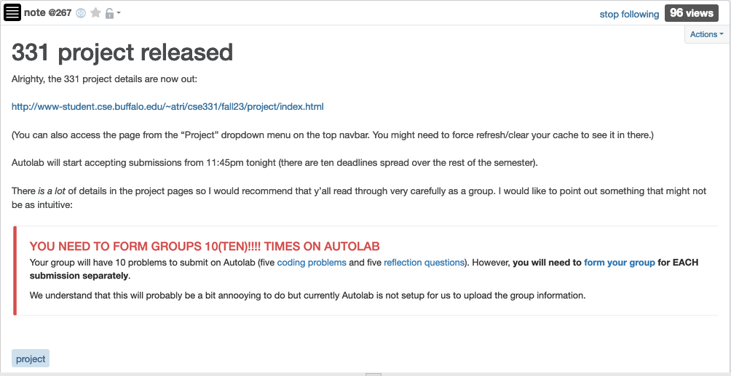
Project released

Slide 8
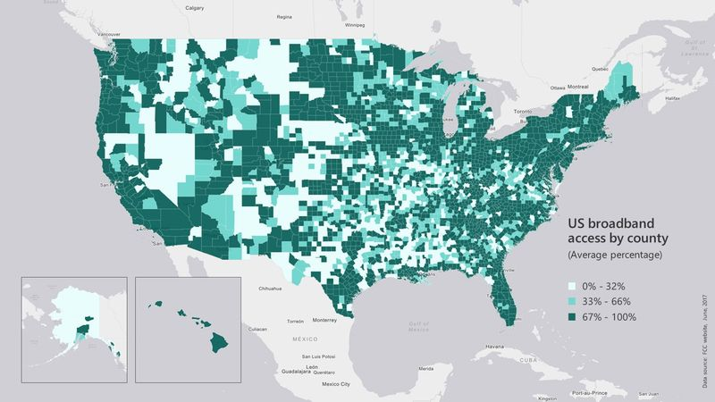
Broadband access
https://assets.bwbx.io/images/users/iqjWHBFdfxIU/iZSjibxE1KJs/v1/800x-1.jpg

Slide 9
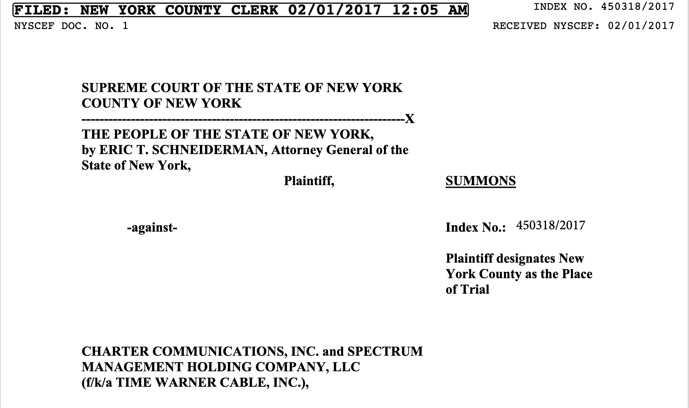
Lawsuit against Spectrum

Slide 10
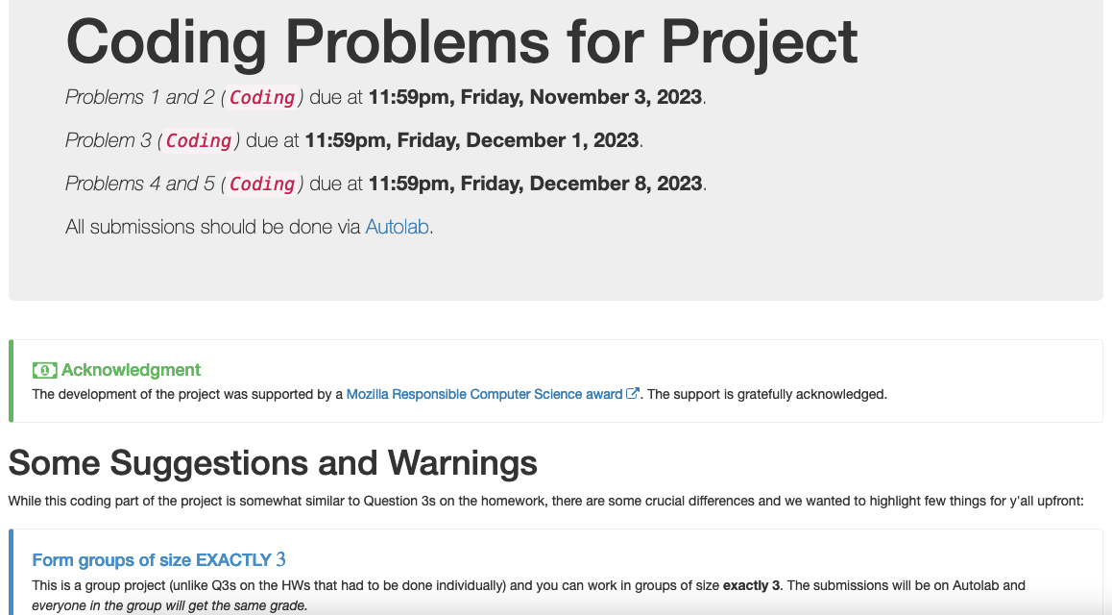
Five coding problems

Slide 11
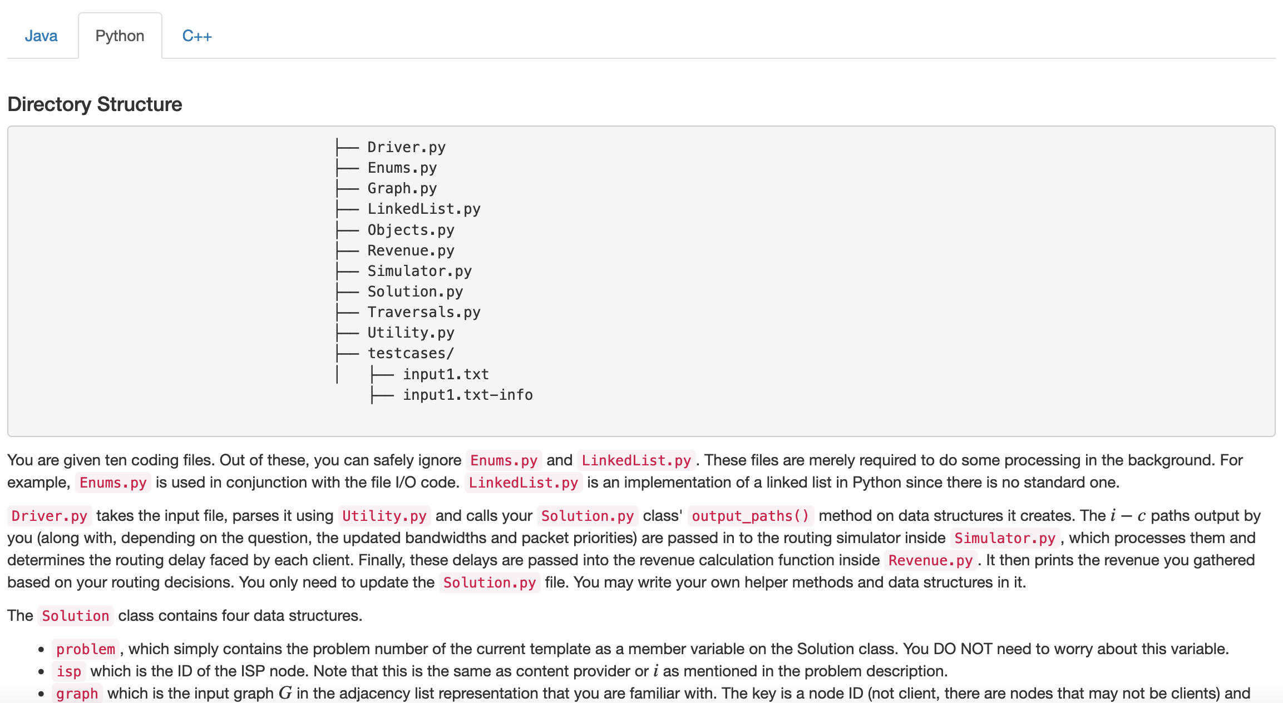
Each like a HW Q3
You can get full credit with code length along the lines of Q3 submissions!
More work to UNDERSTAND the problem

Slide 12
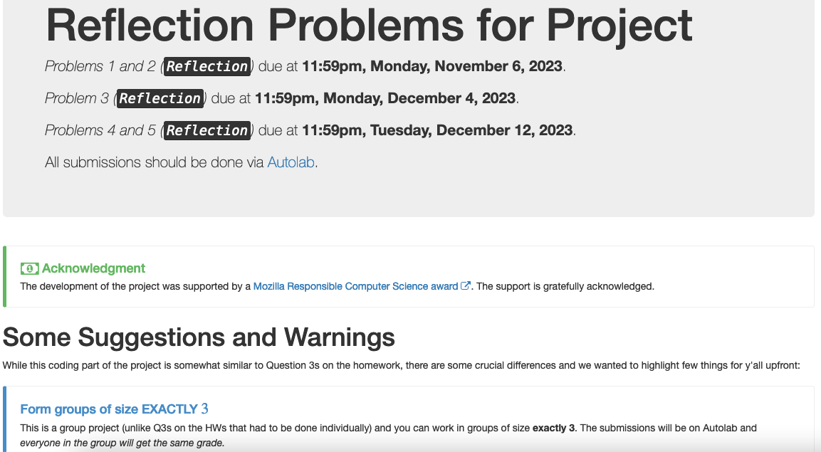
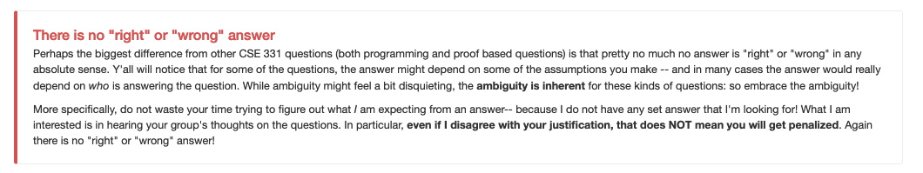
Five reflection problems

Slide 13
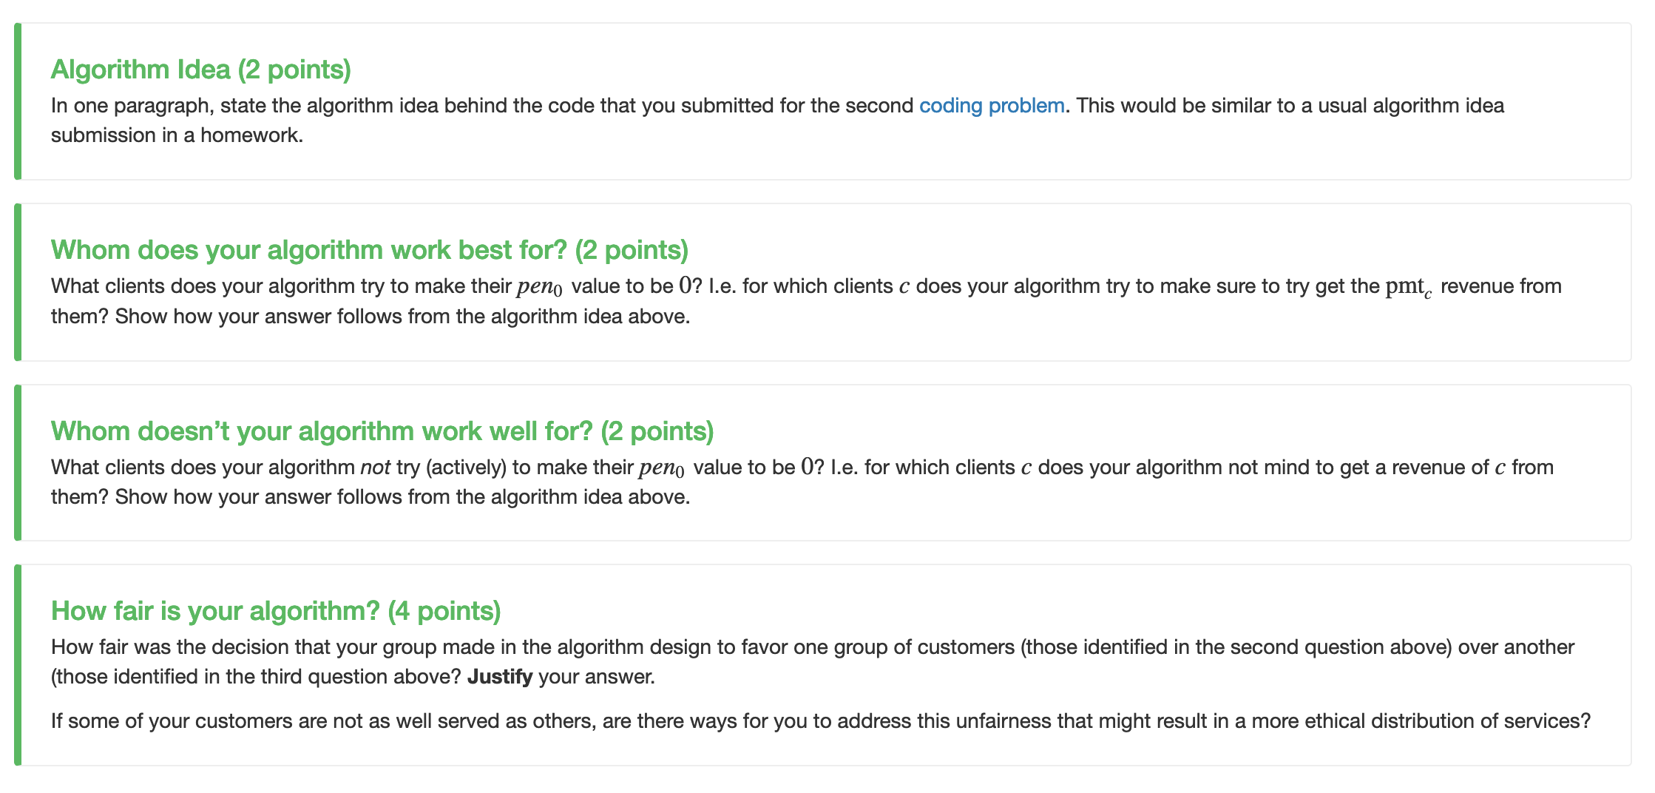
Reflect on your design choices

Slide 14
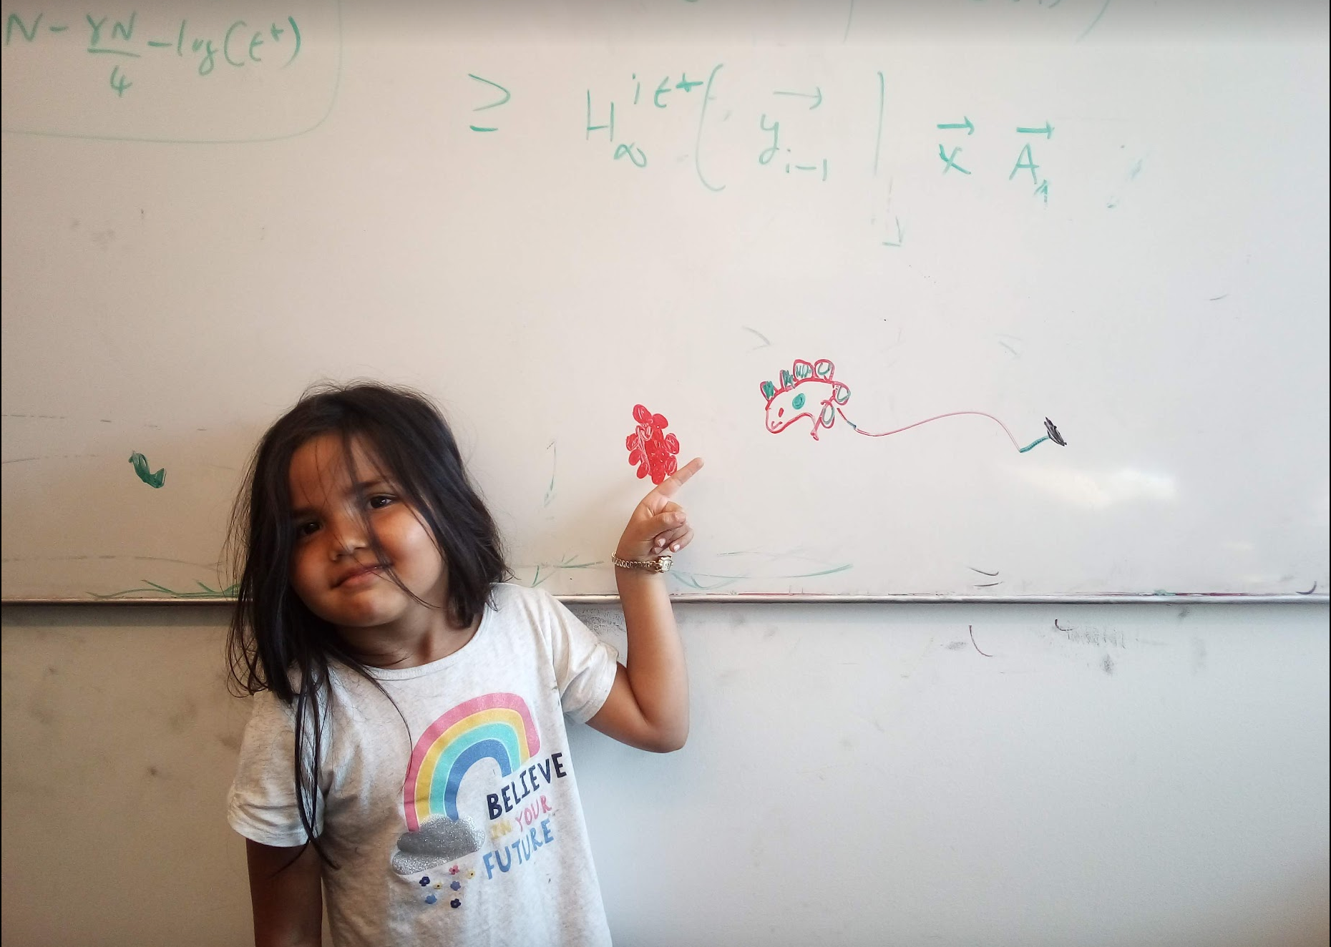
Questions/Comments?

Slide 15
Interval Scheduling Problem
Input: n intervals [s(i), f(i)) for 1≤ i ≤ n
Output: A schedule S of the n intervals
No two intervals in S conflict
|S| is maximized

Slide 16
Analyzing the algorithm
R: set of requests
S* has no conflicts
Set S to be the empty set
While R is not empty
Choose i in R with the earliest finish time
Add i to S
S* is an optimal solution
Remove all requests that conflict with i from R
Return S* = S

Slide 17
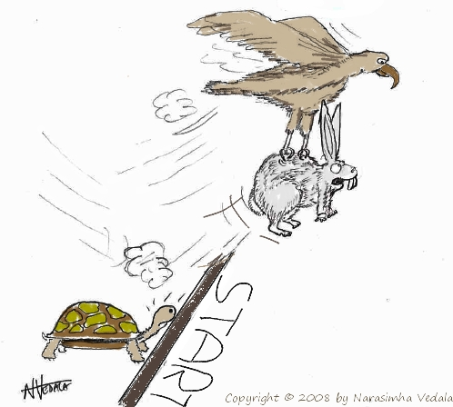
Greedy “stays ahead”
Greedy
OPT

Slide 18
Today’s agenda
Prove the correctness
(If we have time) Analyze run-time of the greedy algorithm

Slide 19
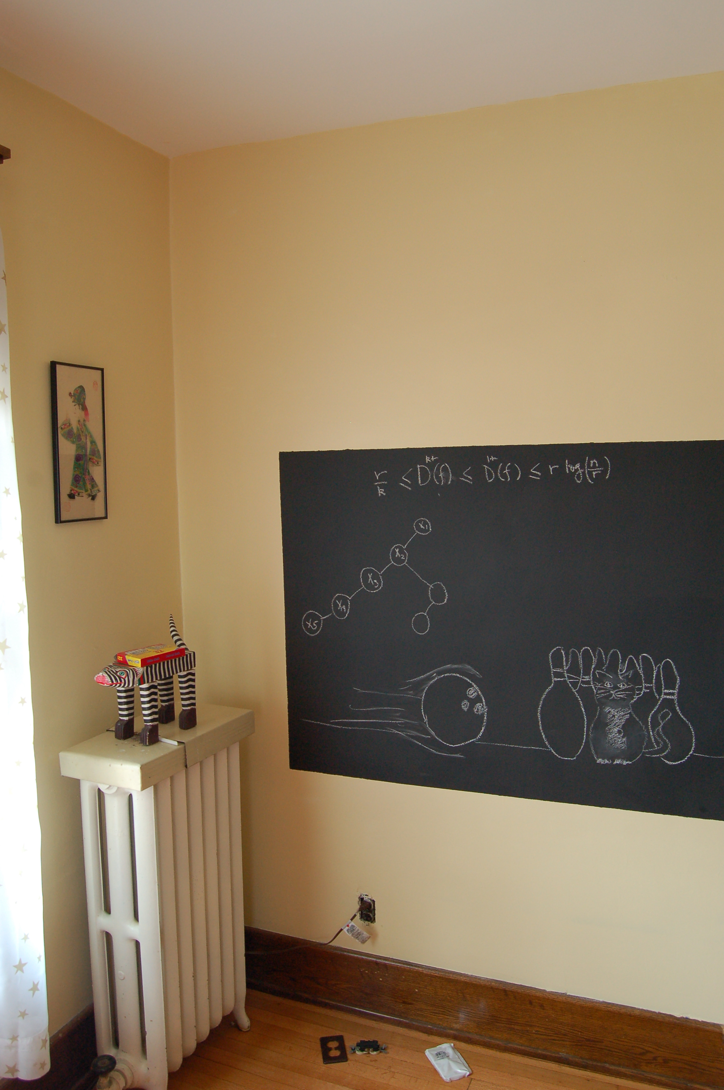
Argue correctness on the board…

