Slide 1
Lecture 18
CSE 331
Oct 11, 2023

Slide 2
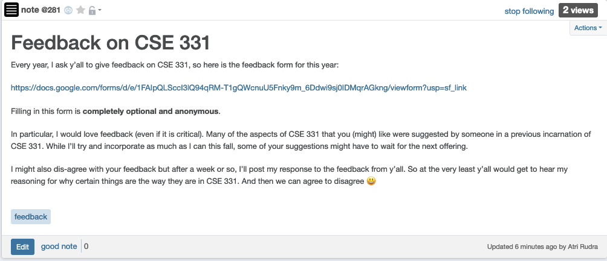
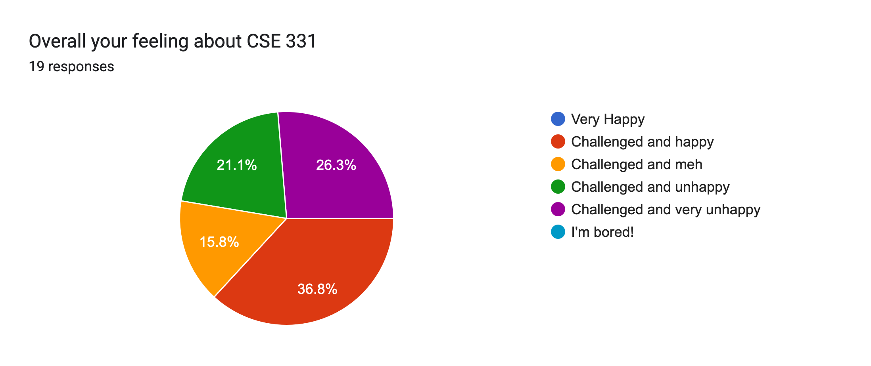
Please do fill in the feedback

Slide 3
Mid-terms next week
Mid-term 1: next Wed in class
Mid-term 2: Fri next week in class

Slide 4
Grading status
Hopefully by tonight: Quiz 1, HW 3

Slide 5
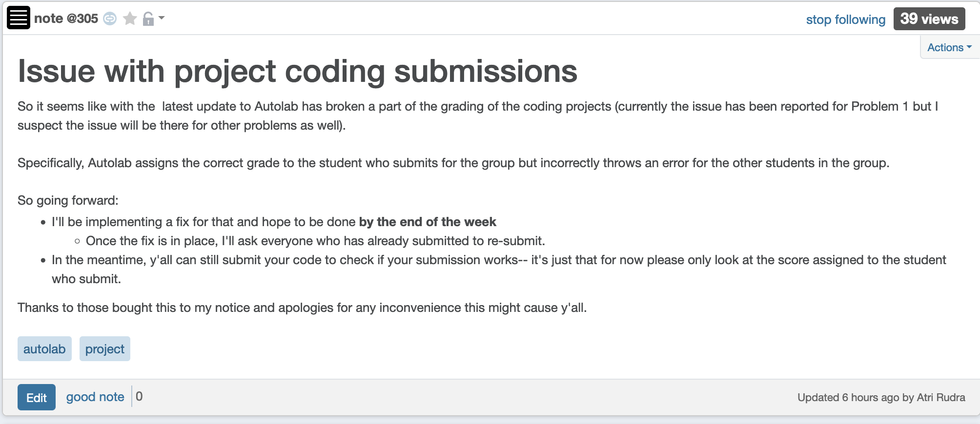
Project Coding submissions

Slide 6
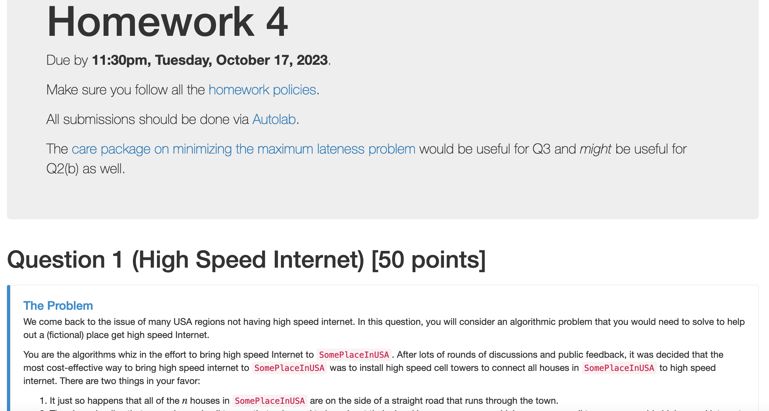
HW 4 is out
Probably the easiest HW

Slide 7
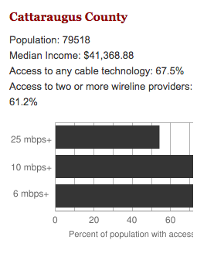
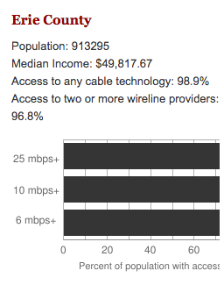
Make broadband more available
BOTH technical and societal issues
Say you are tasked to come up with the infrastructure

Slide 8
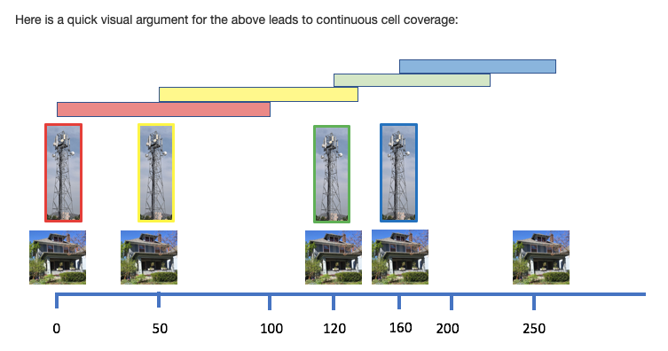
HW 4 Q1: How to lay down towers

Slide 9
Interval Scheduling Problem
Input: n intervals [s(i), f(i)) for 1≤ i ≤ n
Output: A schedule S of the n intervals
No two intervals in S conflict
|S| is maximized

Slide 10
Analyzing the algorithm
R: set of requests
S* has no conflicts
Set S to be the empty set
While R is not empty
Choose i in R with the earliest finish time
Add i to S
S* is an optimal solution
Remove all requests that conflict with i from R
Return S* = S

Slide 11
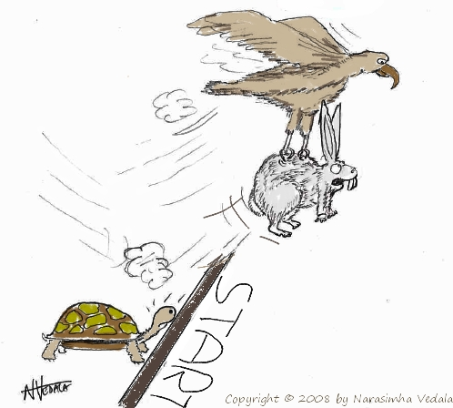
Greedy “stays ahead”
Greedy
OPT

Slide 12
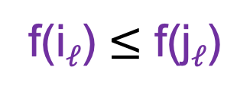

Greedy stays ahead lemma
S* = {i₁,..,i_{k}}
O = {j₁,..,j_{m}}
Lemma 1: For all 1 $≤$ $ℓ$ $≤$ k
f(i$ℓ$) $≤$ f(j$ℓ$)

Slide 13
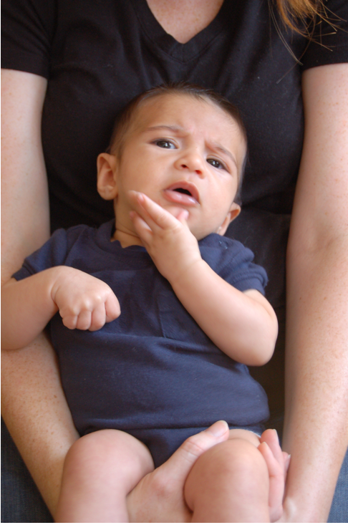
Questions?

Slide 14
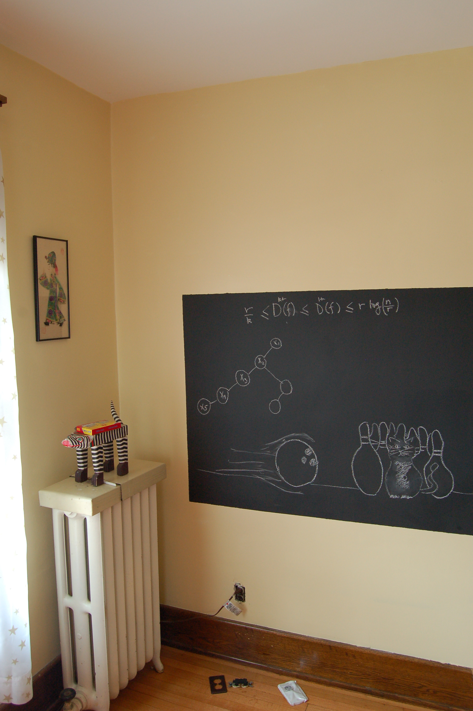
Proof of Lemma 1 on the board…

Slide 15
Runtime analysis of Greedy Algo.
R: set of requests
O(1)
Set S to be the empty set
Repeated at most n times
While R is not empty
O(n)
O(1)
Choose i in R with the earliest finish time
Add i to S
O(n)
Overall: O(n) + n*O(n) = O(n²)
Remove all requests that conflict with i from R
Return S* = S
O(n)

Slide 16
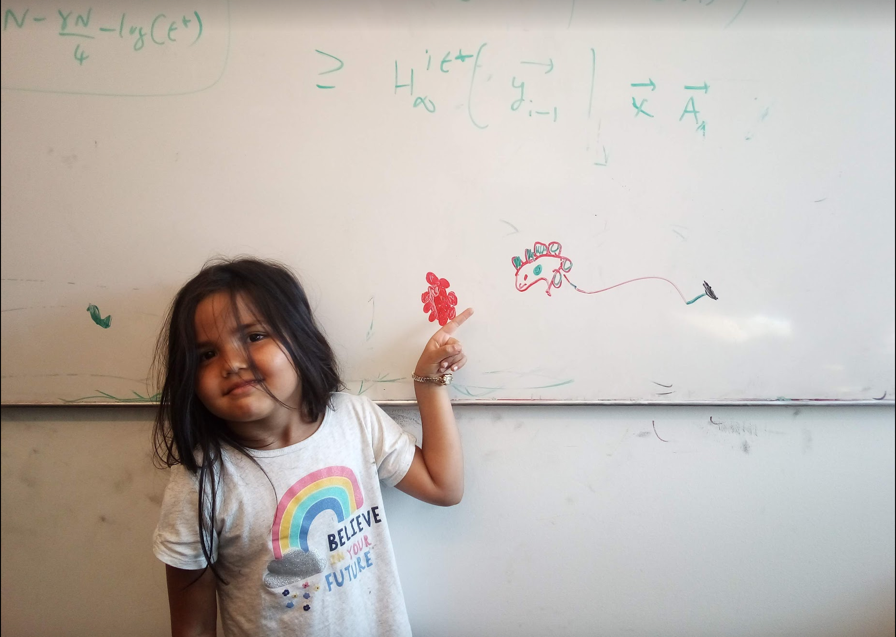
Questions/Comments?

Slide 17
Algorithm implementation
Go through the intervals in order of their finish time
3
How can you tell in O(1) time if any of 2,3 or 4 conflict with 1?
Check if s[i] < f(1)
2
1
4
O(n log n) run time
In general, if jth interval is the last one chosen
Pick smallest i>j such that s[i] ≥ f(j)

Slide 18
The final algo
O(n log n) time sort intervals such that f(i) ≤ f(i+1)
O(n) time build array s[1..n] s.t. s[i] = start time for i
Add 1 to S and set f = f(1)
For i = 2 .. n
If s[i] ≥ f
Add i to S
Set f = f(i)
Return S* = S

Slide 19
Questions/Comments?

Slide 20
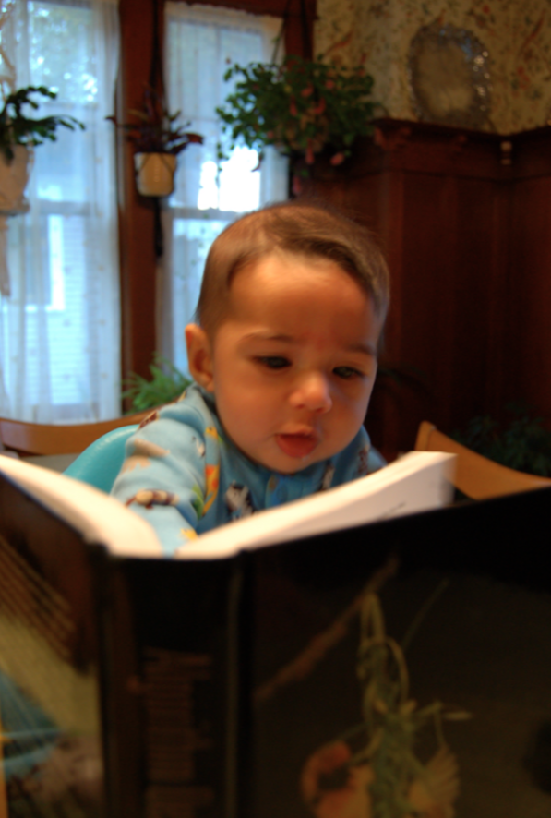
Reading Assignment
Sec 4.1 of [KT]

Slide 21

The “real” end of Semester blues
There are deadlines and durations of tasks
Write up a term paper
Party!
Exam study
331 HW
Project
Friday
Saturday
Sunday
Monday
Tuesday

Slide 22
The “real” end of Semester blues
There are deadlines and durations of tasks
Write up a term paper
Exam study
Party!
331 HW
Project
Friday
Saturday
Sunday
Monday
Tuesday

Slide 23
The algorithmic task
YOU decide when to start each task
Write up a term paper
Exam study
You have to do ALL the tasks
Party!
331 HW
Project
Friday
Saturday
Sunday
Monday
Tuesday

Slide 24
Scheduling to minimize lateness
All the tasks have to be scheduled
GOAL: minimize maximum lateness
Write up a term paper
Exam study
Party!
331 HW
Project
Friday
Saturday
Sunday
Monday
Tuesday

Slide 25
One possible schedule
All the tasks have to be scheduled
GOAL: minimize maximum lateness
Lateness = 0
Lateness = 2
331 HW
Party!
Exam study
Write up a term paper
Friday
Saturday
Sunday
Monday
Tuesday

Slide 26
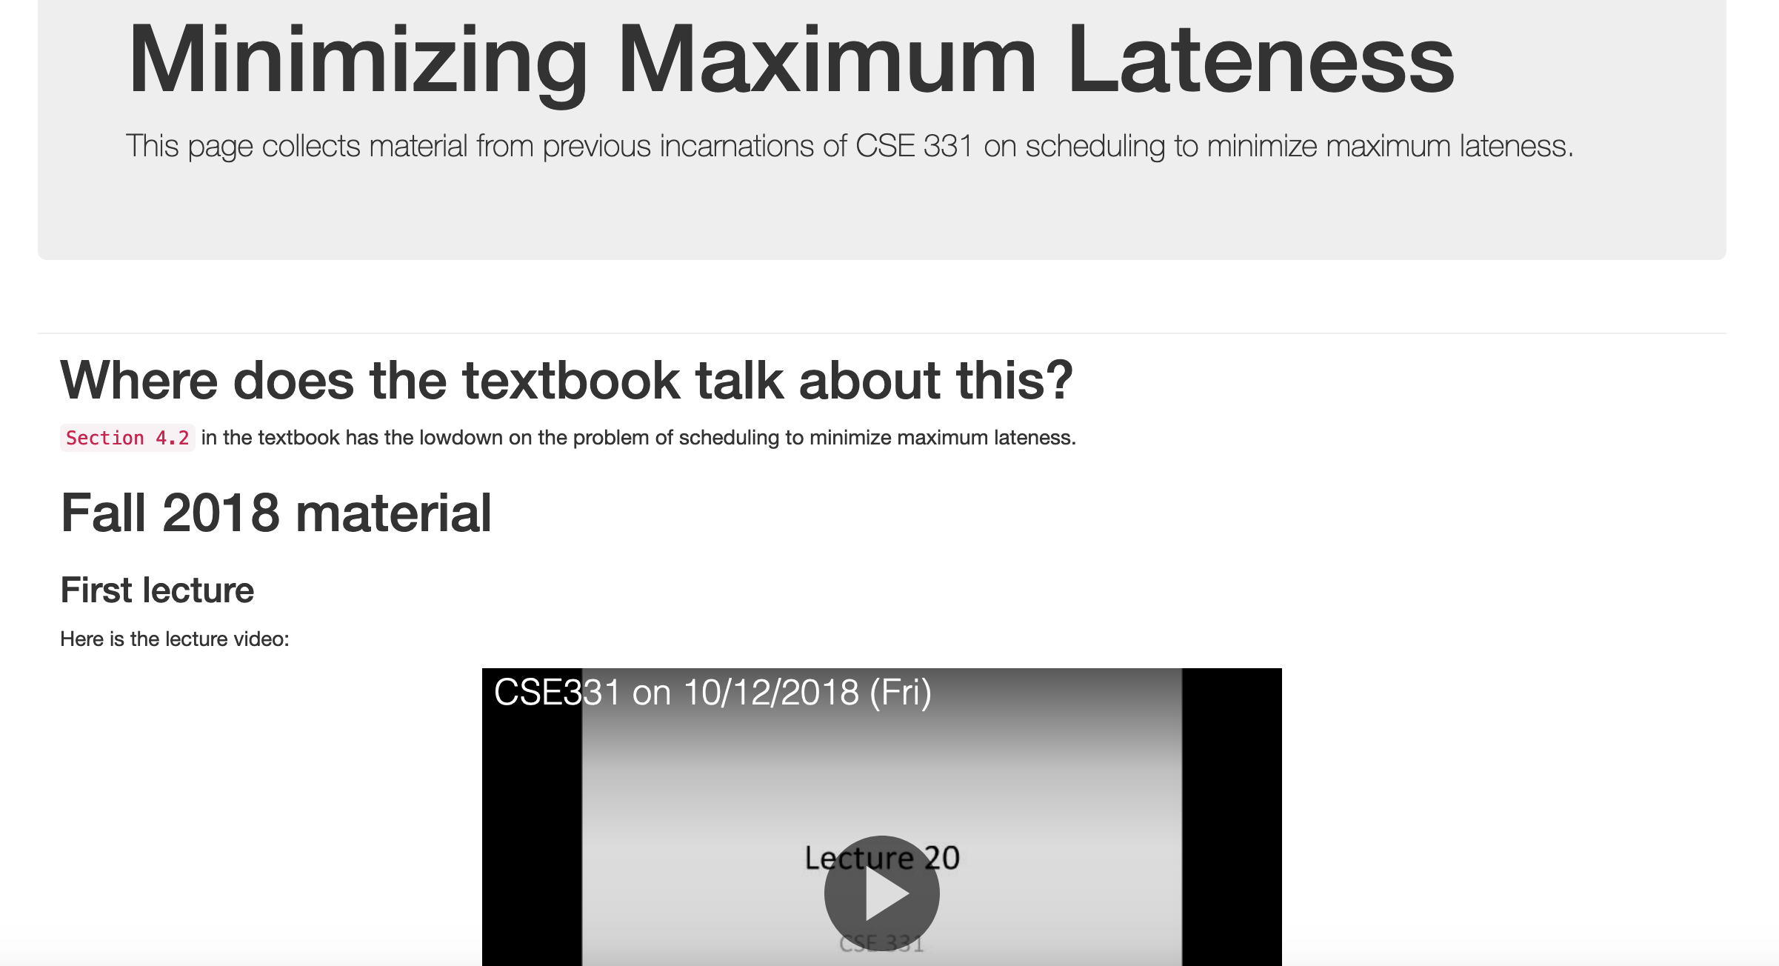
Minimizing Max Lateness

Slide 27
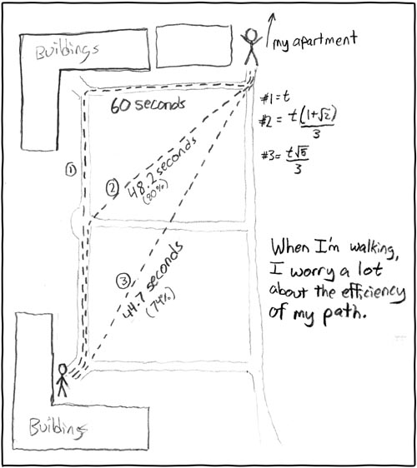
Rest of today
Shortest Path Problem
http://xkcd.com/85/

Slide 28
Reading Assignment
Sec 2.5 of [KT]

Slide 29
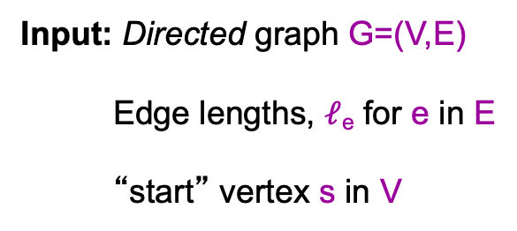
Shortest Path problem
s
100
Input: Directed graph G=(V,E)
Edge lengths, $ℓ$_{e} for e in E
“start” vertex s in V
w
5
15
u
s
s
w
5
5
15
u
u
Output: All shortest paths from s to all nodes in V

Slide 30
Naïve Algorithm
Ω(n!) time

Slide 31
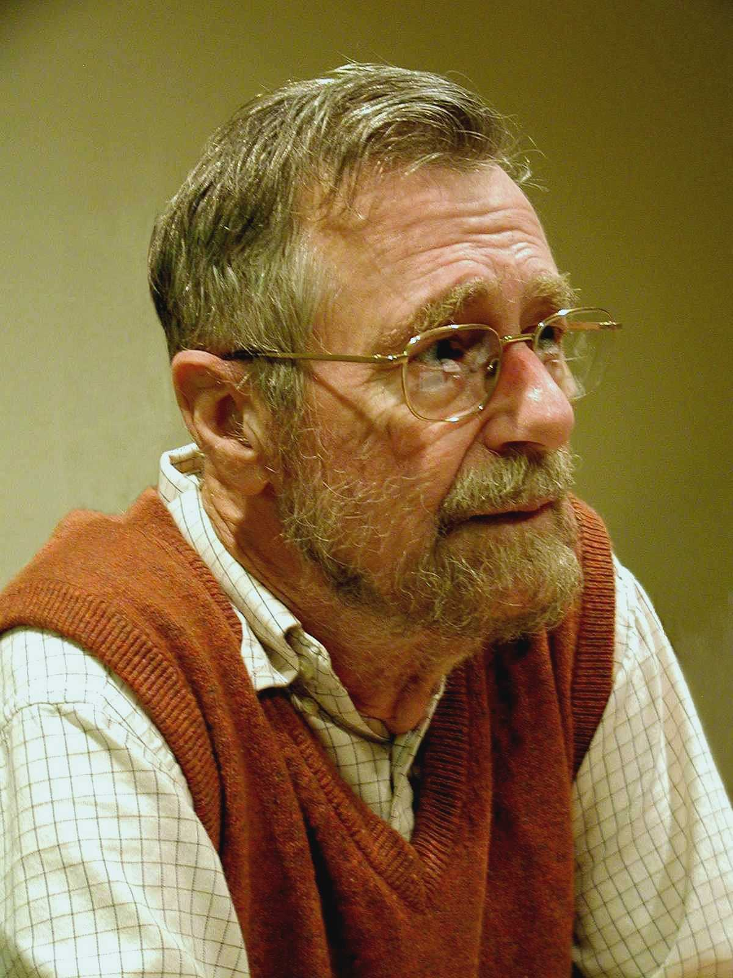
Dijkstra’s shortest path algorithm
E. W. Dijkstra (1930-2002)

