Slide 1
Lecture 19
CSE 331
Oct 13, 2023

Slide 2
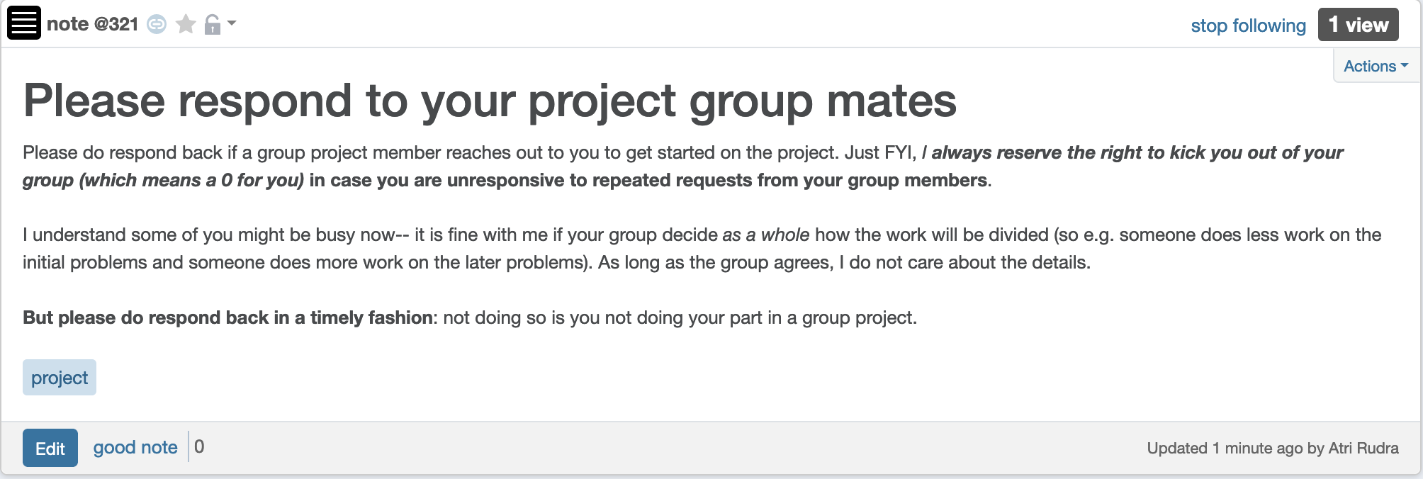
Respond to project group members

Slide 3
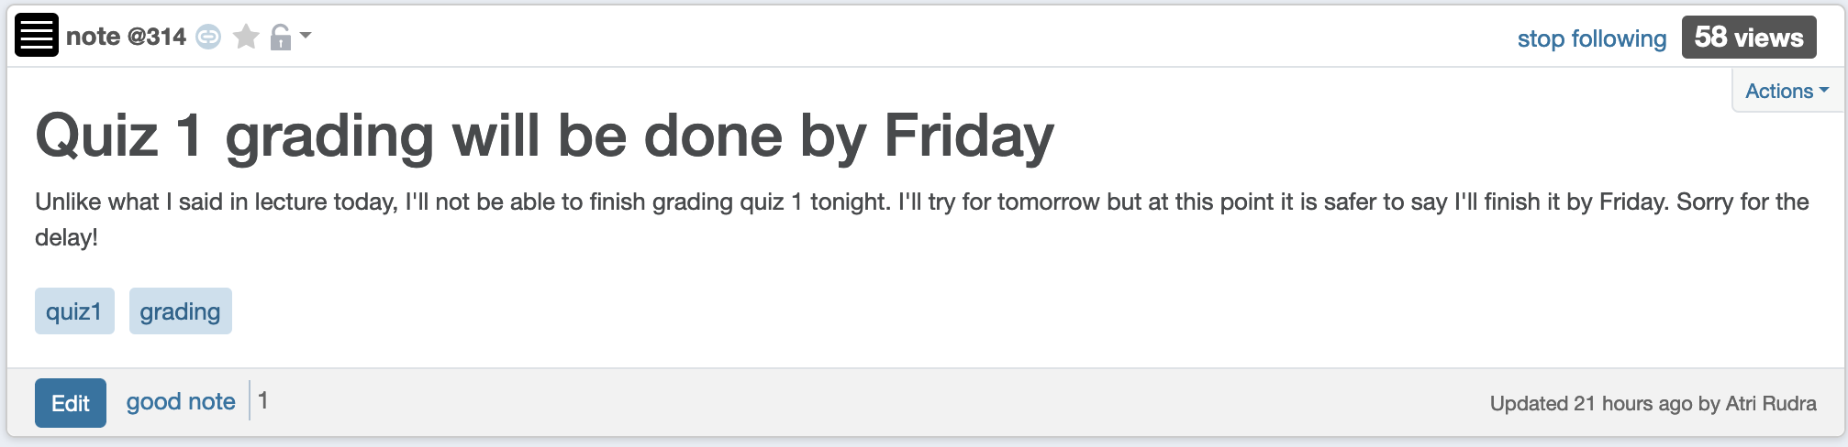
Delay in grading Quiz 1

Slide 4
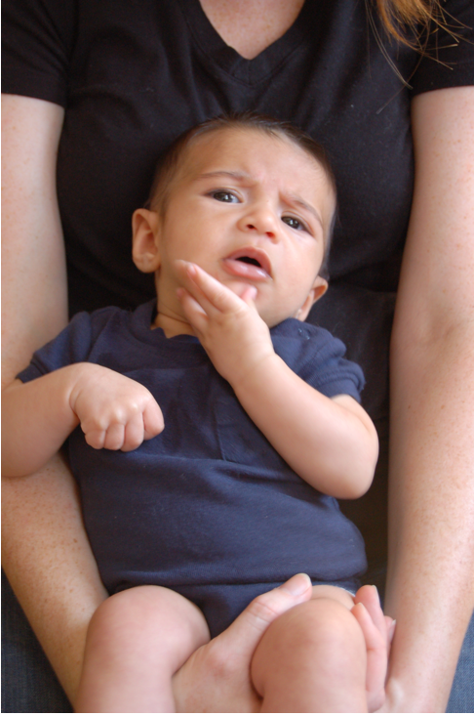
Questions?

Slide 5
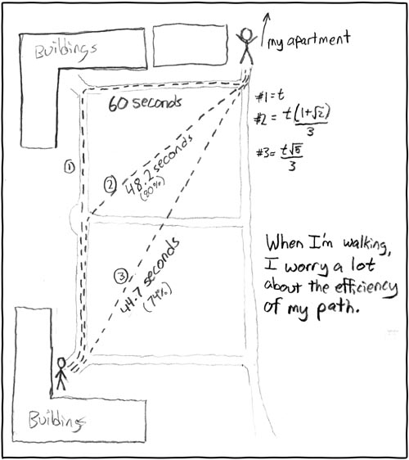
Shortest Path Problem
http://xkcd.com/85/

Slide 6

Another more important application
Is BGP a known acronym for you?
Routing uses shortest path algorithm

Slide 7
Shortest Path problem
s
100
Input: Directed graph G=(V,E)
Edge lengths, l_{e} for e in E
“start” vertex s in V
w
5
15
u
s
s
w
5
5
15
u
u
Output: Length of shortest paths from s to all nodes in V

Slide 8
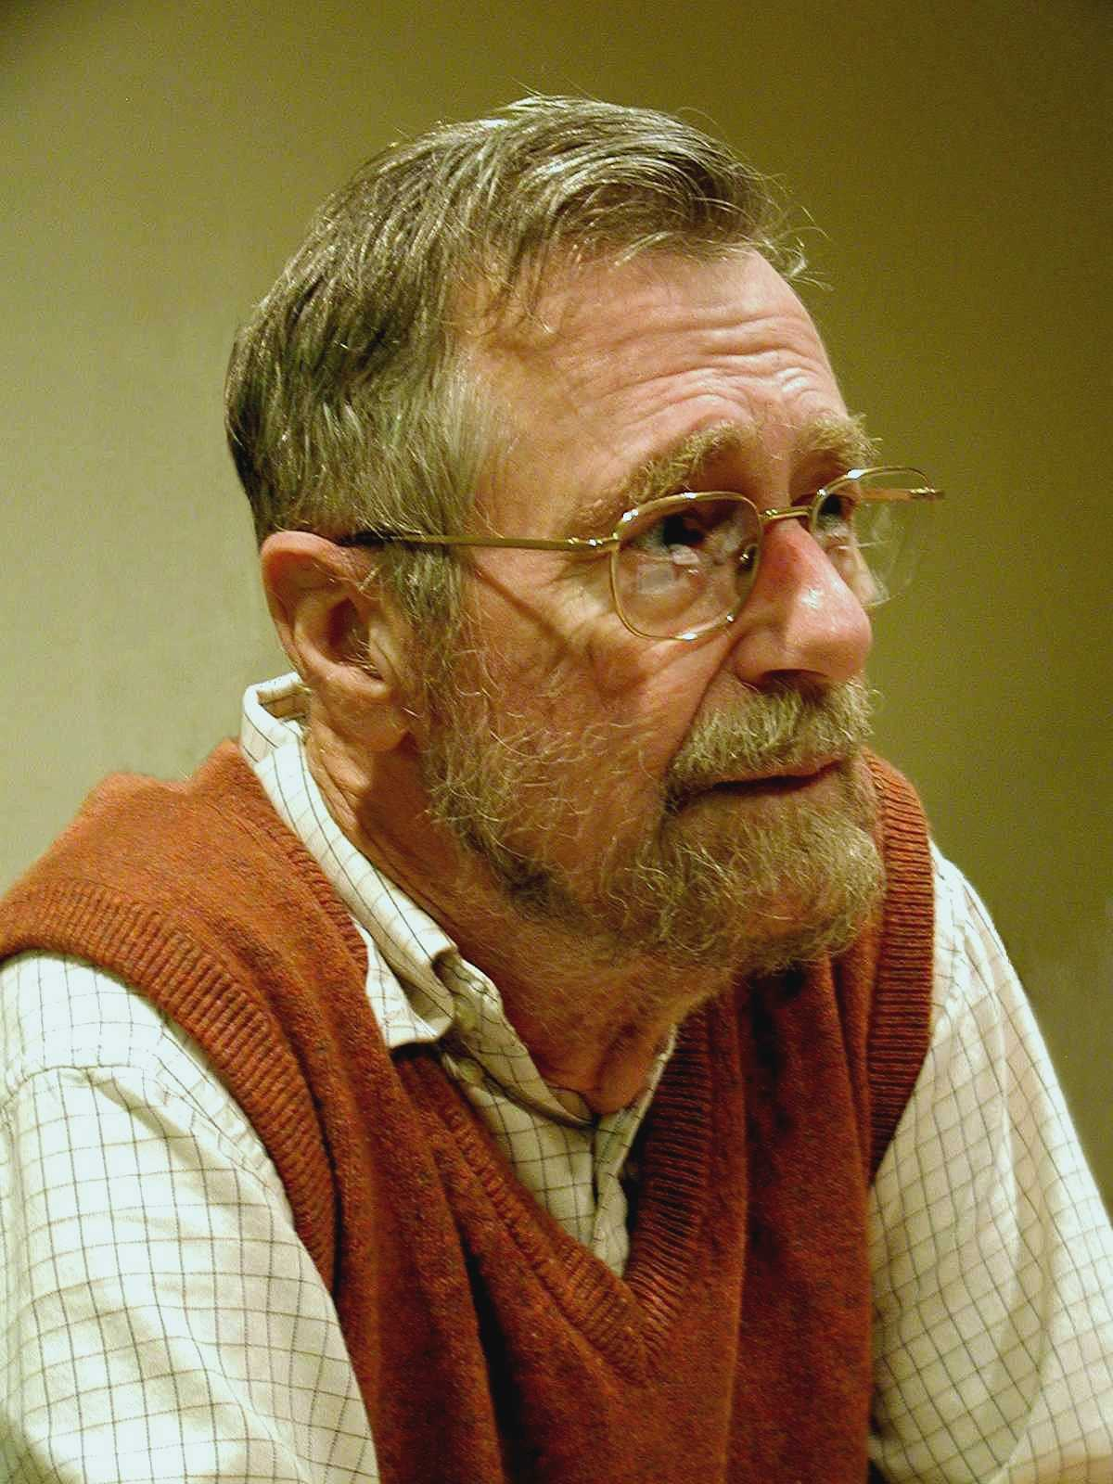
Dijkstra’s shortest path algorithm
E. W. Dijkstra (1930-2002)

Slide 9
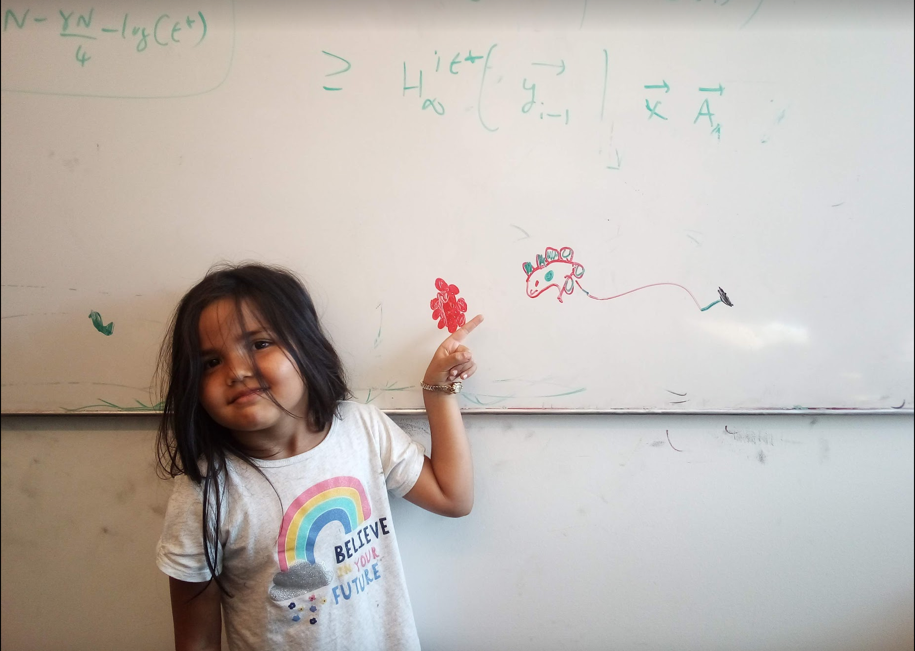
Questions/Comments?

Slide 10
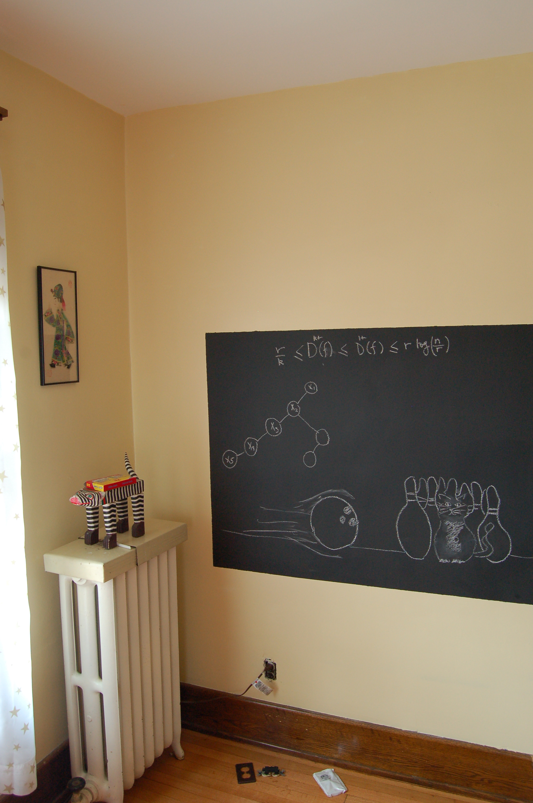
On to the board…

Slide 11
Towards Dijkstra’s algo: part ek
Determine d(t) one by one
s
d(s) = 0
u
x
y

Slide 12

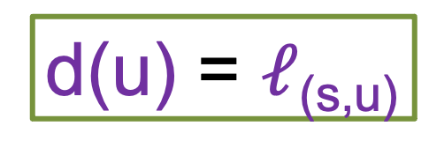
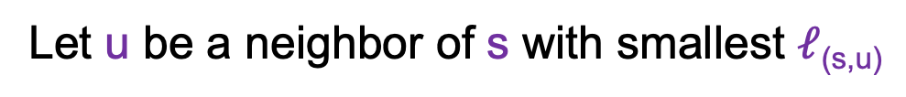
Towards Dijkstra’s algo: part do
Determine d(t) one by one
Let u be a neighbor of s with smallest $ℓ$_{(s,u)}
s
100
3
4
u
x
y
d(u) = $ℓ$_{(s,u)}
Not making any claim on other vertices

Slide 13



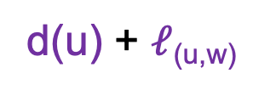
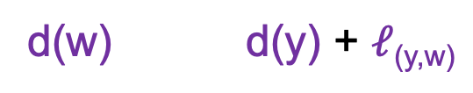
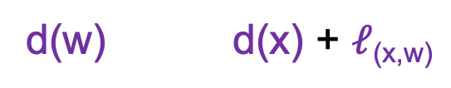
Towards Dijkstra’s algo: part teen
Determine d(t) one by one
R
Assume we know d(v) for every v in R
s
u
x
y
Compute an upper bound d’(w) for every w not in R
d(w)
d(u) + $ℓ$_{(u,w)}
w
d(w) d(x) + $ℓ$_{(x,w)}
d’(w) = min _{e=(u,w) in E, u in R} d(u)+ $ℓ$_{e}
d(w) d(y) + $ℓ$_{(y,w)}

Slide 14
Questions/Comments?

