Slide 1
Lecture 2
CSE 331
Aug 30, 2023

Slide 2
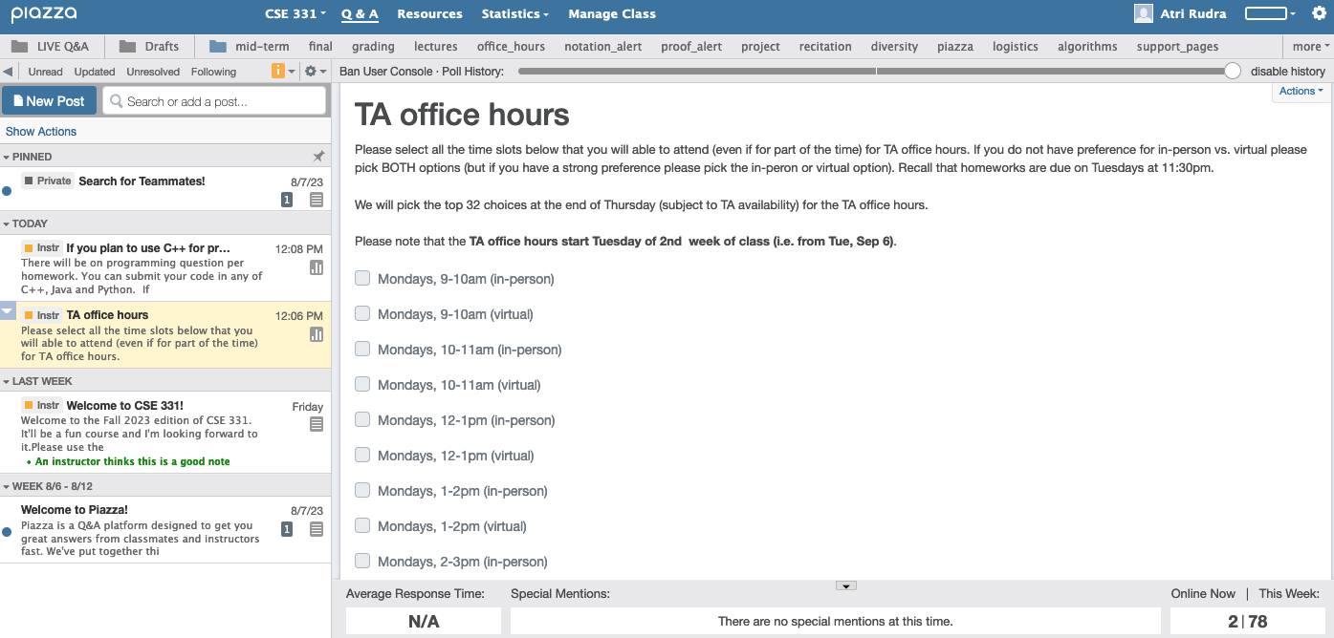
Make sure you are on Piazza
https://piazza.com/buffalo/fall2023/cse331/

Slide 3
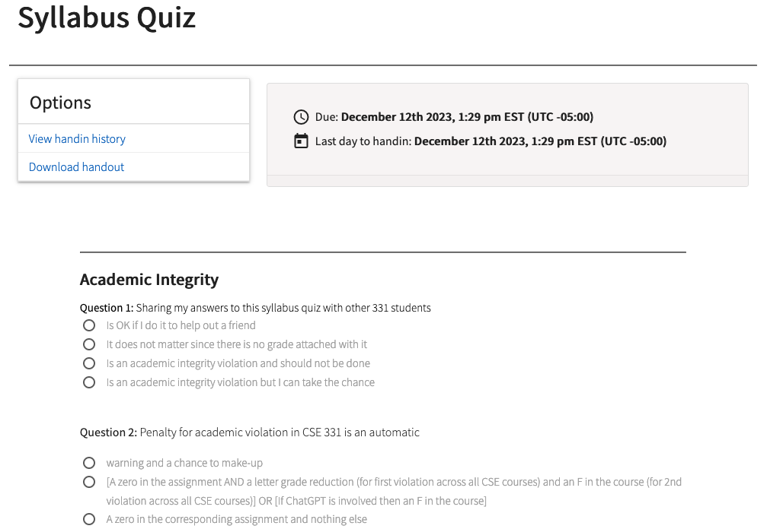
Read the syllabus CAREFULLY!
No graded material will be handed back until you pass the syllabus quiz!

Slide 4
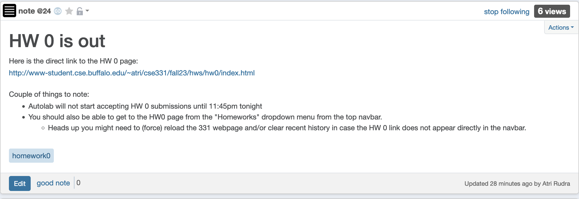
Homework 0 is out

Slide 5
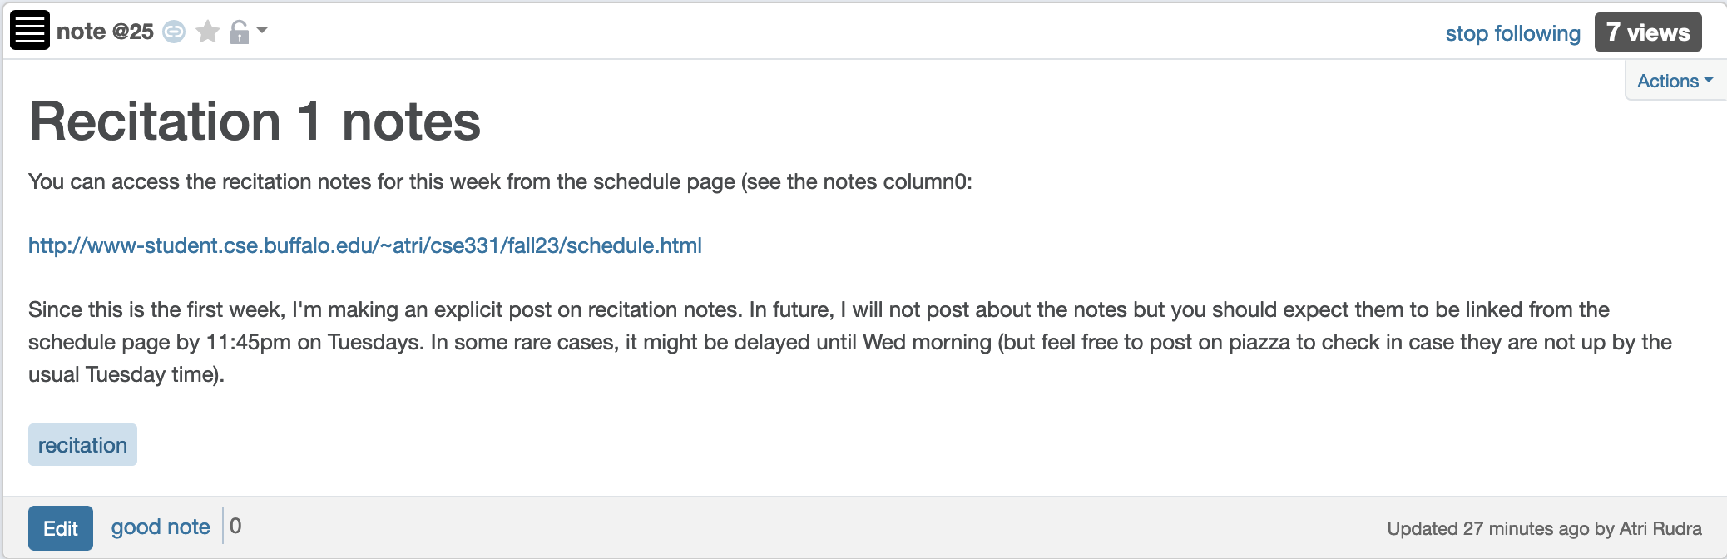
Recitation notes for this week

Slide 6
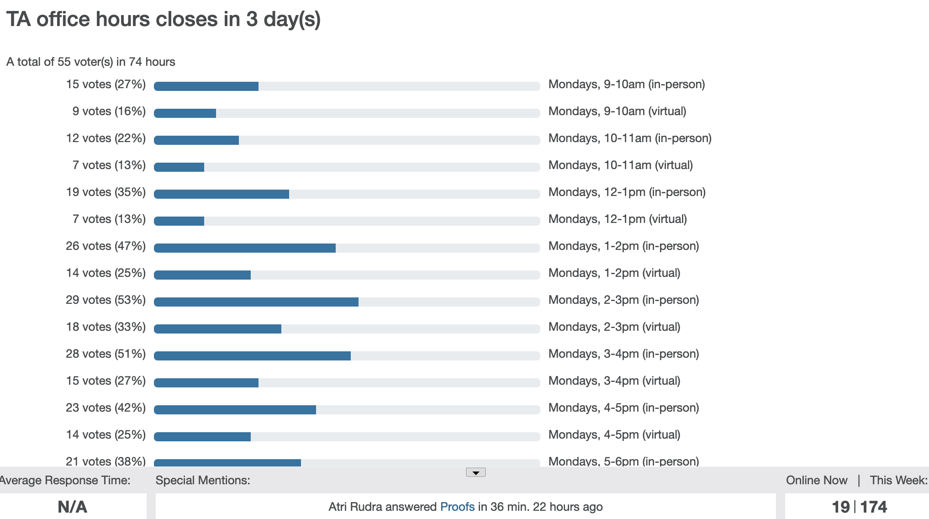
TA Office hours finalized tomorrow

Slide 7
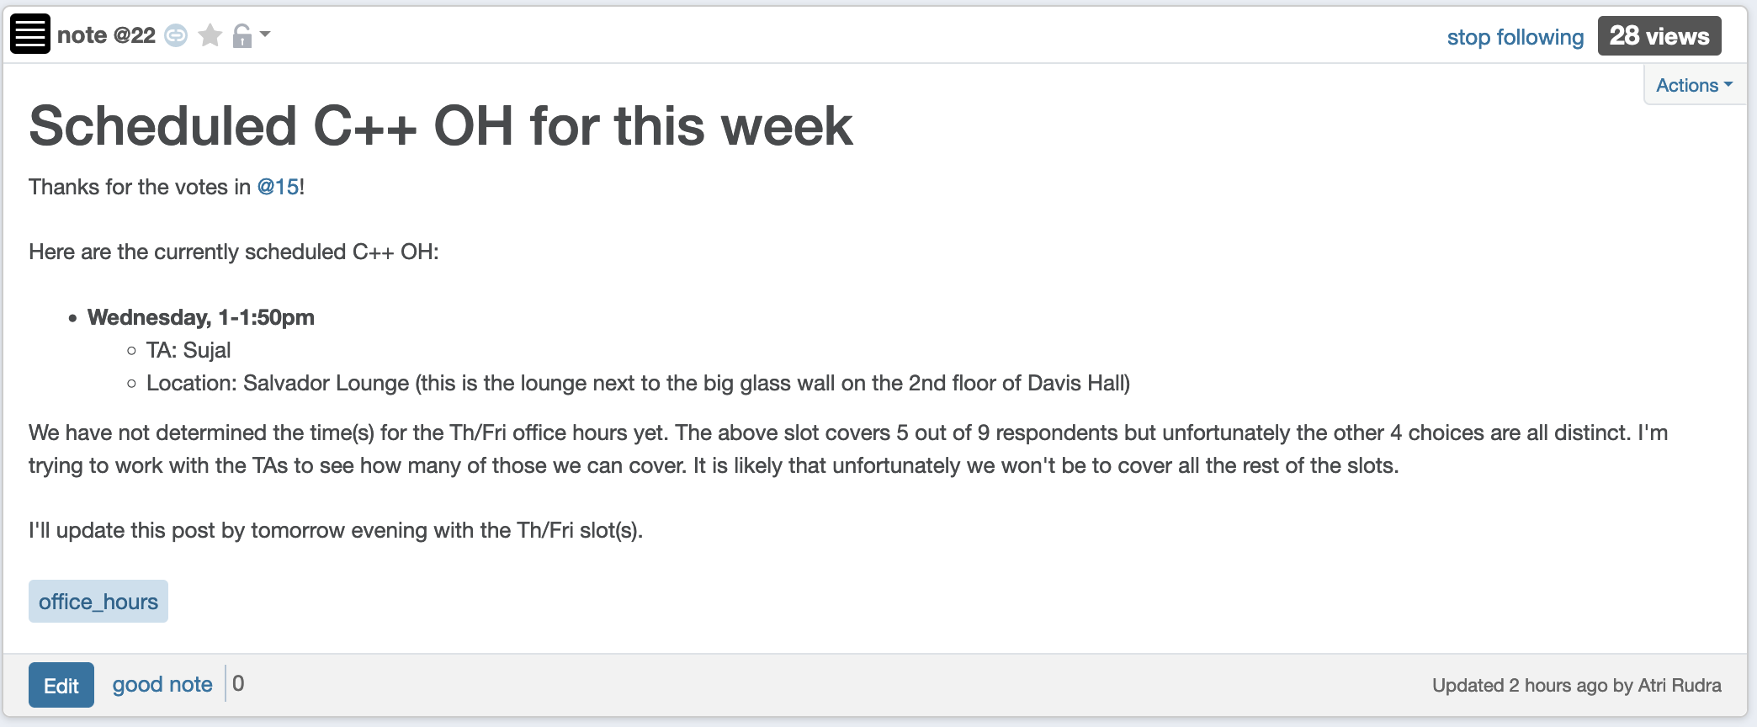
C++ OH times

Slide 8
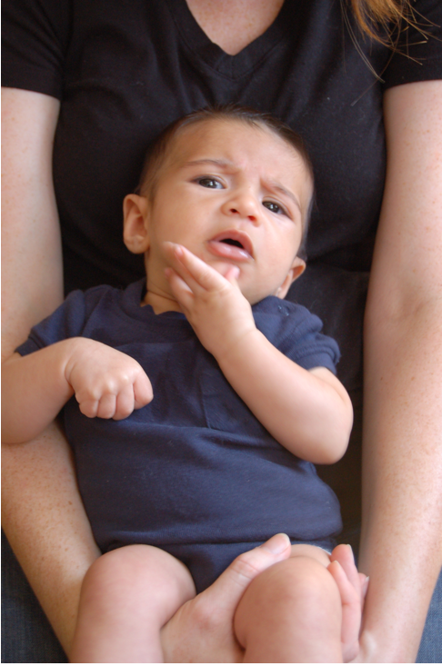
Questions/Comments?

Slide 9
Let’s do a proof!
Recall: There are 8 HWs
Q1 worth 50 pts, Q2 worth 25 pts, Q3 worth 25 pts
At the end of the semester I give you two options
Option 1: I pick sum of your max 6 HW scores (out of 600)
Score on HW i = Q1 score + Q2 score + Q3 score on HW i
Option 2: I pick your max 6 Q1 scores + max 6 Q2 scores +
max 6 Q3 scores (out of 600)
Which of the following is correct?
A. Option 1 is always at least as good
B. Option 2 is always at least as good
C. Depends on the actual scores: sometimes Option 1 is better, sometimes Option 2 is
Give a proof that your answer is correct!

Slide 10
Questions/Comments?

Slide 11
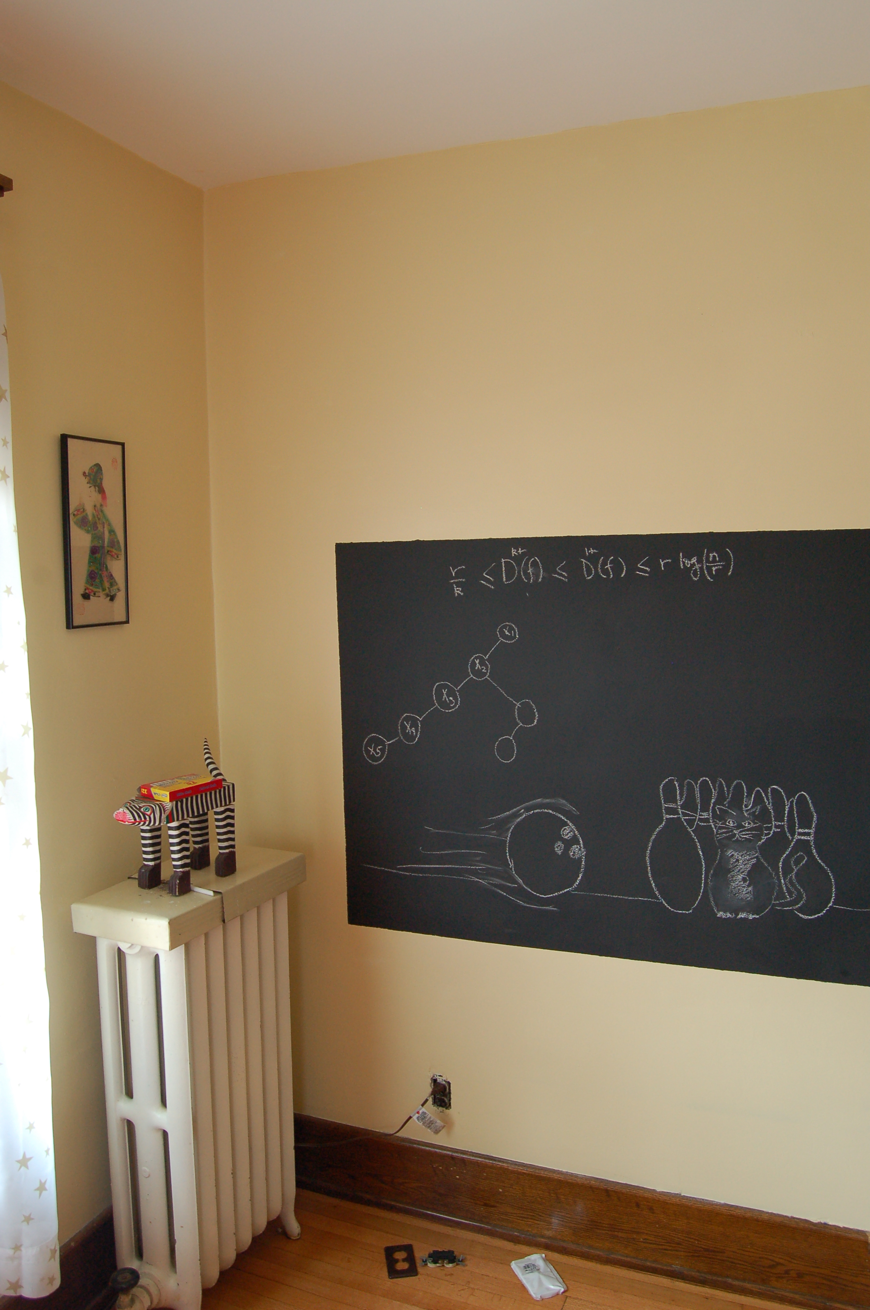
On to the board…

