Slide 1
Lecture 3
CSE 331
Sep 1, 2023

Slide 2
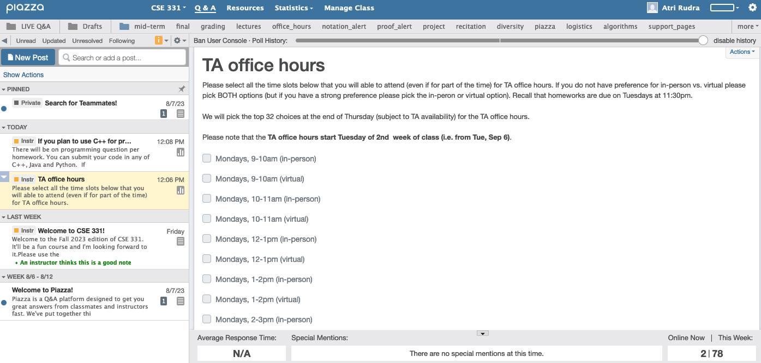
Participate on Piazza
https://piazza.com/buffalo/fall2023/cse331/

Slide 3
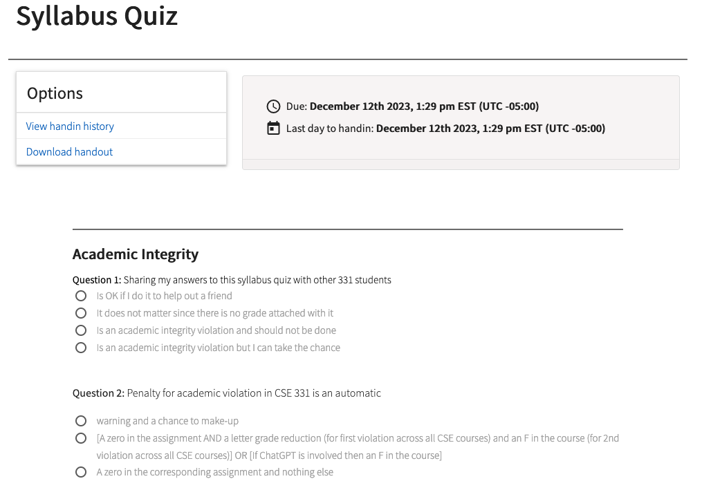
Read the syllabus CAREFULLY!
No graded material will be handed back until you pass the syllabus quiz!

Slide 4
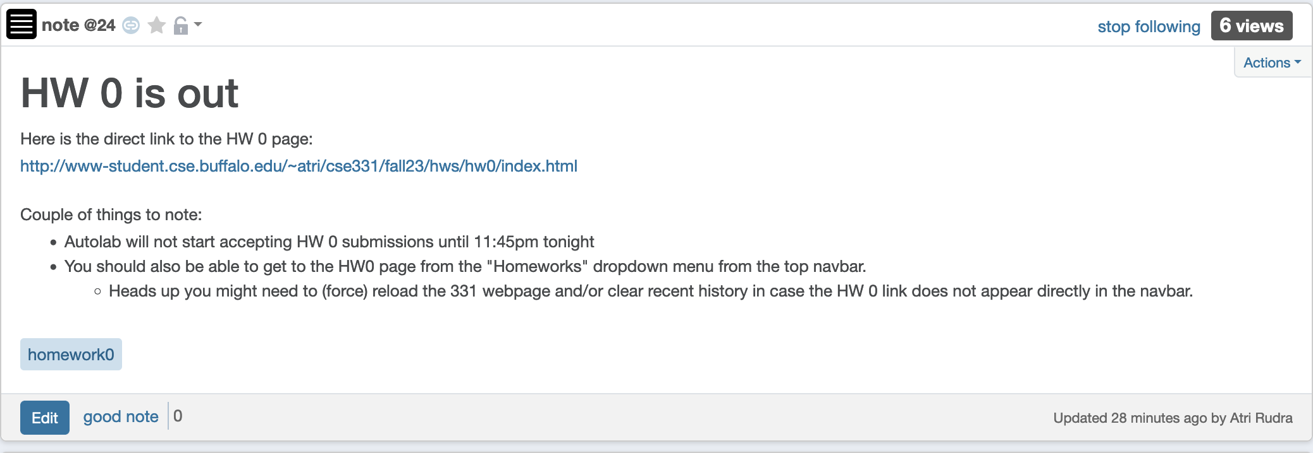
Q1 on HW 0 will be graded as usual

Slide 5
Please do keep on asking Qs!
The only bad question is the one that is not asked!

Slide 6
TA office hours
Finalized by Monday
Details will be posted on piazza
OH next week dedicated to help with proofs

Slide 7
Two comments on Programming
Programming is worth about 15% of your final grade
Algorithm design/proofs are worth about 80% of your final grade
Invest your time wisely

Slide 8
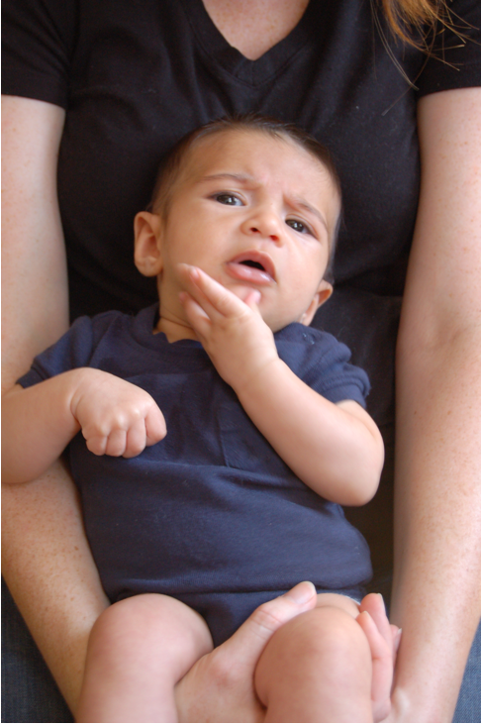
Questions/Comments?

Slide 9

Remember: Stick with your group

Slide 10
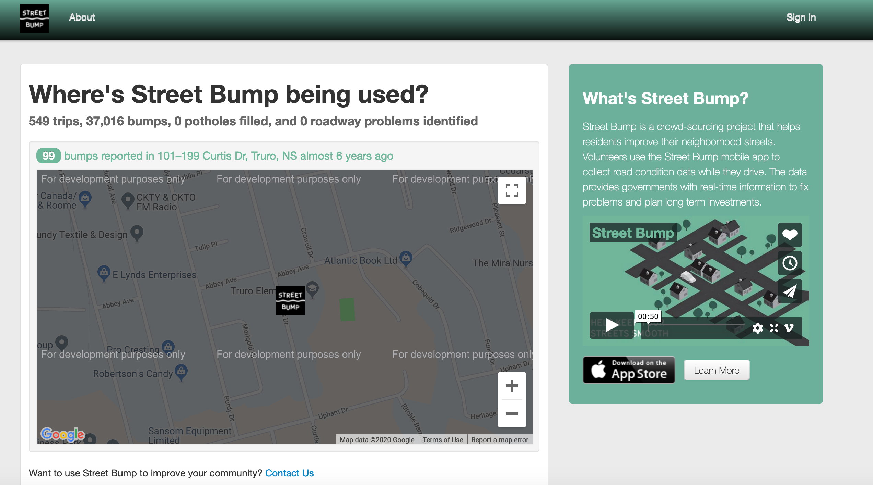
Common solution: Let’s build an app for that!
Potential issues?

Slide 11
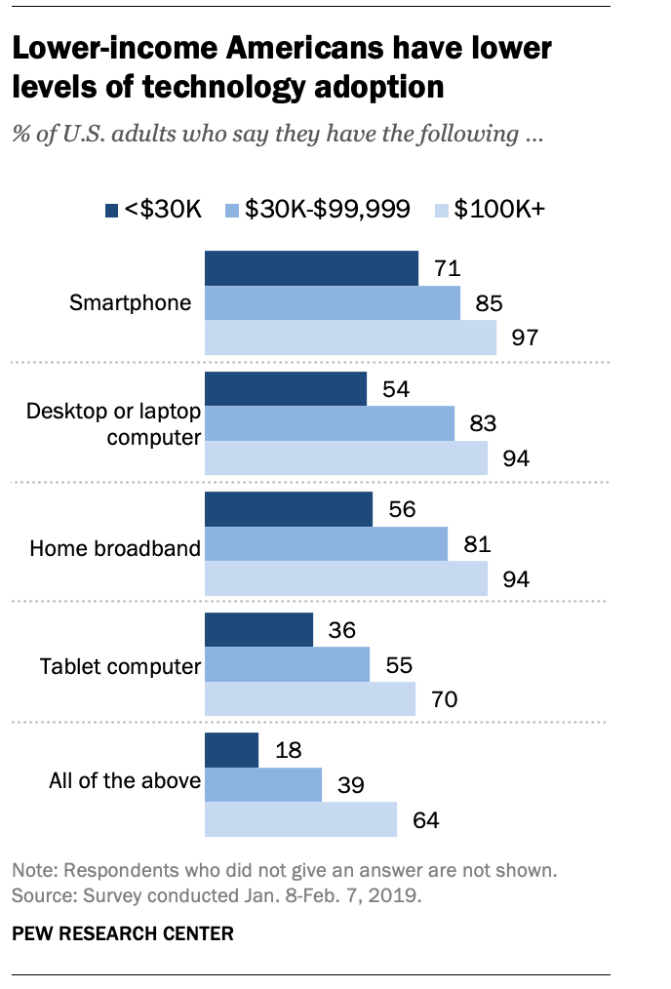
The smartphone blind-spot
Many of us in CSE assume that “everyone”
has smartphones
More generally, we assume “everyone” has access to the Internet

Slide 12
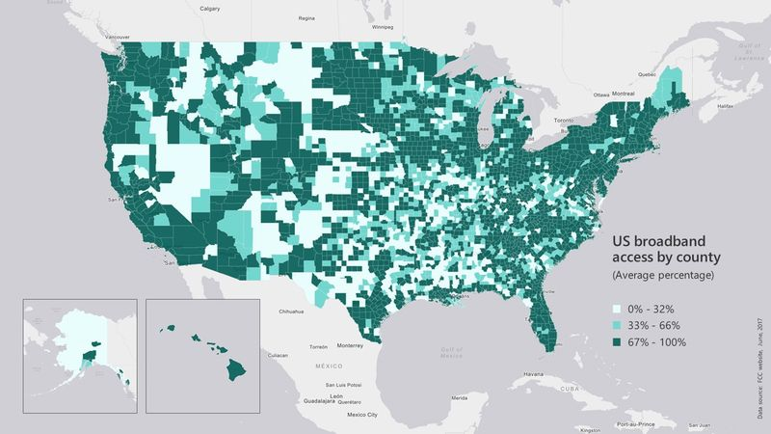
Broadband access
https://assets.bwbx.io/images/users/iqjWHBFdfxIU/iZSjibxE1KJs/v1/800x-1.jpg

Slide 13
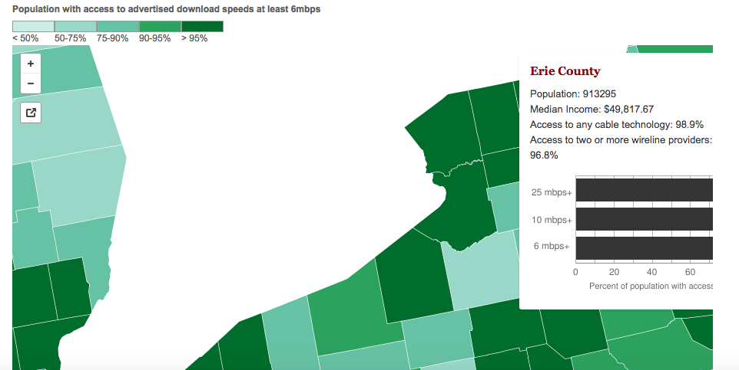
Erie county is reasonably good
http://www.governing.com/gov-data/broadband-speeds-availability.html

Slide 14
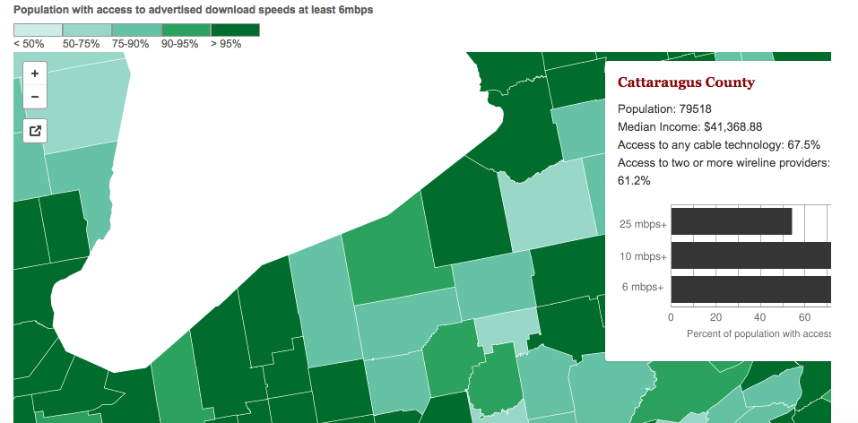
One county over
http://www.governing.com/gov-data/broadband-speeds-availability.html

Slide 15
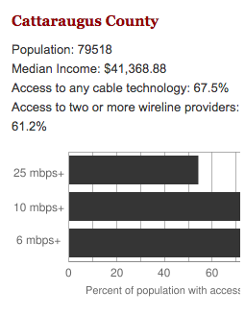
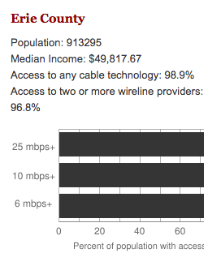
Make broadband more available
BOTH technical and societal issues
Say you are tasked to come up with the infrastructure

Slide 16
Make broadband more available
Input requirements
Is Internet a right?
Environmental factors
Where are the customers located?
Security/Privacy
What are the bandwidth requirements?
Where is funding coming
from?
How is the input represented?
Income inequality in
population
What objective are we optimizing?
How should the connections be configured?
Get regulatory approval
Output requirements
Hire people
Get access to physical space
Problem Definition
Outreach
Where should we lay down the physical stuff?
What algorithm should be use to do this?
Algorithm Design
Implement the scheme
How should we do testing and maintenance?

Slide 17
Main Steps in Algorithm Design
Problem Statement
Real world problem
Problem Definition
Precise mathematical def
Algorithm
“Implementation”
Data Structures
Analysis
Correctness/Run time

Slide 18

National Resident Matching

Slide 19
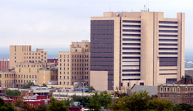
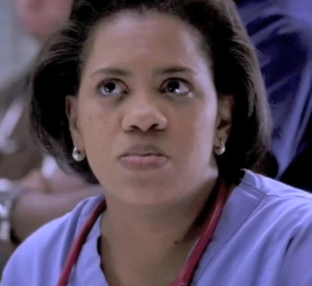
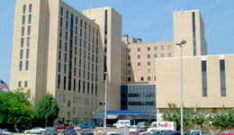

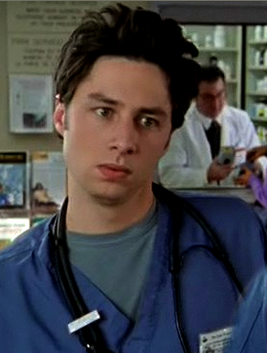
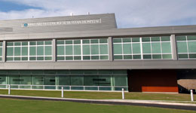
(Screen) Docs are coming to BUF
Buffalo General
Bailey (Grey’s Anatomy)
Millard Filmore (Gates Circle)
JD (Scrubs)
Millard Filmore (Suburban)

Slide 20
What can go wrong?

Slide 21
The situation is unstable!

Slide 22

What happens in real life
Preferences
Information
Preferences

Slide 23
NRMP plays matchmaker

Slide 24
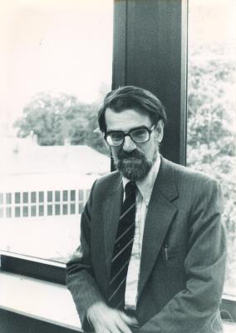
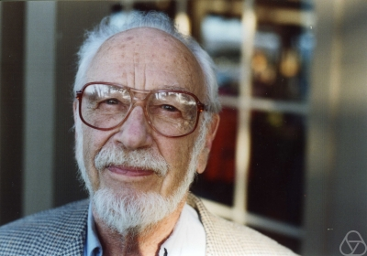
Stable Matching Problem
David Gale
Lloyd Shapley*

