Slide 1
Lecture 34
CSE 331
Nov 27, 2023

Slide 2
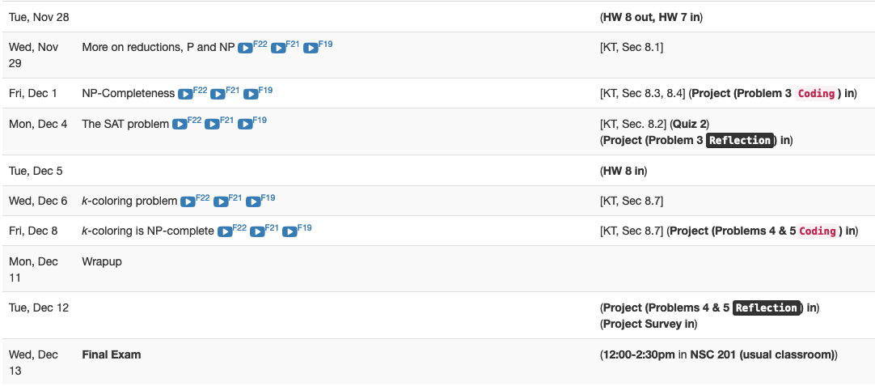
Next <= 2.5 weeks are brutal

Slide 3
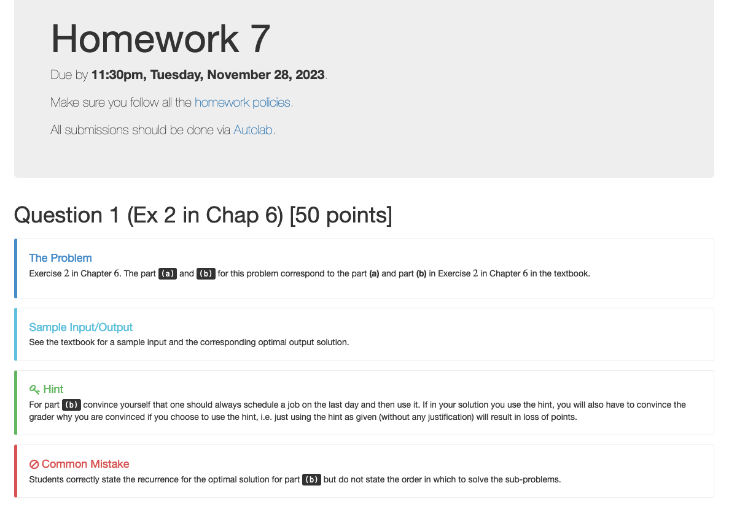
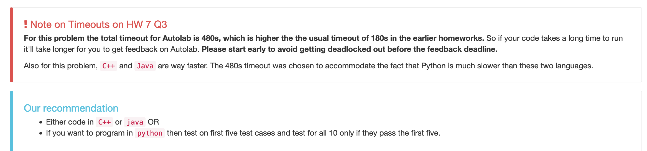
Homework 7 reminders

Slide 4
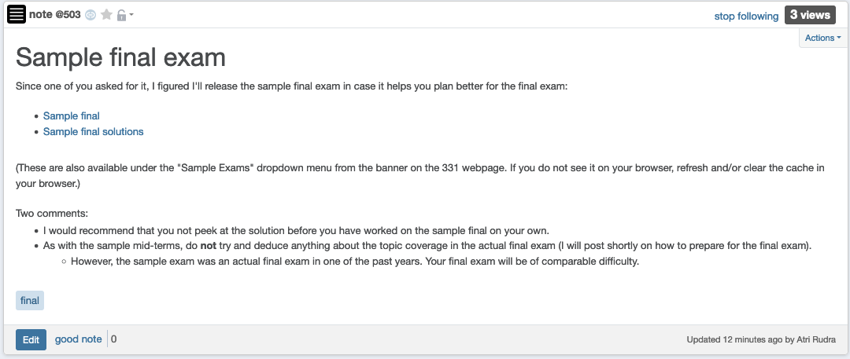
Sample final exam

Slide 5
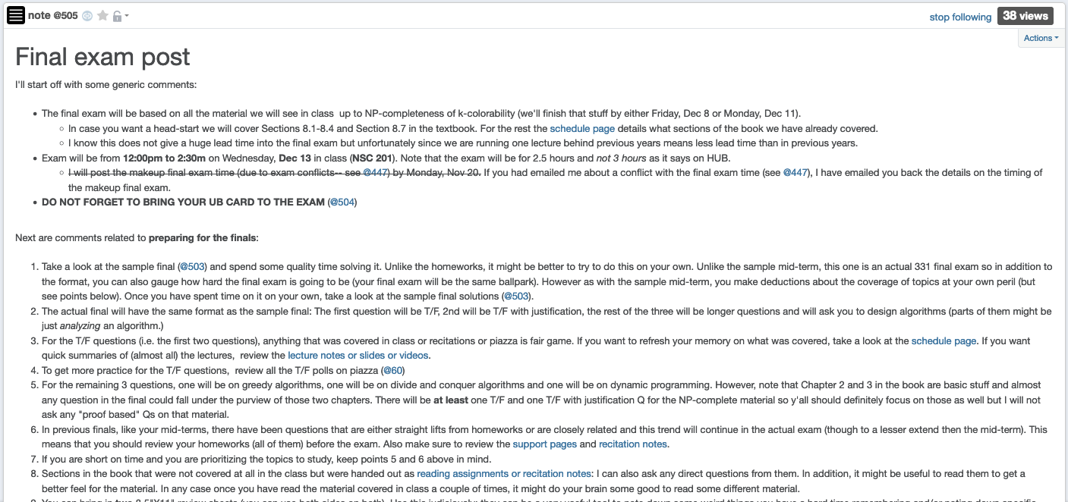
Final exam post

Slide 6
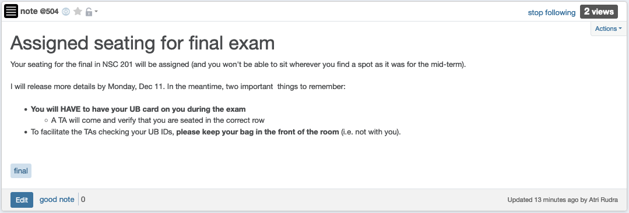
Bring UB card to final exam!

Slide 7
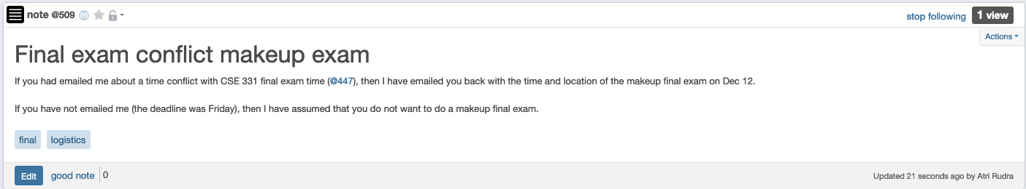
Makeup for final exam conflict

Slide 8
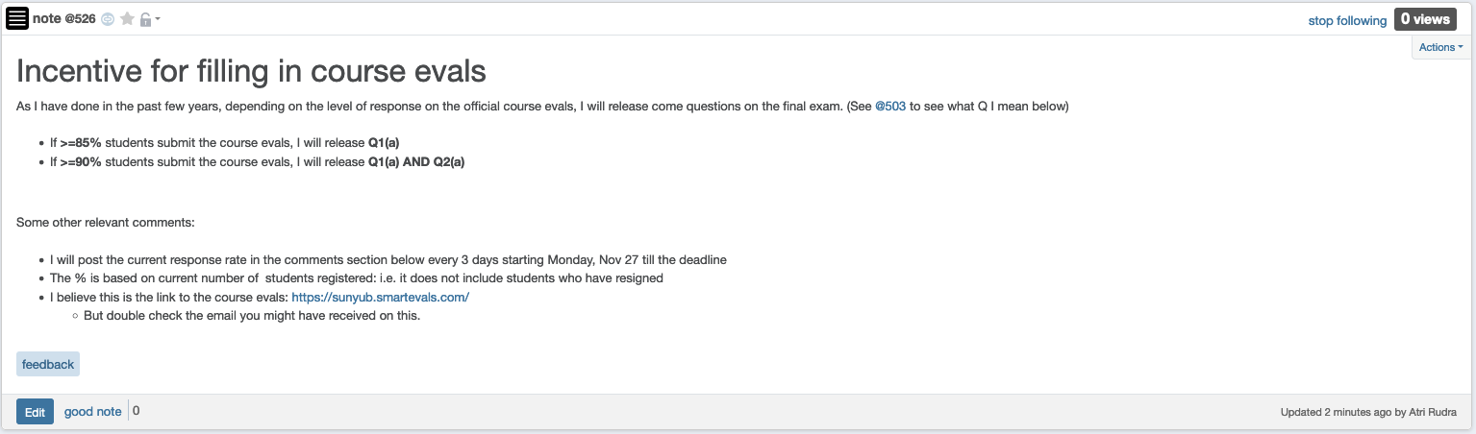
Course evaluations

Slide 9
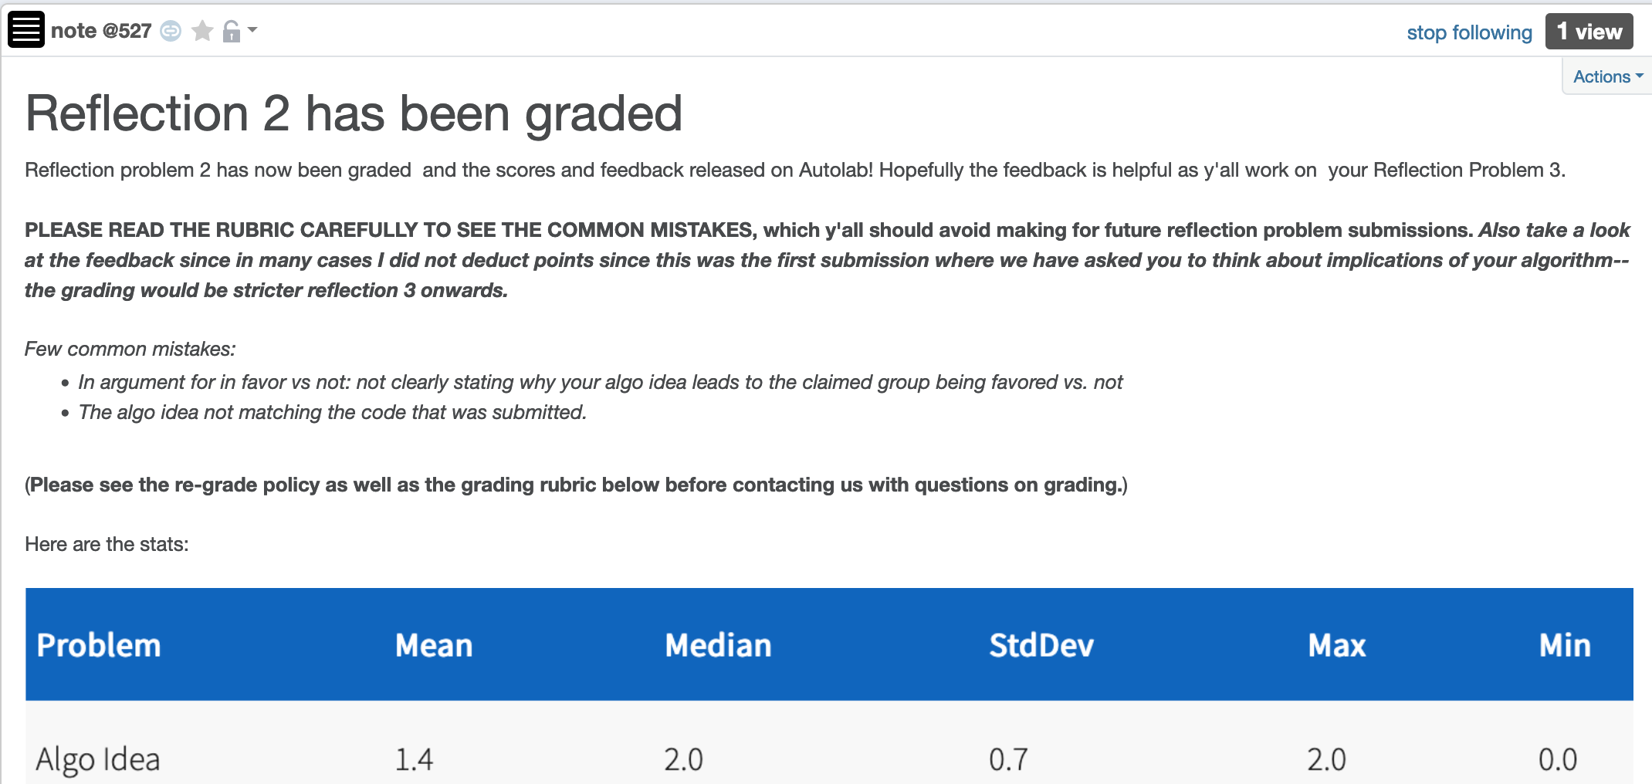
Reflection 2 grading post

Slide 10

Questions?

Slide 11
Shortest Path Problem
Input: (Directed) Graph G=(V,E) and for every edge e has a cost c_{e} (can be <0)
t in V
Output: Shortest path from every s to t
Assume that G has no negative cycle
1
1
s
t
Shortest path has cost negative infinity
899
100
-1000

Slide 12
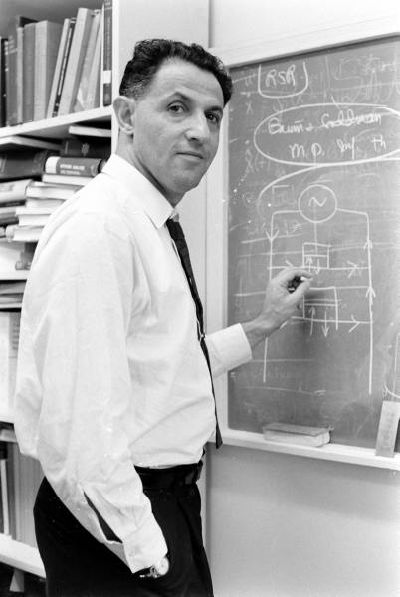
When to use Dynamic Programming
There are polynomially many sub-problems
Richard Bellman
Optimal solution can be computed from solutions to sub-problems
There is an ordering among sub-problem that allows for iterative solution

Slide 13
Questions?

Slide 14
Today’s agenda
Bellman-Ford algorithm
Analyze the run time

Slide 15
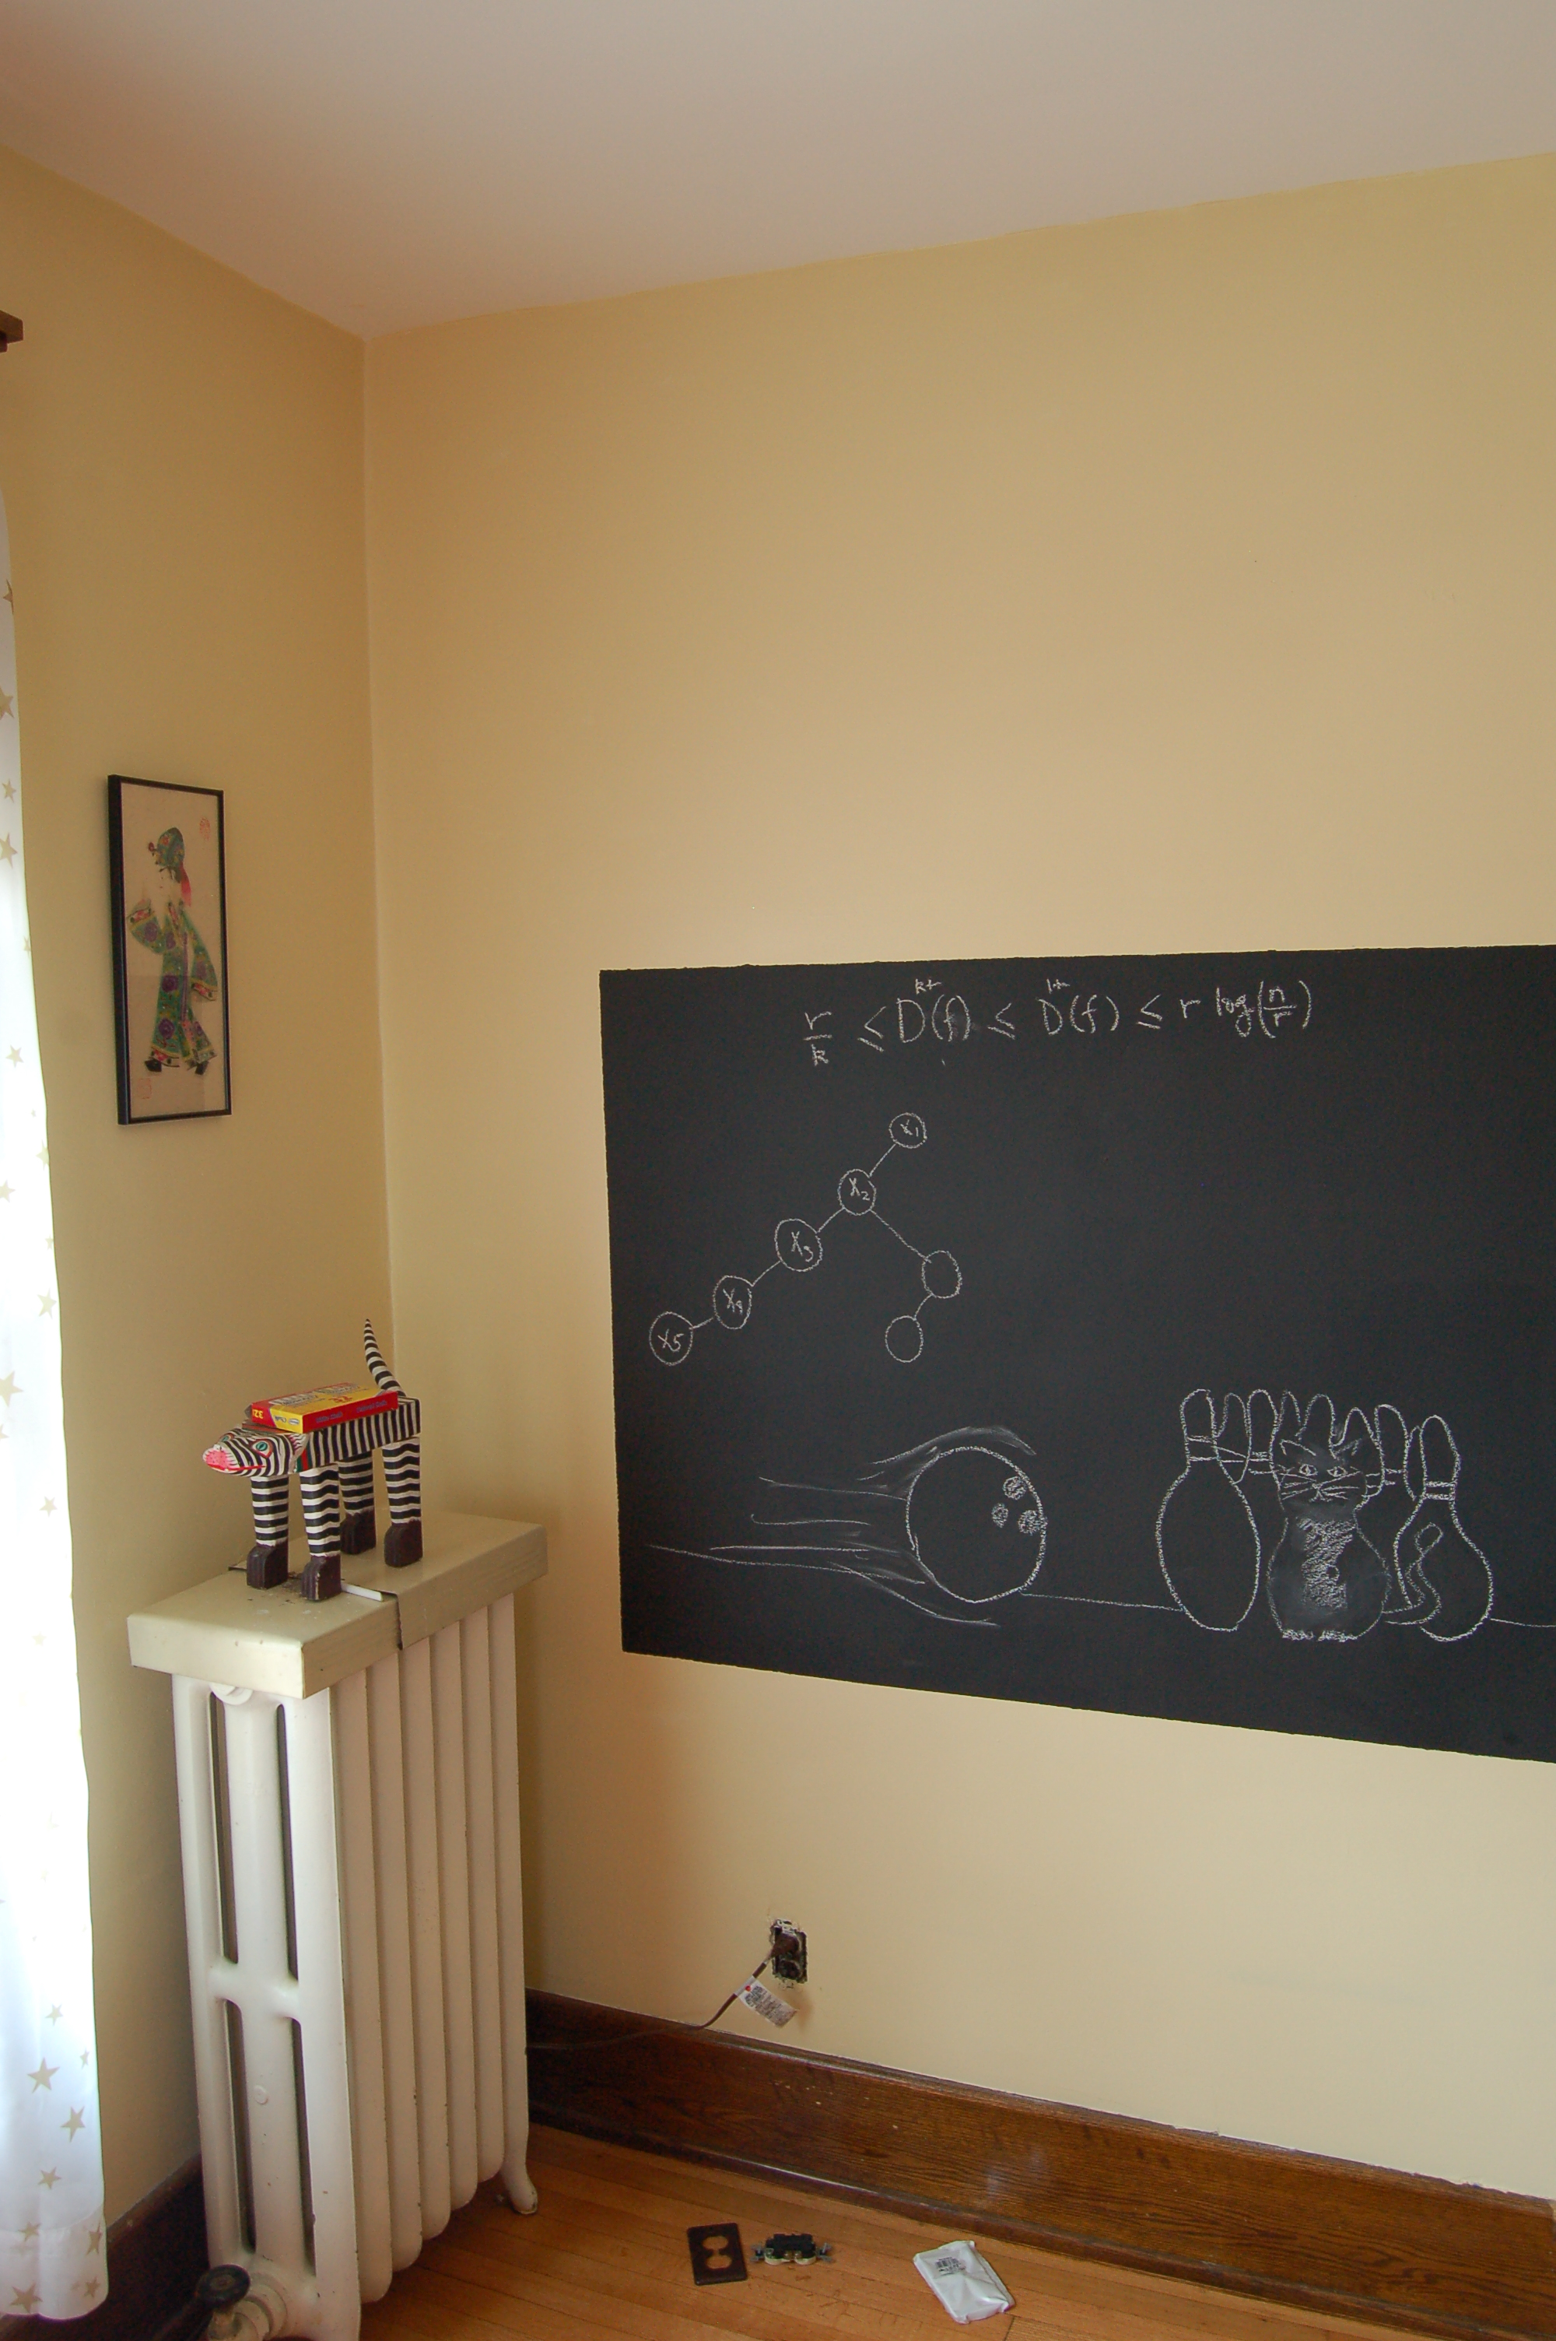
Algo on the board…

Slide 16
The recurrence
OPT(u,i) = shortest path from u to t with at most i edges
OPT(u,i) = min { OPT(u,i-1), min_{(u,w) in E} { c_{u,w} + OPT(w, i-1)} }

Slide 17
Some consequences
OPT(u,i) = cost of shortest path from u to t with at most i edges
OPT(u,i) = min { OPT(u, i-1), min_{(u,w) in E} { c_{u,w} + OPT(w,i-1)} }
OPT(u,n-1) is shortest path cost between u and t
How to compute the shortest path between s and t given all OPT(u,i) values

Slide 18
Bellman-Ford Algorithm
Runs in O(n(m+n)) time
Only needs O(n) additional space

Slide 19
Questions?

Slide 20
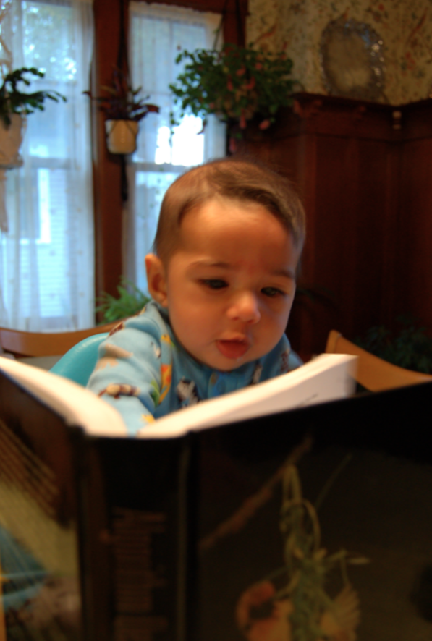
Reading Assignment
Sec 6.8 of [KT]

Slide 21
Longest path problem
Given G, does there exist a simple path of length n-1 ?

Slide 22

Longest vs Shortest Paths

Slide 23

Two sides of the “same” coin
Shortest Path problem
Can be solved by a polynomial time algorithm
Is there a longest path of length n-1?
Given a path can verify in polynomial time if the answer is yes

Slide 24
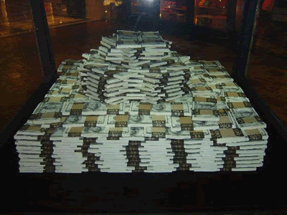
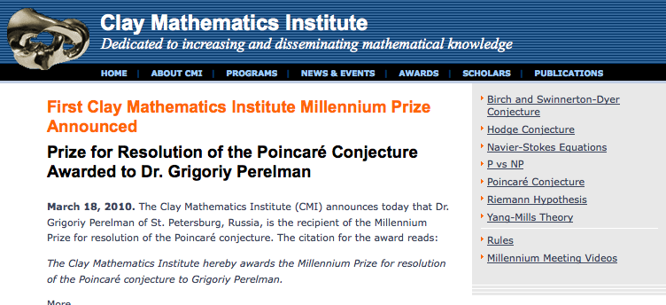
Poly time algo for longest path?

Slide 25
P vs NP question
P: problems that can be solved by poly time algorithms
Is P=NP?
NP: problems that have polynomial time verifiable witness to optimal solution
Alternate NP definition: Guess witness and verify!

Slide 26
Proving P ≠ NP
Pick any one problem in NP and show it cannot be solved in poly time
Pretty much all known proof techniques provably will not work

Slide 27
Proving P = NP
Will make cryptography collapse
Compute the encryption key!
Prove that all problems in NP can be solved by polynomial time algorithms
Solving any ONE problem in here in poly time will prove P=NP!
NP
NP-complete problems

Slide 28

A book on P vs. NP

Slide 29
Questions?

Slide 30

The course so far…
https://www.teepublic.com/sticker/1100935-obama-yes-we-can

Slide 31

The rest of the course…
Under certain assumptions,
https://www.madduckposters.com/products/megamind-no-you-cant?variant=13565168320556

