Slide 1
Lecture 37
CSE 331
Dec 4, 2023

Slide 2
Quiz starts at 11:00 am
and ends at 11:10am

Slide 3
Lecture starts
at 11:15am

Slide 4
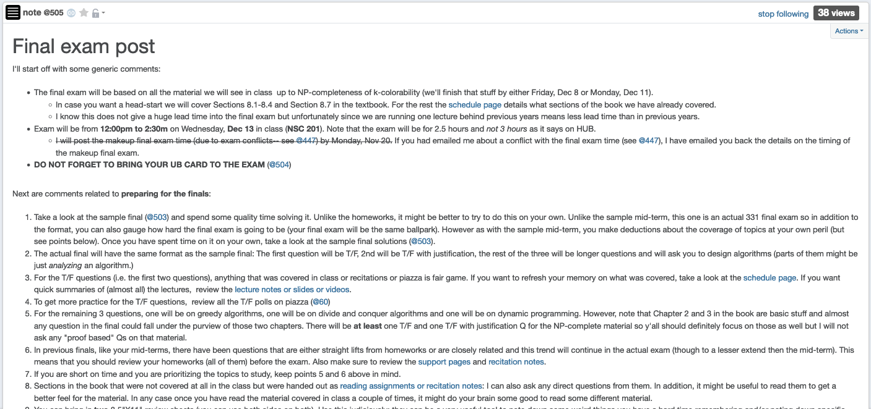
Final exam post

Slide 5
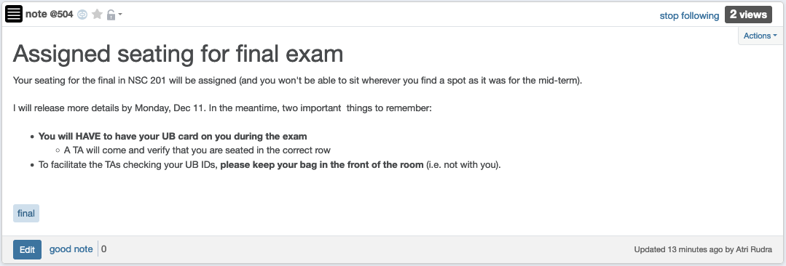
Bring UB card to final exam!

Slide 6
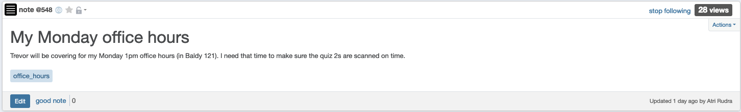
Trevor will cover my OH today

Slide 7

Questions?

Slide 8



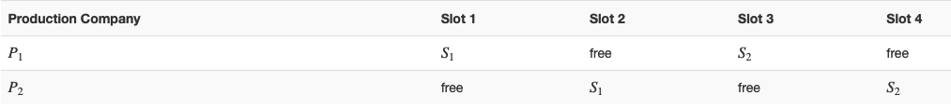
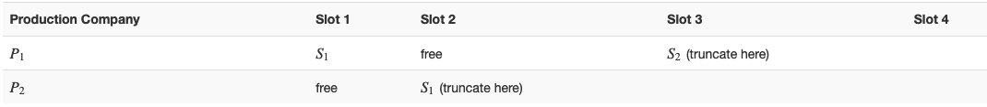



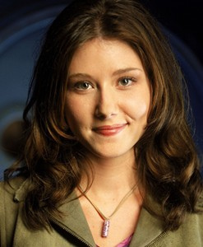


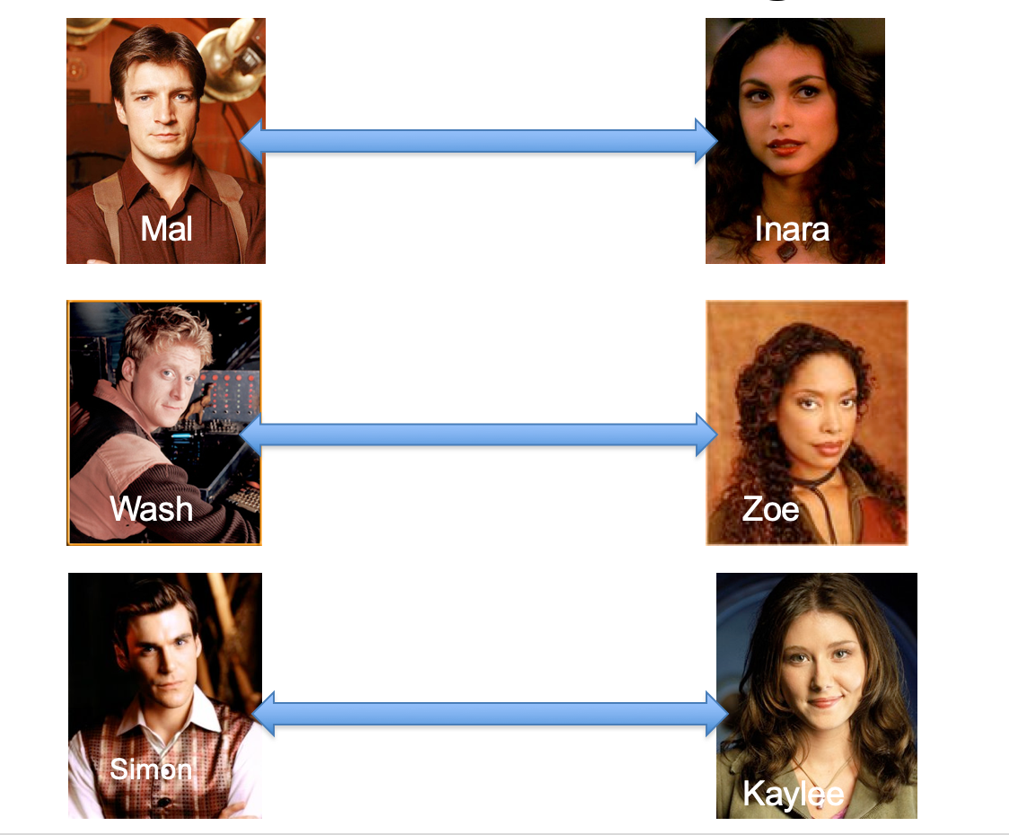
Poly time steps
Arbitrary Y instance
ANY algo for stable matching problem works!
Pre-process the input
Output for Y instance
All processing
is poly-time
Algo for X
Post-process the output

Slide 9



No poly time algo for Y
Poly time algo for X
Arbitrary Y instance
No poly time algo for X
Poly time algo for Y
Pre-process the input
Output for Y instance
All processing
is poly-time
Algo for X
Post-process the output

Slide 10

Problems
Only consider Boolean output problems
A problem Y is a subset of possible input (with output 1)
A(w) denotes output of algo A on input w
A solves Y if A(w) = 1 iff w $∈$ Y

Slide 11

Independent Set (IS)
Input: Graph G = (V,E) and number k
Output: Yes iff G has an IS of size $≥$k

Slide 12
P vs NP question
P: problems that can be solved by poly time algorithms
Is P=NP?
NP: problems that have efficient verifiers

Slide 13
Today’s agenda
NP-Completeness
SAT

