Slide 1
Lecture 39
CSE 331
Dec 8, 2023

Slide 2
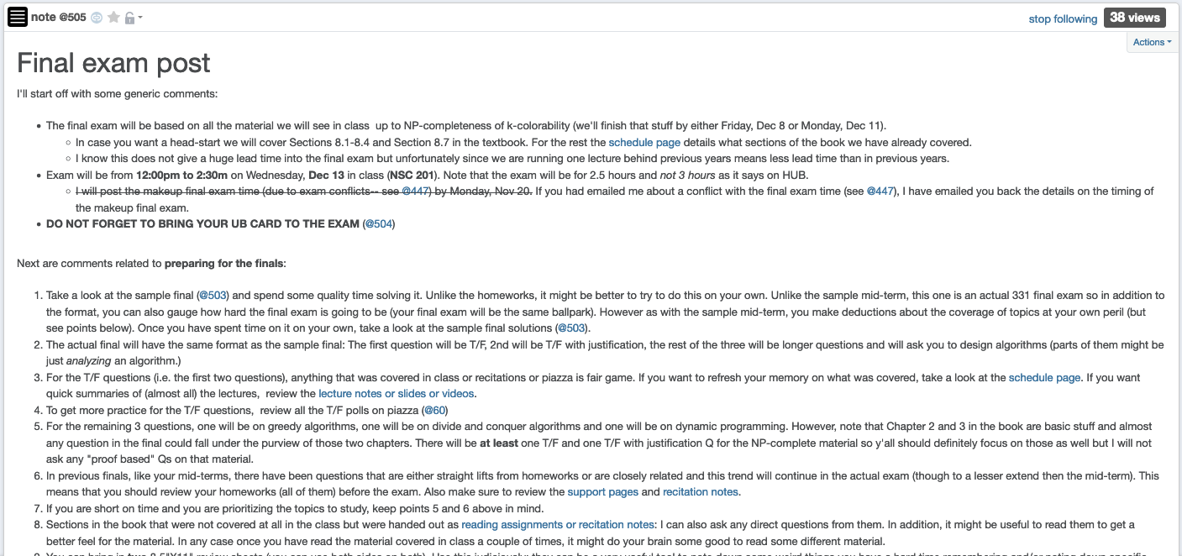
Final exam post

Slide 3
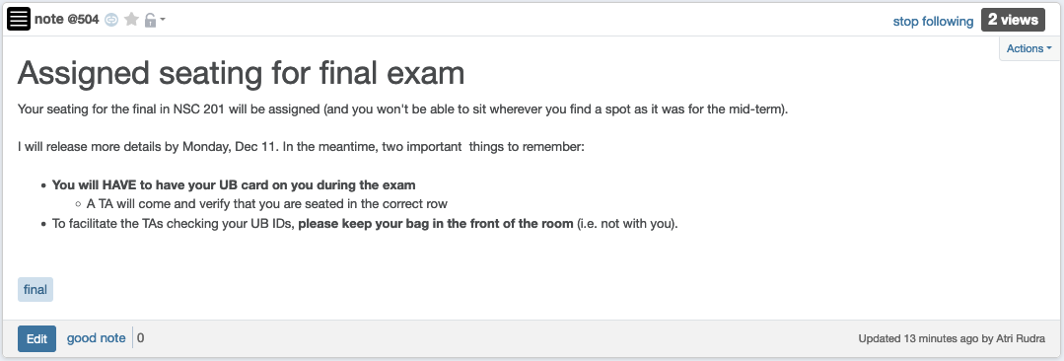
Bring UB card to final exam!

Slide 4
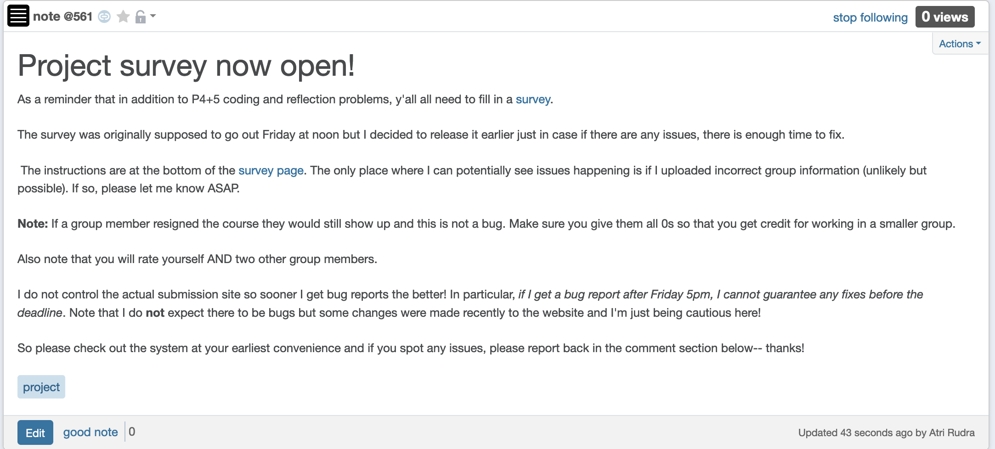
Project Survey Out!

Slide 5
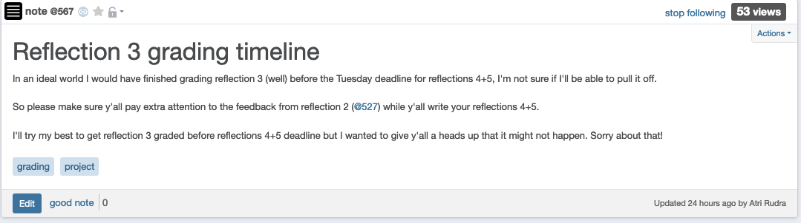
Timeline on reflection 3 grading

Slide 6
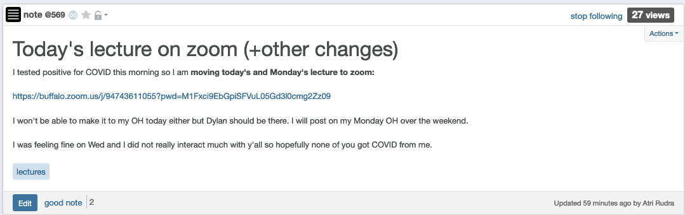
Monday lecture on zoom as well

Slide 7
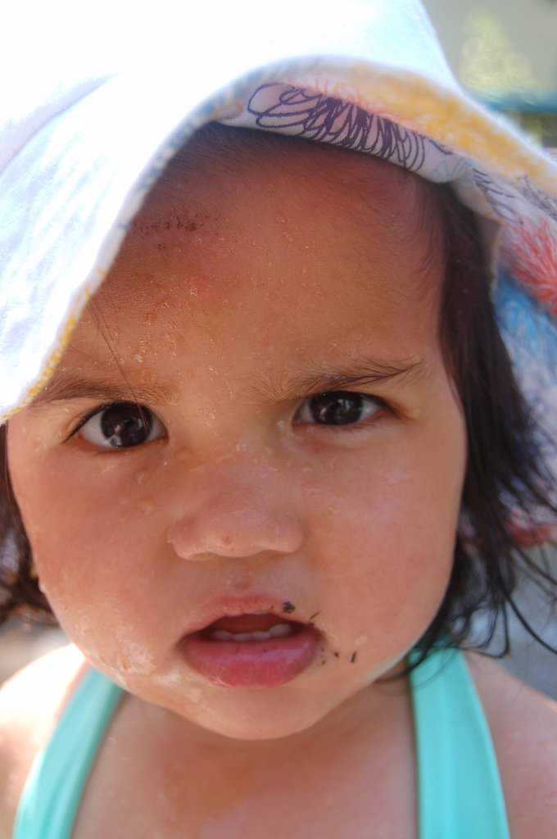
Questions?

Slide 8



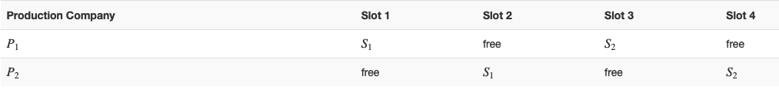
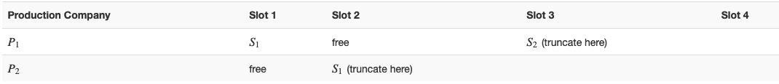



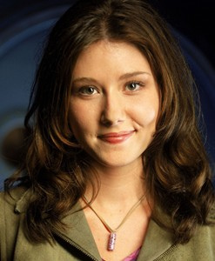
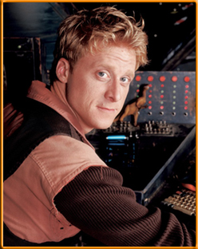

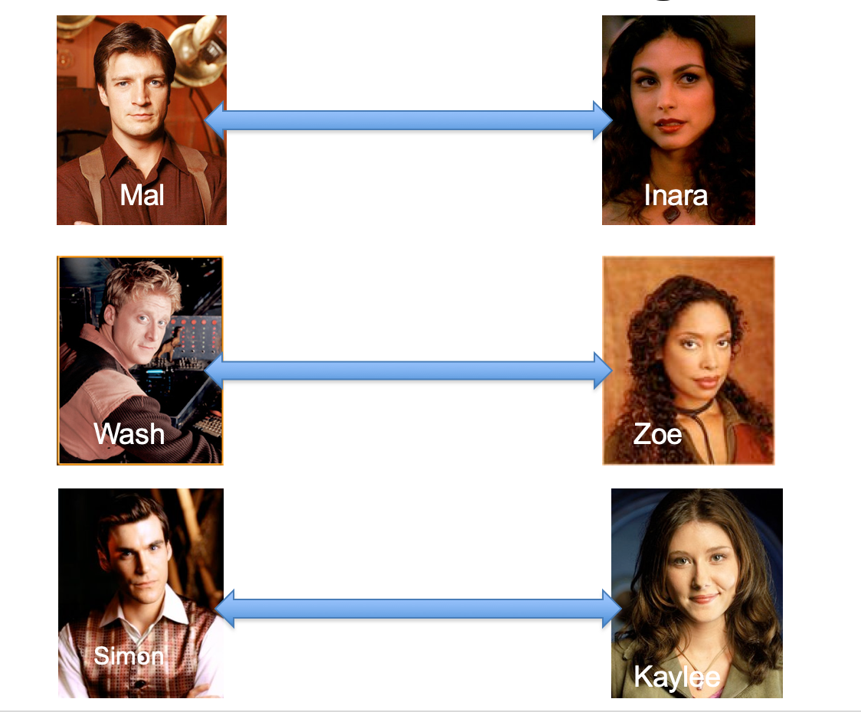
Poly time steps
Arbitrary Y instance
ANY algo for stable matching problem works!
Pre-process the input
Output for Y instance
All processing
is poly-time
Algo for X
Post-process the output

Slide 9



No poly time algo for Y
Poly time algo for X
Arbitrary Y instance
No poly time algo for X
Poly time algo for Y
Pre-process the input
Output for Y instance
All processing
is poly-time
Algo for X
Post-process the output

Slide 10

Arbitrary Y instance
AlgoIS (G,k)
G’ = G
Pre-process the input
Output for Y instance
k’ = n-k
b = AlgoVC(G’,k’)
Algo for X
return b
Post-process the output
(G,n-k)
Algo for VC
(G,k)

Slide 11
Questions?

Slide 12
Today’s agenda
NP-completeness of k-colorability

