Slide 1
Lecture 4
CSE 331
Sep 6, 2023

Slide 2
Please do keep on asking Qs!
The only bad question is the one that is not asked!
Not just technical Qs but also on how the class is run

Slide 3

We’re not mind readers

Slide 4

If you need it, ask for help

Slide 5
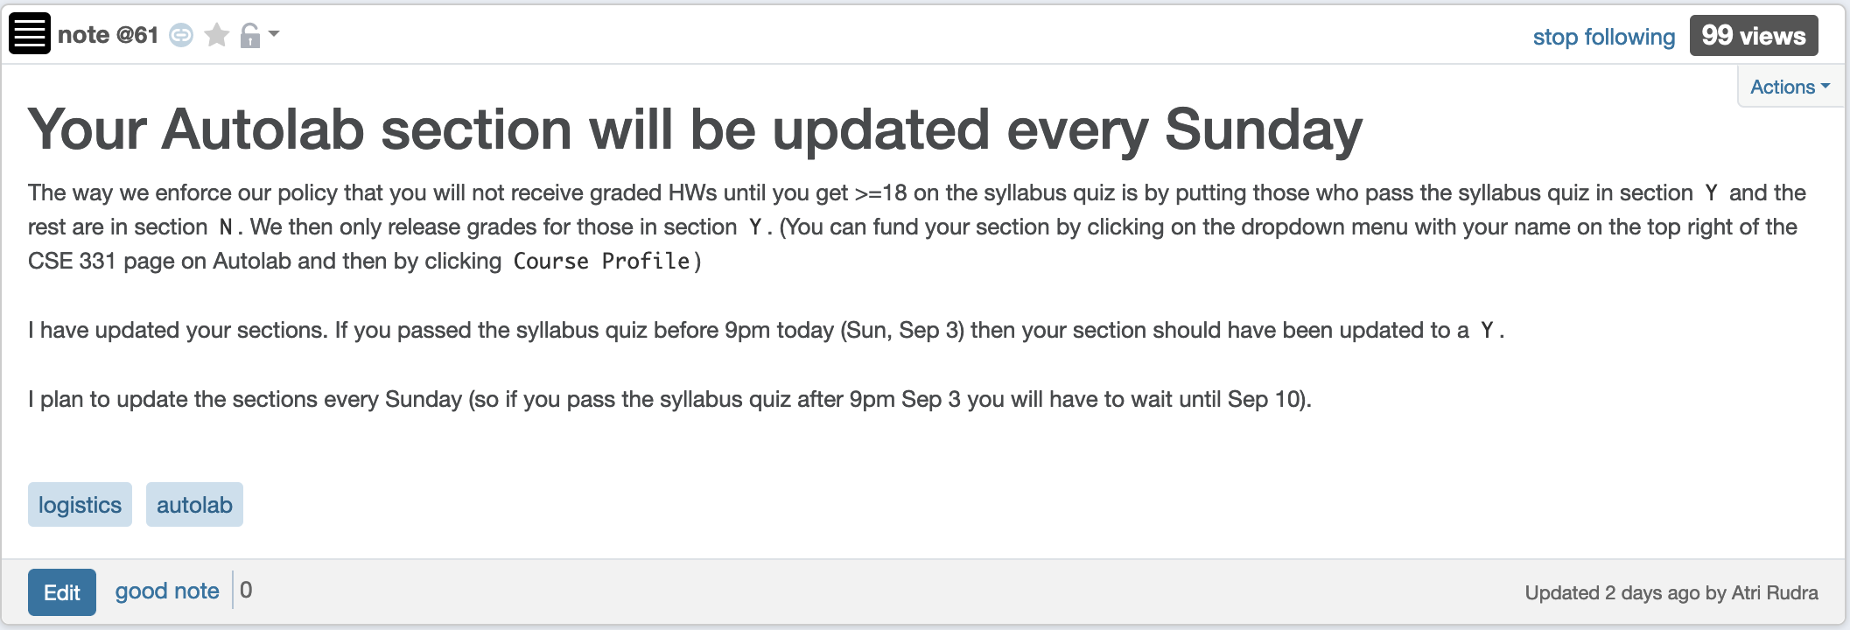
Syllabus Quiz (and sections)

Slide 6
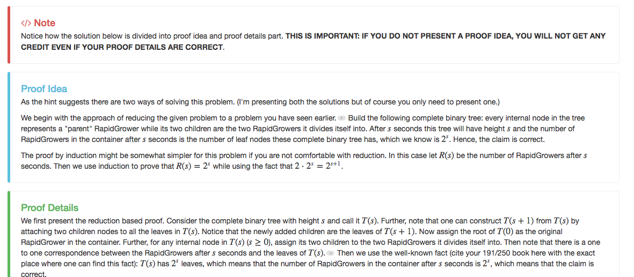
Separate Proof idea/proof details

Slide 7
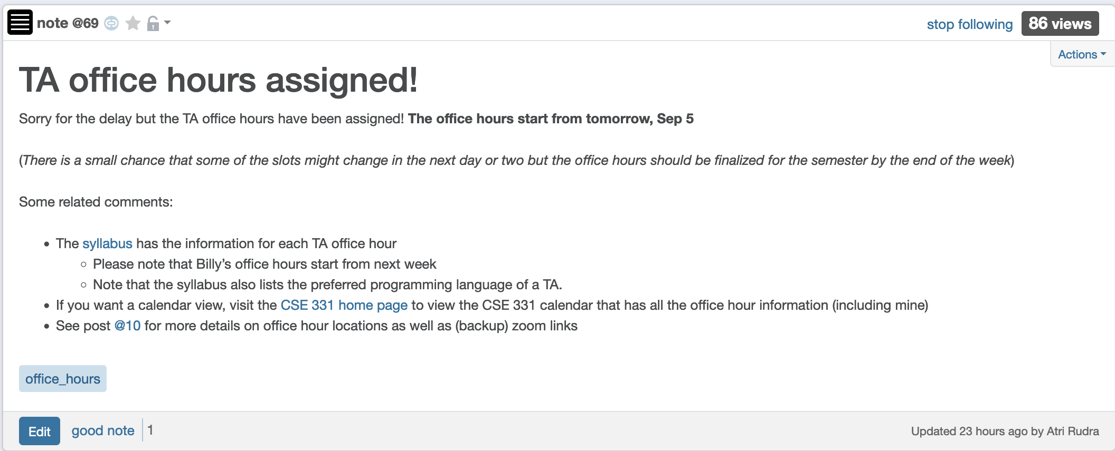
Office hours finalized
Come ask your proof related Questions!

Slide 8
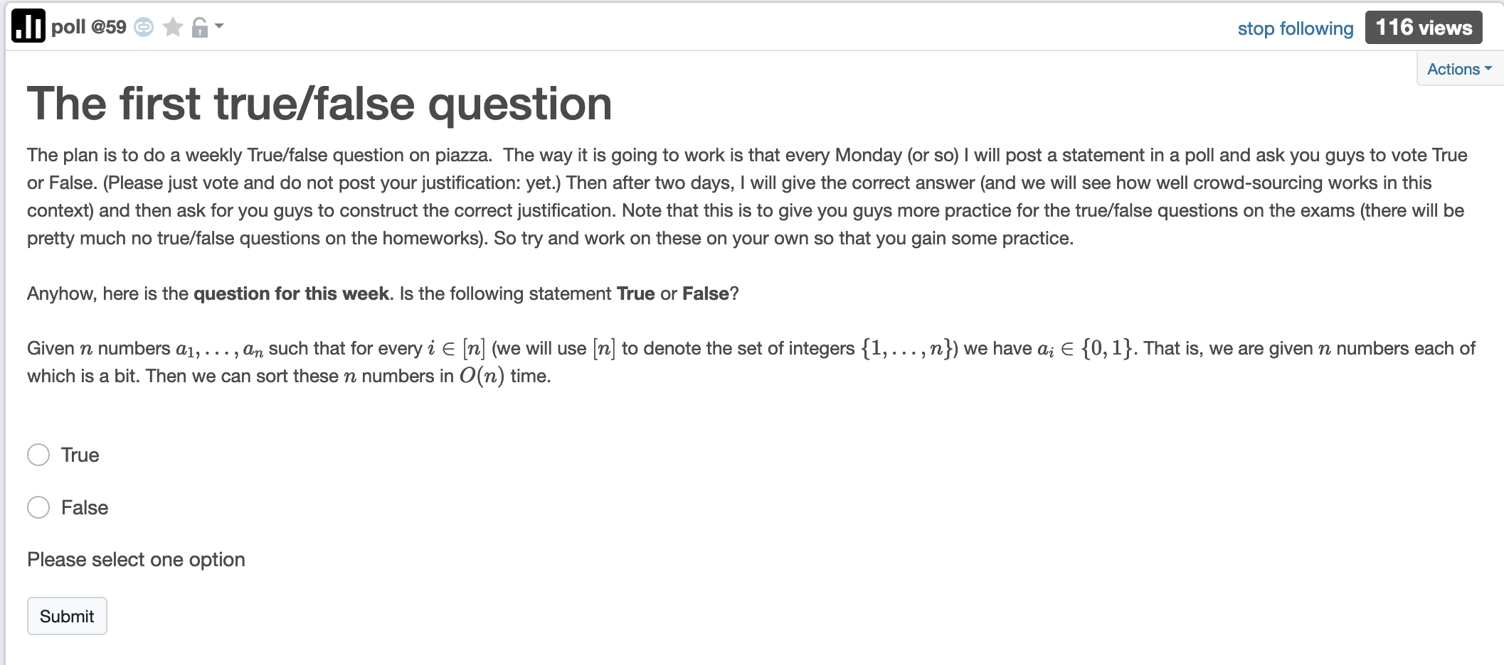
1st True/False poll

Slide 9
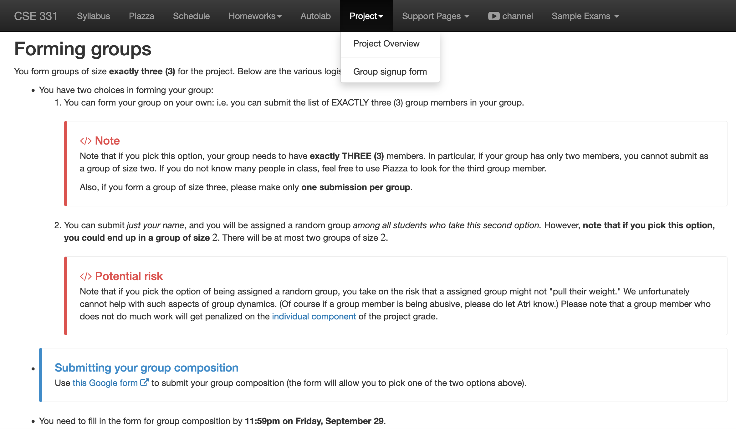
Register your project groups
Deadline: Friday, Sep 29, 11:59pm

Slide 10

Update on dept. linux servers

Slide 11
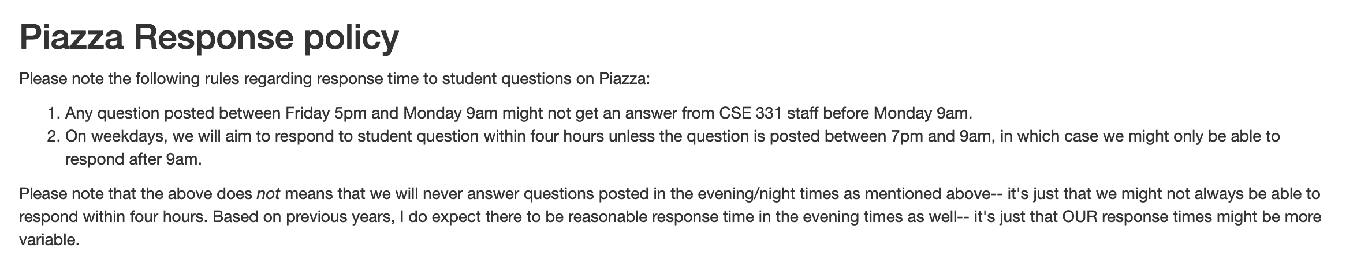
Piazza Response policy

Slide 12
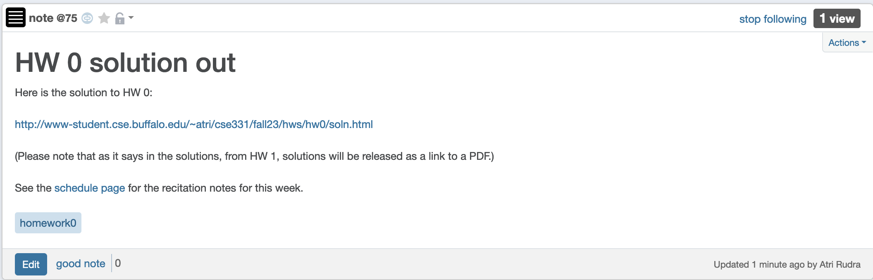
Solutions to HW 0 out

Slide 13
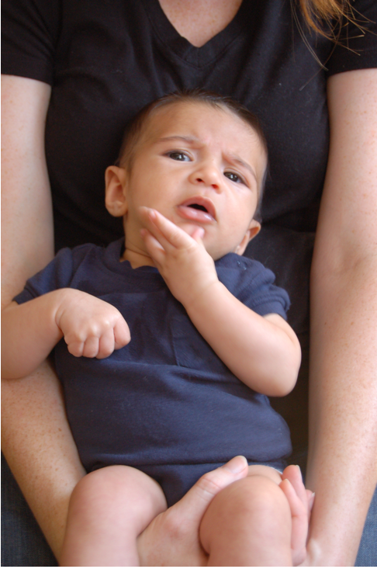
Questions/Comments?

Slide 14

National Resident Matching

Slide 15






The situation is unstable!

Slide 16

What happens in real life
Preferences
Information
Preferences

Slide 17
NRMP plays matchmaker

Slide 18


Stable Matching Problem
David Gale
Lloyd Shapley*

Slide 19
Questions/Comments?

Slide 20
Incorrect Proof Details: Q1(b) on HW0
Argument does not use ANYTHING about the problem statement!
Follows from part (a)
Let P(n) be the number of perfect matchings with n men and n women
Base case: P(1) = 1! = 1
This assumes number of perfect matchings only depends on n
Inductive hypothesis: Assume that P(n-1) = (n-1)!
Inductive step: Note that P(n) = n*P(n-1) = n*(n-1)! = n!
What are the issues with the above “proof”?

Slide 21
Incorrect Proof Details: Q1(b) on HW0
Needs justification
Claim 1: Number of perfect matchings is = number of permutations of
1…n
Claim 2: Number of permutations of 1…n is n!
Needs justification
Claims 1 + 2 prove the result
Follow from 191 (?)
What are the issues with the above proof?

Slide 22
Proof by contradiction for Q1(a)
Assume for contradiction there is an example where number of perfect
matchings depends on the identities of the men and women.
Let n =1 and consider two cases
(1) M = {BP} and W = {JA}
(2) M = {BBT} and W = {AJ}
You can only assume things about the example directly implied by it being a counter-example
In both cases the number of perfect matchings is 1 = 1!
There is NO contradiction
Hence contradiction.
What are the issues with the above proof?

Slide 23
Questions/Comments?

Slide 24
Matching Employers & Applicants
Input: Set of employers (E)
Set of applicants (A)
Preferences
Output: An assignment of applicants to employers that is “stable”
For every x in A and y in E such that x is not assigned to y, either
(i) y prefers every accepted applicant to x; or
(ii) x prefers her employer to y

Slide 25

Simplicity is good
http://xkcd.com/353/

Slide 26
Questions to think about
1) How do we specify preferences?
Preference lists
2) Ratio of applicant vs employers
1:1
3) Formally what is an assignment?
(perfect) matching
4) Can an employer get assigned > 1 applicant?
NO
5) Can an applicant have > 1 job?
NO
6) How many employer/applicants in an applicants/employers preferences?
All of them
7) Can an employer have 0 assigned applicants?
NO
8) Can an applicant have 0 jobs?
NO

Slide 27
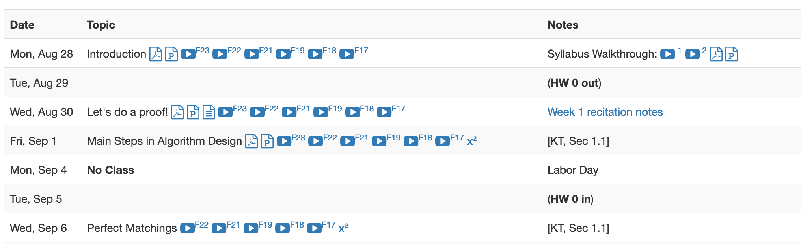
Lost in Notation….

Slide 28
Questions/Comments?

Slide 29
Non-feminist reformulation
n men
Each with a preference list
n women
Match/marry them in a “stable” way

Slide 30







On matchings
Mal
Inara
Wash
Zoe
Simon
Kaylee

Slide 31
Is this a valid matching?
Mal
Inara
Wash
Zoe
Simon
Kaylee

Slide 32
Is this a valid matching?
Mal
Inara
Wash
Zoe
Simon
Kaylee

Slide 33
Is this a valid matching?
Mal
Inara
Wash
Zoe
Simon
Kaylee

Slide 34
Which one is a perfect matching?
Mal
Inara
Wash
Zoe
Simon
Kaylee

Slide 35
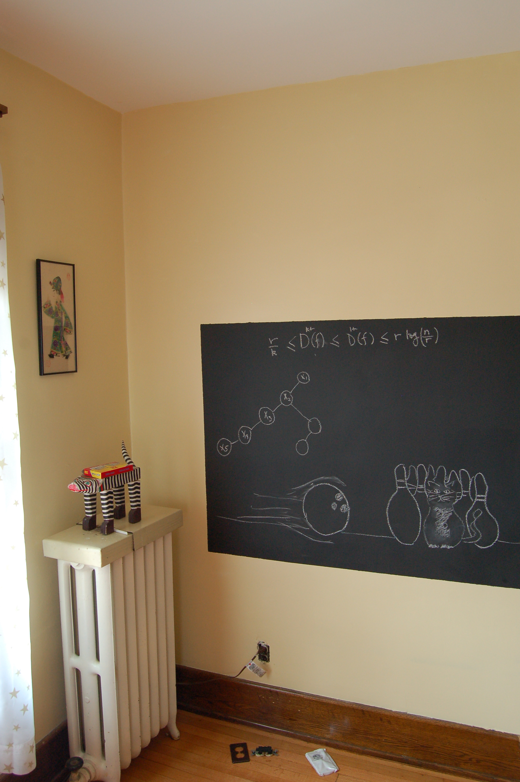
On to the board…

