Slide 1
Lecture 40
CSE 331
Dec 11, 2023

Slide 2
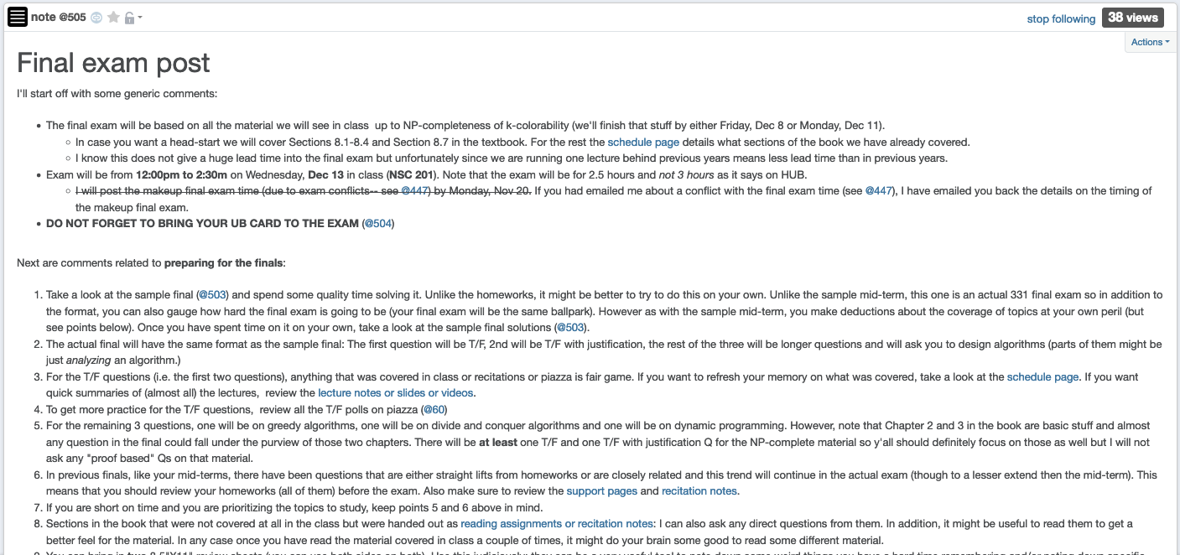
Final exam post

Slide 3
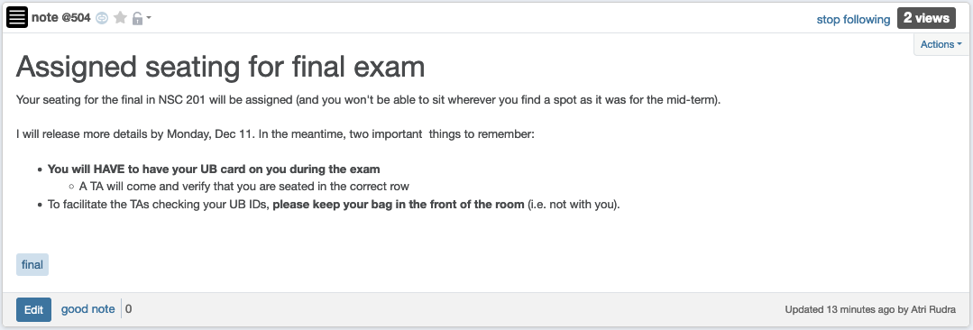
Bring UB card to final exam!
Details on seating assignment by tomorrow 12pm

Slide 4
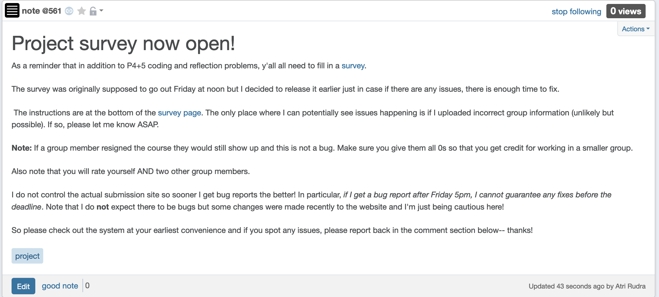
Project Survey Out!

Slide 5
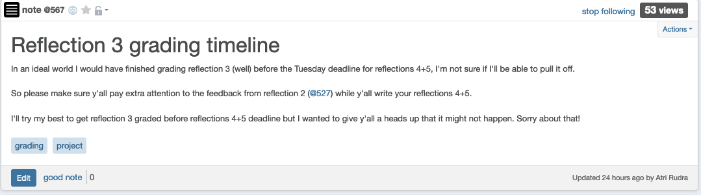
Timeline on reflection 3 grading

Slide 6
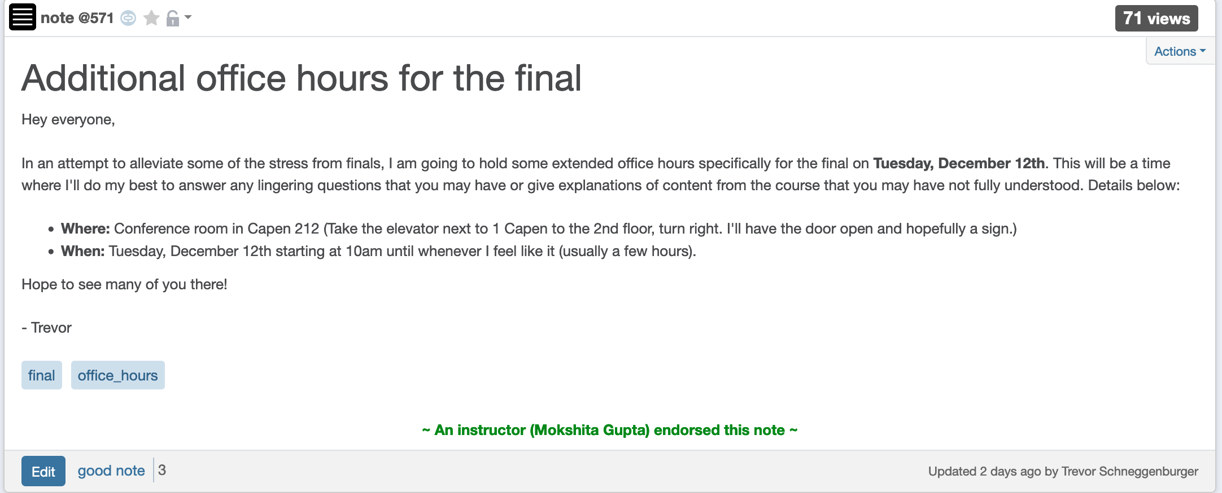
Extended Trevor OH tomorrow

Slide 7
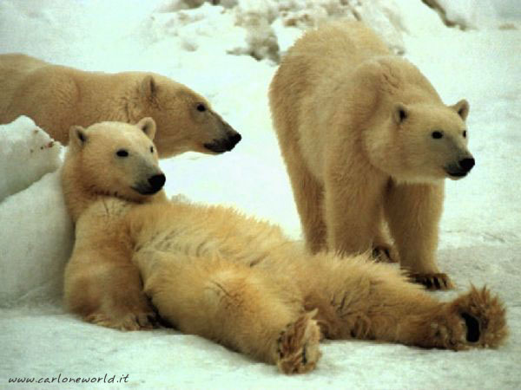
Now relax…

Slide 8
Halting Problem
Input: A program P and input I
Output: Yes if P terminates on I
No otherwise
Theorem: There is no algo A’ for Halting problem (as long as A’ terminates)

Slide 9
Let us assume a magic_box for A’ exists!
def magic_box ( P, I):
# This is a magic box so there is no real code here!
''' Return True if P halts on I and False otherwise'''
Assume that
magic_box terminates on all inputs
magic_box ALWAYS correctly decides if P halts on I or not

Slide 10
A new function contradiction
def contradiction ( P ): # This function takes a program as an input
#Run magic_box on (P,P)
if magic_box (P,P): # Use an UTM to make this call
while True:
pass # Do nothing
return # Just terminate if magic_box(P,P) returns False
Since we assumed magic_box exists contradiction is well defined!

Slide 11
A function call
contradiction (contradiction) # Use an UTM to make this call
Since we assumed contradiction is well defined, the above is a legit function call!

Slide 12
contradiction (contradiction)
What are outcomes of the function call
contradiction (contradiction)?
It terminates
It does not terminate

Slide 13
Case 1:
contradiction (contradiction) terminates
def contradiction ( P ): # This function takes a program as an input
#Run magic_box on (P,P)
if magic_box (P,P): # Use an UTM to make this call
while True:
pass # Do nothing
return # Just terminate if magic_box(P,P) returns False
This does NOT terminate!!
What should this call return?
contradiction (contradiction ):
if magic_box (contradiction, contradiction):
while True:
pass # Do nothing
return
We get into an infinite loop here!

Slide 14
Case 2:
contradiction (contradiction)does not terminate
def contradiction ( P ): # This function takes a program as an input
#Run magic_box on (P,P)
if magic_box (P,P): # Use an UTM to make this call
while True:
pass # Do nothing
return # Just terminate if magic_box(P,P) returns False
This DOES terminate!!
What should this call return?
contradiction (contradiction ):
if magic_box (contradiction, contradiction):
while True:
pass # Do nothing
return
We return here!

Slide 15
Let’s recap: Argue magic_box doesn’t exist
Contradiction!!
1. Assume magic_box exists
2. Defined a function contradiction that uses magic_box
3. Looked at the ONLY two possibilities
3.1. contradiction(contradiction) terminates
contradiction(contradiction) does NOT terminate
3.2. contradiction(contradiction) does NOT terminate
contradiction(contradiction) terminates
Theorem: There is no algo A’ for Halting problem (as long as A’ terminates)

Slide 16

Questions?

Slide 17
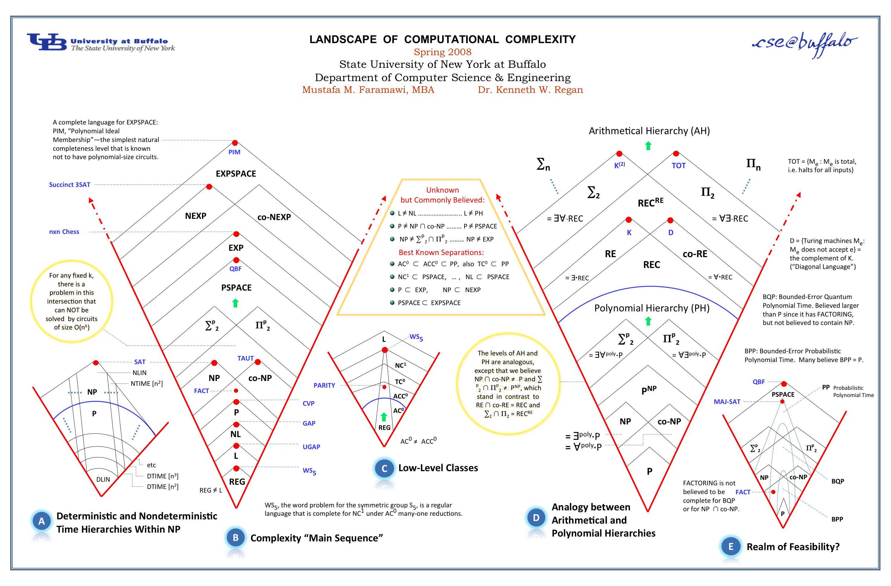
Anything > NP and < undecidability?

Slide 18

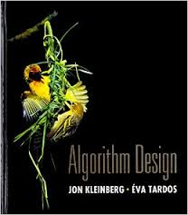
Randomized algorithms
What is different?
Algorithms can toss coins and make decisions
A Representative Problem
Hashing
http://calculator.mathcaptain.com/coin-toss-probability-calculator.html
Further Reading
CSE 432
Chapter 13 of the textbook

Slide 19
Approximation algorithms
Cool twist: NP-hardness of approximations!
What is different?
Algorithms can output a solution that is say 50% as good as the optimal
A Representative Problem
Vertex Cover
Further Reading
Chapter 12 of the textbook

Slide 20
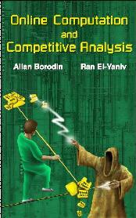
Online algorithms
What is different?
Algorithms have to make decisions before they see all the input
A Representative Problem
Secretary Problem
Further Reading

Slide 21
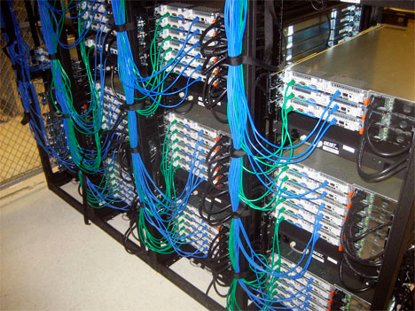
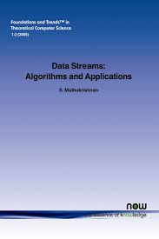
Data streaming algorithms
What is different?
https://www.flickr.com/photos/midom/2134991985/
One pass on the input with severely limited memory
A Representative Problem
Compute the top-10 source IP addresses
Further Reading

Slide 22
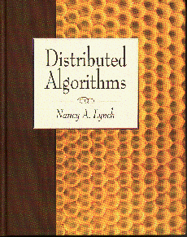
Distributed algorithms
What is different?
Input is distributed over a network
A Representative Problem
Consensus
Further Reading

Slide 23

Beyond-worst case analysis
What is different?
Analyze algorithms in a more instance specific way
A Representative Problem
Intersect two sorted sets
Further Reading
http://timroughgarden.org/f14/f14.html

Slide 24


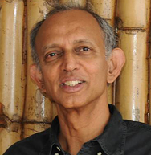
Algorithms for Data Science
What is different?
Algorithms for non-discrete inputs
A Representative Problem
Compute Eigenvalues
Further Reading
https://home.ttic.edu/~avrim/book.pdf

Slide 25
Algorithms and Society
What is different?
Measuring and correcting for harms caused by Algorithms
A Representative Problem
Bias in ML
CSE 440 in Spring 24: ML and Society

Slide 26
Q & A session
CSE 331 related Questions?
Any other Questions?

Slide 27


Whatever your impression of the 331
IT WAS
RIDING

Slide 28
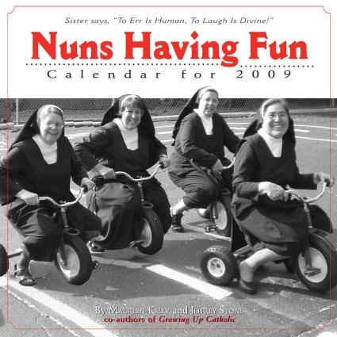
Hopefully it was fun!

Slide 29

Thanks!
Except of course Reflections 4+5, survey and the final exam

