Slide 1
Lecture 6
CSE 331
Sep 11, 2023

Slide 2
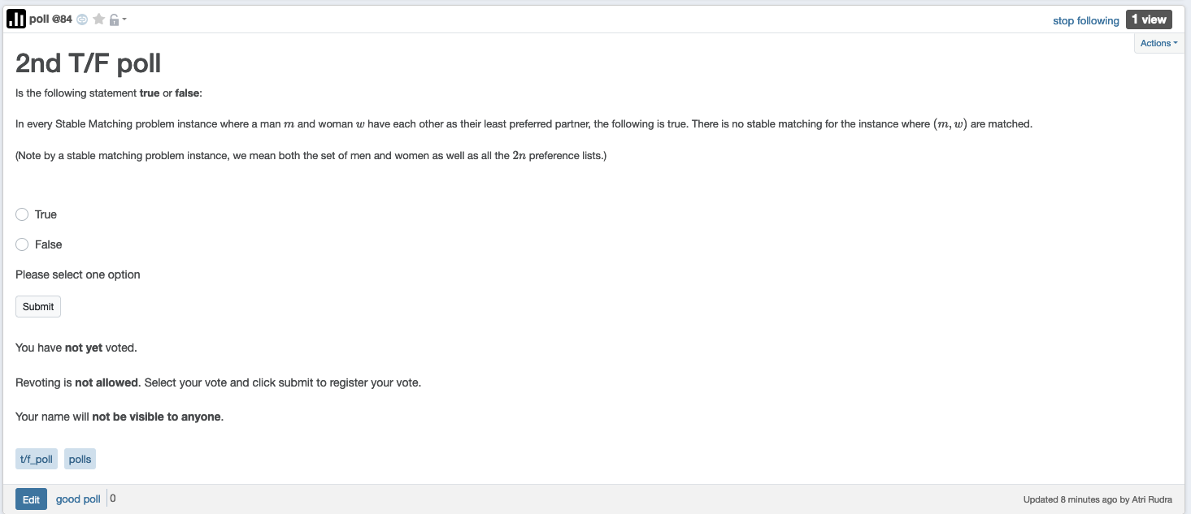
2nd T/F poll up

Slide 3
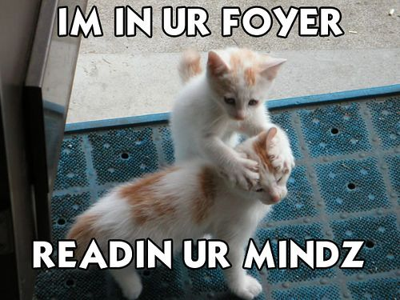
We’re not mind readers

Slide 4

If you need it, ask for help

Slide 5
NEVER apologize
for asking a question!!!

Slide 6
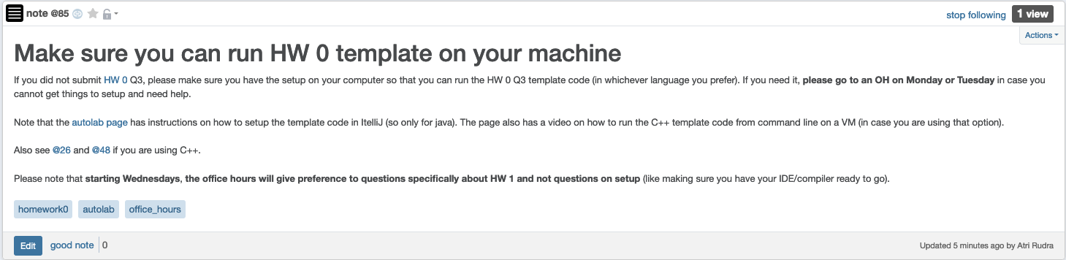
Make sure you can run HW0 code

Slide 7
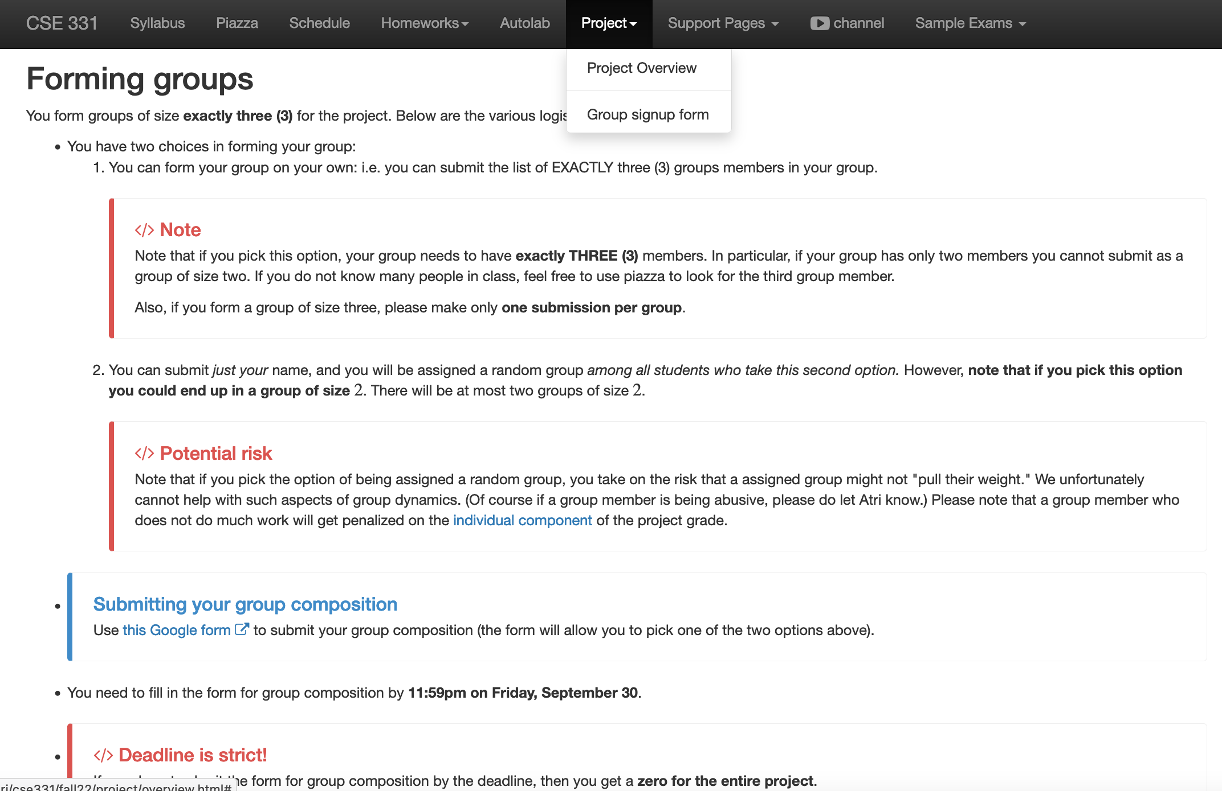
Register your project groups
Deadline: Friday, Sep 29, 11:59pm

Slide 8
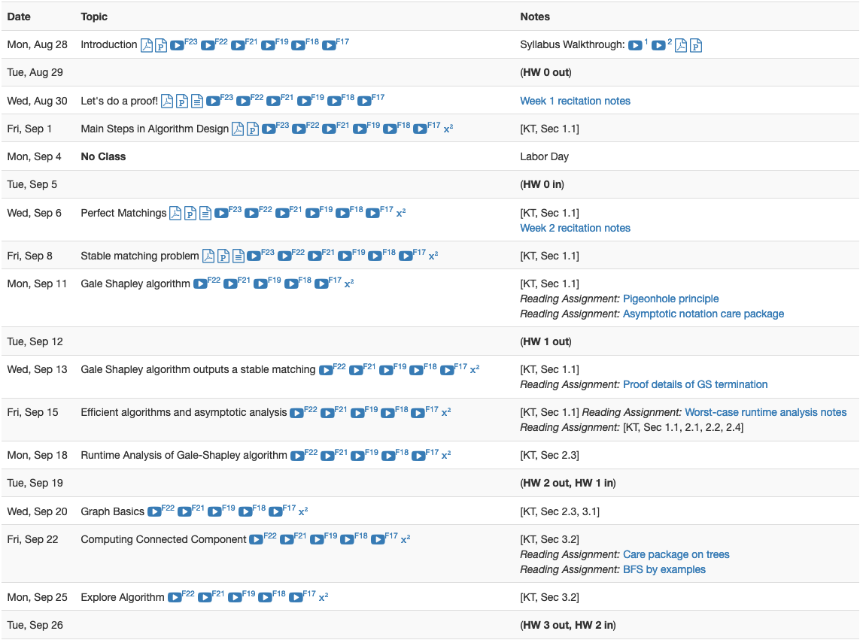
HW 1 gets released this Tue

Slide 9
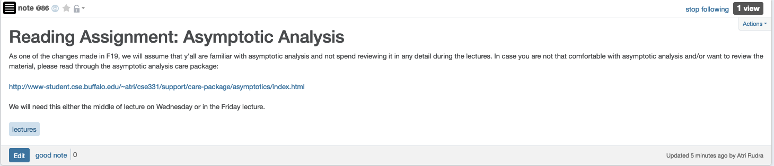
Reading Assignment - I

Slide 10
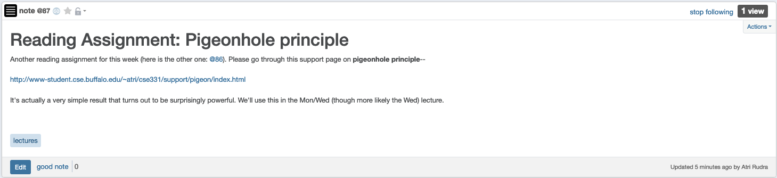
Reading Assignment - II

Slide 11
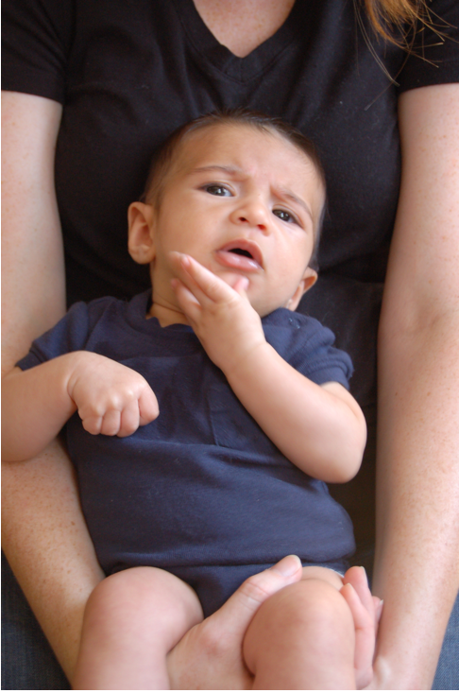
Questions/Comments?

Slide 12
Stable Marriage problem
Input: M and W with preferences
Output: Stable Matching
Set of men M and women W
Preferences (ranking of potential spouses)
Matching (no polyandry/gamy in M X W)
Perfect Matching (everyone gets married)
m
w
Instablity
m’
w’
Stable matching = perfect matching+ no instablity

Slide 13
Two Questions
Does a stable marriage always exist?
If one exists, how quickly can we
compute one?

Slide 14
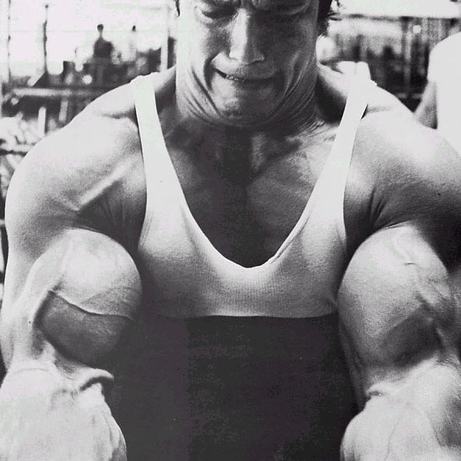
The naïve algorithm
Incremental algorithm to produce all n! prefect matchings?
Go through all possible perfect matchings S
If S is a stable matching
then Stop
n! matchings
Else move to the next perfect matching

Slide 15
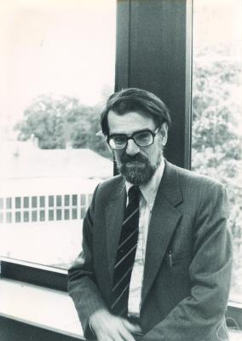
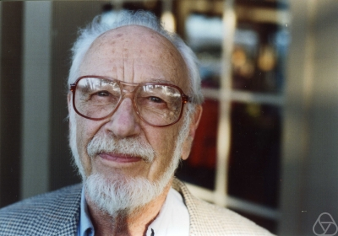
Gale-Shapley Algorithm
David Gale
Lloyd Shapley
O(n²) algorithm

Slide 16
Moral of the story…
>

Slide 17
Questions/Comments?

Slide 18
Rest of today’s agenda
Gale Shapley (GS) algorithm
Run of GS algorithm on an instance
Prove correctness of the GS algorithm

Slide 19
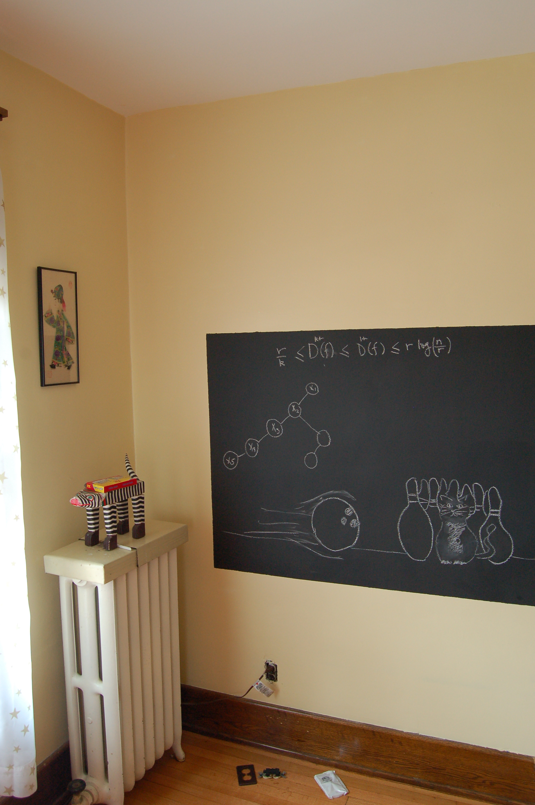
Back to the board…

Slide 20
Gale-Shapley Algorithm
Intially all men and women are free
While there exists a free woman who can propose
Let w be such a woman and m be the best man she has not proposed to
w proposes to m
If m is free
(m,w) get engaged
Else (m,w’) are engaged
If m prefers w’ to w
w remains free
Else
(m,w) get engaged and w’ is free
Output the engaged pairs as the final output

Slide 21
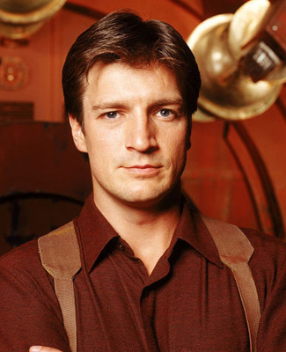
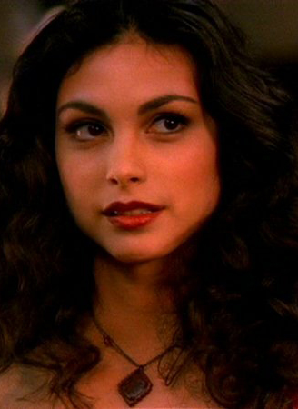

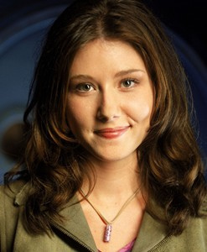
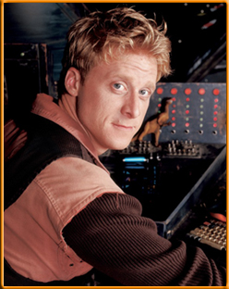
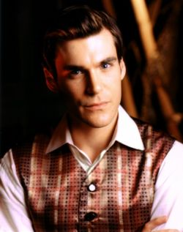
Preferences
Mal
Inara
Wash
Zoe
Simon
Kaylee

Slide 22
GS algorithm: Firefly Edition
Mal
Inara
Wash
Zoe
1
2
3
4
5
6
Simon
Kaylee
1
2
3
4
5
6

