Slide 1
Lecture 9
CSE 331
Sep 18, 2023

Slide 2
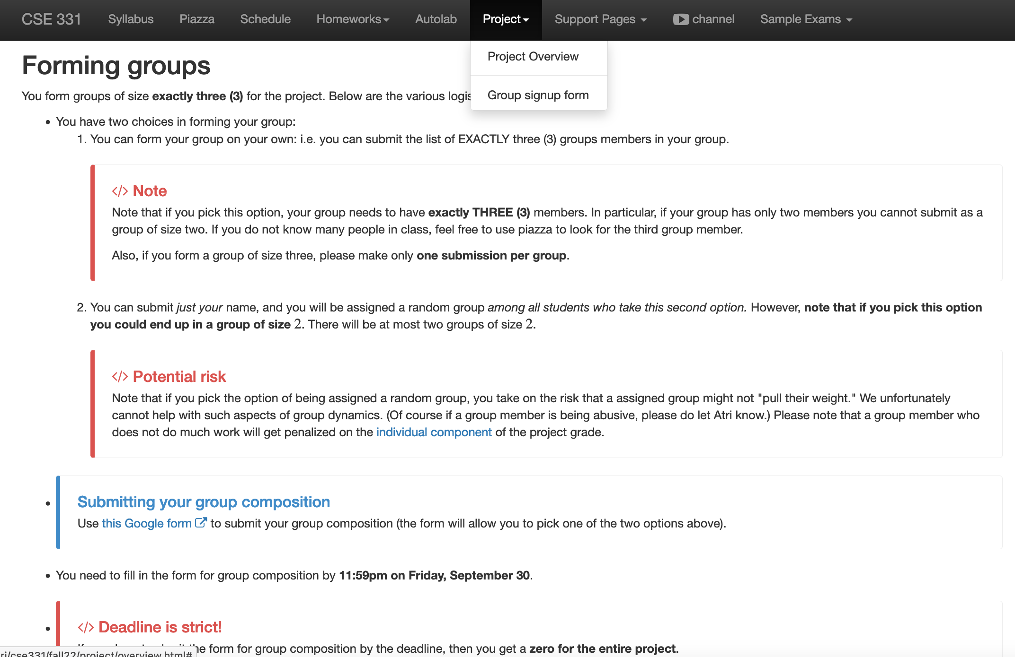
Register your project groups
Deadline: Friday, Sep 29, 11:59pm

Slide 3
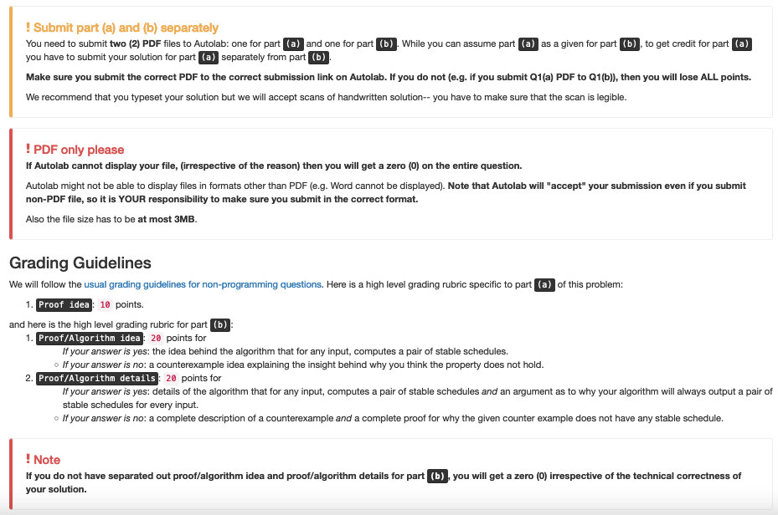
Follow ALL instructions on HW1

Slide 4
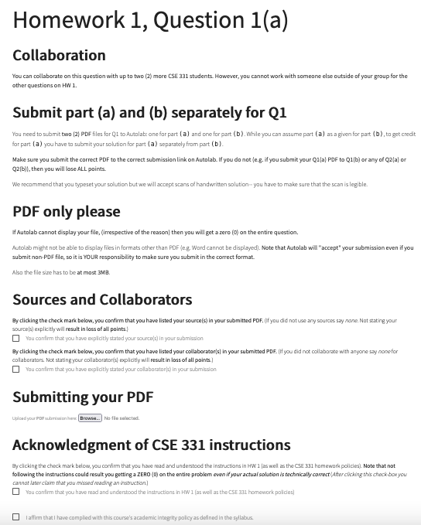
They are repeated on Autolab

Slide 5
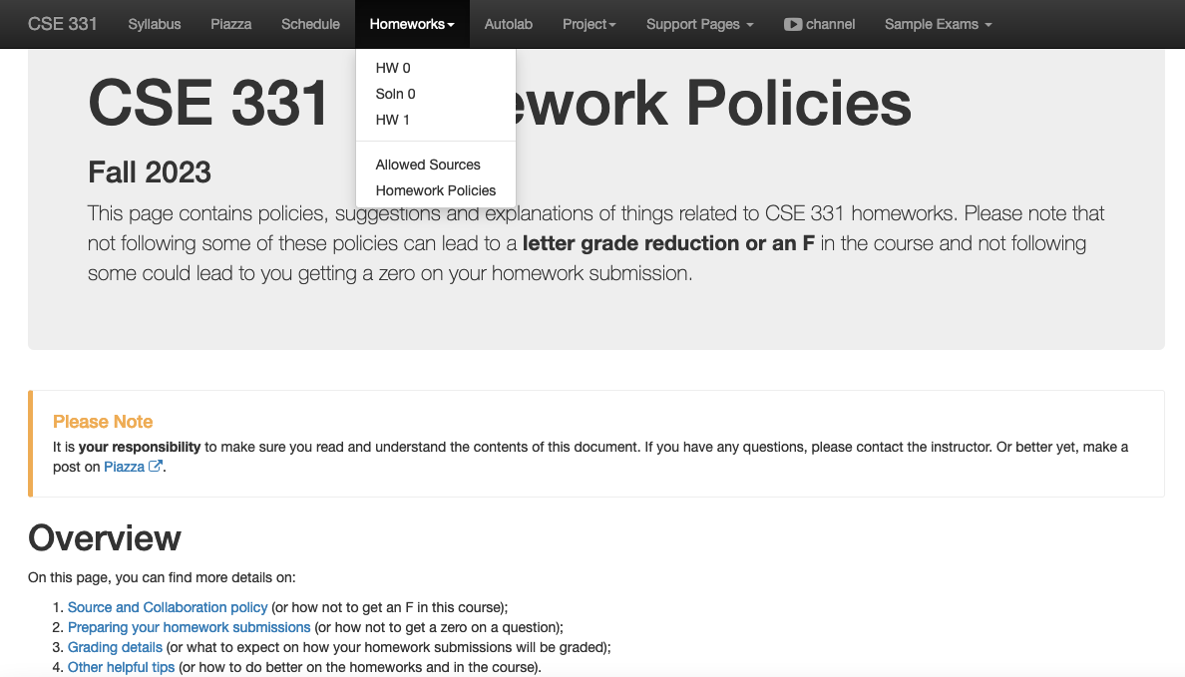
Review the HW policy doc!

Slide 6
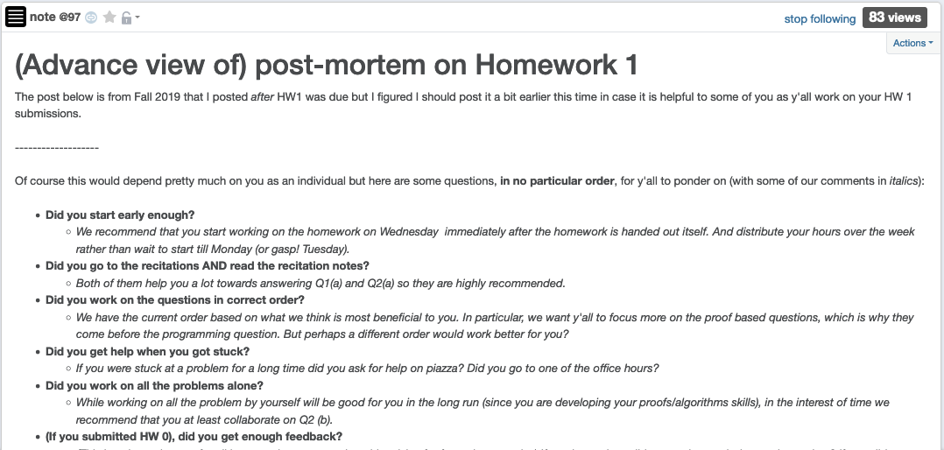
HW 1 (pre)post-mortem

Slide 7
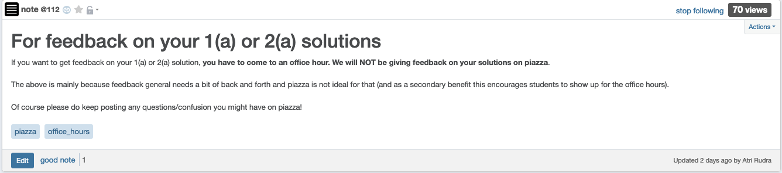
Feedback on Q1(a) and Q2(a)

Slide 8

If you need it, ask for help

Slide 9
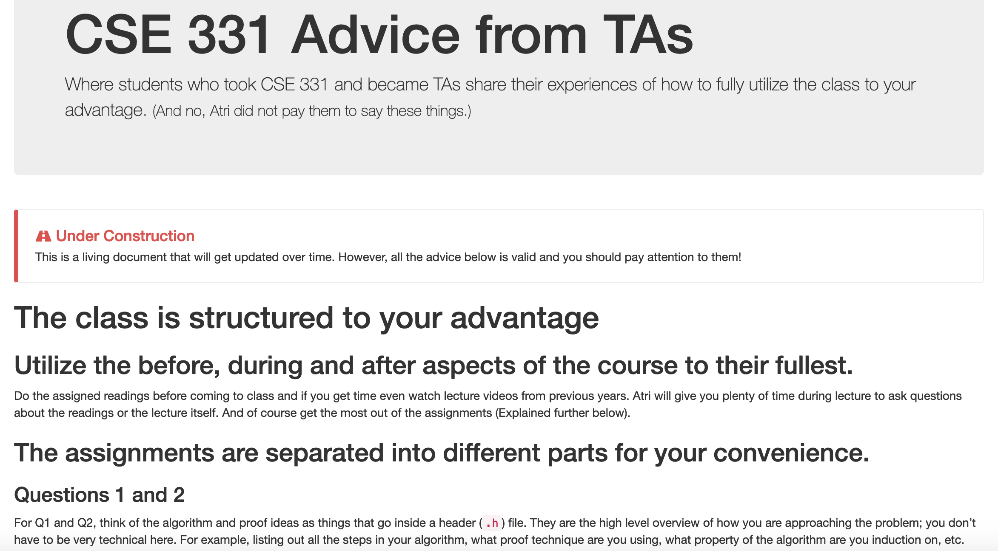
Advice from TAs

Slide 10
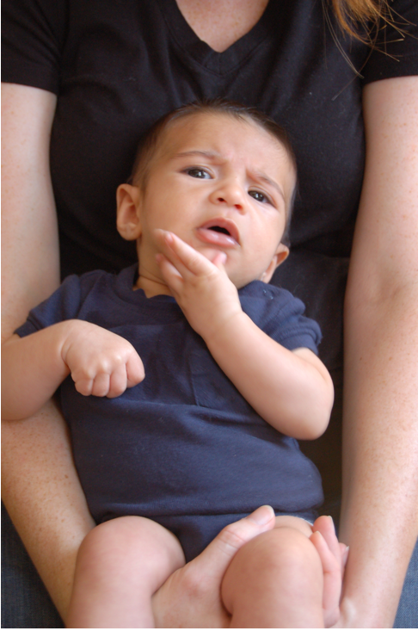
Questions/Comments?

Slide 11
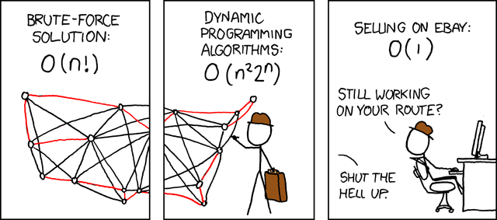
Asymptotic Analysis
Travelling Salesman Problem
(http://xkcd.com/399/)

Slide 12
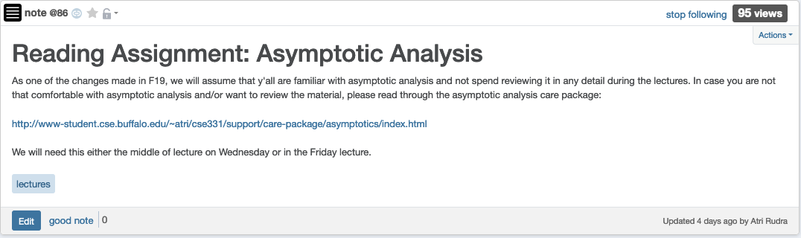
Reading Assignment for today

Slide 13
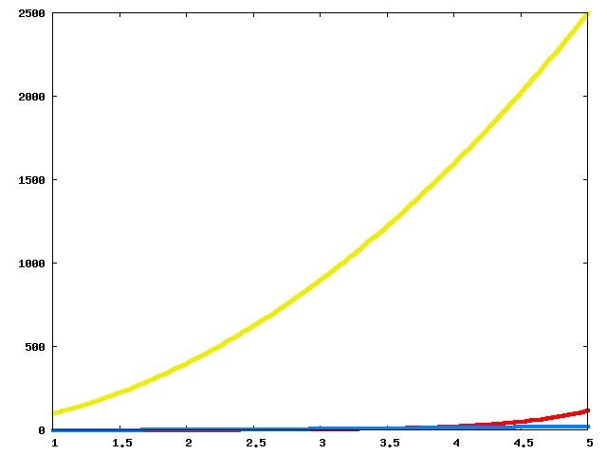
Which one is better?

Slide 14
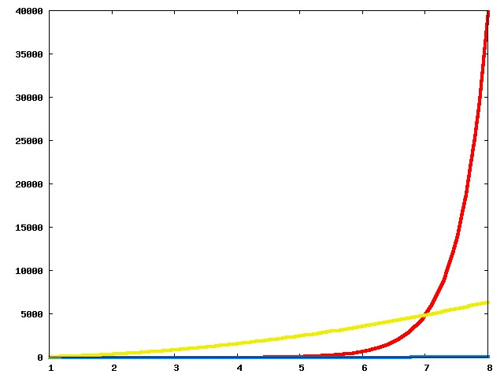
Now?

Slide 15
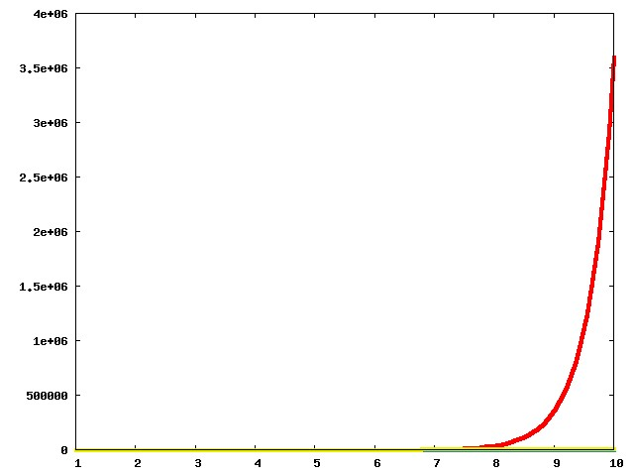
And now?

Slide 16
The actual run times
n!
100n²
Asymptotic View
n²

Slide 17
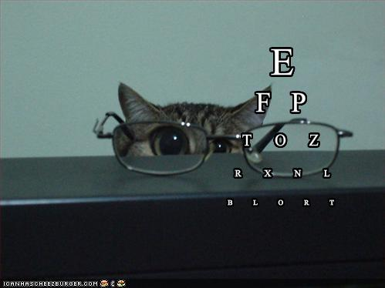
Asymptotic Notation
≤ is O with glasses
≥ is Ω with glasses
= is Θ with glasses

Slide 18
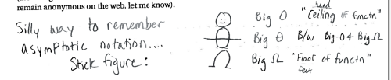
Another view
© Aleksandra Patrzalek, 2012

Slide 19
g(n) is O(f(n))
c*f(n) for some c>0
g(n)
n
n₀

Slide 20
g(n) is Ω(f(n))
g(n)
ε*f(n) for some ε>0
n
n₁

Slide 21
g(n) is Θ(f(n))
g(n)
ε*f(n) for some ε>0
n
n₁

Slide 22
Properties of O (and Ω)
Transitive
g is O(f) and f is O(h) then
g is O(h)
Step 1 // O(n) time
Step 2 // O(n) time
Additive
g is O(h) and f is O(h) then
g+f is O(h)
Overall: O(n) time
Multiplicative
g is O(h₁) and f is O(h₂) then
g*f is O(h₁*h₂)
Overall: O(n²) time
While (loop condition) // O(n²) iterations
Stuff happens // O(1) time

Slide 23
Questions?

Slide 24
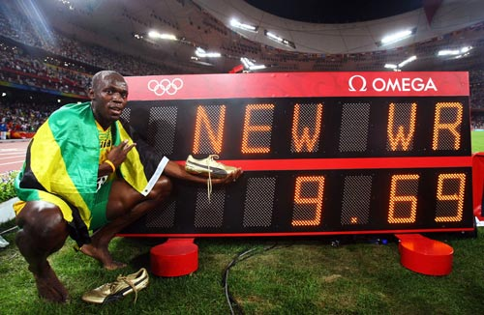
Rest of today’s agenda
O(n²) implementation of the Gale-Shapley algorithm
Some practice with run time analysis

Slide 25
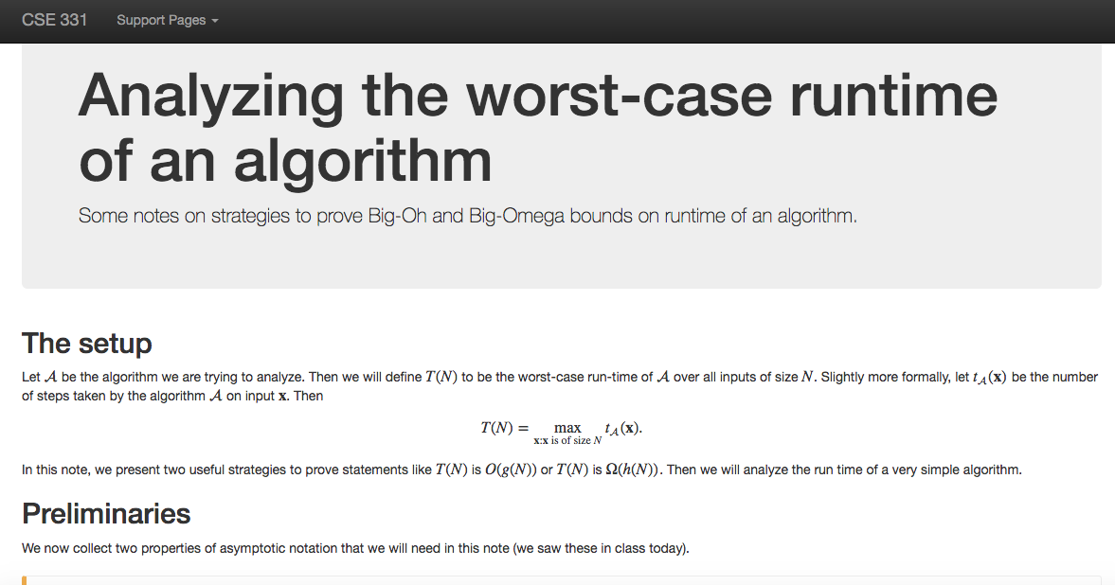
Another Reading Assignment

Slide 26
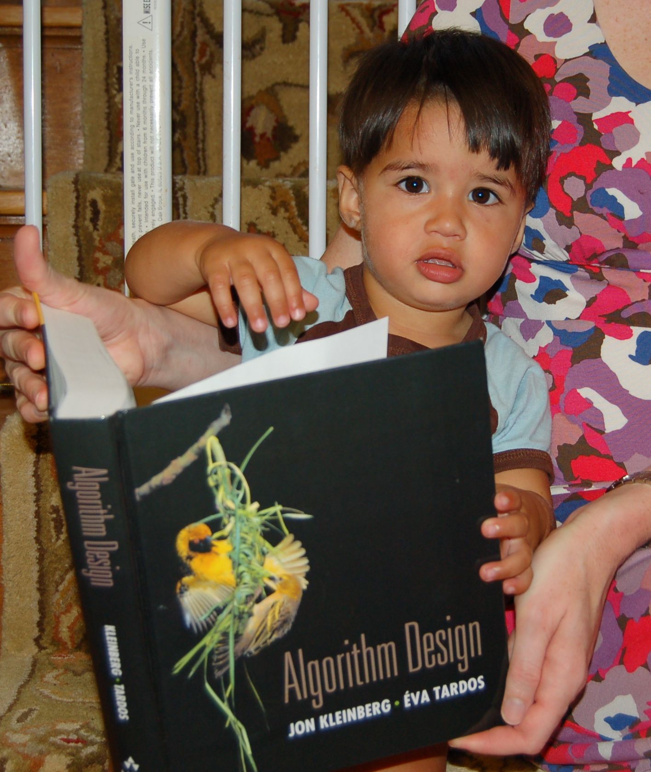
Reading Assignments
Sections 1.1, 1.2, 2.1, 2.2 and 2.4 in [KT]

Slide 27
Gale-Shapley Algorithm
At most n² iterations
Intially all men and women are free
While there exists a free woman who can propose
Let w be such a woman and m be the best man she has not proposed to
w proposes to m
O(1) time implementation
If m is free
(m,w) get engaged
Else (m,w’) are engaged
If m prefers w’ to w
w remains free
Else
(m,w) get engaged and w’ is free
Output the engaged pairs as the final output

Slide 28
Implementation Steps
(0) How to represent the input?
(1) How do we find a free woman w?
(2) How would w pick her best unproposed man m?
(3) How do we know who m is engaged to?
(4) How do we decide if m prefers w’ to w?

Slide 29
Overall running time
Init(1-4)
n² X ( Query/Update(1-4) )

Slide 30
Questions?

Slide 31
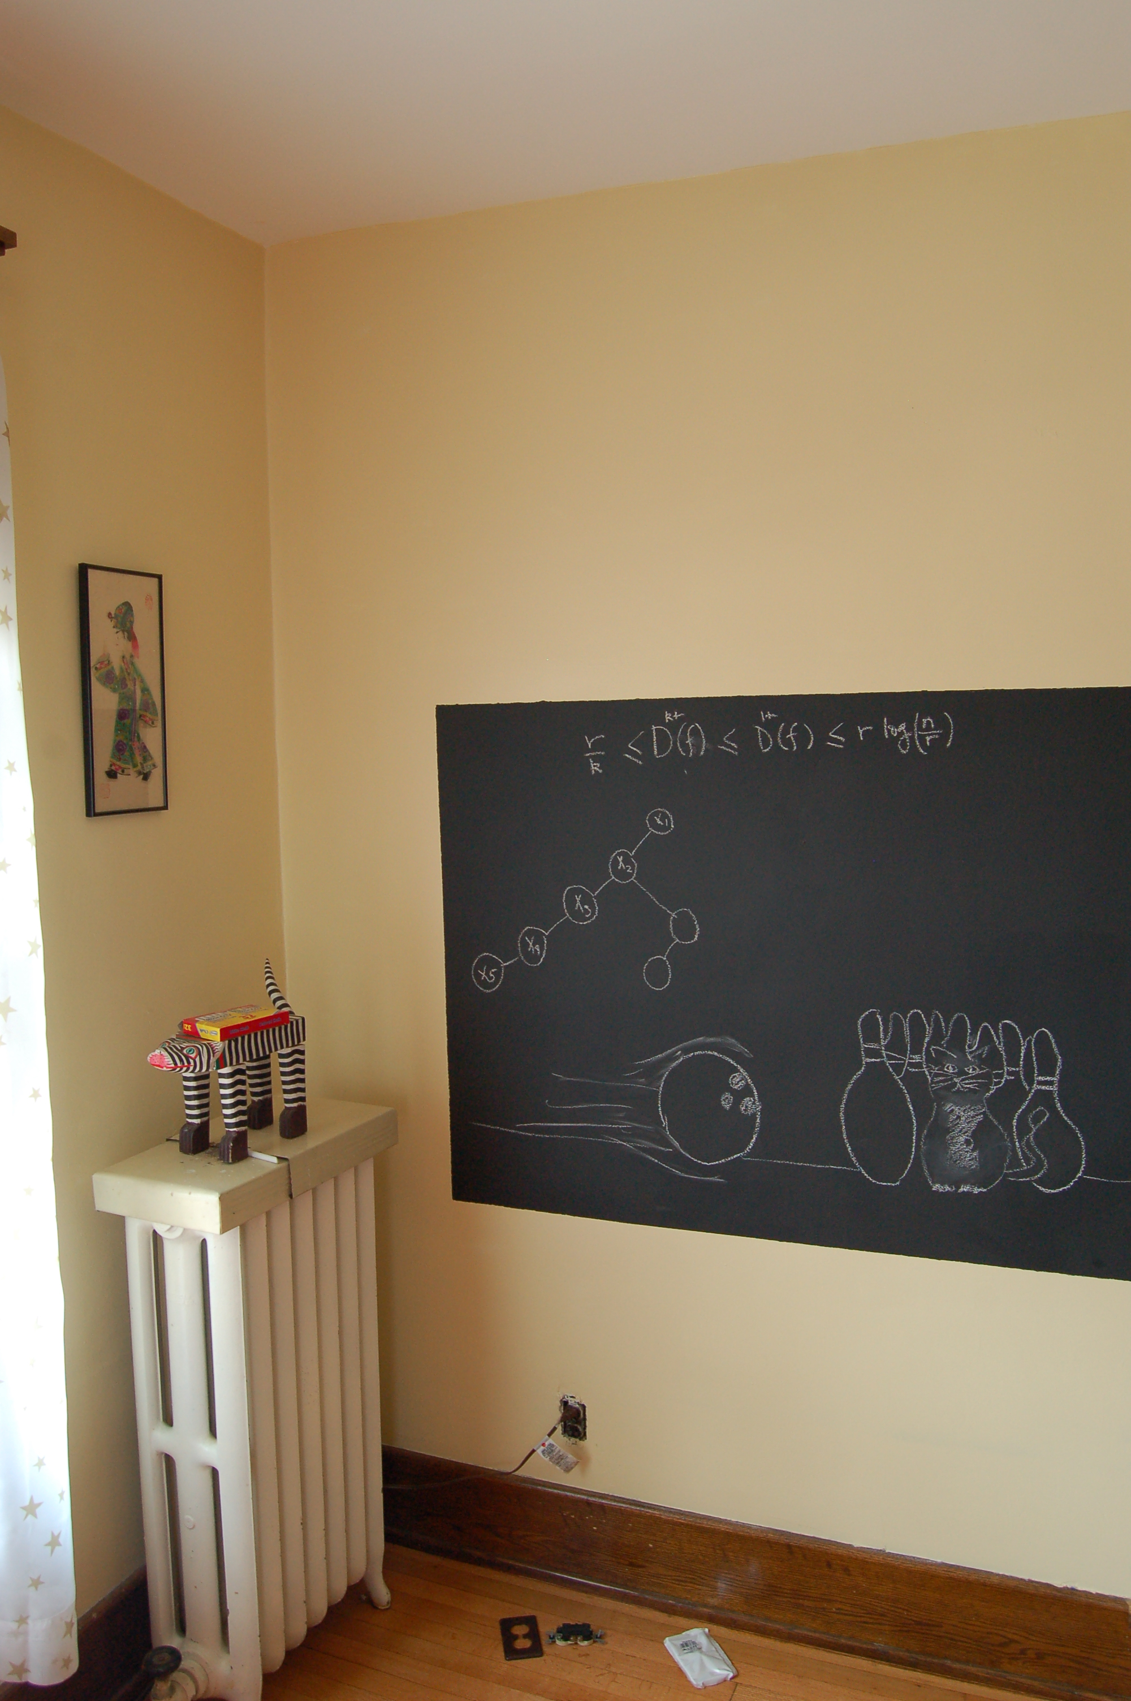
Rest on the board…

