Slide 1
Lecture 10
CSE 331
Sep 18, 2024

Slide 2
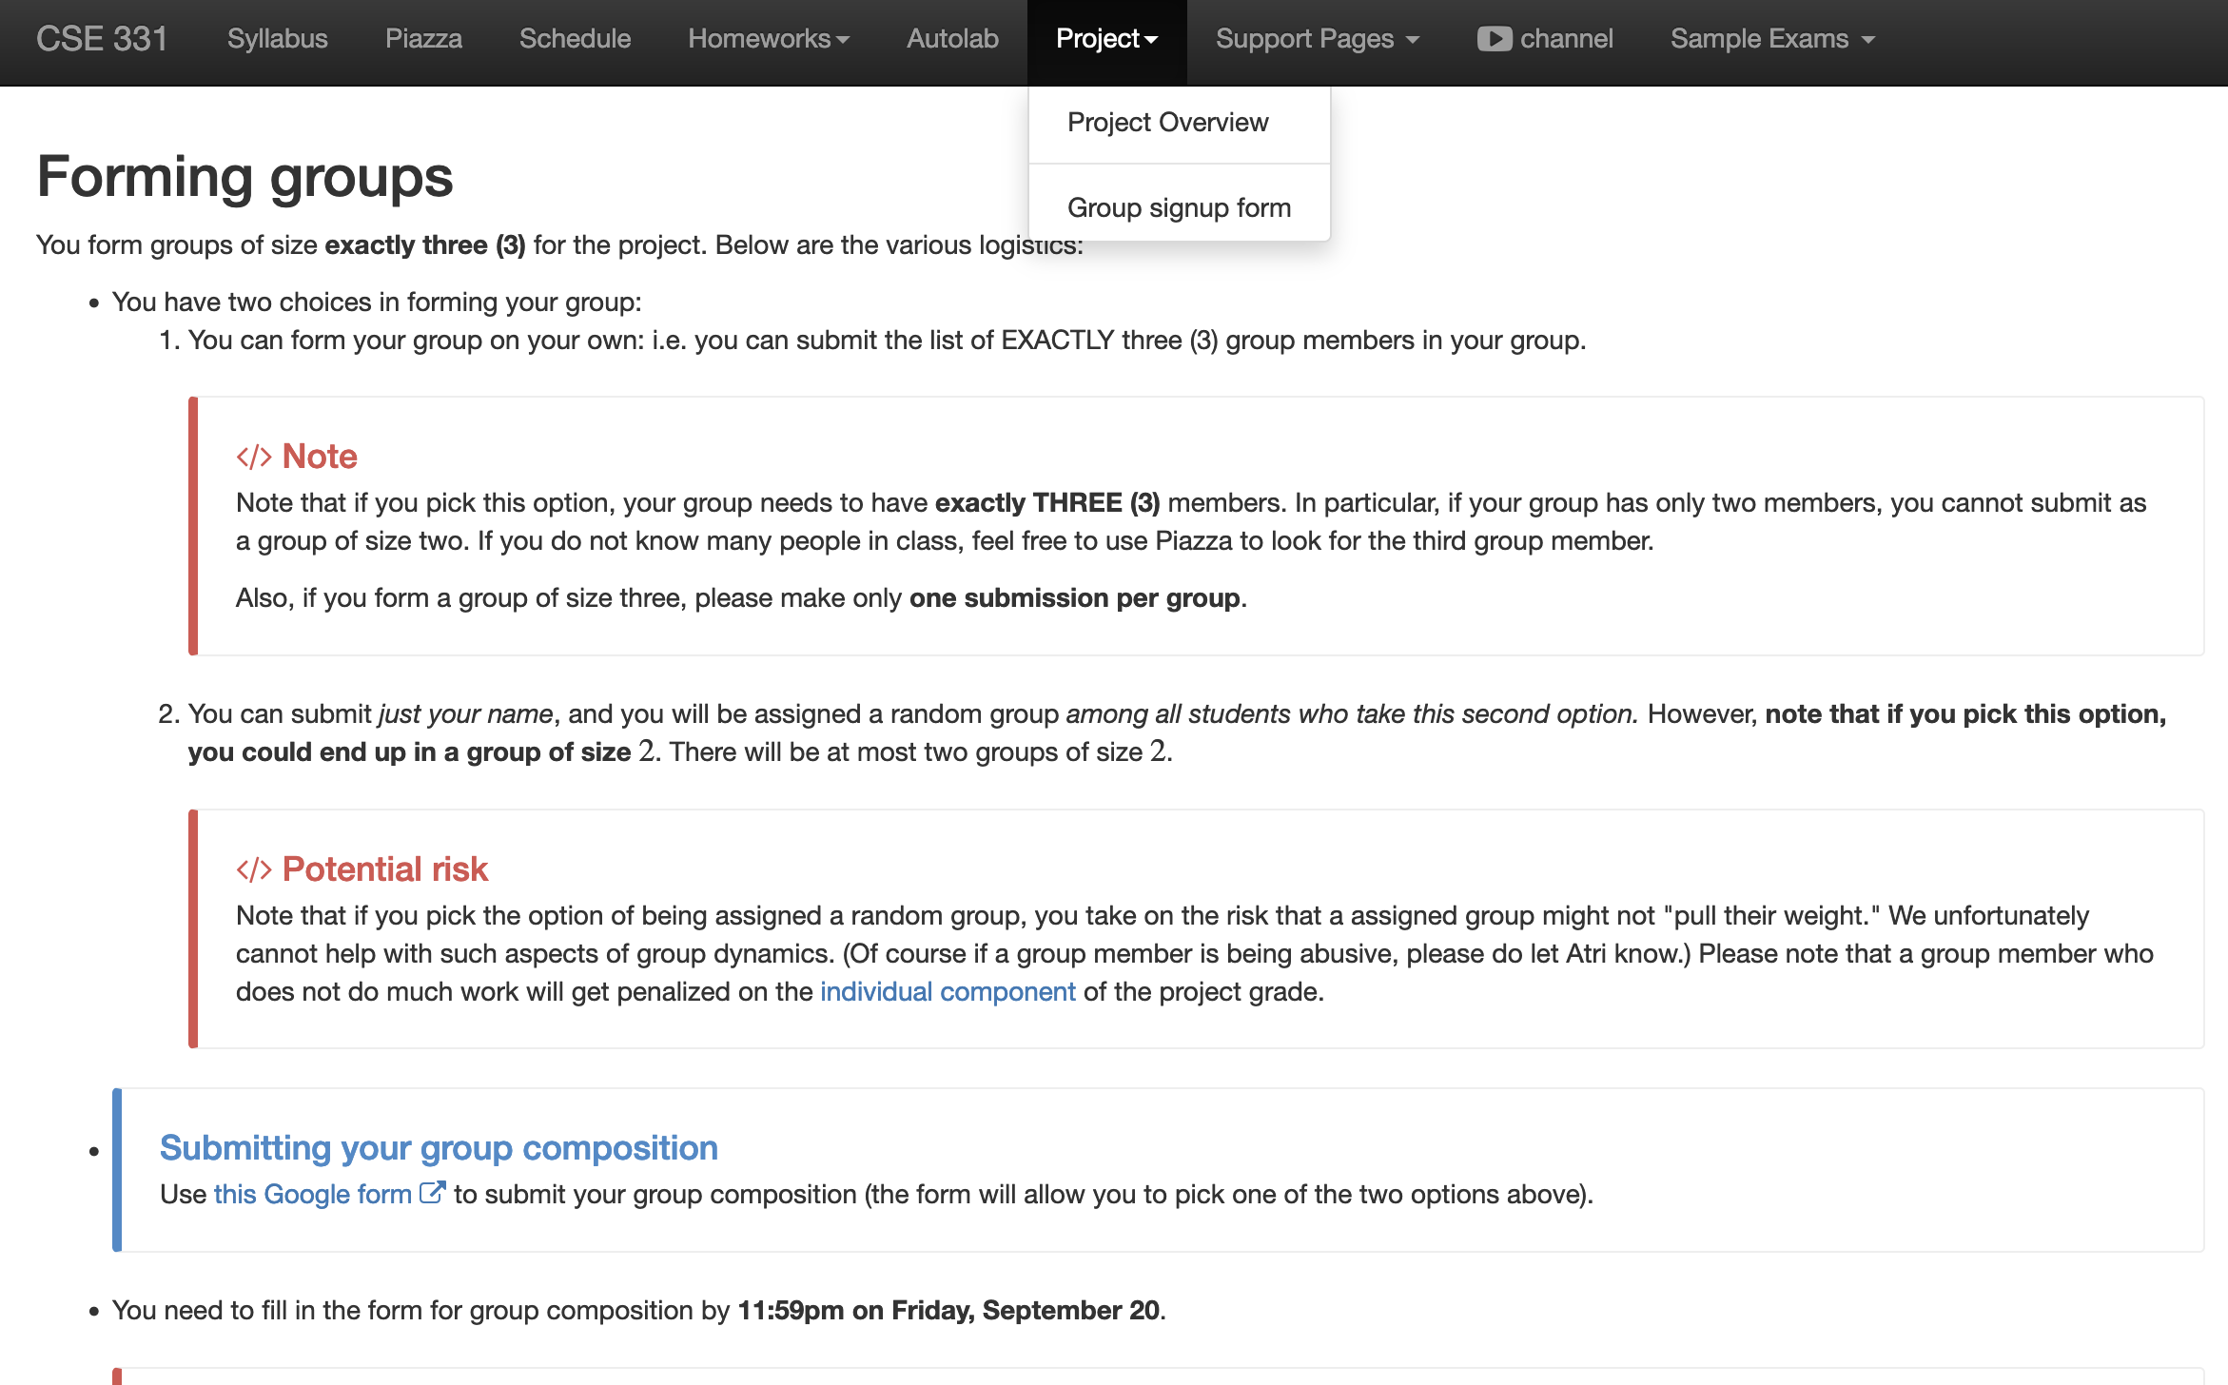
Register your project groups
Deadline: Friday, Sep 20, 11:59pm
If you miss this deadline then you will get a ZERO on the ENTIRE project

Slide 3
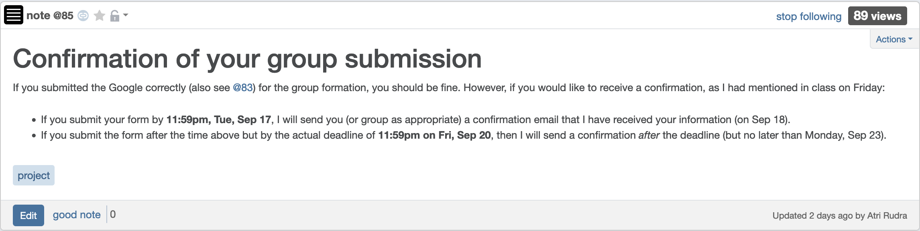
Confirmation of form submission
Expect a confirmation by midnight tonight

Slide 4

If you need it, ask for help

Slide 5
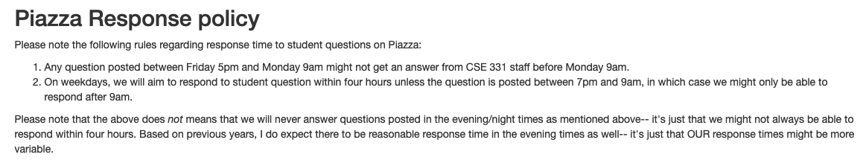
Piazza response policy

Slide 6
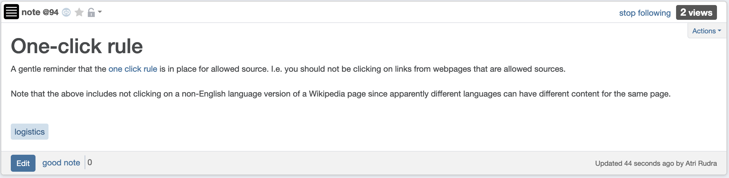
“One click” rule

Slide 7
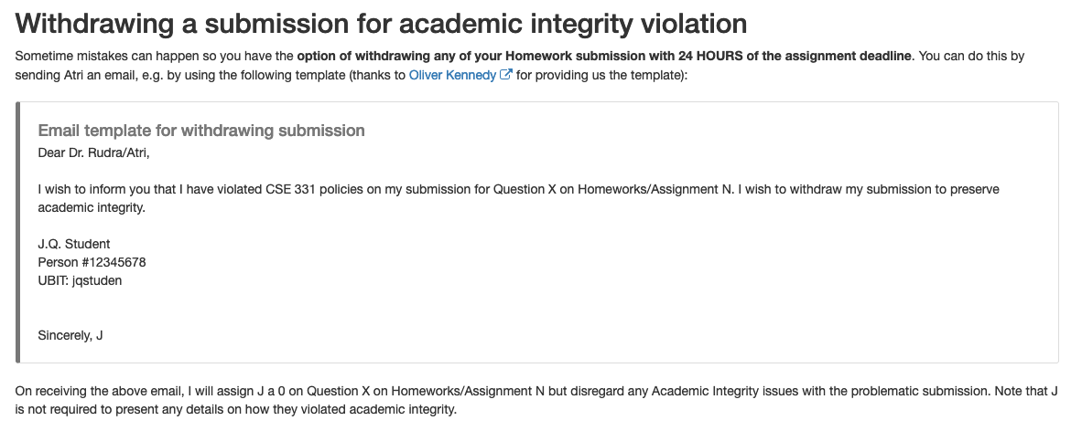
If you did an AI violation on HW 1
You can still withdraw it with no penalty by 11:59pm tonight

Slide 8
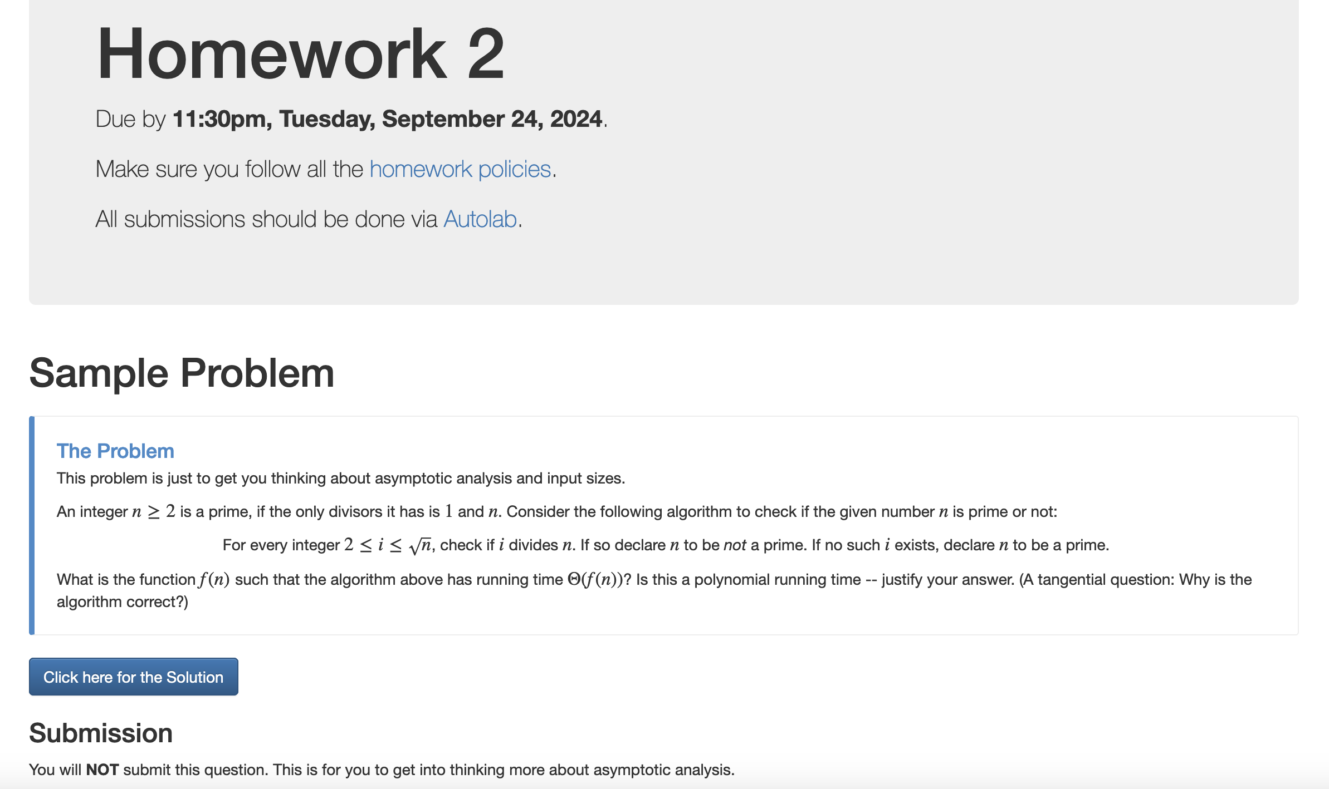
Homework 2 out!

Slide 9
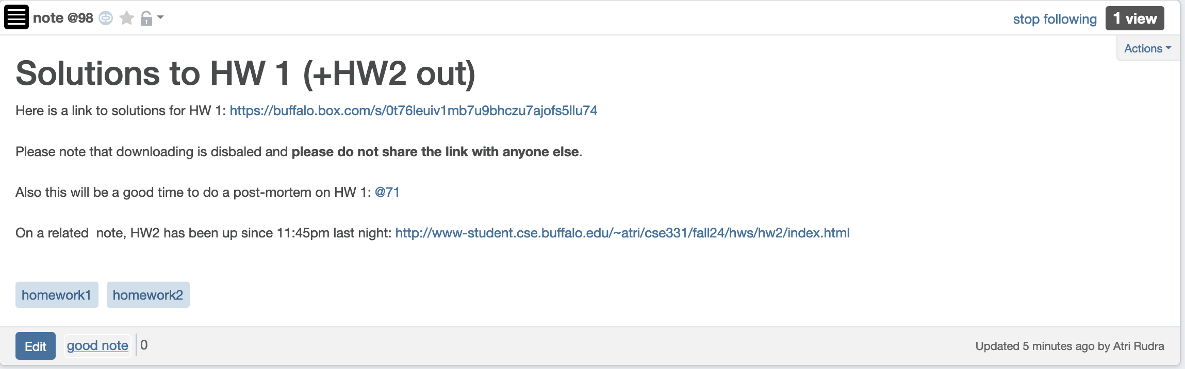
HW 1 solutions out

Slide 10
Implementation Steps
(0) How to represent the input?
2D arrays: WomanPref, ManPref
(1) How do we find a free woman w?
(2) How would w pick her best unproposed man m?
(3) How do we know who m is engaged to?
O(n) init
O(1) query/update
(4) How do we decide if m prefers w’ to w?

Slide 11
Overall running time
Init(1-4)
n² X ( Query/Update(1-4) )

Slide 12
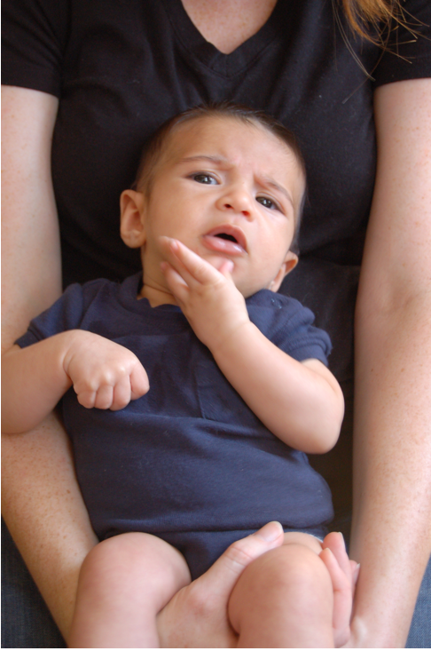
Questions?

Slide 13
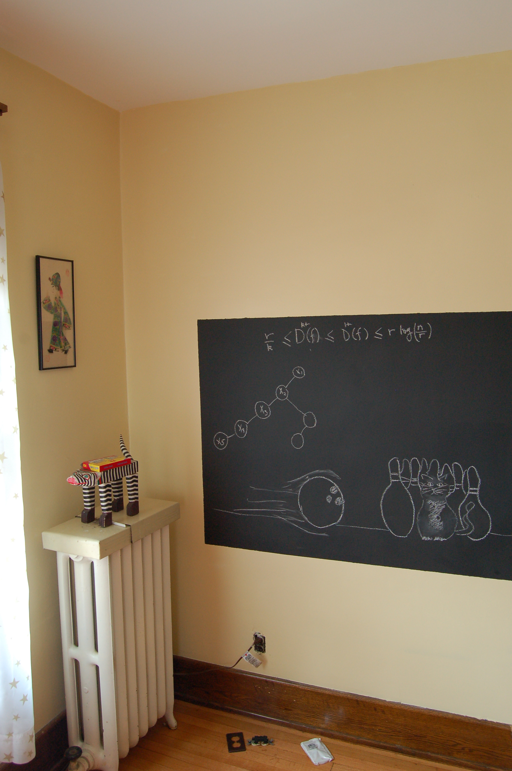
Rest on the board…

Slide 14

Answering Q4
rank i
O(n) for one query $⟹$ O(n³) overall
w
w’
woman w
man m
w
w’
man m
j
k
ManPref [m][i]
Initialization time?
O(n²) time overall
Ranking [m][w]
O(1) query time
(4) How do we decide if m prefers w’ to w?

Slide 15
Puzzle
Prove that any algorithm for the SMP takes Ω(n²) time

