Slide 1
Lecture 11
CSE 331
Sep 20, 2024

Slide 2
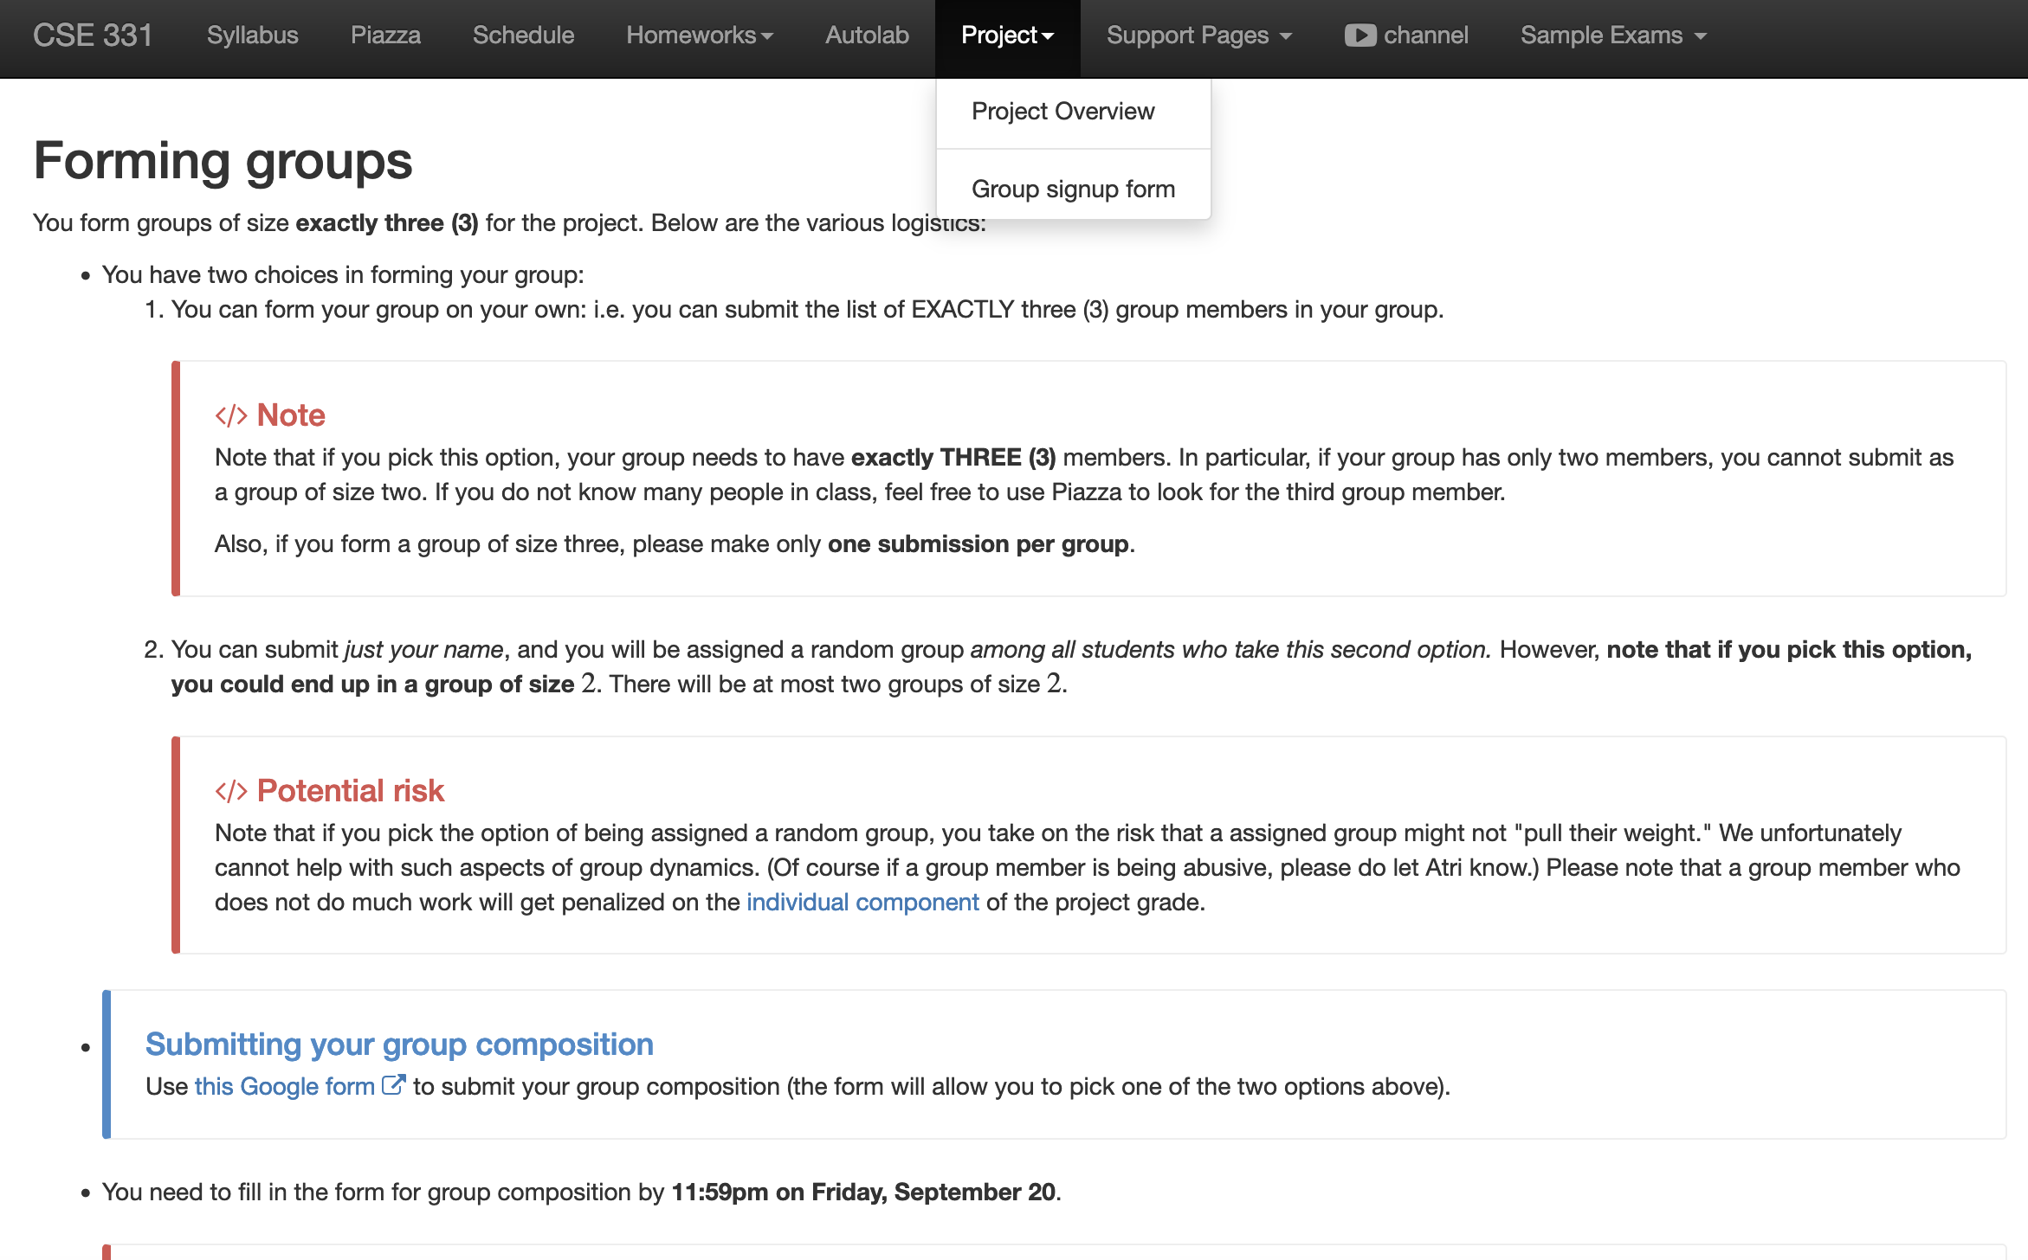
Register your project groups
Deadline: Friday, Sep 20, 11:59pm
If you miss this deadline then you will get a ZERO on the ENTIRE project

Slide 3
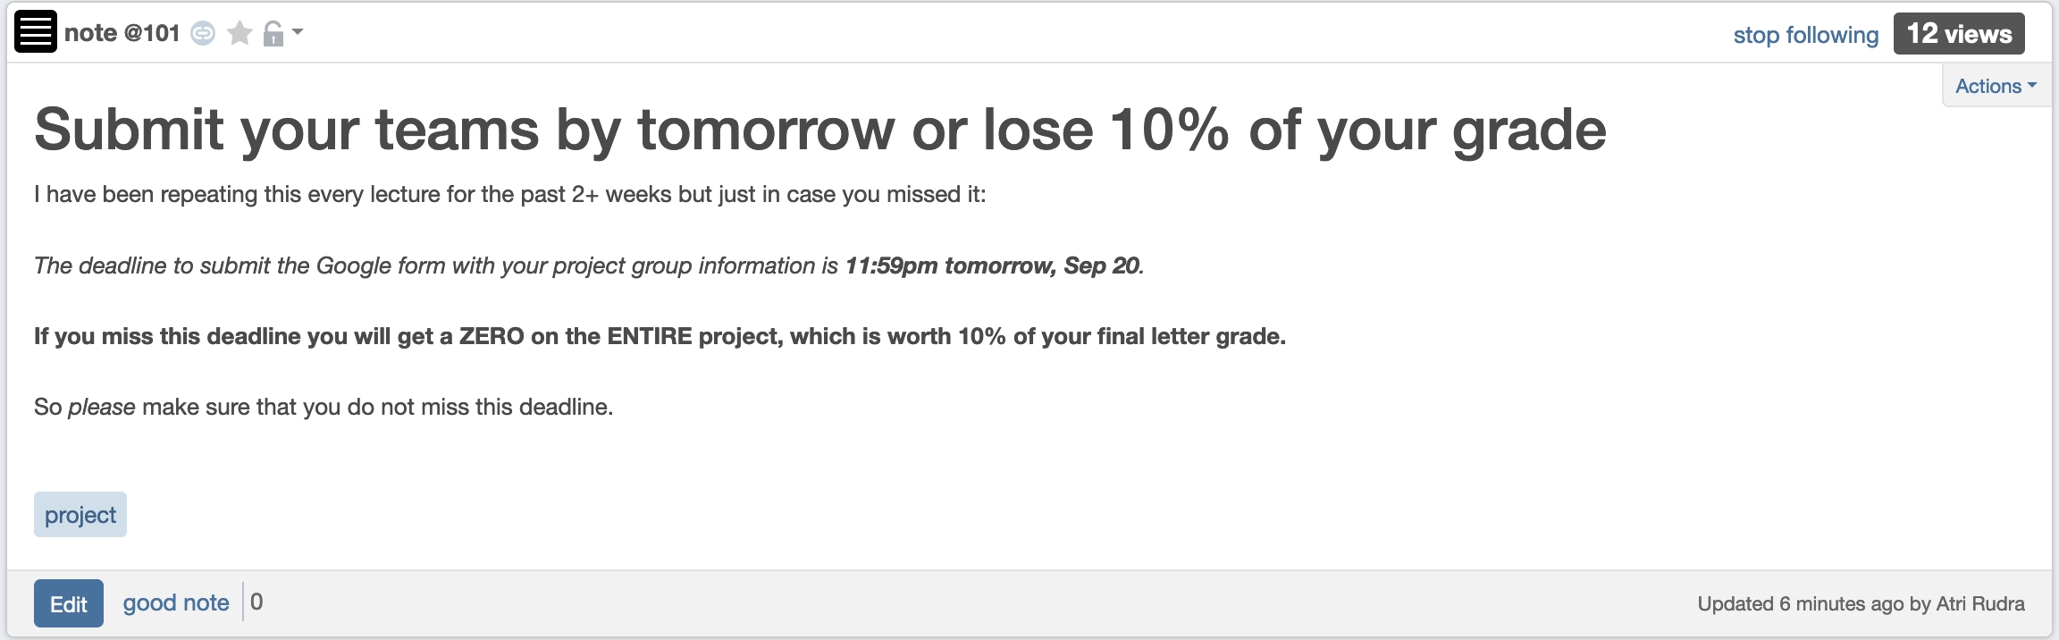
Please…

Slide 4
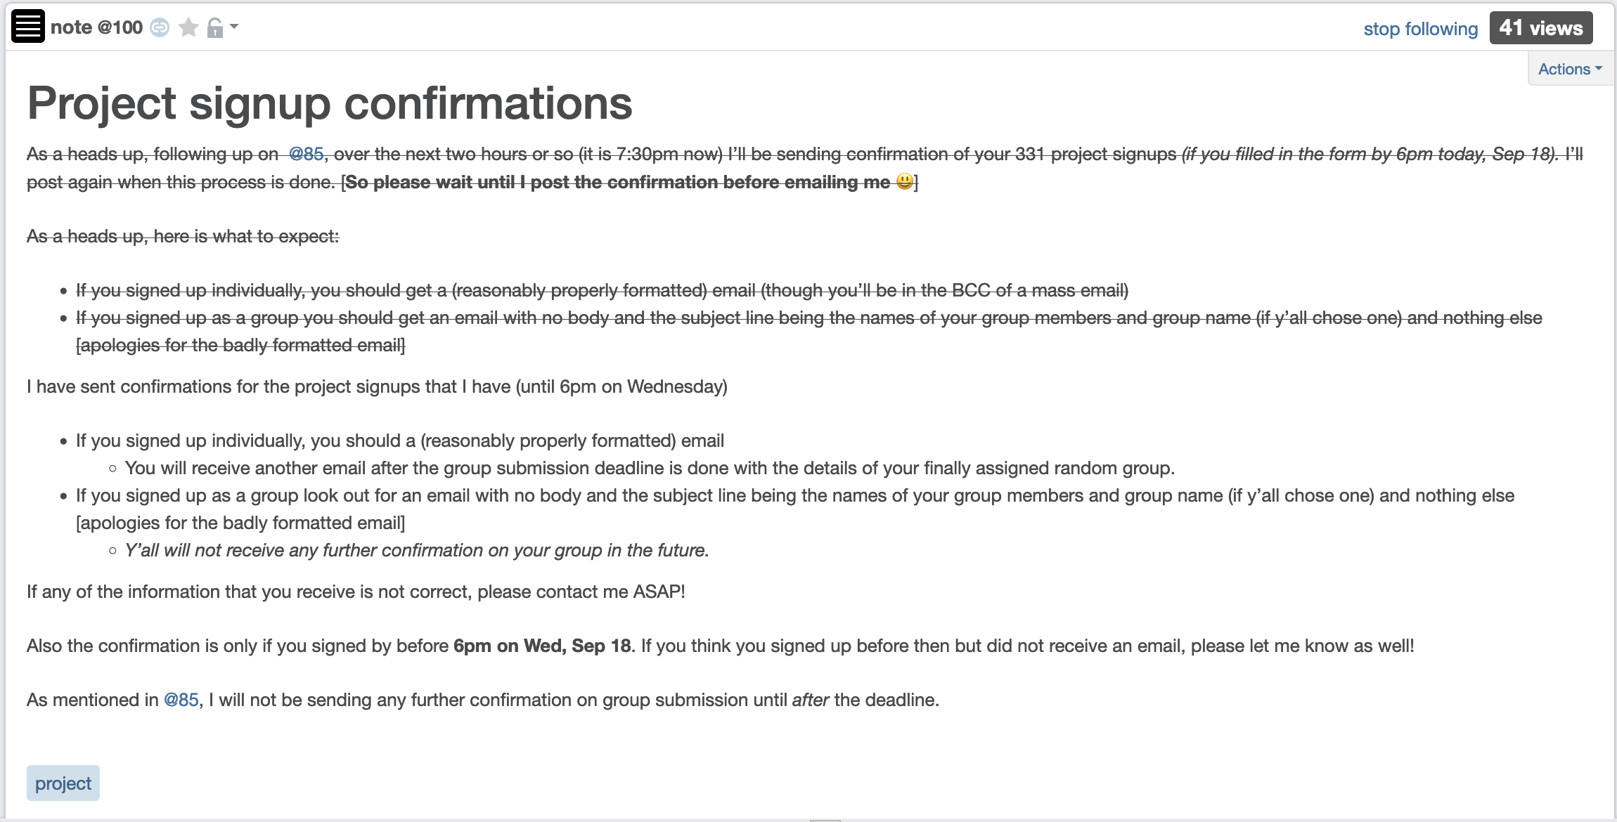
Confirmation of form submission

Slide 5

If you need it, ask for help

Slide 6
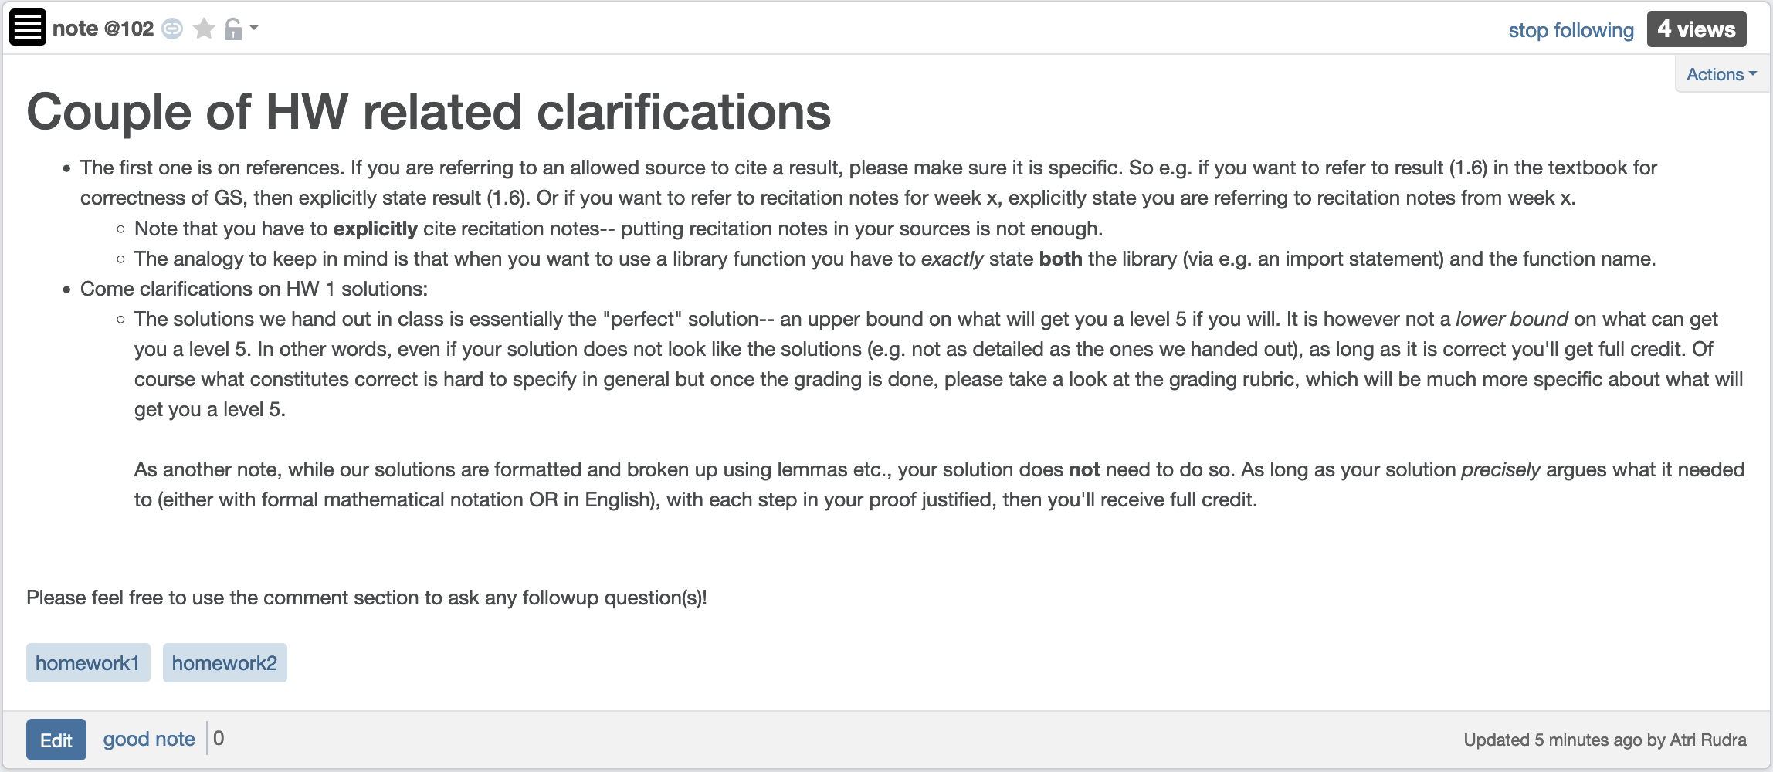
Couple of HW clarifications

Slide 7
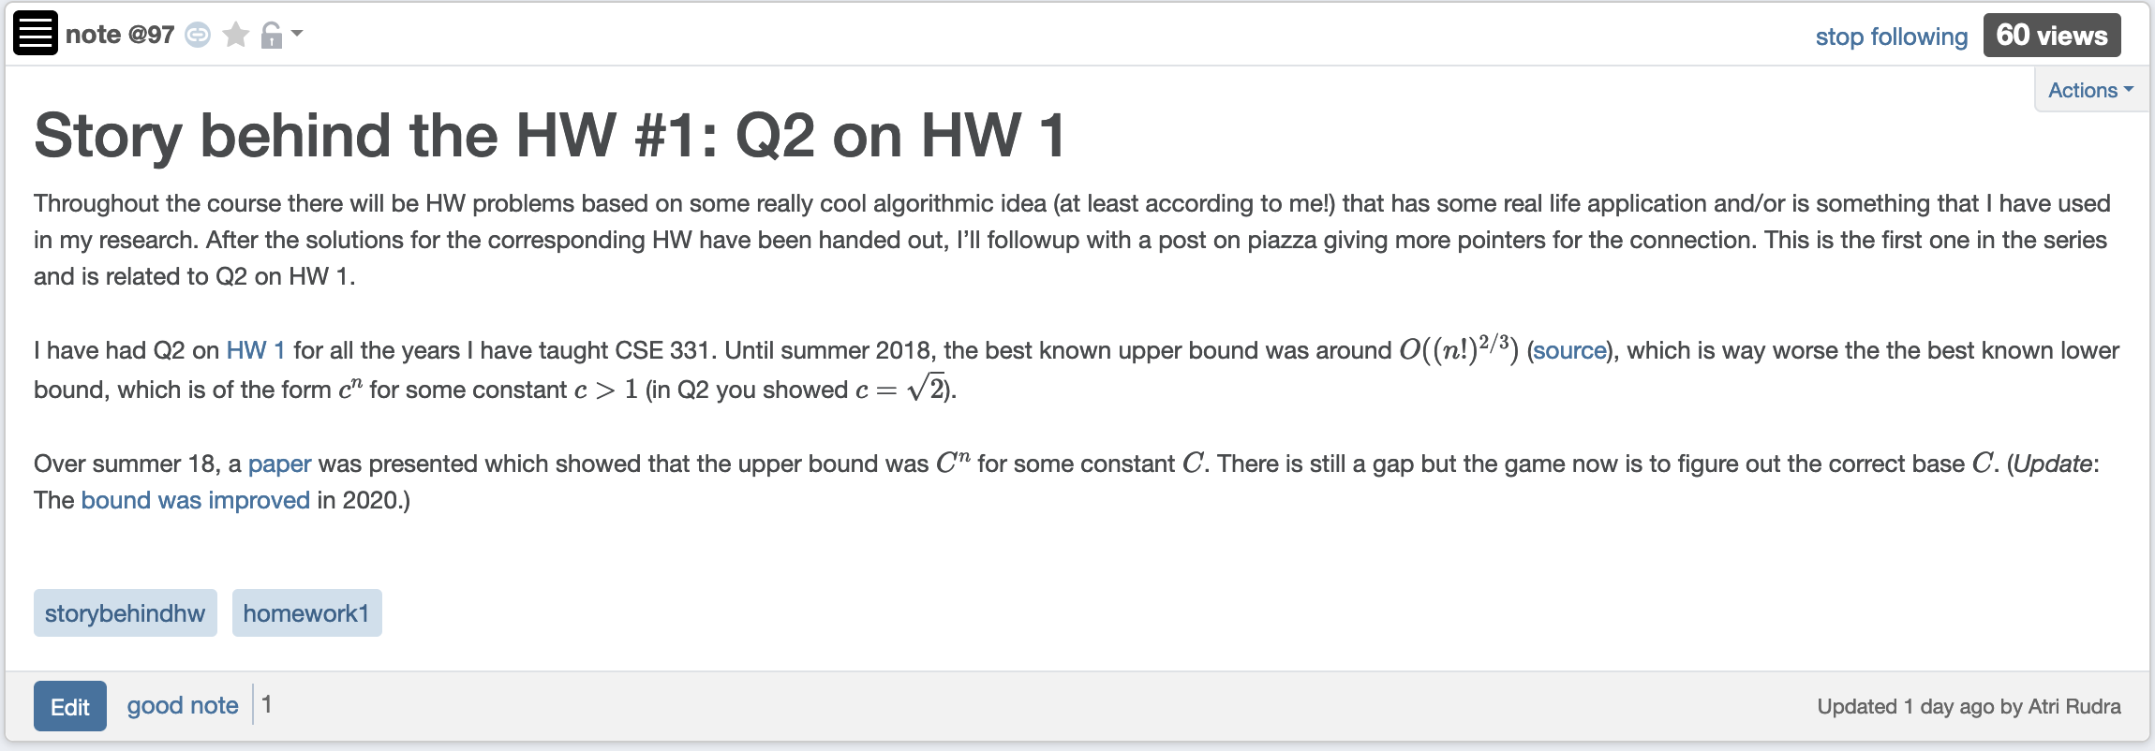
Story behind HW 1 Q2

Slide 8
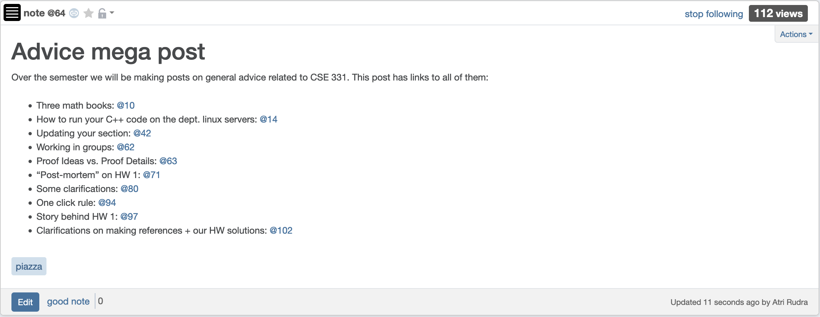
Advice “mega post”

Slide 9
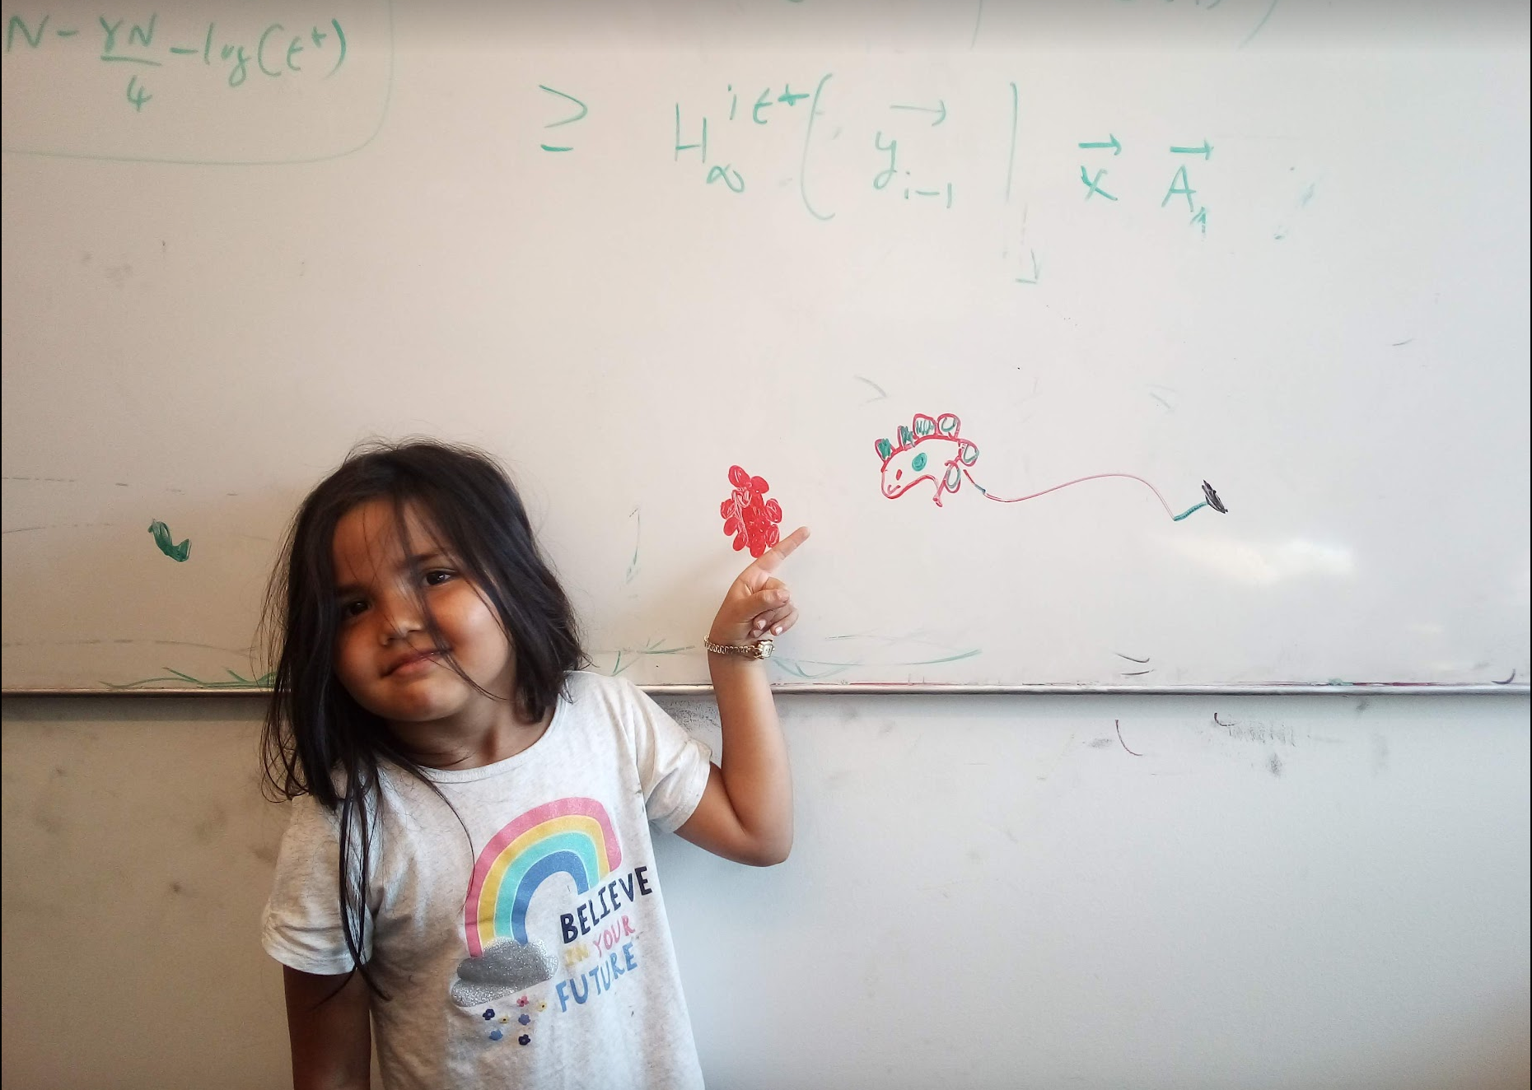
Questions/Comments?

Slide 10








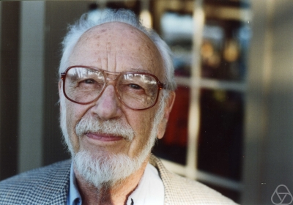
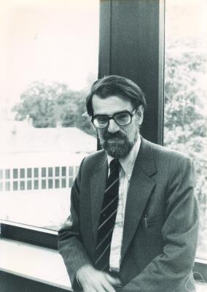
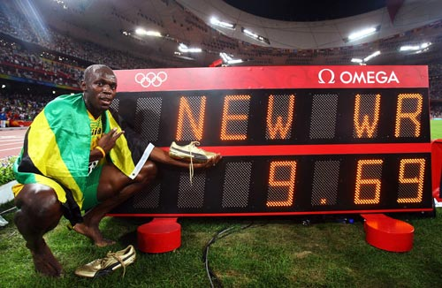
Main Steps in Algorithm Design
Problem Statement
Problem Definition
Algorithm
n!
“Implementation”
Analysis
Correctness Analysis

Slide 11
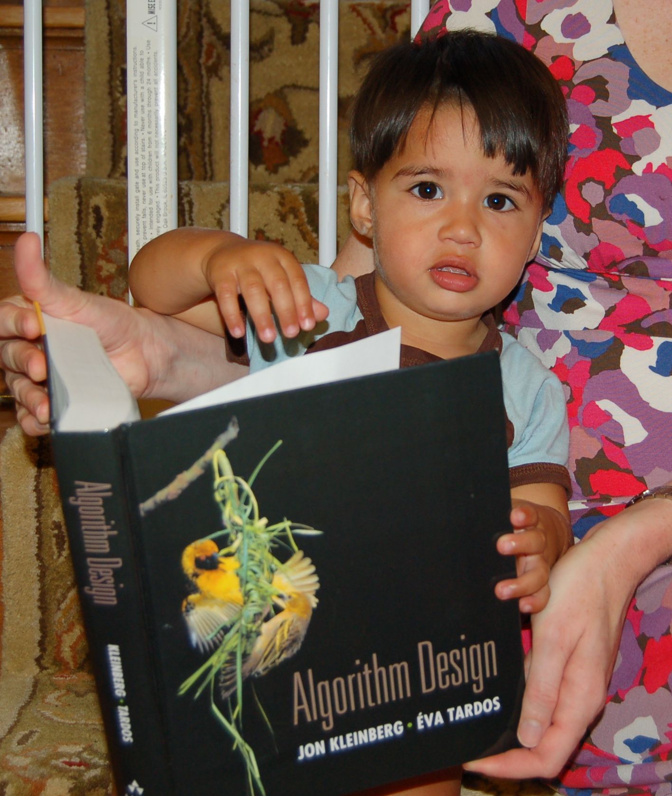
Reading Assignments
Sec 1.1 and Chap. 2 in [KT]

Slide 12
Up Next….
Problem Statement
A generic tool to abstract out problems
Problem Definition
Algorithm
“Implementation”
Analysis

Slide 13
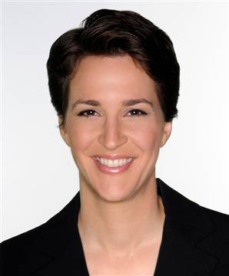






Graphs
Representation of relationships between pairs of entities/elements
Edge
Entities: News hosts
Relationship: Mention in other’s program
Vertex/Node

Slide 14
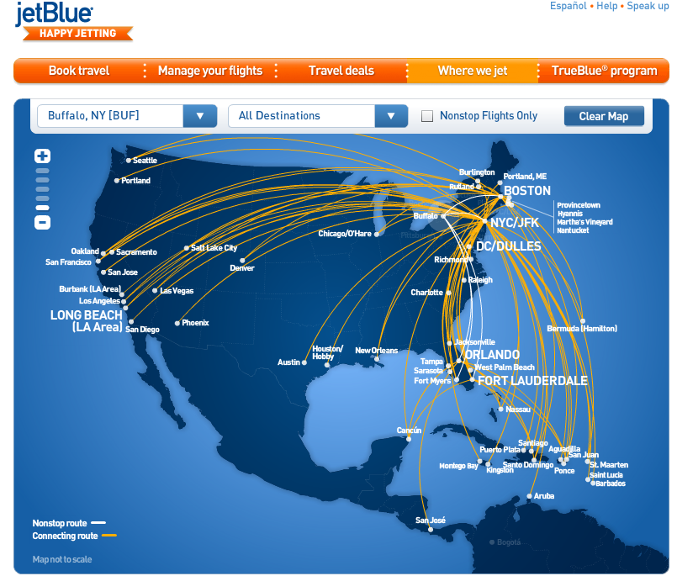
Graphs are omnipresent
Airline Route maps

Slide 15
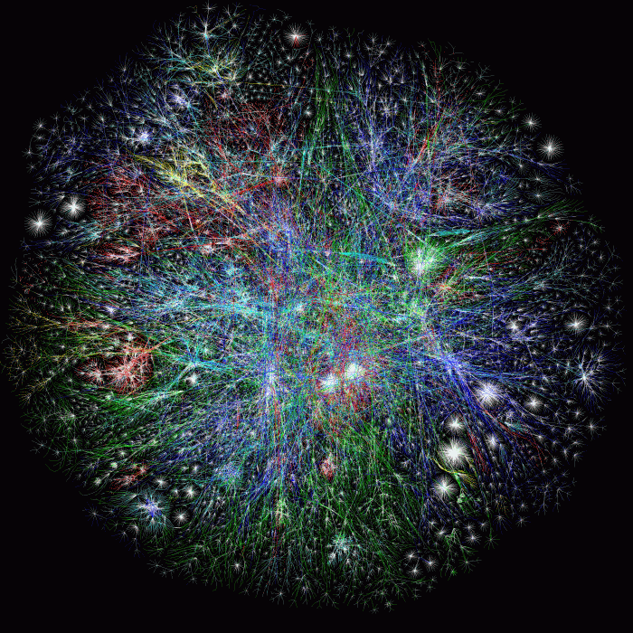
What does this graph represent?
Internet

Slide 16
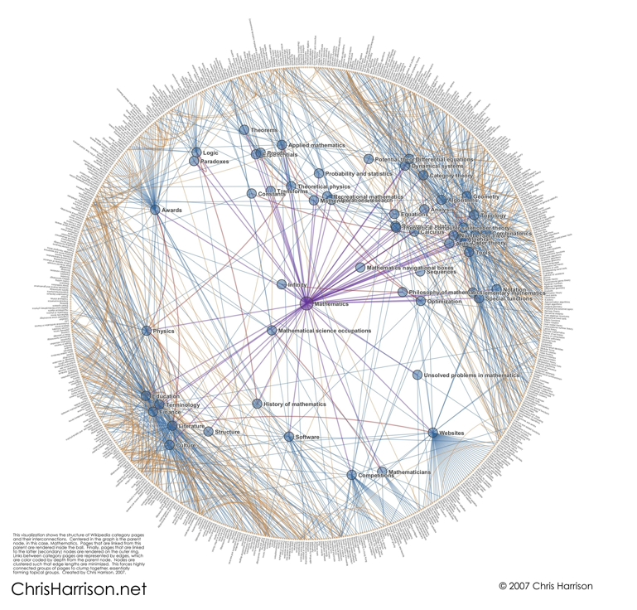
And this one?
Math articles on Wikipedia

Slide 17
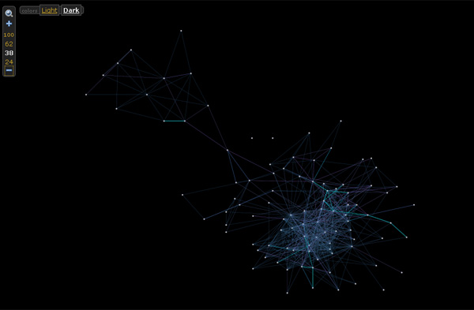

And this one?

Slide 18
Rest of today’s agenda
Basic Graph definitions

Slide 19

Paths
,
Sequence of vertices connected by edges
Connected
Path length 3
,
,
,

Slide 20
Connectivity
u and w are connected iff there is a path between them
A graph is connected iff all pairs of vertices are connected

Slide 21


Connected Graphs
Every pair of vertices has a path between them

Slide 22
Cycles
Sequence of k vertices connected by edges, first k-1 are distinct
,
,
,

Slide 23


Slide 24
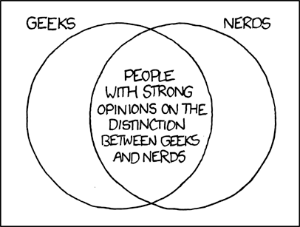
Formally define everything
http://imgs.xkcd.com/comics/geeks_and_nerds.png

Slide 25
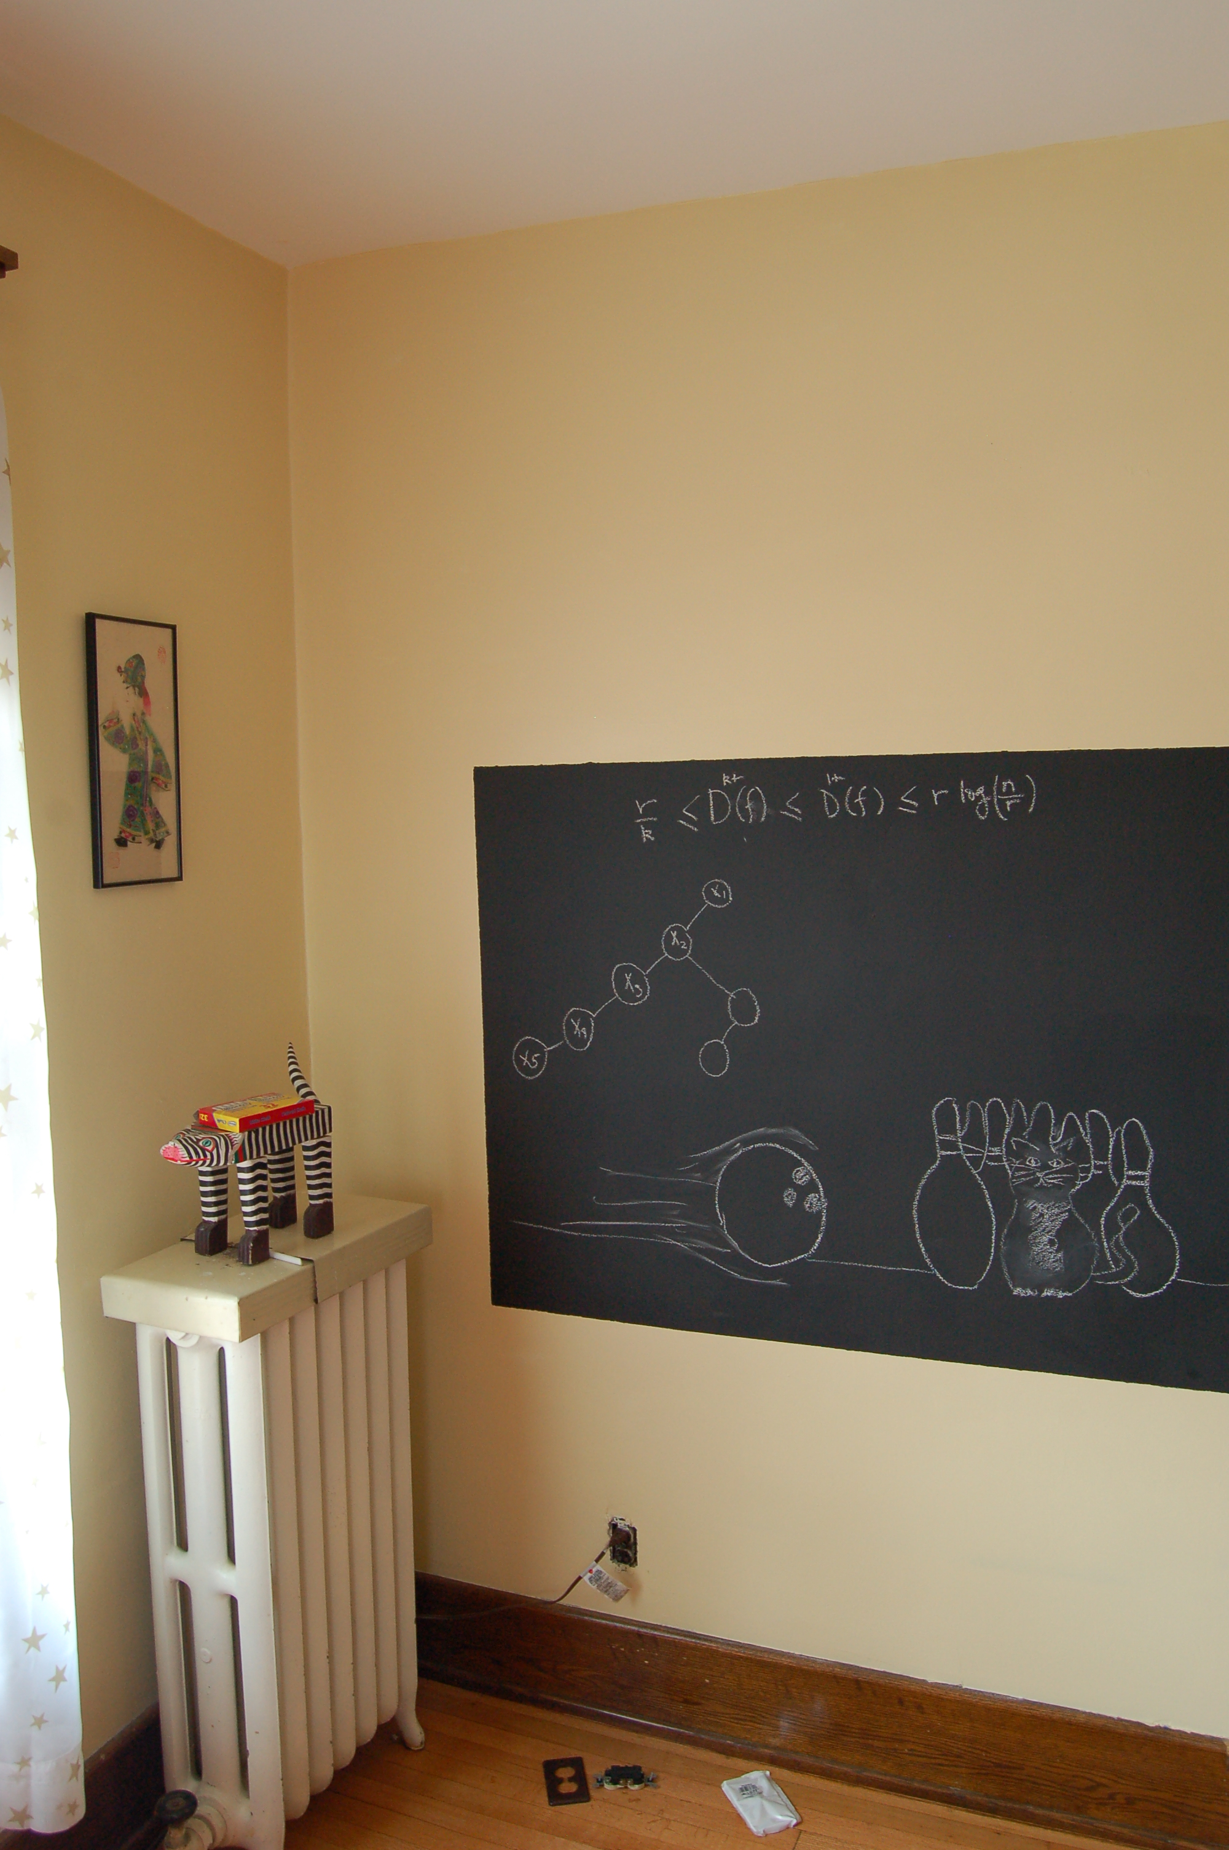
Definitions on the board…

Slide 26
Distance between u and v
Length of the shortest length path between u and v
RM
BO
Distance between RM and BO?
1

Slide 27
Tree
Connected undirected graph with no cycles

Slide 28
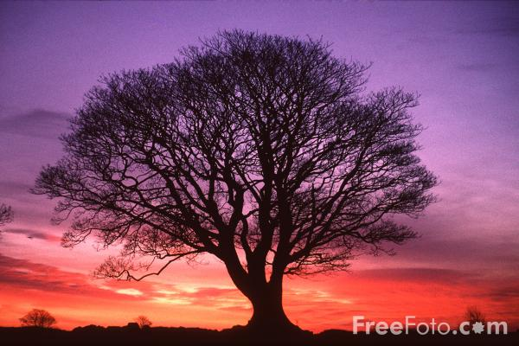
Rooted Tree

Slide 29
A rooted tree
AC’s child=SG
Pick any vertex as root
SG’s parent=AC
Let the rest of the tree hang under “gravity”

Slide 30
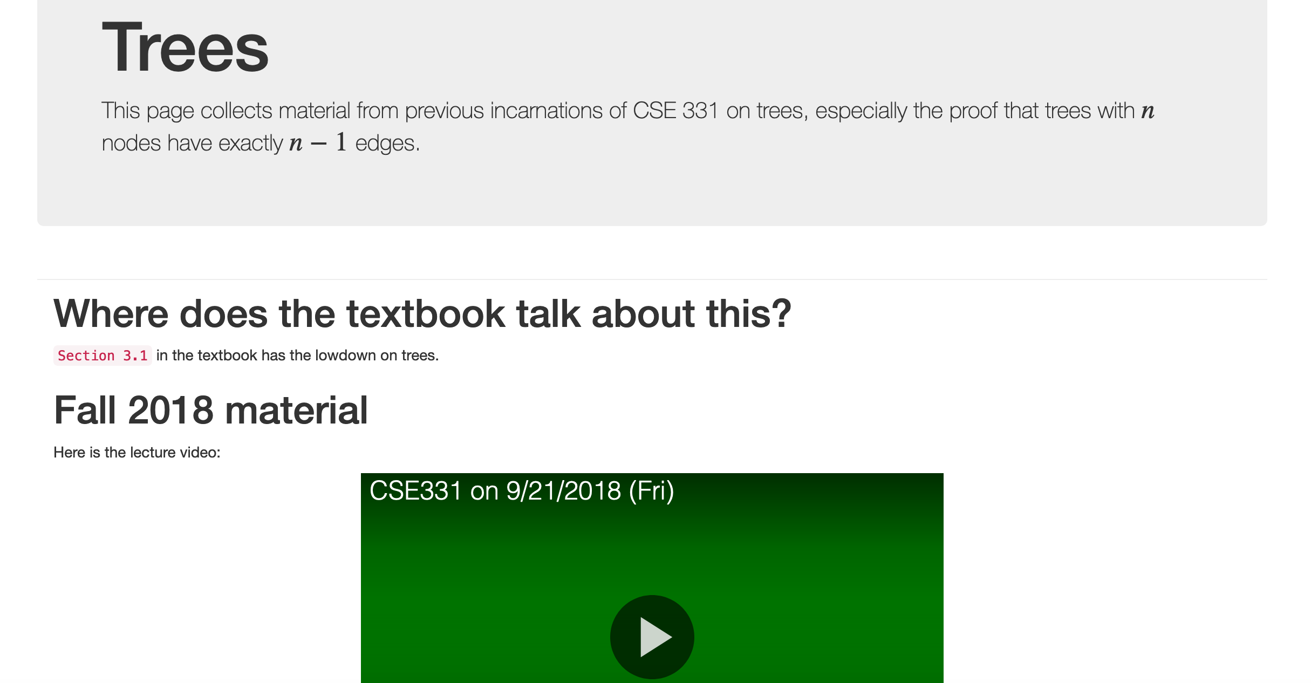
Every n vertex tree has n-1 edges

Slide 31
Every n vertex tree has n-1 edges
Let T be an undirected graph on n nodes
Then ANY two of the following implies the third:
T is connected
T has no cycles
T has n-1 edges

