Slide 1
Lecture 13
CSE 331
Sep 25, 2024

Slide 2

Quiz 1 on Monday

Slide 3
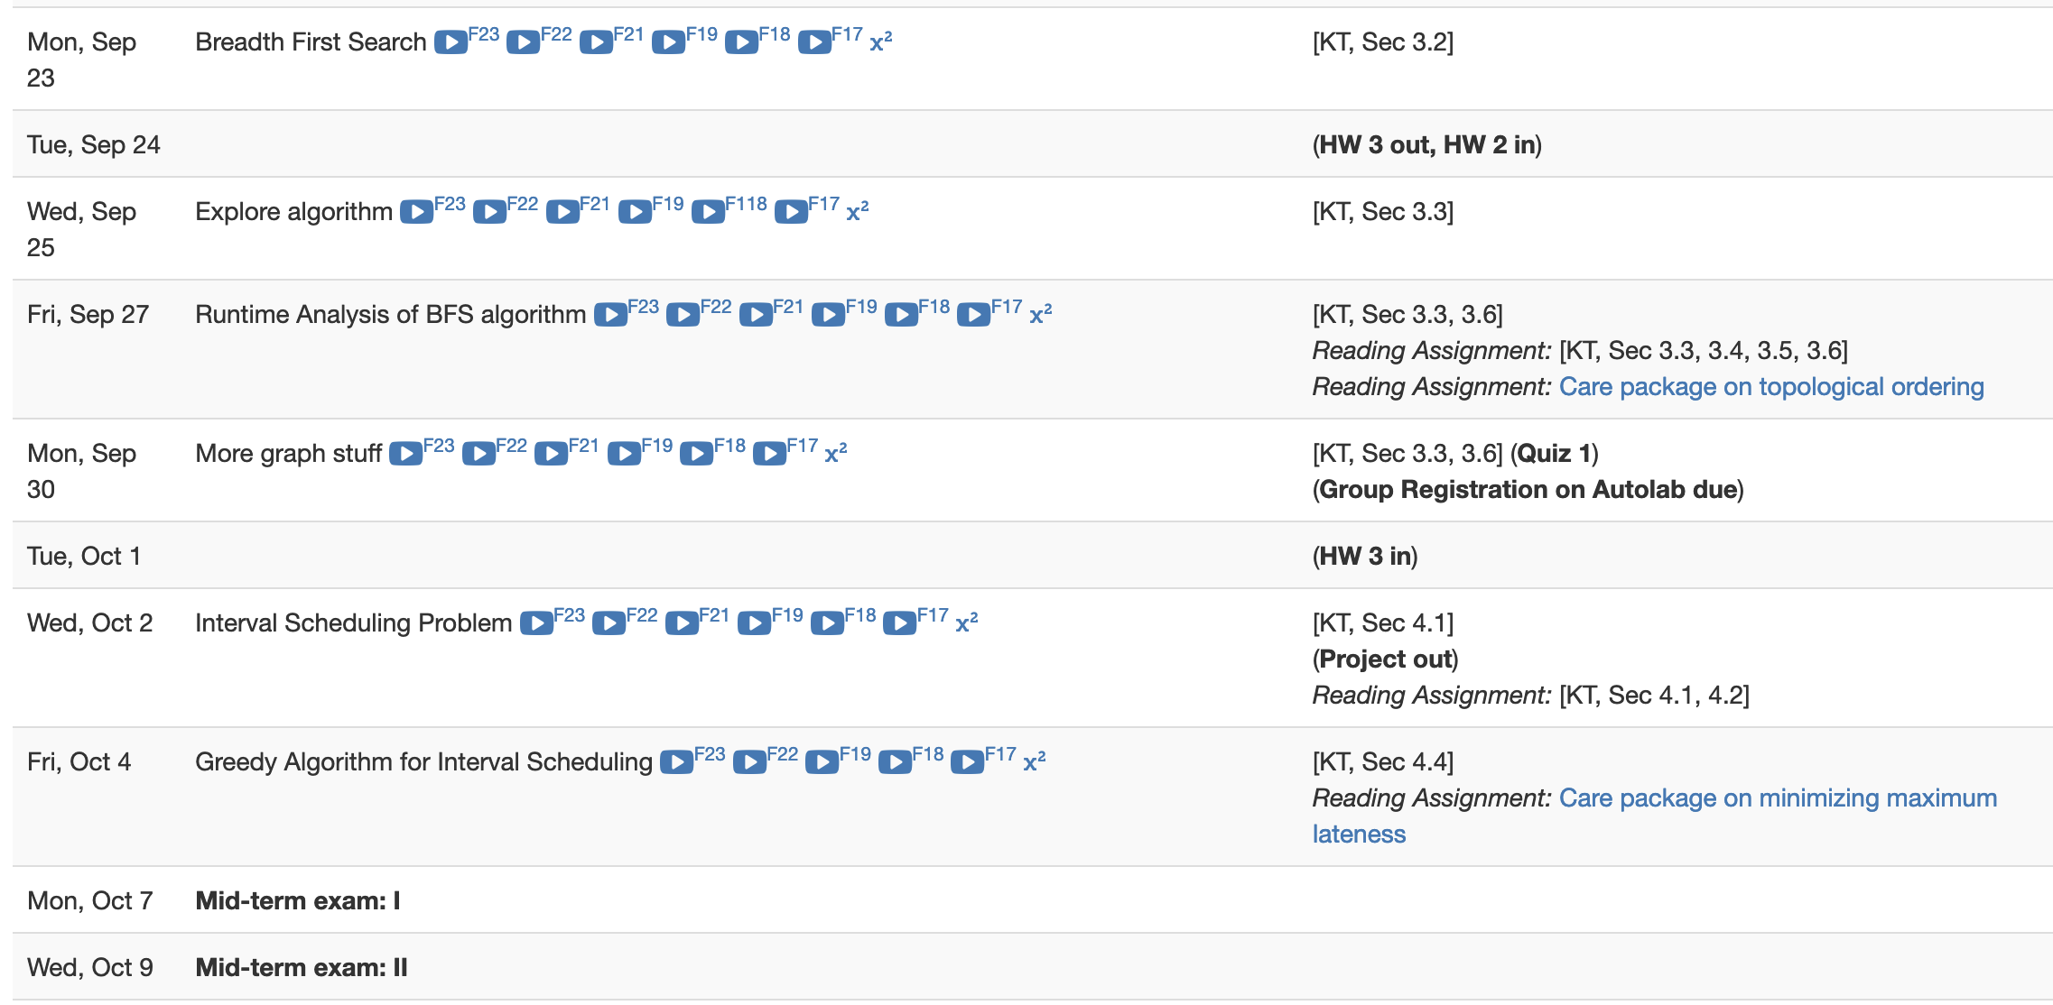
Busy 2 weeks ahead….

Slide 4
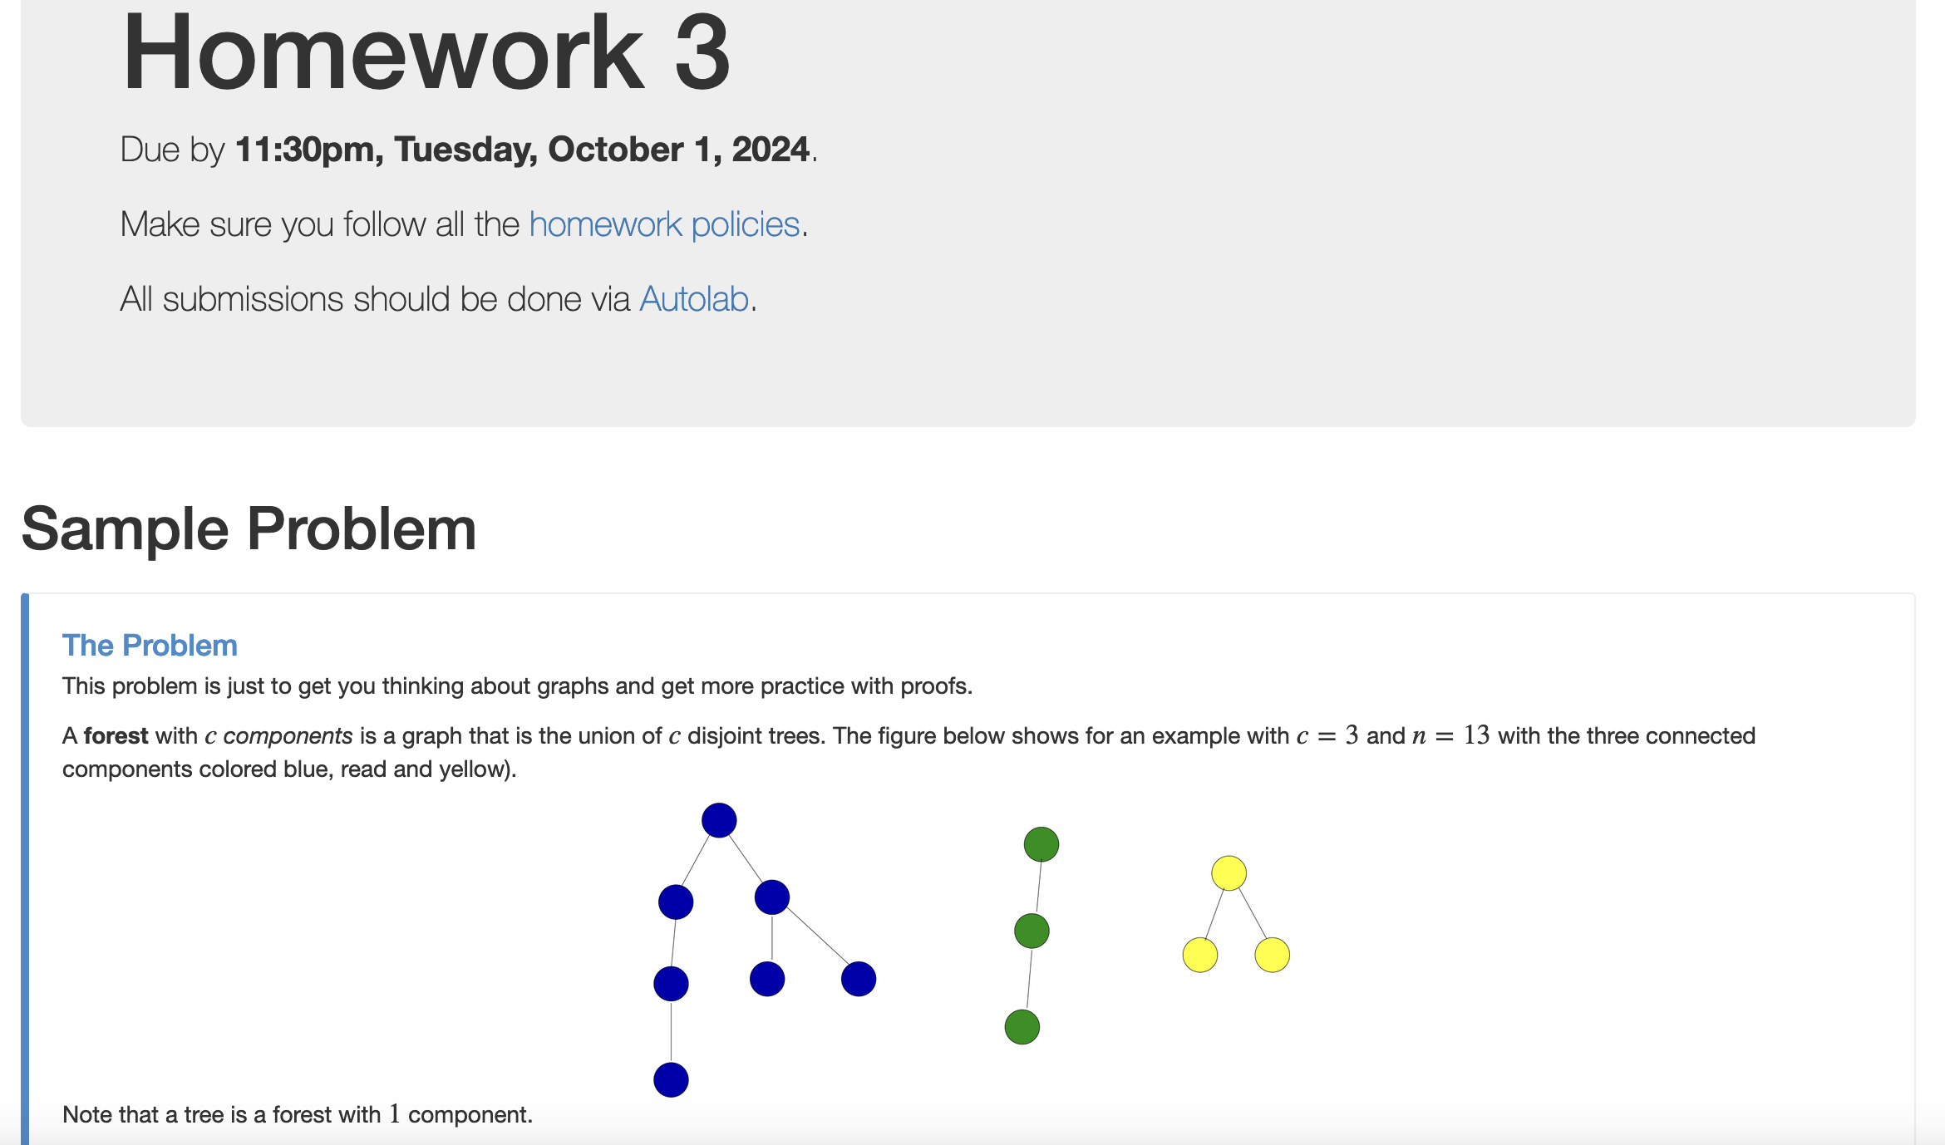
HW 3 out

Slide 5

Autolab Project Group Registration
Also due Monday
If you miss this deadline then you will get a ZERO on the ENTIRE project

Slide 6

Read the instruction carefully

Slide 7
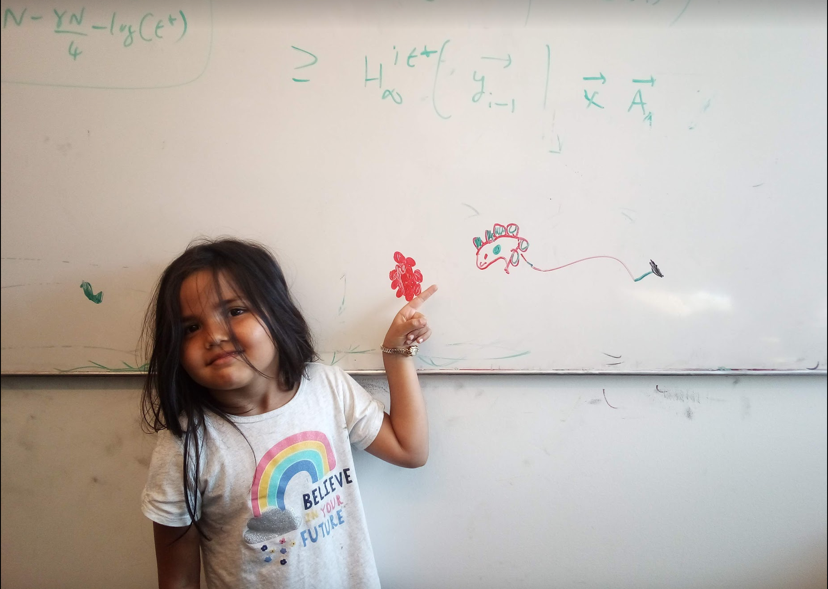
Questions/Comments?

Slide 8
Connectivity Problem
Input: Graph G = (V,E) and s in V
Output: All t connected to s in G
Connected component of s also called CC(s)

Slide 9
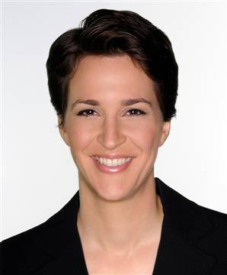
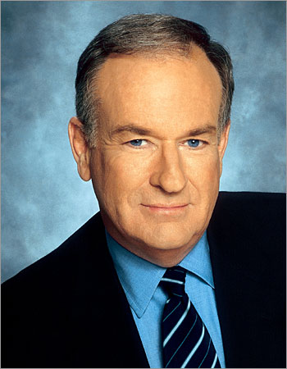



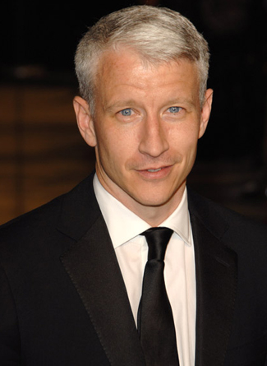

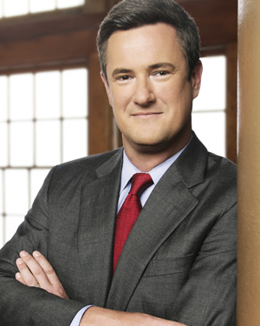


Computing Connected Component
Explore(s)
Start with R = {s}
While exists (u,w) edge w not in R and u in R
Add w to R
Output R* = R
BFS (Build layers of vertices)
L₀ = {s}
Assume L₀,..,L_{j} have been constructed
L_{j+1} set of vertices not chosen yet but are connected to L_{j}
Stop when new layer is empty

Slide 10
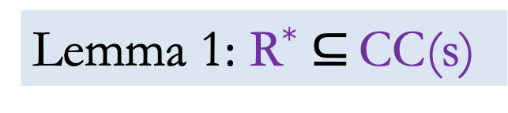
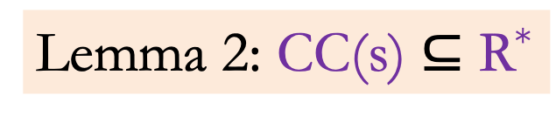
Explore is correct
Theorem: CC(s) = R*
Lemma 1: R* $⊆$ CC(s)
Lemma 2: CC(s) $⊆$ R*

Slide 11
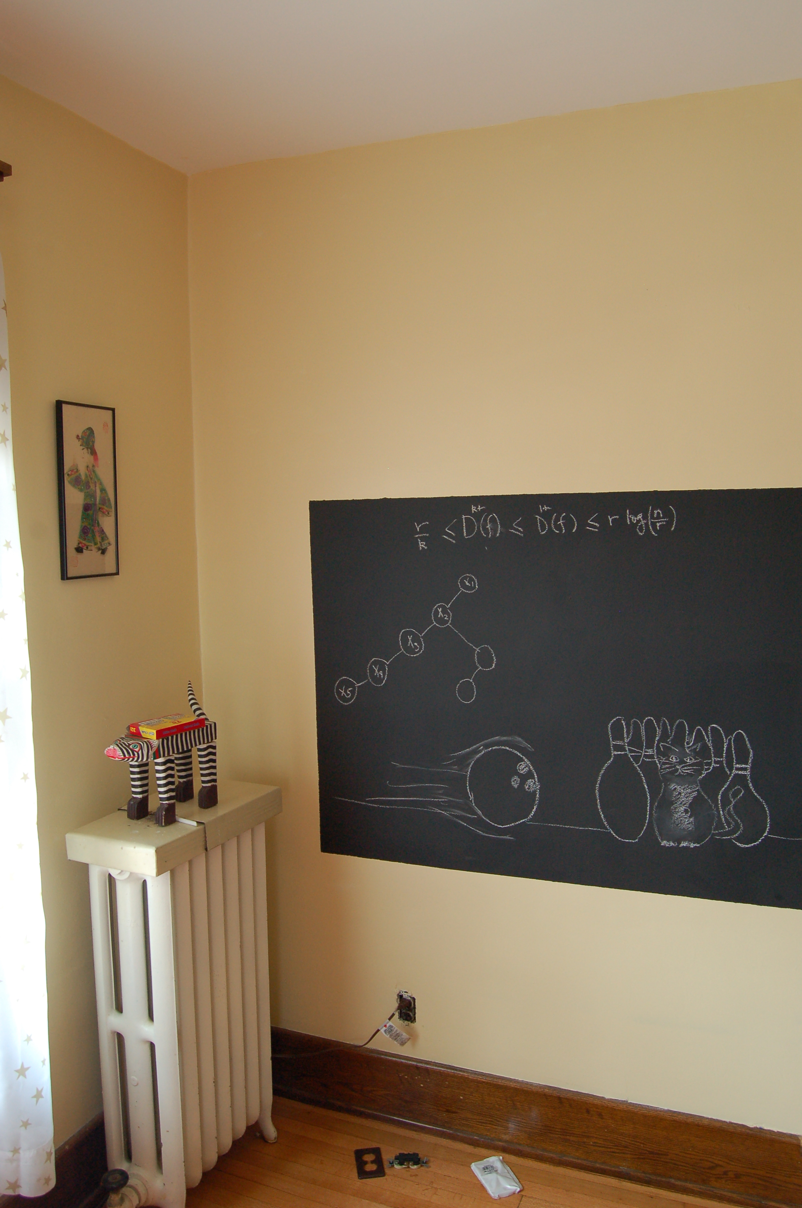
Argue Lemma 2 on the board…

Slide 12

BFS
all

Slide 13
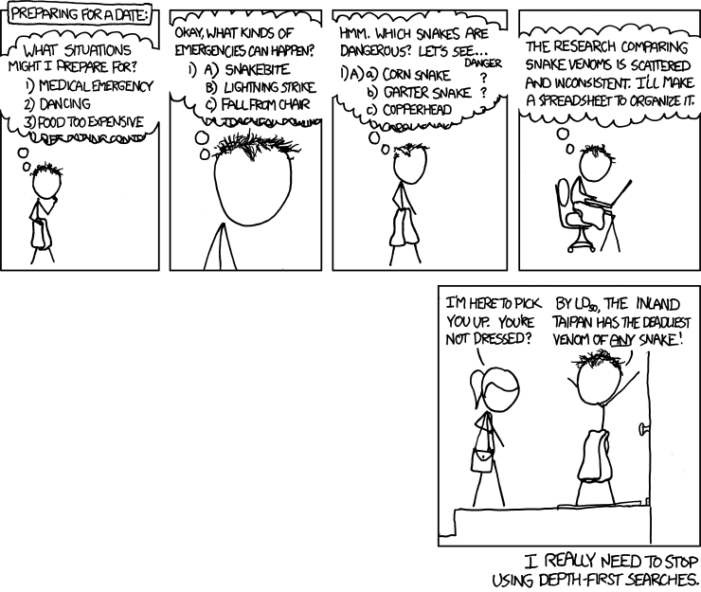
Depth First Search (DFS)
http://xkcd.com/761/

Slide 14
DFS(u)
Mark u as explored and add u to R
For each edge (u,v)
If v is not explored then DFS(v)

Slide 15

Why is DFS a special case of Explore?

Slide 16
A DFS run
Every non-tree edge is between a node and its ancestor
1
DFS(u)
1
7
u is explored
2
2
3
For every unexplored
neighbor v of u
8
4
DFS(v)
4
5
5
DFS tree
6
6
3
8
7
Notes:
Note that the tree is arbitrary based on which neighbor was visited first.

Slide 17
Questions/Comments?

Slide 18
Connected components are disjoint
Either connected components of s and t are the same or are disjoint
Algorithm to compute ALL the connected components?
Can run Explore instead of BFS
Run BFS on some node s. Then run BFS on t that is not connected to s

Slide 19
Computing all CCs
9
0
1
7
9
1
L₀
2
3
L₁
2
3
8
0
4
5
4
5
7
8
L₂
6
6
L₃

Slide 20
Questions/Comments?

Slide 21

Rest of today’s agenda
Run-time analysis of BFS (DFS)

Slide 22

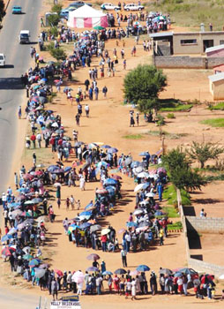
Stacks and Queues
Last in First out
First in First out

Slide 23
But first…
How do we represent graphs?
Notes:
When using an algorithm to solve a problem, the runtime depends on how data is organized.

Slide 24
Graph representations
0
1
1
1
0
0
Better for sparse graphs and traversals
1
0
0
Adjacency matrix
Adjacency List
O(1)
(u,v) in E?
O(n) [ O(n_{v}) ]
O(n)
All neighbors of u?
O(n_{u})
O(n²)
Space?
O(m+n)

Slide 25
Questions/Comments?

Slide 26
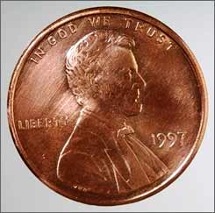
2 # edges = sum of # neighbors
2m = Σ _{u in V} n_{u}
Rest of the graph
Give 2 pennies to each edge
Total # of pennies = 2m
n_{v}=3
u
n_{u}=4
v
Each edges gives one penny to its end points
# of pennies u receives = n_{u}

