Slide 1
Lecture 14
CSE 331
Sep 27, 2024

Slide 2
Upcoming quiz/exams
Quiz 1 on MONDAY
Mid-term 1 Mon Oct 7
Mid-term 2 Wed two days after Mid-term 1

Slide 3
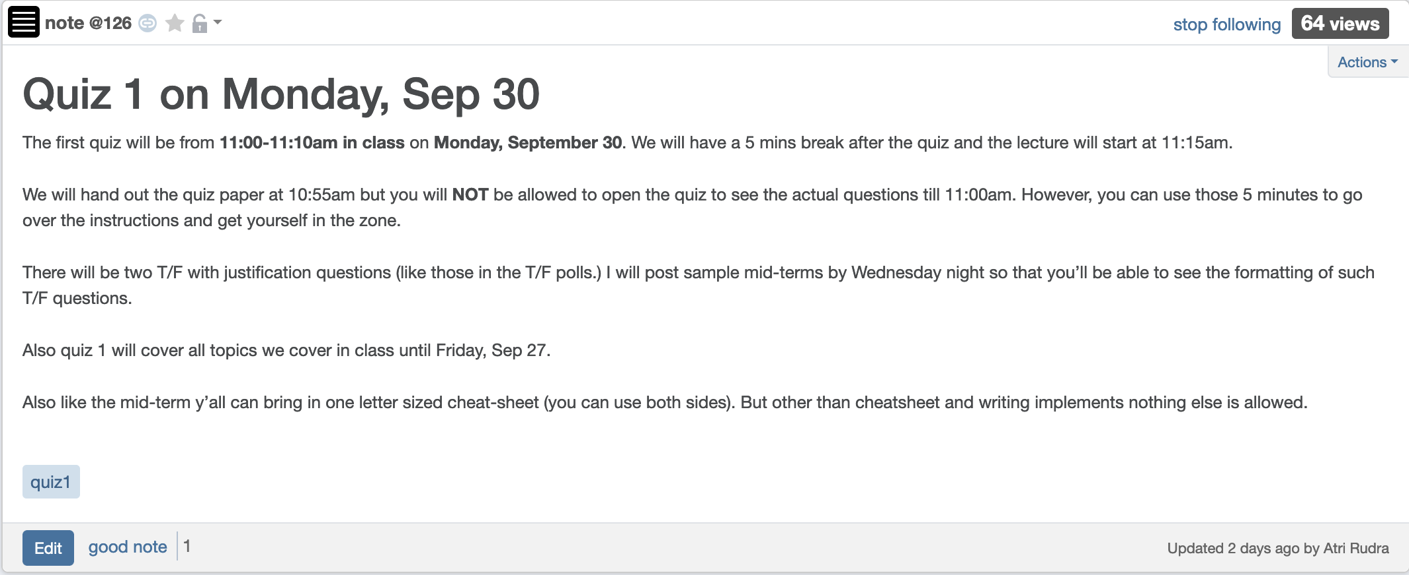
Bit more on Quiz 1

Slide 4
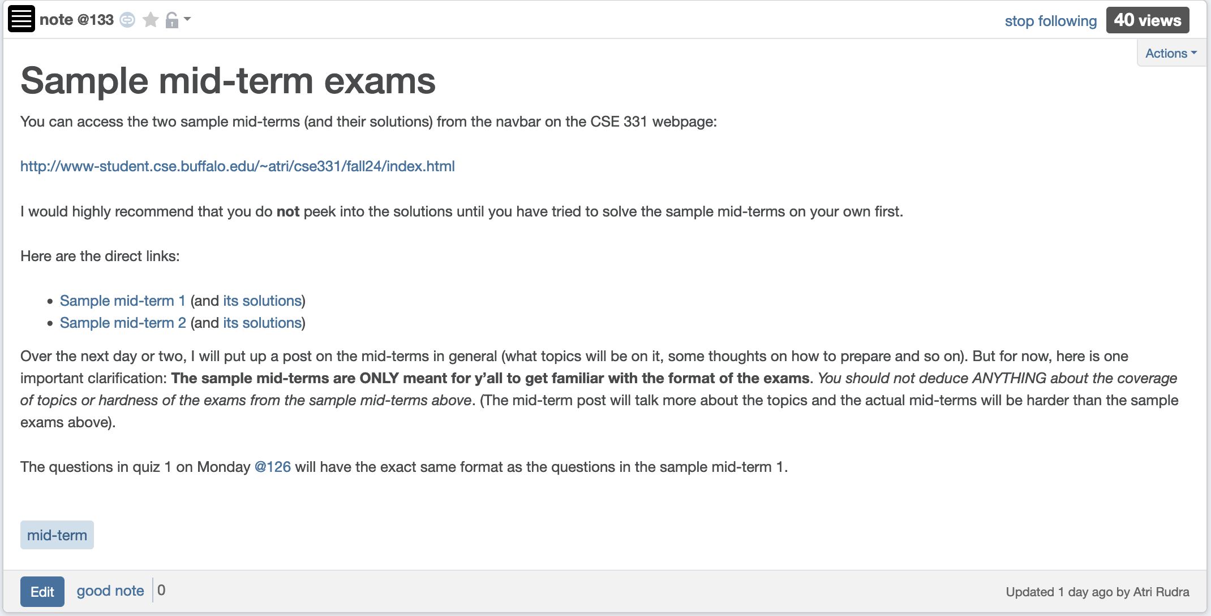
Sample mid-terms

Slide 5
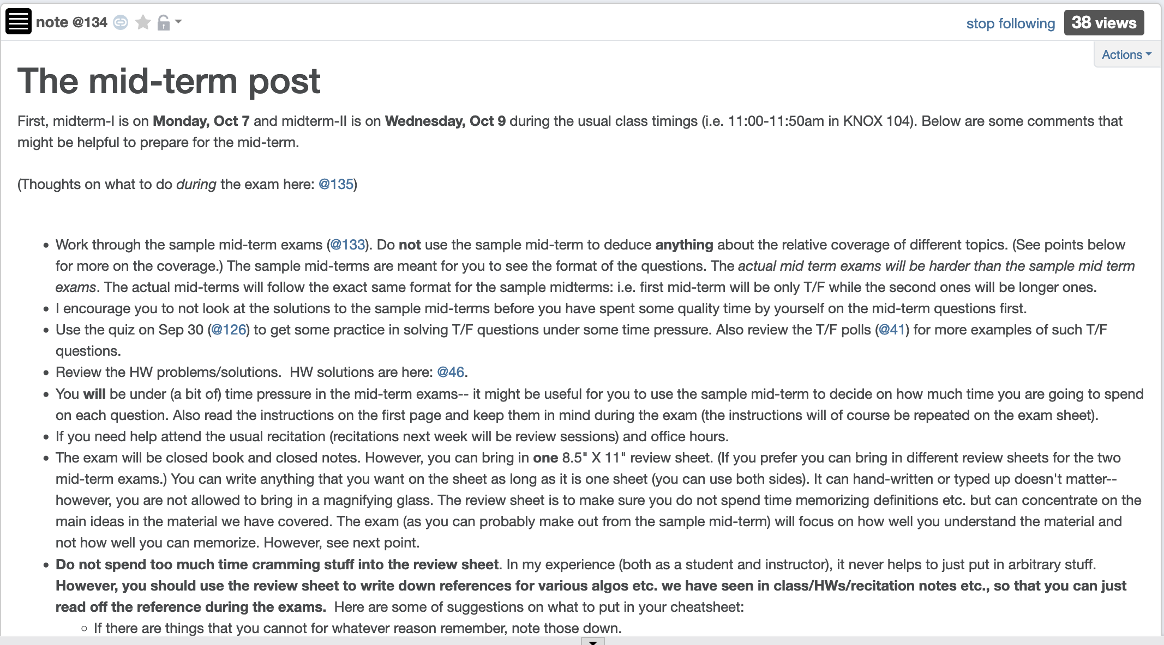
Mid-term post 1

Slide 6
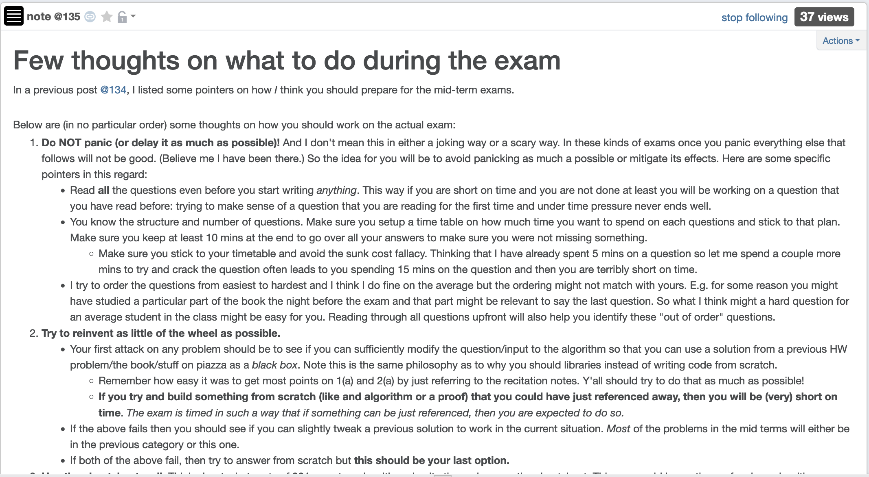
Mid-term post 2

Slide 7
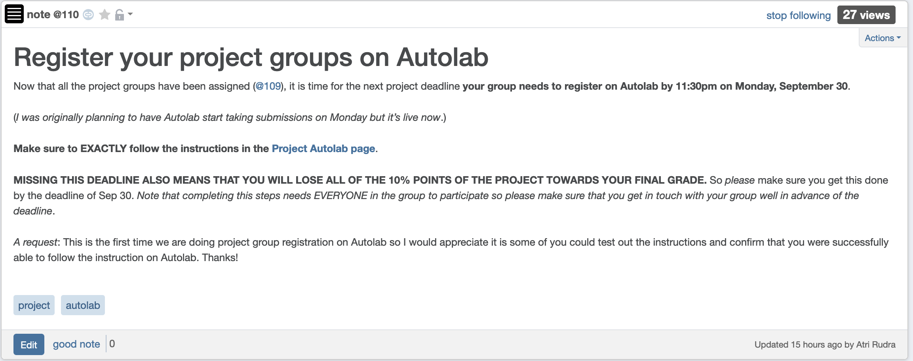
Autolab Project Group Registration
Also due Monday
If you miss this deadline then you will get a ZERO on the ENTIRE project

Slide 8
Submission stats on HW 2
Q1(a) submissions: 110 (FA 22: 150)
Q1(b) submissions: 97 (FA 22: 130)
Q2(a) submissions: 80 (FA 22: 112)
Q2(b) submissions: 46 (FA 22: 83)

Slide 9
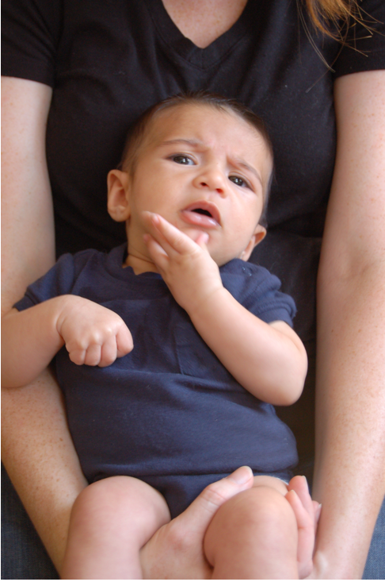
Questions?

Slide 10
Graph representations
0
1
1
1
0
0
Better for sparse graphs and traversals
1
0
0
Adjacency matrix
Adjacency List
O(1)
(u,v) in E?
O(n) [ O(n_{v}) ]
O(n)
All neighbors of u?
O(n_{u})
O(n²)
Space?
O(m+n)

Slide 11
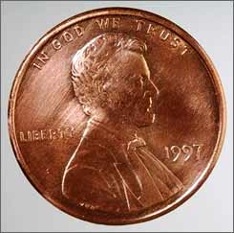
2 # edges = sum of # neighbors
2m = Σ _{u in V} n_{u}
Rest of the graph
Give 2 pennies to each edge
Total # of pennies = 2m
n_{v}=3
u
n_{u}=4
v
Each edges gives one penny to its end points
# of pennies u receives = n_{u}

Slide 12
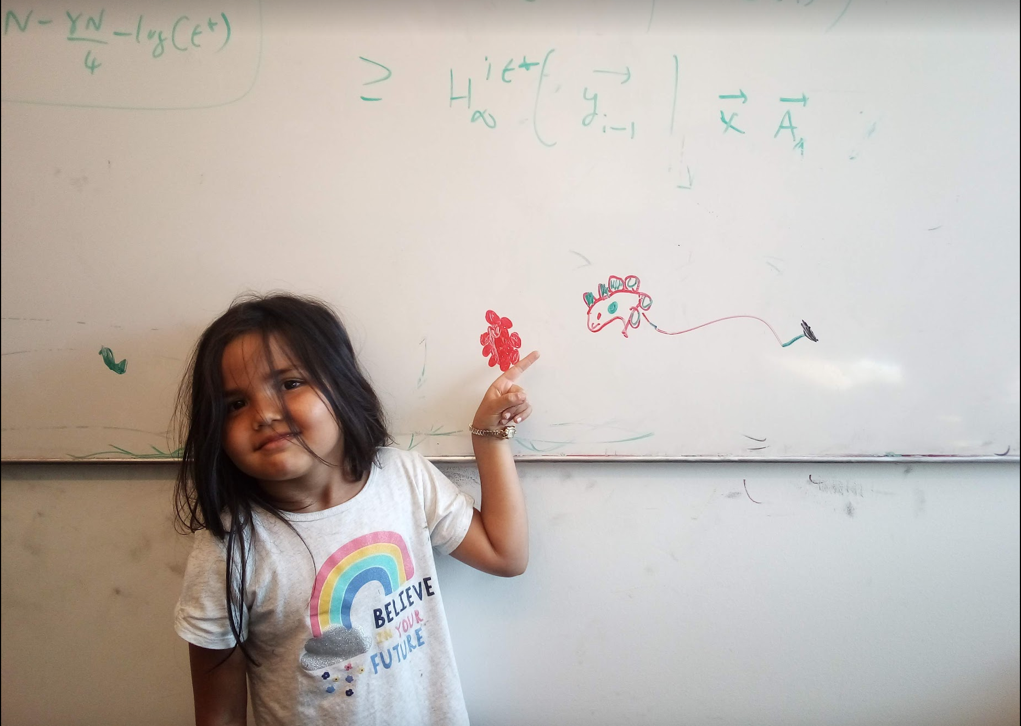
Questions/Comments?

Slide 13
Breadth First Search (BFS)
Build layers of vertices connected to s
L₀ = {s}
Assume L₀,..,L_{j} have been constructed
L_{j+1} set of vertices not chosen yet but are connected to L_{j}
Stop when new layer is empty
Use CC[v] array
Use linked lists

Slide 14
Rest of Today’s agenda
Quick run time analysis for BFS
Quick run time analysis for DFS (and Queue version of BFS)
Helping you schedule your activities for the day

Slide 15
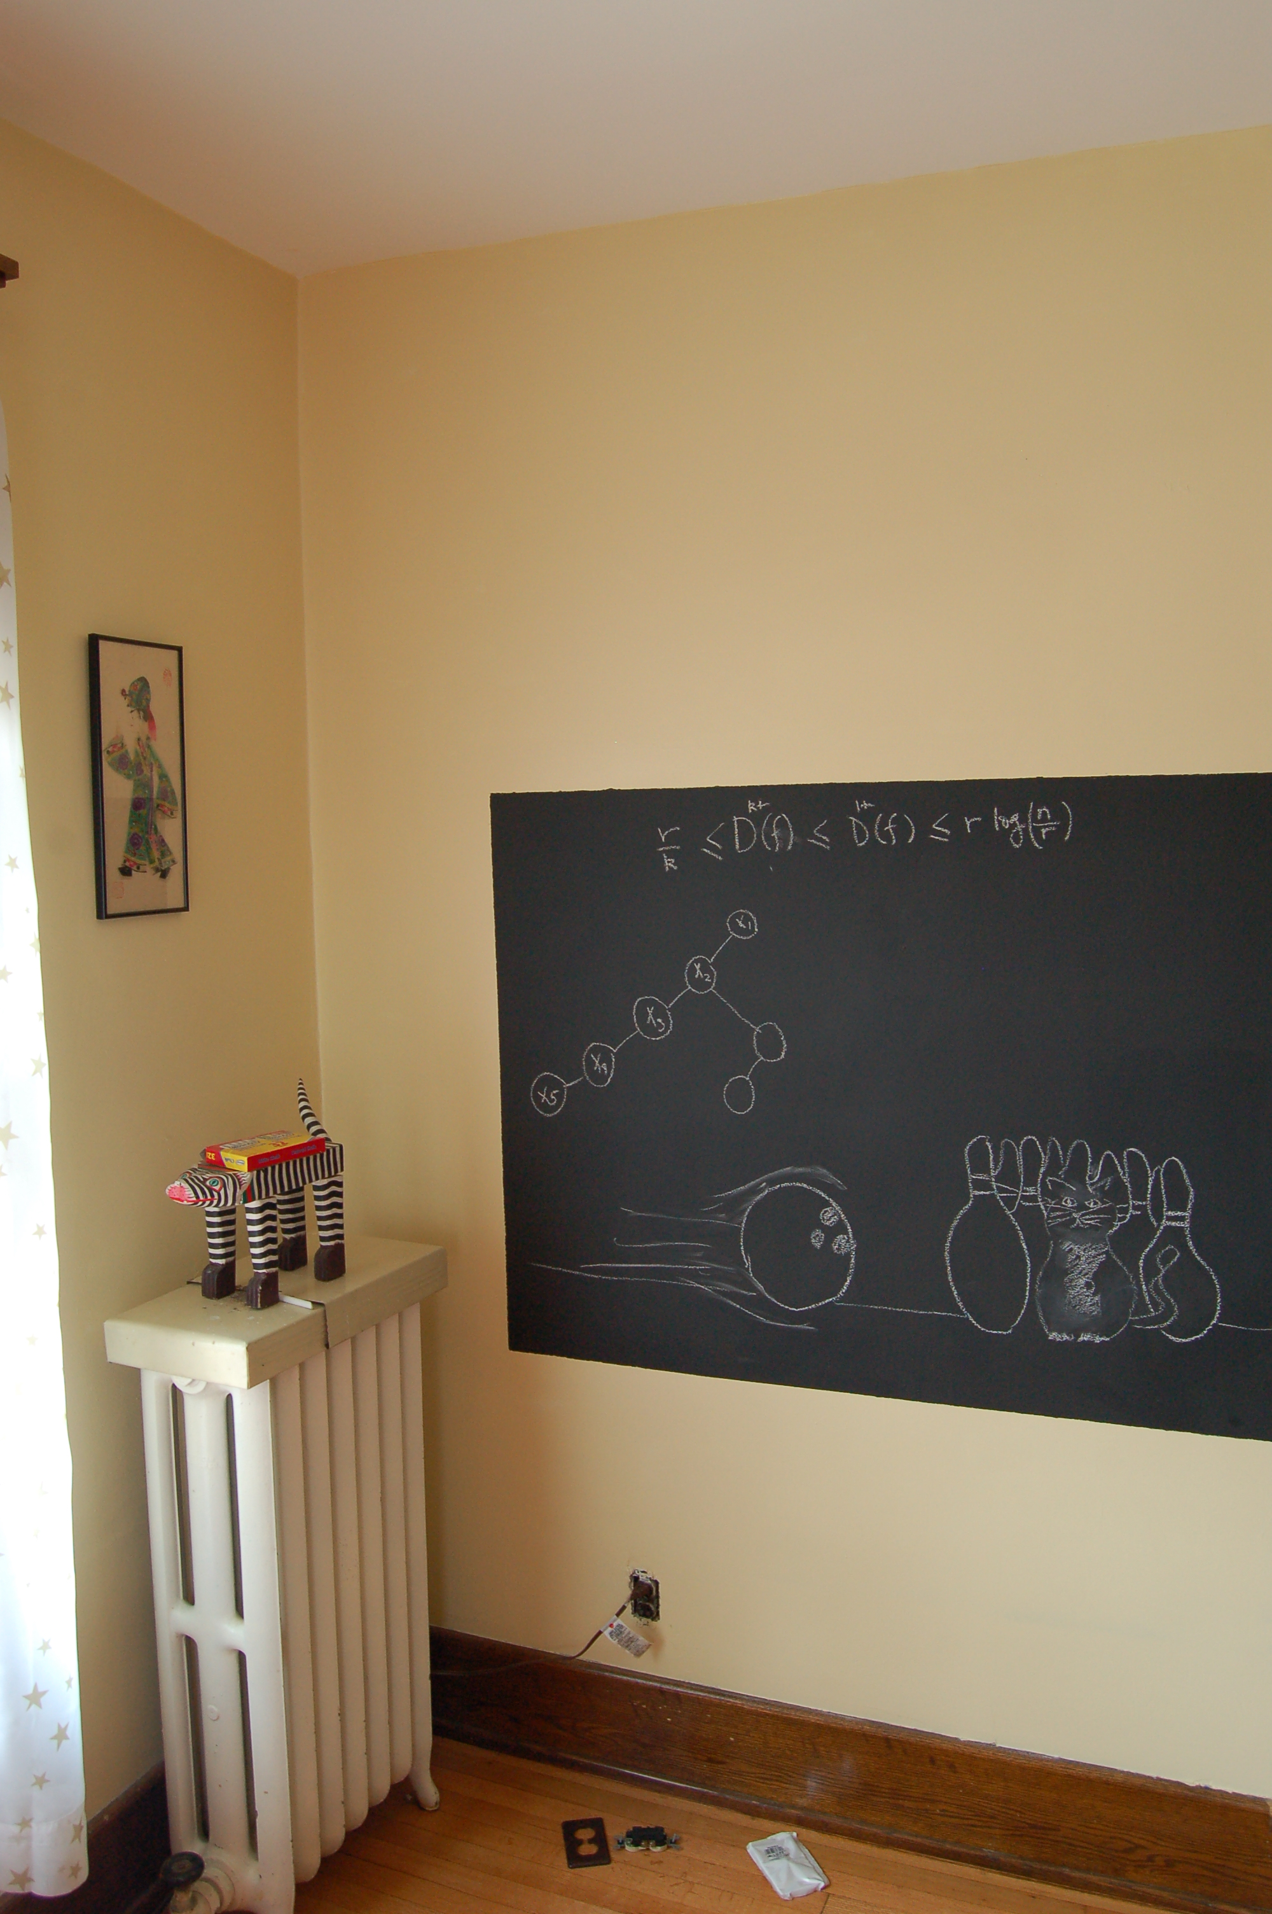
Initial BFS analysis on the board…

Slide 16
O(m+n) BFS Implementation
Input graph as Adjacency list
BFS(s)
Array
CC[s] = T and CC[w] = F for every w≠ s
Set i = 0
Set L₀= {s}
While L_{i} is not empty
Linked List
L_{i+1} = Ø
For every u in L_{i}
For every edge (u,w)
Version in KT also computes a BFS tree
If CC[w] = F then
CC[w] = T
Add w to L_{i+1}
i++

Slide 17
All the layers as one
BFS(s)
All layers are considered in first-in-first-out order
CC[s] = T and CC[w] = F for every w≠ s
Set i = 0
Set L₀= {s}
While L_{i} is not empty
L_{i+1} = Ø
For every u in L_{i}
Can combine all layers into one queue: all the children of a node are added to the end of the queue
For every edge (u,w)
If CC[w] = F then
CC[w] = T
Add w to L_{i+1}
i++

Slide 18
An illustration
1
2
3
4
5
7
8
6
1
7
2
3
8
4
5
6

Slide 19
Queue O(m+n) implementation
BFS(s)
CC[s] = T and CC[w] = F for every w≠ s
O(n)
Intitialize Q= {s}
O(1)
While Q is not empty
Repeated at most once for each vertex u
Σ_{u} O(n_{u}) =
O(Σ_{u} n_{u}) =
O(m)
Delete the front element u in Q
For every edge (u,w)
Repeated n_{u} times
O(1)
If CC[w] = F then
O(n_{u})
CC[w] = T
O(1)
Add w to the back of Q

Slide 20
Questions/Comments?

Slide 21
Implementing DFS in O(m+n) time
Same as BFS except stack instead of a queue

Slide 22
A DFS run using an explicit stack
7
8
1
7
6
7
3
2
3
5
8
4
4
5
5
3
6
2
3
1

