Slide 1
Lecture 15
CSE 331
Sep 30, 2024

Slide 2
Quiz 1– 11:00-11:10am

Slide 3
Lecture starts at 11:15am

Slide 4
Quiz 1 timelines
Solutions: posted by today evening
Grading: finished by the weekend

Slide 5
Upcoming exams
Mid-term 1 next Mon Oct 7
Mid-term 2 Wed two days after Mid-term 1

Slide 6
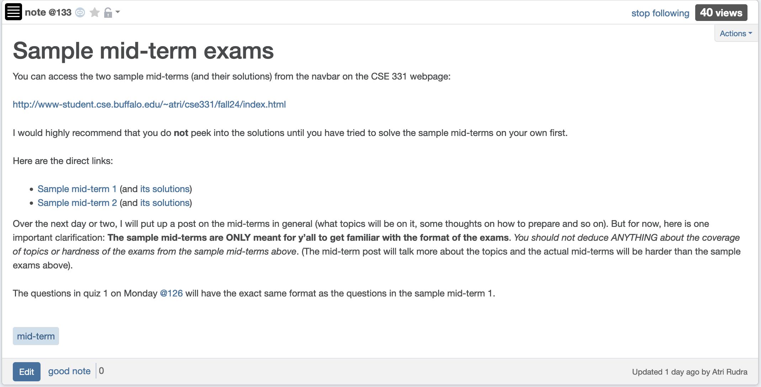
Sample mid-terms

Slide 7
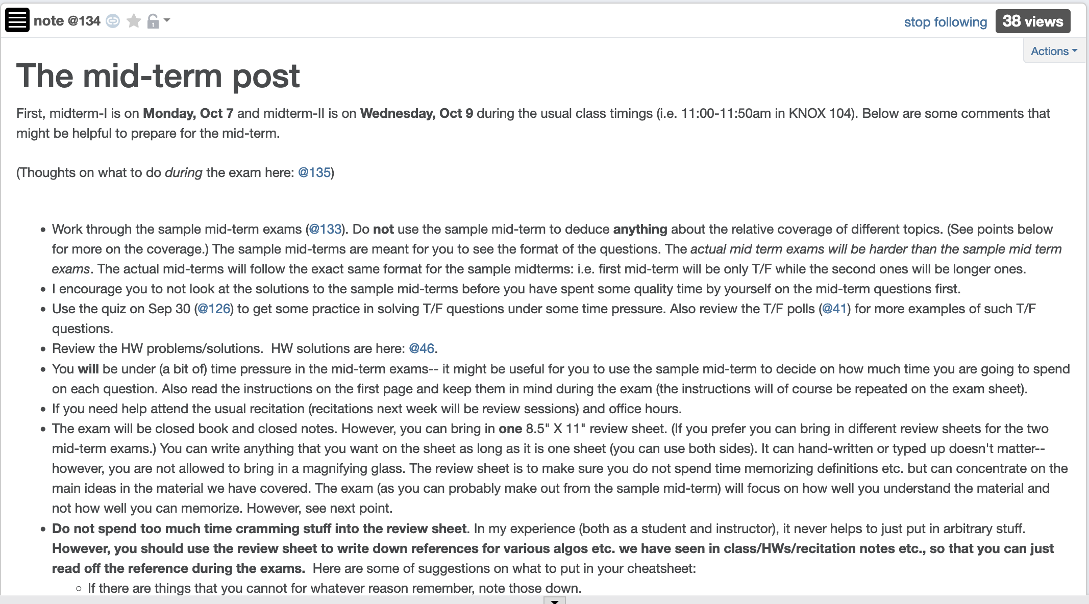
Mid-term post 1

Slide 8
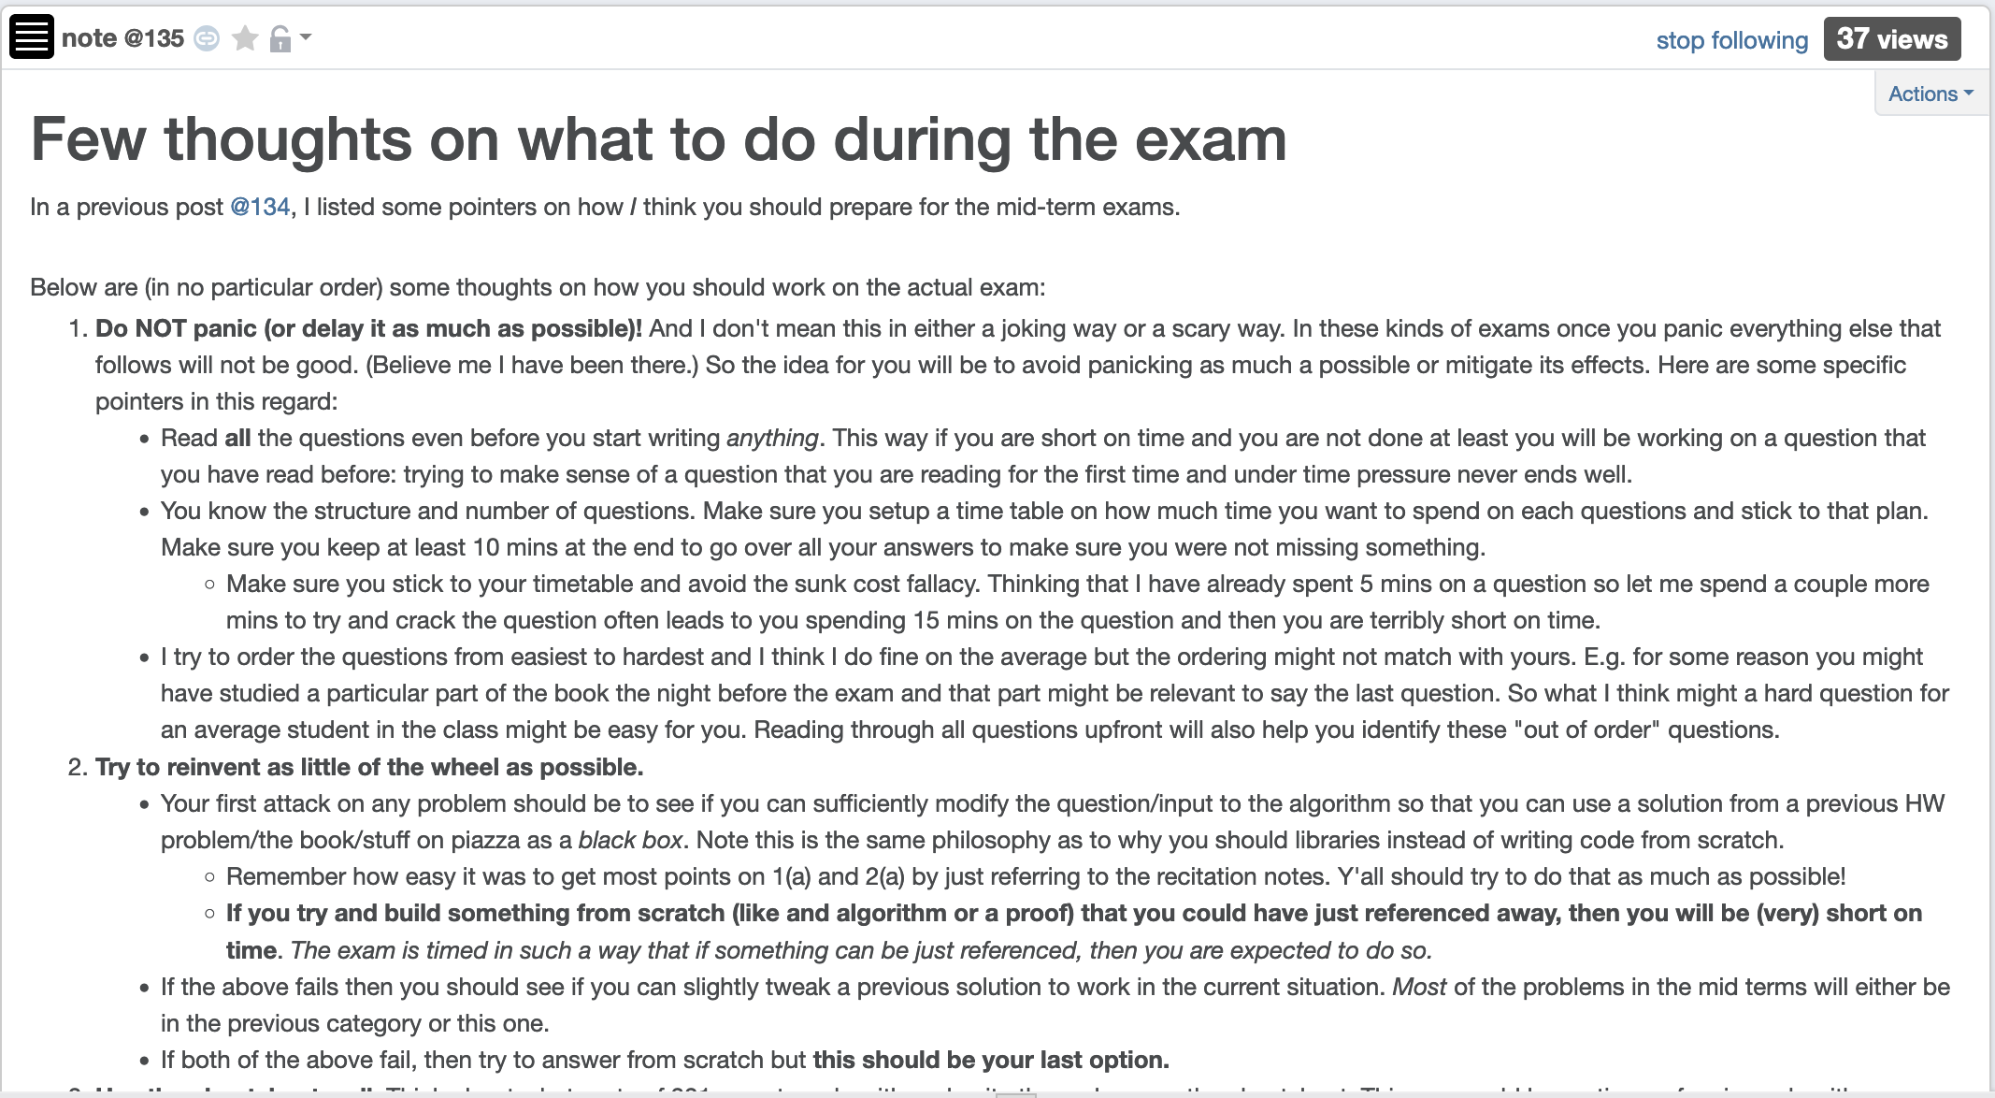
Mid-term post 2

Slide 9
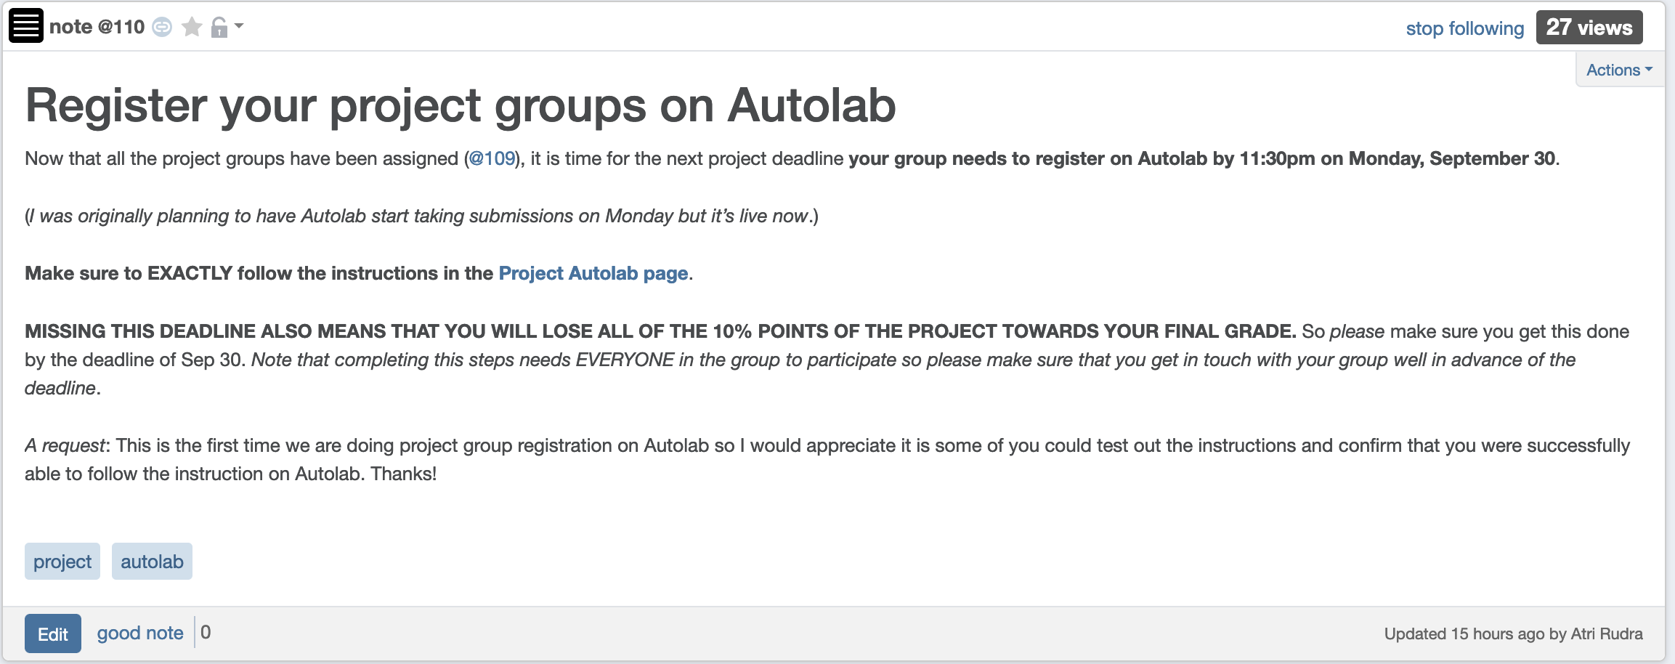
Autolab Project Group Registration
Due TODAY
If you miss this deadline then you will get a ZERO on the ENTIRE project

Slide 10
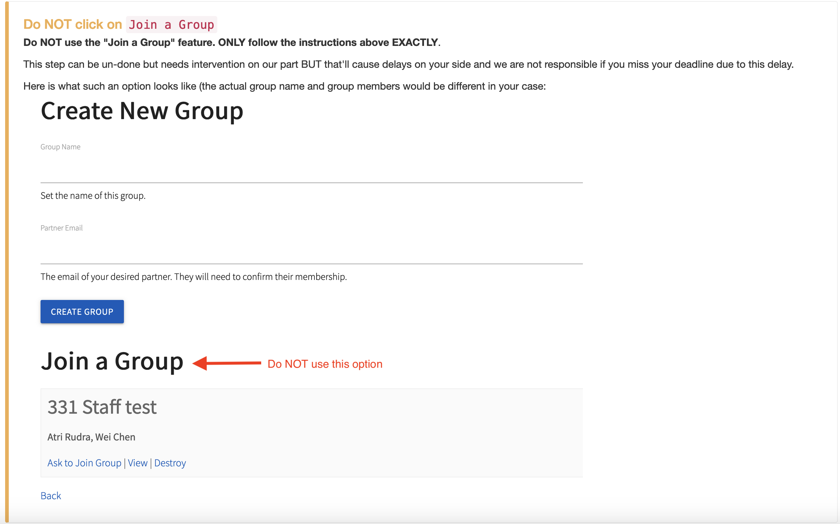
Please follow ALL instructions

Slide 11
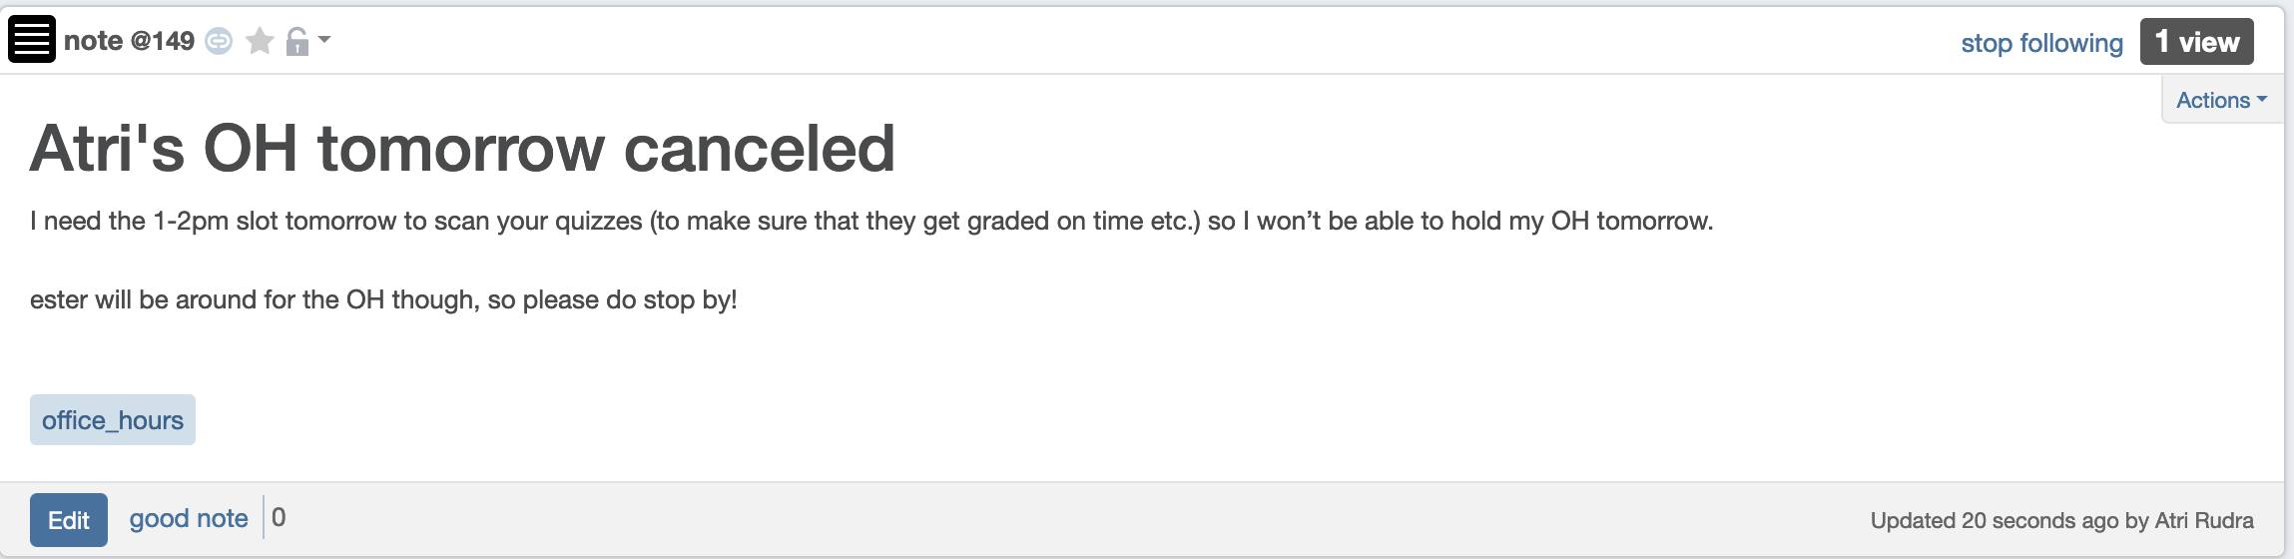
I won’t have OH today

Slide 12
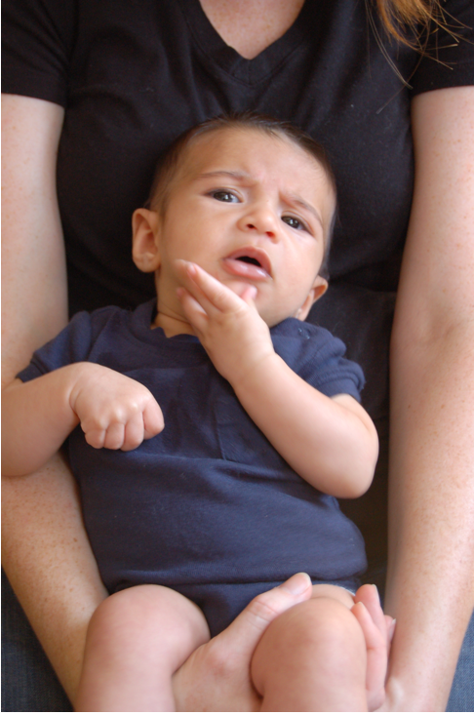
Questions?

Slide 13
Queue O(m+n) implementation
BFS(s)
CC[s] = T and CC[w] = F for every w≠ s
O(n)
Intitialize Q= {s}
O(1)
While Q is not empty
Repeated at most once for each vertex u
Σ_{u} O(n_{u}) =
O(Σ_{u} n_{u}) =
O(m)
Delete the front element u in Q
For every edge (u,w)
Repeated n_{u} times
O(1)
If CC[w] = F then
O(n_{u})
CC[w] = T
O(1)
Add w to the back of Q

Slide 14
A DFS run using an explicit stack
7
8
1
7
6
7
3
2
3
5
8
4
4
5
5
3
6
2
3
1

Slide 15
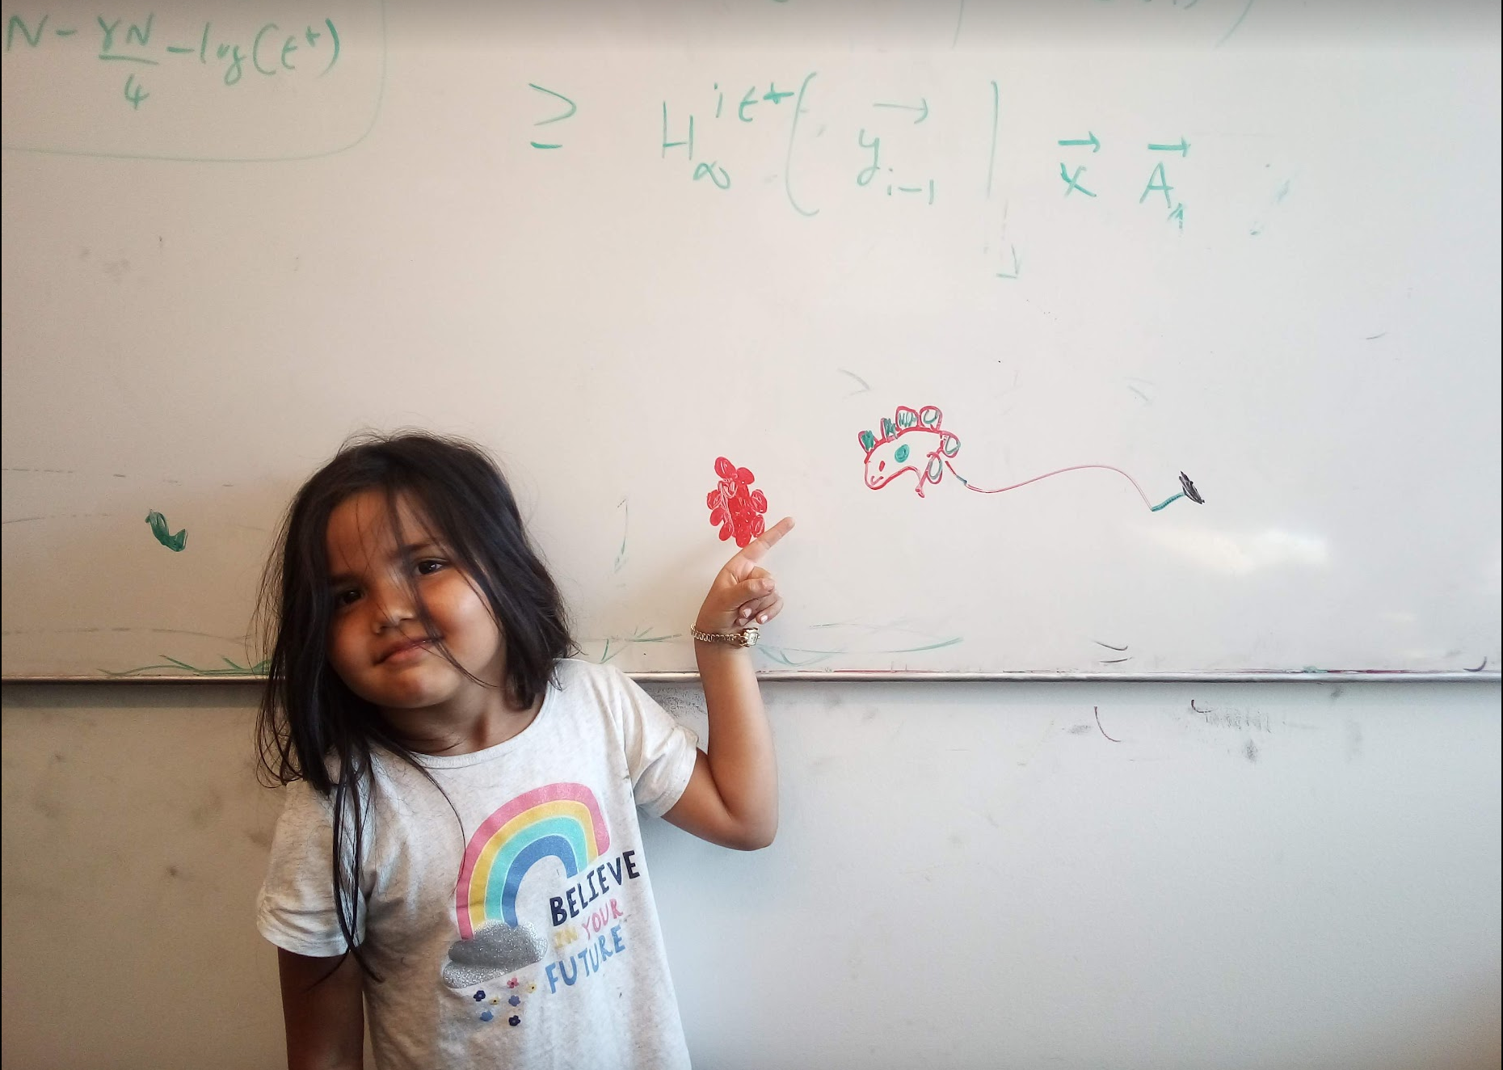
Questions/Comments?

Slide 16
Implementing DFS in O(m+n) time
Same as BFS except stack instead of a queue

Slide 17
DFS stack implementation
DFS(s)
CC[s] = T and CC[w] = F for every w≠ s
Same
O(m+n) run time analysis as for BFS
Intitialize Ŝ = {s}
While Ŝ is not empty
Pop the top element u in Ŝ
If CC[u] = F then
CC[u] = T
For every edge (u,w)
Push w to the top of Ŝ

Slide 18
Questions/Comments?

Slide 19
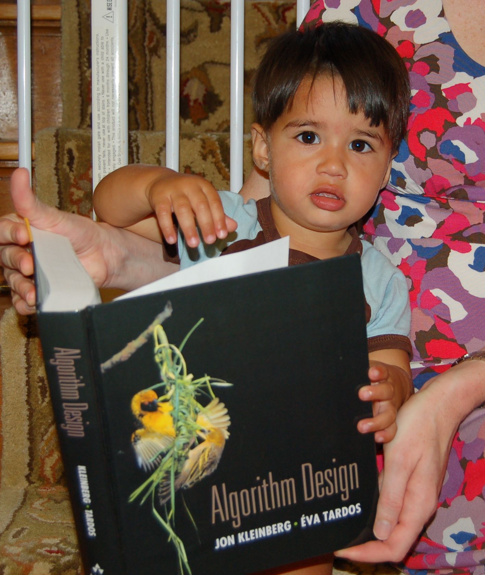
Reading Assignment
Sec 3.3, 3.4, 3.5 and 3.6 of [KT]

Slide 20


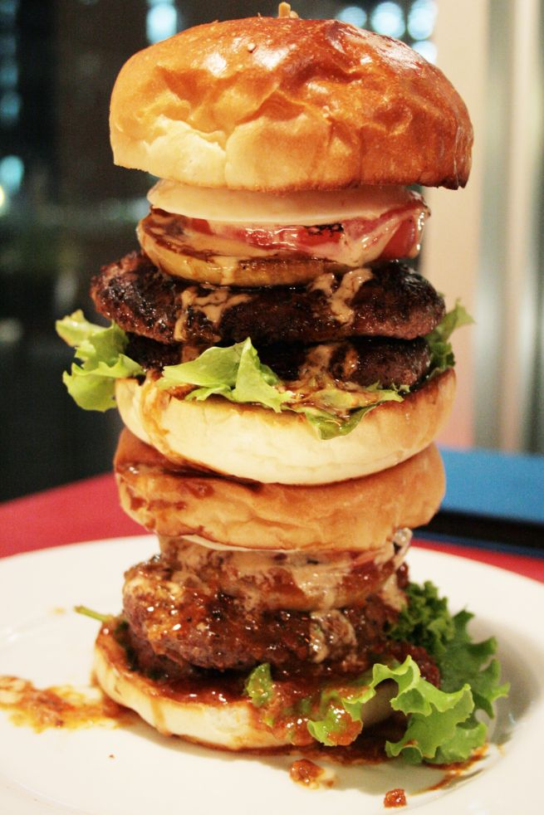
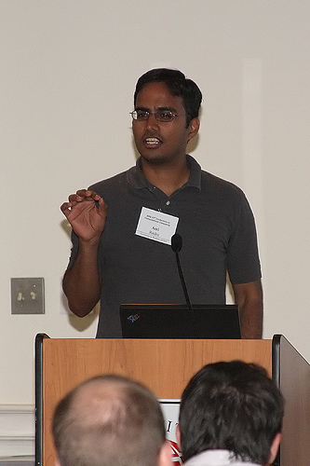
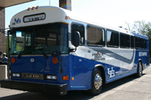
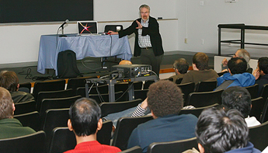
Directed graphs
Model asymmetric relationships
Precedence relationships
u needs to be done before w means (u,w) edge

Slide 21
Directed graphs
Adjacency matrix is not symmetric
Each vertex has two lists in Adj. list rep.

Slide 22
Directed Acyclic Graph (DAG)
No directed cycles
Precedence relationships are consistent

Slide 23
Topological Sorting of a DAG
Order the vertices so that all edges go “forward”

Slide 24


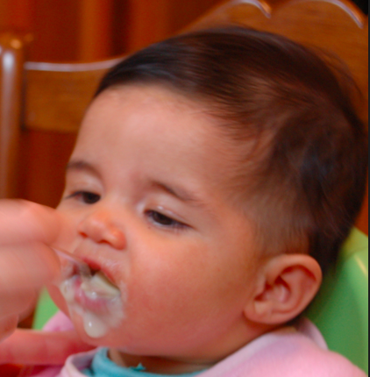

Probabilistic Graphical Models (PGMs)
http://ginaskokopelli.com/wp-content/uploads/2013/01/DiaperDealsLogo.jpg
D
E
H
f_{S|E}(s,e) = Pr[S=s|E=e]
S
S
E
f_{S|E}
Σ
1
1
0.8
φ (h) =
f_{H|D,S}(h,d,s) × f_{S|E}(s,e)
× f_{D|E}(d,e) × f_{E}(e)
1
0
0.3
d,s,e
0
1
0.2
0
0
0.7

Slide 25
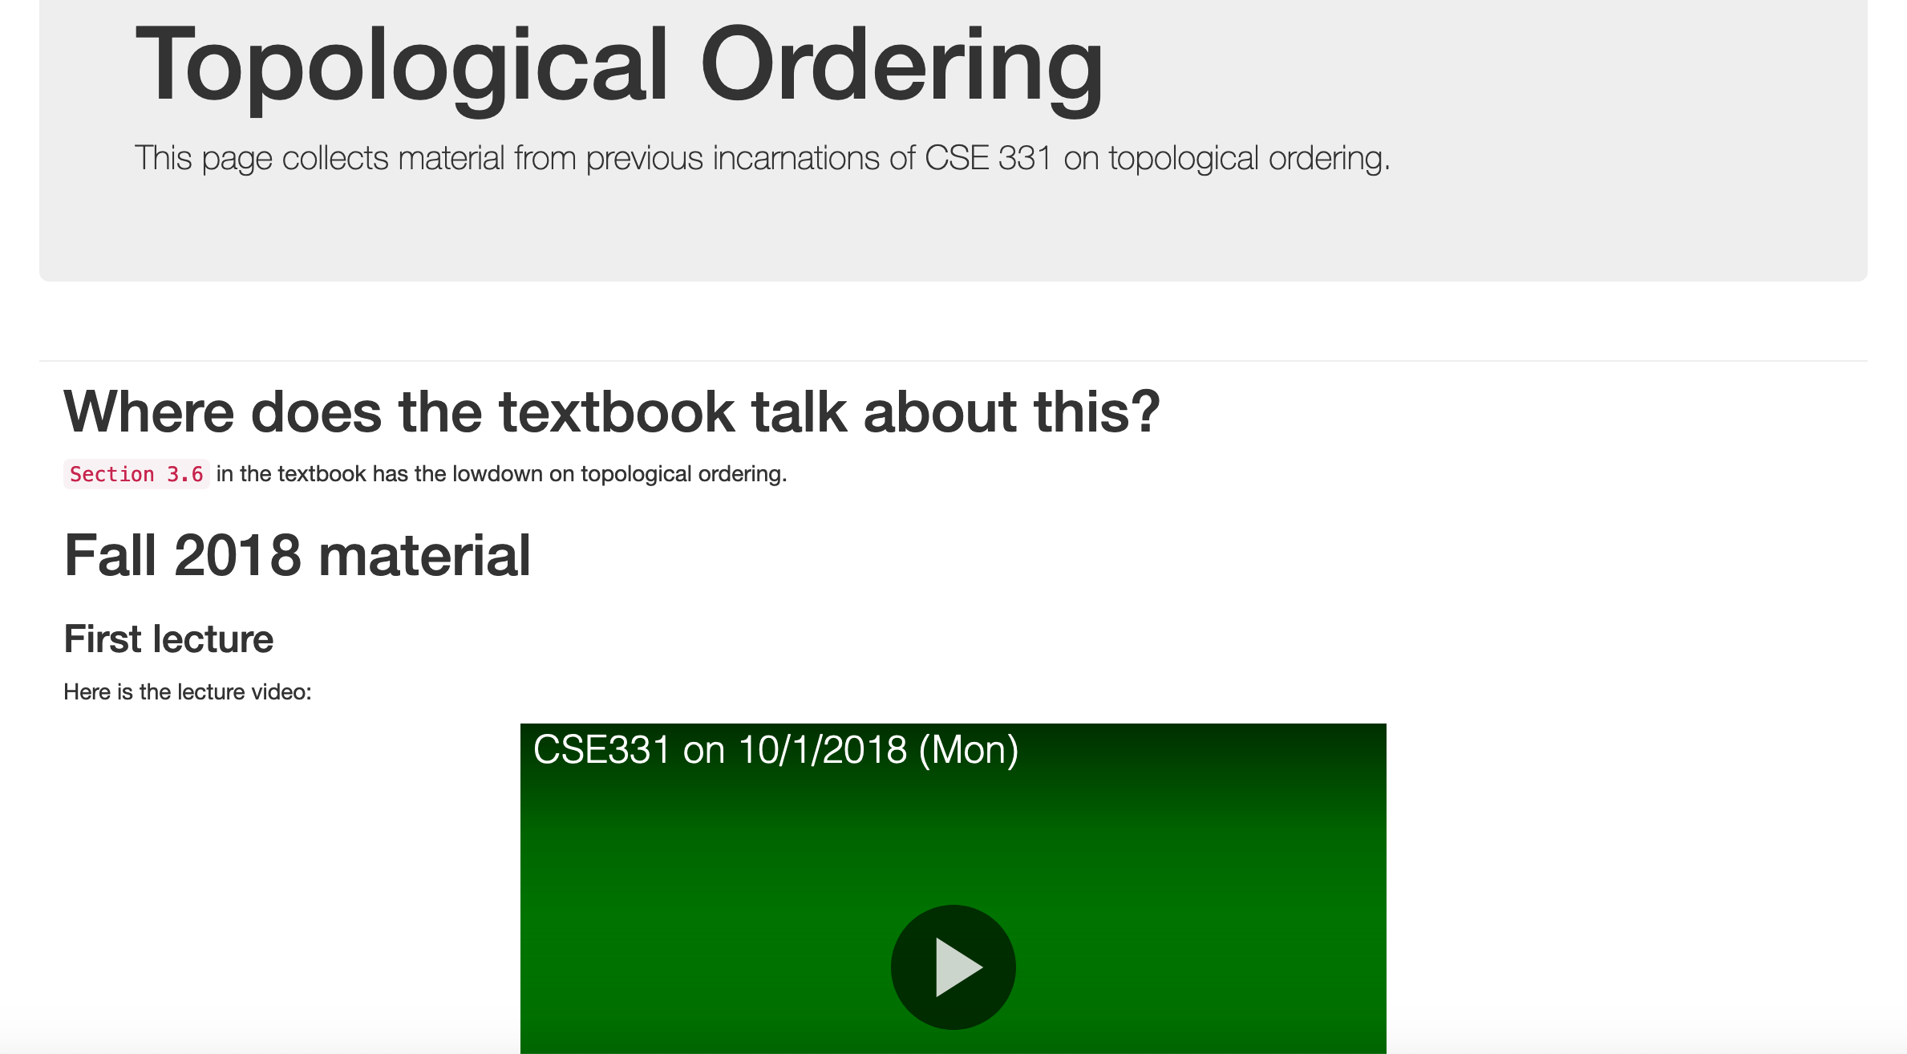
More details on Topological sort

Slide 26
Questions/Comments?

Slide 27
Mid-term material until here

Slide 28







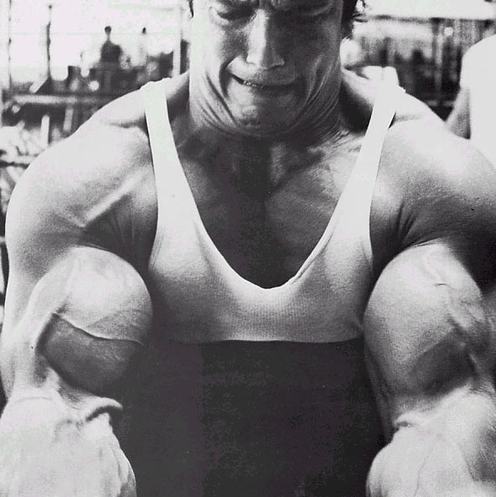
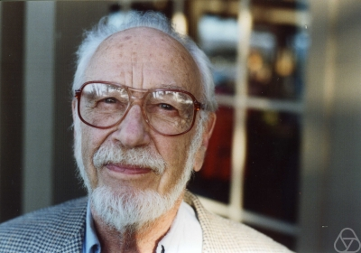
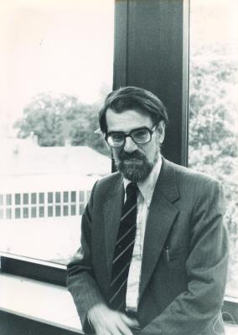
Main Steps in Algorithm Design
Problem Statement
Problem Definition
Algorithm
n!
“Implementation”
Data Structures
Analysis
Correctness+Runtime Analysis

Slide 29
Where do graphs fit in?
Problem Statement
A tool to define problems
Problem Definition
Algorithm
“Implementation”
Data Structures
Analysis
Correctness+Runtime Analysis

Slide 30
Rest of the course*
Problem Statement
Problem Definition
Three general techniques
Algorithm
“Implementation”
Data Structures
Analysis
Correctness+Runtime Analysis

Slide 31

Greedy algorithms
Build the final solution piece by piece
Being short sighted on each piece
Never undo a decision
Know when you see it

Slide 32

End of Semester blues
Can only do one thing at any day: what is the maximum number of tasks that you can do?
Write up a term paper
Party!
Exam study
331 homework
331 HW
Project
Friday
Saturday
Sunday
Monday
Tuesday

Slide 33
The optimal solution
Can only do one thing at any day: what is the maximum number of tasks that you can do?
Party!
Exam study
331 HW
Friday
Saturday
Sunday
Monday
Tuesday

Slide 34
Interval Scheduling Problem
Input: n intervals [s(i), f(i)) for 1≤ i ≤ n
{ s(i), … ,f(i)-1 }
Output: A schedule S of the n intervals
No two intervals in S conflict
|S| is maximized

