Slide 1
Lecture 17
CSE 331
Oct 4, 2024

Slide 2
Upcoming exams
Mid-term 1 on Mon Oct 7
Mid-term 2 next Wed Oct 9

Slide 3
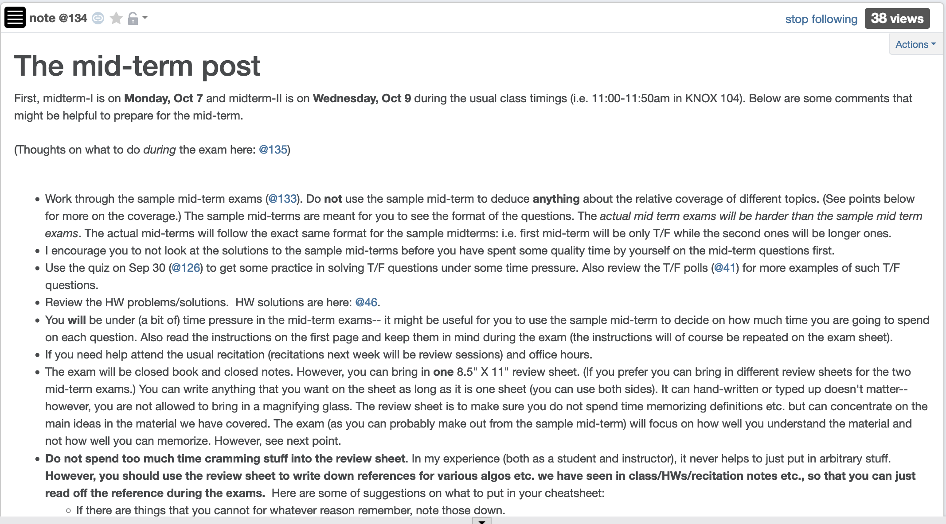
Mid-term post 1

Slide 4
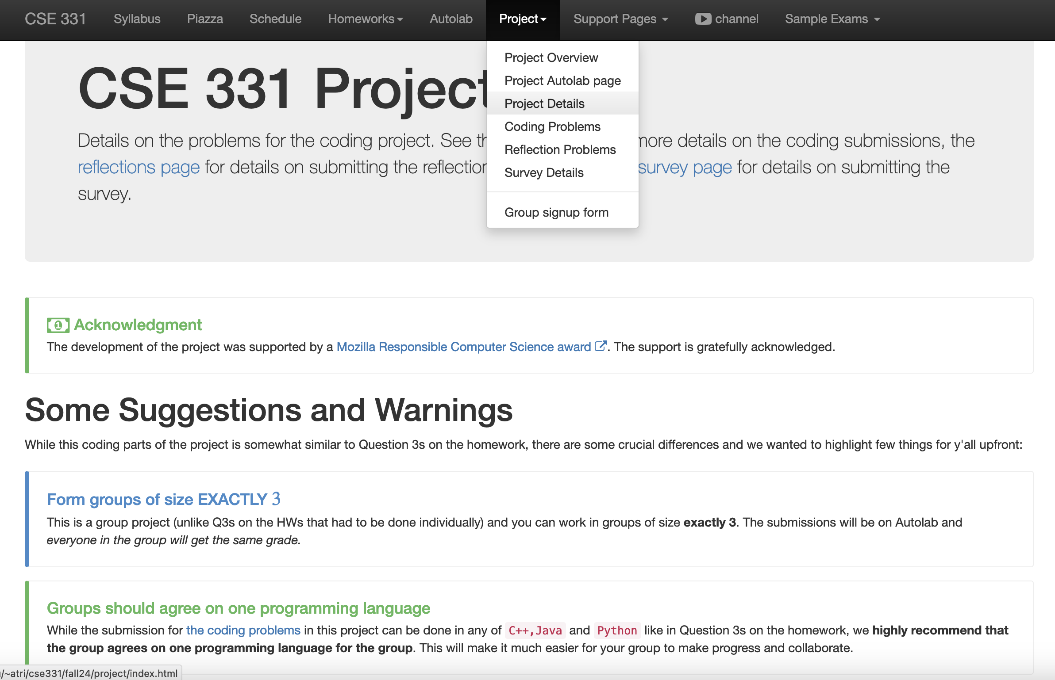
Project has been released!

Slide 5
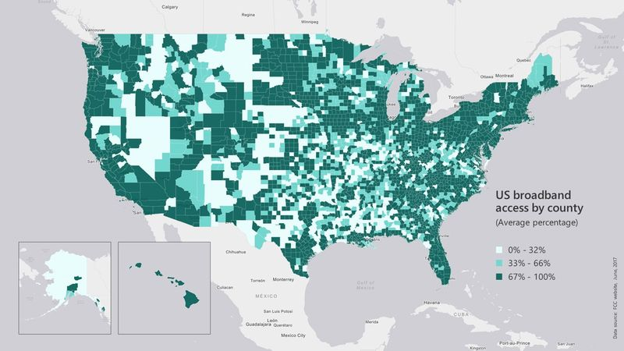
Broadband access
https://assets.bwbx.io/images/users/iqjWHBFdfxIU/iZSjibxE1KJs/v1/800x-1.jpg

Slide 6
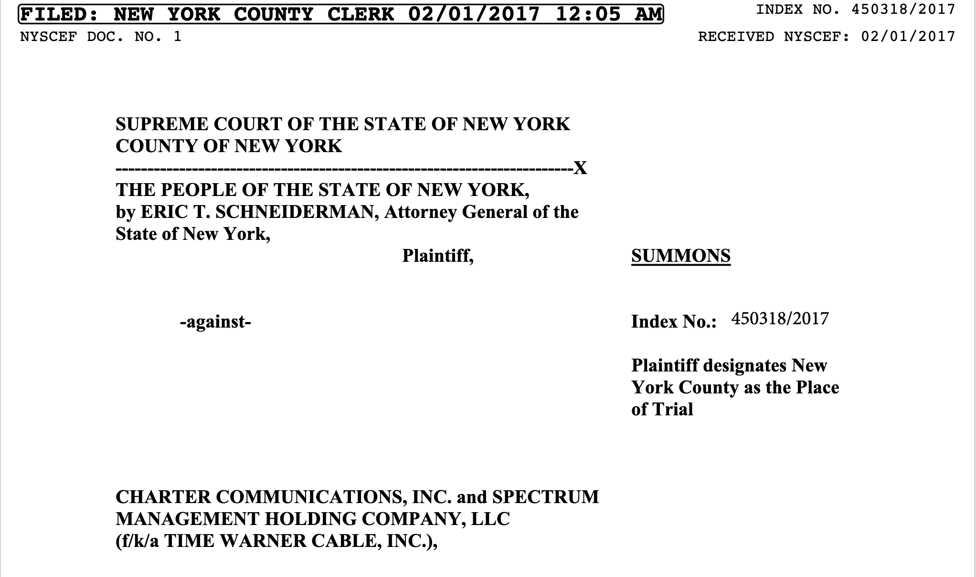
Lawsuit against Spectrum

Slide 7
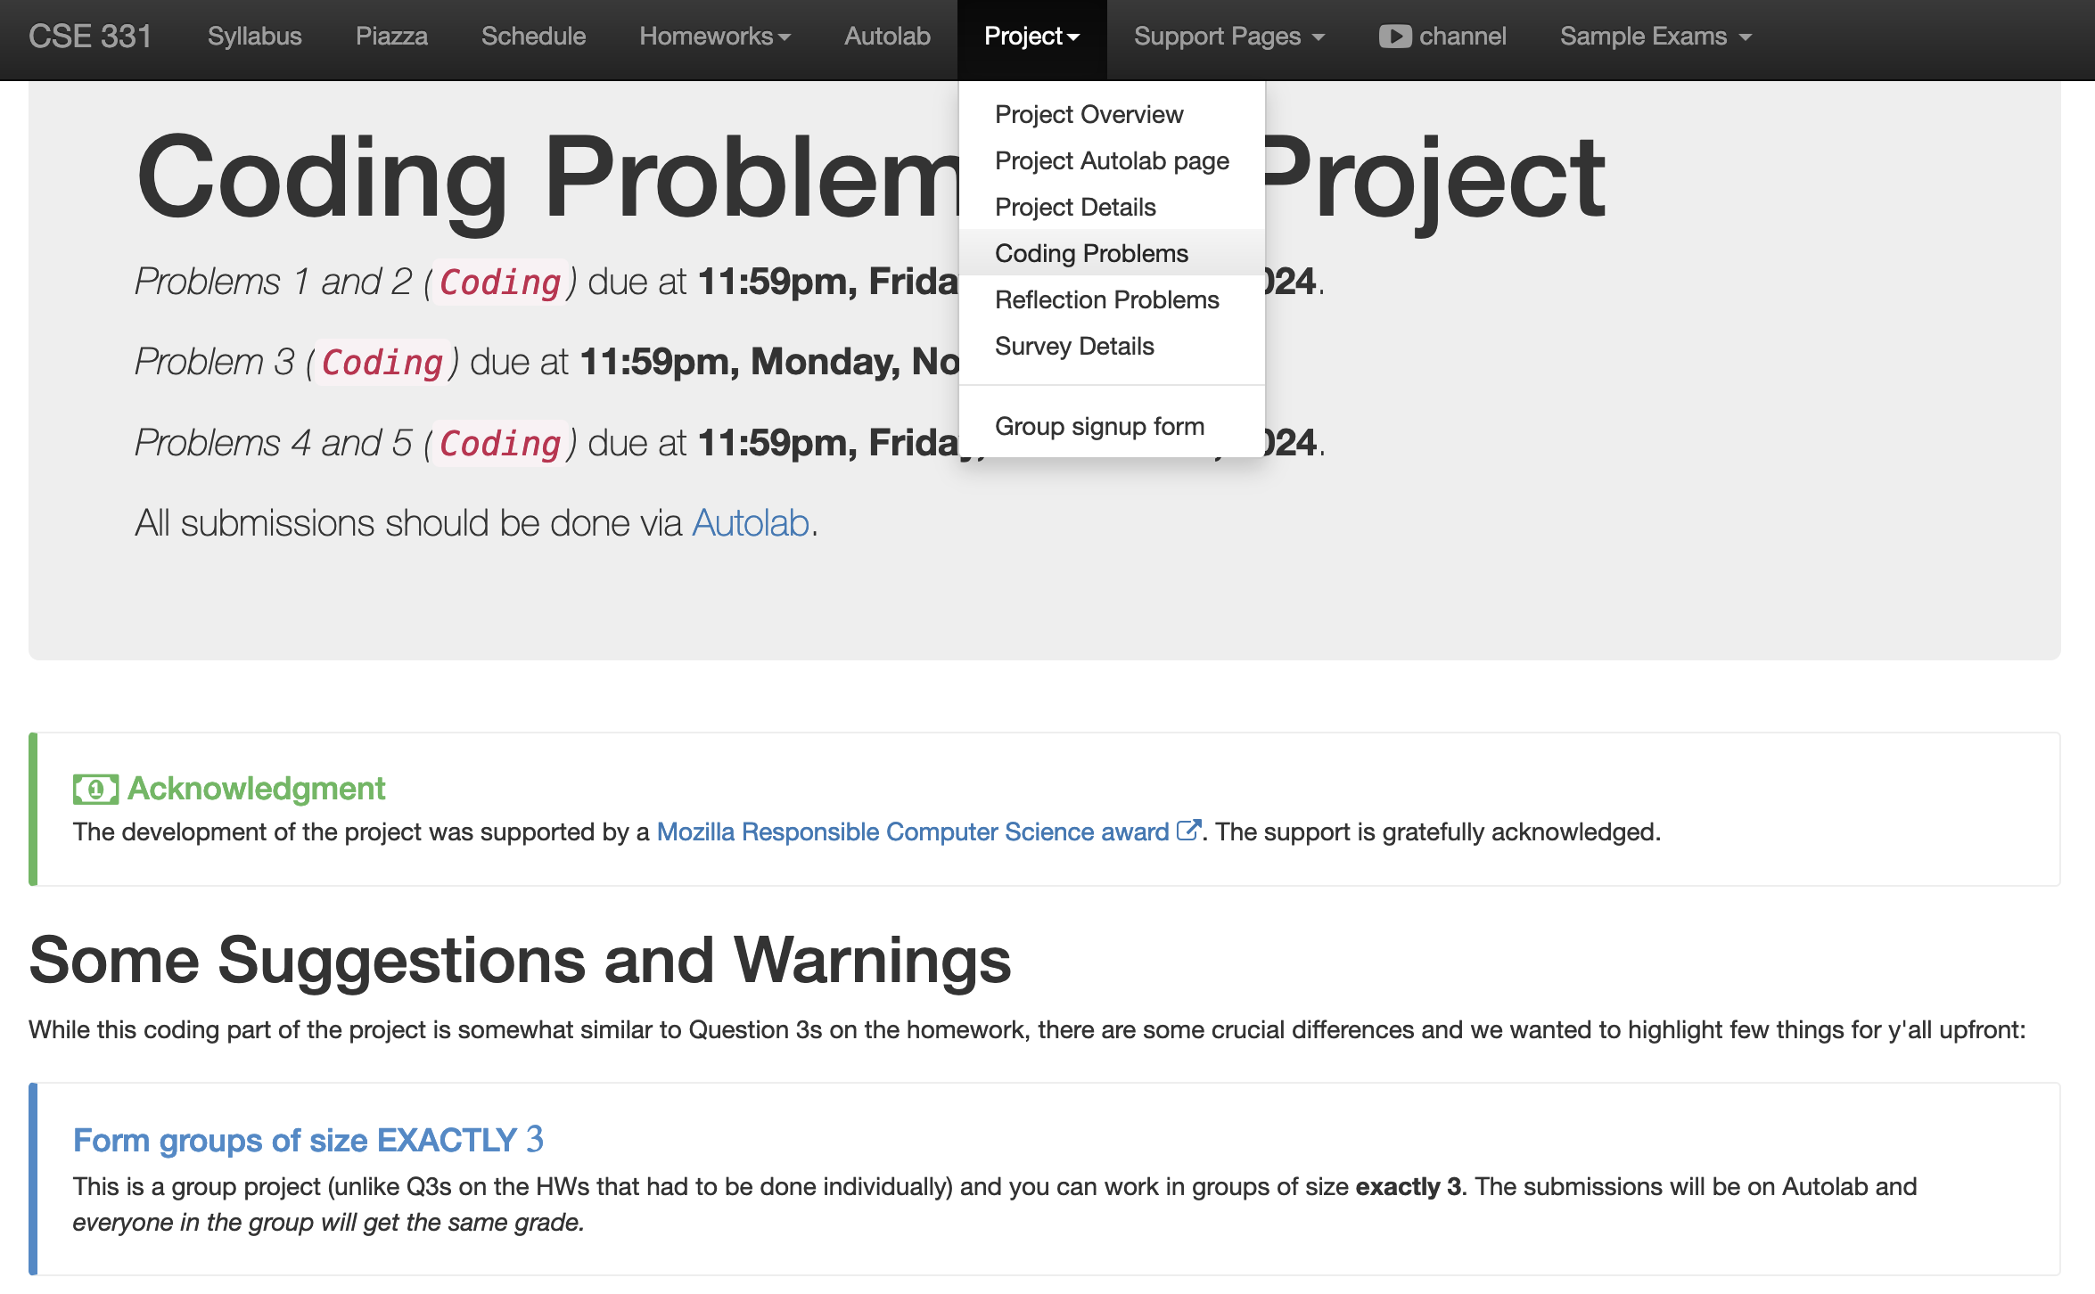
Five coding problems

Slide 8
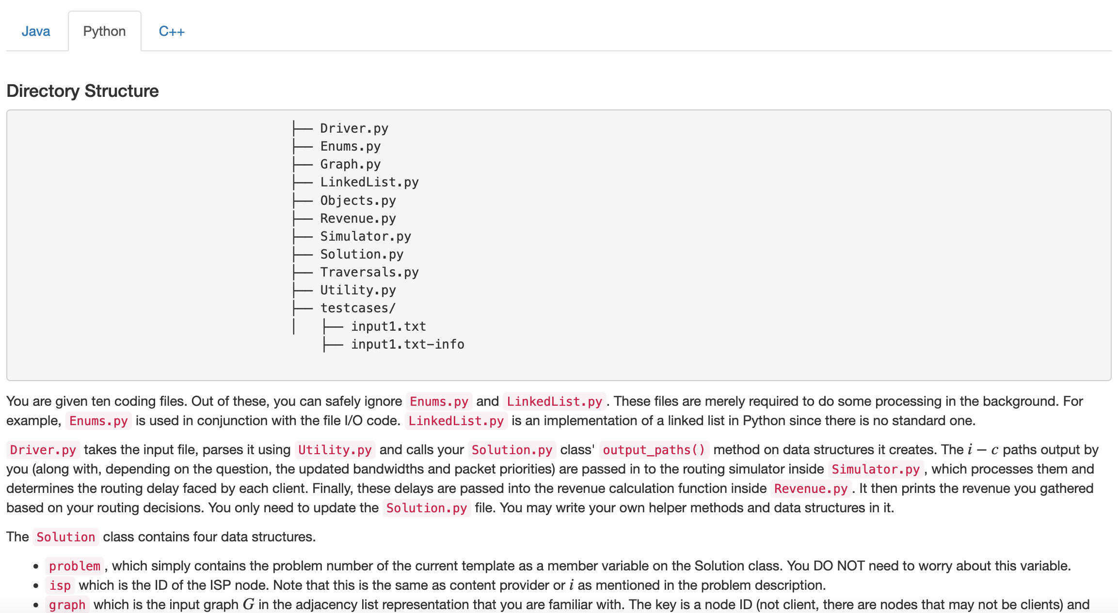
Each like a HW Q3
You can get full credit with code length along the lines of Q3 submissions!
More work to UNDERSTAND the problem

Slide 9
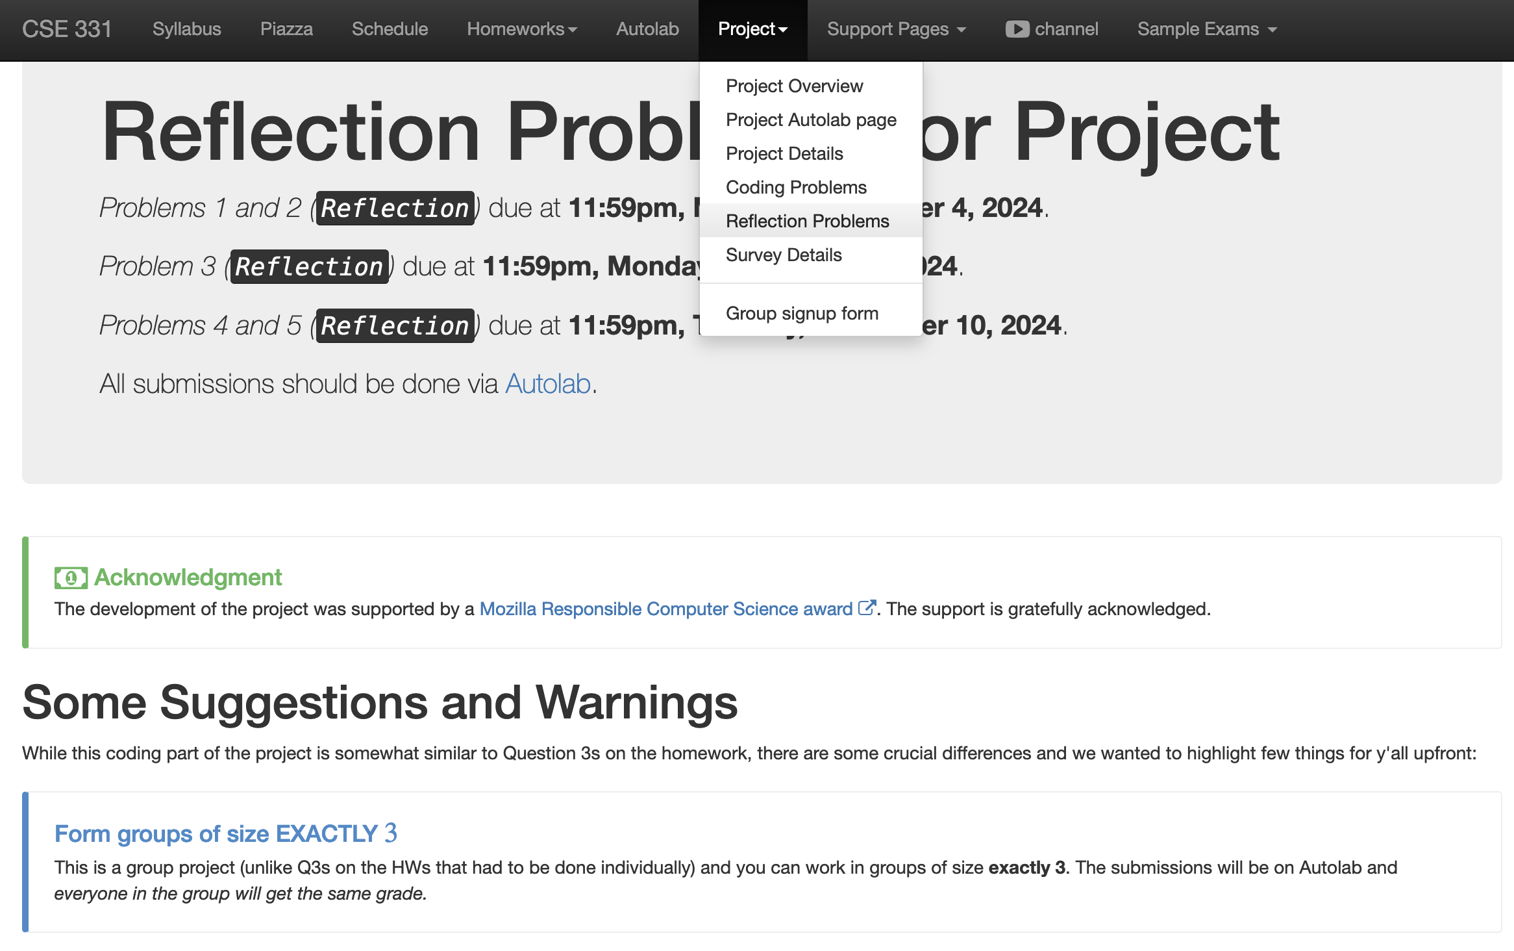
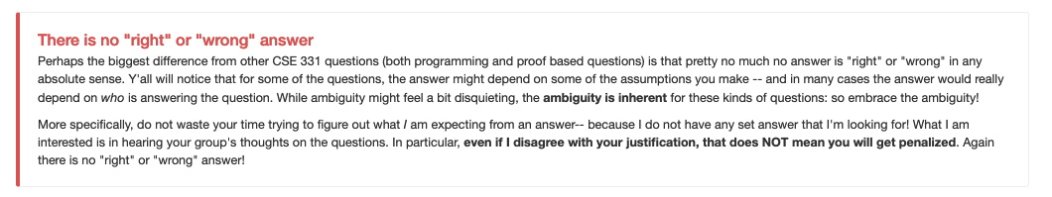
Five reflection problems

Slide 10
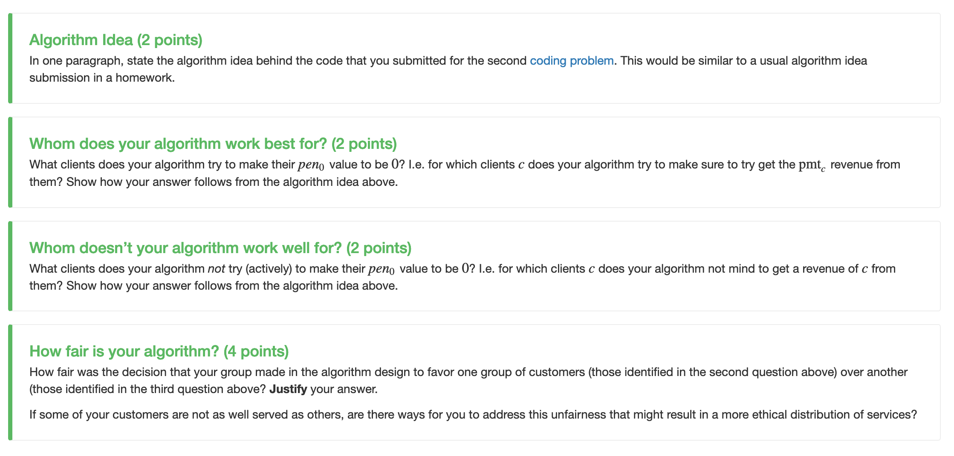
Reflect on your design choices

Slide 11
Quiz 1 Grading
Will be done by tonight

Slide 12
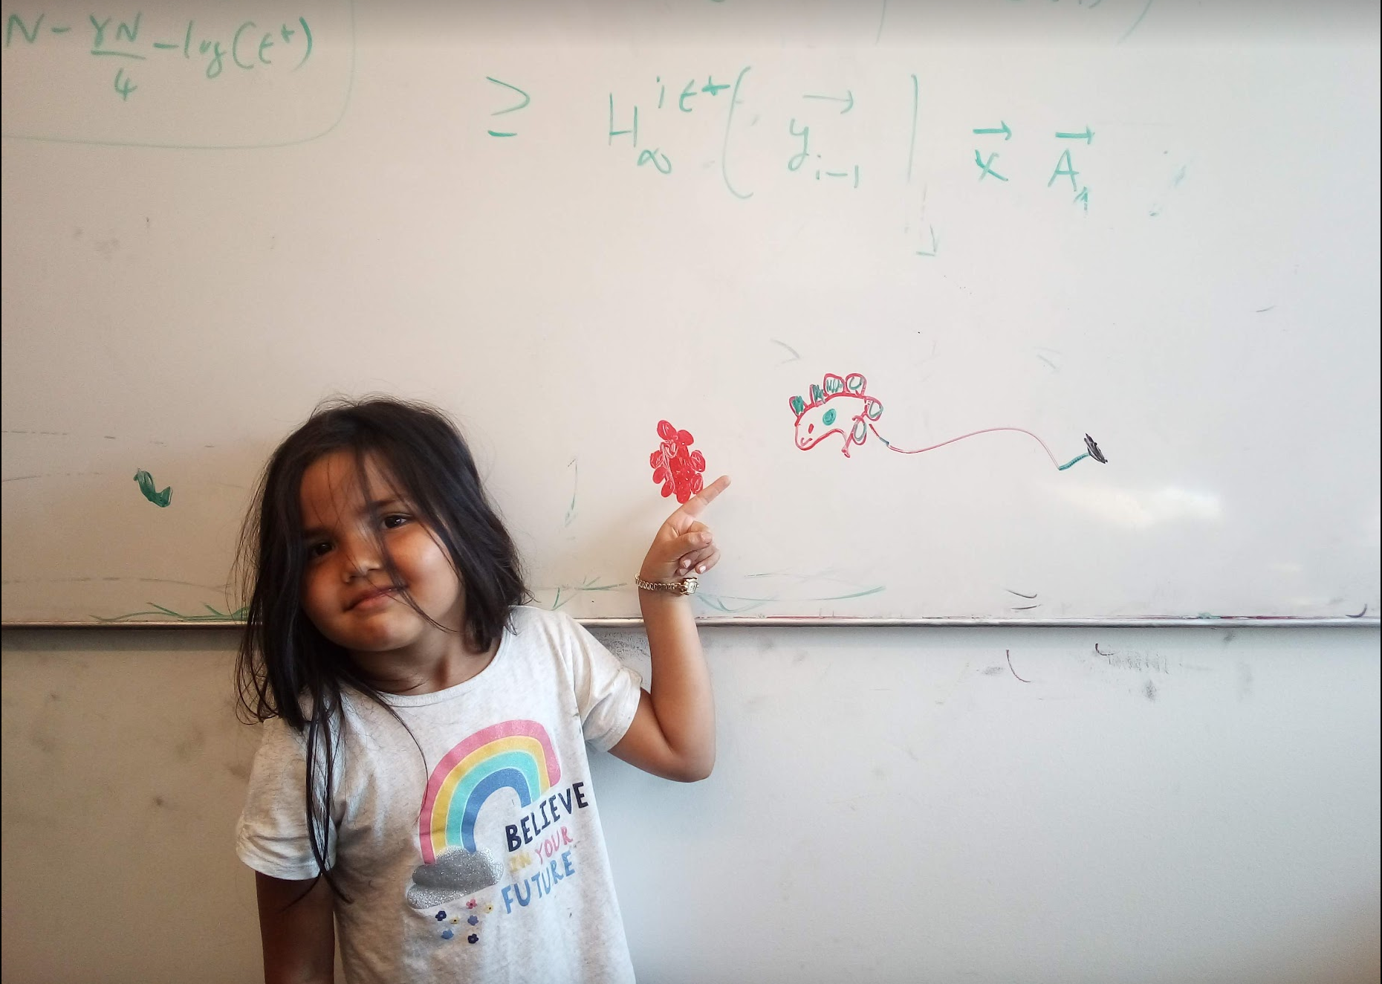
Questions/Comments?

Slide 13
Interval Scheduling Problem
Input: n intervals [s(i), f(i)) for 1≤ i ≤ n
Output: A schedule S of the n intervals
No two intervals in S conflict
|S| is maximized

Slide 14
Analyzing the algorithm
R: set of requests
S* has no conflicts
Set S to be the empty set
While R is not empty
Choose i in R with the earliest finish time
Add i to S
S* is an optimal solution
Remove all requests that conflict with i from R
Return S* = S

Slide 15
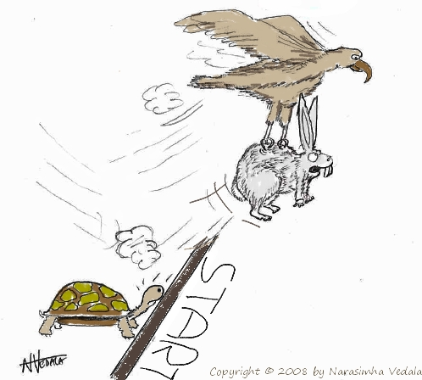
Greedy “stays ahead”
Greedy
OPT

Slide 16
Today’s agenda
Prove the correctness
(If we have time) Analyze run-time of the greedy algorithm

Slide 17
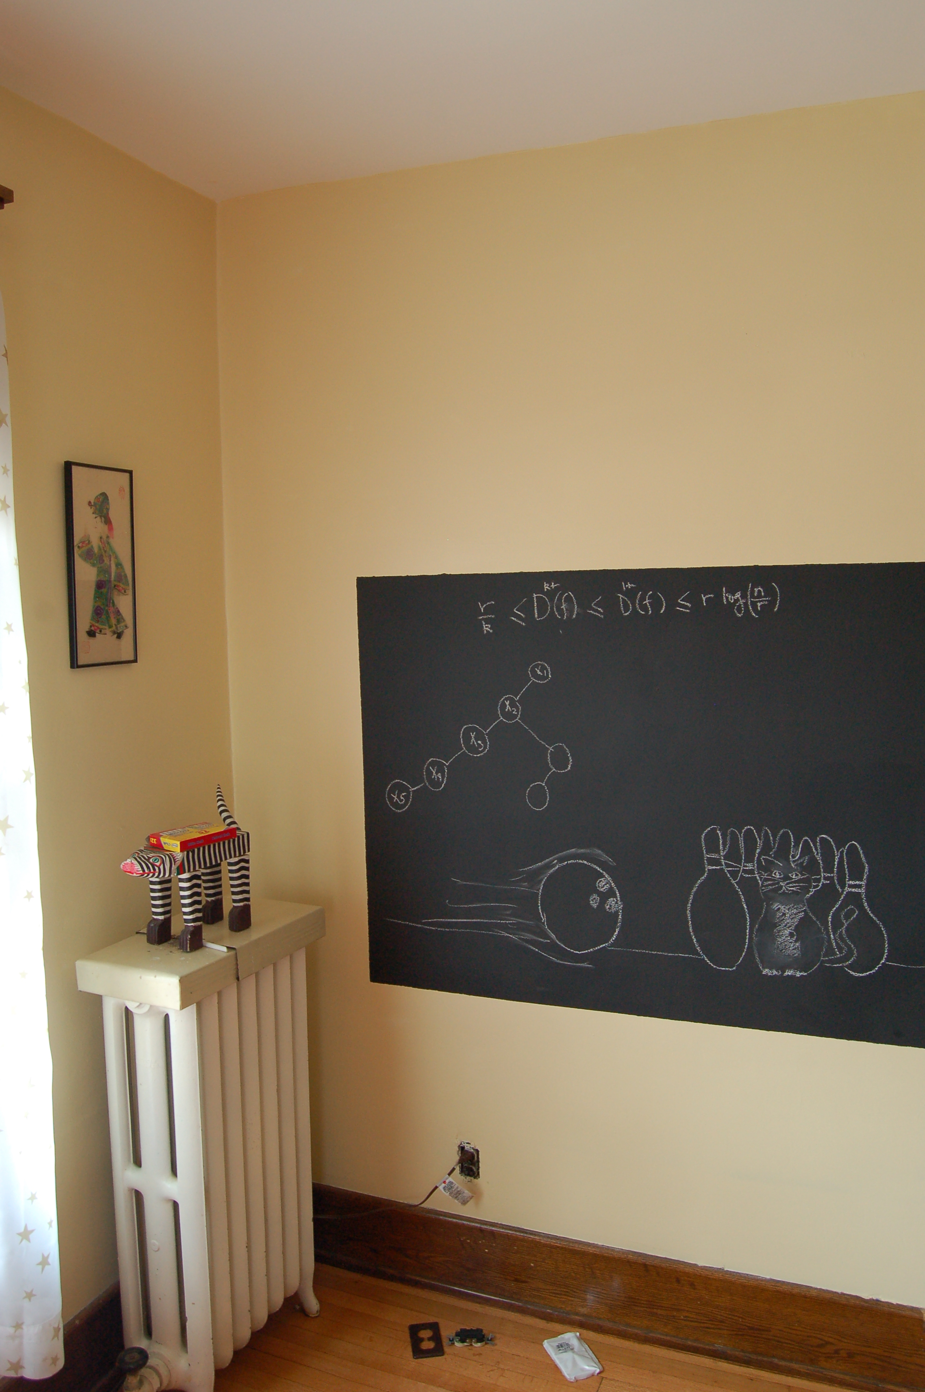
Argue correctness on the board…

