Slide 1
Lecture 18
CSE 331
Oct 11, 2024

Slide 2
Grading update
Mid terms should hopefully be handed back next Th

Slide 3
Interval Scheduling Problem
Input: n intervals [s(i), f(i)) for 1≤ i ≤ n
Output: A schedule S of the n intervals
No two intervals in S conflict
|S| is maximized

Slide 4
Analyzing the algorithm
R: set of requests
S* has no conflicts
Set S to be the empty set
While R is not empty
Choose i in R with the earliest finish time
Add i to S
S* is an optimal solution
Remove all requests that conflict with i from R
Return S* = S

Slide 5
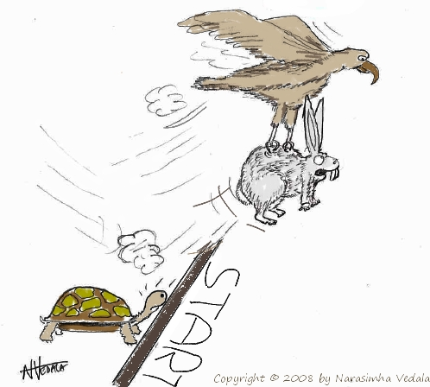
Greedy “stays ahead”
Greedy
OPT

Slide 6
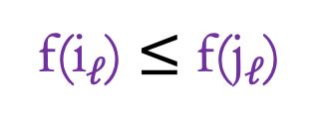

Greedy stays ahead lemma
S* = {i₁,..,i_{k}}
O = {j₁,..,j_{m}}
Lemma 1: For all 1 $≤$ $ℓ$ $≤$ k
f(i$ℓ$) $≤$ f(j$ℓ$)

Slide 7
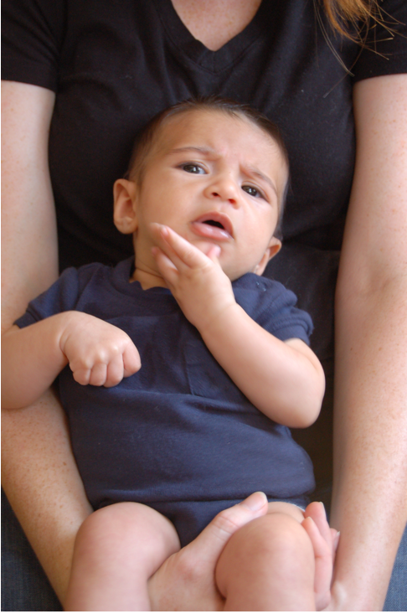
Questions?

Slide 8
Runtime analysis of Greedy Algo.
R: set of requests
O(1)
Set S to be the empty set
Repeated at most n times
While R is not empty
O(n)
O(1)
Choose i in R with the earliest finish time
Add i to S
O(n)
Overall: O(n) + n*O(n) = O(n²)
Remove all requests that conflict with i from R
Return S* = S
O(n)

Slide 9
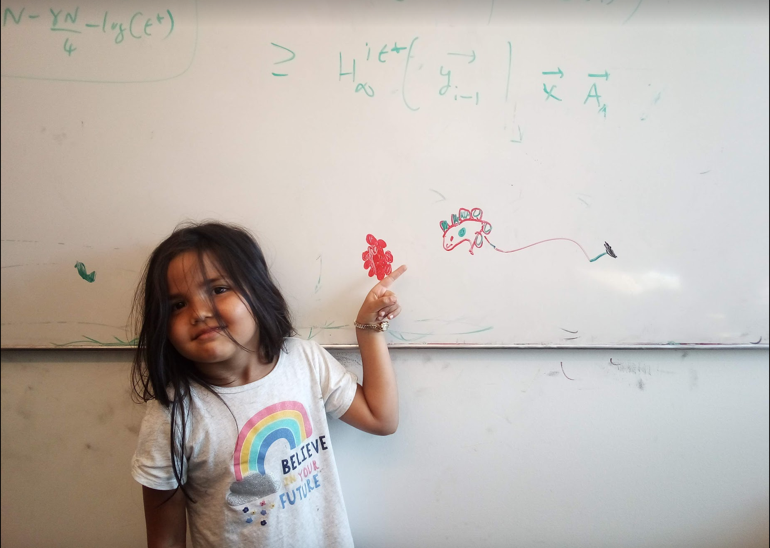
Questions/Comments?

Slide 10
Algorithm implementation
Go through the intervals in order of their finish time
3
How can you tell in O(1) time if any of 2,3 or 4 conflict with 1?
Check if s[i] < f(1)
2
1
4
O(n log n) run time
In general, if jth interval is the last one chosen
Pick smallest i>j such that s[i] ≥ f(j)

Slide 11
The final algo
O(n log n) time sort intervals such that f(i) ≤ f(i+1)
O(n) time build array s[1..n] s.t. s[i] = start time for i
Add 1 to S and set f = f(1)
For i = 2 .. n
If s[i] ≥ f
Add i to S
Set f = f(i)
Return S* = S

Slide 12
Questions/Comments?

Slide 13
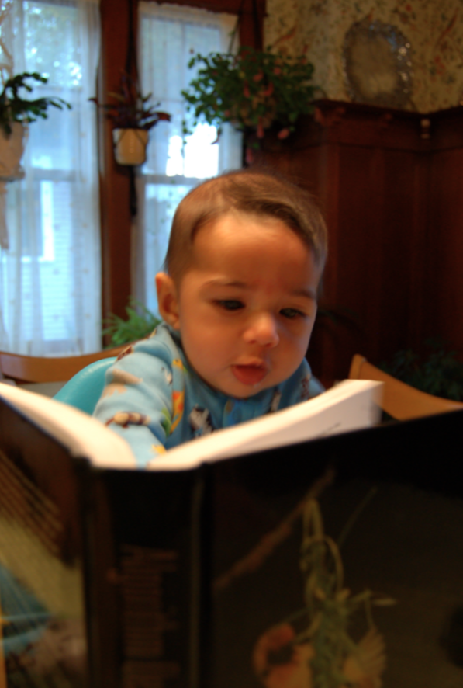
Reading Assignment
Sec 4.1 of [KT]

Slide 14

The “real” end of Semester blues
There are deadlines and durations of tasks
Write up a term paper
Party!
Exam study
331 HW
Project
Friday
Saturday
Sunday
Monday
Tuesday

Slide 15
The “real” end of Semester blues
There are deadlines and durations of tasks
Write up a term paper
Exam study
Party!
331 HW
Project
Friday
Saturday
Sunday
Monday
Tuesday

Slide 16
The algorithmic task
YOU decide when to start each task
Write up a term paper
Exam study
You have to do ALL the tasks
Party!
331 HW
Project
Friday
Saturday
Sunday
Monday
Tuesday

Slide 17
Scheduling to minimize lateness
All the tasks have to be scheduled
GOAL: minimize maximum lateness
Write up a term paper
Exam study
Party!
331 HW
Project
Friday
Saturday
Sunday
Monday
Tuesday

Slide 18
One possible schedule
All the tasks have to be scheduled
GOAL: minimize maximum lateness
Lateness = 0
Lateness = 2
331 HW
Party!
Exam study
Write up a term paper
Friday
Saturday
Sunday
Monday
Tuesday

Slide 19
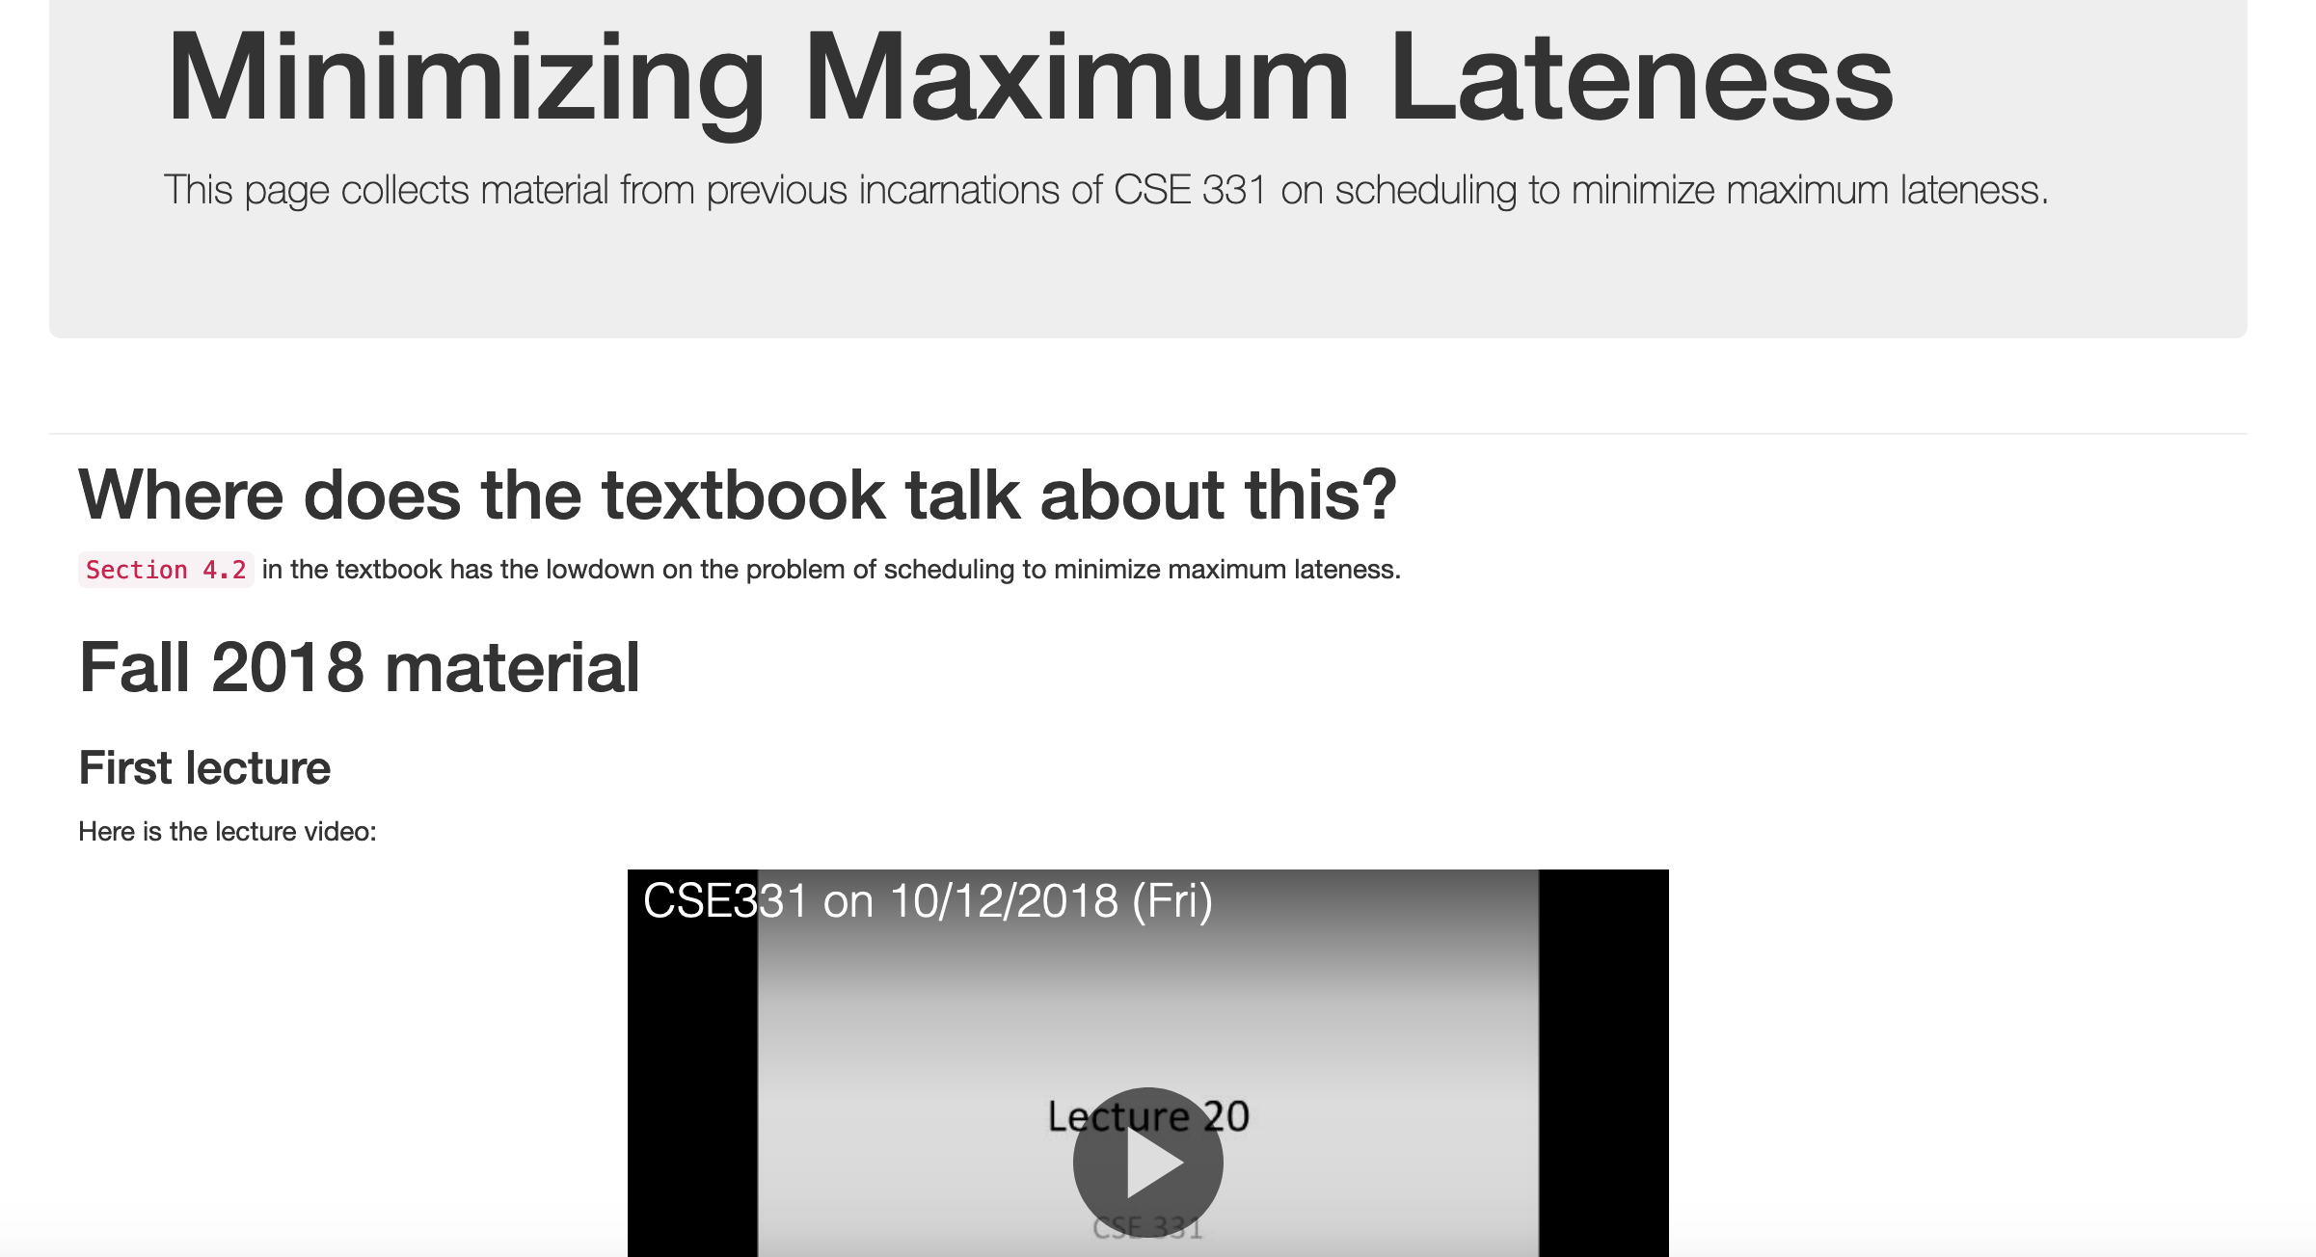
Minimizing Max Lateness

Slide 20
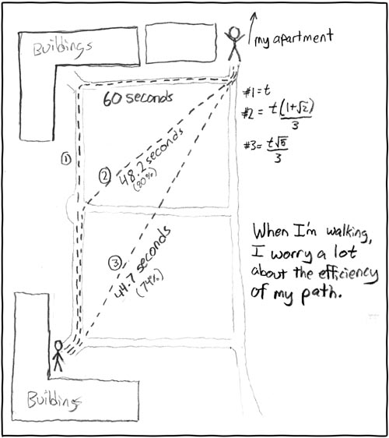
Rest of today
Shortest Path Problem
http://xkcd.com/85/

Slide 21
Reading Assignment
Sec 2.5 of [KT]

Slide 22
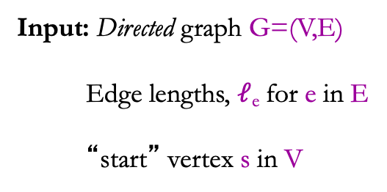
Shortest Path problem
s
100
Input: Directed graph G=(V,E)
Edge lengths, $ℓ$_{e} for e in E
“start” vertex s in V
w
5
15
u
s
s
w
5
5
15
u
u
Output: All shortest paths from s to all nodes in V

Slide 23
Naïve Algorithm
Ω(n!) time

Slide 24
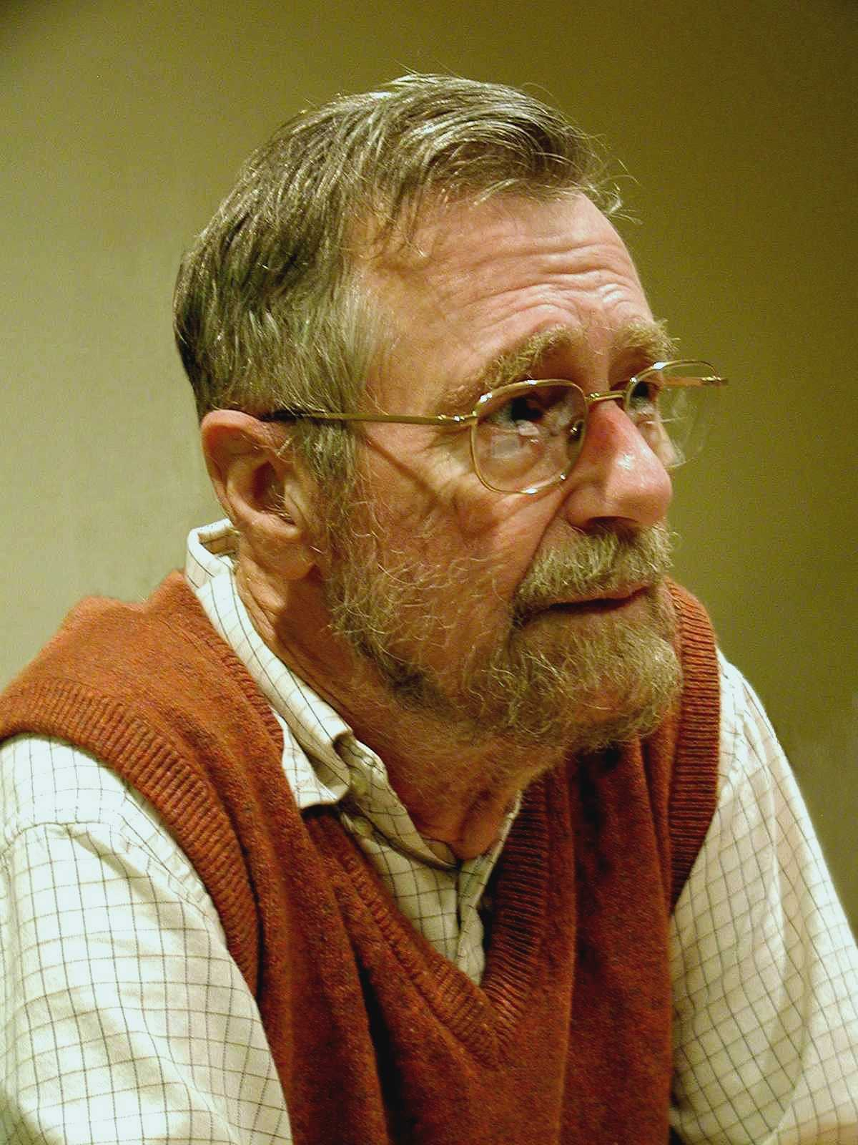
Dijkstra’s shortest path algorithm
E. W. Dijkstra (1930-2002)

Slide 25
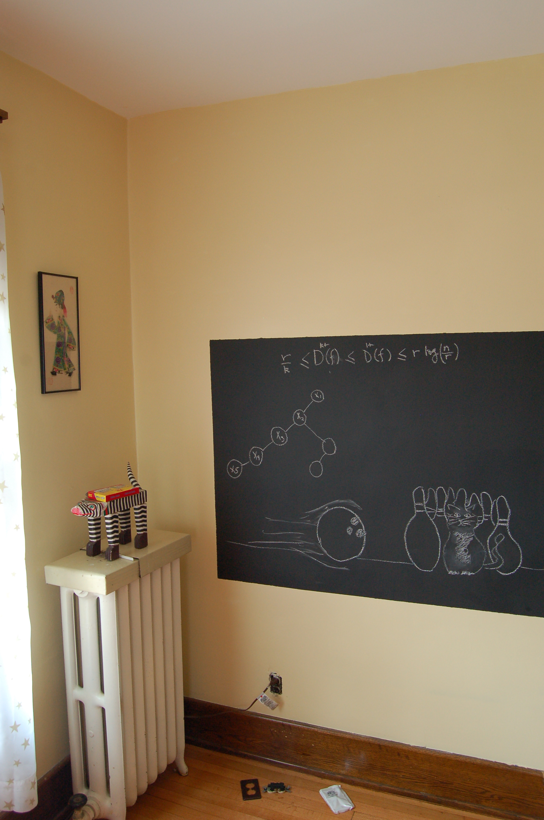
On to the board…

