Slide 1
Lecture 2
CSE 331
Aug 28, 2024

Slide 2
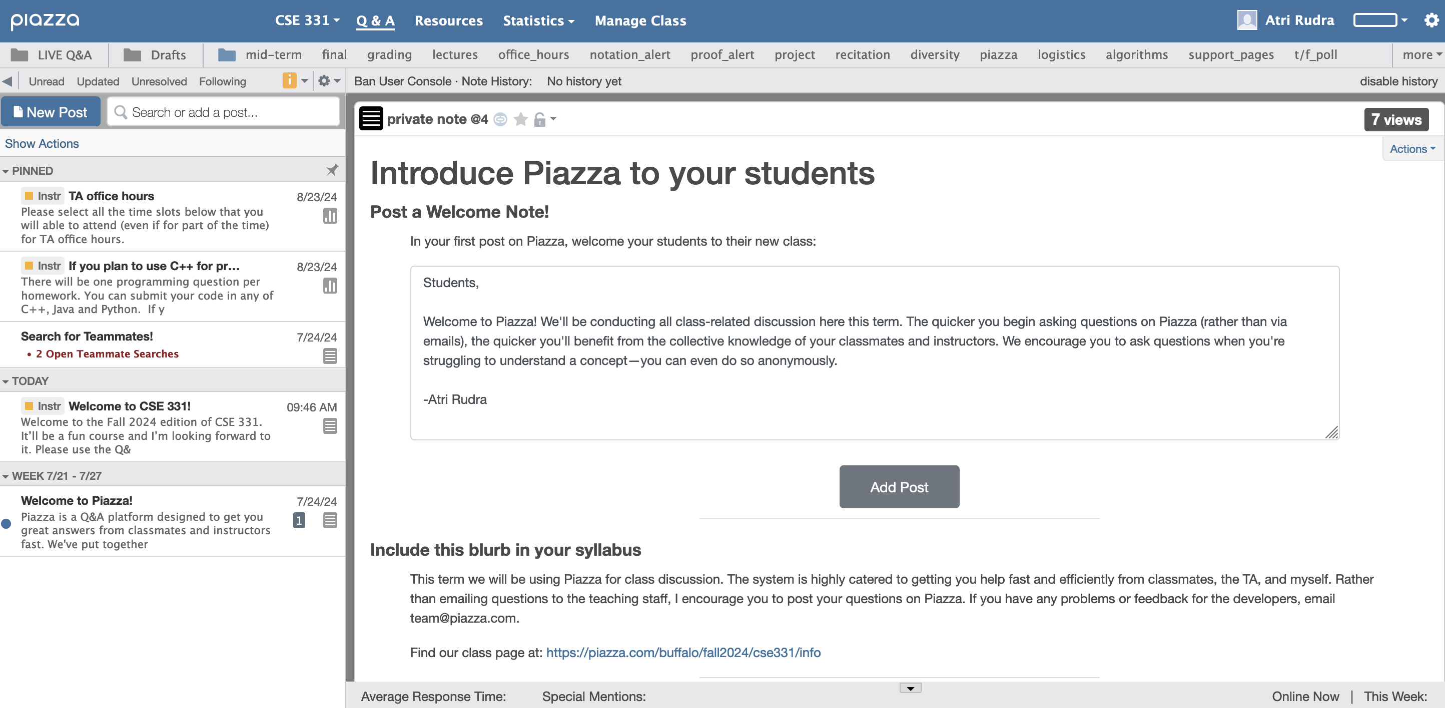
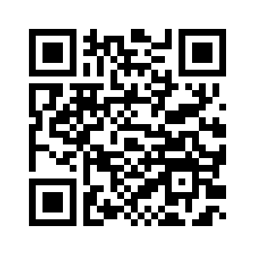
Make sure you are on Piazza
https://piazza.com/buffalo/fall2024/cse331/

Slide 3
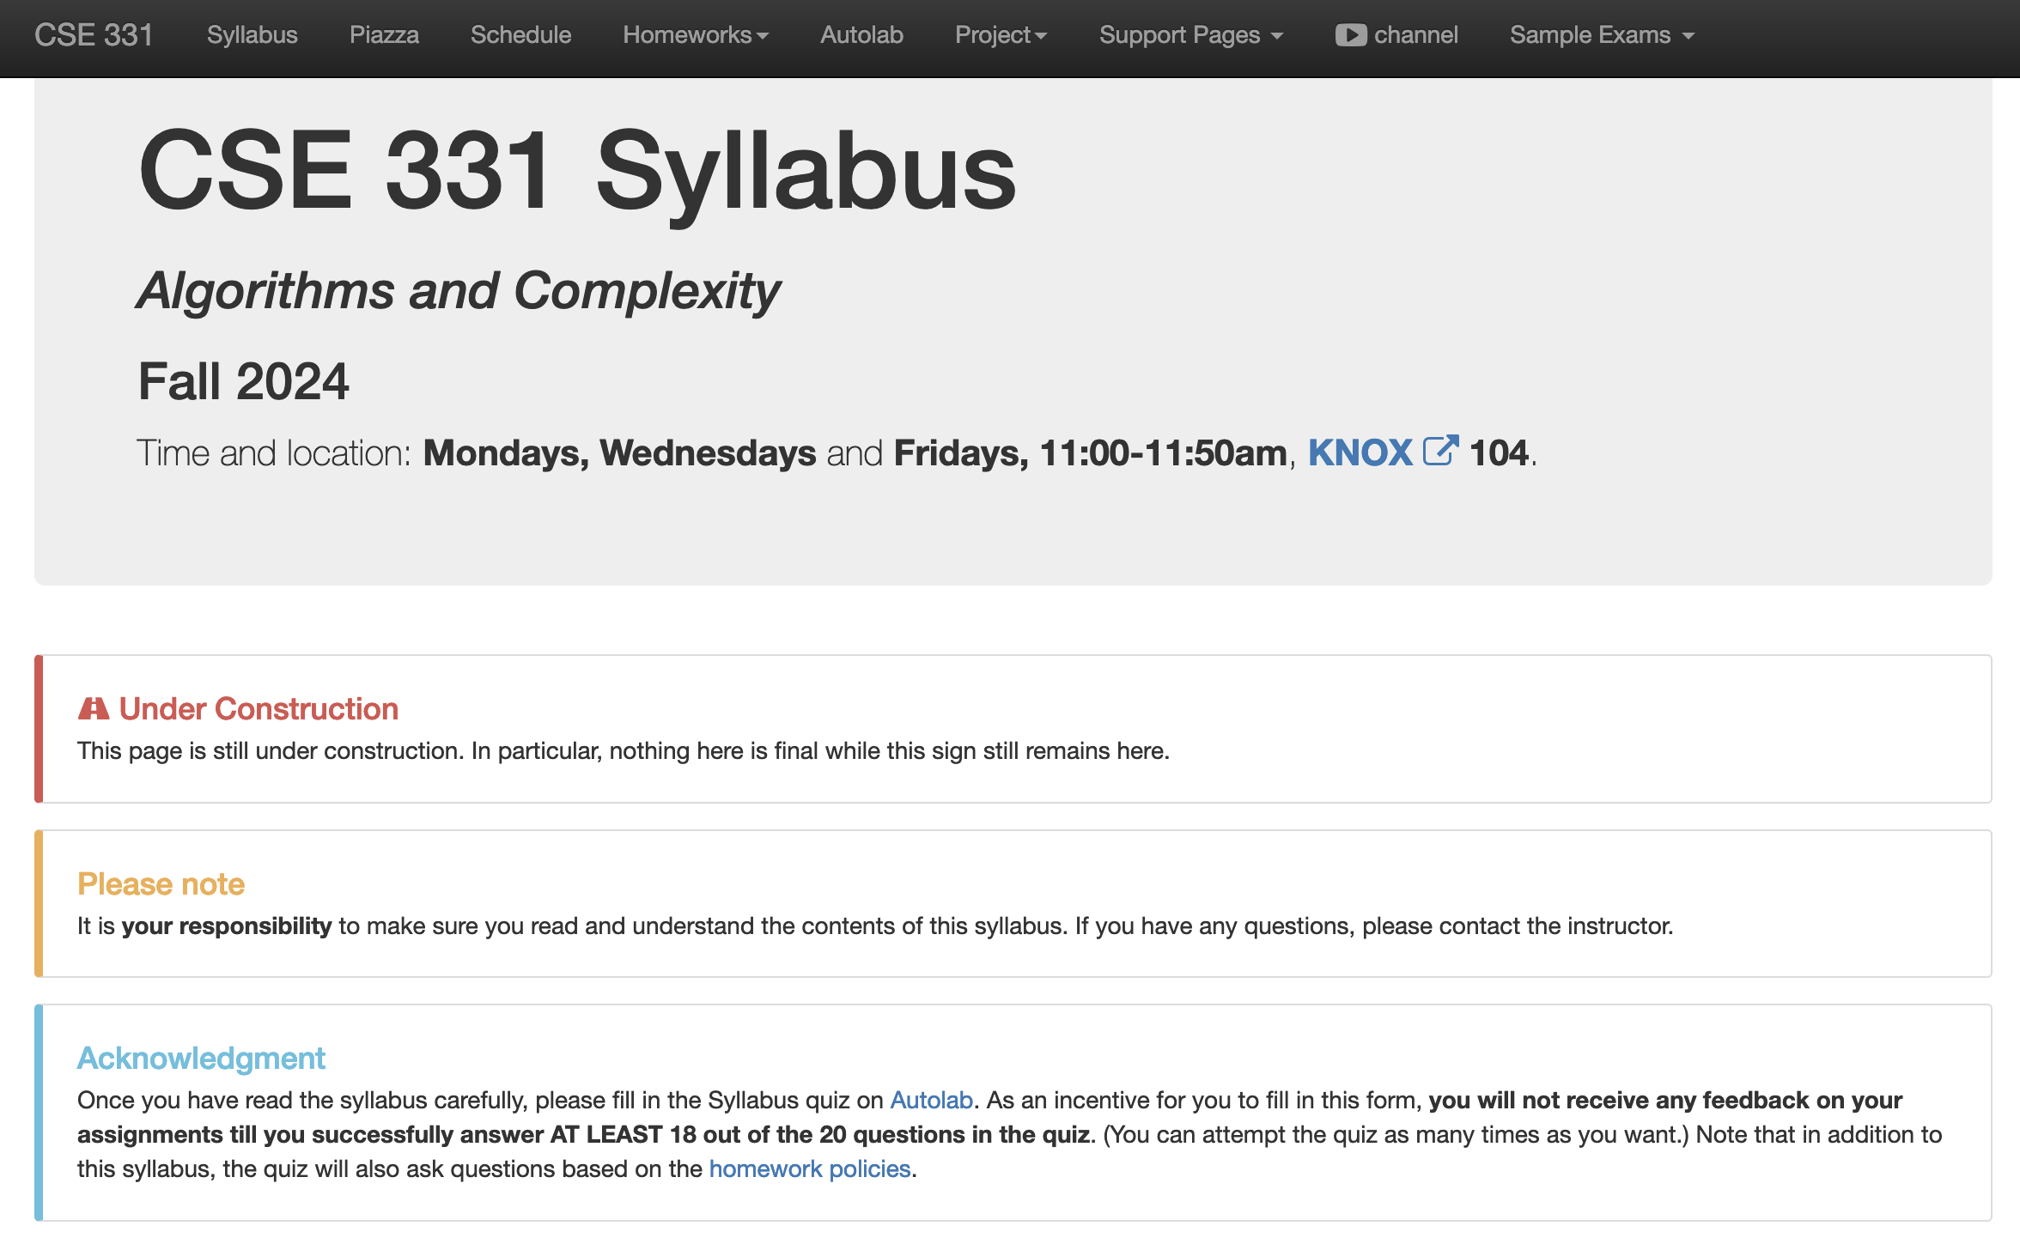
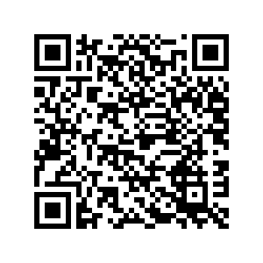
Read the syllabus CAREFULLY!

Slide 4
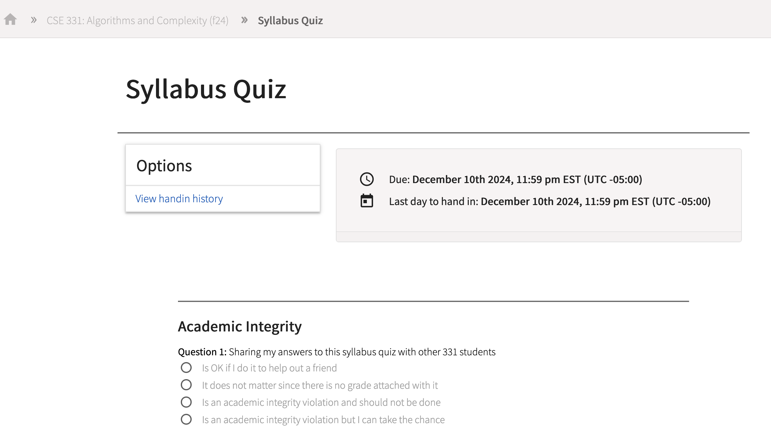
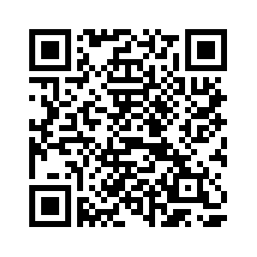
In spirit of trust but verify
No graded material will be handed back until you pass the syllabus quiz!

Slide 5
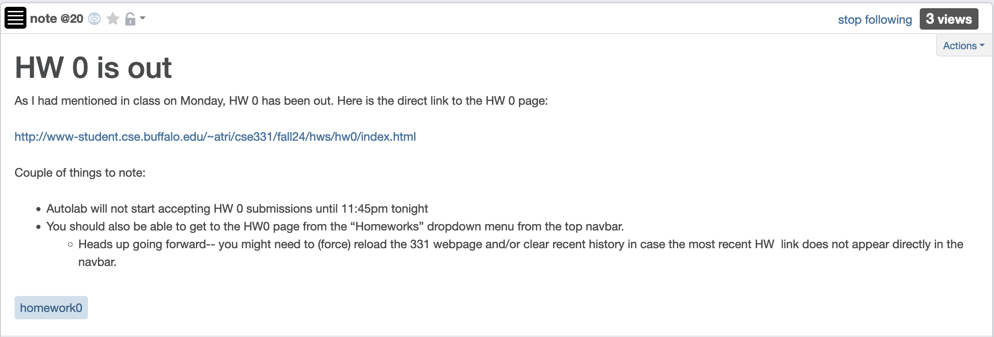
Homework 0 is out

Slide 6
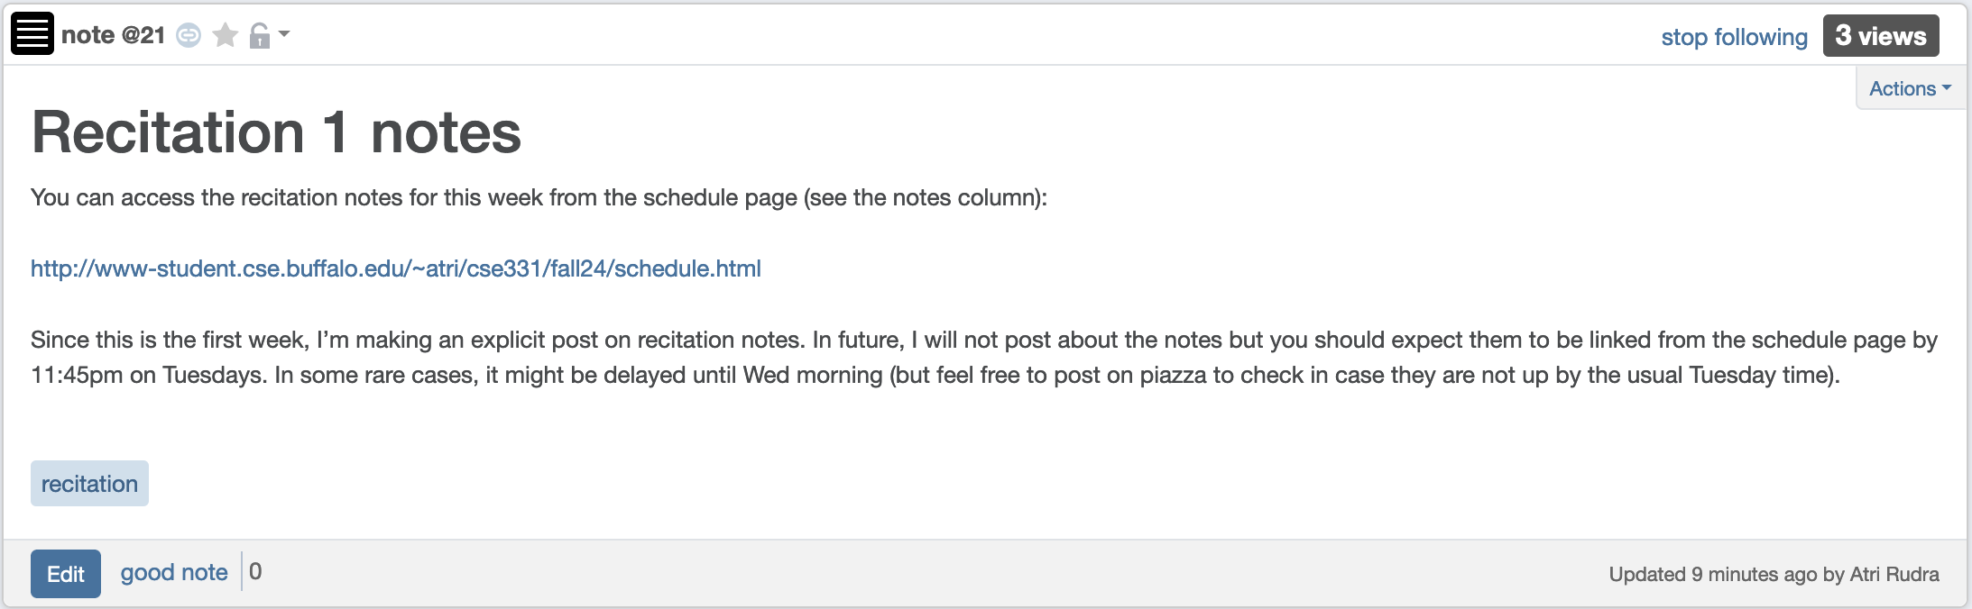
Recitation notes for this week
Recitations start this week!

Slide 7
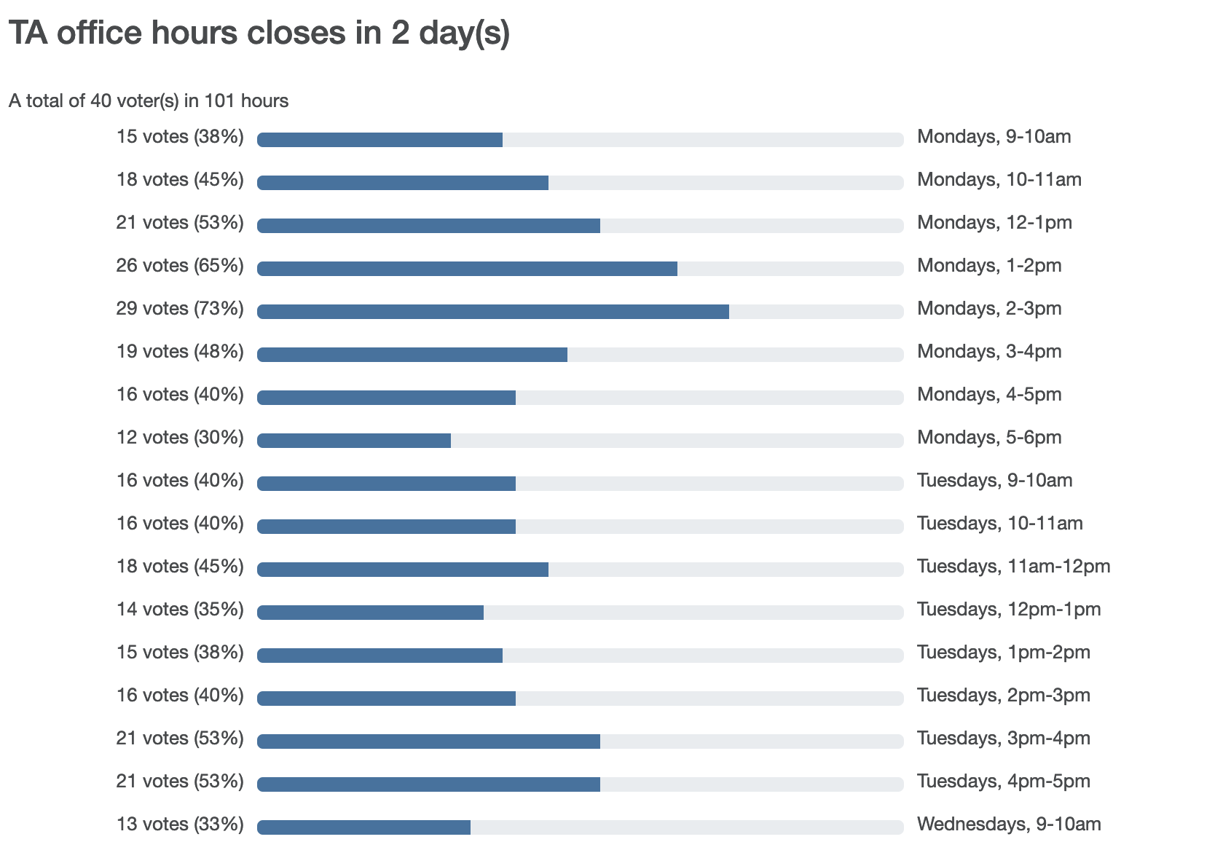
TA Office hours finalized tomorrow

Slide 8
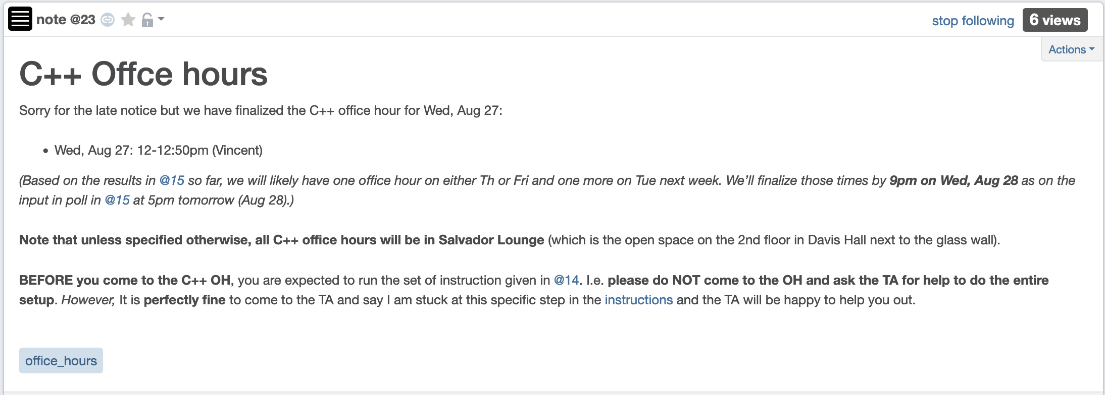
C++ OH times

Slide 9
Mon recap: Halting Problem
Input: A program P
Output: Yes if P terminates on all possible inputs
No otherwise
Let A be a program that solves the Halting problem on all inputs
def add (a,b):
c = a+b
return c
def add (a,b):
c = a+b
return c
A
Yes, if returns some c
on every input (a , b)
def add (a,b):
c = a+b
return c
No, if doesn’t return any c
on some input (a , b)

Slide 10
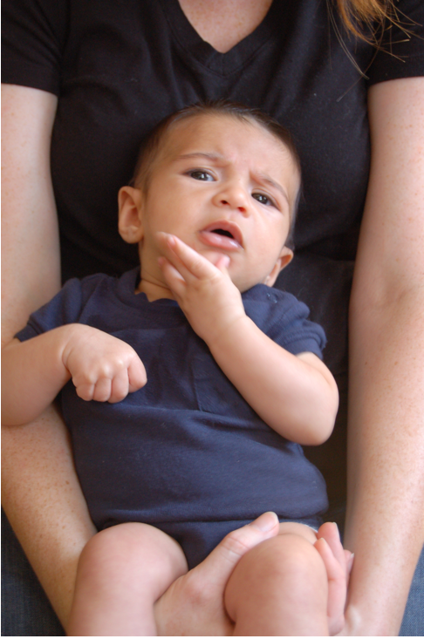
Questions/Comments?

Slide 11
Meta Q: Halting Problem (ver 2)
Input: A program P and input I
Output: Yes if P terminates on I
No otherwise
Let A’ be a program that solves the Halting problem (ver 2)
def add (a,b):
c = a+b
return c
def add (a,b):
c = a+b
return c
A’
Yes, if returns some c
on input (9 , 101)
(9,101)
def add (a,b):
c = a+b
return c
No, if doesn’t return any c
on input (9 , 101)

Slide 12
Halting Problem: ver 1 vs. ver 2
Input: A program P
Input: A program P and input I
Output: Yes if P terminates on all possible inputs
No otherwise
Output: Yes if P terminates on I
No otherwise
Ver 1 is harder than ver 2 (can prove this!)
Theorem: There is no magic box A’ for ver 2 (as long as A’ terminates)

Slide 13
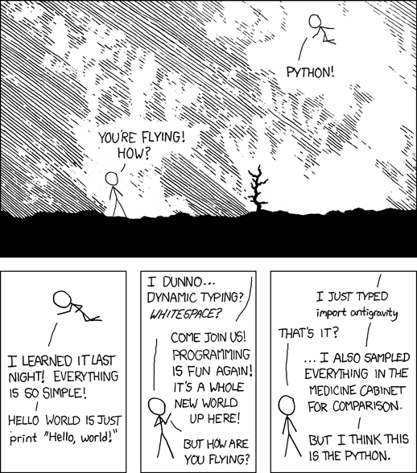
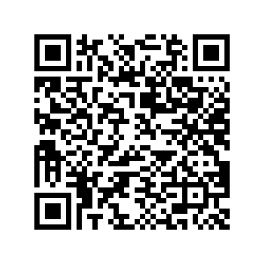
Notebook detour
Let’s define some functions in Python
https://xkcd.com/353/
Notes:
Probably will not have time to do this

Slide 14
Questions?

Slide 15
Next up:
Input: A program P and input I
Output: Yes if P terminates on I
No otherwise
Theorem: There is no magic box A’ for ver 2 (as long as A’ terminates)

Slide 16
Let us assume a magic_box for A’ exists!
def magic_box ( P, I):
# This is a magic box so there is no real code here!
''' Return True if P halts on I and False otherwise'''
Assume that
magic_box terminates on all inputs
magic_box ALWAYS correctly decides if P halts on I or not

Slide 17
A new function contradiction
def contradiction ( P ): # This function takes a program as an input
#Run magic_box on (P,P)
if magic_box (P,P): # Use an UTM to make this call
while True:
pass # Do nothing
return # Just terminate if magic_box(P,P) returns False
Since we assumed magic_box exists contradiction is well defined!

Slide 18
A function call
contradiction (contradiction) # Use an UTM to make this call
Since we assumed contradiction is well defined, the above is a legit function call!

Slide 19
Wait, what?!!!

Slide 20
contradiction (contradiction)
What are outcomes of the function call
contradiction (contradiction)?
It terminates
It does not terminate
Any other possibility?

Slide 21
Case 1:
contradiction (contradiction) terminates
def contradiction ( P ): # This function takes a program as an input
#Run magic_box on (P,P)
if magic_box (P,P): # Use an UTM to make this call
while True:
pass # Do nothing
return # Just terminate if magic_box(P,P) returns False
This does NOT terminate!!
What should this call return?
contradiction (contradiction ):
if magic_box (contradiction, contradiction):
while True:
pass # Do nothing
return
We get into an infinite loop here!

Slide 22
Case 2:
contradiction (contradiction)does not terminate
def contradiction ( P ): # This function takes a program as an input
#Run magic_box on (P,P)
if magic_box (P,P): # Use an UTM to make this call
while True:
pass # Do nothing
return # Just terminate if magic_box(P,P) returns False
This DOES terminate!!
What should this call return?
contradiction (contradiction ):
if magic_box (contradiction, contradiction):
while True:
pass # Do nothing
return
We return here!

Slide 23
Questions?

Slide 24
Let’s recap: Argue magic_box doesn’t exist
This clearly is absurd!!
1. Assume magic_box exists
2. Defined a function contradiction that uses magic_box
3. Looked at the ONLY two possibilities
3.1. contradiction(contradiction) terminates
contradiction(contradiction) does NOT terminate
3.2. contradiction(contradiction) does NOT terminate
contradiction(contradiction) terminates
Which specific step in the above “argument” is wrong?

Slide 25
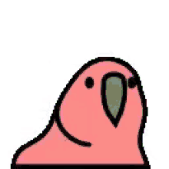
Congrats: You just did your 1st 331 proof!

Slide 26
Questions?

Slide 27
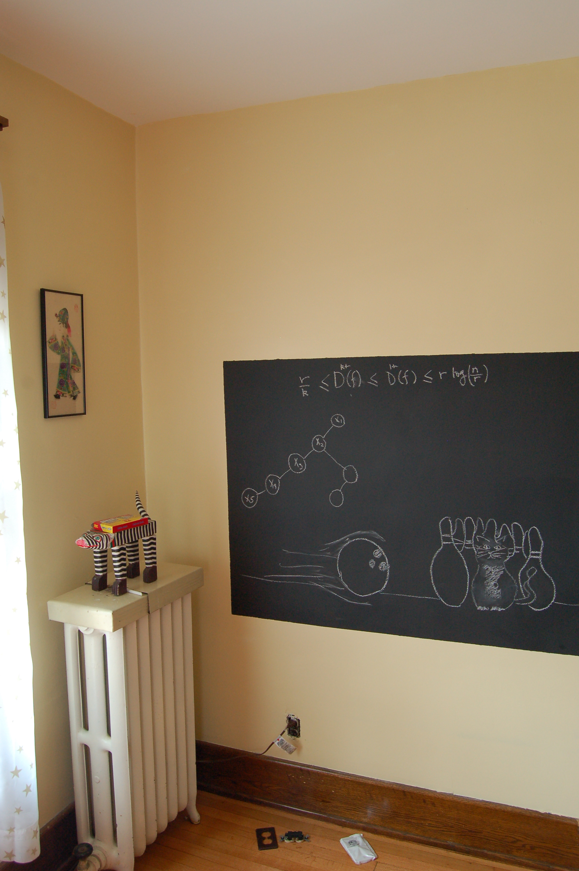
Proof Idea on the board…

