Slide 1
Lecture 20
CSE 331
Oct 18, 2024

Slide 2
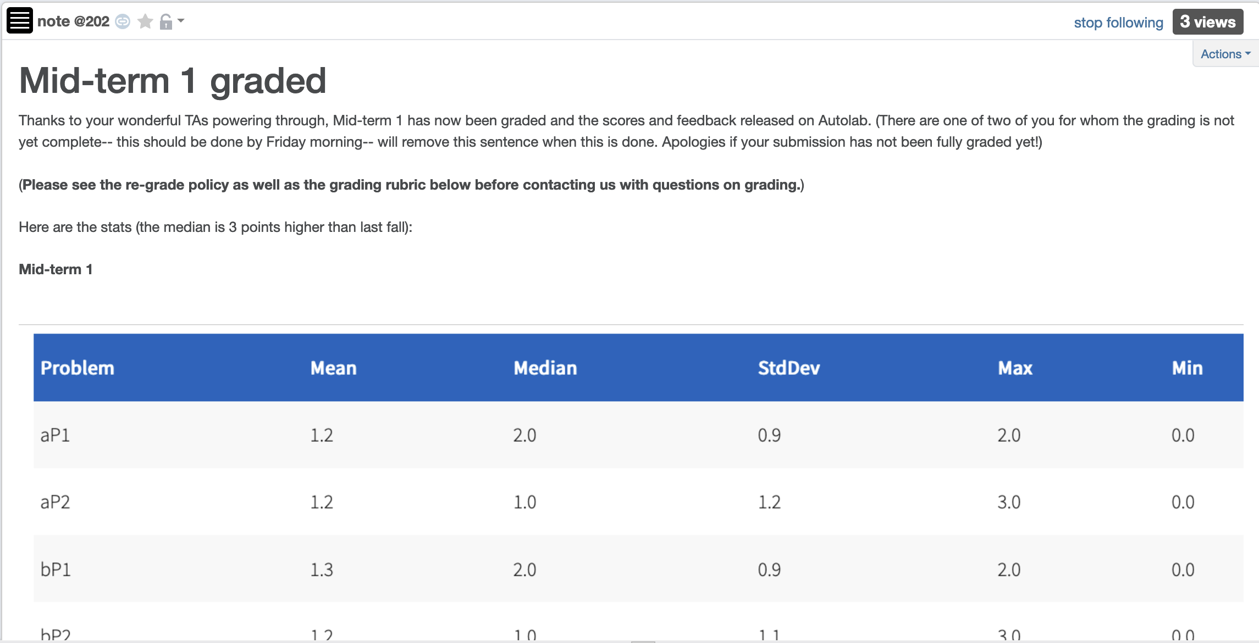
Mid-term 1 graded

Slide 3
Grading timeline
Mid term 2 grading delayed by a day

Slide 4
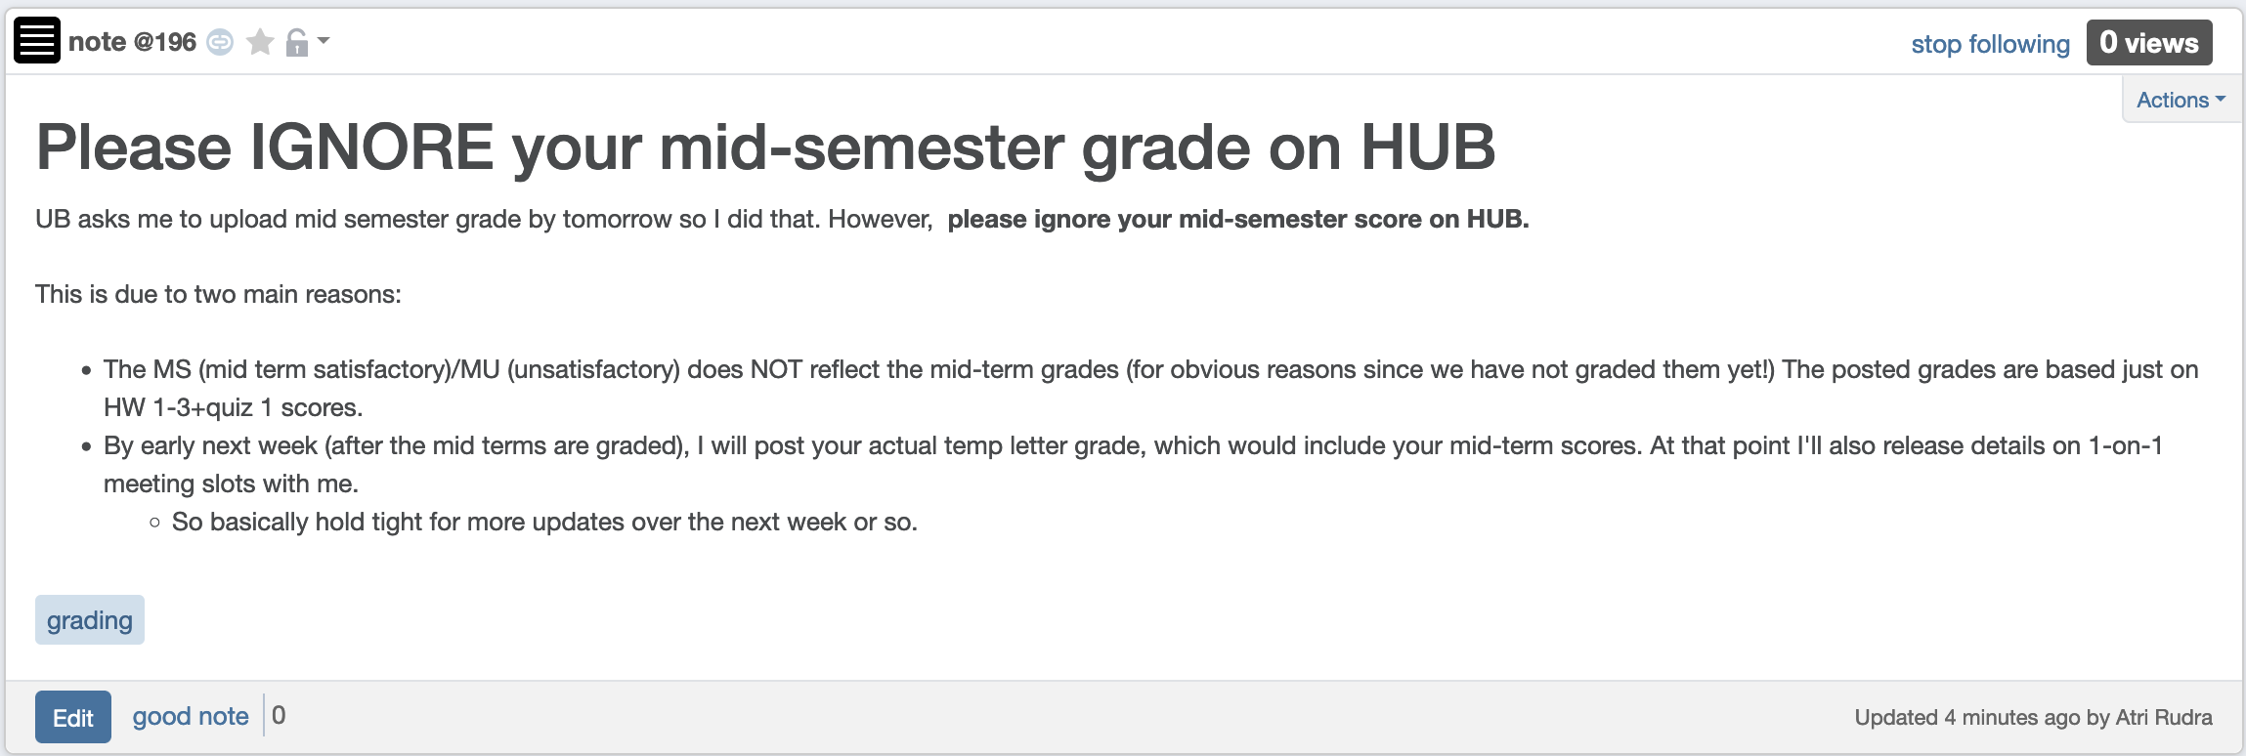
Ignore HUB mid-semester grade

Slide 5
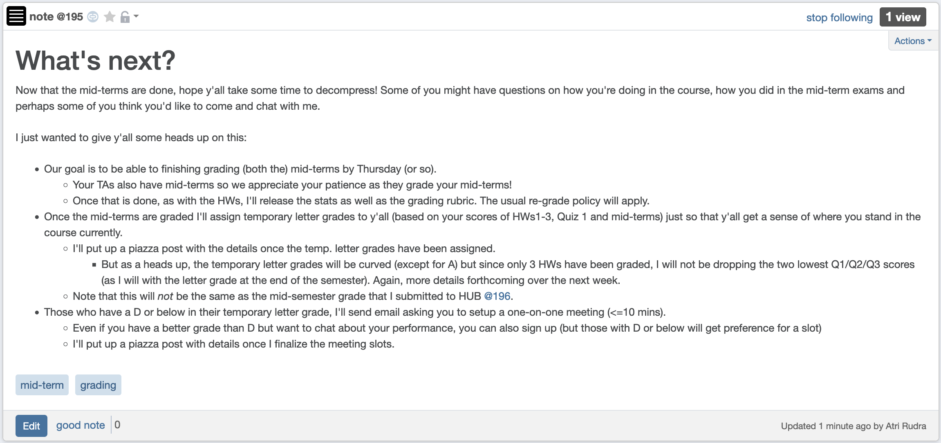
Your actual mid-term letter grade

Slide 6
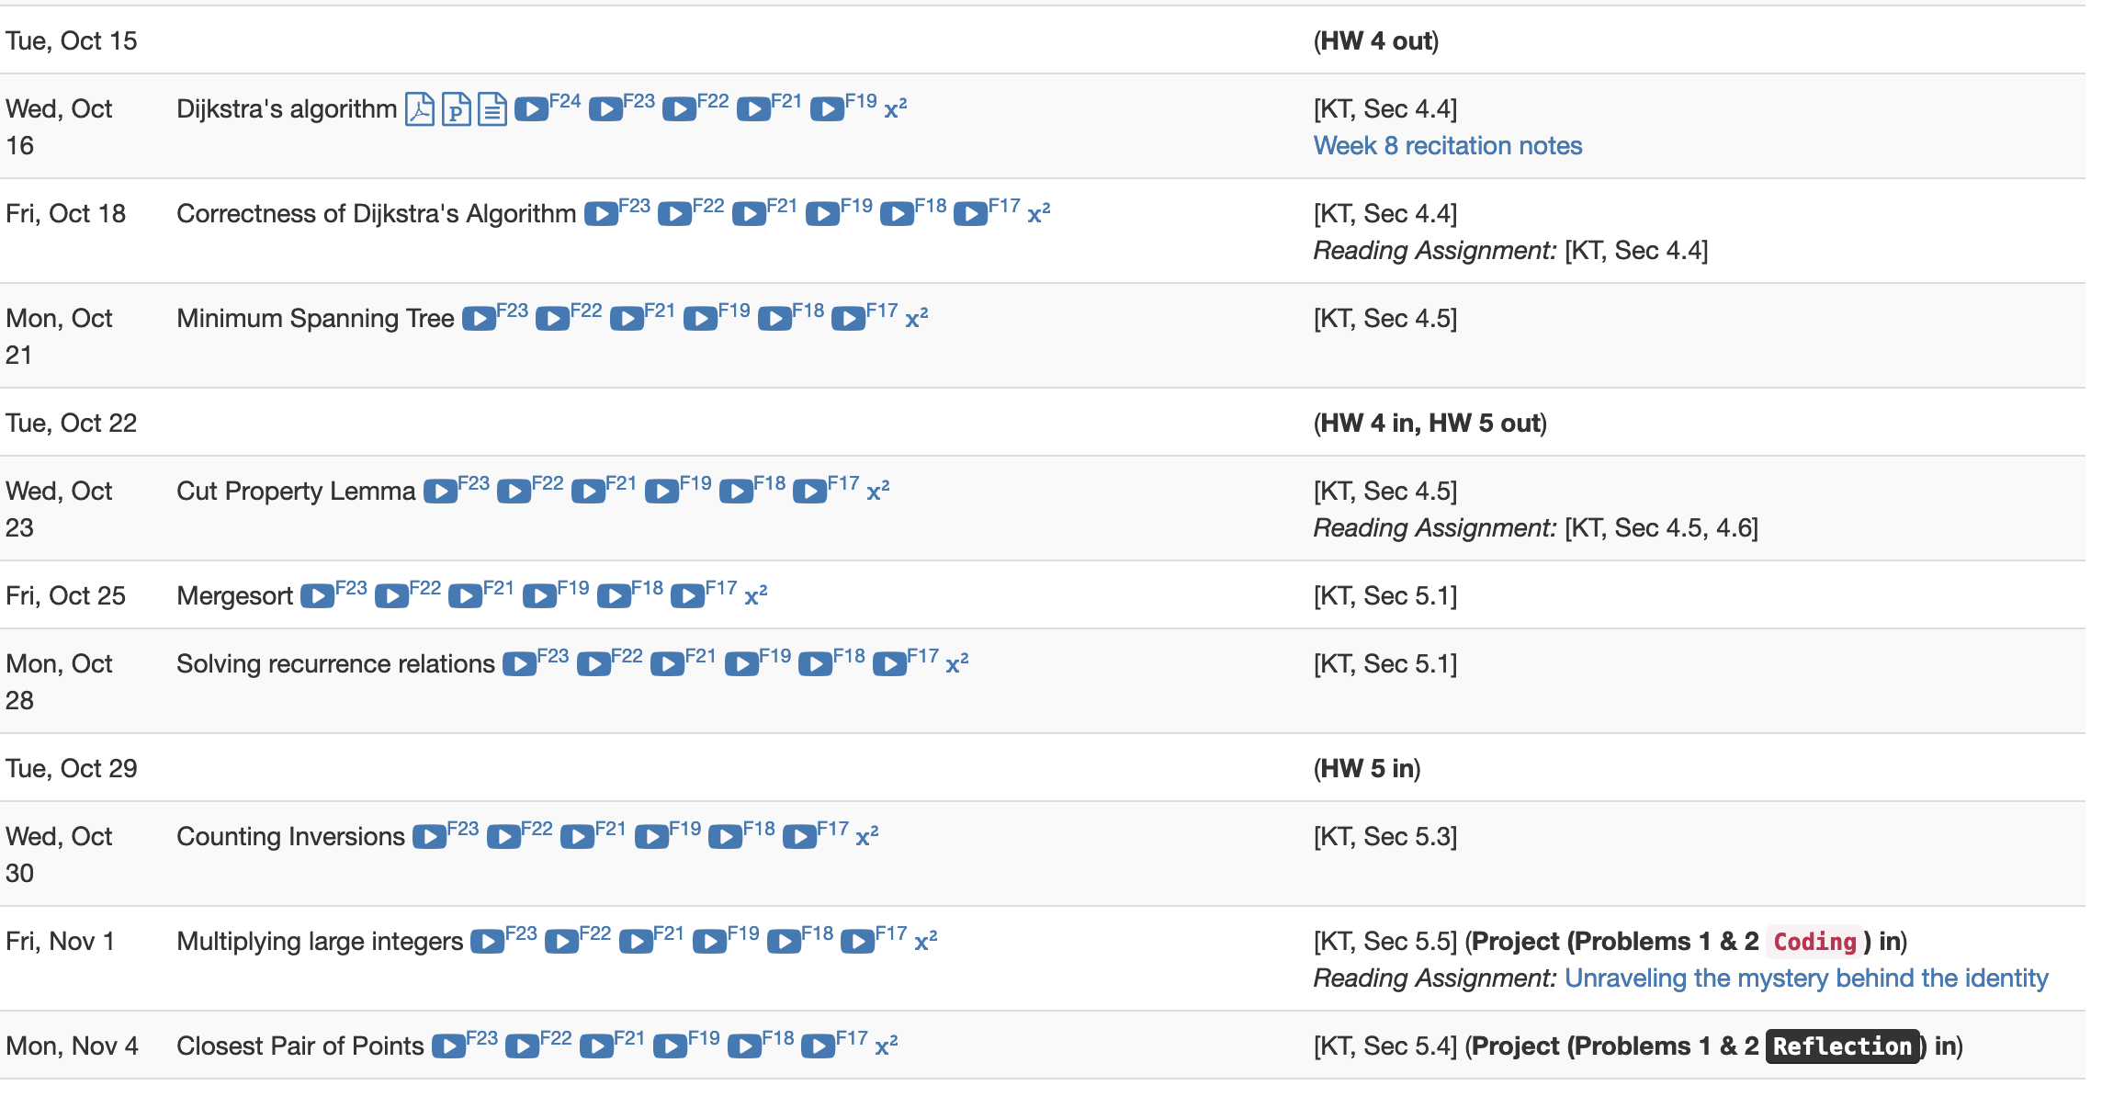
Project deadlines coming up

Slide 7
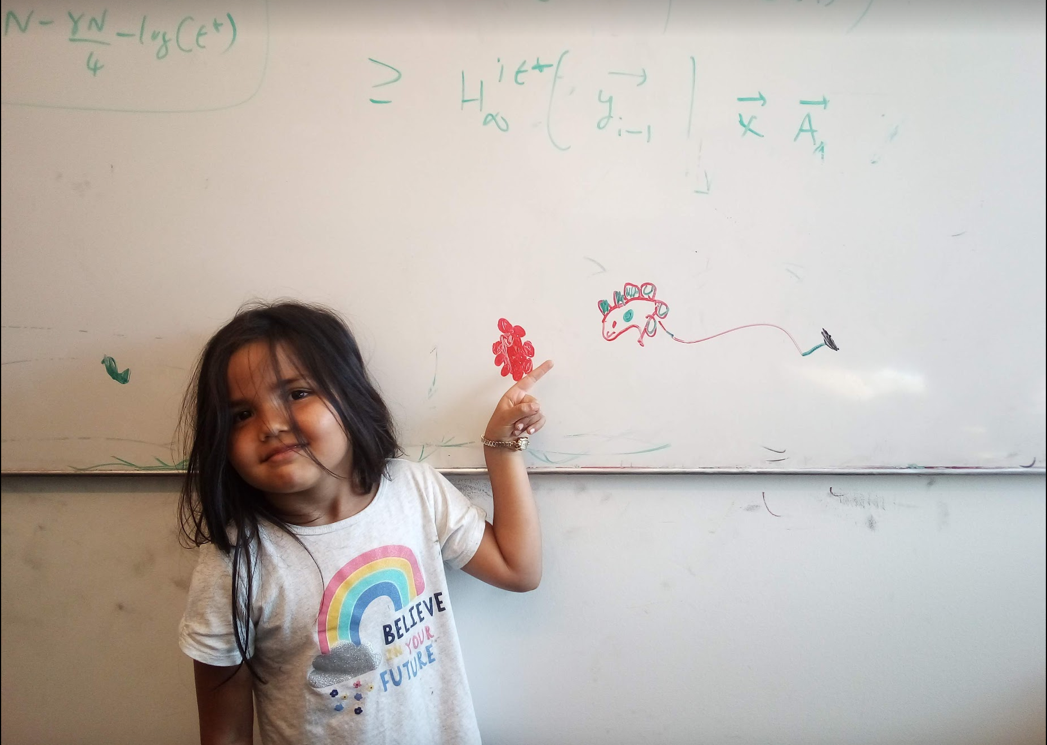
Questions/Comments?

Slide 8


Dijkstra’s shortest path algorithm
1
d’(w) = min _{e=(u,w) in E, u in R} d(u)+ $ℓ$_{e}
3
y
3
u
4
1
1
1
d(s) = 0
d(u) = 1
s
4
x
4
2
d(w) = 2
d(x) = 2
2
2
2
d(y) = 3
d(z) = 4
w
z
5
3
4
2
s
Input: Directed G=(V,E), $ℓ$_{e} ≥ 0, s in V
u
w
R = {s}, d(s) =0
Shortest paths
While there is a x not in R with (u,x) in E, u in R
x
Pick w that minimizes d’(w)
Add w to R
y
z
d(w) = d’(w)

Slide 9
Questions/Comments?

Slide 10
Couple of remarks
The Dijkstra’s algo does not explicitly compute the shortest paths
Can maintain “shortest path tree” separately
Dijkstra’s algorithm does not work with negative weights
Left as an exercise

Slide 11
Rest of Today’s agenda
Prove the correctness of Dijkstra’s Algorithm

Slide 12


Dijkstra’s shortest path algorithm
d’(w) = min _{e=(u,w) in E, u in R} d(u)+$ℓ$_{e}
P_{u} shortest s-u path in “Dijkstra tree”
Input: Directed G=(V,E), $ℓ$_{e} ≥ 0, s in V
R = {s}, d(s) =0
While there is a x not in R with (u,x) in E, u in R
Pick w that minimizes d’(w)
Add w to R
d(w) = d’(w)
Lemma 1: At end of each iteration, if u in R, then P_{u} is a shortest s-u path
Lemma 2: If u is connected to s, then u in R at the end

Slide 13
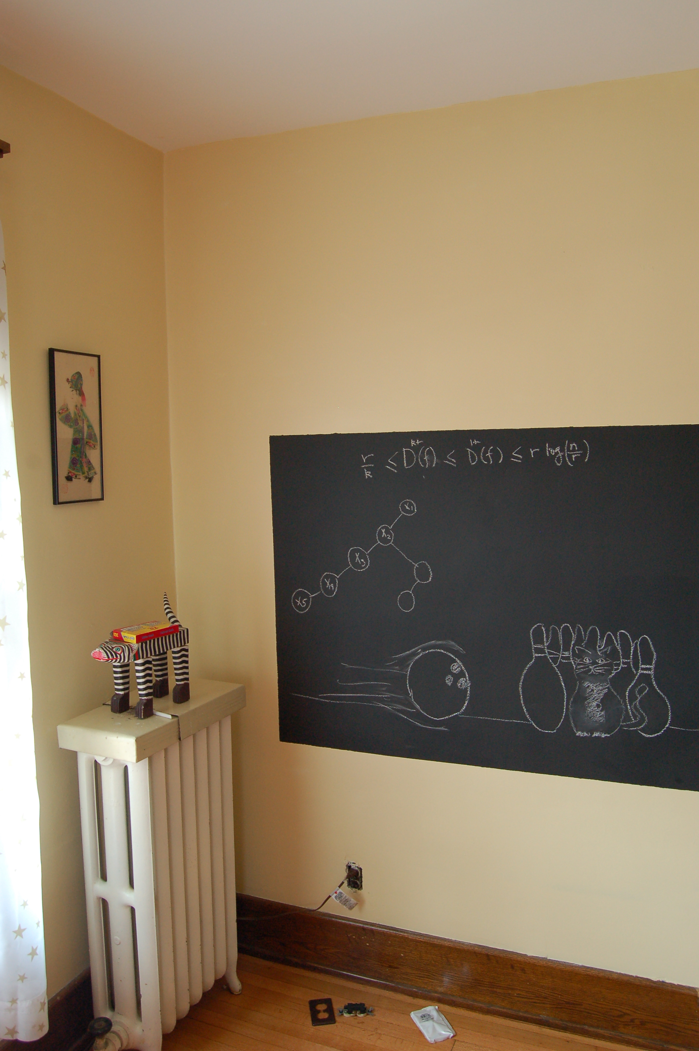
Proof idea of Lemma 1

Slide 14
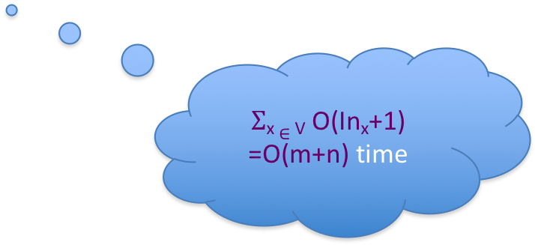
Dijkstra’s shortest path algorithm
d’(w) = min _{e=(u,w) in E, u in R} d(u)+$ℓ$_{e}
Input: Directed G=(V,E), $ℓ$_{e} ≥ 0, s in V
R = {s}, d(s) =0
While there is a x not in R with (u,x) in E, u in R
At most n iterations
Pick w that minimizes d’(w)
Add w to R
d(w) = d’(w)
O((m+n)n) time bound is trivial
O((m+n) log n) time implementation with priority Q

Slide 15

Reading Assignment
Sec 4.4 of [KT]

