Slide 1
Lecture 21
CSE 331
Oct 21, 2024

Slide 2
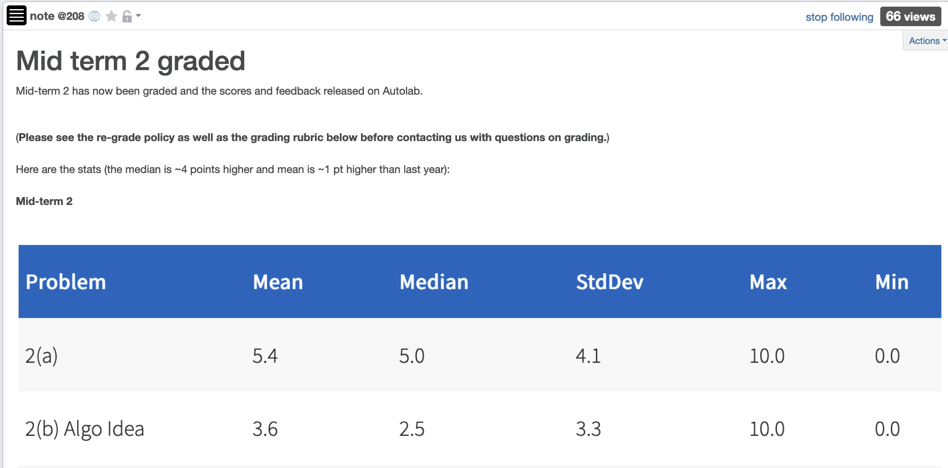
Mid-term 2 graded

Slide 3
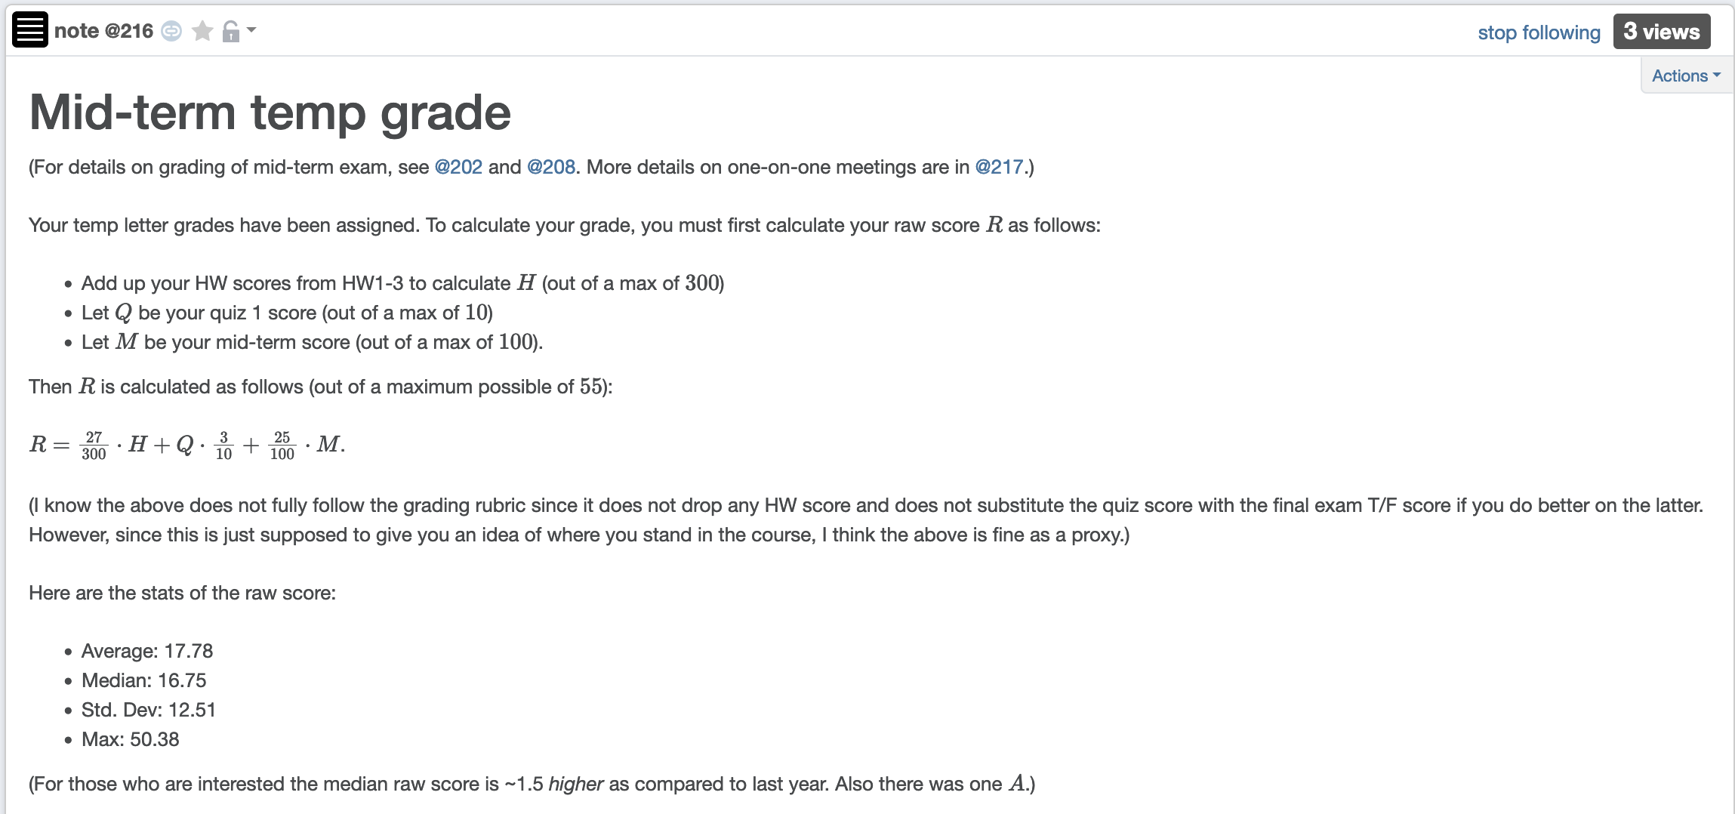
Temp mid-term grade assigned

Slide 4
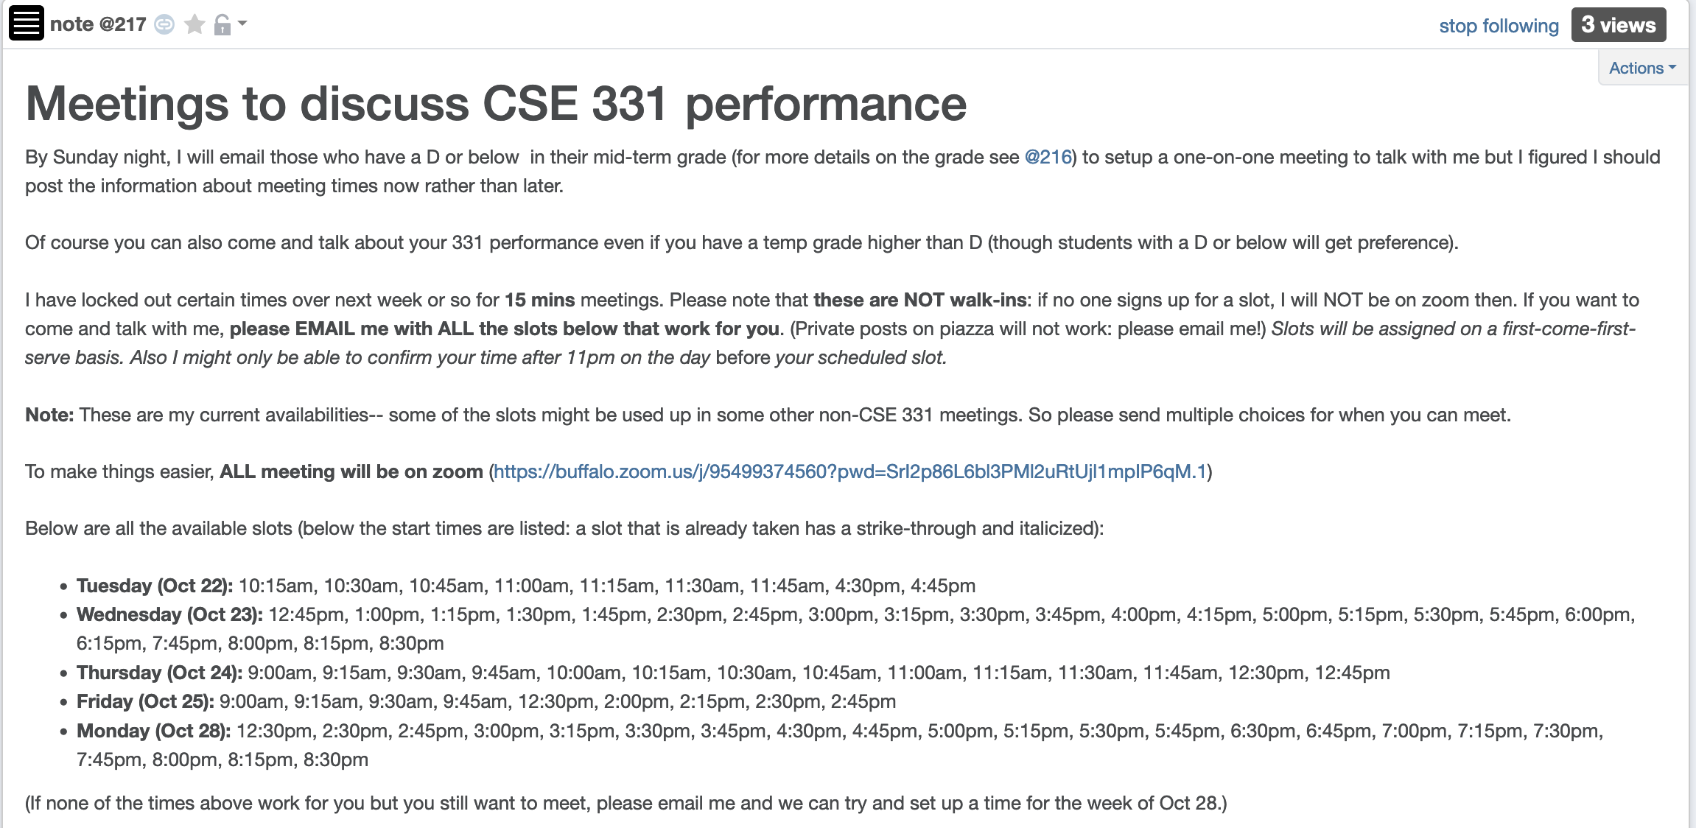
Details on 1-on-1 meetings

Slide 5
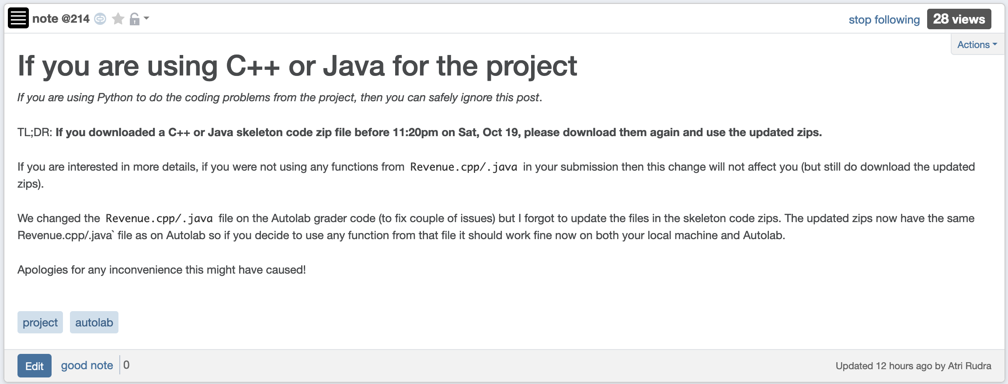
C++/Java project zips

Slide 6
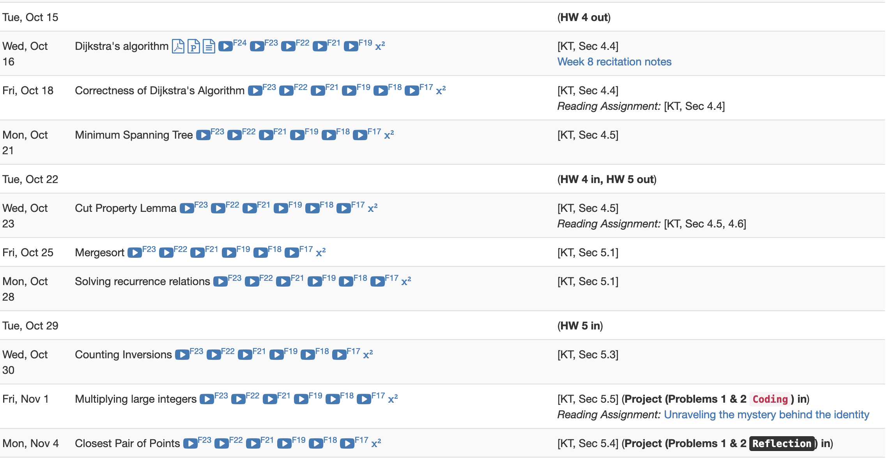
Project deadlines coming up

Slide 7
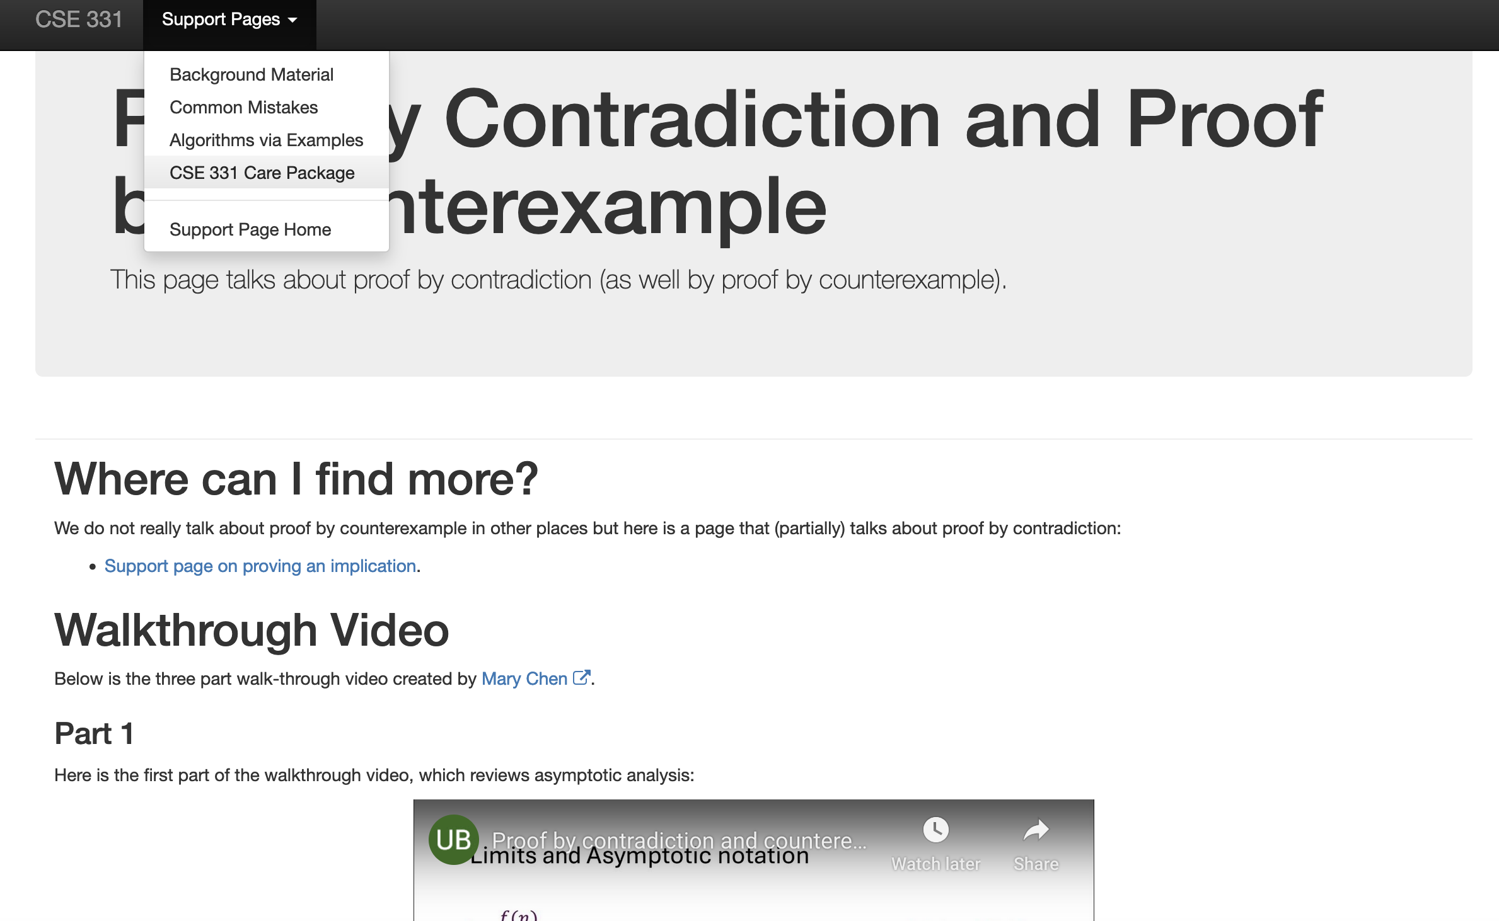
New walkthrough videos up

Slide 8
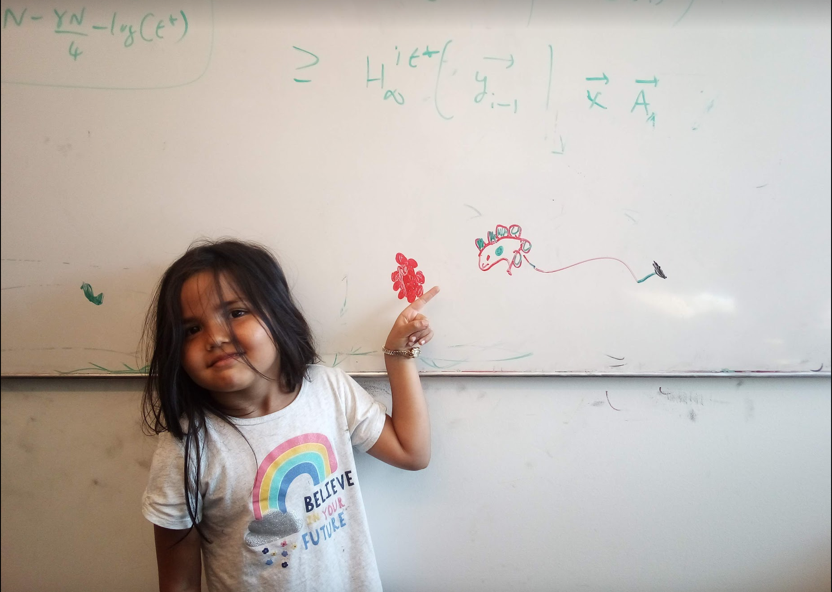
Questions/Comments?

Slide 9
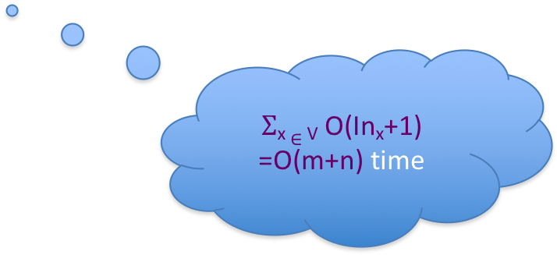


Dijkstra’s shortest path algorithm
d’(w) = min _{e=(u,w) in E, u in R} d(u)+$ℓ$_{e}
Input: Directed G=(V,E), $ℓ$_{e} ≥ 0, s in V
R = {s}, d(s) =0
While there is a x not in R with (u,x) in E, u in R
At most n iterations
Pick w that minimizes d’(w)
Add w to R
d(w) = d’(w)
O((m+n)n) time bound is trivial
O((m+n) log n) time implementation with priority Q

Slide 10
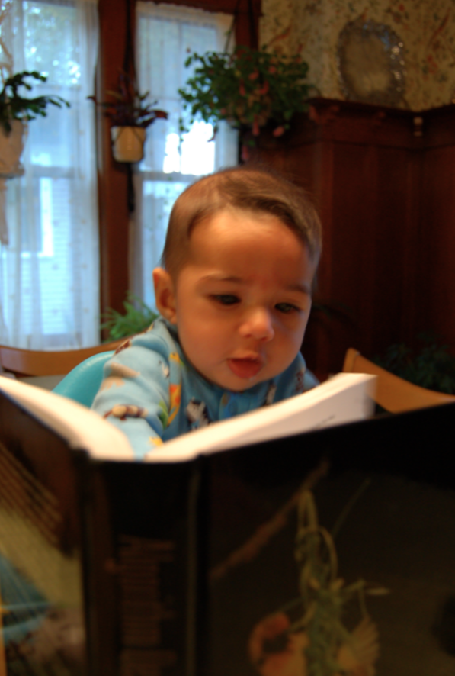
Reading Assignment
Sec 4.4 of [KT]

Slide 11
Questions/Comments?

Slide 12
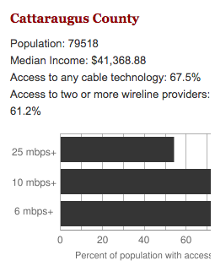
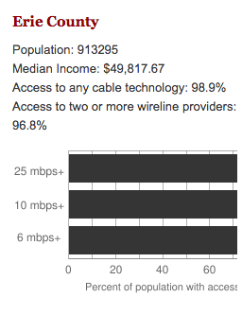
Make broadband more available
BOTH technical and societal issues
Say you are tasked to come up with the infrastructure

Slide 13
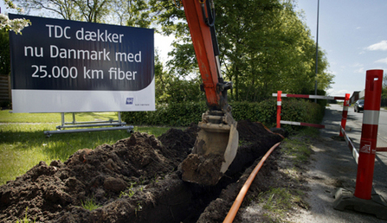
Building a fiber network
Lay down fibers to connect n locations
All n locations should be connected
Laying down a fiber costs money
What is the cheapest way to lay down the fibers?

Slide 14
Today’s agenda
Minimum Spanning Tree (MST) Problem
Greedy algorithm(s) for MST problem

Slide 15
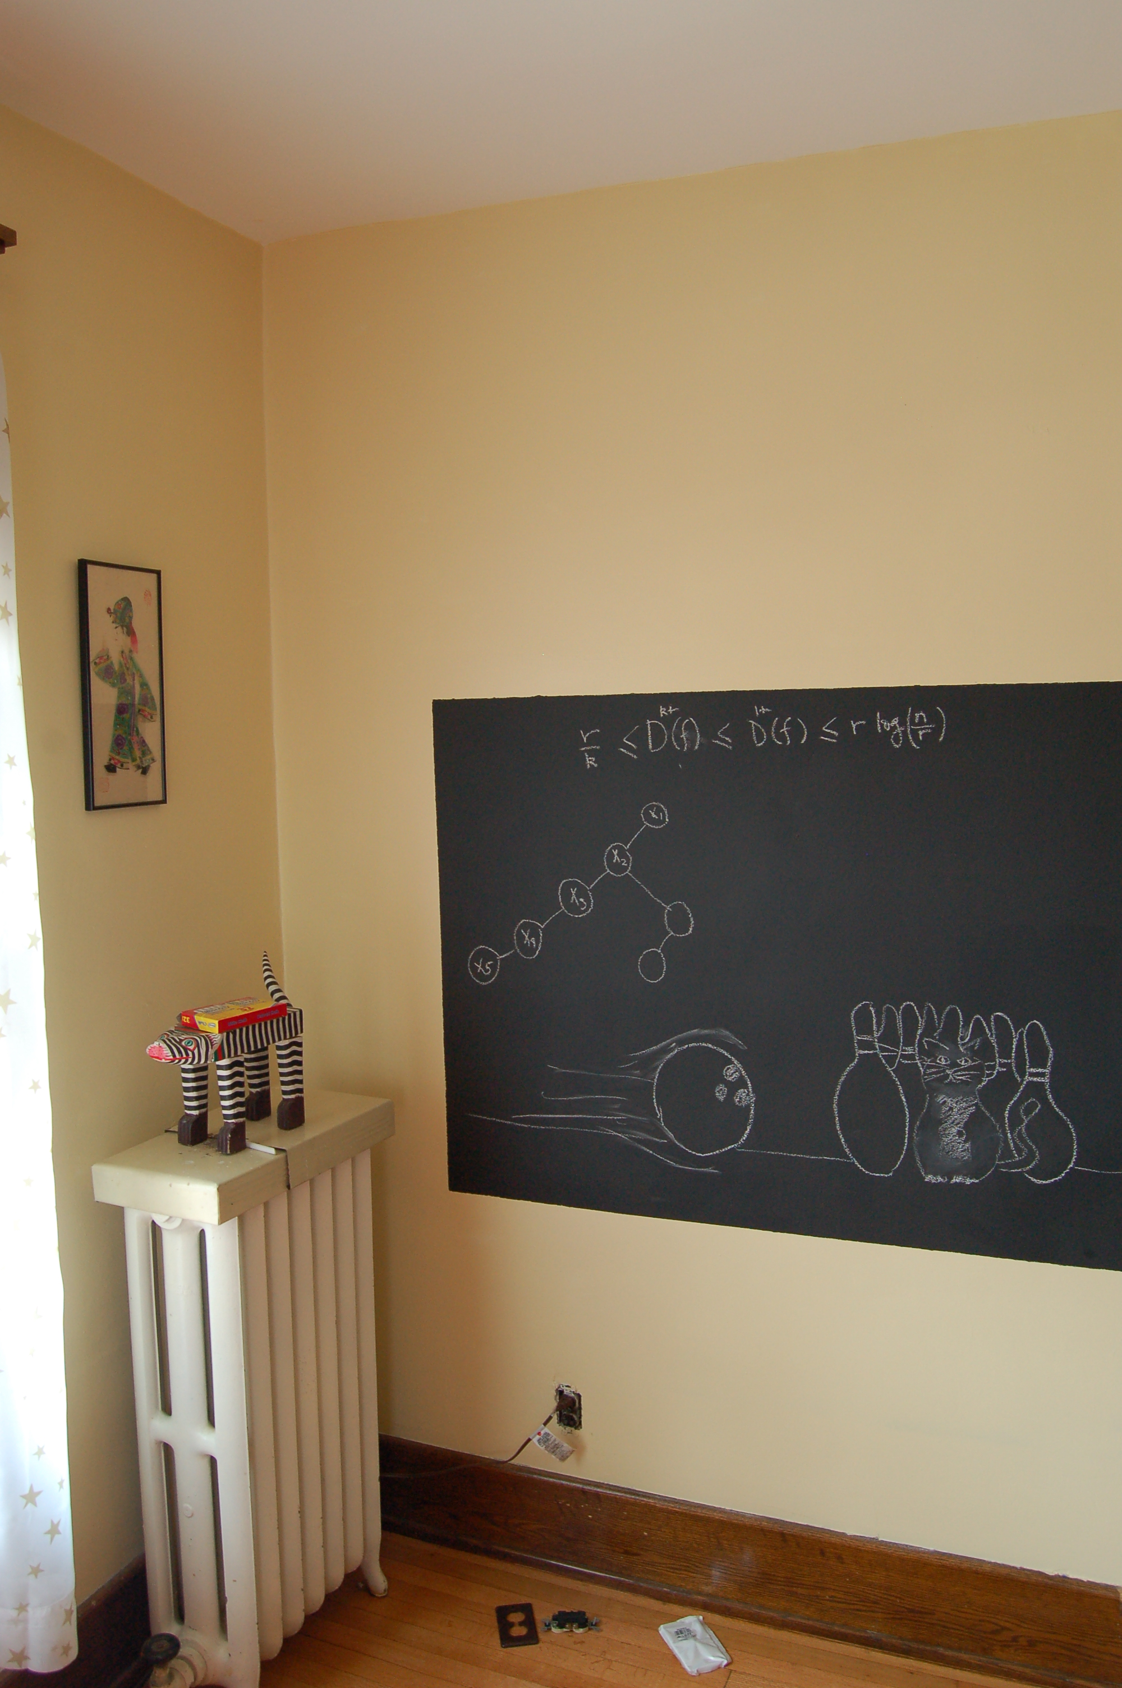
On to the board…

Slide 16
Minimum Spanning Tree Problem
Input: Undirected, connected G = (V,E), edge costs c_{e}
Output: Subset E’ ⊆ E, s.t. T = (V,E’) is connected
C(T) is minimized
If all c_{e} > 0, then T is indeed a tree

Slide 17
Rest of today’s agenda
Greedy algorithm(s) for MST problem

Slide 18

Discuss: Greedy algorithm!

Slide 19
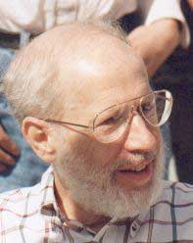
Kruskal’s Algorithm
Input: G=(V,E), c_{e}> 0 for every e in E
T = Ø
Sort edges in increasing order of their cost
Joseph B. Kruskal
Consider edges in sorted order
If an edge can be added to T without adding a cycle then add it to T

Slide 20
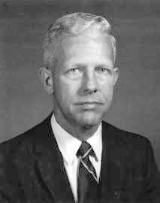
Prim’s algorithm
Similar to Dijkstra’s algorithm
2
0.5
1
3
50
51
Robert Prim
2
0.5
Input: G=(V,E), c_{e}> 0 for every e in E
S = {s}, T = Ø
1
50
While S is not the same as V
Among edges e= (u,w) with u in S and w not in S, pick one with minimum cost
Add w to S, e to T

Slide 21
Reverse-Delete Algorithm
2
0.5
1
3
50
51
Input: G=(V,E), c_{e}> 0 for every e in E
2
0.5
T = E
1
3
50
Sort edges in decreasing order of their cost
51
Consider edges in sorted order
If an edge can be removed T without disconnecting T then remove it

Slide 22
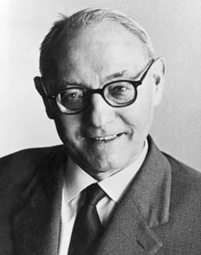
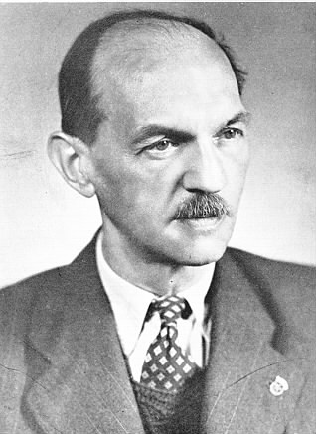
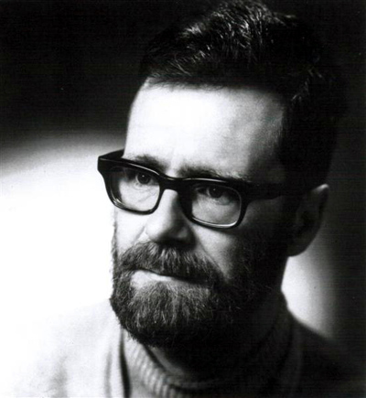
(Old) History of MST algorithms
1920: Otakar Borůvka
1930: Vojtěch Jarník
Same algo!
1956: Kruskal
1957: Prim
1959: Dijkstra

