Slide 1
Lecture 26
CSE 331
Nov 1, 2024

Slide 2
Coding Project 1+2 due TODAY

Slide 3
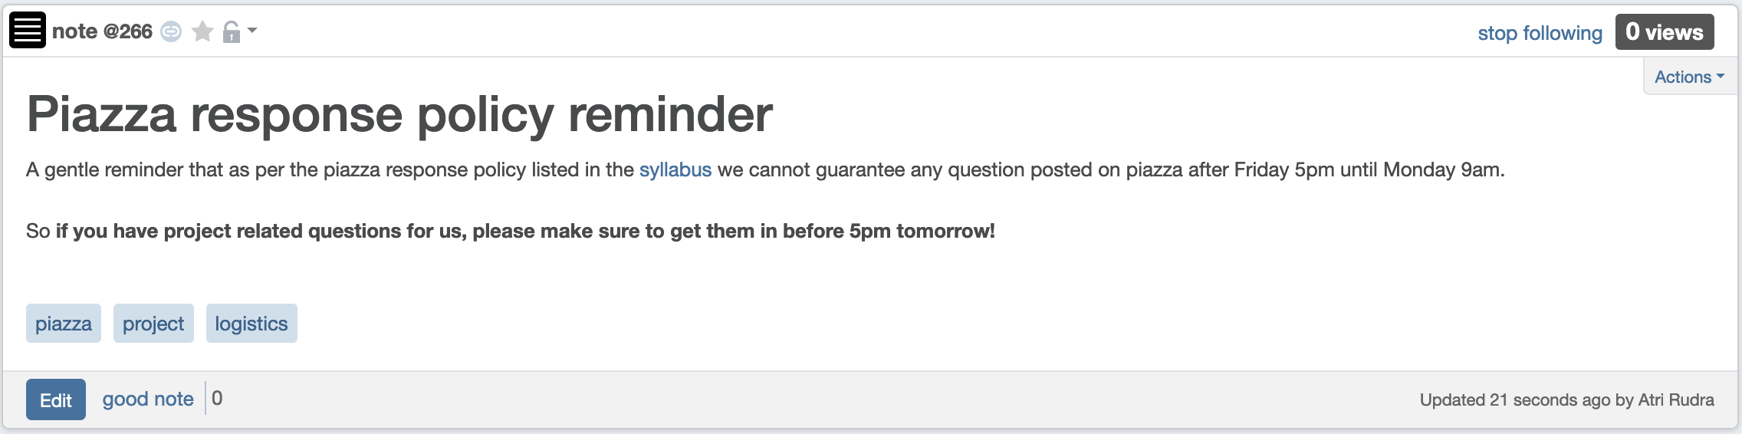
Get your piazza Qs in by 5pm!

Slide 4
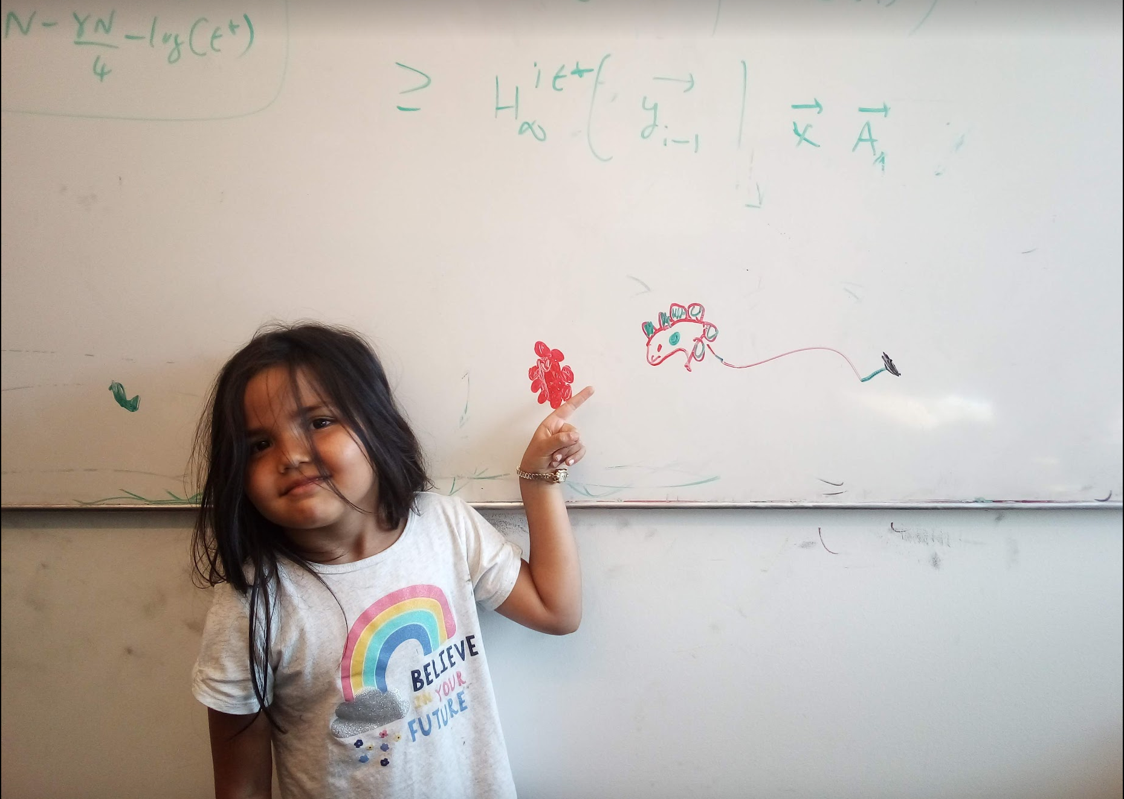
Questions/Comments?

Slide 5
Divide and Conquer
Divide up the problem into at least two sub-problems
Recursively solve the sub-problems
“Patch up” the solutions to the sub-problems for the final solution

Slide 6
Improvements on a smaller scale
Greedy algorithms: exponential → poly time
(Typical) Divide and Conquer: O(n²) → asymptotically smaller running time

Slide 7
Multiplying two numbers
Given two numbers a and b in binary
a=(a_{n-1},..,a₀) and b = (b_{n-1},…,b₀)
Elementary school algorithm is O(n²)
Compute c = a x b

Slide 8
The current algorithm scheme
Shift by O(n) bits
Adding O(n) bit numbers
Mult over n bits
a • b = a^{L}b^{L} •2^{2[n/2]} + (a^{L}b^{R}+a^{R}b^{L})•2^{[n/2]} + a^{R}b^{R}
Multiplication over n/2 bit inputs
T(n) is O(n²)
T(n) ≤ 4T(n/2) + cn
T(1) ≤ c

Slide 9
The key identity
a^{L}b^{R}+a^{R}b^{L}= (a^{L}+a^{R})(b^{L}+b^{R}) - a^{L}b^{L} - a^{R}b^{R}

Slide 10
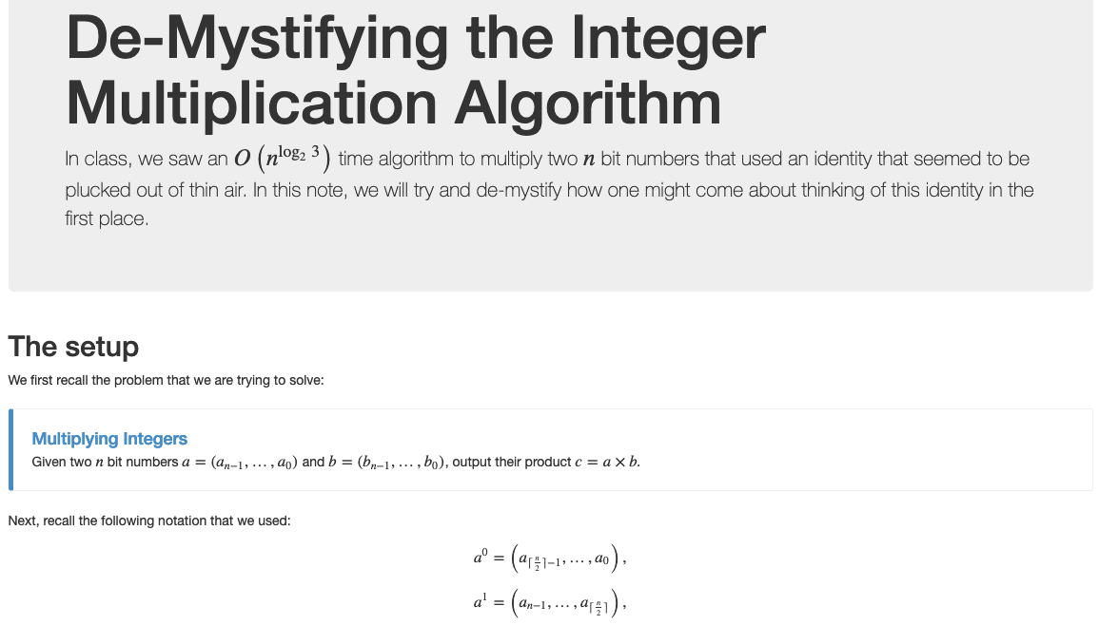
Wait, how do you think of that?

Slide 11
The final algorithm
Input: a = (a_{n-1},..,a₀) and b = (b_{n-1},…,b₀)
T(1) ≤ c
Mult (a, b)
If n = 1 return a₀b₀
T(n) ≤ 3T(n/2) + cn
a^{L} = a_{n-1},…,a_{[n/2]} and a^{R} = a_{[n/2]-1},…, a₀
O(n^{log}₂ ³) = O(n^{1.59})
run time
Compute b^{L} and b^{R} from b
x = a^{L} + a^{R} and y = b^{L} + b^{R}
Let p = Mult (x, y), D = Mult (a^{L}, b^{L}), E = Mult (a^{R}, b^{R})
All green operations
are O(n) time
F = p - D - E
return D • 2^{2[n/2]} + F • 2^{[n/2]} + E
a • b = a^{L}b^{L} •2^{2[n/2]} +( (a^{L}+a^{R})(b^{L}+b^{R}) – a^{L}b^{L} - a^{R}b^{R} ) •2^{[n/2]} + a^{R}b^{R}

