Slide 1
Lecture 28
CSE 331
Nov 6, 2024

Slide 2
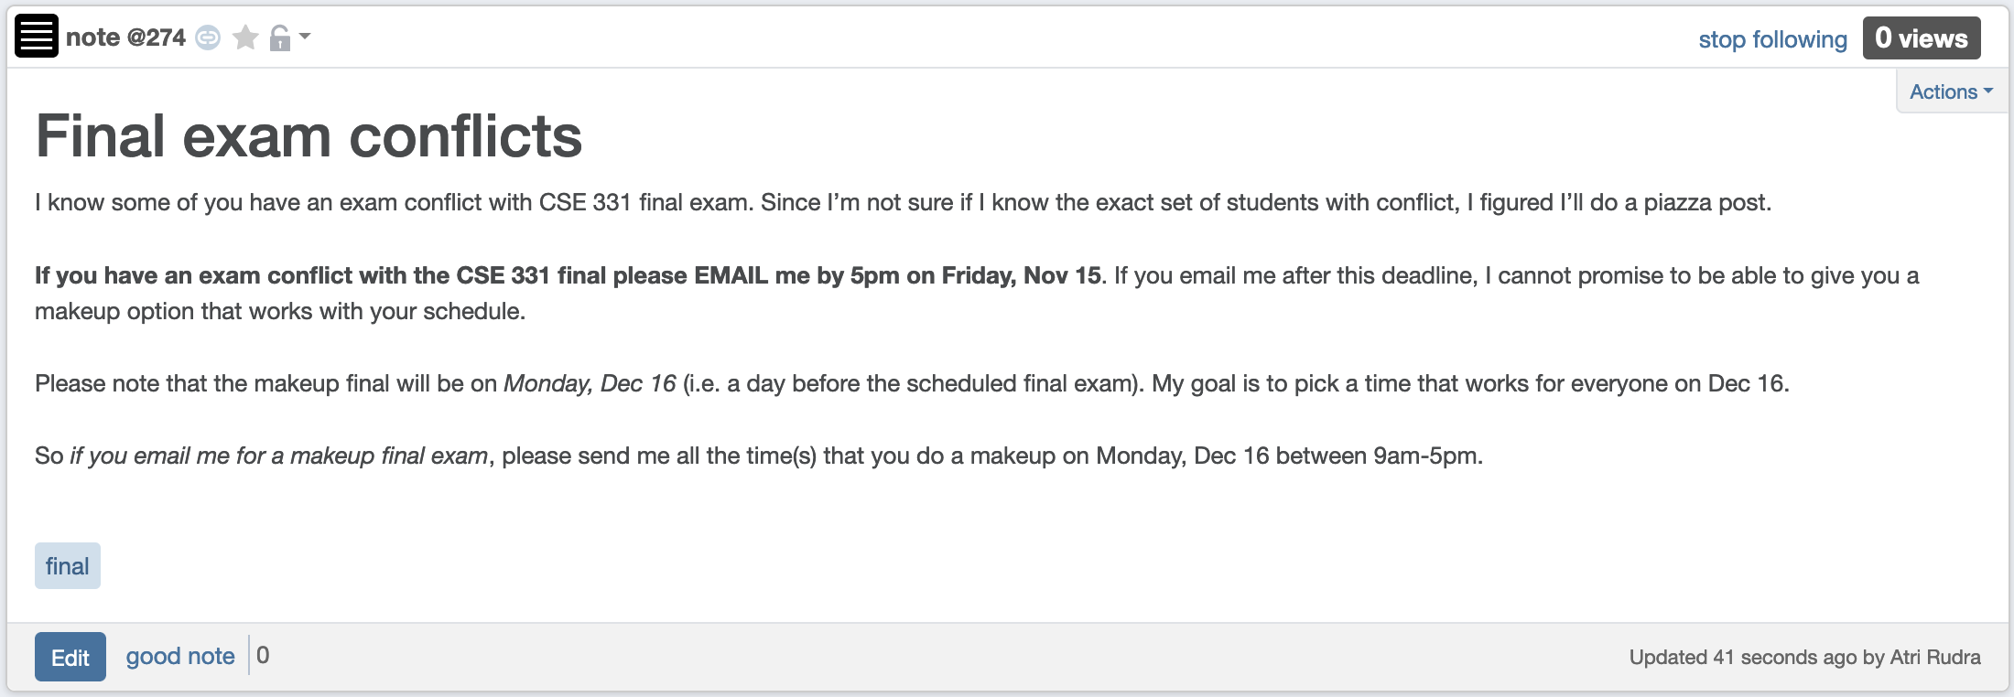
Final exam conflict

Slide 3
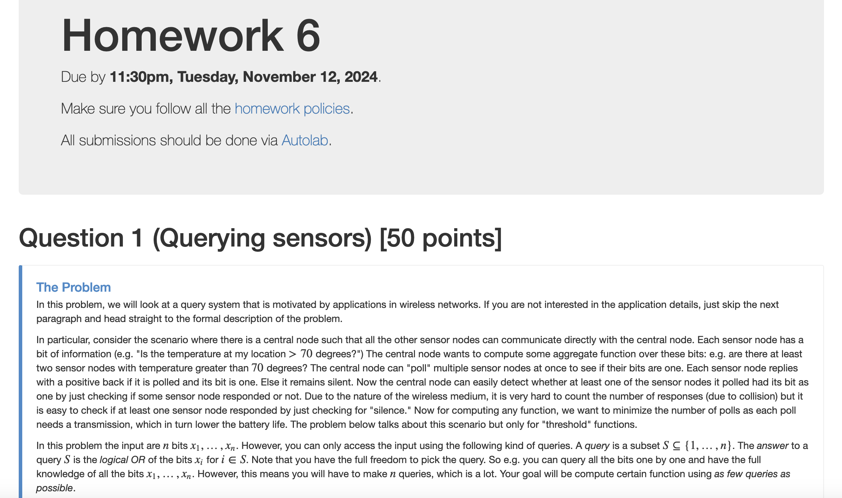
HW 6 is out

Slide 4
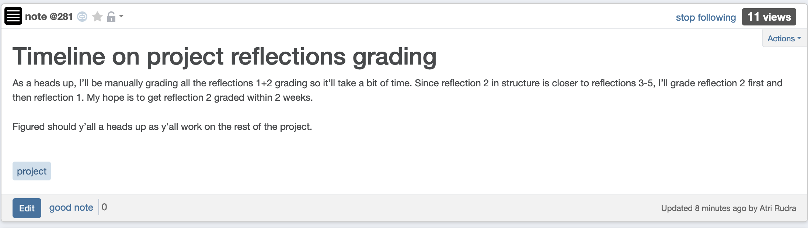
Reflections 2+1 grading timeline

Slide 5
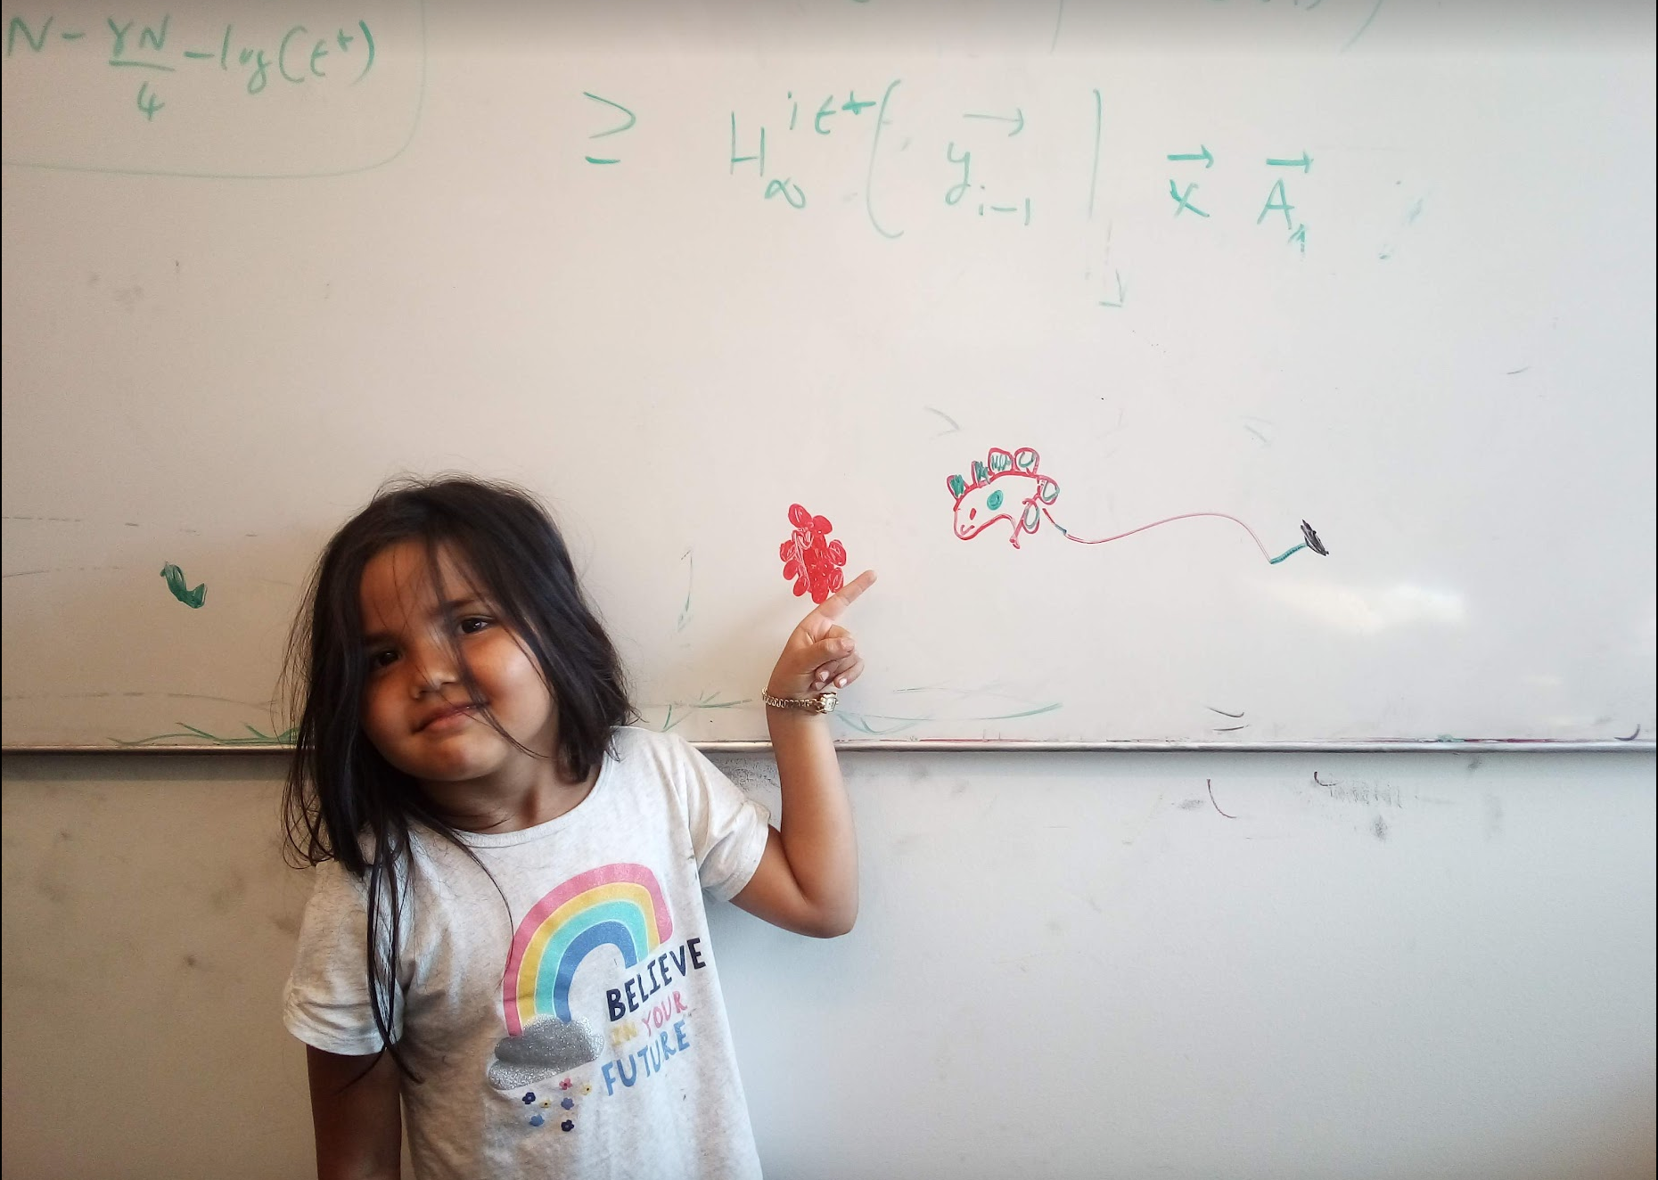
Questions/Comments?

Slide 6
Dividing up P
R
Q
First n/2 points according to the x-coord

Slide 7
Recursively find closest pairs
R
Q
δ = min (blue, green)

Slide 8
An aside: maintain sorted lists
P_{x} and P_{y} are P sorted by x-coord and y-coord
Q_{x}, Q_{y}, R_{x}, R_{y} can be computed from P_{x} and P_{y} in O(n) time

Slide 9

An easy case
> δ
R
Q
All “crossing” pairs have distance > δ
δ = min (blue, green)

Slide 10
Life is not so easy though
R
Q
δ = min (blue, green)

Slide 11
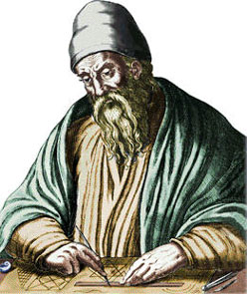
Euclid to the rescue (?)
d(p_{i},p_{j}) = ( (x_{i}-x_{j})²+(y_{i}-y_{j})²)^{1/2}
y_{j}
y_{i}
x_{i}
x_{j}
The distance is larger than the x or y-coord difference

Slide 12
Life is not so easy though
δ
δ
> δ
R
Q
> δ
> δ
δ = min (blue, green)

Slide 13
All we have to do now
δ
δ
R
Q
S
Figure if a pair in S has distance < δ
δ = min (blue, green)

Slide 14
The algorithm so far…
O(n log n) + T(n)
Input: n 2-D points P = {p₁,…,p_{n}}; p_{i}=(x_{i},y_{i})
Sort P to get P_{x} and P_{y}
Closest-Pair (P_{x}, P_{y})
O(n log n)
T(< 4) = c
If n < 4 then find closest point by brute-force
T(n) = 2T(n/2) + cn
Q is first half of P_{x} and R is the rest
O(n)
Compute Q_{x}, Q_{y}, R_{x} and R_{y}
O(n)
(q₀,q₁) = Closest-Pair (Q_{x}, Q_{y})
O(n log n) overall
(r₀,r₁) = Closest-Pair (R_{x}, R_{y})
O(n)
δ = min ( d(q₀,q₁), d(r₀,r₁) )
O(n)
S = points (x,y) in P s.t. |x – x*| < δ
return Closest-in-box (S, (q₀,q₁), (r₀,r₁))
Assume can be done in O(n)

Slide 15
Questions/Comments?

Slide 16
Rest of today’s agenda
Implement Closest-in-box in O(n) time

