Slide 1
Lecture 3
CSE 331
Aug 30, 2024

Slide 2
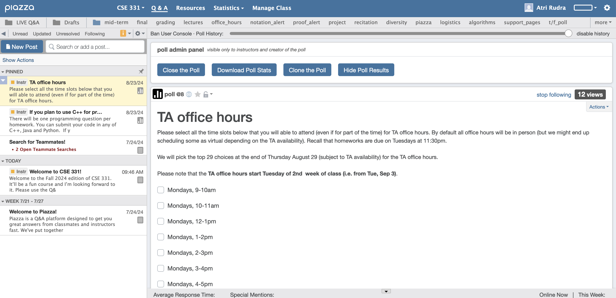
Participate on Piazza
https://piazza.com/buffalo/fall2023/cse331/

Slide 3
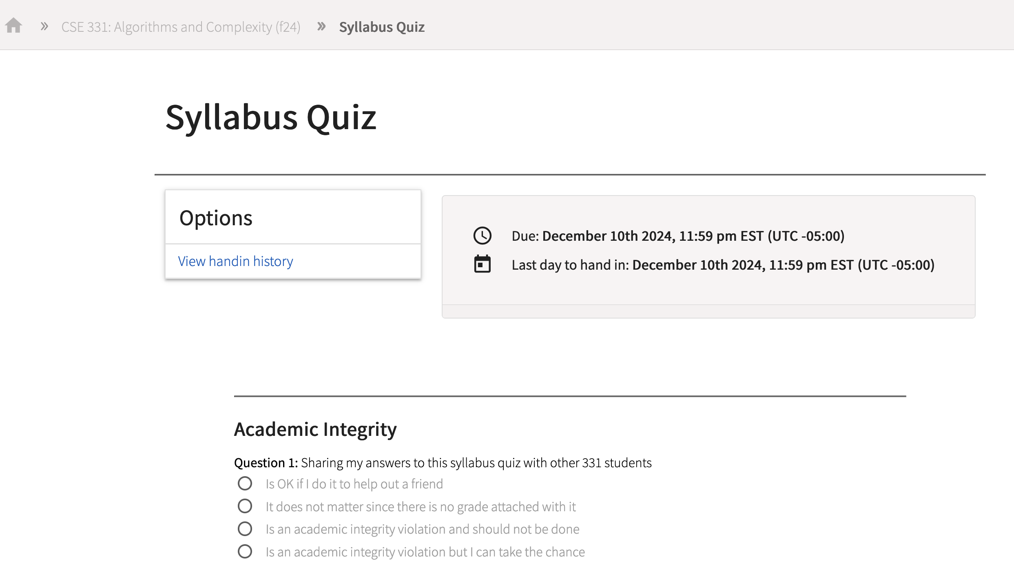
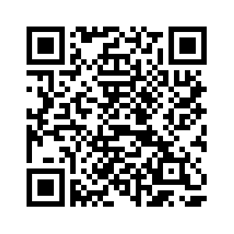
Read the syllabus CAREFULLY
No graded material will be handed back until you pass the syllabus quiz!

Slide 4
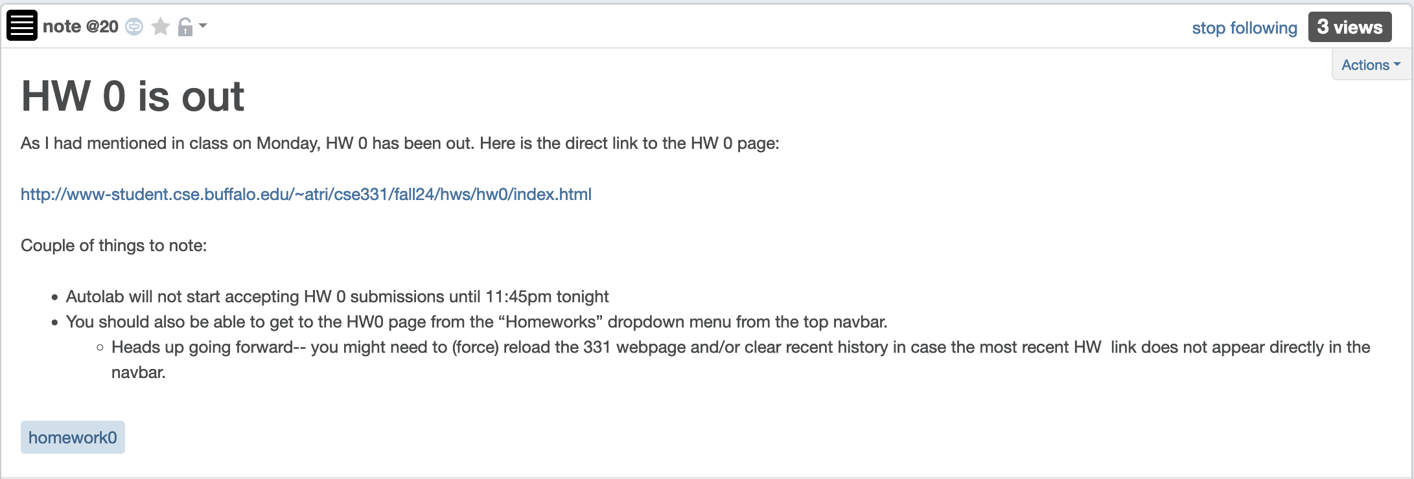
Q1 on HW 0 will be graded as usual

Slide 5
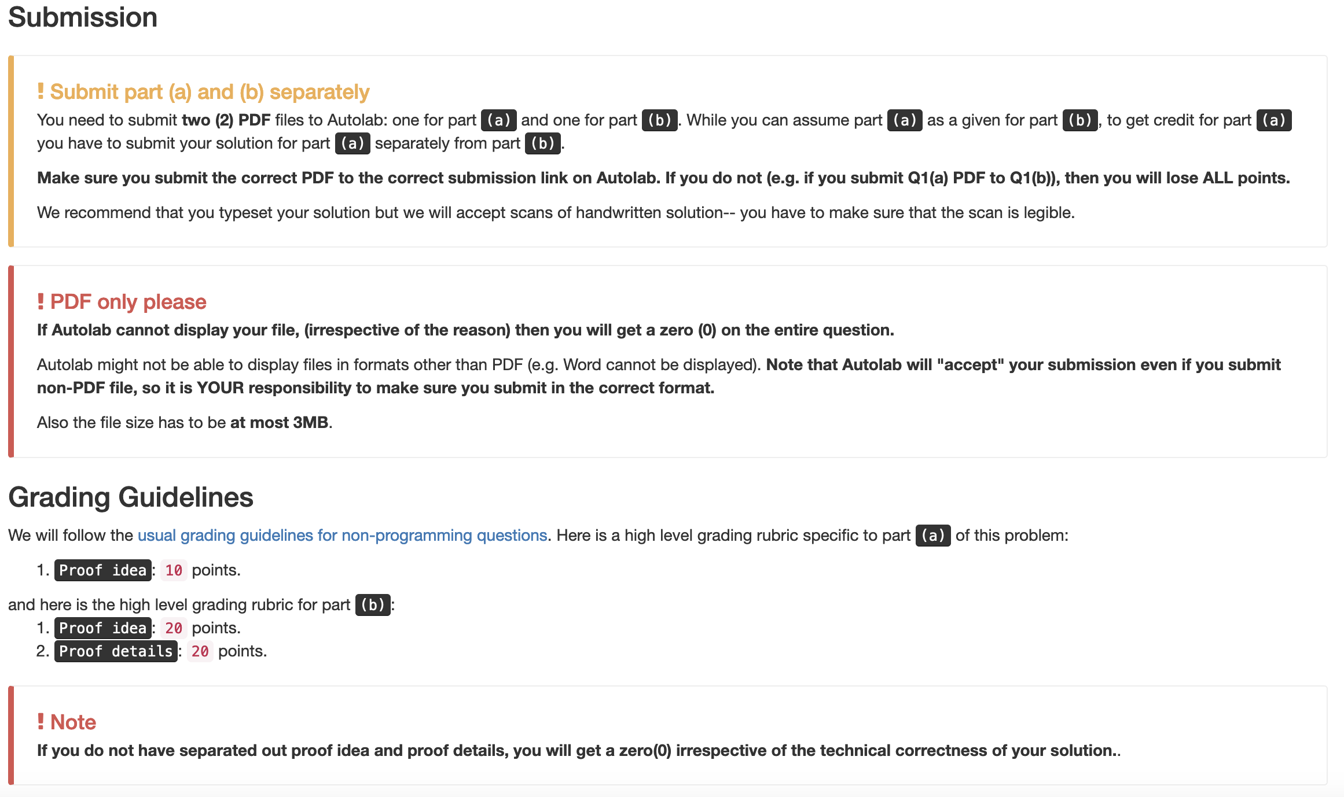
Submission requirements

Slide 6
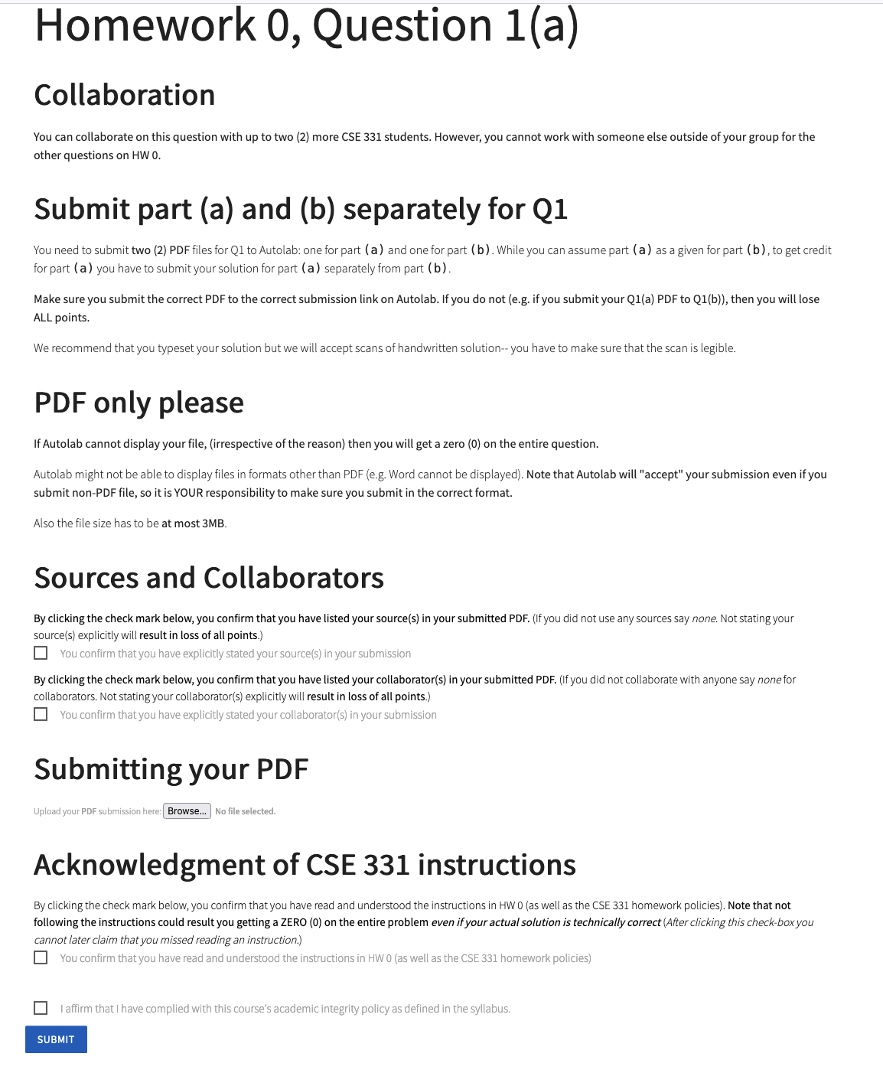
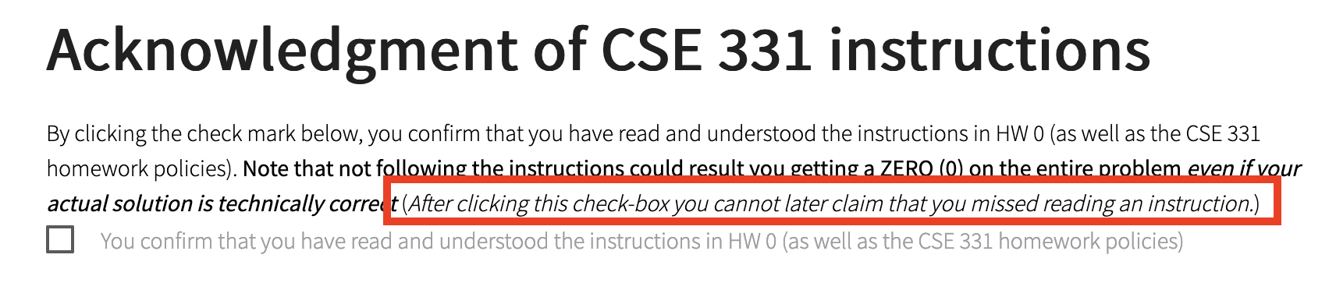
You need to confirm that you followed the requirements

Slide 7
Please do keep on asking Qs!
The only bad question is the one that is not asked!

Slide 8
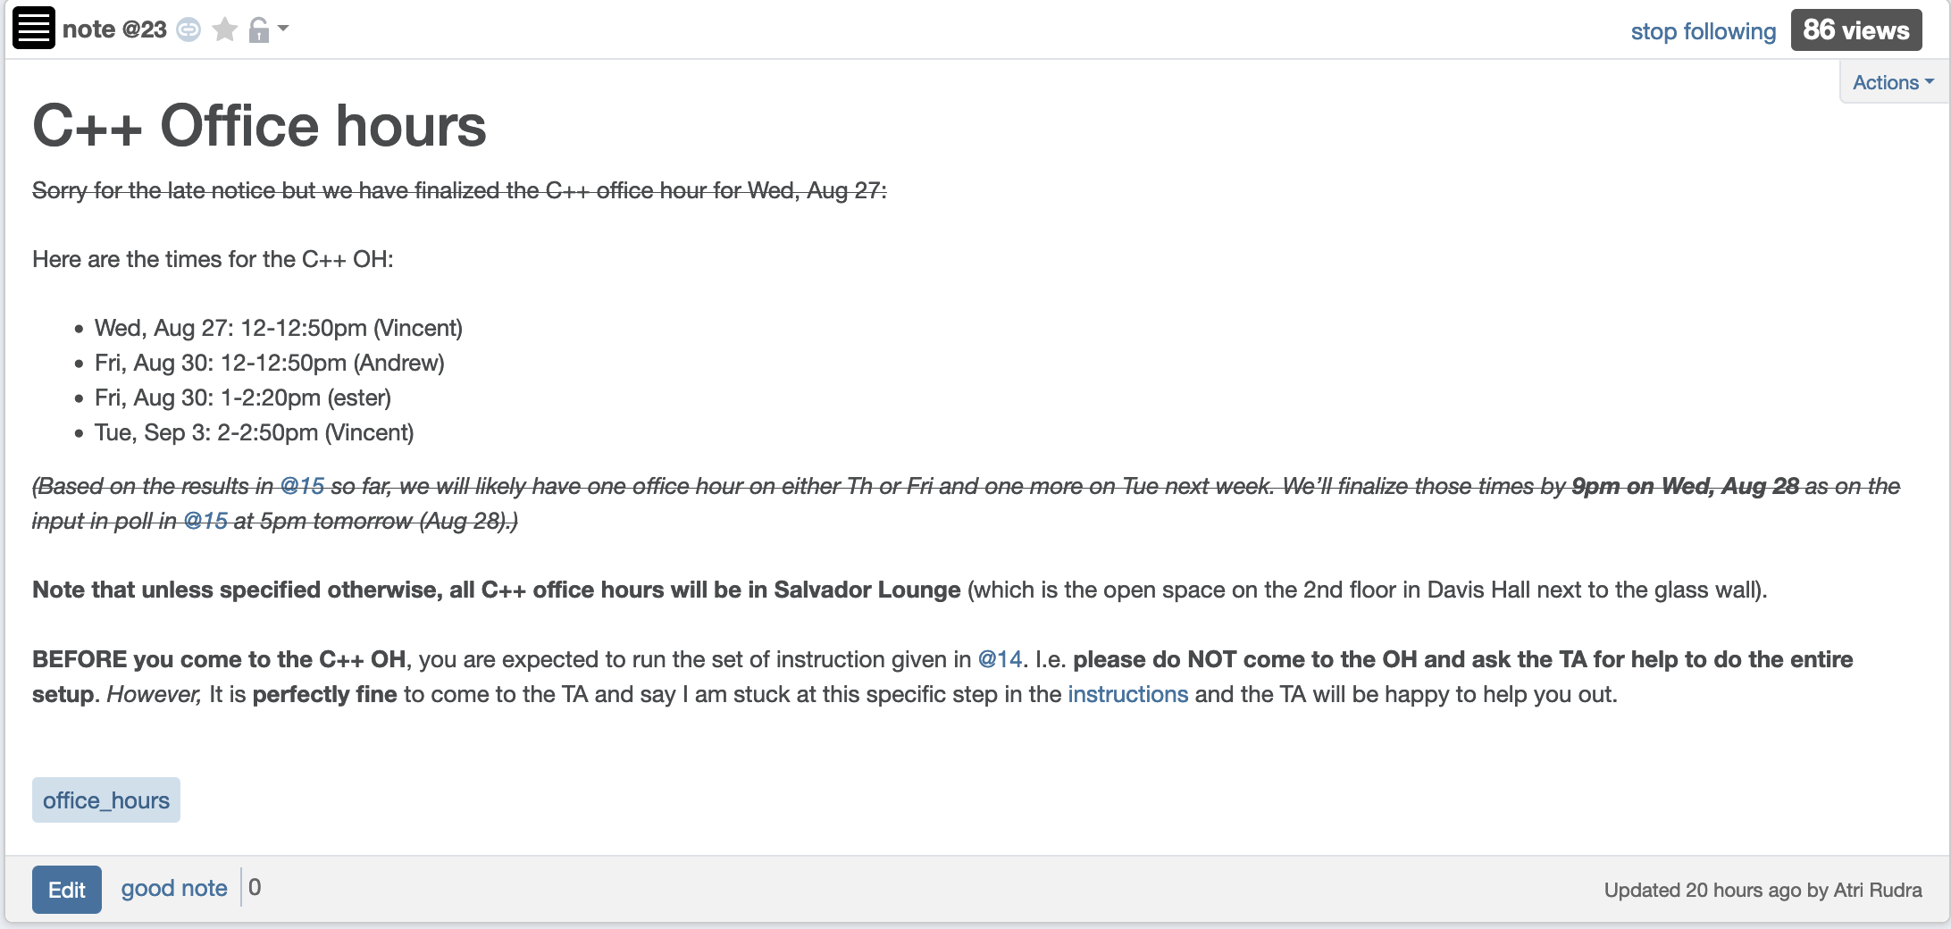
More C++ Office hours

Slide 9
TA office hours (starting Tue)
Finalized by Sunday
Details will be posted on piazza
OH next week dedicated to help with proofs

Slide 10
Two comments on Programming
Programming is worth about 15% of your final grade
Algorithm design/proofs are worth about 80% of your final grade
Invest your time wisely

Slide 11
On Wednesday:
Input: A program P and input I
Output: Yes if P terminates on I
No otherwise
Theorem: There is no magic box A’ for ver 2 (as long as A’ terminates)

Slide 12
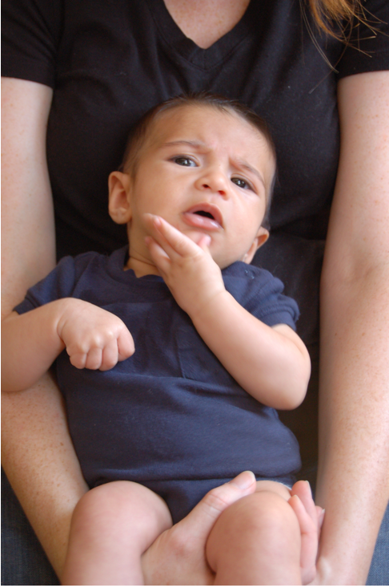
Questions/Comments?

Slide 13
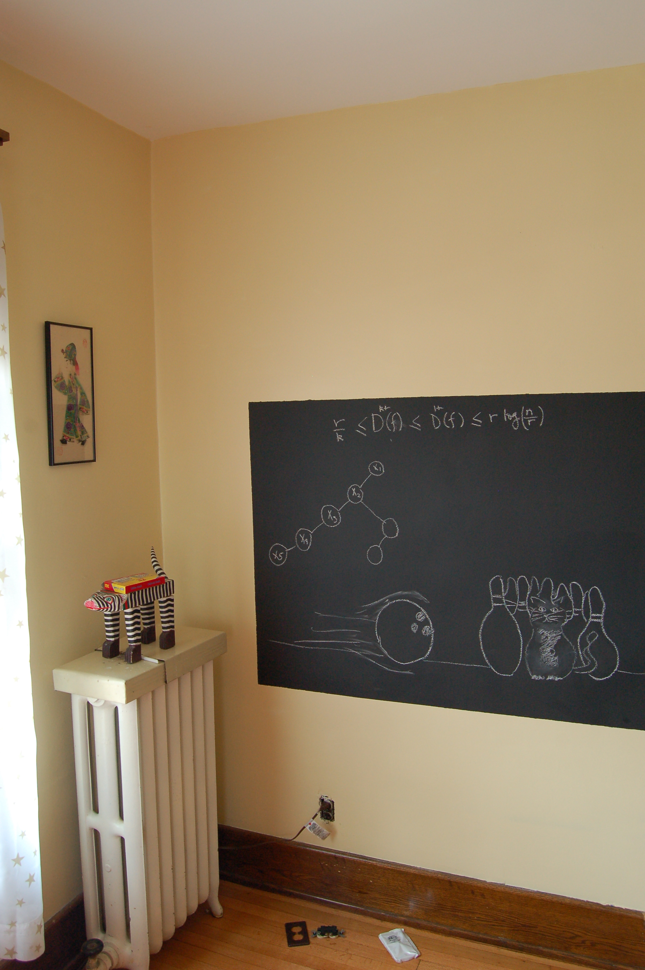
Finish off the proof on the board…

Slide 14
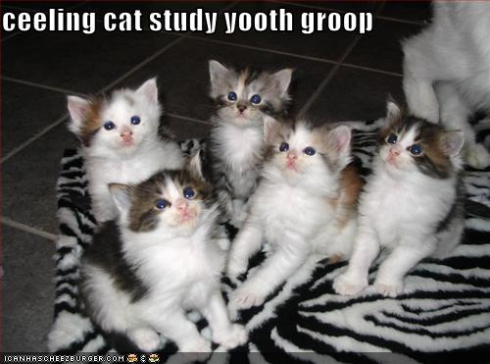
Remember: Stick with your group

Slide 15
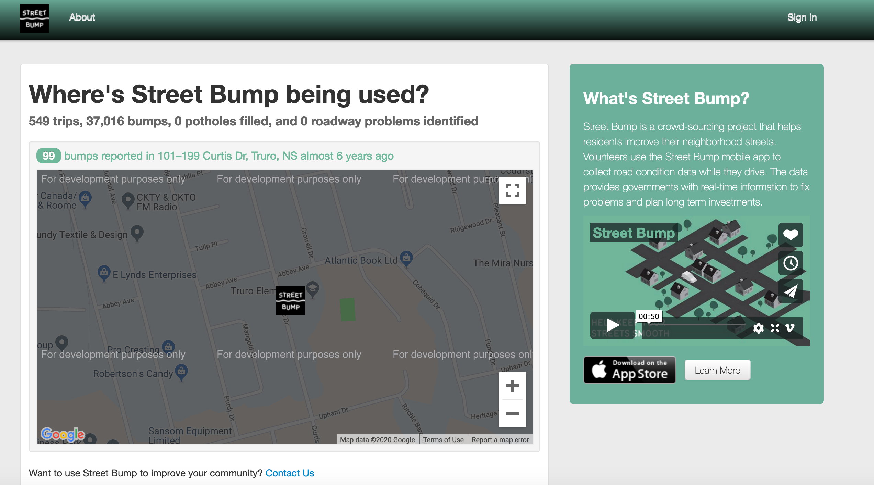
Common solution: Let’s build an app for that!
Potential issues?

Slide 16
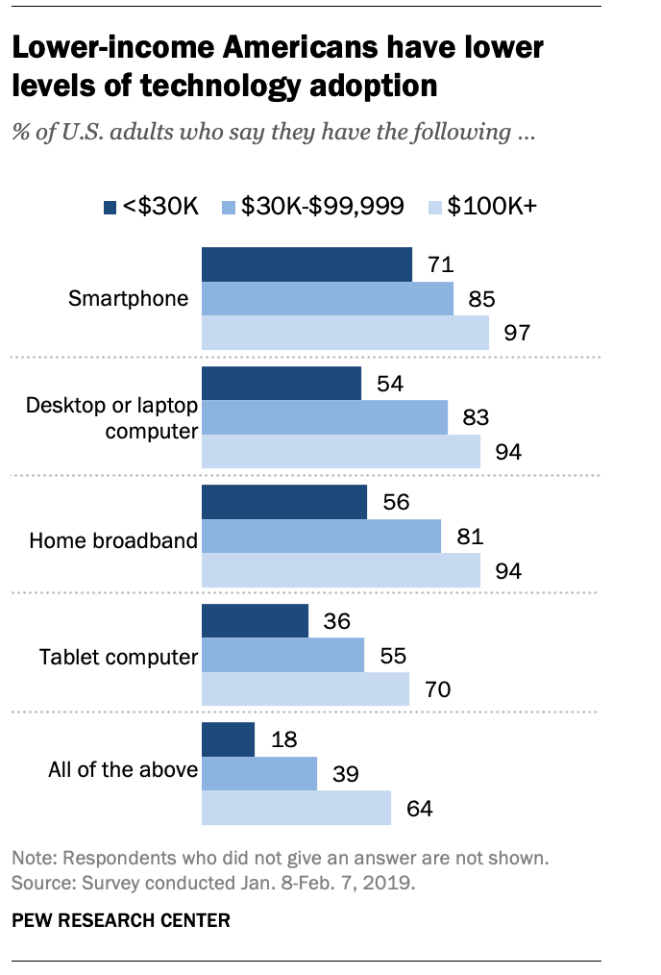
The smartphone blind-spot
Many of us in CSE assume that “everyone”
has smartphones
More generally, we assume “everyone” has access to the Internet

Slide 17
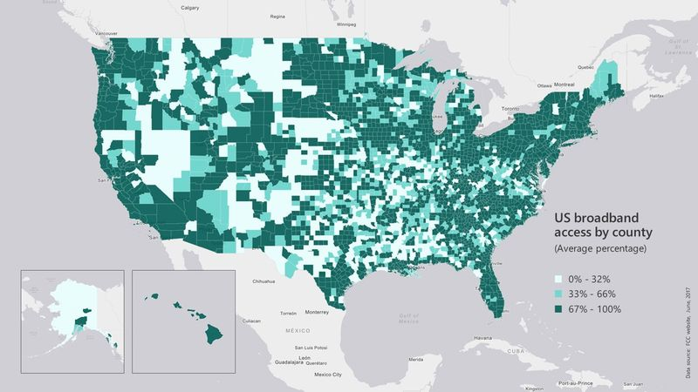
Broadband access
https://assets.bwbx.io/images/users/iqjWHBFdfxIU/iZSjibxE1KJs/v1/800x-1.jpg

Slide 18
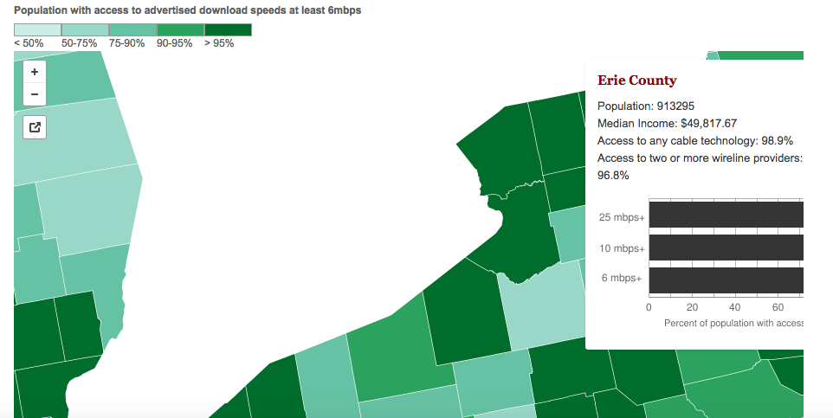
Erie county is reasonably good
http://www.governing.com/gov-data/broadband-speeds-availability.html

Slide 19
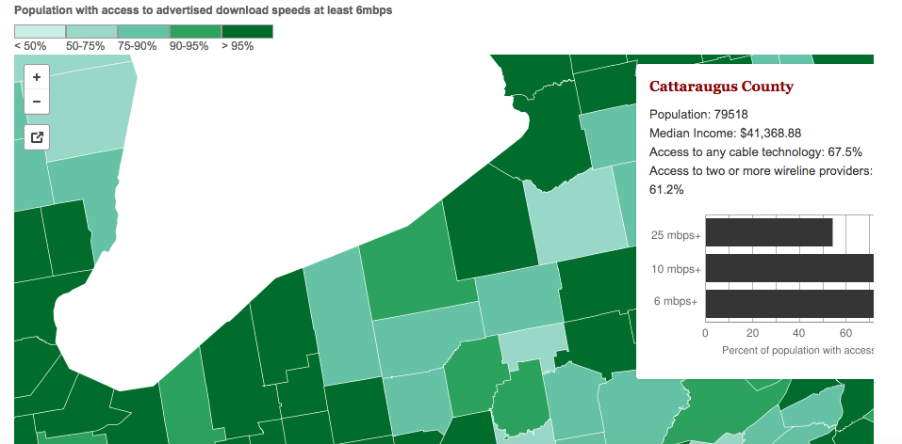
One county over
http://www.governing.com/gov-data/broadband-speeds-availability.html

Slide 20
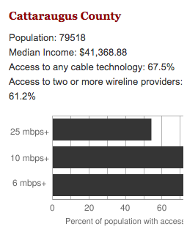
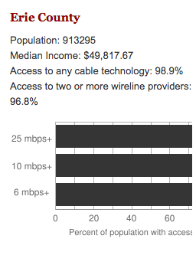
Make broadband more available
BOTH technical and societal issues
Say you are tasked to come up with the infrastructure

