Slide 1
Lecture 31
CSE 331
Nov 13, 2024

Slide 2
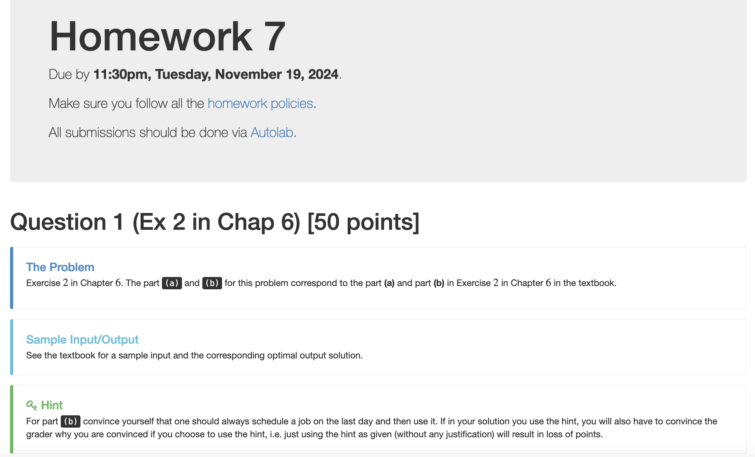
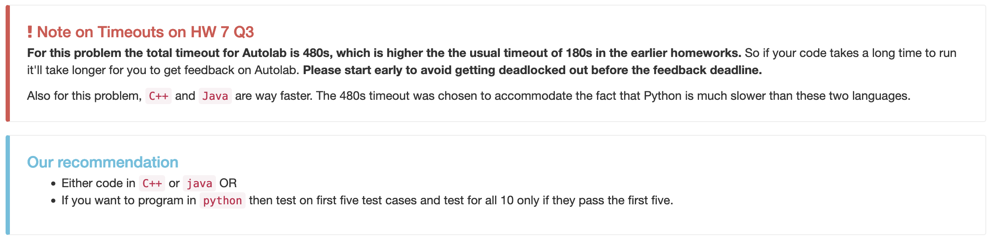
Homework 7 out

Slide 3
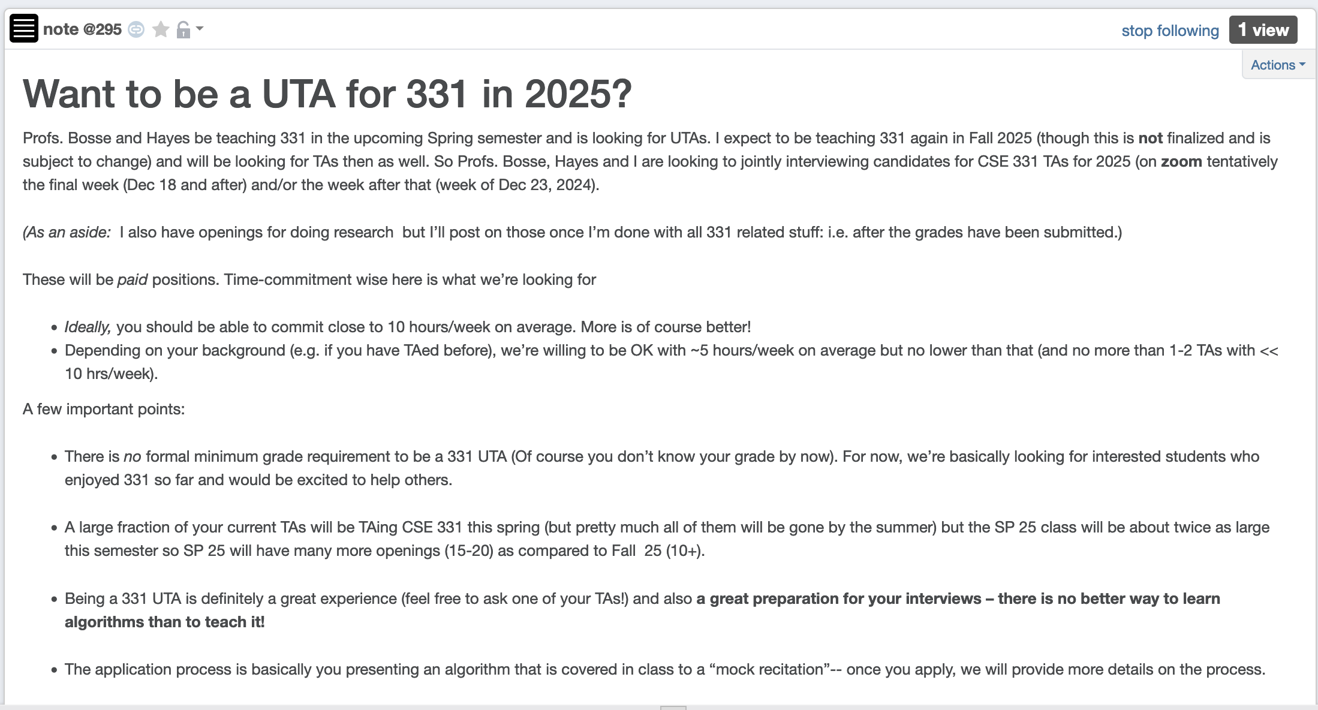
Apply to be a CSE 331 TA in 2025!

Slide 4
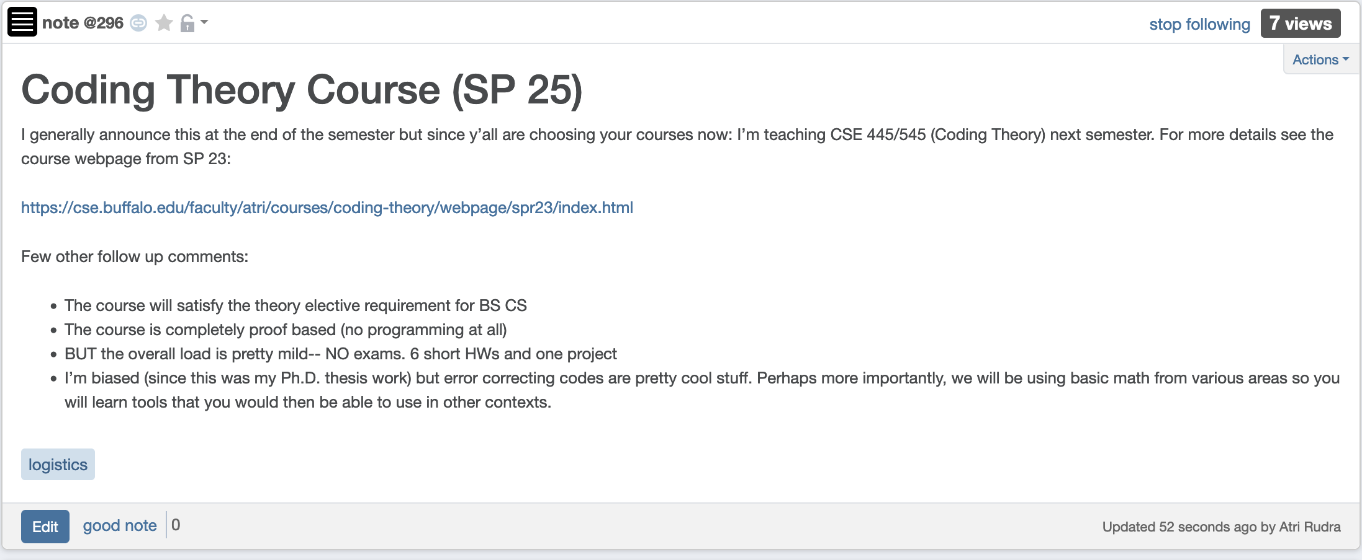
Coding Theory (Spring 25)

Slide 5
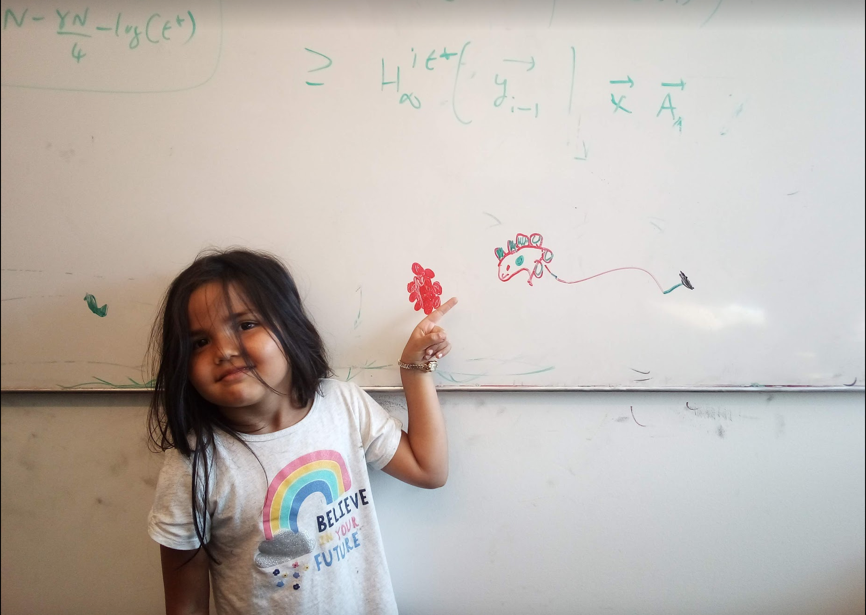
Questions/Comments?

Slide 6
Weighted Interval Scheduling
Input: n jobs (s_{i},f_{i},v_{i})
Output: A schedule S s.t. no two jobs in S have a conflict
Goal: max Σ_{i in S} v_{j}
Assume: jobs are sorted by their finish time

Slide 7
Couple more definitions
p(j) = largest i < j s.t. i does not conflict with j
p(j) < j
= 0 if no such i exists
OPT(j) = optimal value on instance 1,..,j

Slide 8
Property of OPT
j not in OPT(j)
j in OPT(j)
OPT(j) = max { v_{j} + OPT( p(j) ), OPT(j-1) }
Given OPT(1),…., OPT(j-1), how can one figure out if j in optimal solution or not?

Slide 9
A recursive algorithm
Compute-Opt(j)
If j = 0 then return 0
return max { v_{j} + Compute-Opt( p(j) ), Compute-Opt( j-1 ) }
OPT(j) = max { v_{j} + OPT( p(j) ), OPT(j-1) }

Slide 10
Exponential Running Time
1
p(j) = j-2
2
3
Only 5 OPT values!
4
5
OPT(5)
Formal proof: Ex.
OPT(3)
OPT(4)
OPT(3)
OPT(1)
OPT(2)
OPT(2)
OPT(1)
OPT(2)
OPT(1)
OPT(1)
OPT(1)

Slide 11
A recursive algorithm
M-Compute-Opt(j) = OPT(j)
M-Compute-Opt(j)
If j = 0 then return 0
If M[j] is not null then return M[j]
M[j] = max { v_{j} + M-Compute-Opt( p(j) ), M-Compute-Opt( j-1 ) }
return M[j]
Run time = O(# recursive calls)

Slide 12
Bounding # recursions
M-Compute-Opt(j)
O(n) overall
If j = 0 then return 0
If M[j] is not null then return M[j]
M[j] = max { v_{j} + M-Compute-Opt( p(j) ), M-Compute-Opt( j-1 ) }
return M[j]
Whenever a recursive call is made an M value is assigned
At most n values of M can be assigned

Slide 13
Questions/Comments?

Slide 14
Property of OPT
OPT(j) = max { v_{j} + OPT( p(j) ), OPT(j-1) }
Given OPT(1), …, OPT(j-1),
one can compute OPT(j)

Slide 15
Recursion+ memory = Iteration
Iteratively compute the OPT(j) values
Iterative-Compute-Opt
M[0] = 0
For j=1,…,n
M[j] = max { v_{j} + M[p(j)], M[j-1] }
M[j] = OPT(j)
O(n) run time

Slide 16


Slide 17
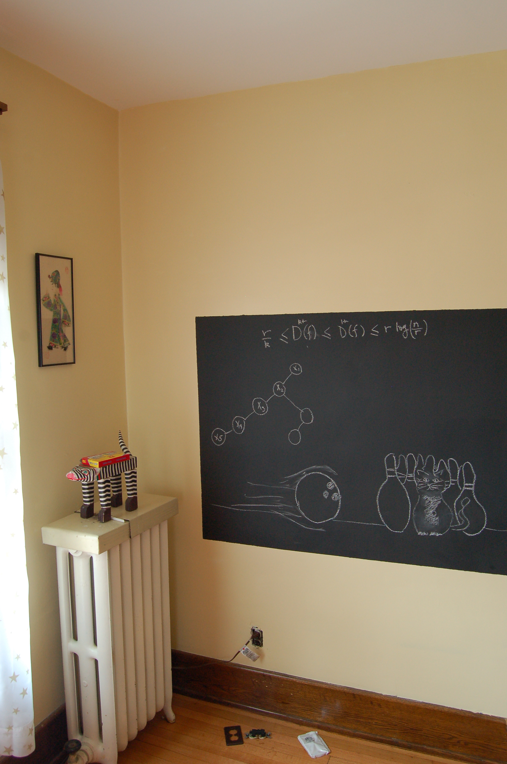
Algo run on the board…

Slide 18

Reading Assignment
Sec 6.1, 6.2 of [KT]

Slide 19
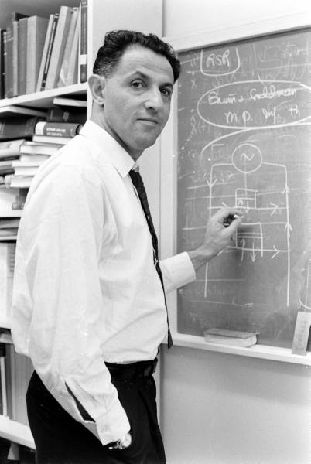
When to use Dynamic Programming
There are polynomially many sub-problems
OPT(1), …, OPT(n)
Richard Bellman
Optimal solution can be computed from solutions to sub-problems
OPT(j) = max { v_{j} + OPT( p(j) ), OPT(j-1) }
There is an ordering among sub-problem that allows for iterative solution
OPT (j) only depends on OPT(j-1), …, OPT(1)

