Slide 1
Lecture 35
CSE 331
Nov 22, 2024

Slide 2
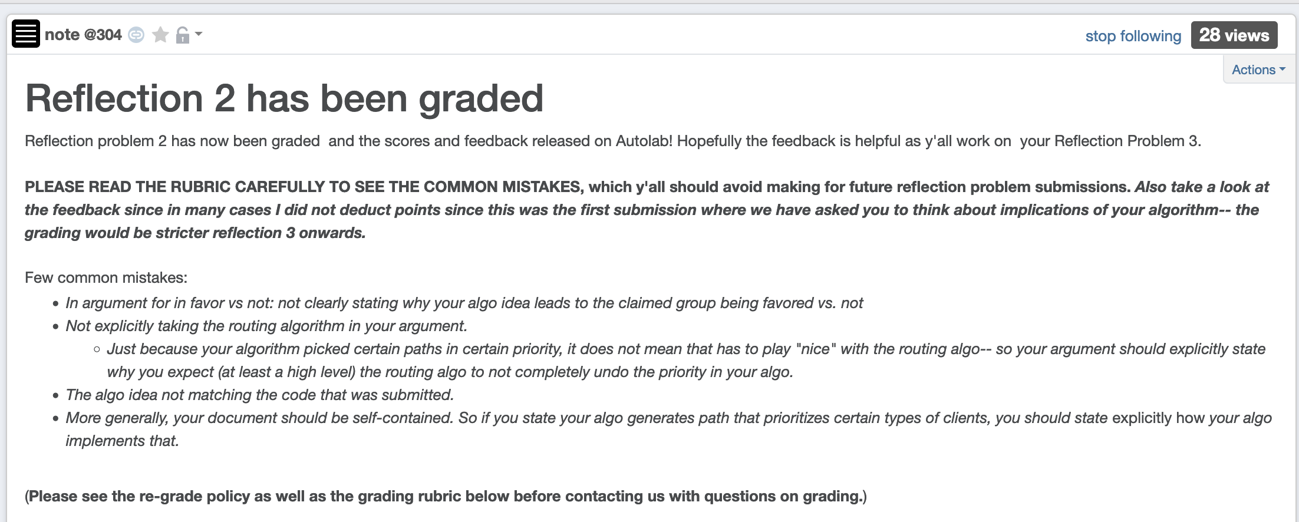
Reflection 2 has been graded

Slide 3
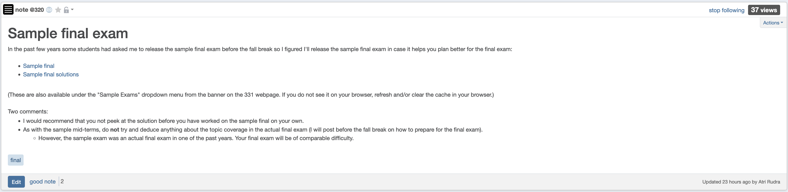
Sample final exam

Slide 4
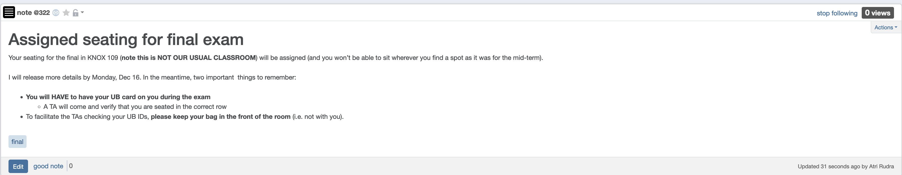
Bring UB card to final exam

Slide 5
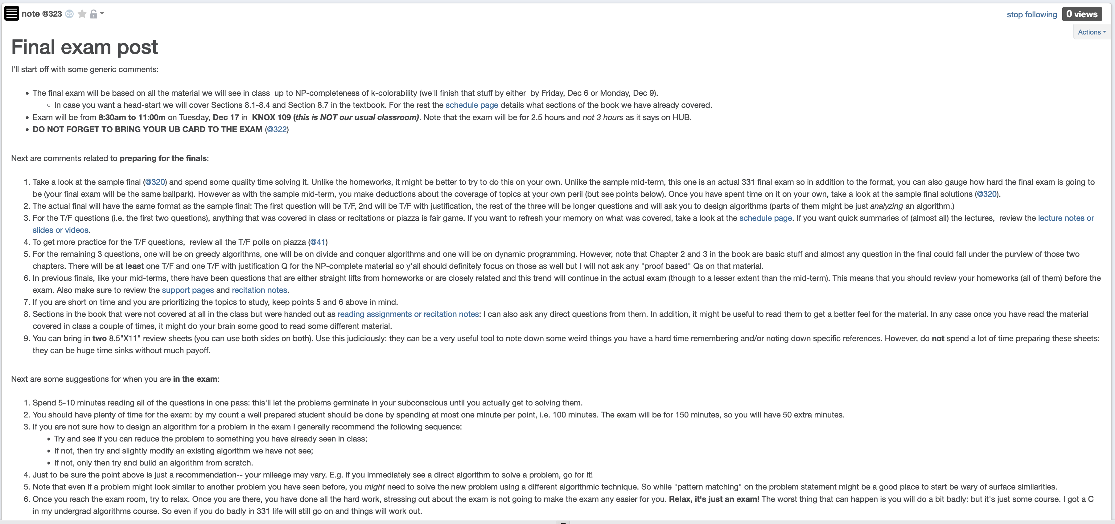
Final exam post

Slide 6
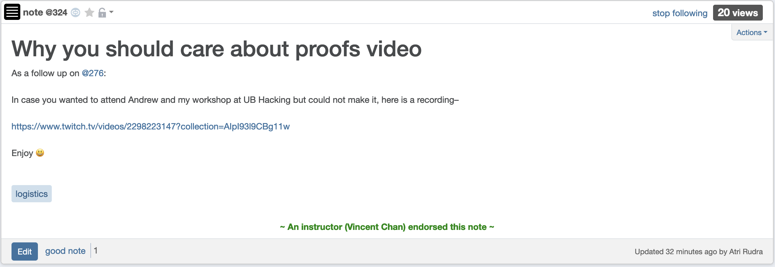
In case you missed it

Slide 7
Longest path problem
Given G, does there exist a simple path of length n-1 ?

Slide 8

Questions?

Slide 9

Longest vs Shortest Paths

Slide 10

Two sides of the “same” coin
Shortest Path problem
Can be solved by a polynomial time algorithm
Is there a longest path of length n-1?
Given a path can verify in polynomial time if the answer is yes

Slide 11
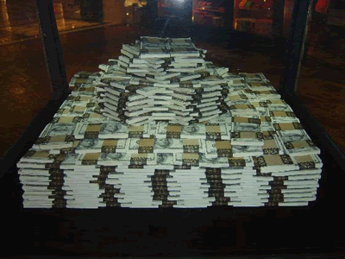
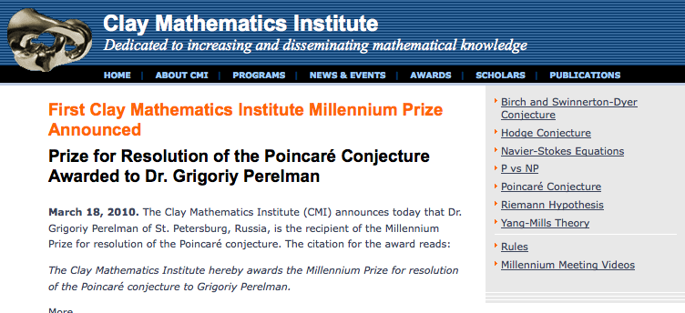
Poly time algo for longest path?

Slide 12
P vs NP question
P: problems that can be solved by poly time algorithms
Is P=NP?
NP: problems that have polynomial time verifiable witness to optimal solution
Alternate NP definition: Guess witness and verify!

Slide 13
Proving P ≠ NP
Pick any one problem in NP and show it cannot be solved in poly time
Pretty much all known proof techniques provably will not work

Slide 14
Proving P = NP
Will make cryptography collapse
Compute the encryption key!
Prove that all problems in NP can be solved by polynomial time algorithms
Solving any ONE problem in here in poly time will prove P=NP!
NP
NP-complete problems

Slide 15

A book on P vs. NP

Slide 16
Questions?

Slide 17

The course so far…
https://www.teepublic.com/sticker/1100935-obama-yes-we-can

Slide 18

The rest of the course…
Under certain assumptions,
https://www.madduckposters.com/products/megamind-no-you-cant?variant=13565168320556

Slide 19
Questions?

Slide 20
No, you can’t– what does it mean?
NO algorithm will be able to solve a problem in polynomial time
Still for worst-case runtime

Slide 21
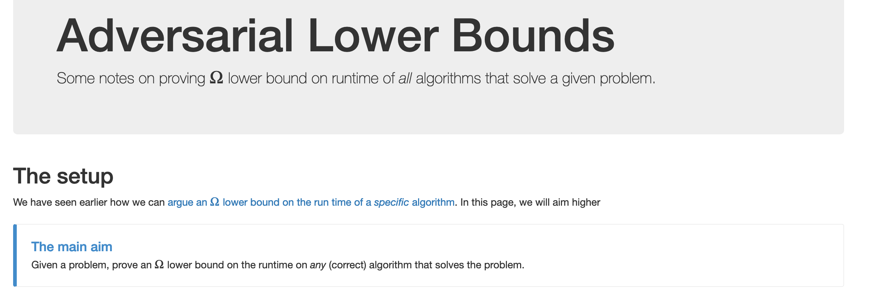
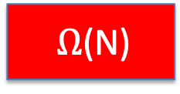
No, you can’t take- 1
What is the best lower bound you can prove?

Slide 22
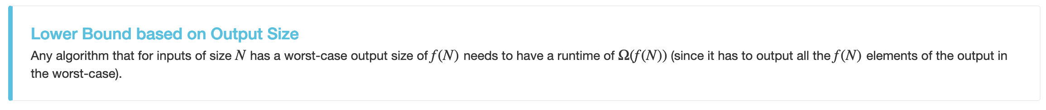
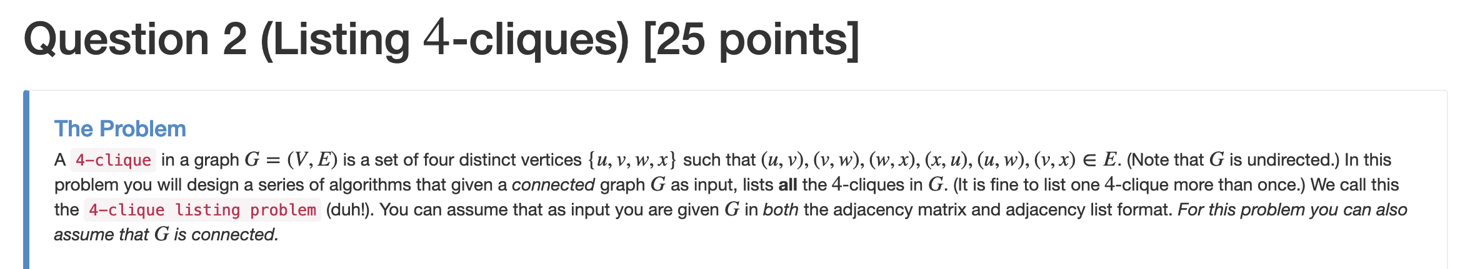

No, you can’t take- 2
Lower bounds based on output size
Exists graphs with m² 4-cliques

Slide 23
No, you can’t take- 2
Lower bounds based on output size
On input n, output 2^{n} many ones
Every algo takes (doubly) exponential time
But at heart problem is “trivial”
From now on, output size is always O(N) and could even be binary.

Slide 24
No, you can’t take -3
Argue that a given problem is AS HARD AS
a “known” hard problem
How can we argue something like this?
Reductions

Slide 25
So far: “Yes, we can” reductions
https://www.teepublic.com/sticker/1100935-obama-yes-we-can

Slide 26
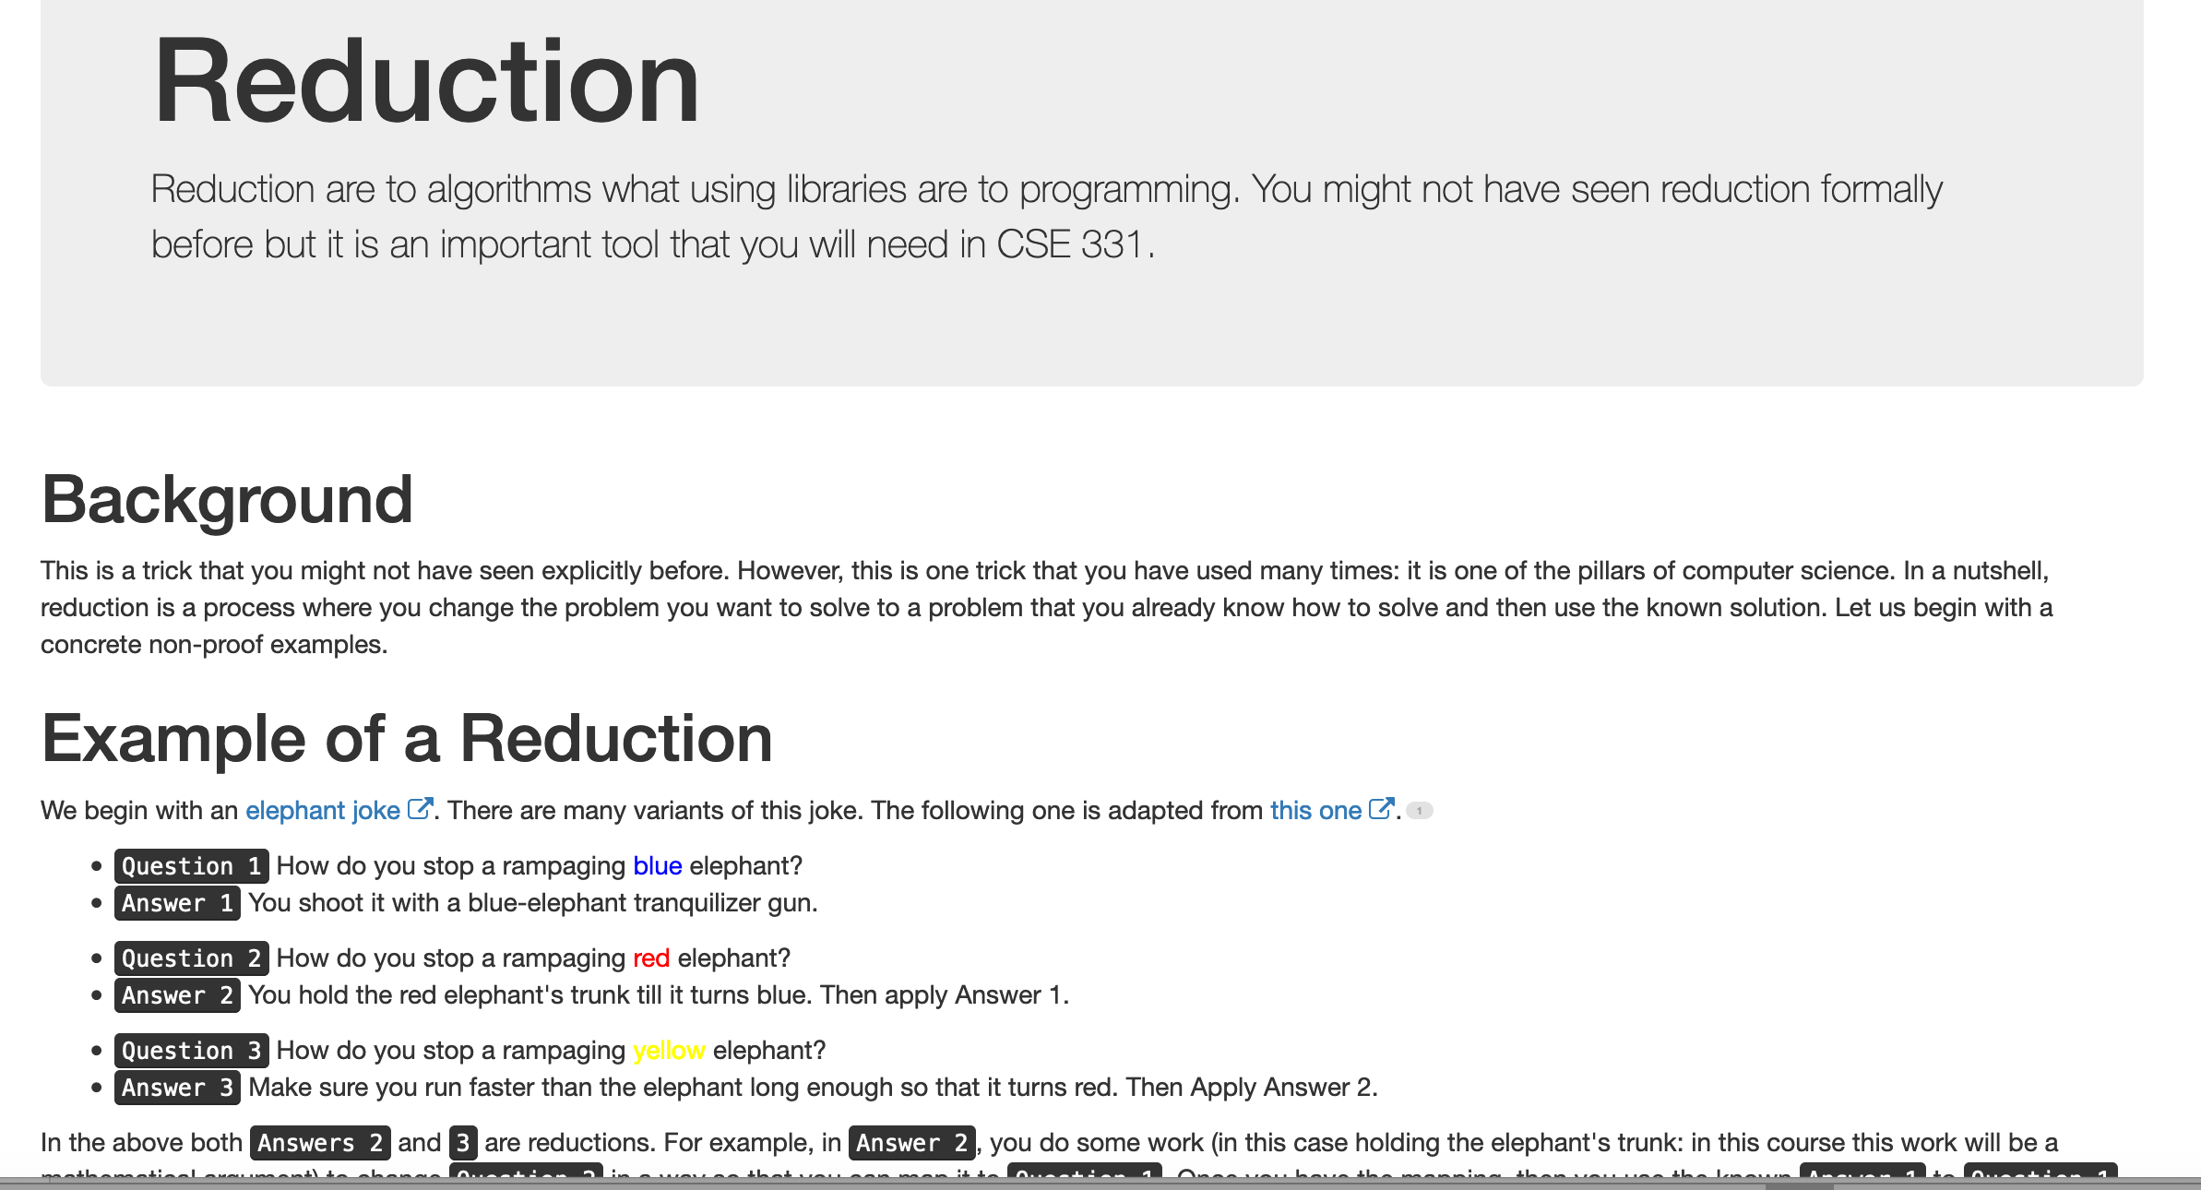
Reduce Y to X where X is “easy”

Slide 27
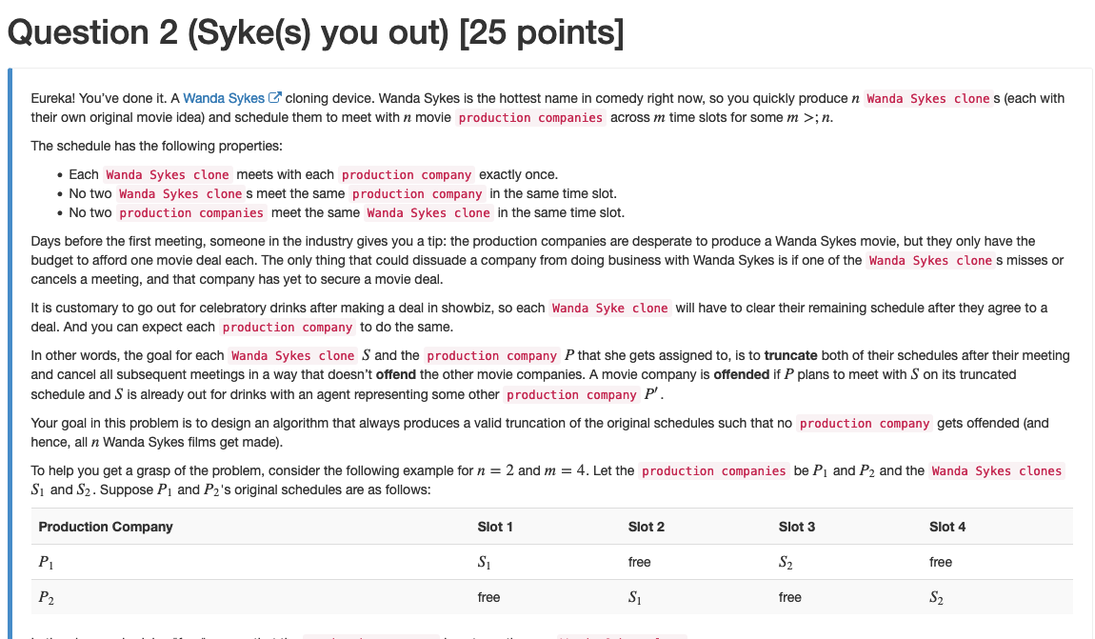
“Yes, we can” reductions (Example)

Slide 28


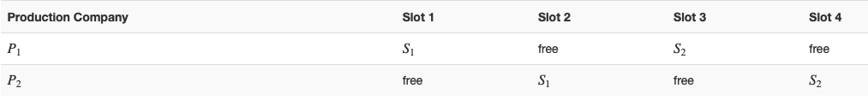
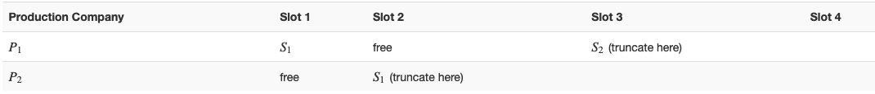






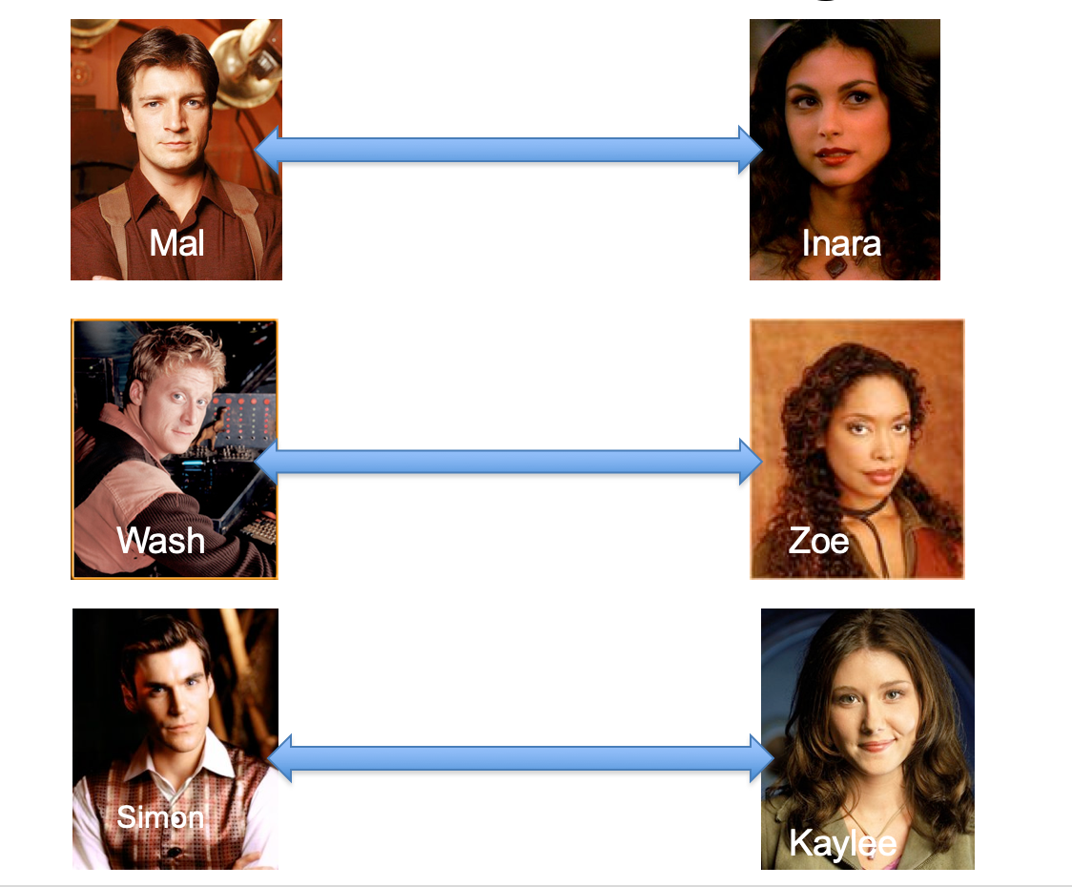
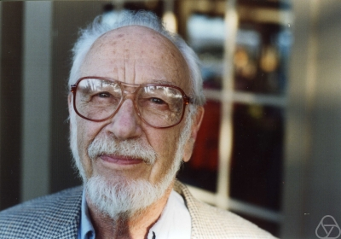
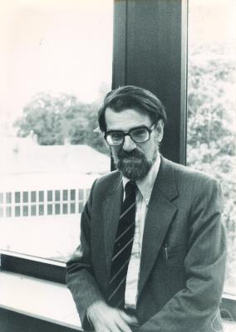
Overview of the reduction

Slide 29
Nothing special about GS algo
ANY algo for stable matching problem works!

Slide 30
Another observation
Poly time steps
ANY algo for stable matching problem works!

Slide 31
Poly time reductions
Poly time steps
ANY algo for stable matching problem works!

Slide 32

Poly time steps
Arbitrary Y instance
ANY algo for stable matching problem works!
Pre-process the input
Output for Y instance
All processing
is poly-time
Algo for X
Post-process the output

Slide 33


Poly time algo for X
Arbitrary Y instance
Poly time algo for Y
Pre-process the input
Output for Y instance
All processing
is poly-time
Algo for X
Post-process the output

Slide 34

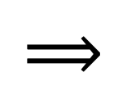
!B !A

Slide 35

No poly time algo for Y
Poly time algo for X
Arbitrary Y instance
No poly time algo for X
Poly time algo for Y
Pre-process the input
Output for Y instance
All processing
is poly-time
Algo for X
Post-process the output

Slide 36
Plan for rest of today
More on reductions
(If there is time) Quick definition of P and NP

