Slide 1
Lecture 36
CSE 331
Nov 25, 2024

Slide 2
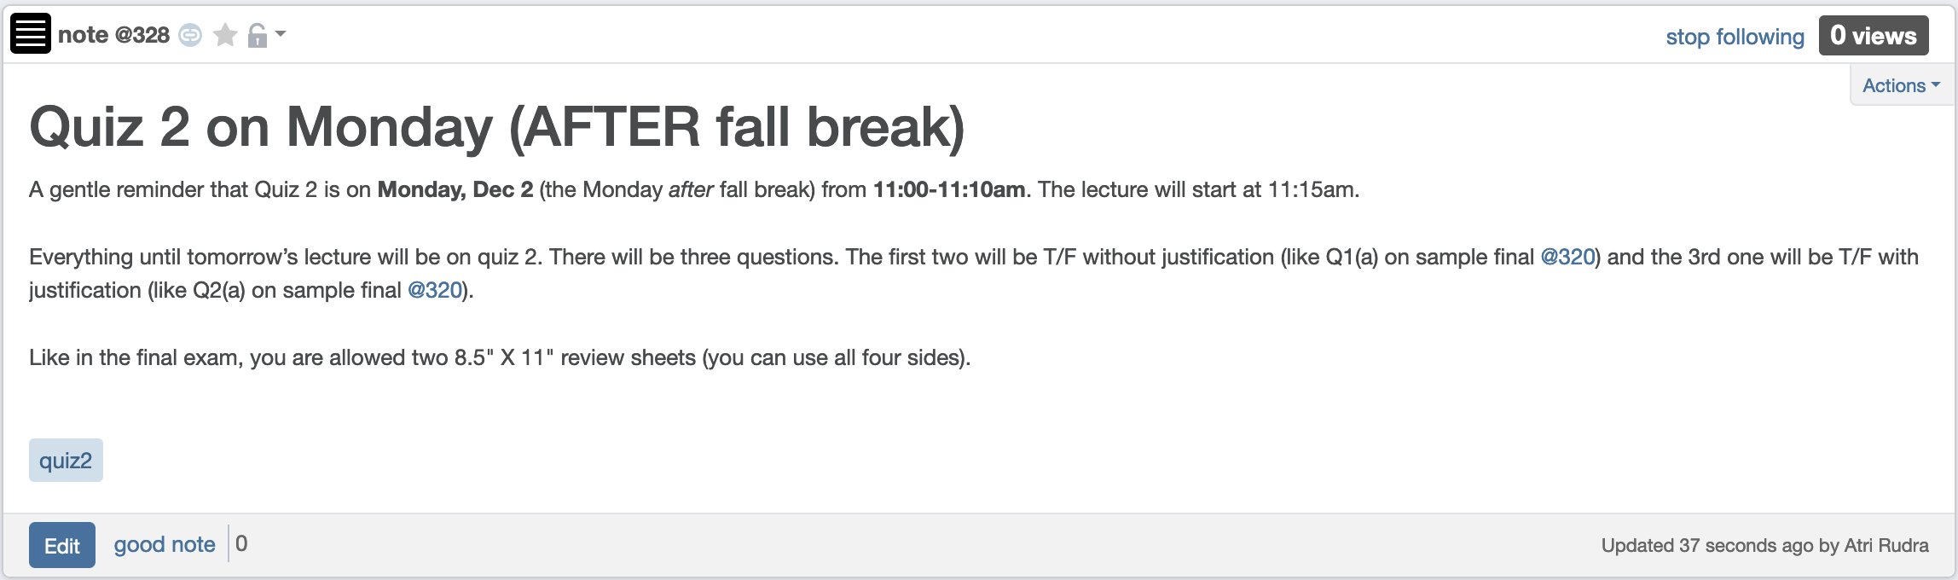
Quiz 2 on Monday after fall break

Slide 3
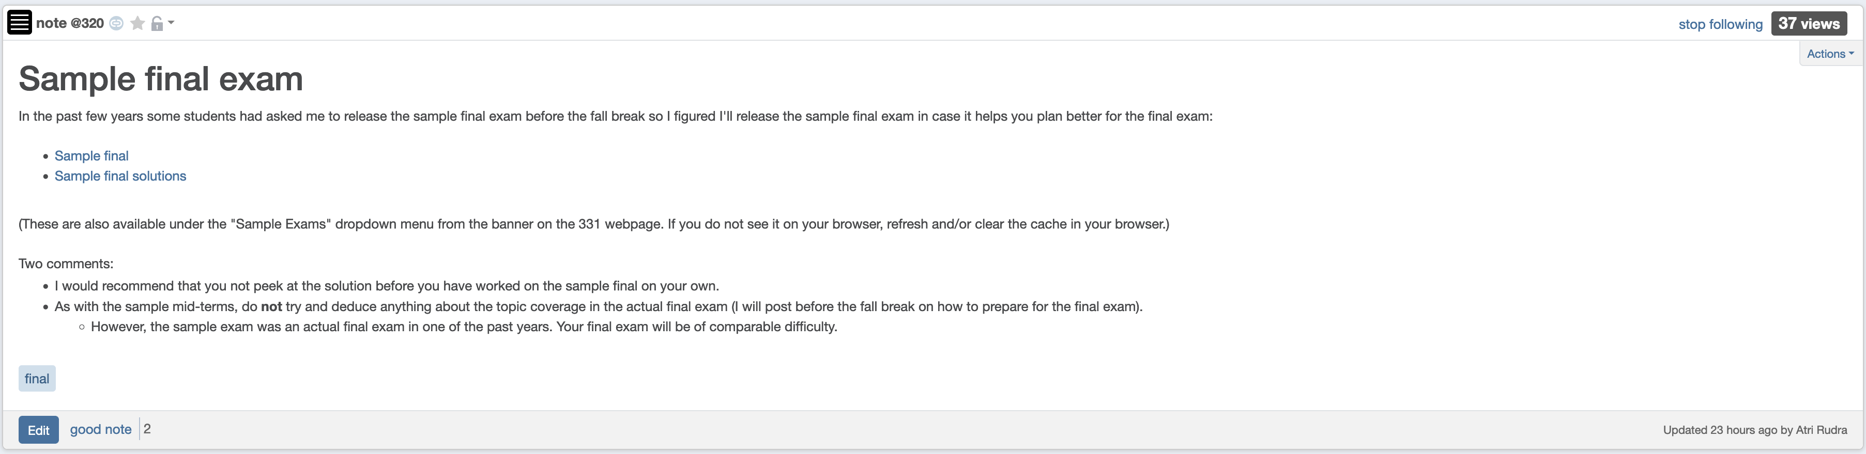
Sample final exam

Slide 4
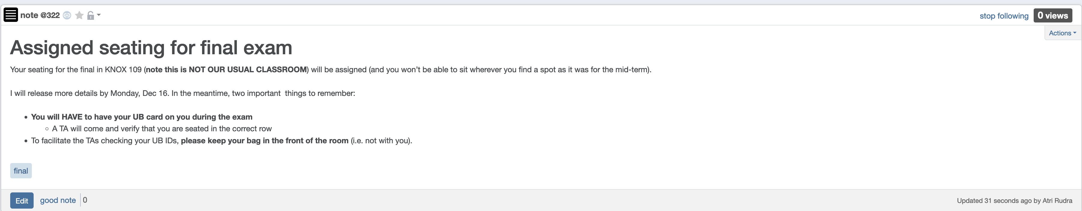
Bring UB card to final exam

Slide 5
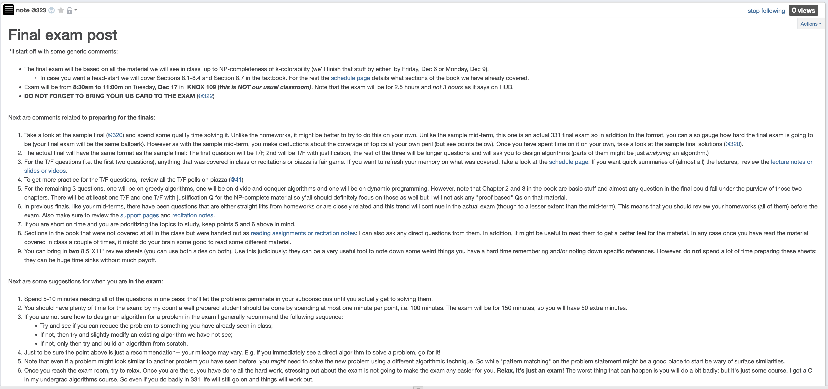
Final exam post

Slide 6
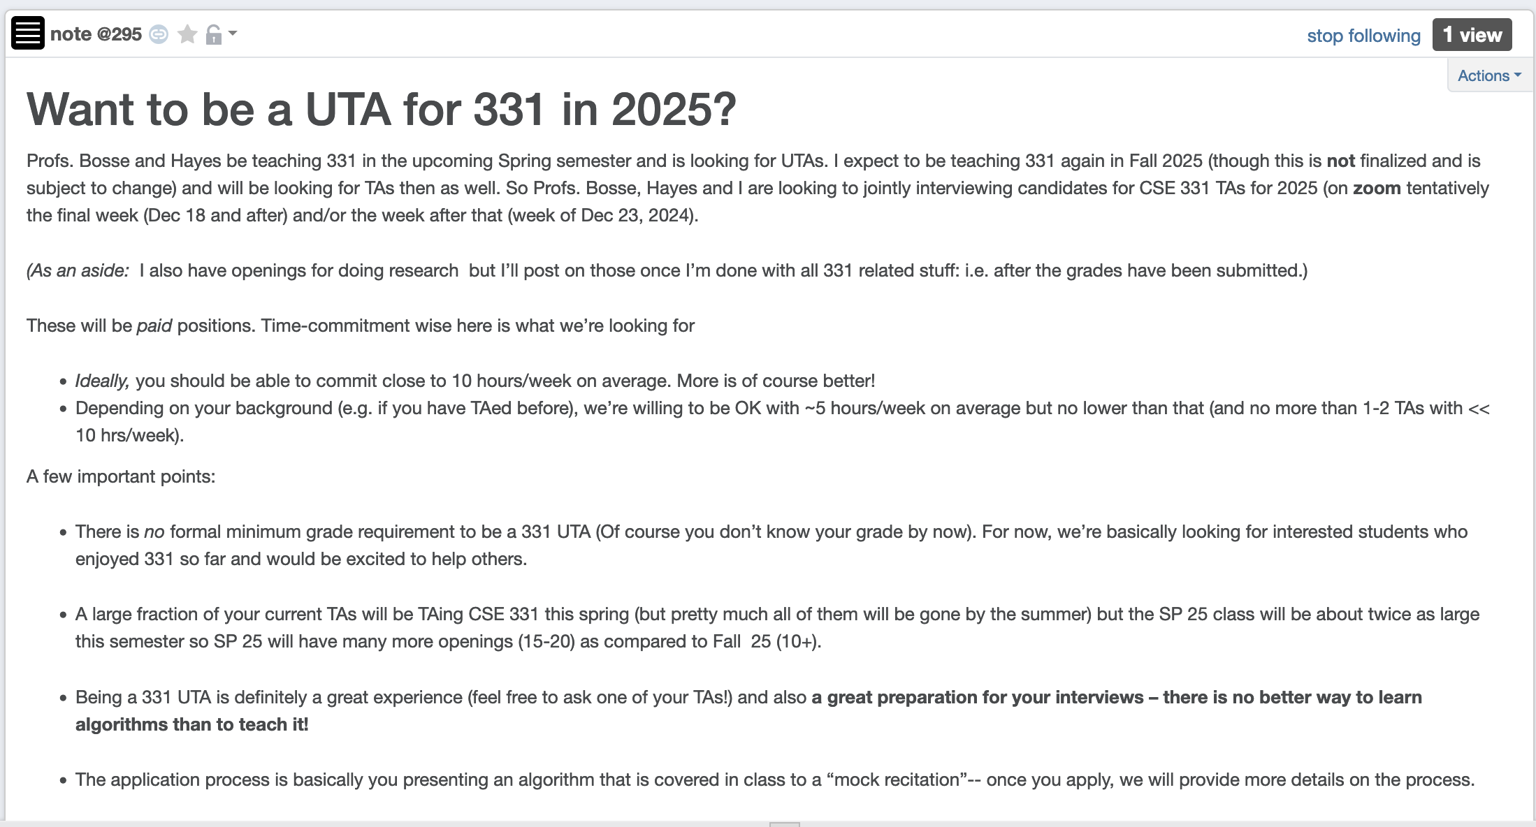
Apply to be a CSE 331 TA in 2025!

Slide 7
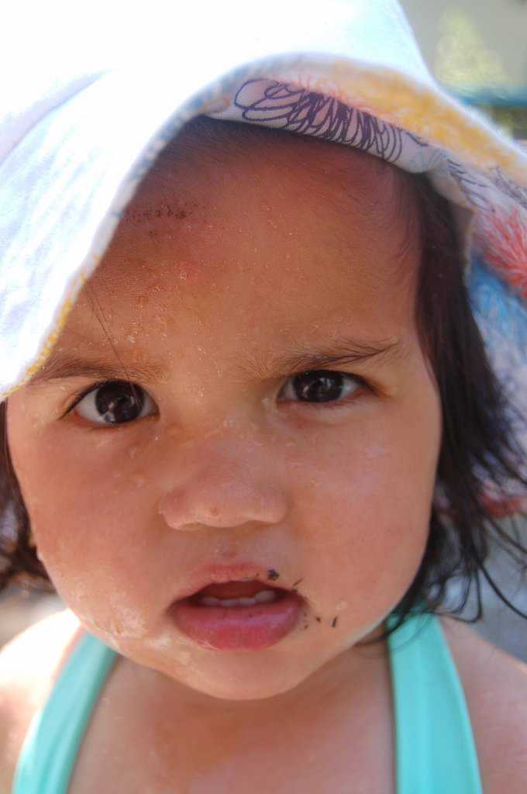
Questions?

Slide 8



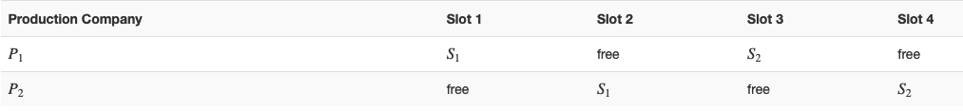
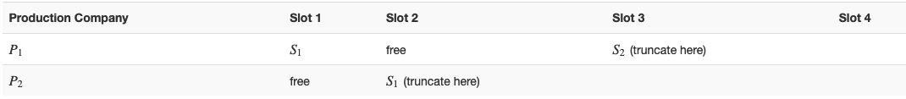






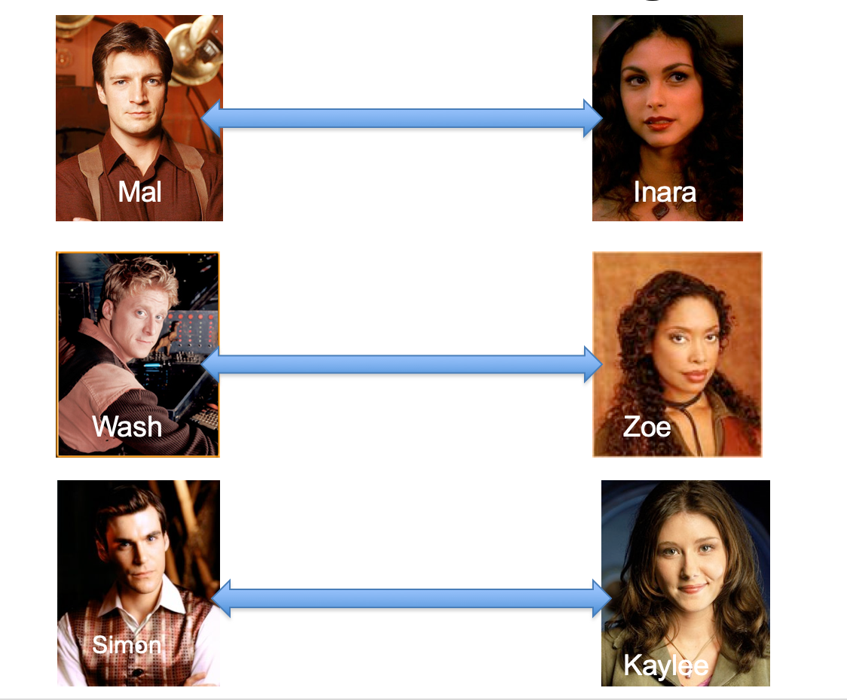
Poly time steps
Arbitrary Y instance
ANY algo for stable matching problem works!
Pre-process the input
Output for Y instance
All processing
is poly-time
Algo for X
Post-process the output

Slide 9



No poly time algo for Y
Poly time algo for X
Arbitrary Y instance
No poly time algo for X
Poly time algo for Y
Pre-process the input
Output for Y instance
All processing
is poly-time
Algo for X
Post-process the output

Slide 10
P vs NP question
P: problems that can be solved by poly time algorithms
Is P=NP?
NP: problems that have polynomial time verifiable witness to optimal solution

Slide 11

Independent Set (IS)
Input: Graph G = (V,E) and number k
Output: Yes iff G has an IS of size $≥$k

Slide 12
Questions?

Slide 13
Plan for today
Vertex Cover (VC) problem
Define P and NP
(If there is time) define NP-completeness

