Slide 1
Lecture 37
CSE 331
Dec 2, 2024

Slide 2
Quiz starts at 11:00 am
and ends at 11:10am

Slide 3
Lecture starts
at 11:15am

Slide 4
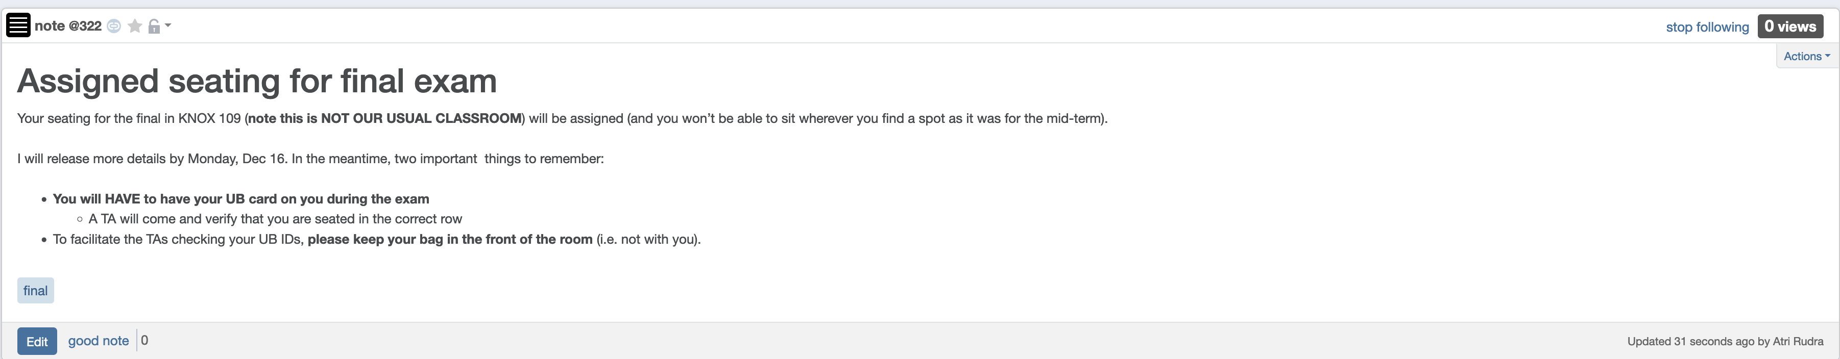
Bring UB card to final exam

Slide 5
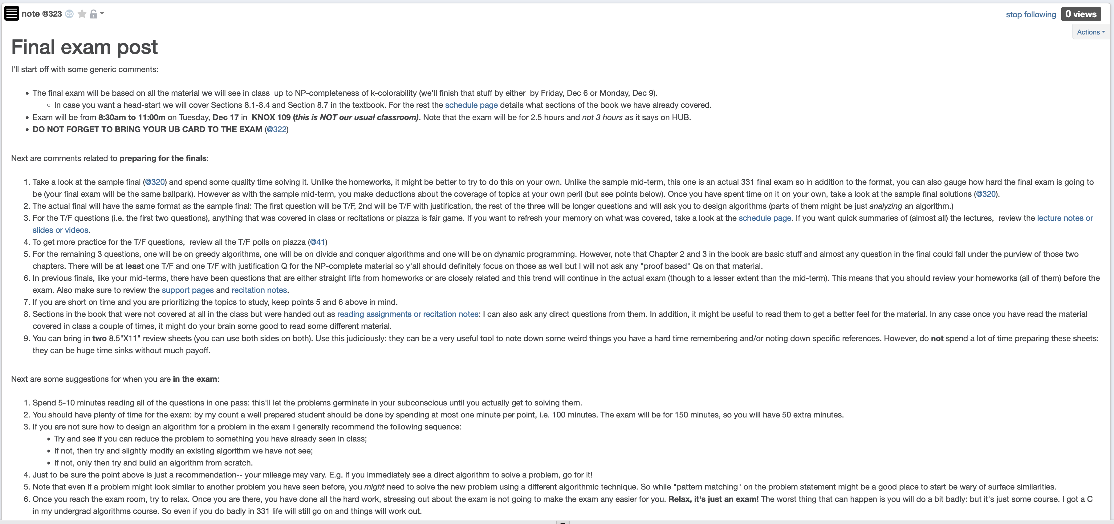
Final exam post

Slide 6
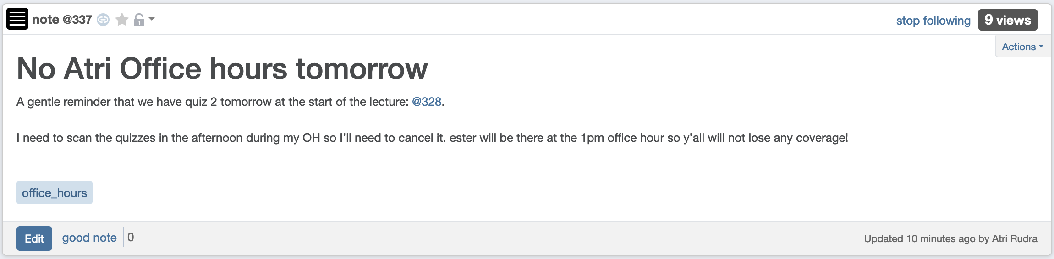
My OH today canceled

Slide 7
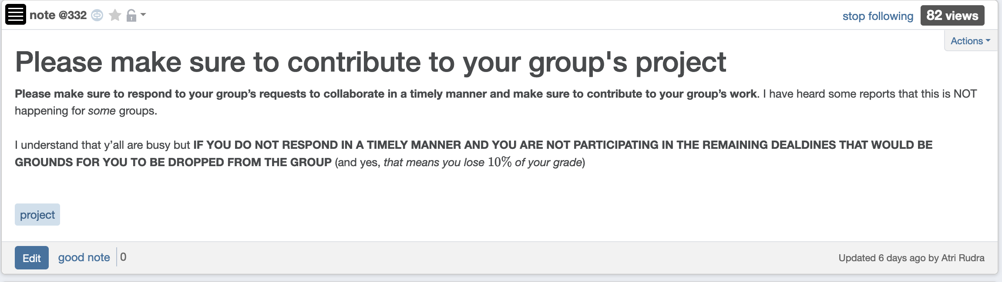
Please contribute to your group

Slide 8
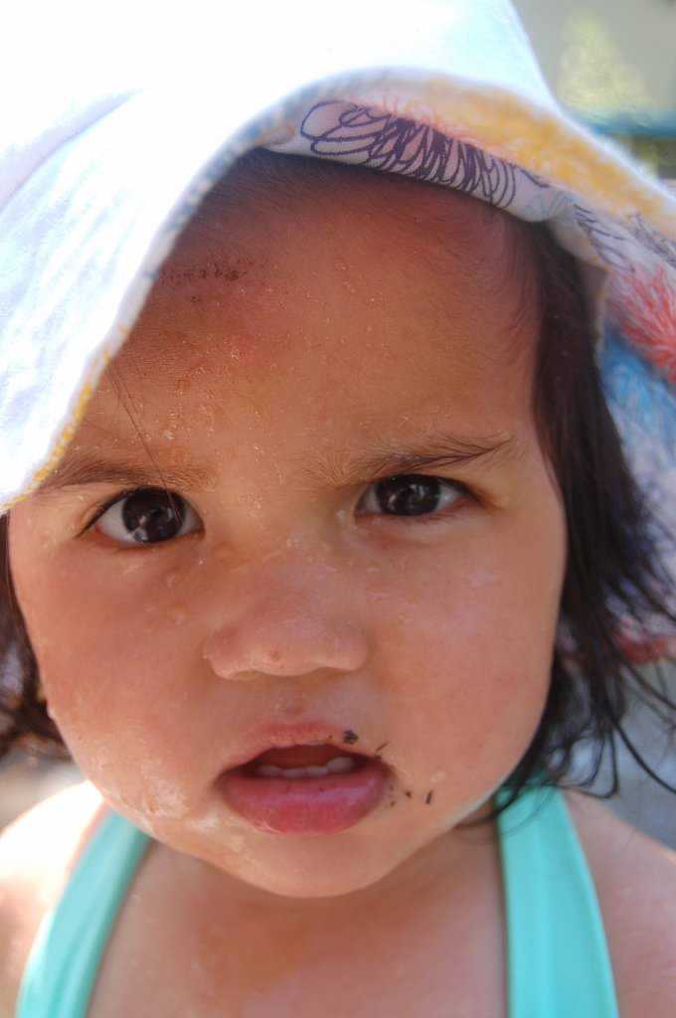
Questions?

Slide 9



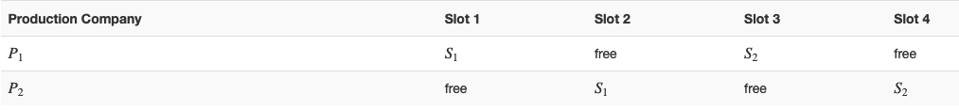
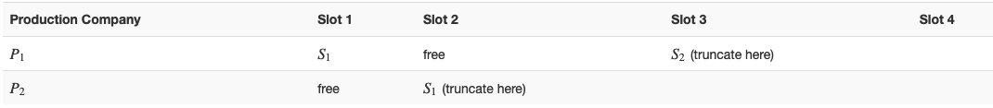






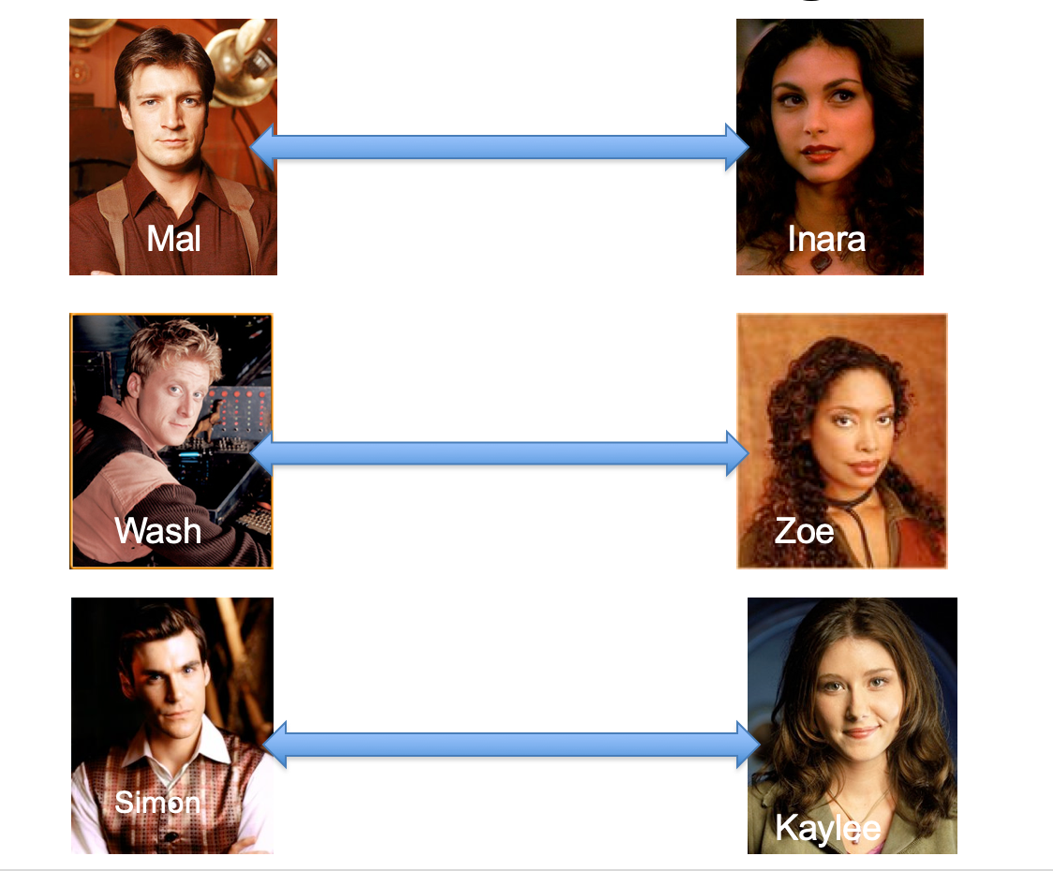
Poly time steps
Arbitrary Y instance
ANY algo for stable matching problem works!
Pre-process the input
Output for Y instance
All processing
is poly-time
Algo for X
Post-process the output

Slide 10



No poly time algo for Y
Poly time algo for X
Arbitrary Y instance
No poly time algo for X
Poly time algo for Y
Pre-process the input
Output for Y instance
All processing
is poly-time
Algo for X
Post-process the output

Slide 11

Problems
Only consider Boolean output problems
A problem Y is a subset of possible input (with output 1)
A(w) denotes output of algo A on input w
A solves Y if A(w) = 1 iff w $∈$ Y

Slide 12

Independent Set (IS)
Input: Graph G = (V,E) and number k
Output: Yes iff G has an IS of size $≥$k

Slide 13

Vertex Cover (VC)
Input: Graph G = (V,E) and number k
Output: Yes iff G has a VC of size $≤$k

Slide 14
P vs NP question
P: problems that can be solved by poly time algorithms
Is P=NP?
NP: problems that have efficient verifiers

Slide 15
Today’s agenda
NP-Completeness
SAT

